Slide 1
Amphibians and Reptiles of Bidoup National Park
Lam Dong Province Vietnam
Robert Wayne Van Devender
Paul Moler
Randy Babb

Slide 2
Amphibia
Family Bufonidae – 1 species
Family Dicroglossidae – 2 species
Family Megophryidae – 6 species
Family Microhylidae – 3 species
Family Ranidae – 6 species
Family Rhacophoridae – 6 species
Total = 24 species

Slide 3
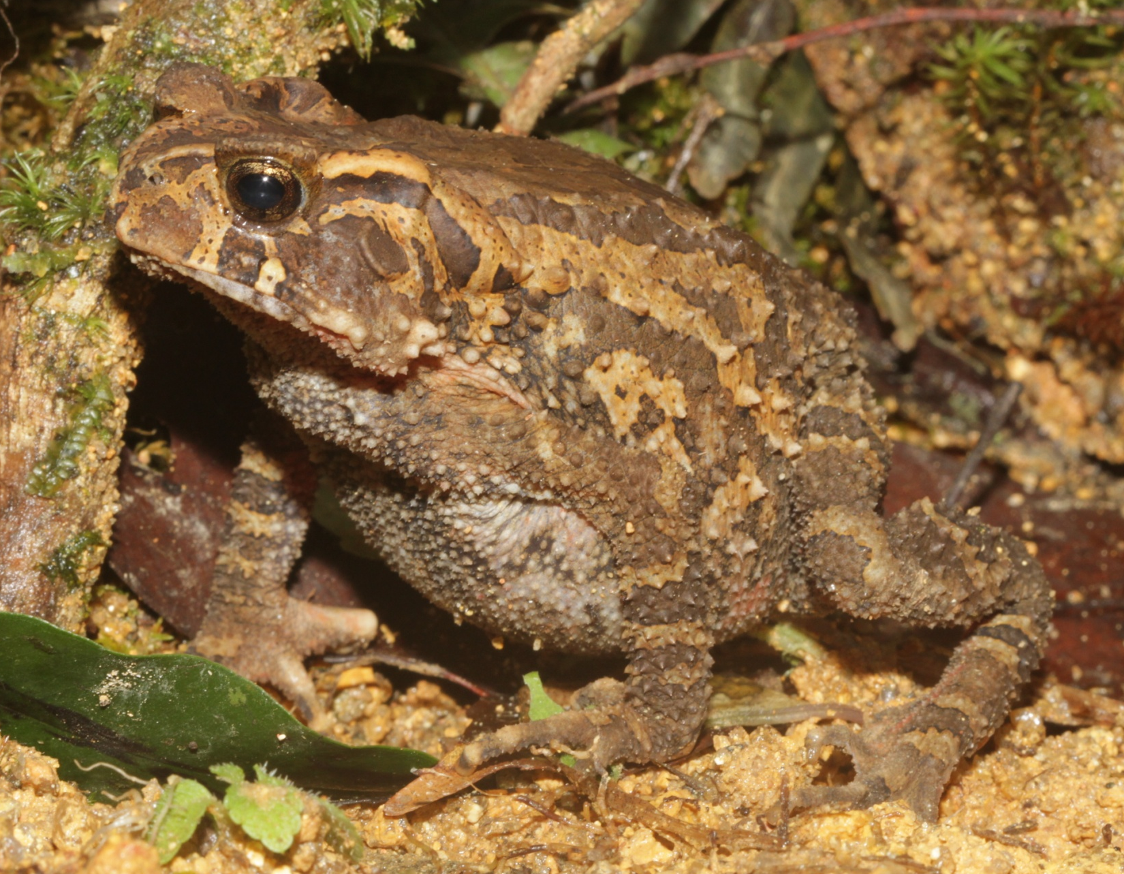
Bufonidae – Ingerophrynus galeatus
Female
87 mm SVL

Slide 4
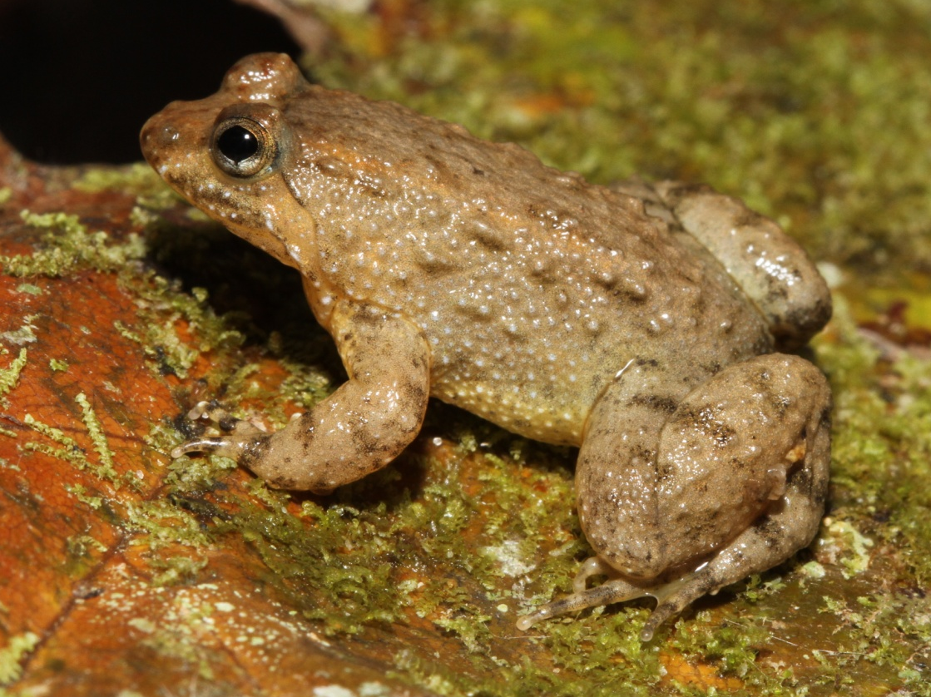
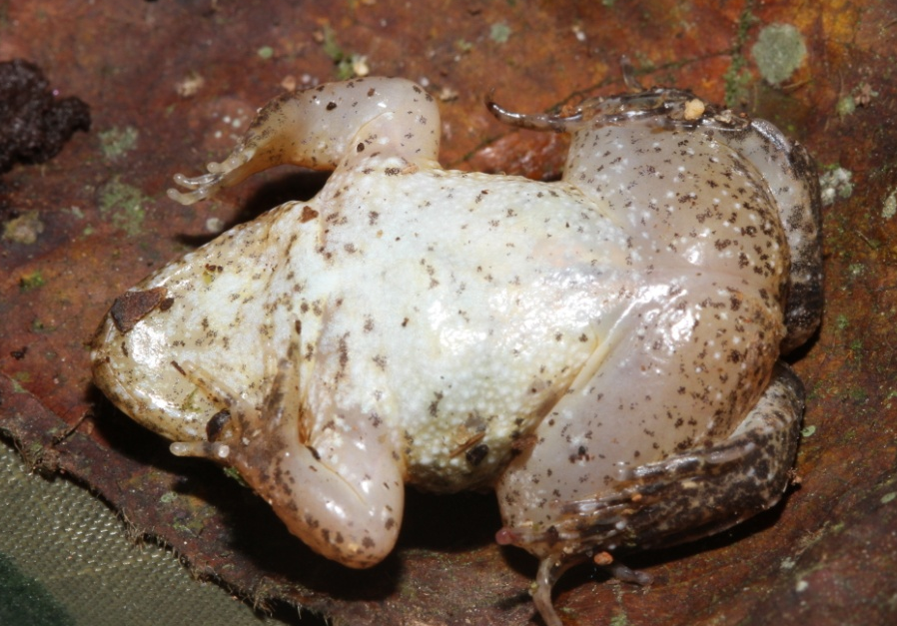
Dicroglossidae – Occidozyga martensii
26 mm SVL

Slide 5
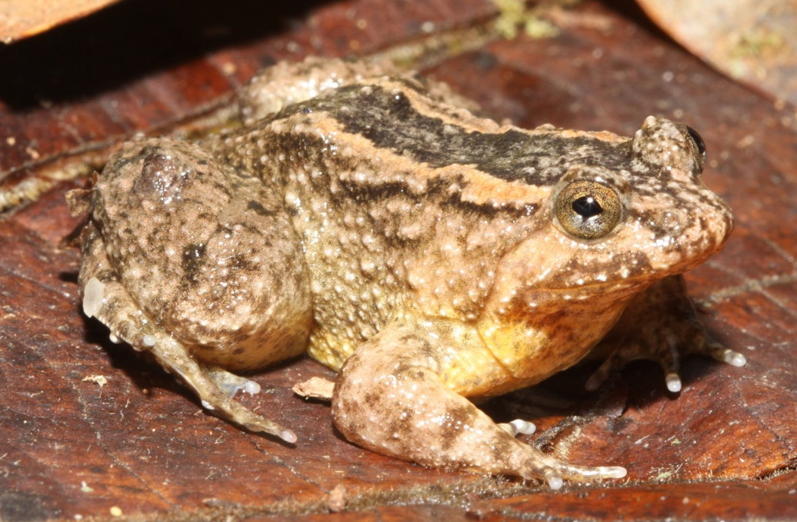
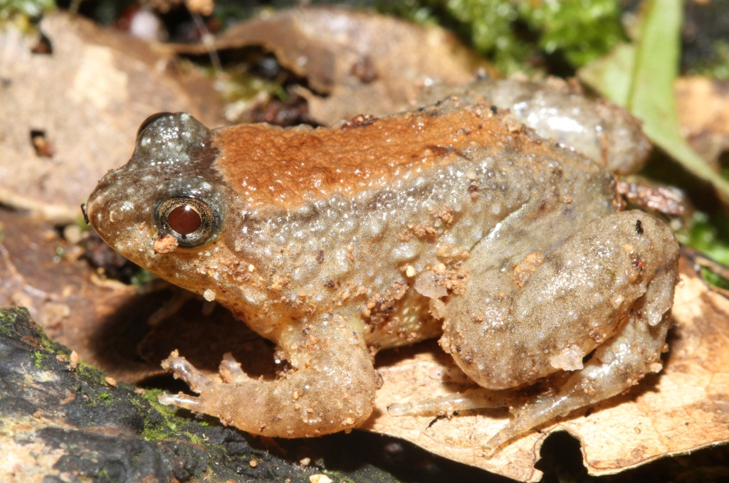
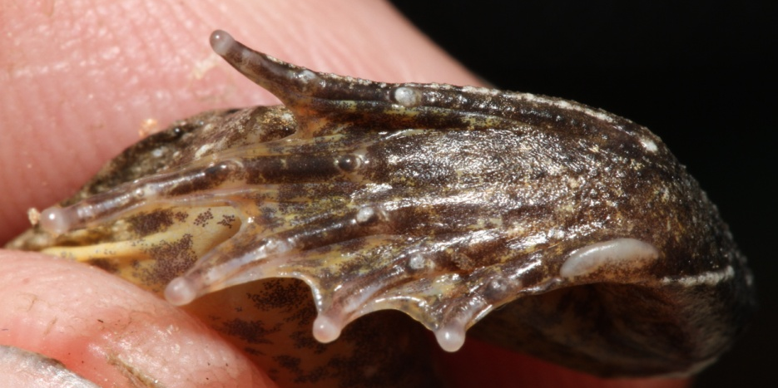
Dicroglossidae – Occidozyga vittatus
39 mm SVL
40 mm SVL

Slide 6
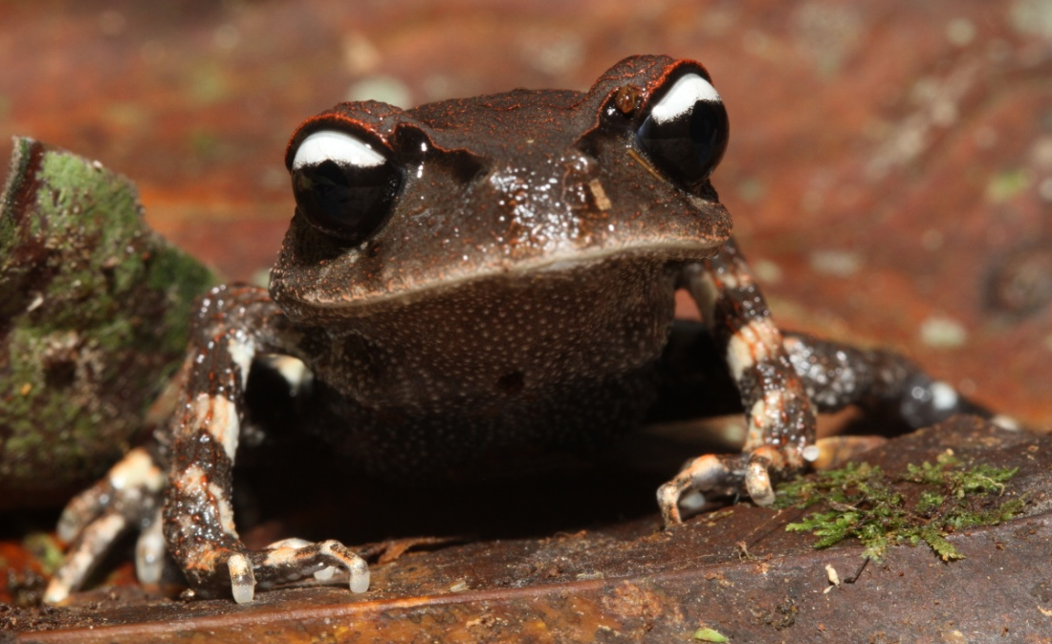
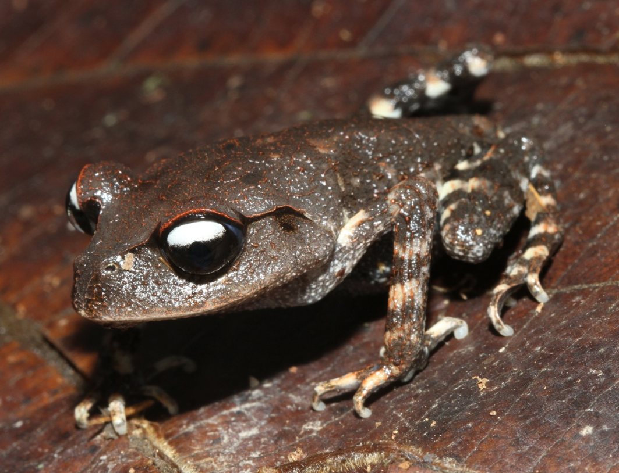
Megophryidae
Leptobrachium leucops
39 mm SVL

Slide 7
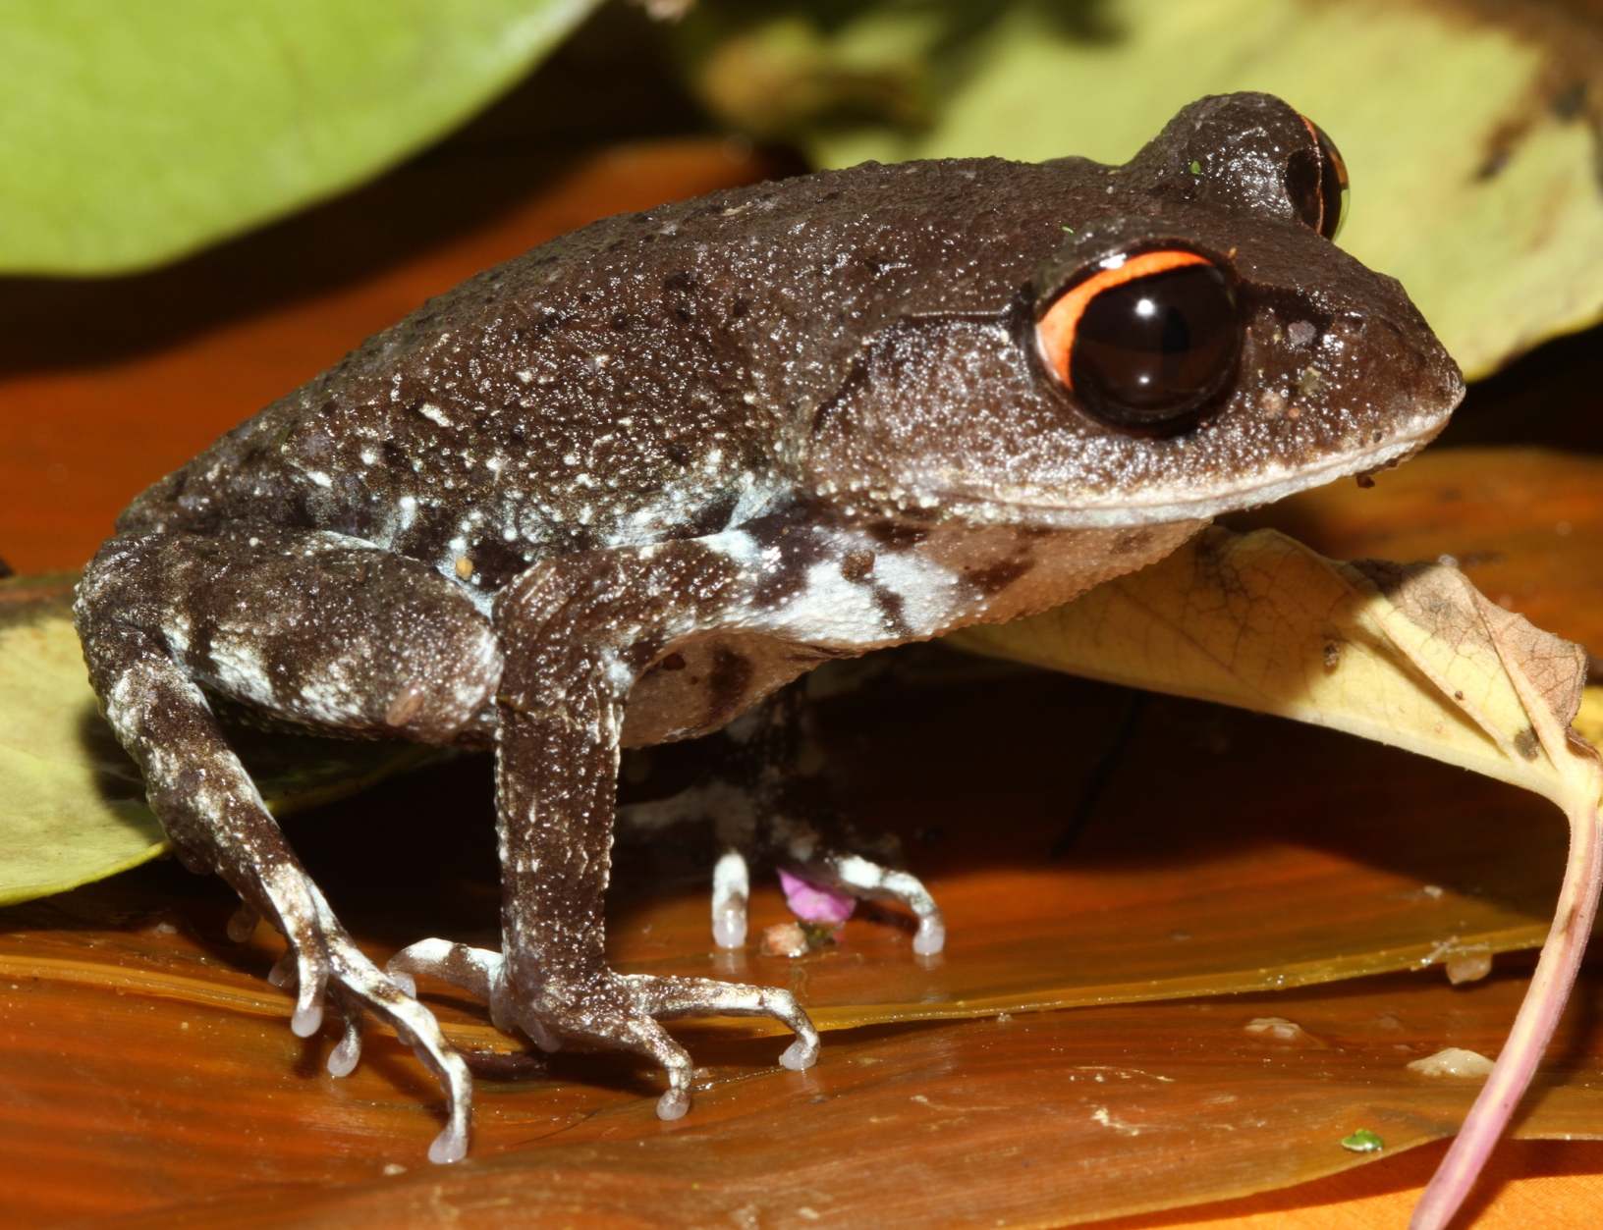
Megophryidae
Leptobrachium pullum
ca. 40 mm SVL

Slide 8
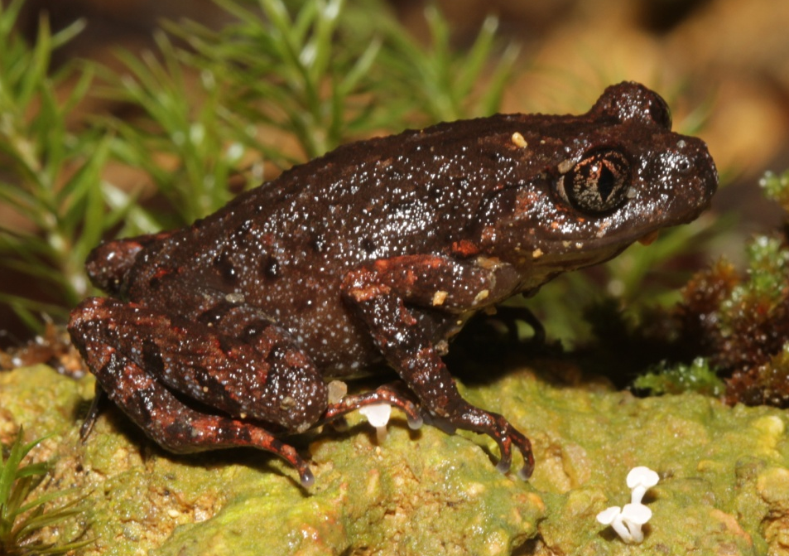
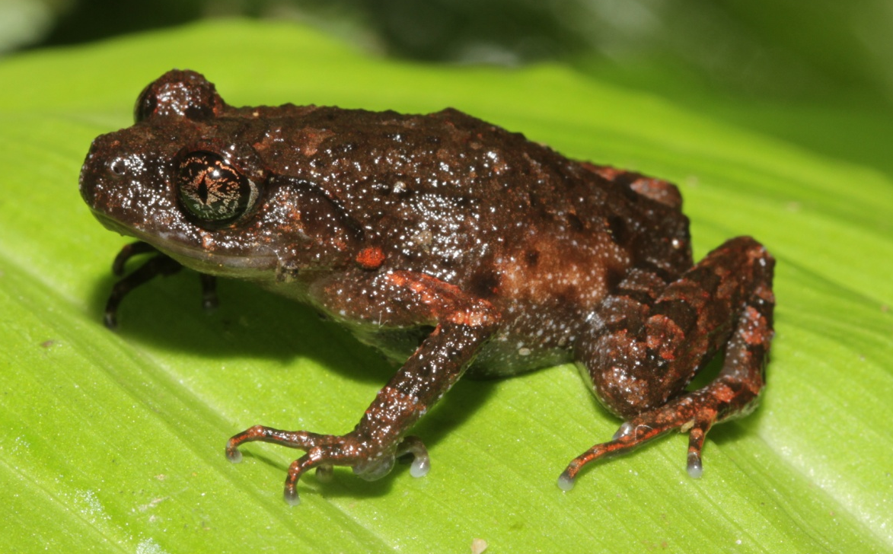
Megophryidae
Leptolalax bidoupensis
32 mm SVL

Slide 9
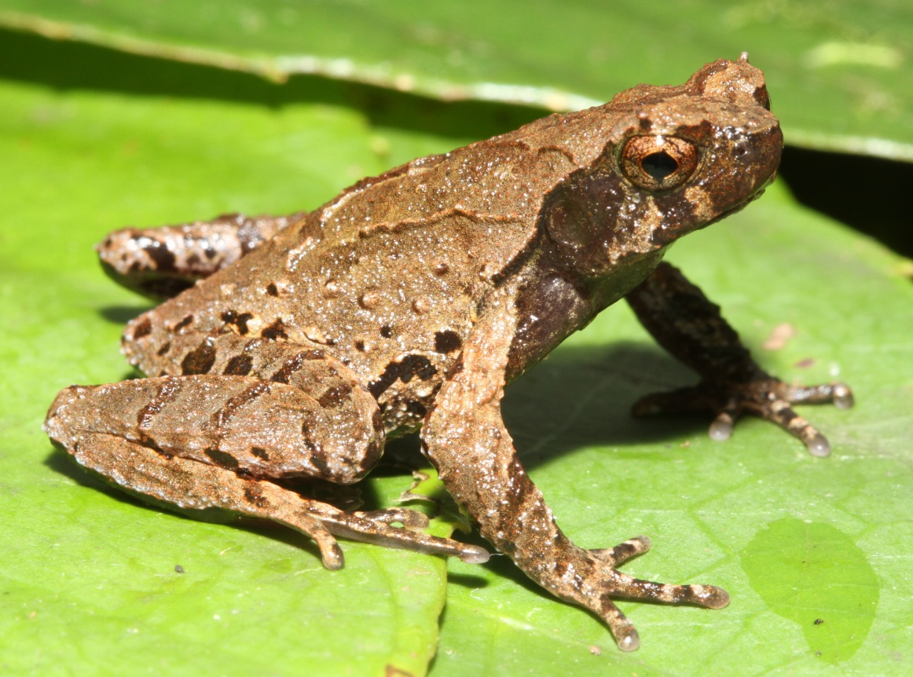
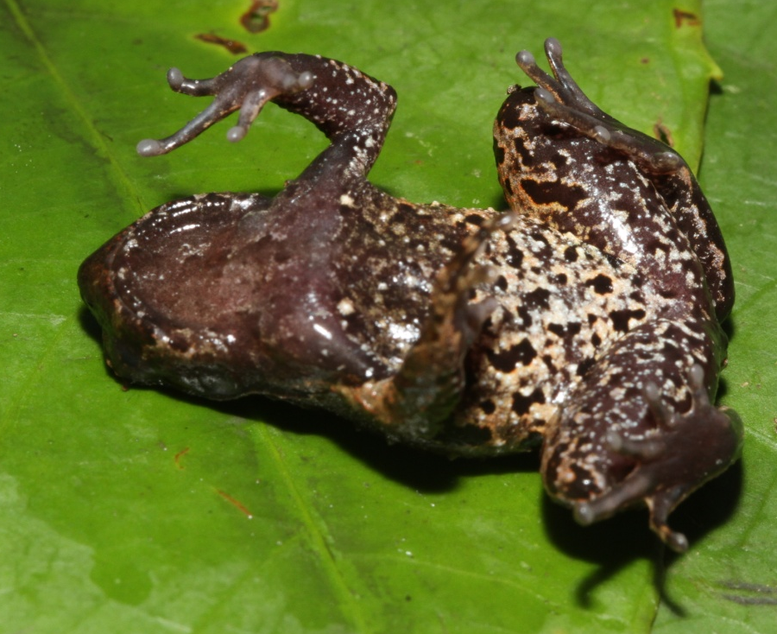
Megophryidae
Ophryphryne cf. gerti
30 mm SVL

Slide 10
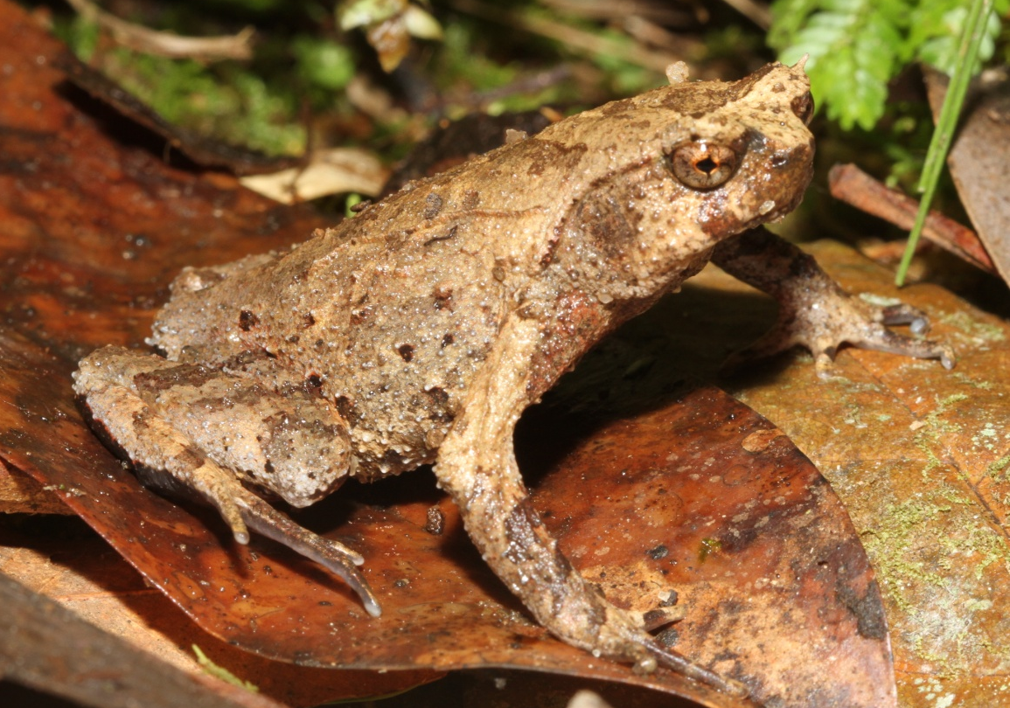
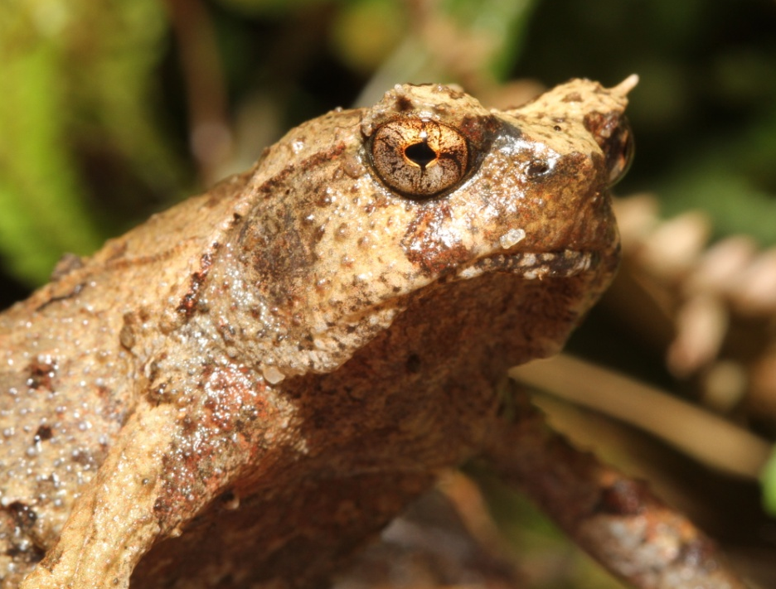
Megophryidae
Ophryphryne cf. hansi
58 mm SVL

Slide 11
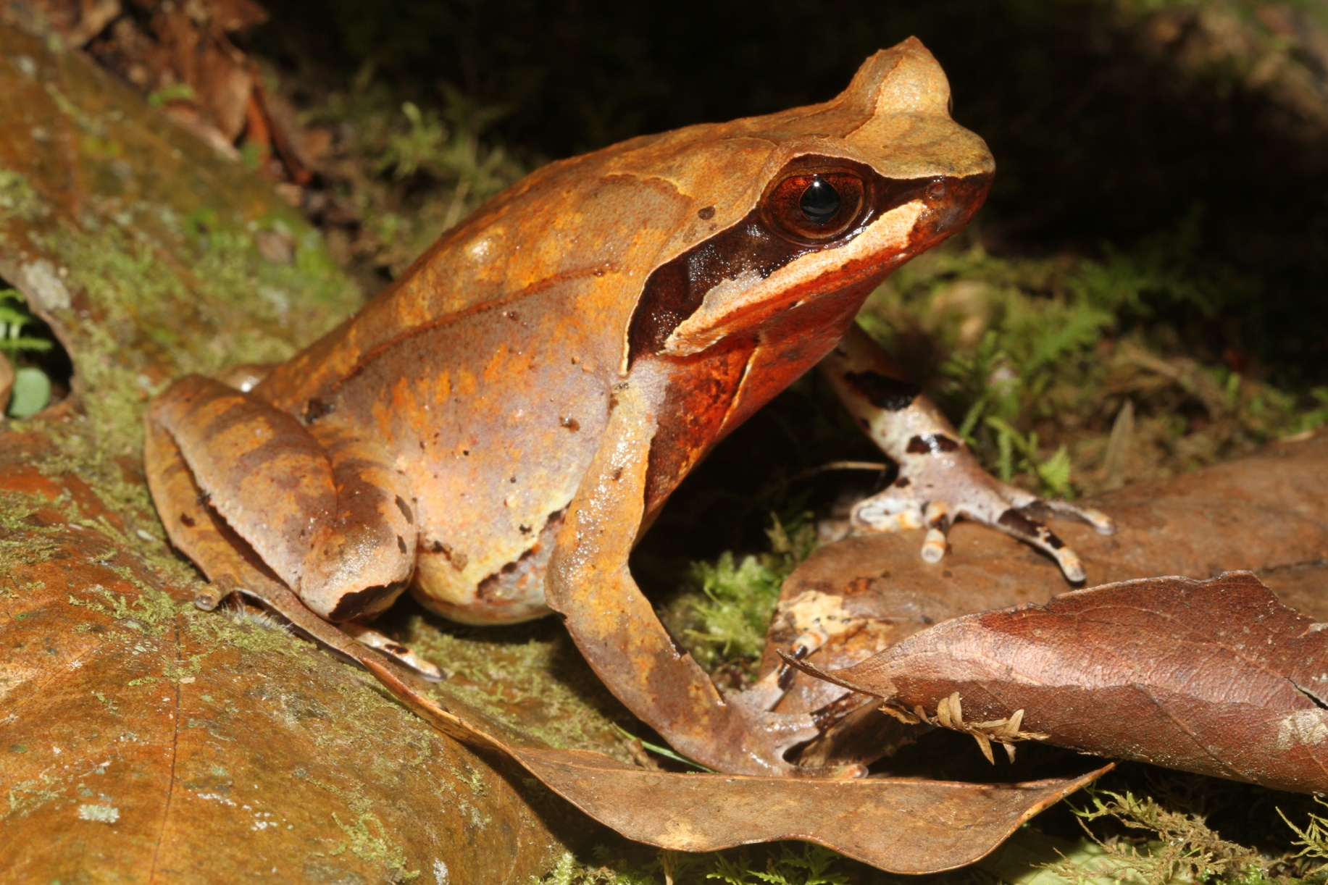
Megophryidae – Xenophrys major
62 mm SVL

Slide 12
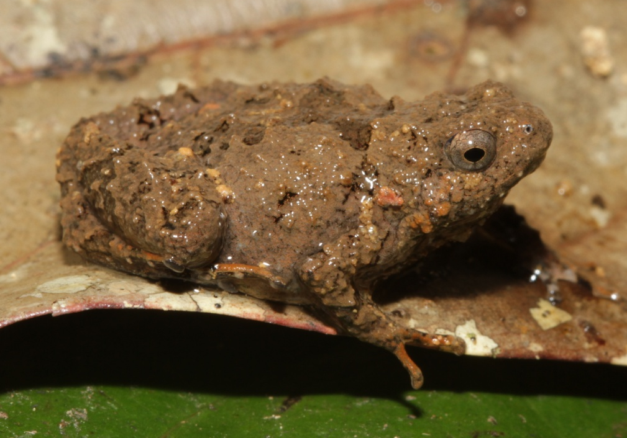
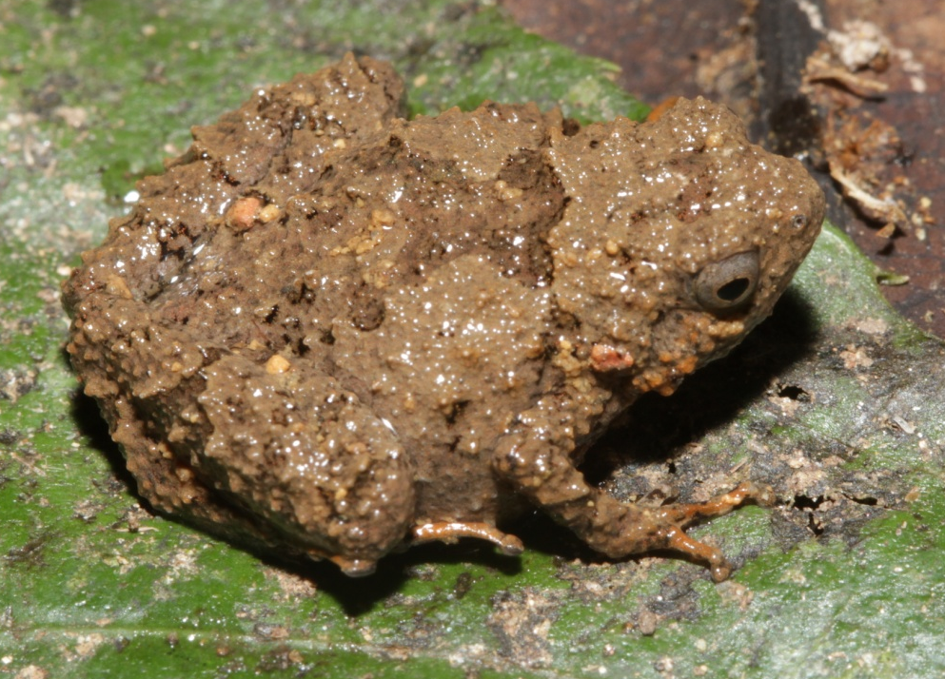
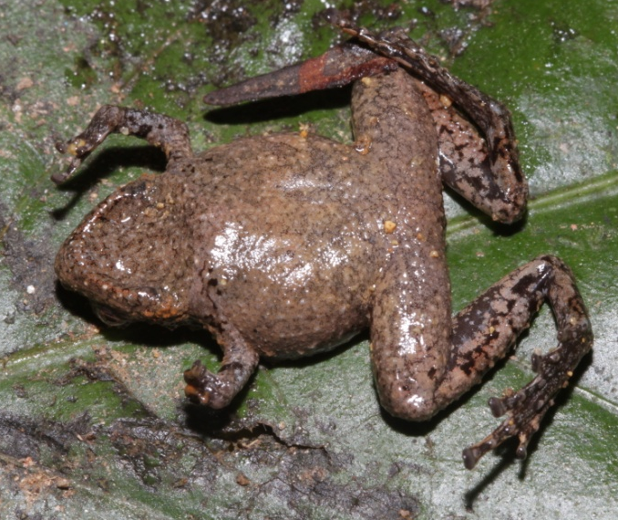
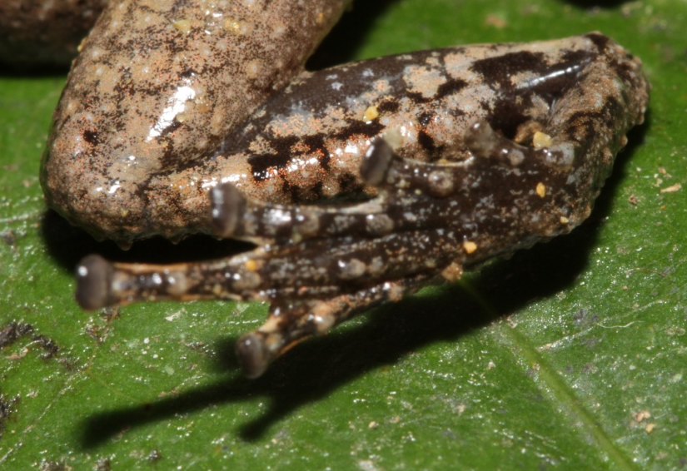
Microhylidae – Microhyla species 1
21 mm SVL
Notes:
Pustulose body and pattern similar to descriptions of M. annamensis but seems much larger than that species.

Slide 13
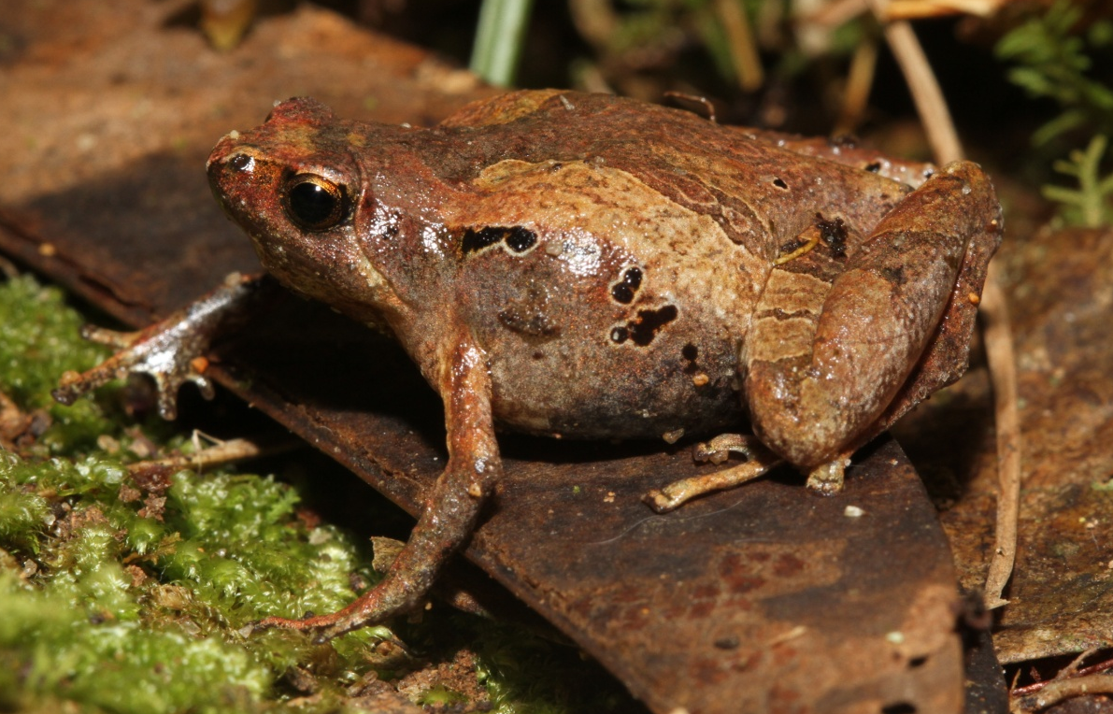
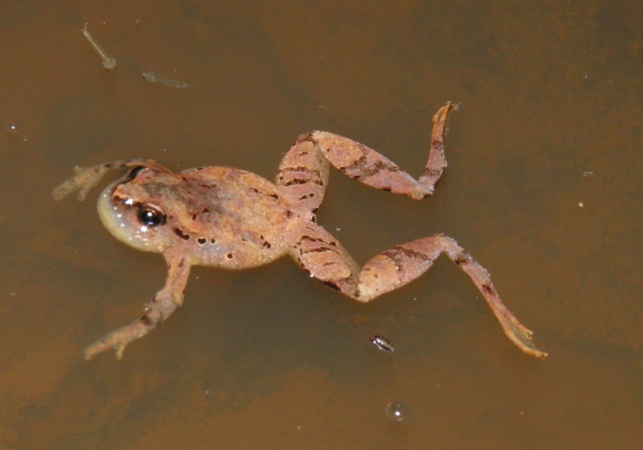
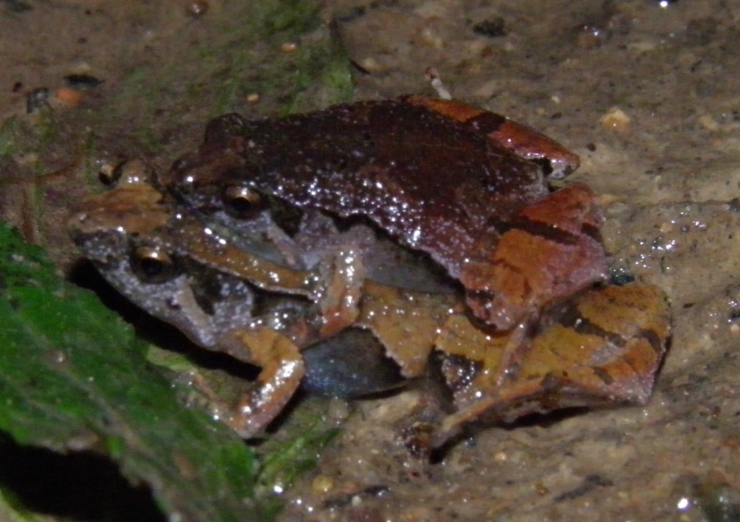
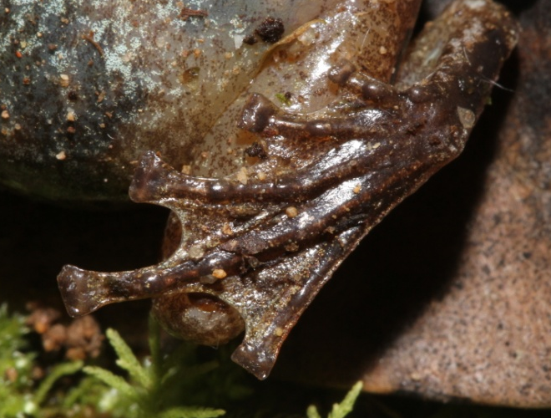
Microhylidae – Microhyla species 2
amplexus
27 mm SVL
Notes:
Toe webbing is extensive like M. berdmorei and M. marmorata.
Legs much smaller than in M. berdmorei.
Calcar-like fringes of M. marmorata is absent.
Finger 3 very long in both sexes and spatulate in males.

Slide 14
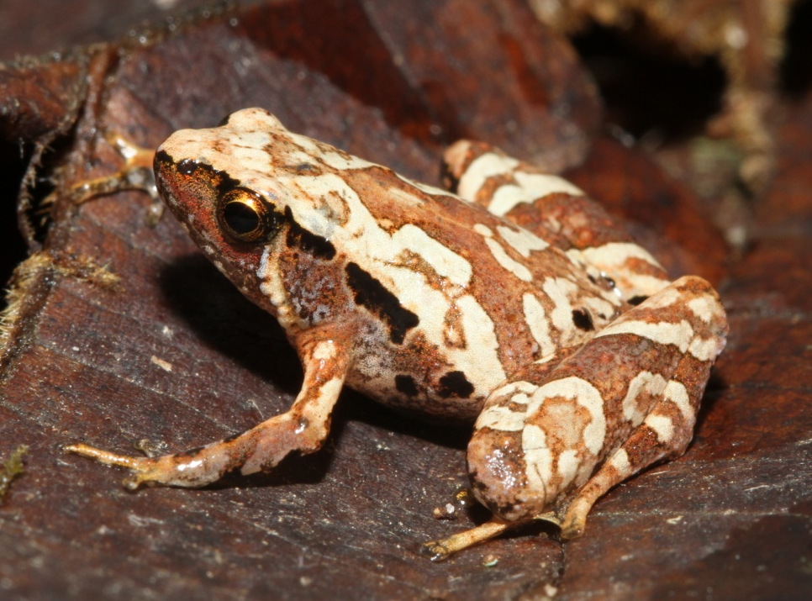
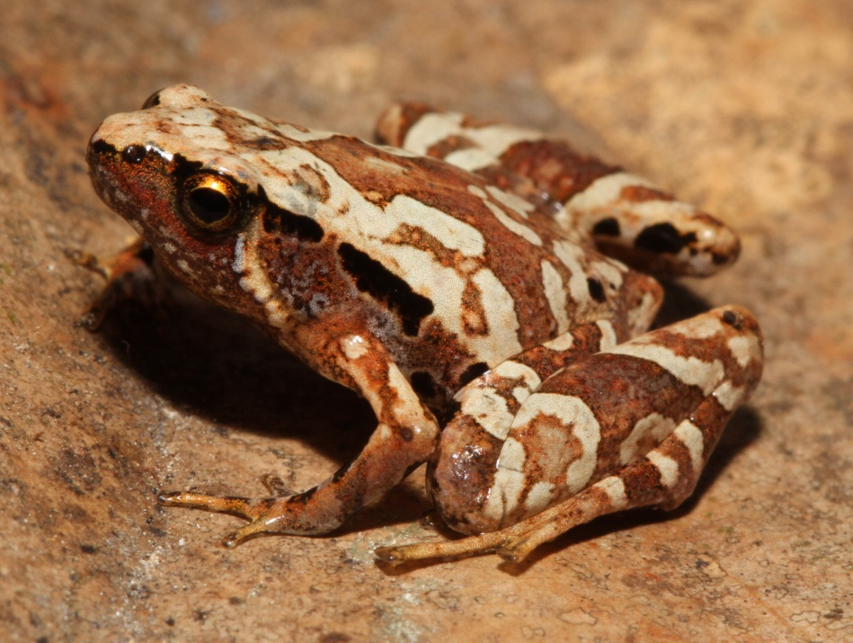
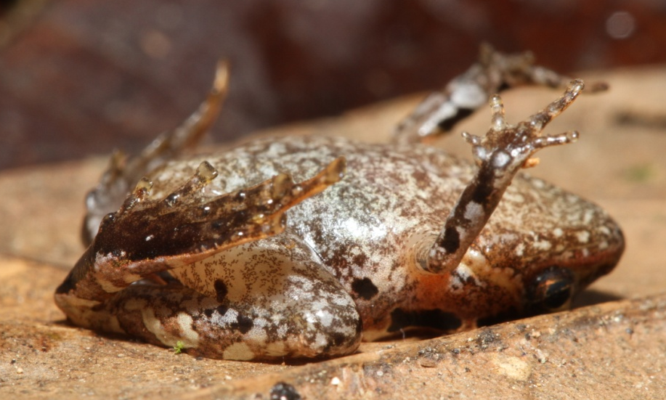
Microhylidae – Microhyla species 2
15 mm SVL
Notes:
Toe webbing is extensive like M. berdmorei and M. marmorata.
Legs much smaller than in M. berdmorei.
Calcar-like fringes of M. marmorata is absent.
Finger 3 very long in both sexes and spatulate in males.

Slide 15
Microhylidae – Microhyla species 2
amplexus
27 mm SVL
Notes:
Toe webbing is extensive like M. berdmorei and M. marmorata.
Legs much smaller than in M. berdmorei.
Calcar-like fringes of M. marmorata is absent.
Finger 3 very long in both sexes and spatulate in males.

Slide 16
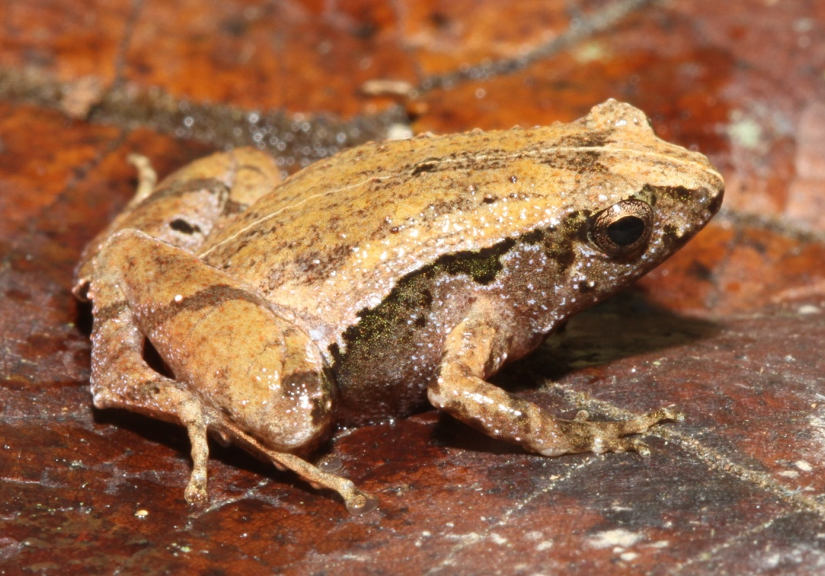
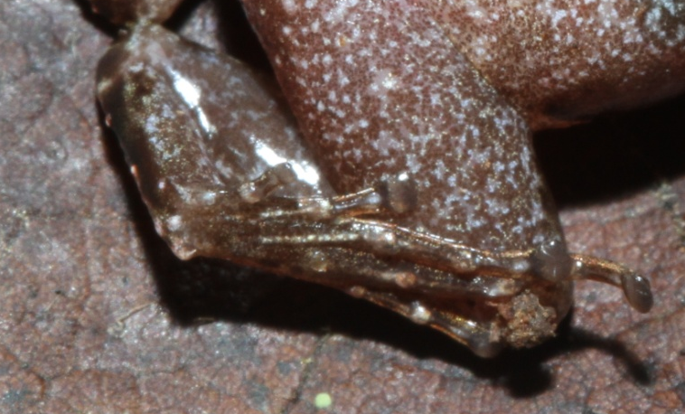
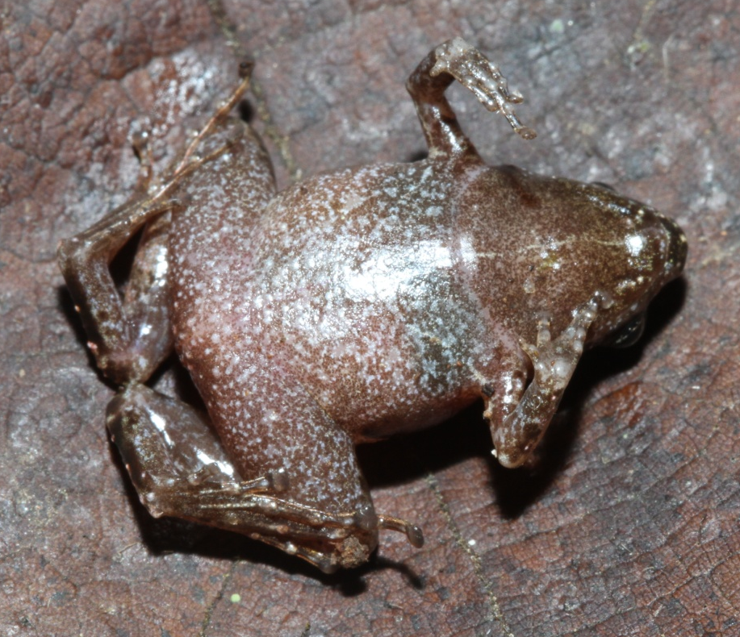
Microhylidae – Microhyla species 3
19 mm SVL
Notes:
Toe webbing greatly reduced.
Similar to M. fissipes.

Slide 17
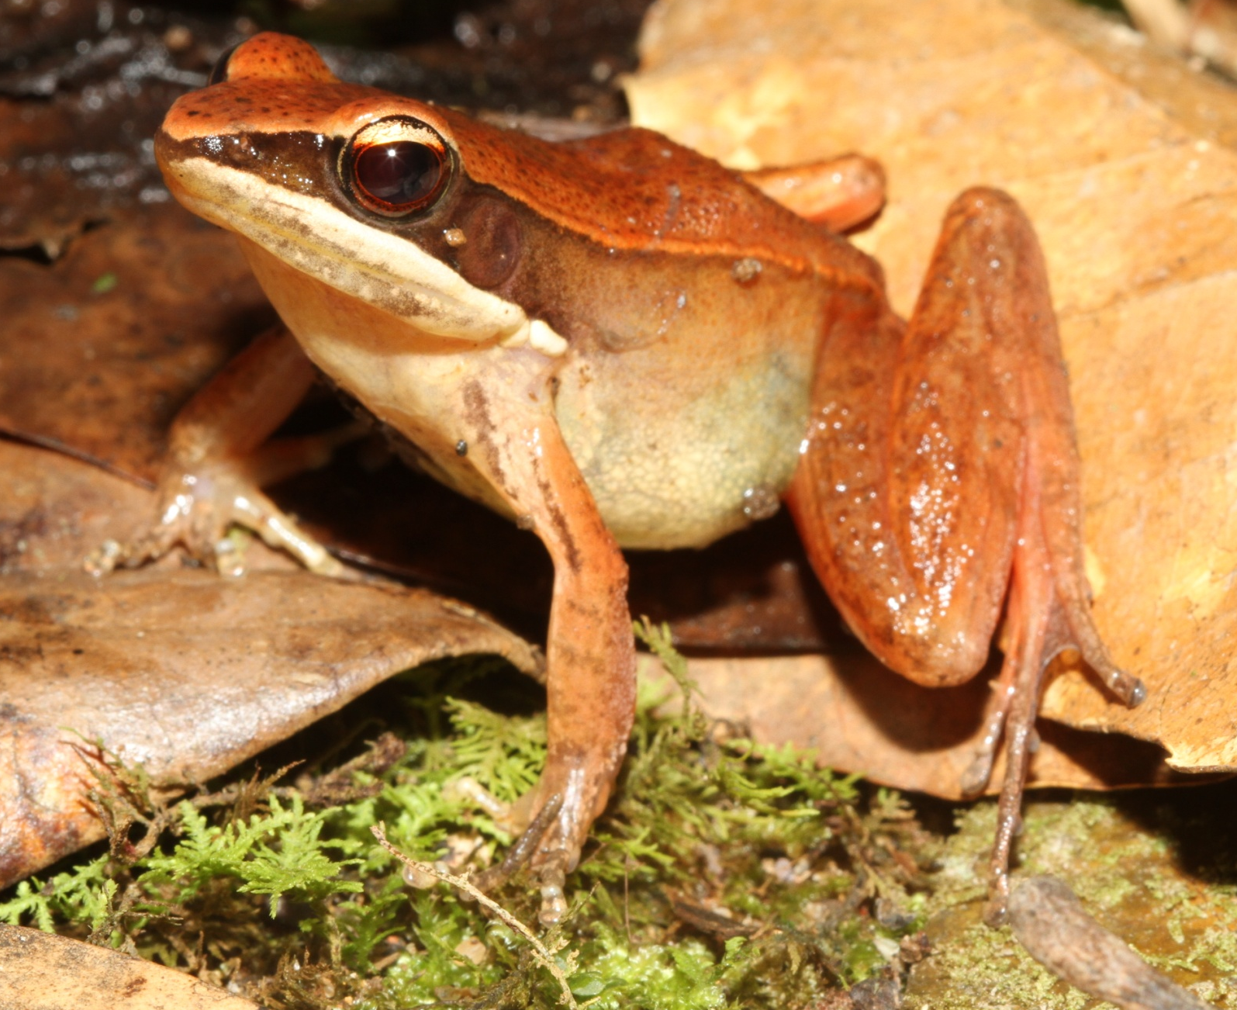
Ranidae – Hylarana milleti
Notes:
Distinct dorsolateral folds.
Distinct facial dark stripe.
Ground color somewhat variable.

Slide 18
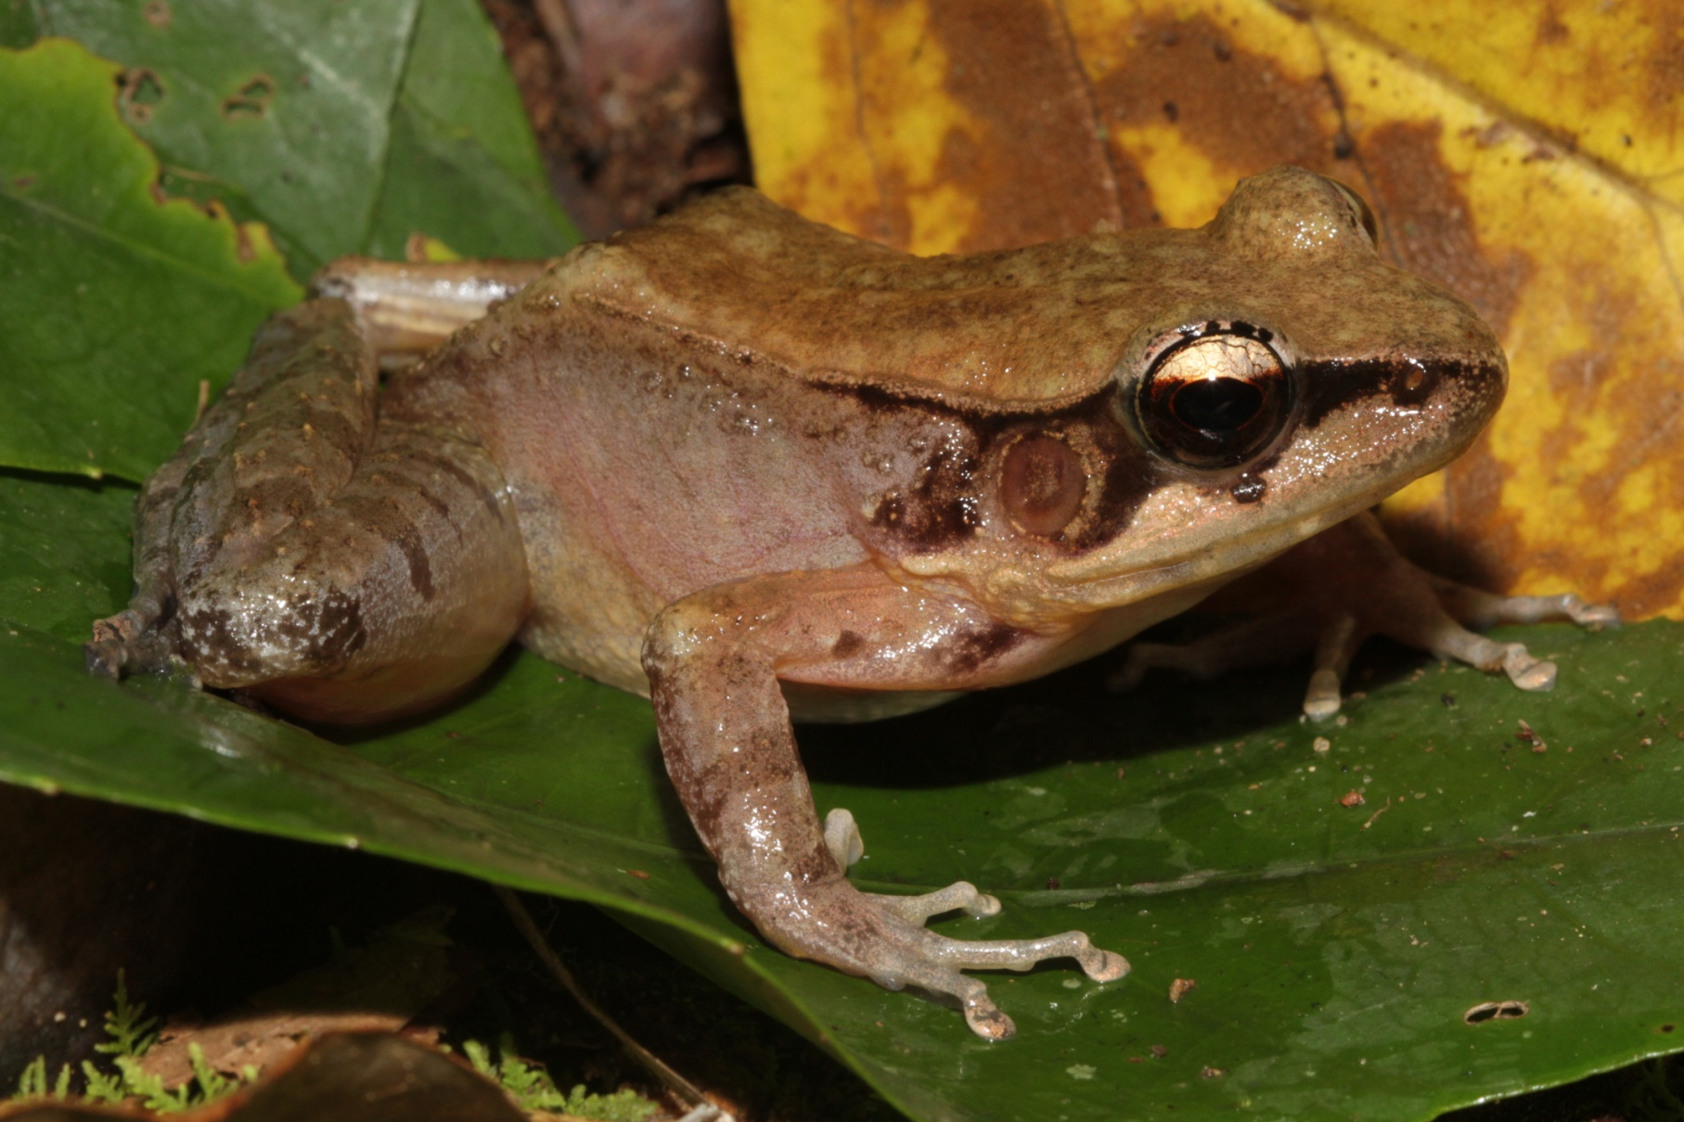
Ranidae – Hylarana cf. montivaga
60 mm SVL

Slide 19
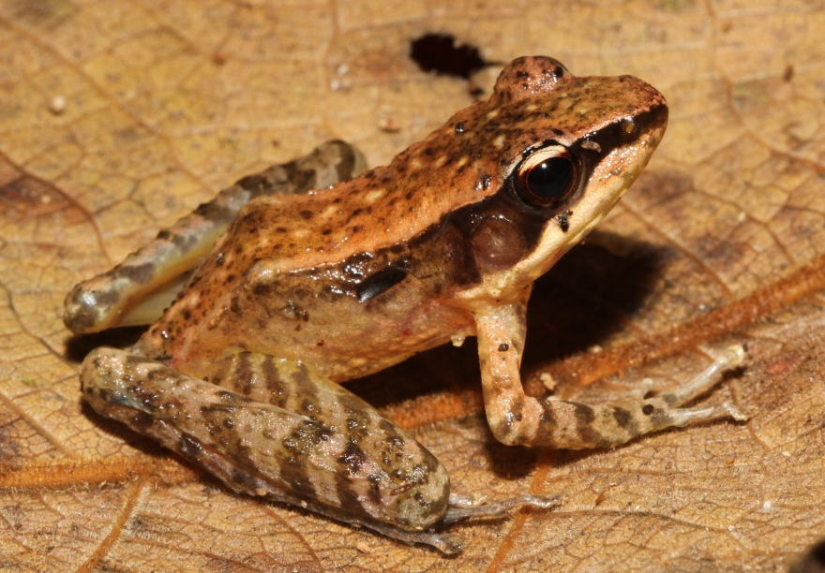
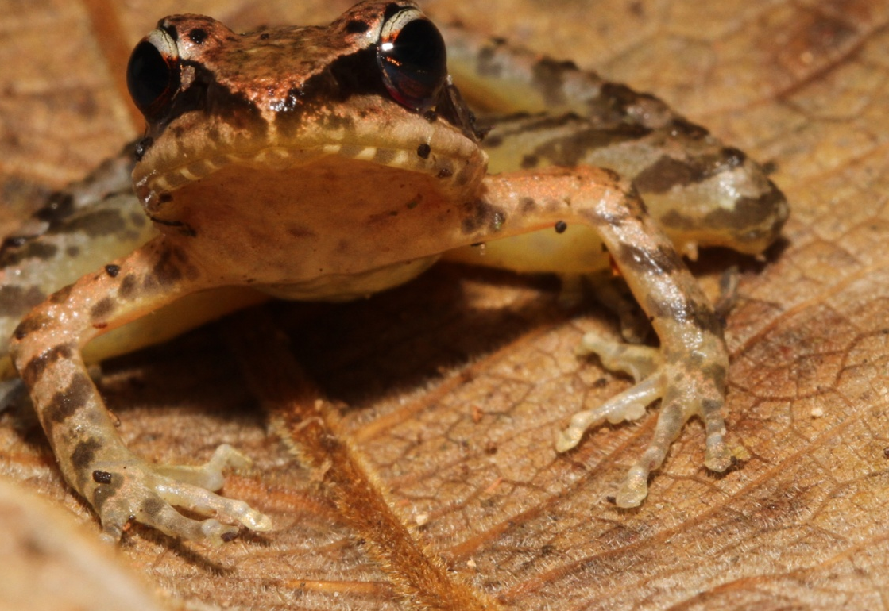
Ranidae – Hylarana species 1
37 mm SVL
Notes:
Very long legs with well marked with bands.
Concealed surfaces not bright yellow.

Slide 20
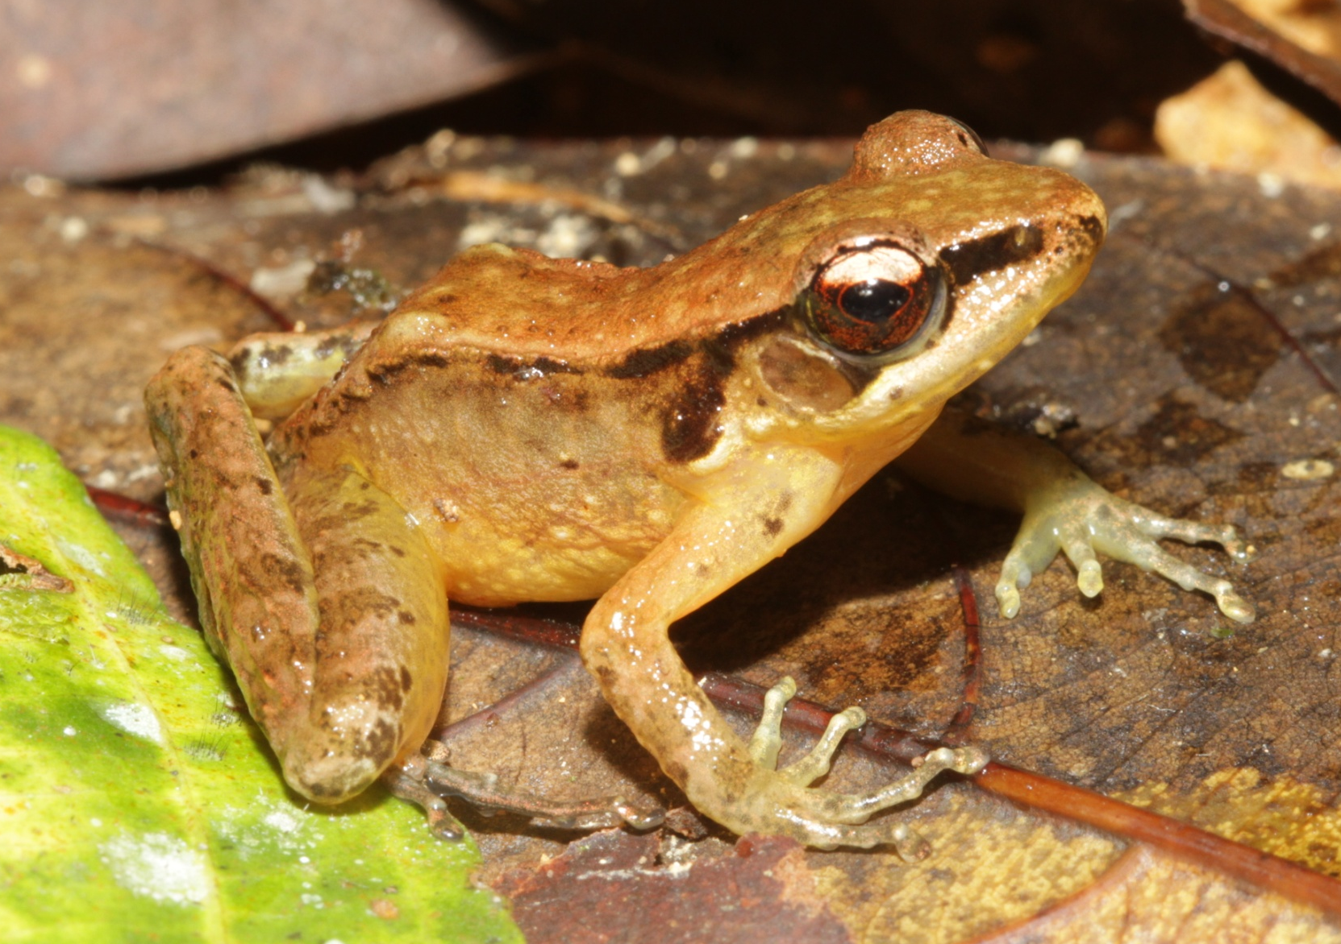
Ranidae – Hylarana species 2
33 mm SVL
Notes:
Long hind legs with distinct crossbands.
Concealed surfaces and venter bright yellow.

Slide 21
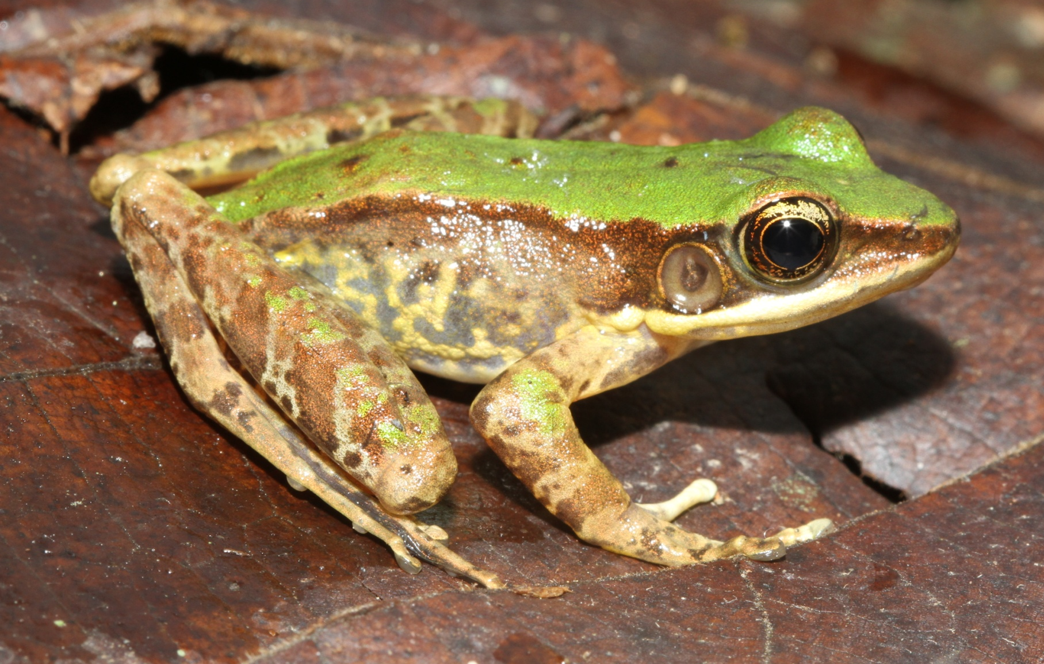
Ranidae – Odorrana cf. chloronota
42 mm SVL
Notes:
Green dorsum places this frog in the Odorrana livida group.

Slide 22
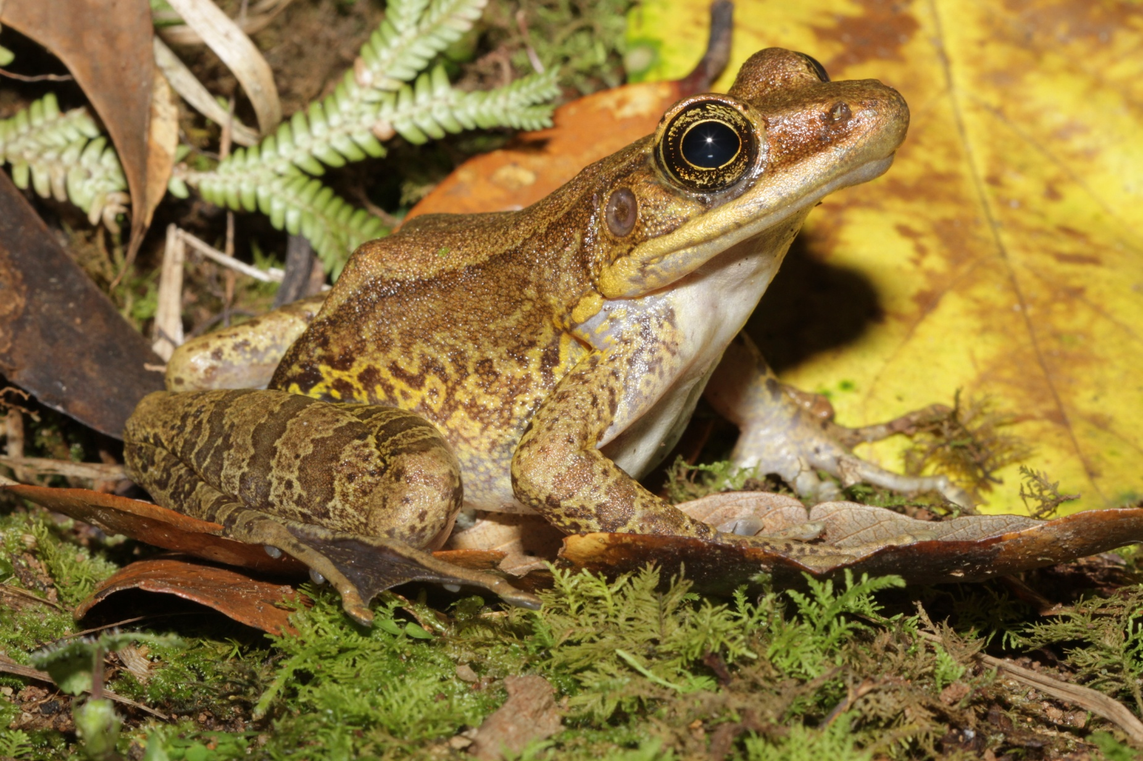
Ranidae – Odorrana cf. tiannanensis
87 mm SVL
Notes:
Very large, especially females.
Webbing extensive.
Toe pads large and pointed.

Slide 23
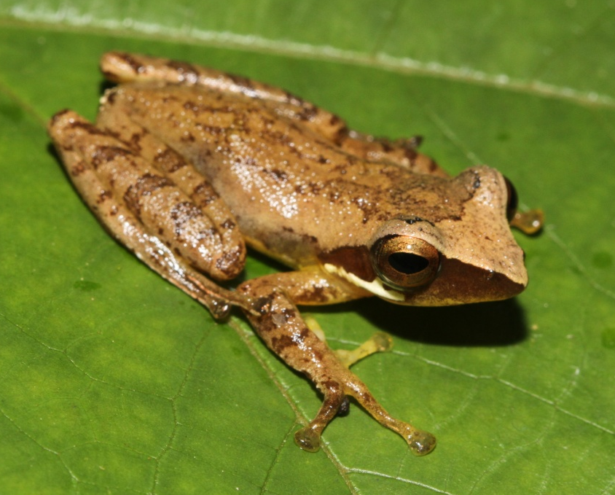
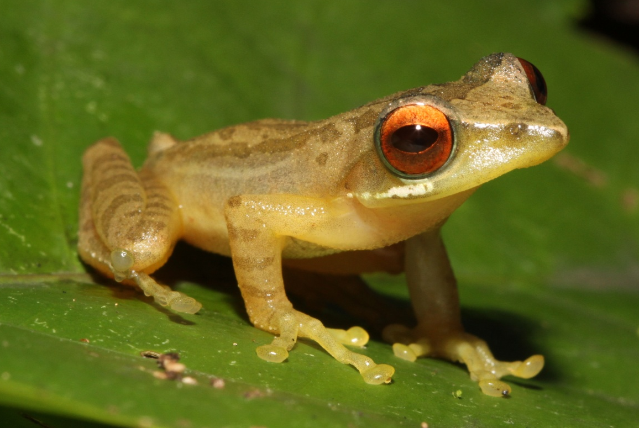
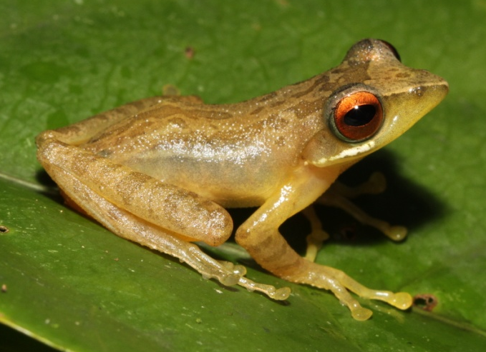
Rhacophoridae – Feihyla palpebralis
27-28 mm SVL
Notes:
Appears greenish at night and brown in the daytime.
Eyes are dull red colored at night and dark brown by day.

Slide 24
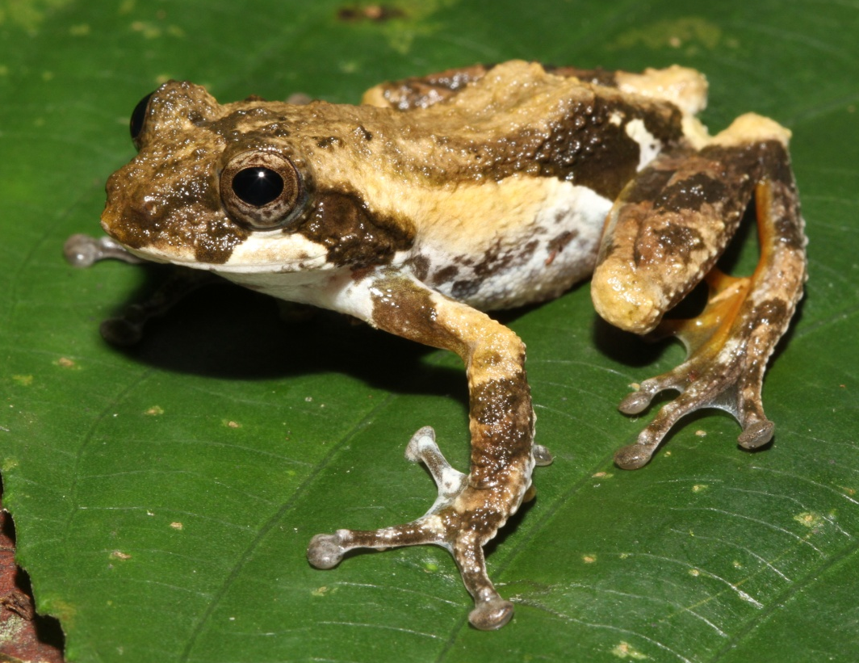
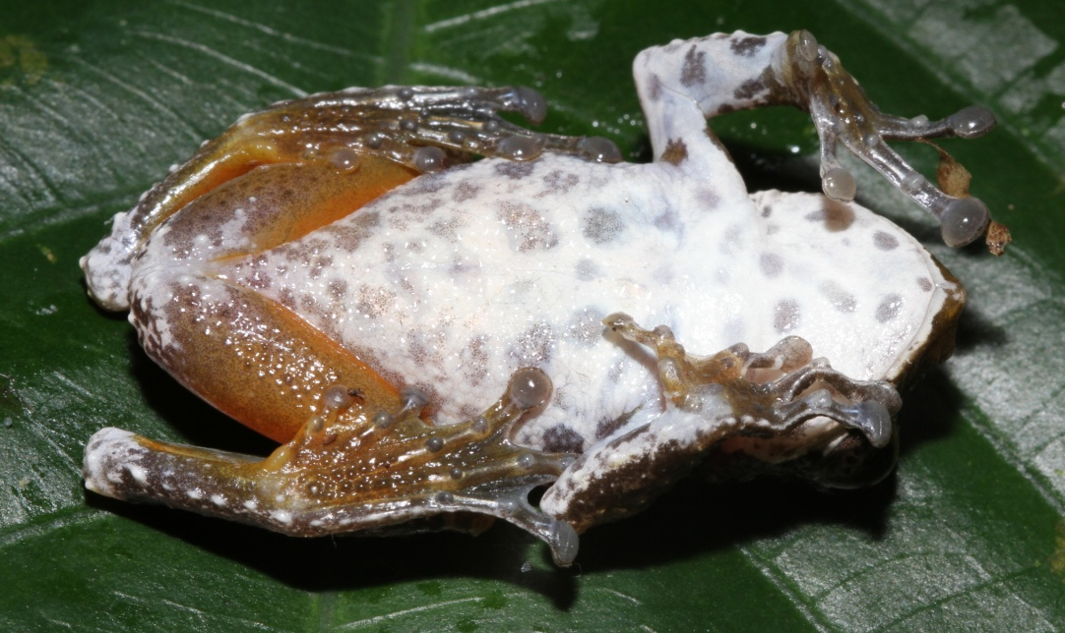
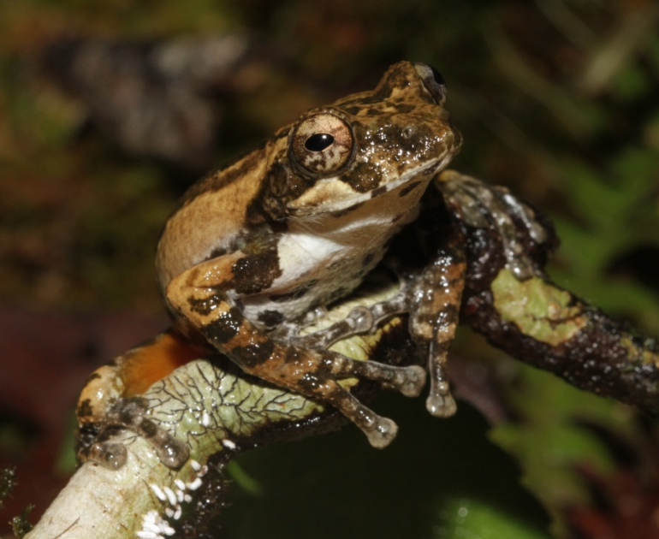
Rhacophoridae – Kurixalus baliogaster
Male 37 mm SVL
Female

Slide 25
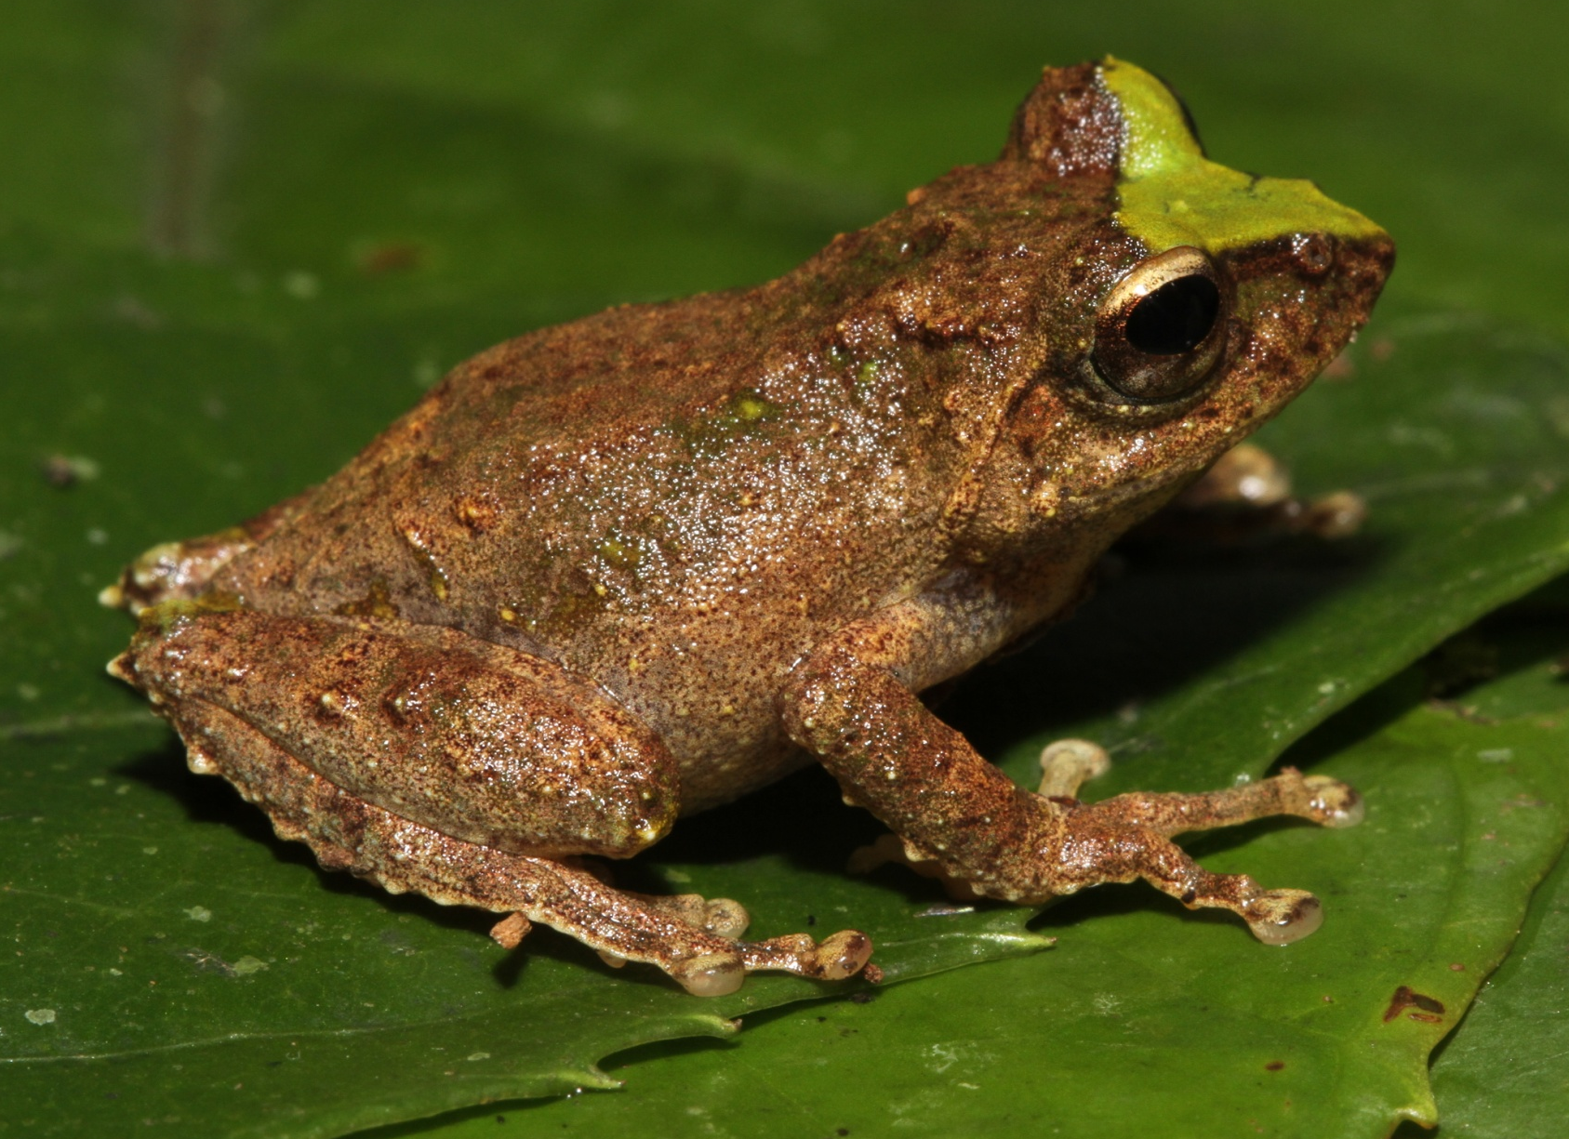
Rhacophoridae – Kurixalus species 1
29 mm SVL male
Notes:
May be Raorchestes gryllus.

Slide 26
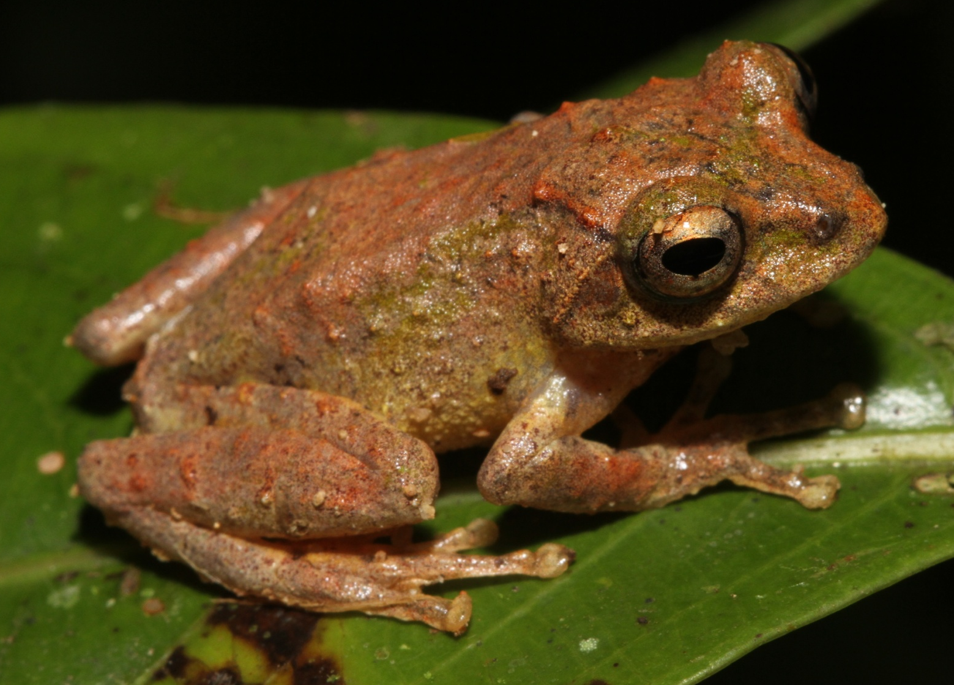
Rhacophoridae – Kurixalus species 1
26 mm SVL male
Notes:
May be Raorchestes gryllus.

Slide 27
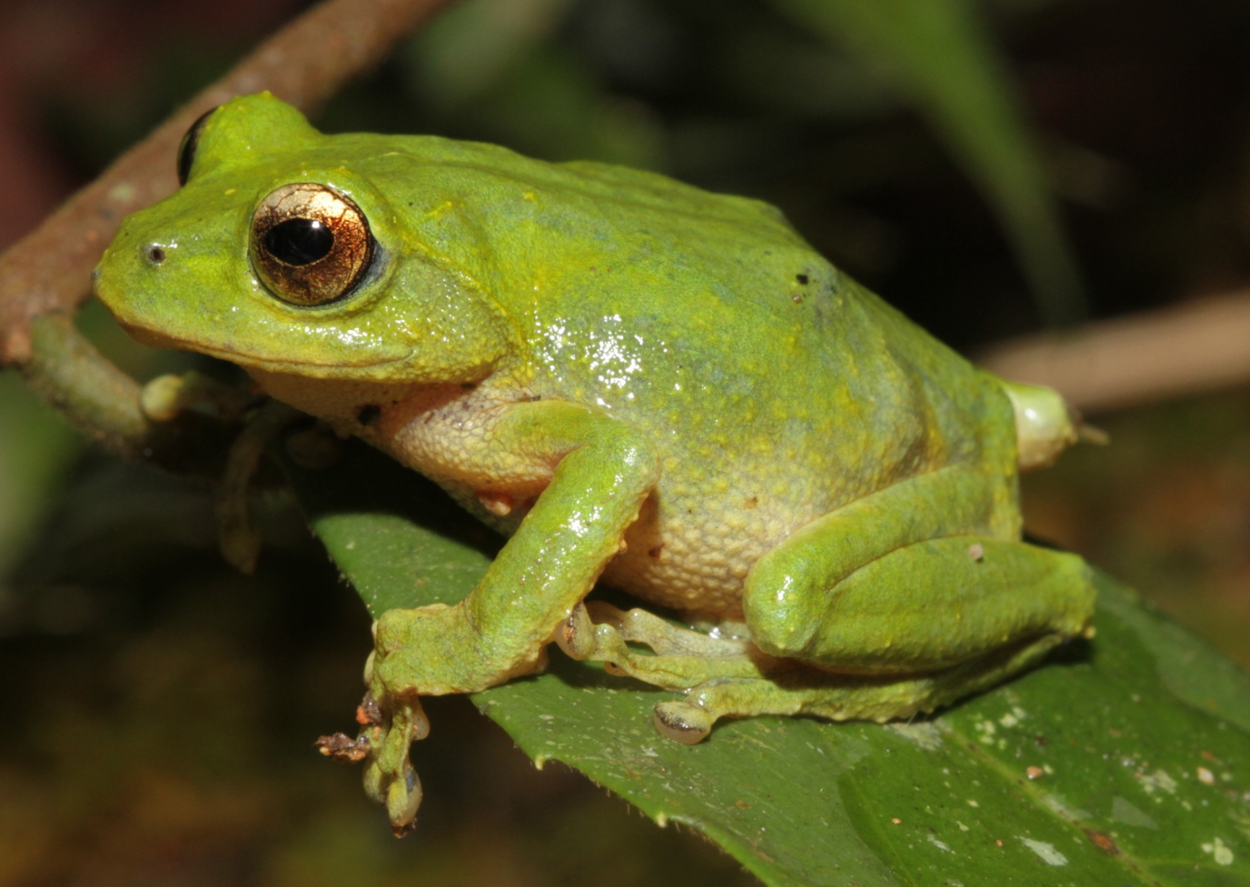
Rhacophoridae – Kurixalus species 1
34 mm SVL
Notes:
May be Raorchestes gryllus.

Slide 28
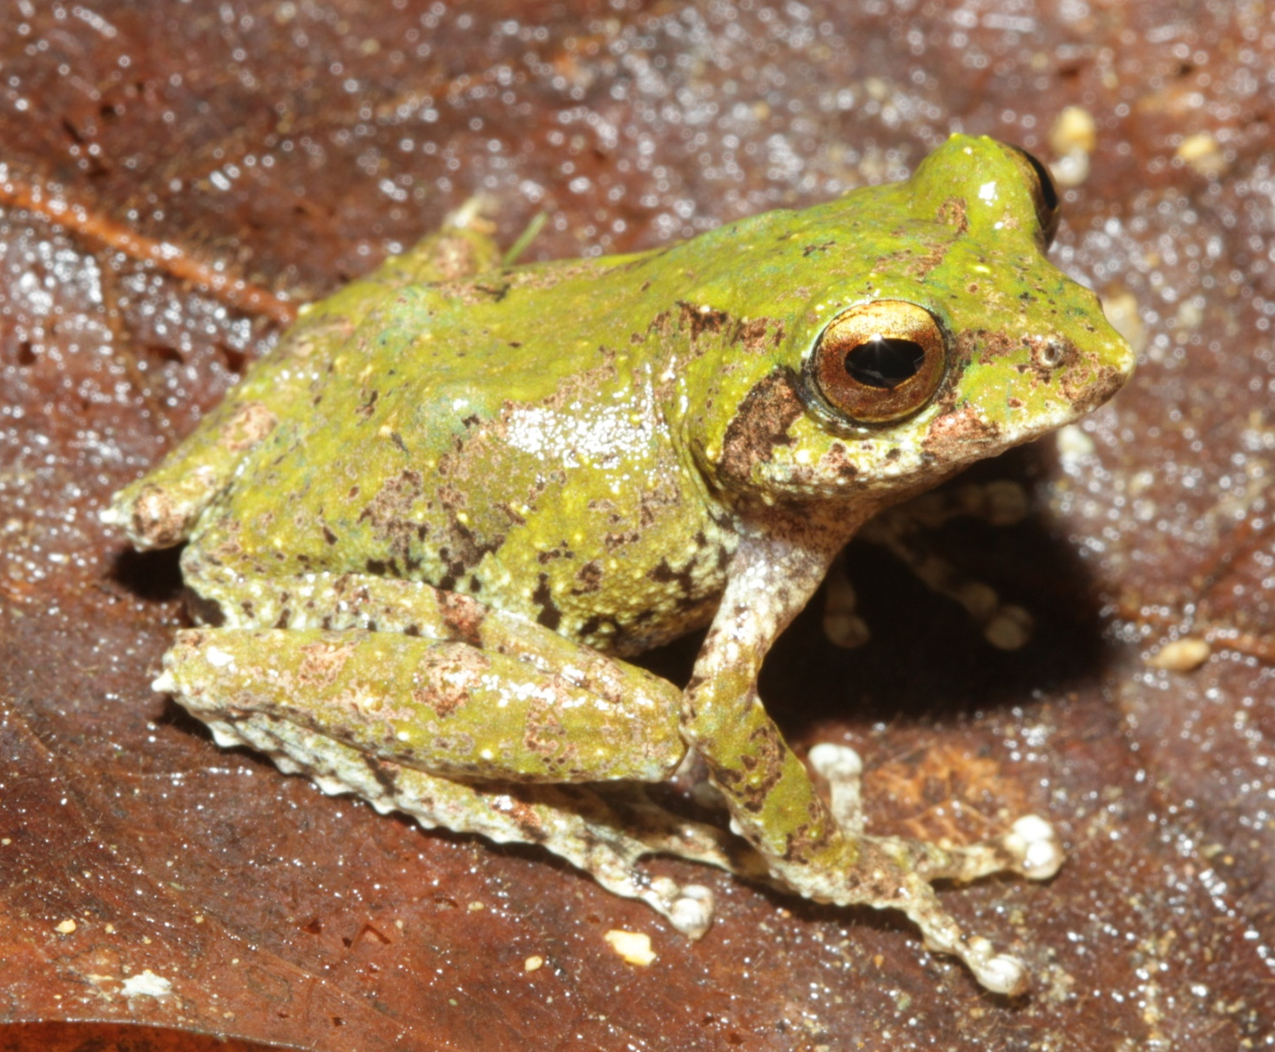
Rhacophoridae – Kurixalus species 1
27 mm SVL male
Notes:
May be Raorchestes gryllus.

Slide 29
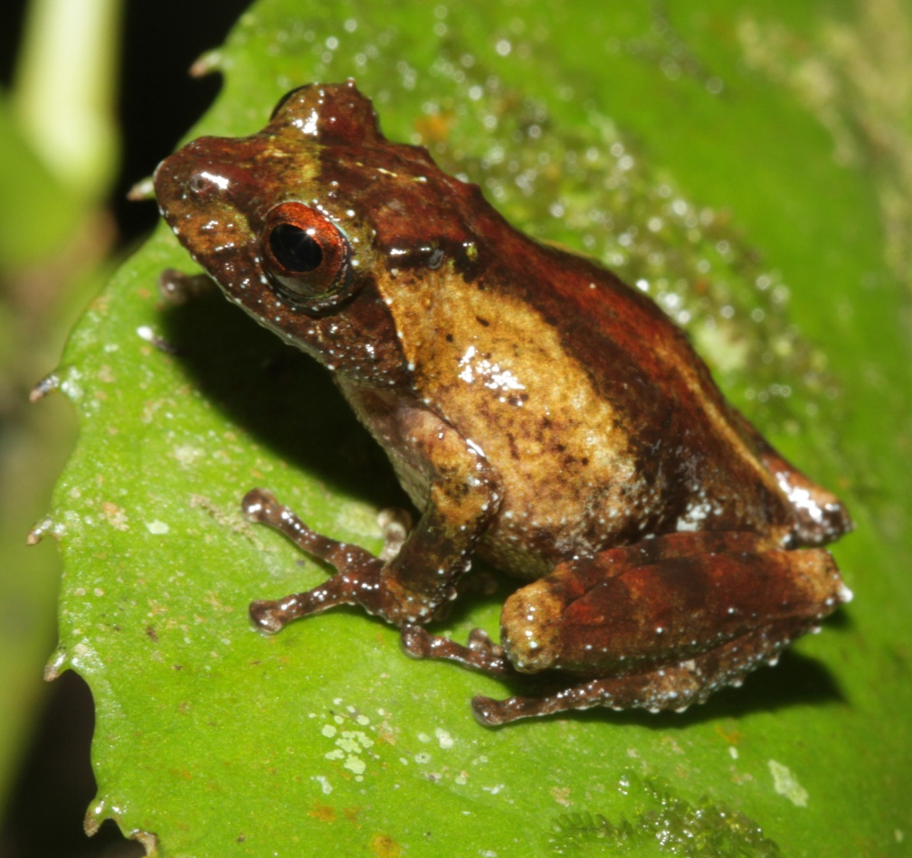
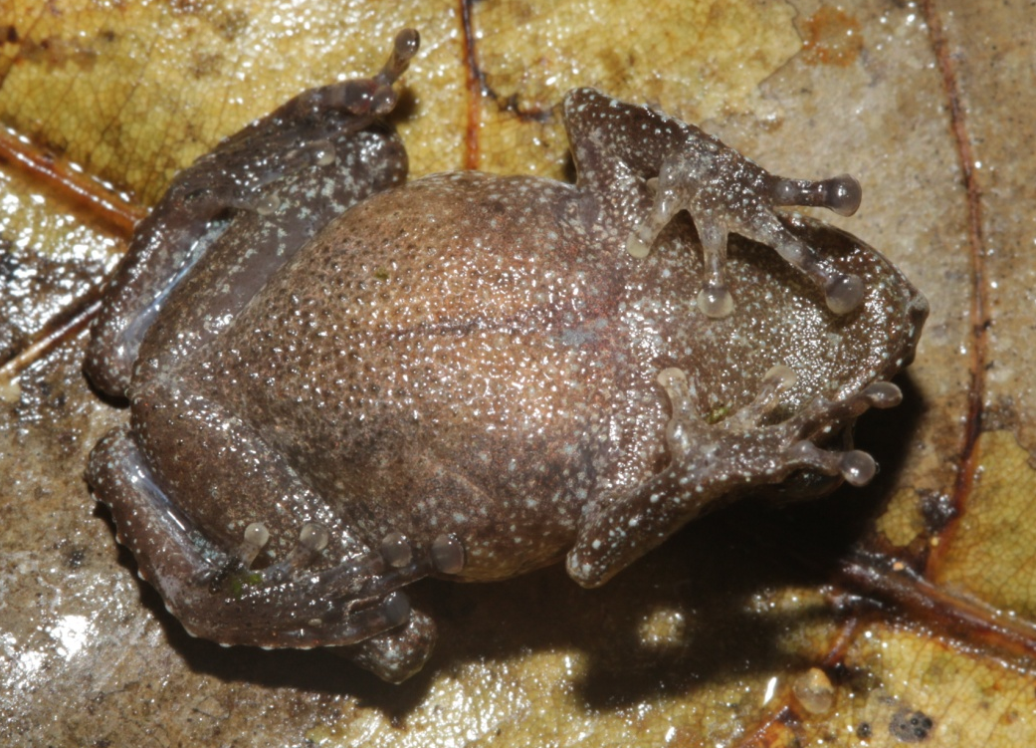
Rhacophoridae – Kurixalus species 2
20 mm SVL male
Notes:
Resembles Philautus abditus.

Slide 30
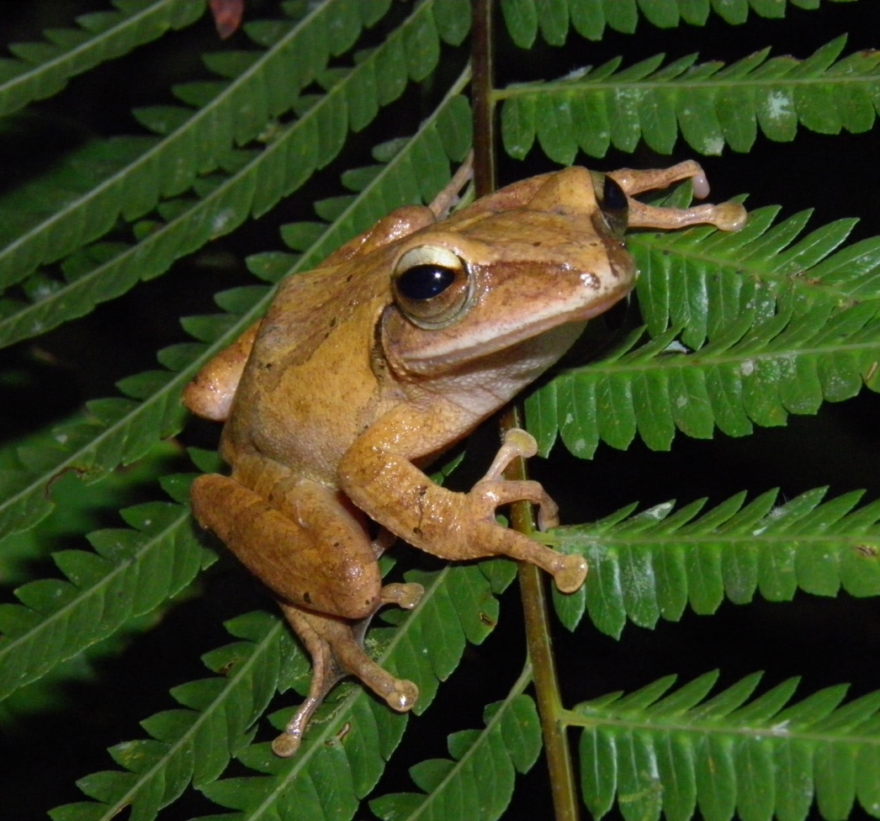

Rhacophoridae
Polypedates megacephalus
40 mm SVL

Slide 31



Rhacophoridae
Rhacophorus chuyangsinensis
males

Slide 32



Rhacophoridae
Rhacophorus chuyangsinensis
Pair in
amplexus
females

Slide 33
Reptilia
Family Agamidae – 2 species
Family Scincidae – 1 species
Family Gekkonidae – 1 species
Family Colubridae – 6 species
Family Viperidae – 1 species
Total = 11 species

Slide 34


Agamidae – Draco cf. maculatus
Photo by Tien

Slide 35


Agamidae – Pseudocalotes microps

Slide 36



Gekkonidae –
Cyrtodactylus species (irregularis group)
Juvenile
adult

Slide 37




Scincidae
Sphenomorphus buenloicus

Slide 38




Colubridae – Calamaria buchi

Slide 39

Colubridae – Dinodon septentrionale

Slide 40

Colubridae – Dinodon septentrionale

Slide 41

Colubridae
Oreocryptophis porphyraceus

Slide 42

Colubridae – Parahelicops annamensis

Slide 43

Colubridae – Parahelicops annamensis

Slide 44

Colubridae – Pareas hamptoni

Slide 45

Colubridae – Pareas hamptoni

Slide 46

Colubridae – Pseudoxenodon macrops

Slide 47

Colubridae – Pseudoxenodon macrops

Slide 48

Colubridae – Pseudoxenodon macrops

Slide 49

Viperidae – Viridovipera vogeli

