Slide 1
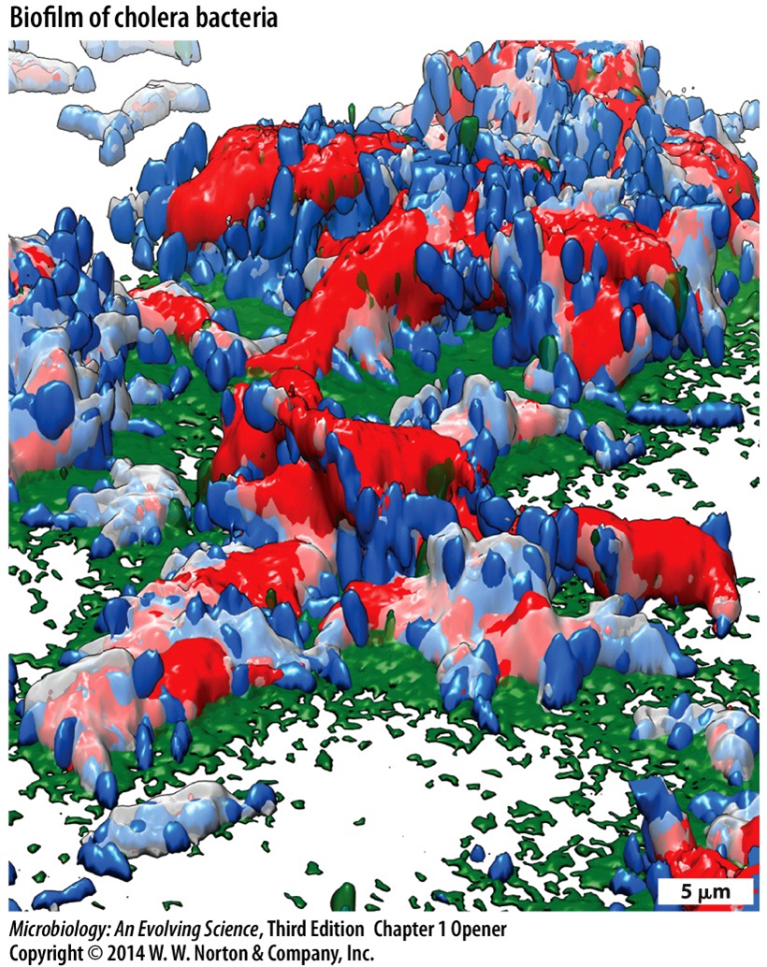
BIO 3308
MICROBIOLOGY

Slide 2
Chapter 1
Microbial Life: Origin and Discovery

Slide 3
What will we study?
Modules:
  Introduction, history, microscopy
  Cell structure and function
  Growth and development
  Metabolism
  Genetics and molecular regulation
  Human-microbe interactions

Slide 4
What is a microorganism?
What is a microorganism (microbe)?
Living organisms that can only be seen through a microscope
Less than about 1 mm across
  10⁻³ meters (1 mm) to 10⁻⁷ meters (0.1 micrometer (micron))

Slide 5
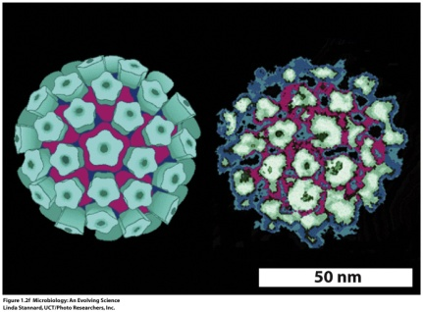
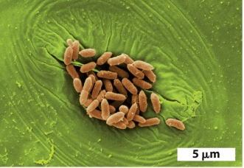
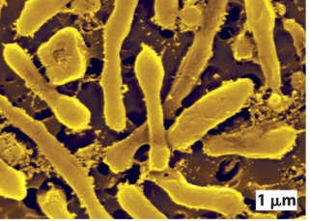
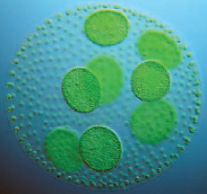
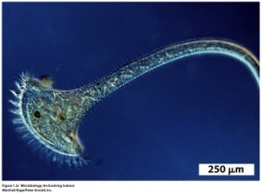
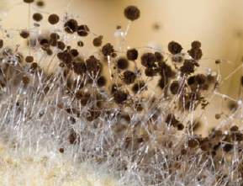
What Is a Microbe?
Microorganisms
Cellular
Acellular
Viruses
Prokaryotic
(bacteria, archaea)
Eukaryotic
(algae,protists, fungi)

Slide 6
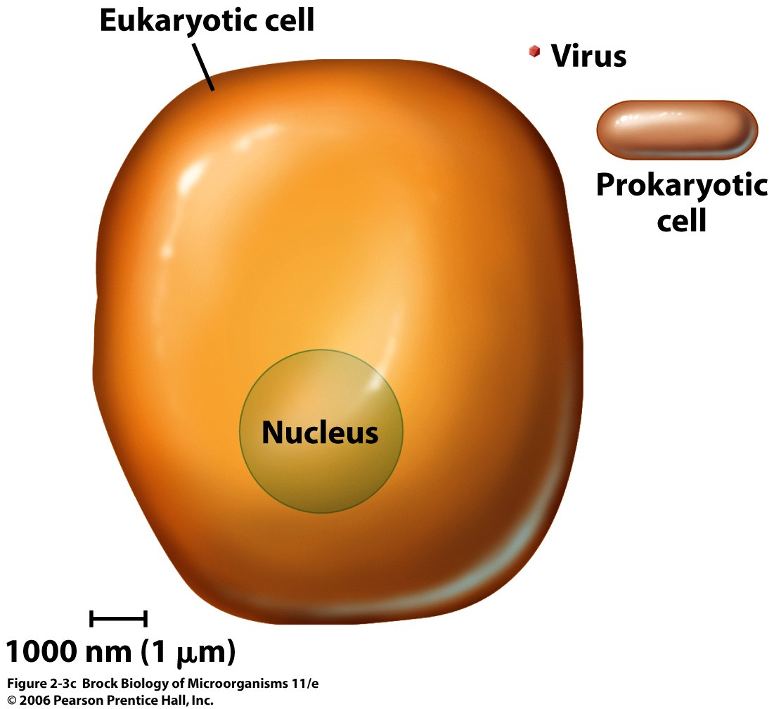
Microorganisms-size comparison
Prokaryotic cell: 1-3 μm
Eukaryotic cell: 15-20 μm
Virus: 20-200 nm

Slide 7
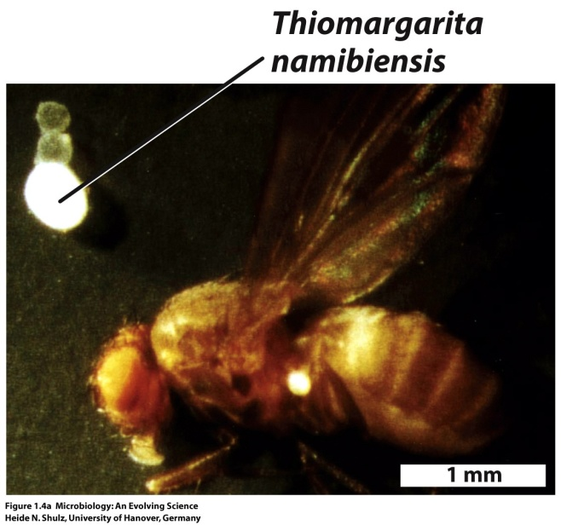
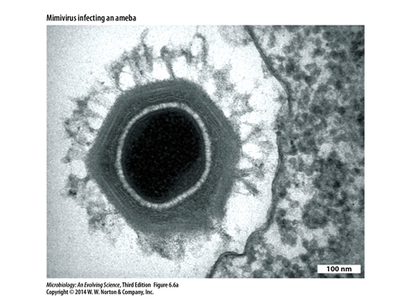
The Giants
Giant bacterium
Giant virus

Slide 8
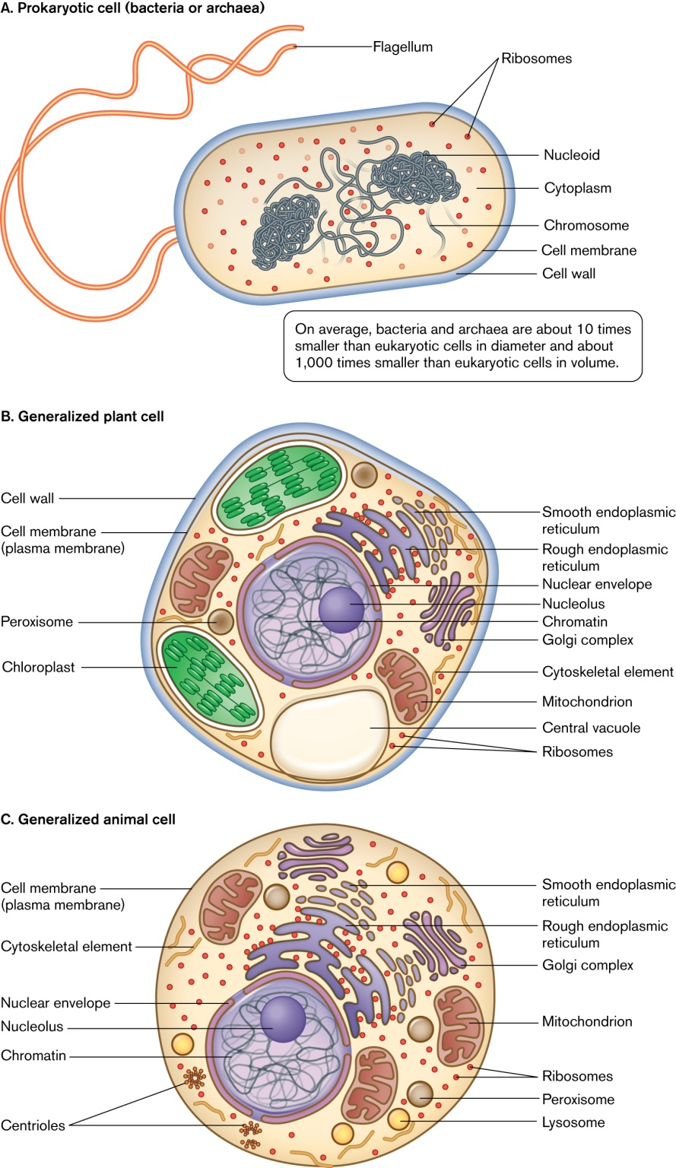
Prokaryotes vs eukaryotes

Slide 9
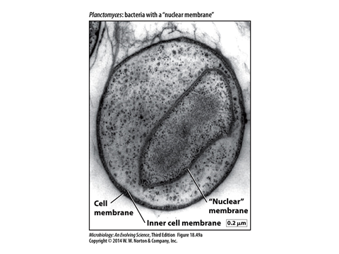
Bacteria with a nucleus?
Gemmata obscuriglobus

Slide 10
Small but significant?
Biomass: 5x10³⁰ cells of prokaryotes
Same amount of carbon as plants
10X as much nitrogen and phosphorus as plants
Prokaryotes: The unseen majority

Slide 11
Where do we find prokaryotes?

Slide 12
Current issues in Microbiology?

Slide 13
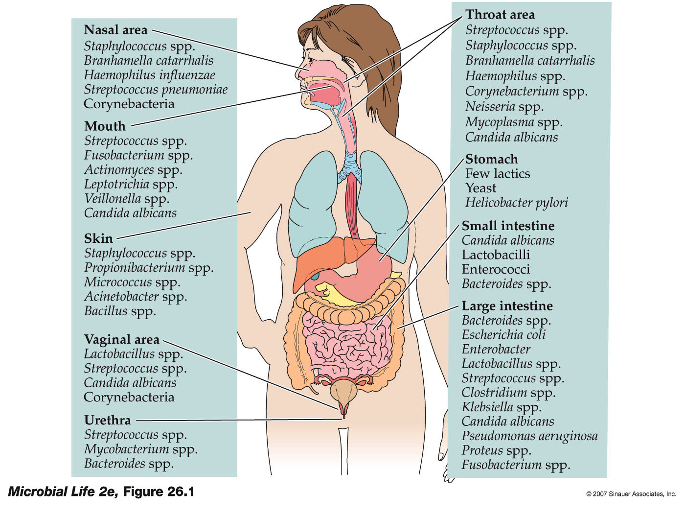
Normal Human Microbiota

Slide 14
Human beings as symbionts
~ number of human cells: 10¹³
~ number of prokaryotes on and in humans: 10¹⁴

Slide 15
Prokaryotes: The bad, the good
Some numbers:
  Many species of bacteria known (millions?)
  ~ 170 are pathogenic
    All bacteria. No archaea.

Slide 16
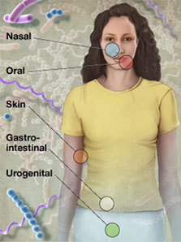
The human microbiome
Human genome vs human microbiome !!
  http://nihroadmap.nih.gov/hmp/

