Slide 1
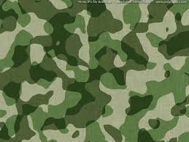
The Paraguayan War: Paraguay, Argentina, Brazil, Uruguay
Total War in the Southern Cone
Indigenous Participation

Slide 2
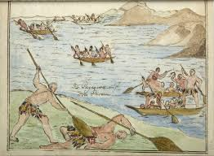
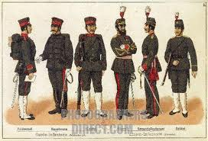
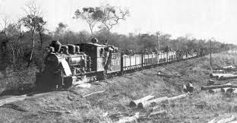
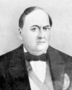
A. Causes
President Carlos Antonio López
1840, Carlos Antonio López controlled the Triumvirate in Paraguay
Amazing expansion of Paraguay’s economy
Iron foundry at Humaita, most modern of type in La. America
Transportation, roads and canals, fleet merchant ships
Short railway line, Asunción-Trinidad
Grew state apparatus and sector
Enlarged the armed forces

Slide 3
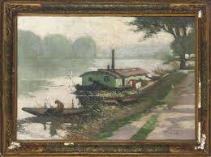

Lopez’ Social Policies, Domestic Programs
Yerba mate: state ownership of forest lands
Important expansion of the economy, education with 435 schools constructed
Agricultural exports still dominated the economy
Transportation improved
Grew state sector of national economy
1842 Law of the Free Womb
Paraguay most progressive state in Latin America
Destabilized regional power

Slide 4
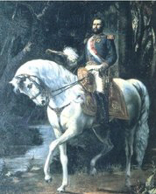
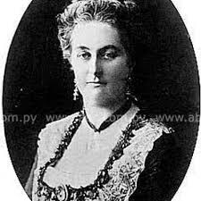
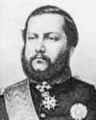
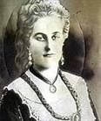
C. Francisco Solano López: 1862-1870
Madame Eliza Lynch Irish

Slide 5
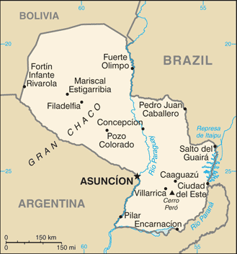
International Threats to Paraguay
Why did Antonio Lopez’ policies destabilize the Southern Cone?
López feared that Brazil would control Uruguay
Secret treaty with Uruguayn allies
Paraguay defies neighboring giants
Population only 450,000 in 1865

Slide 6
D. Writing History Sources
Peter Beattie, “Illustrating Race and Nation in the Parguayan War Era,”
Maria Costa, “Indigenous People of Brazil and the War of the Triple Alliance,”
Thomas Whiggham, Emeritus University of Georgia
War: Causes and Early Conduct, 2nd Edition
The Paraguayan War. The Road to Armageddon: Paraguay Versus the Triple Alliance, 1866-70

Slide 7
E. Course of the War 1864-1870
November 1864, Paraguay toook Brazilian ship
Py invaded Matto Grosso, May 1865
Qom Guaikuru indigenous people fought on both sides of the war
Paraguayan soldiers suicidal valor
1 May, 1865: Argentina, Brazil, Uruguay: sign the Triple Alliance
War drags on for five years
By1867, Paraguay lost 60,000 soldados
Py conscripted boys down to the age of 9
War of slowly wearing down enemy (Paraguay)

Slide 8
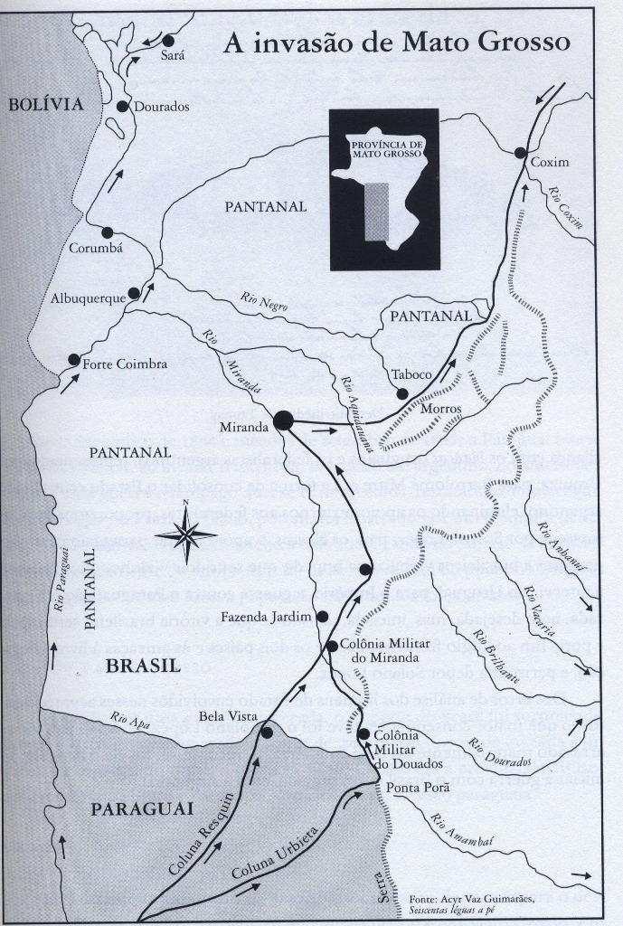
Paraguayan Invasion of Mato Grosso 1864

Slide 9
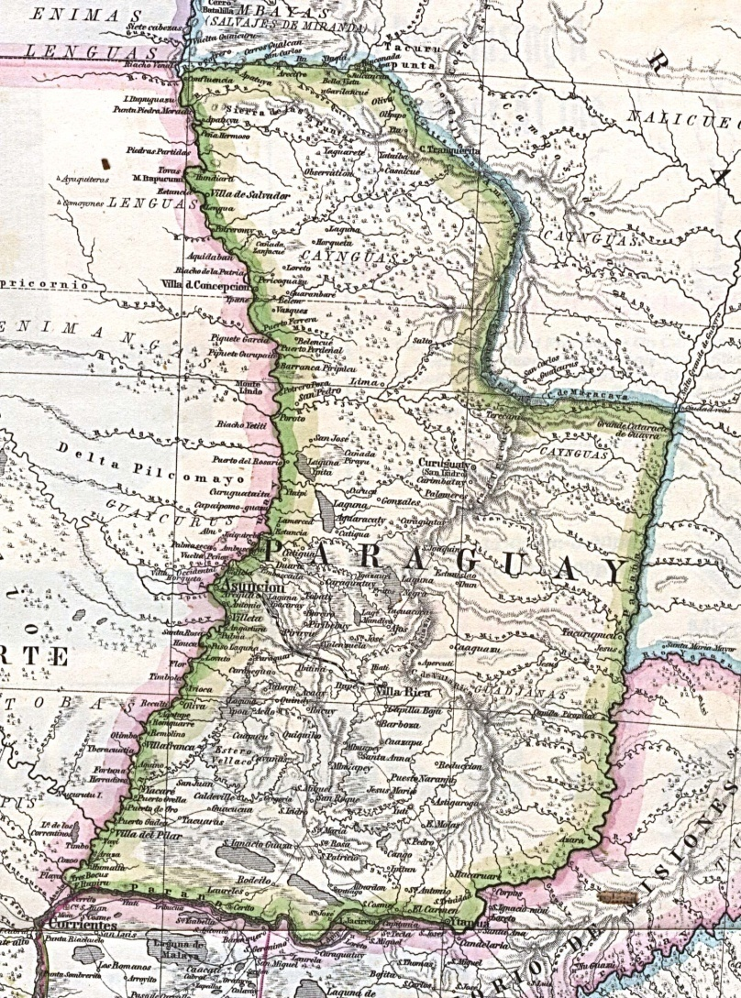
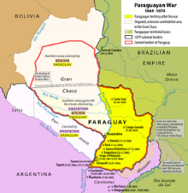
Eastern
Paraguay

Slide 10
E. Results of the War for the Southern Cone
Death of half of the Paraguyan population
1/3 of all the men killed
Heavy reparations to the allied powers $$$
Brazil imposes a temporary government
Argentine forces occupy Paraguay
State lands sold to Argentine and Brazilian speculators
Results for Indigenous people in the Mato Grosso
Main takeaways from today’s class?
Assessment…?

