Slide 1
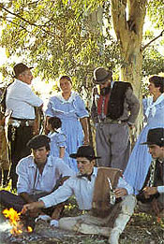
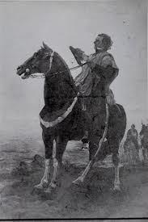
Artigas, The Eastern Band and the Gauchos
Jose’ Gervasio Artigas
Grew up among the Gauchos and the Charruas

Slide 2
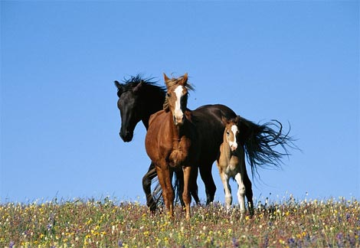
A. Gauchos: Results of racial and cultural mixtures
A. Cattle industry expanded into southern Rio Grande do Sul in Brazil
Argentina, Uruguay, closely tied to ranching interests
Nomadic, very independent, the mean gaucho
Cowboys called guasos in Chile
Vaqueiro in Brazil
Gauchos in Urugay and Argentina
Culture and way of life?
Expert horsemen
Blend of cultures
Speech blend of Portuguese, Spanish, Guaraní
Temporary unions
Vagabonds, semi-nomadic
All types of limitations and abuse
Dress: loose baggy trousers, “bolas” balls of stone rawhide rope, used to bring down animals
Became symbols of Uruguayan, Argentine, Chilean culture
Importance for the Southern Cone

Slide 3
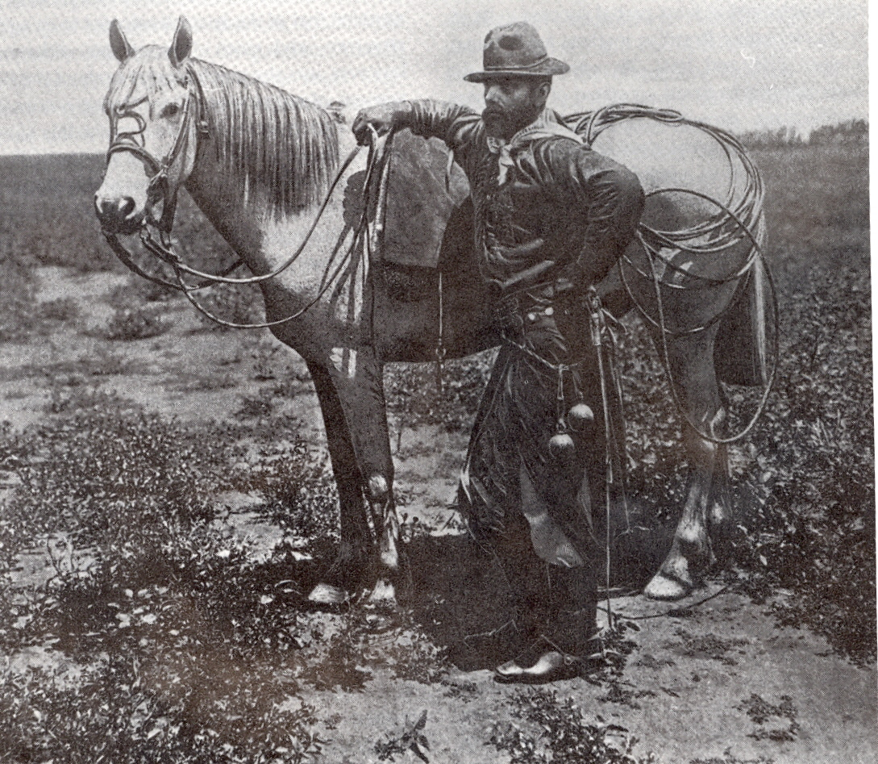
Gauchos at work

Slide 4
Jose Hernández, Martin Fierro http://sparrowthorn.com/part1.pdf
Here I come to sing to the beat of my guitar:
because a man who is kept from sleep by an uncommon sorrow
comforts himself with singing, like a solitary bird.
I beg the saints in heaven to help my thoughts:
I beg them here and now as I start to sing my story
that they refresh my memory and make my understanding clear.
Come, saints with your miracles, come all of you to my aid,
because my tongue is twisting and my sight growing dim—
I beg my God to help me at this hard time.

Slide 5
Martín Fierro continued…
I have seen many singers whose fame was well won,
and after they've achieved it they can't keep it up --
it's as if they'd tired in the trial runs without ever starting the race.
But where another criollo* goes Martin Fierro will go too:
there's nothing sets him back, even ghosts don't scare him --
and since everybody sings I want to sing also.
Singing I'll die, singing they'll bury me,
and singing I'll arrive at the Eternal Father's feet –
out of my mother's womb I came into this world to sing

Slide 6
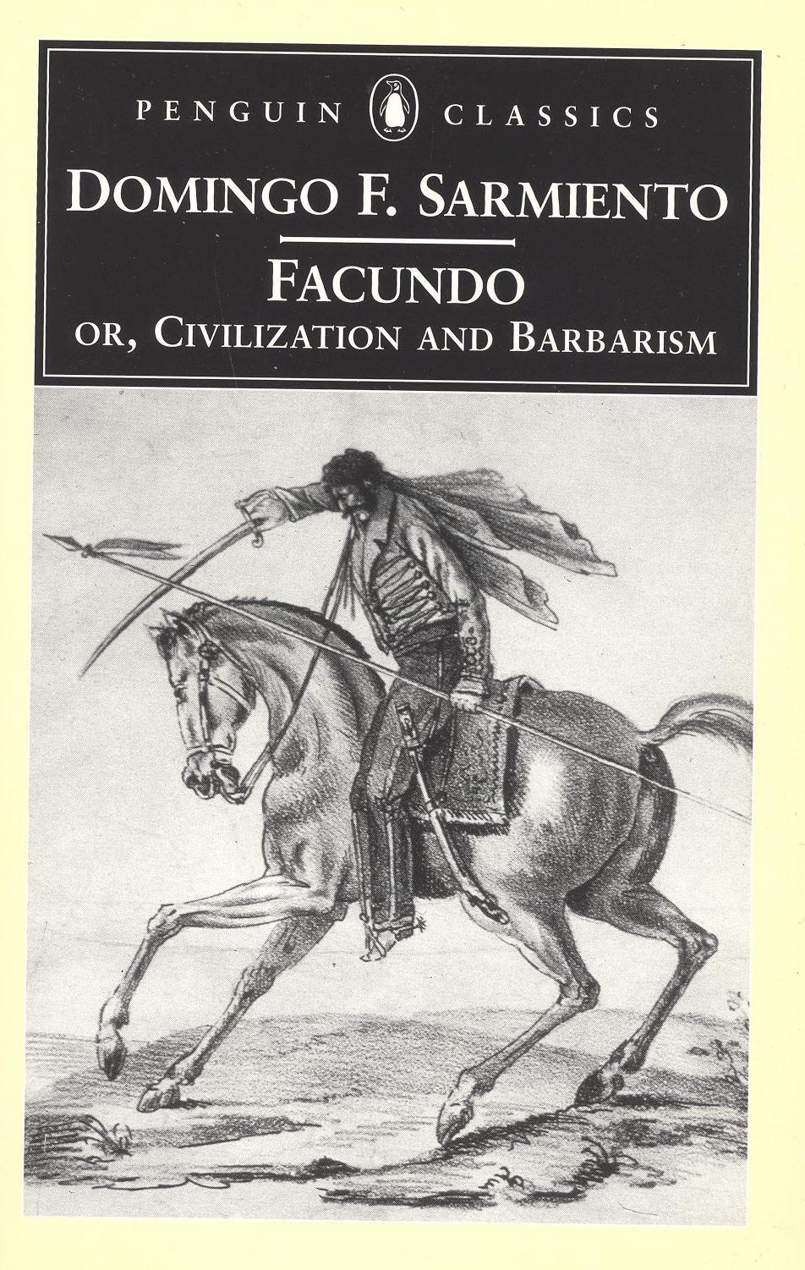
After 1810, gaucho conditions worsened… tp: why?

Slide 7
What is a Frontier?
Howard Lamar and Leonard Thompson
The Frontier in History, North America and South Africa Compared, 1981 7-8
A frontier is not a boundary or line, but rather a territory or zone of interpenetration between two previously distinct societies.

Slide 8
B. The Eastern Band
Northern and Eastern frontier territory
Only place in the western hemisphere where
plans for territorial expansion
led to prolonged military conflict Jose Artigas
Many Rio Grandenses (?) migrated into the area
Brazil had long desired to take Eastern Band; Colonia settlement
Brazil invaded Uruguay in the 1850s and 1860s
For ½ century, Uruguay improved frontier region
The caudillos in Uruguay depended on the gauchos

Slide 9
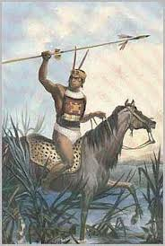
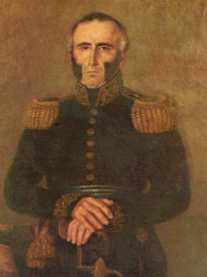
C. Artigas and Uruguayan Independence
1811 Alliance with the Charruas to fight Spanish
Salto Chico, 9 Marzo, 1812
400 Charrua warriers helped Artigas
Batlle of Carumbe 27 Oc, 1816
Civil war and conflict, Juan Antonio Lavalleja
1830-1833 expeditions against the Charruas

Slide 10
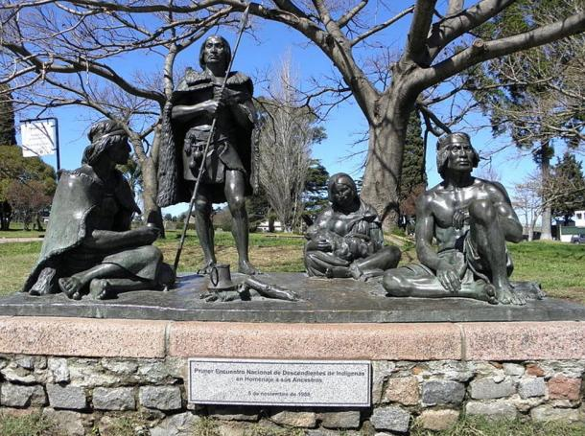
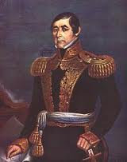
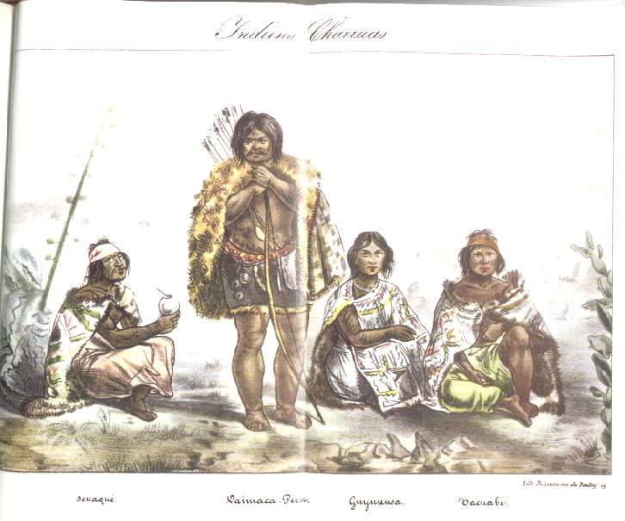
Extermination
1830 General Fructuoso Rivera, President
Pretext of peace treaty
Queguay, 1200 troops, massacred 400-500 Charruas
Principal leaders: Peru, Polidorio, Adivino, Venado,

Slide 11
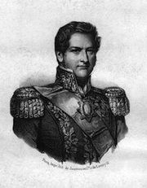
D. Gauchos under Rosas' dictatorship
Argentina, Dictatorship of Rosas, 1829-1852
Fearful of common people, Rosas employed gauchos and urban Afro-Argentines to control them
“As you know, the dispossessed are always prepared to rise up against the wealthy and powerful. So I thought it important to win decisive influence over this class to control and direct it.”
TP analysis: why ally of gauchos against
Common urban people?
Was this also a way to control the gauchos?

Slide 12
“Rosas, differes from all that we have in our nation, in that he owes his great popularity among the gauchos and peasants to having assimilated the most extreme aspects of their way of life, their clothing, their labor, even their sports… being himself more attractive and admired by this race of half-savage men… In some ways he is also extremely meek and in some ways resembles our indigenous leaders.” 50.
John Formes, British business delegate to Argentina

Slide 13
Gauchos at rest

Slide 14
D. Civil War and Gauchos in Uruguay
Through 19th C. Uruguay ranching boom
By 1890s, new Republic of Brasil in political crisis
Uruguay took control of frontier border with Brasil
Gumercindo Saravia invaded Brasil January 1893 with his Montonera, (troop of gauchos)
Why attack such a superior force?
Support allied ranchers in Rio Grande
Marched 960 kms north through states of Rio Grande do Sul, Santa Catarina, y Paraná in Brazil

Slide 15
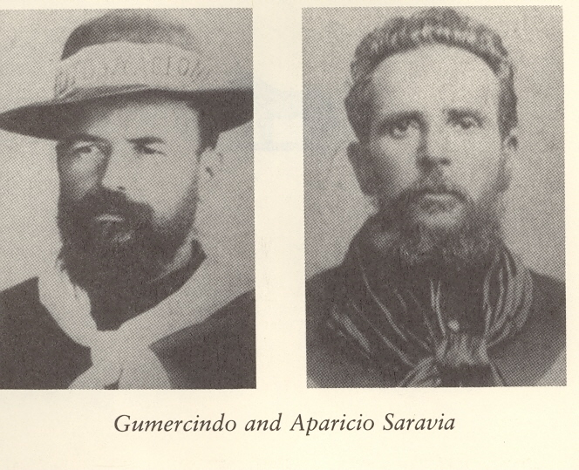
Saravia's War in 1893
Two Brothers: Gumercindo and Aparicio Saravia

Slide 16
Historical Analysis
Saravia bros. jumped into civil war Brasil 1893-1895
Saravias were caudillos, leaders who inspired intense devotion among followers
After forming army of gauchos, named generals
Why was there so much conflict in Uruguay and the Southern Cone by end of 19th Century?

Slide 17
Saravias' Frontier Zone

Slide 18
Course of the Conflict
Saravias took their gauchos from ranches
Afro-Uruguayans, Indigenous people, creoles, mixed heritage
Entire group called Maragatos
Fe, 1893, Gumercindo Saravia invaded Brasil to support his conservative allies in Federalist Revolution
In four weeks, hundreds of gauchos joined force
Took the name liberating force
Gumercindo proclaimed revolution against Brasil
Brasil called them “bandits”
Explain reason for the slam
Deny political legitimacy

Slide 19
Saravia Campaigns into Brasil:

Slide 20
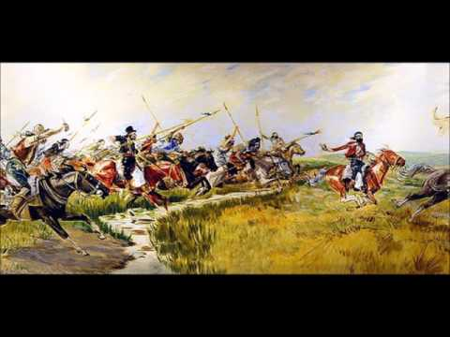
E. Results of Gaucho Campaigns
Saravia defeated at battle of Arbolito, rebellion in March 1897
Three Trees, White Victories, same month
Uruguay’s Political Parties Form
Civil War in Uruguay 1904
Longer Civil War than 1897 had been
State Colorado Forces used automatic weapons
As before, revolutionary forces lost every battle
After 9 months war, Saravia’s army west of Uruguay River
Ambushed by Red forces, killed Aparicio
White movments disintegrated, Red Victory
Guacho forces disarmed

Slide 21
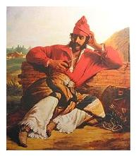
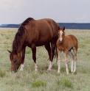
F. Conclusions: Gauchos and Civil War Uruguay
What is a frontier?
Why did frontiers matter in the S.C.?
Why were Artigas and gauchos important in the SC?
What does Saravia’s campaign teach us about the SC?
How might the civil war have changed Uruguay?
Changed the entire SC?
Homework: We: Review and Prep for First exam

