Slide 1
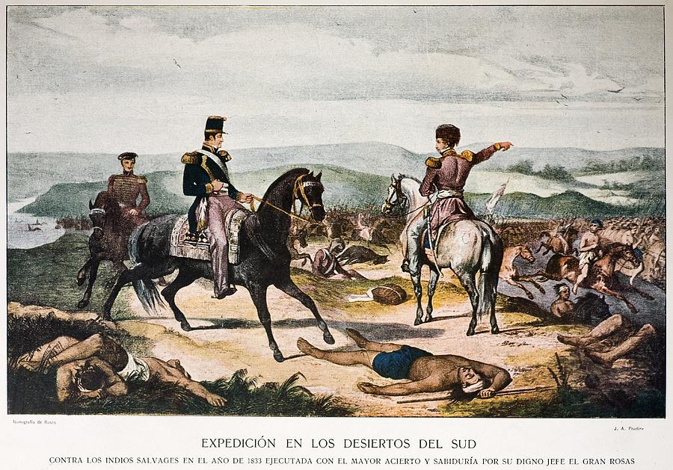
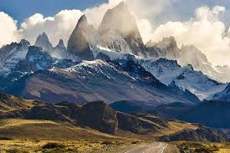
Struggle for Legitimacy
Militarism and Enduring Indigenous Nations

Slide 2
A. The Struggle for Legitimacy
Given what we have studied about the independence of SC, why might these new nations have sought legitimacy?
What does political legitimacy mean anyway? TP: figure it out
Where might the new nations have sought this legitimacy? And how?
Social reasons?
Economic reasons?
Internal and External reasons?

Slide 3
B. The struggle for Legitimacy
Militarism and enduring Indigenous nations

Slide 4
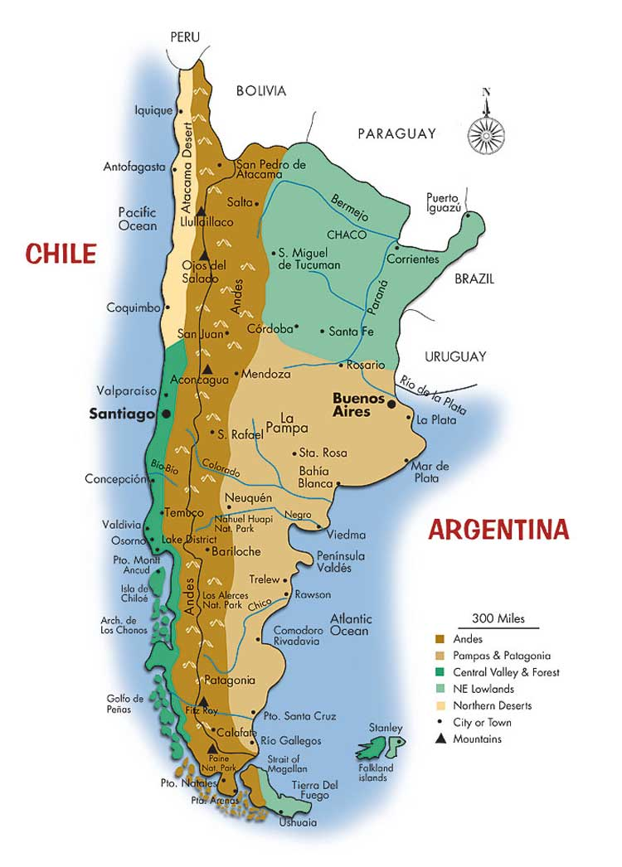
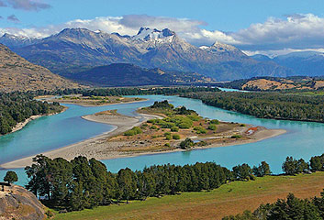
1. Chile
What should be done with the Reche (Mapuche) in the south?
Why did these people pose problems for the new nation?

Slide 5
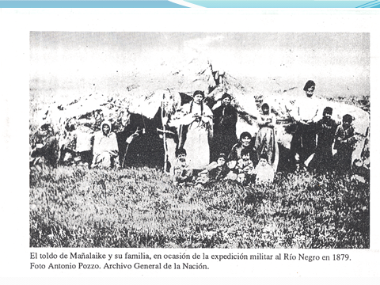

Slide 6
Liberal leaders: political stability through fraudulent elections
Declared the Auraucanos (Reche) citizens
Yet given never been conquered, unable to force cultural change
Settlers south of the Biobio River flood Wallmapu, Reche land
Simply ignored restrictions to settle

Slide 7
Genocidal Program
The Reche participated in political changes of 1851 y 1859
Legislators tried to subdue and quiet them
The Reche unsuccessfully asked help Arg.
1869, Chile crushed Reche in brutal attacks on settlements and destruction crops
Massacred the Reche population
Why didn’t the liberal administrations see room for Indigenous people within nations?

Slide 8
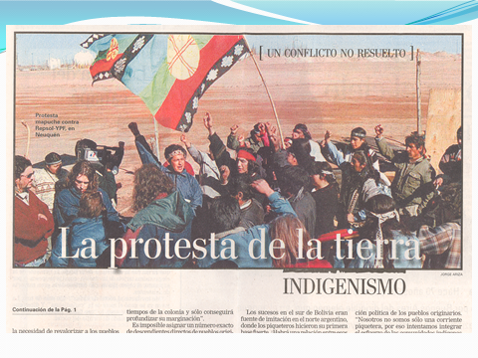

Slide 9
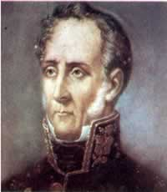
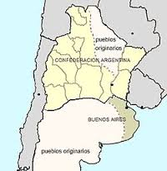
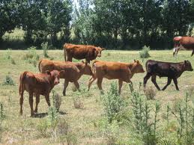
2. Argentina
1820 Extended hegemony west to settlement La Independencia
Martín Rodríguez, Gov. Buenos Aires
Key word: Subordination to “respect for authority, social order and private property” SG: analysis of the governor’s terms… ?

Slide 10
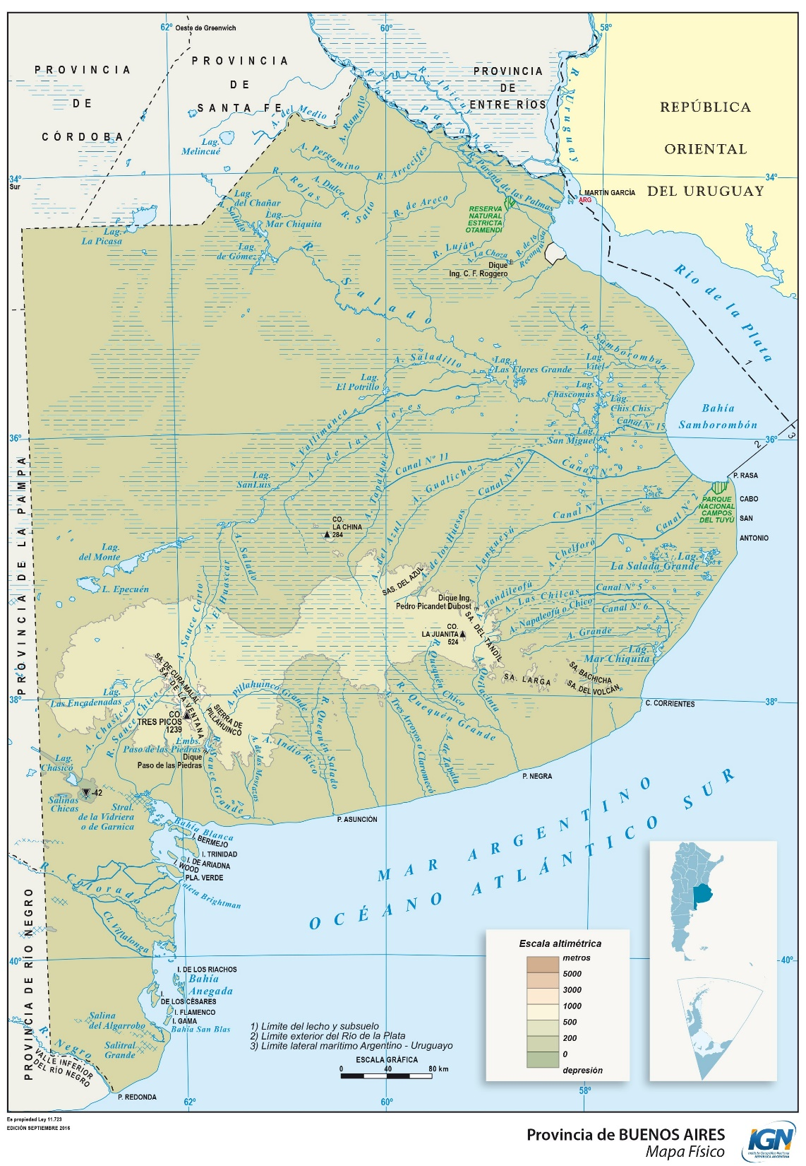
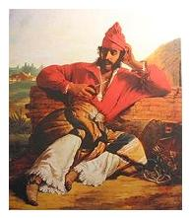
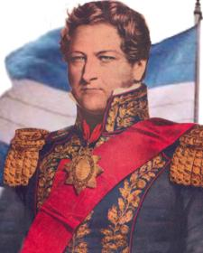
Juan Manuel de Rosas
Rosas from wealthy family, largest cattle ranches in Arg.
He spent youth in the countryside.
Acquired land south of the Salado River, in Bs As Province.
Gathered gaucho force, became a caudillo
He married well in 1813
Administered a meat-salting plant known as Los Cerrillos.
Huge ranching interests
Gov. Buenos Aires Prov. 1835-1852
1833 Rosas “Wilderness Campaign”
Massacred Tehuelches & Ranqueles
3,200 dead; 1,200 imprisoned

Slide 11

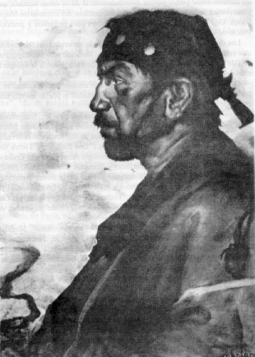
Contradictory Politics
Pact of Nonagression at Salinas Grandes with Teguelche leader Calfucura
Non-official pact until 1852
After Rosas removed,
Native attacks on frontier
towns worsened.

Slide 12
Actiity: the Fishbowl
Struggle for Legitimacy
Number off by 3
Make a fishbowl with 5 chairs in middle
and a larger circle around fishbowl
Take turns discussing questions 3 min.
How did the U.S. achieve legitimacy following independence in 1776?
How did U.S. approach Indigenous peoples?
Compare U.S. and S.C. policies for Natives
Fishbowl takeaways?

Slide 13

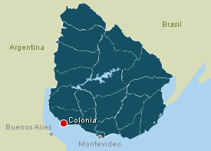
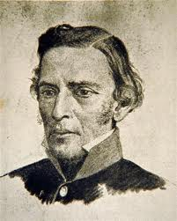
C. Uruguay
1796 Artigas created corps Blandenges
1800-1801 Two expeditions to exterminate the Charruas:
1. northeast by Félix de Azara
2. Via Uruguay River by
Cpt. Jorge Pacheco
At battles of Arapey, Sopas and Tacuarembó
exterminated most of the Charrua people
1805 Artigas in Uruguay (Grandfater Antonio)
1811 Charrua alliance with Artigas

Slide 14
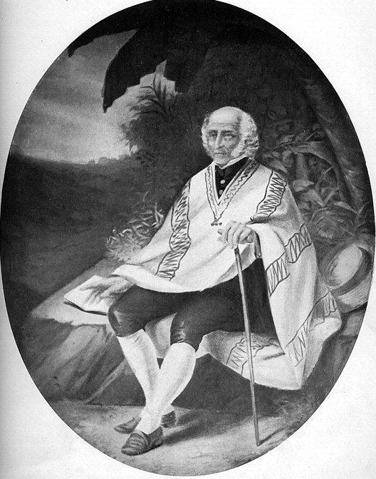
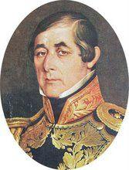
Artigas and Indigenous people
Battle of Carumbe 27 Oc 1816
1831 Campaign to exterminate Charruas
Pres. Fructuoso Rivera
Salsipuedes massacre 1831
Artigas exiled to Paraguay

Slide 15
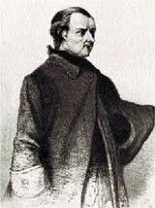
D. Paraguay
José Gaspar Rodríguez de Francia
“Dictador for Life” 1816-1840
“Supreme Dictator”
Strengthen special heritage of Native peoples
State recognized Indigenous communities
Took away lands from church and large landlords
Divided this land among peasants and Natives
Forced creoles to marry Indigenous women
Class analysis of these policies and his goals?
TP: Contrast to our other three nations’ policies?

Slide 16
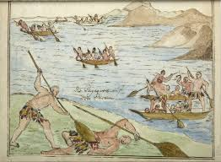
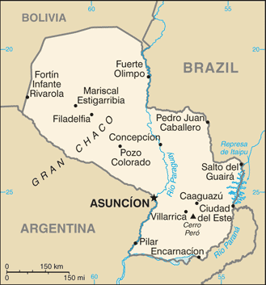
Francia, continuado
Evueví, Payagua peoples
Northern Paraguay River
Canoe flotillas terrorized commerce along river
Francia hired Evueví as
his riverine coast guard

Slide 17
Conclusions
Post Independence Southern Cone
States and Indigenous peoples
Compare state social policies throughout
How to explain such differences?

