Slide 1
Search for Political Order 1830’s-1850’s

Slide 2
Final Course Projects
Two final Class Research Projects: Food + Art
Friday, May 1, 2-4:30 PM
1. Working in groups of two, students prepare a dish from the Southern Cone to share with the class during our final course meal.
2. Artistic Presentation during final exam period. Working in a different group of two people, students create an artistic piece that represents the Southern Cone. Mediums in one of the following: music, dance, art, poetry, sculpture, theater
3. During the final exam period, after the meal, student groups present their art work. Presentations last 5 minutes in length and explain historical relevance and the creations process. Together write and submit a one-page paper explaining the project, its historical significance, and a list of the sources consulted
A. Choose a partner for groups of two. Must be different people for different projects
B. Choose a historical subject for both
C. Discuss a format for final presentations
D. Presentations: Friday, May 1, 2-4:30 PM
E. Take 5 minutes to start talking about projects and finding partners

Slide 3
A. The Search for Political Order
Principal leaders in first half 19th C.: Francia, Portales, Rosas, Artigas
Background and Characteristics of Caudillos
What is a caudillo? Figure it out…
Usually veterans of wars for independence who used personal charisma
To connect with followers, often including Indigenous people, free Afro-Latin Americans, and mestizos. The name comes from the Arawk term kassequa, adopted into Spanish as cacique, chief
By 19th C, Caudillo ruled over number of caciques or their people
Large landowners with personal armies and resources for supporters
Power
Support
Political Strategies
Results for the Southern Cone?

Slide 4
B. Oriental Band and José G. Artigas
Artigas lifted his siege of Montevideo at the beginning of 1814
Warfare continued among Uruguayans, Spaniards, and Argentines.
June 1814, Montevideo surrendered to Buenos Aires
Artigas controlled the countryside, his army retook city early 1815
After Buenos Aires had withdrawn, Oriental Band first government.
Federal League of six provinces
Included four present-day Argentine provinces
Bordered by Rio Parana, Rio Uruguay, and Rio de la Plata—Montevideo as the overseas port.
Customs unification and free internal trade

Slide 5
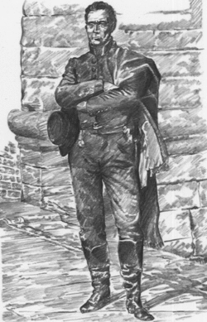
1815 Bs. As. Left Montevideo to José Artigas
Caudillo Gaucho Artigas y and his social reforms called "Instructions of the Year Thirteen,"
Declaration of independence and autonomy from La Plata
Inspired by the Constitution of the United States
However, the assembly refused to seat the delegates
Artigas broke with Buenos Aires and again besieged Montevideo.
Uruguay remained deeply divided
1817 Brazilian army invades
Artigas exiled to Paraguay for rest of life

Slide 6
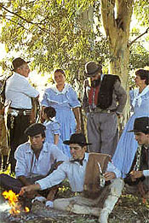
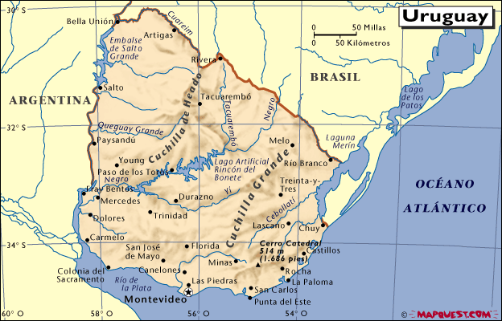
TP Analysis
Why was Great Britain so afraid of Uruguay falling to neighbors?
John Chasteen, Heroes on Horseback

Slide 7
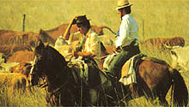
Los Gauchos y el ganado

Slide 8
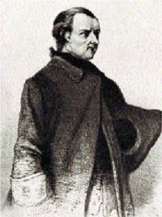
C. Dr. Francia in Paraguay
José Rodríguez de Francia: “a fragile man in a black frock”
Admired radical elements of French Revolution
Known as Caraí Guazú (Great Lord)
Dictatorship to destroy power of upper class
Advance the common interests
Built a strong, prosperous, secure and
Independent nation at time when
Existence of Paraguay as nation was in doubt

Slide 9
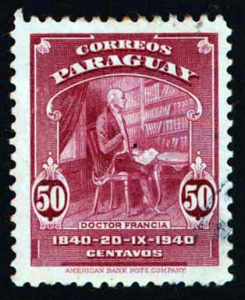
The Franciata 1816-1840
Internal espionage to eliminate freedom of expression, arbitrary arrests, disappearances
Chamber of Truth tortuered suspicious
1816 Named “Dictator for Life” The Supreme Dictator
Took land from rich, distributed to poor
Francia doubled Paraguay’s treasury
Social preference to Afro-Paraguayans,
Indigenous people, zambos,
Lower-class creoles
Forced marriages

Slide 10
D. Return Papers 1
Using Inés of My Soul and Padden’s “Cultural Adaptation”, explain how the Reche shaped the Spanish conquest of Chile.
Myth vs. historial reality?
How can we really know about the Indigenous role in Spanish settlement of Chile?
Compare notes on thesis arguments at your table

Slide 11
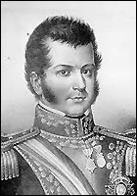
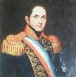
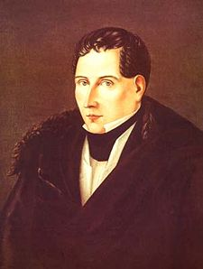
D. Portales in Chile
1818-1823, Bernardo O’Higgins first leader
Weaken the aristocracy
Capitalist economic development
1830, conservatives reimposed conservative Joaquín Prieto
Council of Ministers under Diego Portales

Slide 12
Diego Portales
Diego Portales and Council of Ministers
Religion
Taxes
Monetary Policies
Constitution of 1833
Reche challenges to rule throughout

Slide 13
Histrical Sources
John Lynch: Argentine Caudillo: Chs 1-3

Slide 14
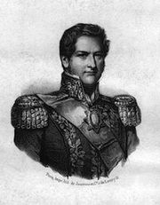
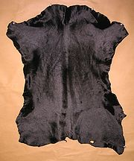
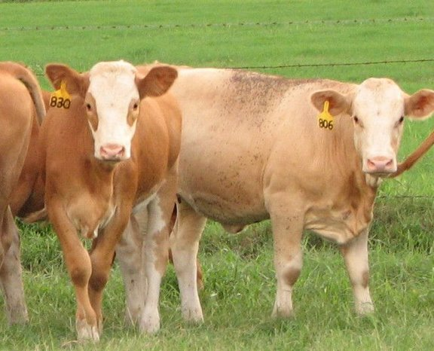
E. Rosas in Argentina
Caudillo, landowner
Governor of Buenos Aires 1829-1852
Occupied the Pampas
Absolute Power
Pastoral Revolution
Lynch, Argentine Caudillo, chs. 1-3

Slide 15
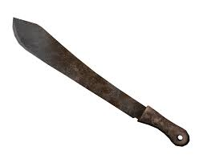
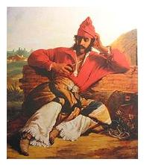
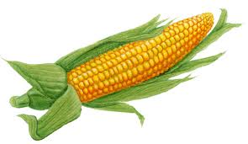
Rosas Continued
The Alternative Argentina: Urban Society
The Monster and State Terrorism:
La Mazorca (Ear of Corn)
1839-1842 the Supreme Terror
1850: Brazil, Great Britain, Uruguay
and Paraguay
1852 Justo José de Urquiza
Battle of 1852

Slide 16
Conclusions
What did you learn about the search for political order in the Southern Cone during the early 19th Century?
Here is what I tried to communicate…
Historical Sources Discussed
Assignments for next class?
Two chapters on the Paraguayan War from my book
Military Struggle and Identity Formation in Latin America

