Slide 1
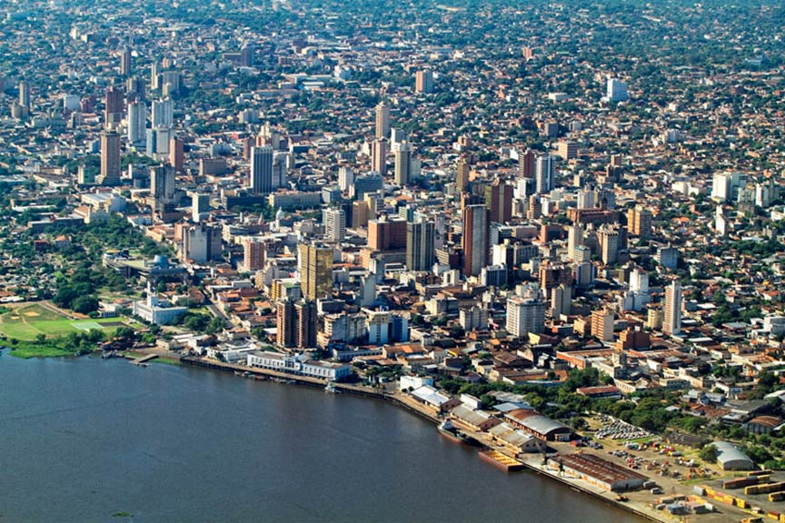
History of the Southern Cone
Spring 2020
Bienvenidxs!

Slide 2
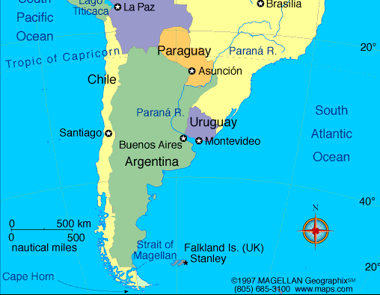
What do you know about the
Southern Cone?
Background?
Experience?
Travel?
The News?
Tell and meet each other

Slide 3
Our Class His 3301 Spring 2020
Your Professor: Dr. René Harder Horst
I.G. Greer Distinguished Professor in History 2018-2021
Belk 249E Look for the Black & Gold Door Frame
Office Hours: M: 9-12; W: 9-11; R: 8-11, or by appointment, call 6007
or write to horstrh@appstate.edu to make an appointment
Class: 2:00 pm - 3:15 pm MW Belk Hall 240
Introduce each other: where from, field of study, why excited about this class?

Slide 4
Some Questions and Information. Divide into 9 groups of 2 and find answers to the question by your number
1. What are the Grasslands of Argentina and Uruguay called?
2. What is the Southern Tip of South America?
3. One land-locked country? And is it really?
4. What was the Dirty War?
5. Who are the Indigenous People and which are the languages of Paraguay?
6. Who were the wives of Juan Domingo Peron?
7. Who are the Indigenous Peoples of Southern Chile?
8. Who and where Ex-Priest elected President by a large majority?
9. Why does this part of the world matter at all to you?

Slide 5
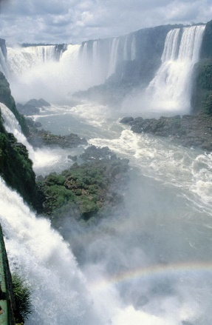

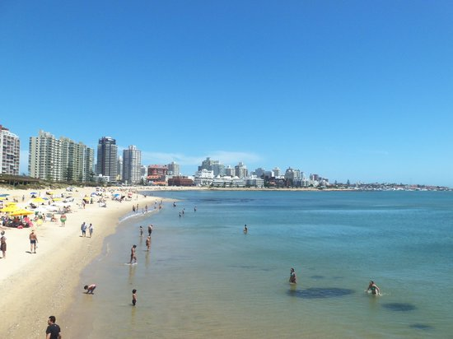
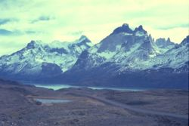
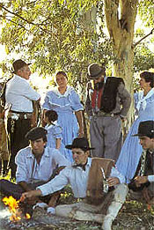
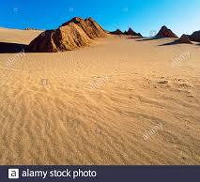
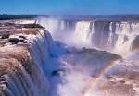
History of the Southern Cone
His 3301 Spring 2020

Slide 6
A. Who’s in the Class?
Find someone who… write down name… prize to the first one finished
1. Likes/enjoys traveling to other countries
2. Knows what a gaucho used to bring down a cow
3. Thinks that Perón was a populist president
4. Is good at passing history exams
5. Has already had a class with Dr. Horst
6. Is motivated by interactive learning
7. Believes that people will be able to stop environmental change.
8. Has studied Spanish and can talk in Spanish
9. Dislikes eating chinchulines
10. Has a great idea for a Southern Cone dish for our final group meal

Slide 7
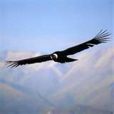
B. Course Requirements and Schedule
ASULEARN Course Page
Course Syllabus and Requirements
Assignments and Reading
Course Activities
Attendance
Course Participation
Grades

Slide 8
C. Required Course Texts:
Allende, Isabel, Inés of My Soul, Harper Collins, 2007
Chasteen, John, Heroes on Horseback: A Life and Times of the Last Gaucho Caudillos,
Harder Horst, René, The Stroessner Regime and Indigenous Resistance in Paraguay
Rampolla, A Pocket Guide to Writing in History, Ninth Edition
Additional course readings posted on ASULEARN

Slide 9
D. Excellence in Education
History 3301 History of the Southern Cone Spring 2020
Excellent Learning
Excellent Teaching
3000 level courses in the Department of History
Find out and read aloud what is expected:
1. Department of History
2. Students
3. History Skills Guide by Level (3000 level classes)

Slide 10
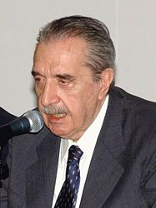
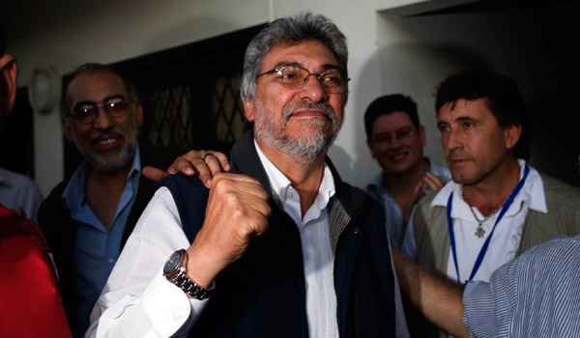
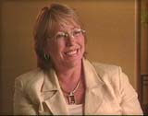
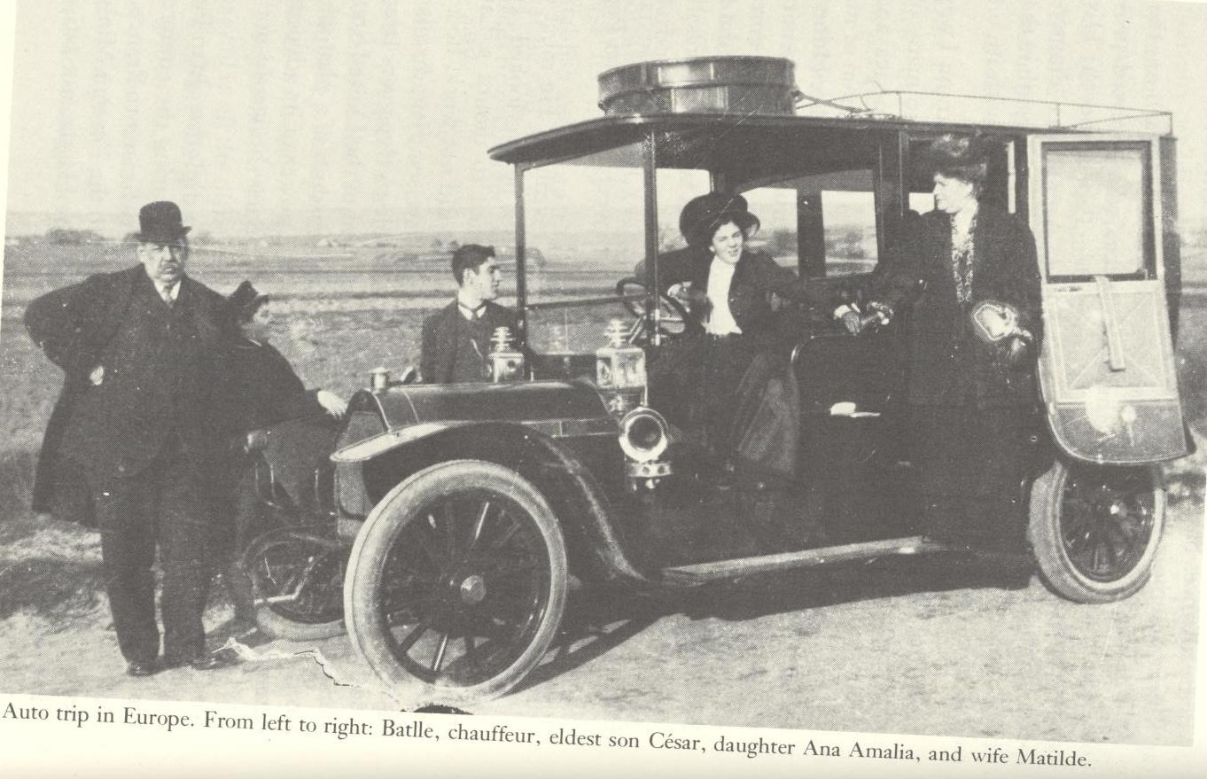
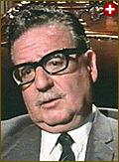
E. Some Images:

Slide 11
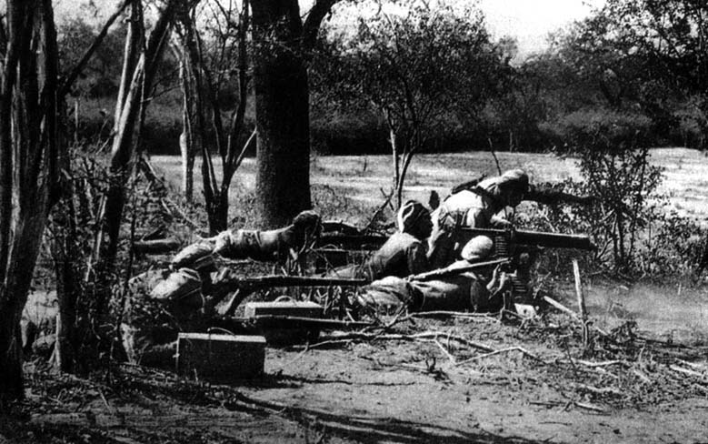
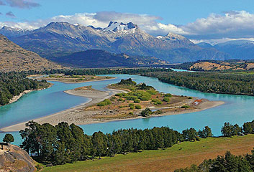
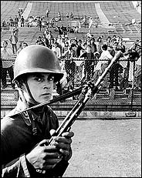
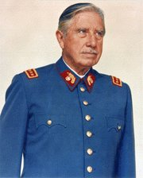
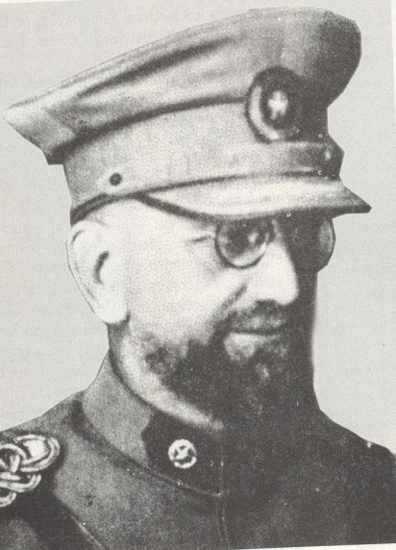
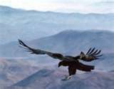
More Pictures:

Slide 12
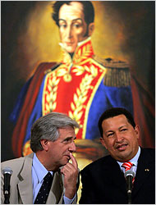
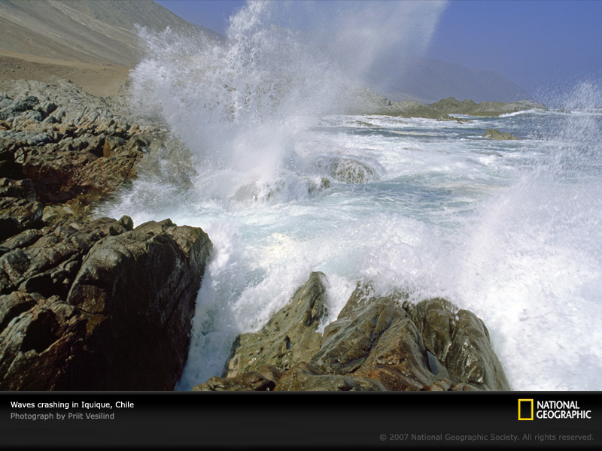
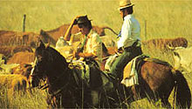
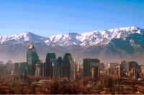
More Pictures

Slide 13
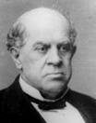
Domingo F. Sarmiento

Slide 14
F. What do I prepare for We?
15 Southern Latin America: The Conquest and Colonial Legacy
Allende, Inés, Ch. 1-2 (expect the first reading quiz)
Class… Activity: TV Commercial on Conquest of Colonial Southern Cone by SG of 3 students: Southeastern Fringe, Tupian Fringe, Tucumán, Chile, Strait of Magellan.
Humble Suggestion: use the long weekend to get ahead in Inés of my soul
20 State Holiday No Class
See The Mission before Wednesday 22 Ja

Slide 15
G. Class Assessment
What did you learn?
Who did you meet?
Was this introductory class effective?
Was anything confusing?
Is everything clear about preparation for the next class?

