Slide 1
Development of Nations & Gender Relations
Late 19th Century: Social, Political and Economic Changes in the Southern Cone

Slide 2
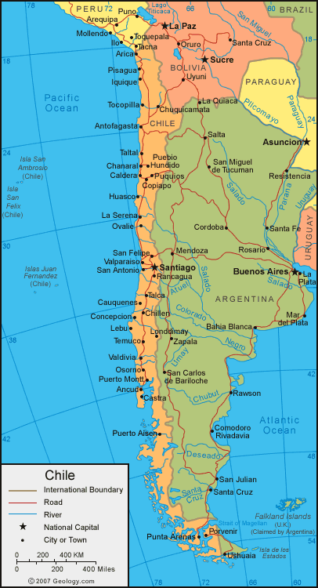
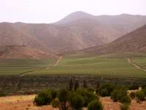

A. Chile research by table
1. Nitrates and land conflicts
2. Map of Bolivia by 1860: how was it different?
5. Chilean mining interests
4. Mapuche Resistence in South by 1860s

Slide 3
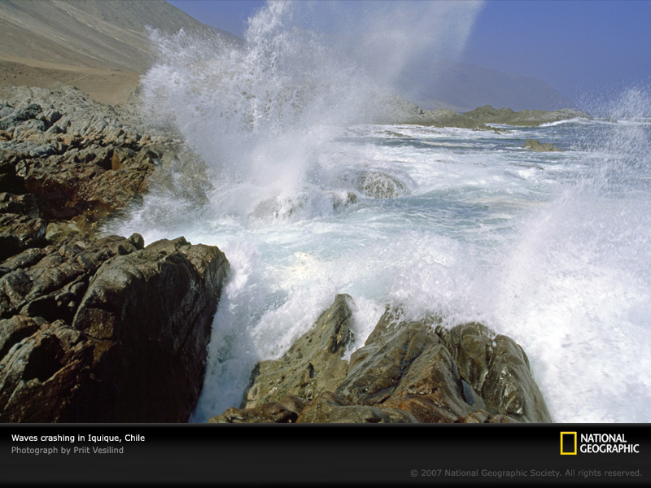

Slide 4
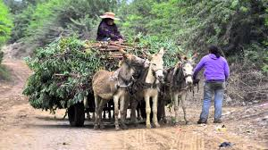

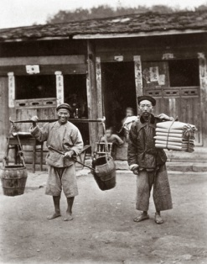
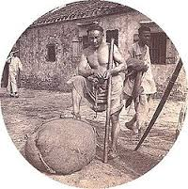
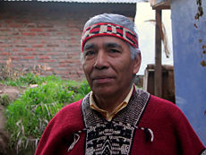
4. War of the Pacific
a. Chilean liberal president Anibal Pinto
1876-1881
Severe economic crisis (1874-79)
wheat and copper prices collapse
b. Chilean advantages
c. Tables: research course of war
1 Bolivia; 2 Peru; 5 Chile; 4 England
e. Massacre of Cañete 1881
Over 1,000 Chinese workers assassinated by peasant women
d. Indigenous participation
Florencia Mallon, Peasant and Nation, 1995

Slide 5
War of the Pacific: Indigenous Participation
Indigenous peoples from all three countries participated in this war. Native peasants in Peru’s central highlands provided the foundation of resistance against occupying Chilean forces, and in Cajamarca they actually fought alongside the landowning elite ‘in defense of a common interest they termed Peruvian.”
Mapuche warriors, despite their long hostility against outsiders, surprisingly volunteered to fight alongside Chilean forces. By 1879, over 900 Mapuche had volunteered for active duty and fought against Peru in their own “Arauco” battalion. Chile heralded them them heroically as “sons of Lautaro,” the Reche leader who had fought against the Spanish in the sixteenth century. (Remember Felipe?)

Slide 6
Surprisingly, given their past interaction with Chile, some Mapuche still saw military duty as a way to further their own territorial and personal goals.
These volunteers sought recognition of their traditional lands, distinctive ethnic identity, and a pluralistic, inclusive country at a time when Chileans were attacking their lands and culture.
Other Mapuche contributed funds to the war effort: Don Pedro Millaleo and Don Juan Quilamán each gave 20 pesos, an important amount in 1879, to help Chile purchase a warship. Indigenous participation in the conflict, even as Chile violently occupied their homeland over fierce opposition, reveals divisions within Native communities.

Slide 7
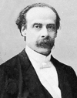
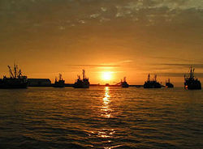
5. Results of the War
Resistence and Mapuche integration
British capital to nitrate fields
Jose Manuel Balmaceda (nationalist)
Congressional revolt 7 Ja 1891
Army (pres) against Navy (congress)
Army lost and Balmaceda suicide
Anti- imperialistic reforms end
Chile: Arica port at evening

Slide 8
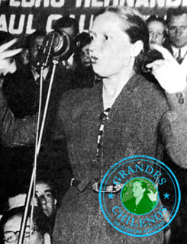
6. Chilean Women 19th-early 20th centuries
Each table researches and short reports on one:
1. Domitila Silva y Lepe
2. Esther Valdéz de Díaz
5. Amalia Errazuriz de Subercaseaux
4. Amanda Labarca

Slide 9
Writing History for Dr. Horst
Writing History doc. On ASULEARN
Rampolla, A Pocket Guide to Writing History
Short Paper 2: due Monday 24
Thinking as an historian, do some research and explain how the Southern Cone’s colonial legacy made it different than the rest of Latin America.
How and why did politics, economics and society develop uniquely in the region throughout the nineteenth century? Be sure to cite your sources correctly. (2 pages)
Good Sources for comparing the S.C. with the rest of Latin America could include: Chasteen, Born in Blood and Fire, Keen and Haynes, History of Latin America, Garrard, Latin America in the Modern World, etc.
Discussion and questions about the assignment

Slide 10
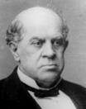
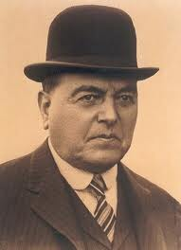
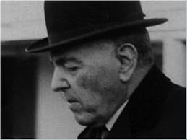
B. Argentina
Domingo Faustino Sarmiento
Technological Innovations
Immigration: 1889 and after, 200,000 per year
Unequal development
New Radical Party1890
Hipólito Yrigoyen

Slide 11
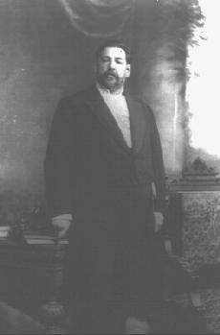
C. Uruguay
Jose Batlle y Ordoñez (1856-1929)
President 1903-07, 1911-15
-ISI Import Substitution Industrialization
-Social Reforms
-Labor Reforms
-Education
-No Agrarian Reform: TP why not?

Slide 12
D. Paraguay
Research: what is tannin and for what is it used?
The disaster of the Paraguayan War
Argentine and Brazilian Occupation & Investments
How would you resist a foreign occupation?
Resurgence and use of Guaraní
Fiscal lands in Chaco sold to Carlos Casado Co.
  (Anglo-Argentine investments in the Chaco:
  Land, Quebracho extraction and social results

Slide 13
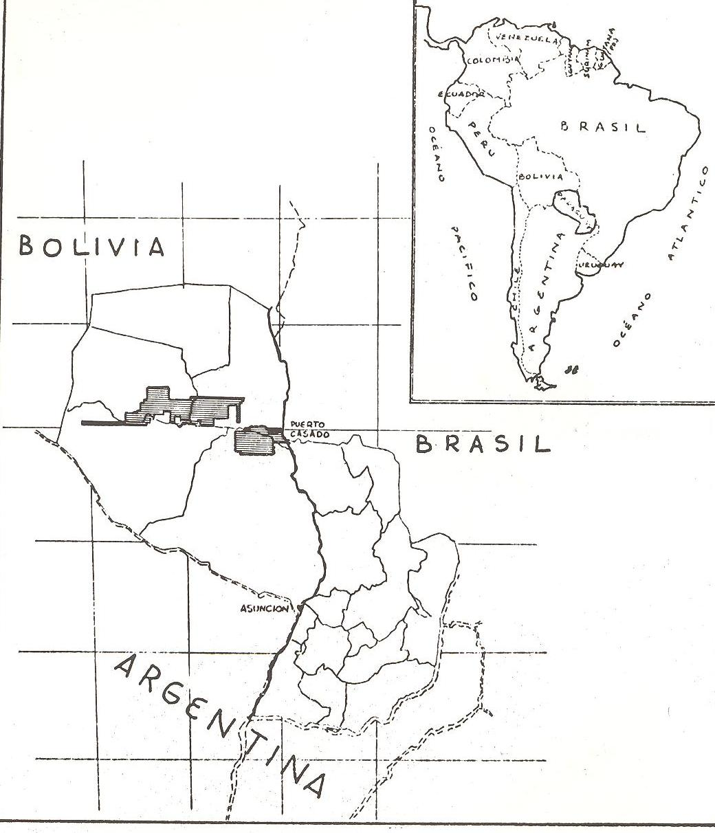
Carlos Casado Inc.
What
Is
Debt
Peonage?

Slide 14
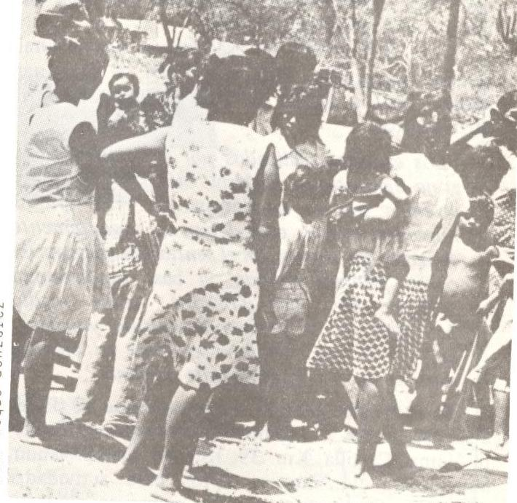
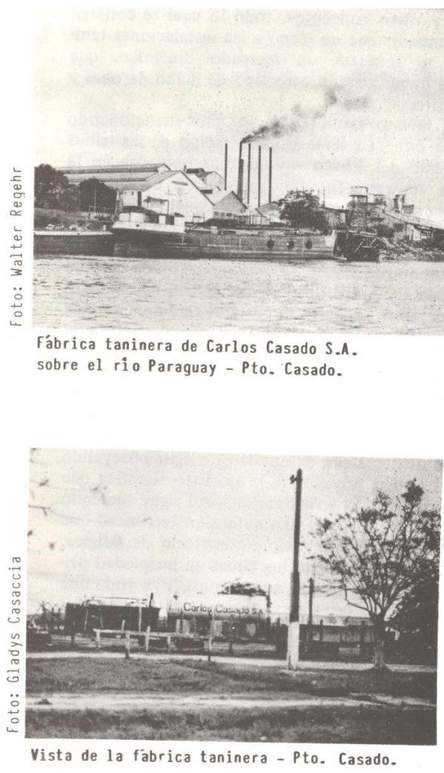
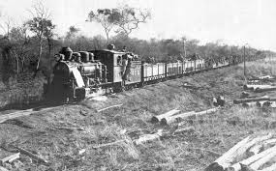
Indigenous workers at Puerto Casado
Why were social condition worse for Indigenous women?

Slide 15
Exam 1 Discussion
Class average
Maps
Id’s
Essays

Slide 16
Conclusions
National development by end ot 19th Century
Changing Gender relations in the Southern Cone?
What are the important takeaways from today?
Here is what I communicated?

