Slide 1
The Chaco War and the Febrerista Revolution in Paraguay
Inter-American Defense and Facism: the Southern Cone in World War II

Slide 2
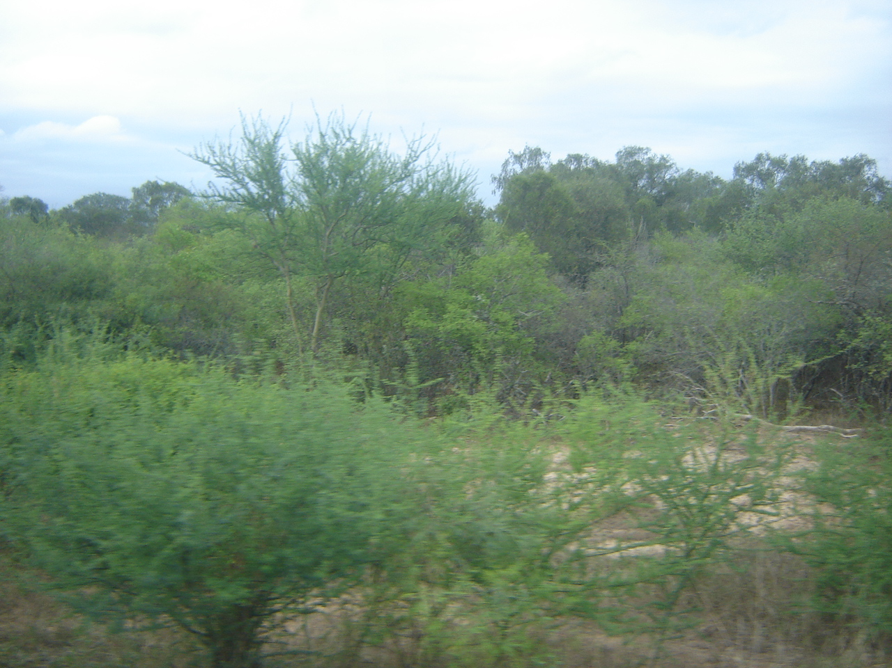
A. Chaco WAR 1932-1935
The Chaco before the war

Slide 3
Map of the Chaco

Slide 4
Bolivian Forts in the Chaco

Slide 5
Indigenous peoples of the Chaco
Ayoreode and Yishiro: Zamuco
Enxet, Enlhit, Sanapana’, Guana’, Enenlhit:
Lengua Maskoy
Yofuaxa, Nivacle, Mak’a: Mataco-Mataguayo
Toba-Qom: Guaicurú
Western Guaraní, Guaraní ñandeva: Guaraní
Quichua, Aymara

Slide 6
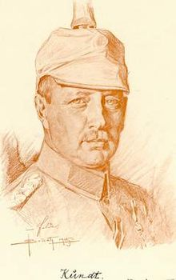
John Belaieff: White Russian General Hans Kundt: German military officer

Slide 7
Paraguayan troops Fort Boquero’n

Slide 8
Paraguayan Soldiers at Alihuatá

Slide 9
Medical contingent Villarrica

Slide 10
Paraguayan Prisioners of War

Slide 11
Paraguayas Troops deploy on Paraguay River

Slide 12
Paraguayan plane in Air Force

Slide 13
Indigenous guides

Slide 14
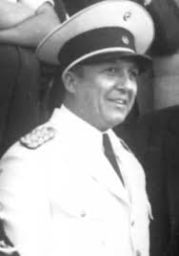
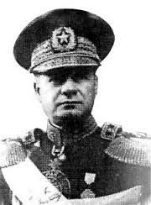
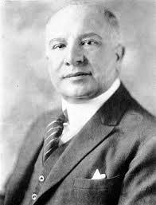
B. Febrerista Revolution 1936
Presidente Eusebio Ayala term ended
Reform constitution to allow reelection?
Demobilization challenging, soldiers angry
General José Estigarríbia threatened take charge
Officials led by Coronel Rafael Franco
threaten army should seize power
Franco exiled in January 1936

Slide 15
Febrerista Revolution 1936
Conspiracy continued without Franco
President Ayala ordered retirement of officials
17 Feb. 1936 Campo Grande forces rebelled
March into Asunción, police and Ayala resist
Fighting all day, Ayala resigned arrested by night
Soldiers forced Colonel Franco to presidency
Fascist Decree 152 “Liberating Revolution 1936”
Activities outside of the state prohibited. All political party activities suppressed for one year.
All social policies assumed by Ministry of Interior.
Created the National Department of Labor to
control all labor organization in Paraguay.

Slide 16
Franco’s fascist Government 1936-37
Anti liberal, anti oligarchic, above all Nationalist
Abolished Constitution of 1870
Dissolved Congress
Organized National Revolutionary Union Party
Exiled Liberal leaders Ayala and Estigarribia
Nazi and fascist ideologies prevalent
Ministries of Agriculture, Public Health,
National Bank
Agrarian Reform Law
1936 National Federation of Labor, 67 Unions
8-hr work day, salaries, unions

Slide 17
Franco’s administration
Women’s Union of Paraguay
Journal For Women Who Work and Think
Directed by María de Casati
Prisoner exchange with Bolivia
First Religious Congress
Sale of war material taken from Bolivians
Changes too fast, many opposed
Military coup 13 Au 1937, Franco resigned

Slide 18
Short Paper 3 and Sources Mr. 04 2020
Short Paper 3: “Using Heroes and Horseback, explain how Brazilian immigrants and gauchos shaped the birth of modern Uruguay in the early twentieth century. Cite examples form the book to support your argument.”
Compare thesis arguments at table
Challenges of writing on consolidation
of Uruguay

Slide 19
C. Southern Cone in World War II
Every nation responded in its own way
US viewed SC as friendly, but distant, strange
Some in the US wanted to help, but didn’t know how

Slide 20
Diplomatic Relations
De 1933, Montevideo, Secretary of State Cordell Hull (Good Neighbor Policy) promised end to gunboat intervention, opened trade negotiations
Great Depression
Chile and Argentina not negotiate
US congress protectionist, insulted S.C. nations
Reciprocal trade negotiations hurt US standing in the S.C.

Slide 21
D. International Events
US redefines Good Neighbor Policy
1935-36, fascism grows in Latin America
US refuses trade with Argentina cereals and beef
1936 Bs. As. meeting: Argentina rejects U.S. leadership, no control of Latin America

Slide 22
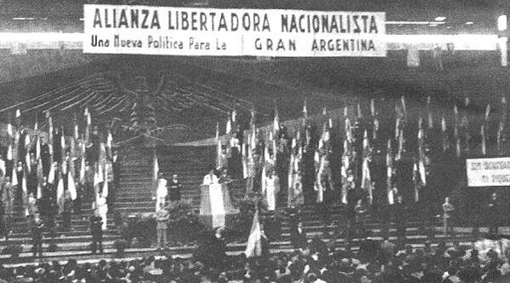
E. Nazi Influence in Southern Cone
Nazi threat in Uruguay
Hitler Youth Parties
Nazis in Paraguay
Chief of police named son “Adolf Hirohito”
Russian migrants to Paraguay, fascist support
Argentine Fascist
Party

Slide 23
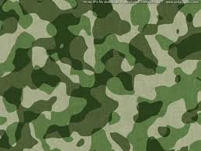
World War II
1939 US attaches increase
Se. 1939, 53% US public supports sending troops to defend Chile and others
1940 US general agreement
Argentina refuses: colony of the US?
After Pearl Harbor, US pressures
1942 Foreign ministers meet in Rio de Janeiro
Argentine embassies Germany, Italy, Japan
German trade with Argentina grows until 1939
US meddles in Chaco War treaty
Espionage for both Allies and Axis
FDR uses worries about SC to help Great Britain

Slide 24
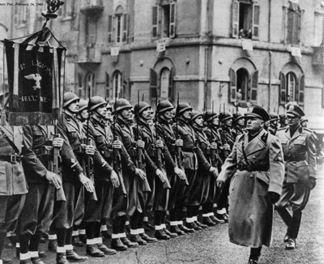
F. Southern Cone Responses
Geography important
Axis agencies
TP: Why was fascism attractive?
Chile and Argentina active fascist parties
Brazilian Integralist Party: jack boots green uniforms admiration for Mussolini

Slide 25
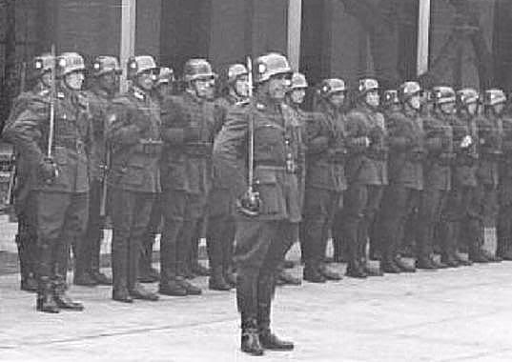
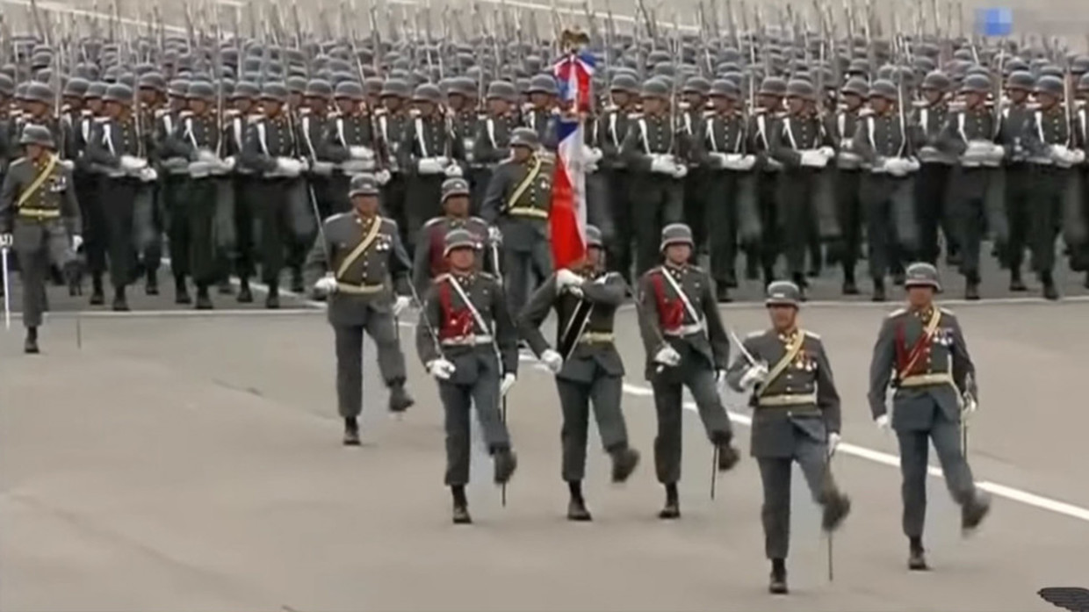
Argentine troops WW2
Chilean troops WW2
Chilean troops 2018

Slide 26
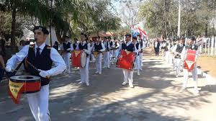
Course of WWII
US gave very little help to Argentina and Chile for not severing ties with Axis
Over 1 million Germans in Brazil
Chile: German population influential, economically important
Paraguay: German Mennonite colonies in the Chaco, Germans in East, Nueva Germania
Chile: Neutrality cost it armaments, US finances
Argentine continued neutrality since WW1
US refusal to compromise caused years mistrust

Slide 27
Conclusions:
Chaco War
February Revolution
World War II
Homework for 16 March:
2 articles: James’ “Peron and the People”
Martínez, “Saint Evita”
March 18: Final Projects Research day
Meet in our classroom 2 pm

