Slide 1
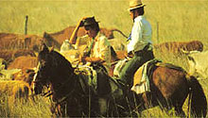
Bourbon Reforms:
A New Viceroyalty, Cattle and Native Resistance

Slide 2
Reading Quiz 2
The Mission, Inés of My Soul Chs. 3-4
1. Why did Spanish troops destroy Mission San Carlos?
2. Why did Rodrigo join the Jesuits above the falls?
3. How does Ines help the Spanish on the way to Chile?
4. Who was Catalina?
5. Who was Felipe?

Slide 3
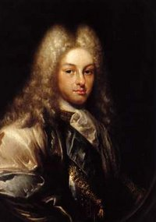
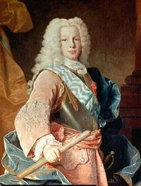
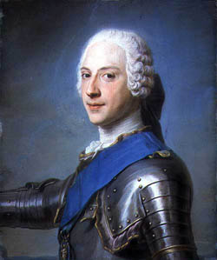
The Bourbon Reforms
A. The Bourbon Reforms push towards Independence
1. Political Situation in Europe by the 18th Century
Phillip V (1665-1700), and sons Ferdinand VI (1746-59)
and Charles III (1759-88)

Slide 4
Small Group Challenge:
SG: if you were the Queen or King of Spain, what might you have seen in need of reforms in your southern colonies by 1750?
What was life like for people in the colonies by 1750?
In what situation was the government?

Slide 5
1. Political: Efficiency and Greater Control
a. A New Viceroyalty: La Plata 1776
SG: Why carve out a new administrative unit in the Southern Cone? Three small groups
Analyze reasons by 1776
Contribute to the list on board:
1. Geopolitical:
2. Economic:
3. Social:

Slide 6
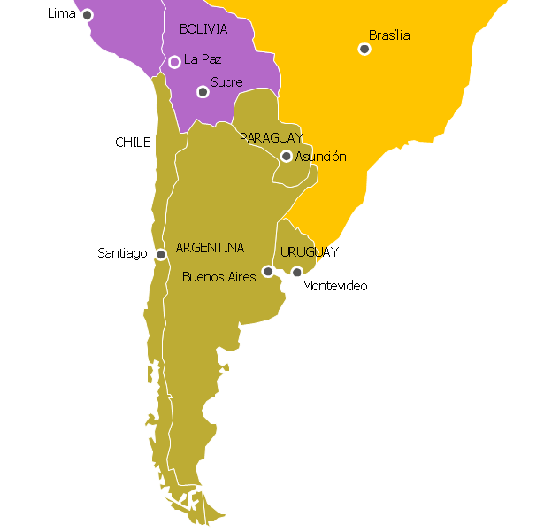
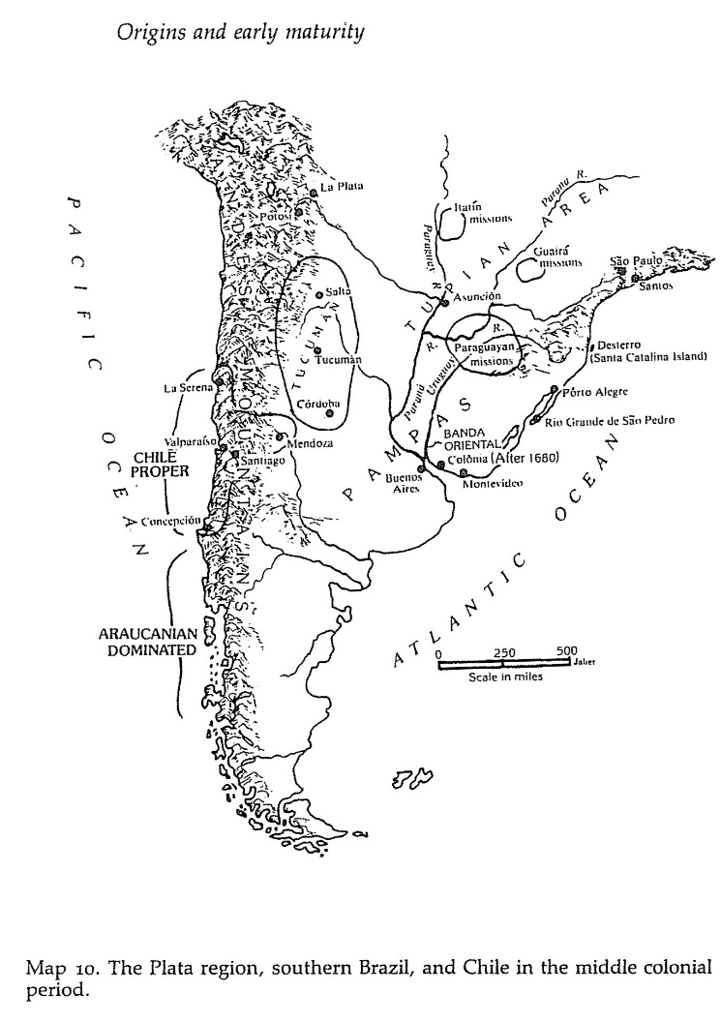
Viceroyalty of La Plata 1776

Slide 7
b. Intendencies
b. System of Intendencies to improve local rule, make political system more efficient
Explain to each other why greater political and military control at local level might have helped the Crown?

Slide 8
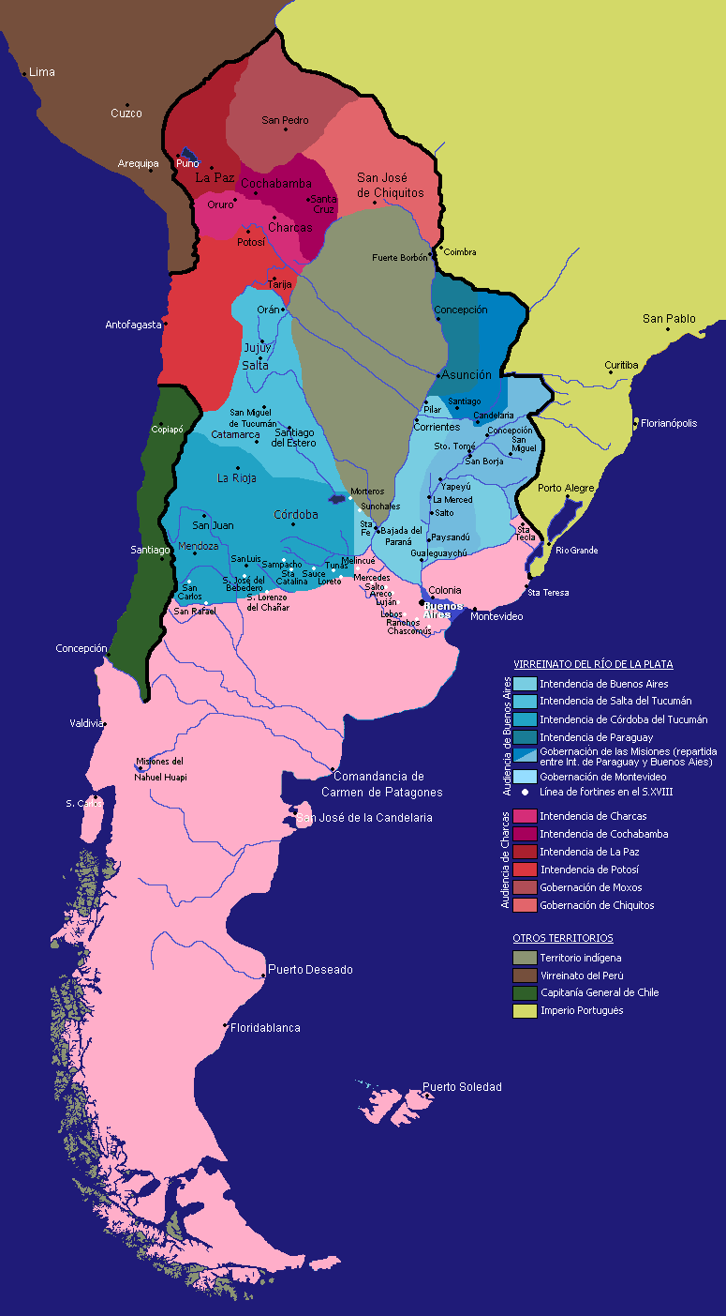
Intendencies and Territories
Draw a Map as a group: everyone draws and adds one intendency from the map
1. Buenos Aires
2. Salta del Tucumán
3. Córdoba del Tucumán
4. Paraguay
5. Gobernación de las Misiones
6. Gobernación de Montevideo
7. Charcas
8. Cochabamba
9. La Paz
10. Potosí
11. Moxos
12. Chiquitos
Other Territories
13. Indigenous
14. Viceroyalty of Peru
15. General Captaincy of Chile
16. Portuguese Empire

Slide 9
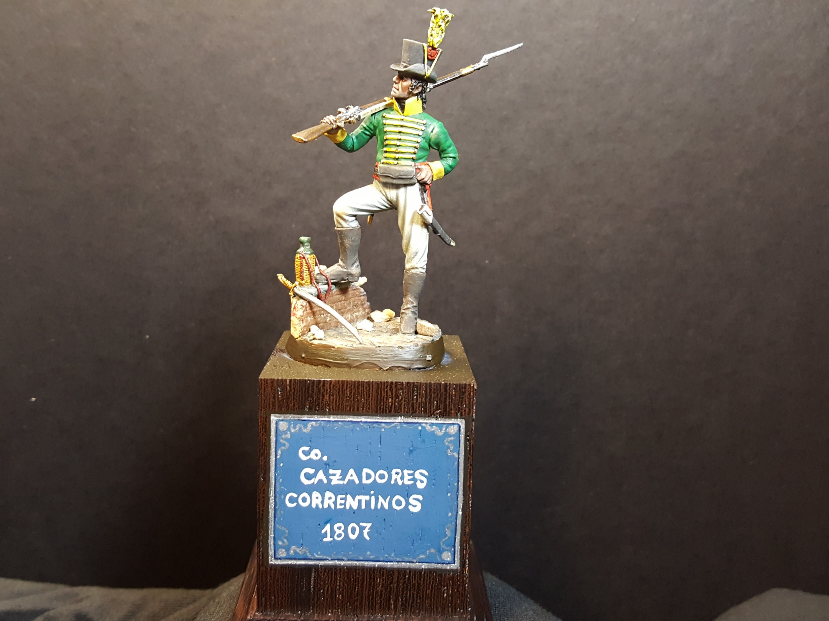
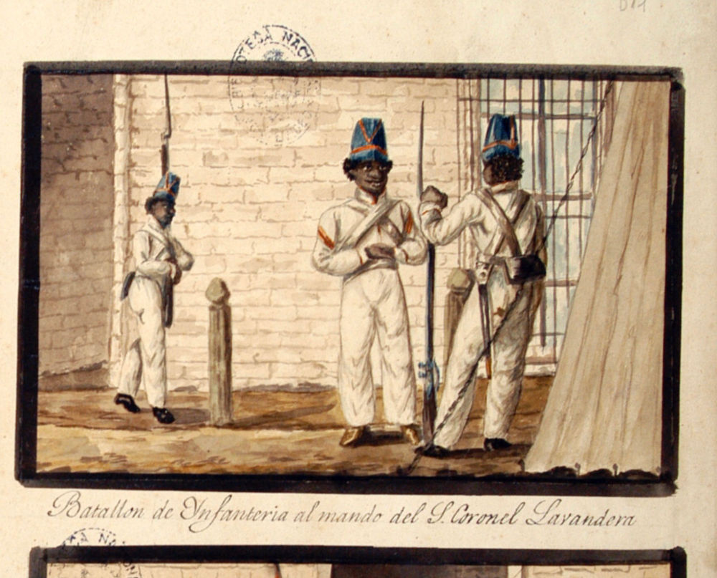
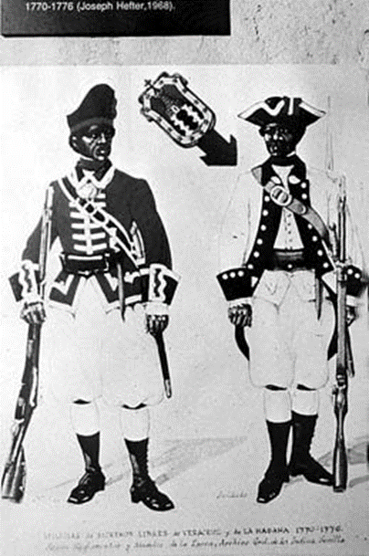
c. Colonial Militia in 1760s
Veracruz Militia
Havana Militia
Afro-Uruguayan Militias
Correntino Militias
Compare to your Minutemen
Discuss long-term results?

Slide 10
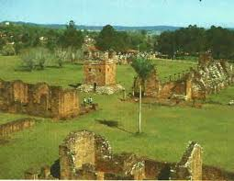
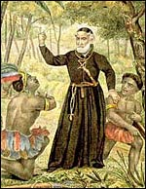
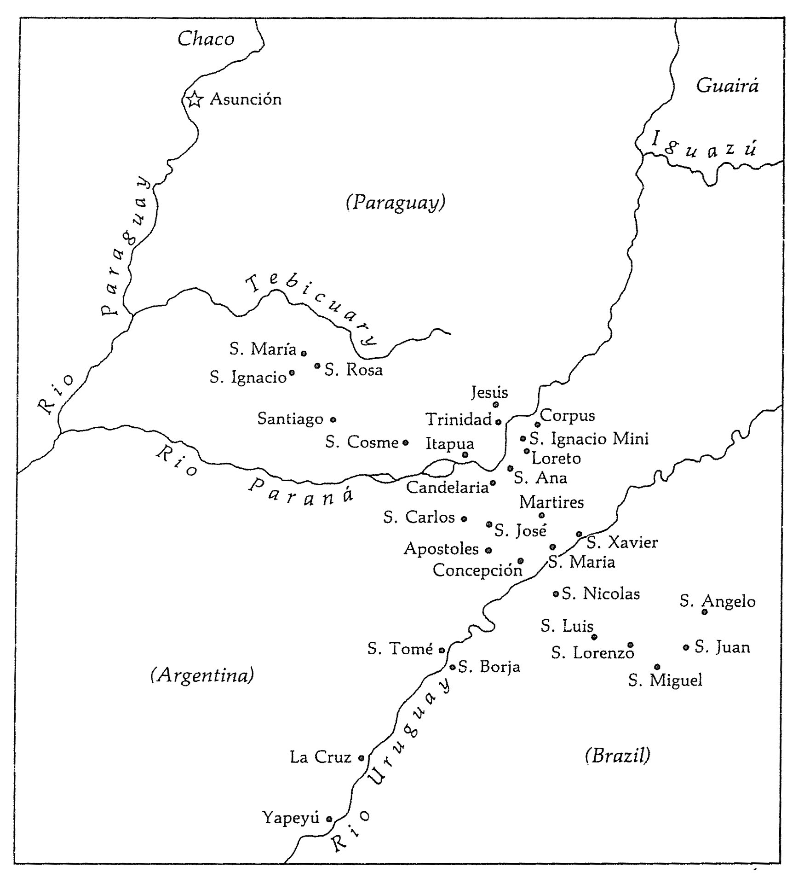
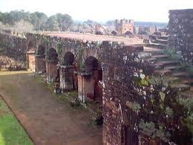
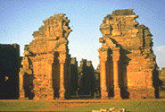
The Mission: Discussion

Slide 11
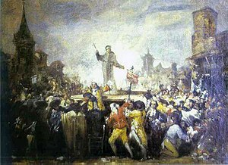
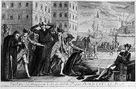
d. Expulsion of Jesuits
What is Regalism?
Portugal 1759
Spain 1767

Slide 12
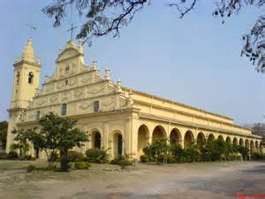
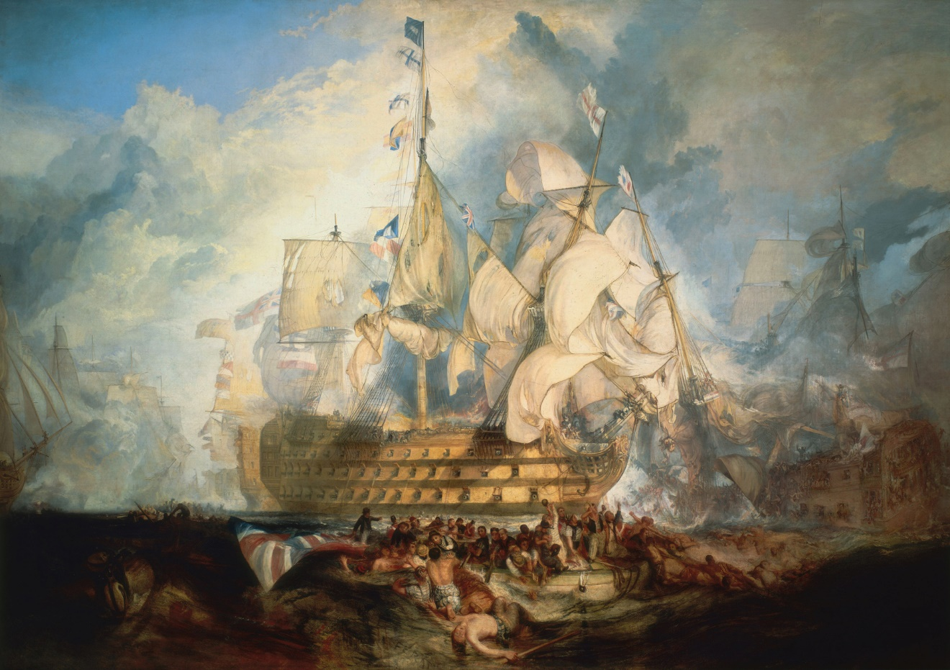
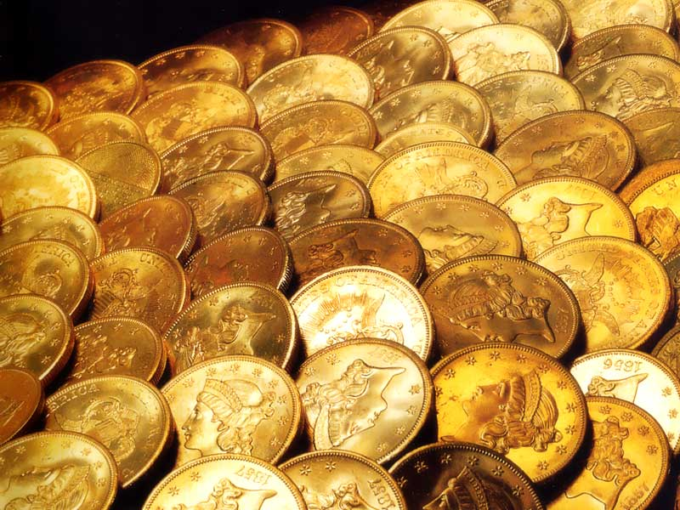
2. Economic Reforms: To Raise Money
a. encouraged trade between colonies
b. increased taxes on commerce
c. 1800 Royal decree prohibited
manufactures in the colonies
d. Consolidation decree of 1804
e. World events again heightened the crisis
Anglo-Spanish War 1796-1808 Catastrophic for Spain

Slide 13
Reading Discussion: Inés 3-4

Slide 14
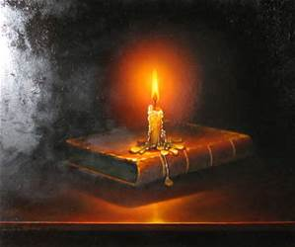
B. Social Reasons for Independence
1. European Enlightenment ideas to LA
2. Conflict between Creoles and Peninsulares
Act it out: two sides of the room, explain your differences
3. Racial considerations

Slide 15
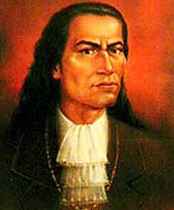
4. Peasant Uprisings and Social Unrest
a. Peru
-1730-1780 128 rebellions
-1780 José Gabriel Condorcanqui (Tupac Amaru II)
b. New Granada (1781)
-Revolt of Comuneros, intolerable economic conditions, creoles and mestizos
c. Santo Domingo (1791) massive slave revolt, proclaimed Haiti the first independent republic in the Americas
d. Bahia (1798) Pop. Classes, spoke of free trade, opposed excessive taxation, royal restrictions
We will focus on the closest rebellion, the Comuneros Revolt in Paraguay

Slide 16
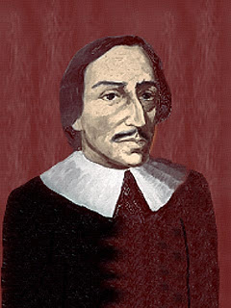
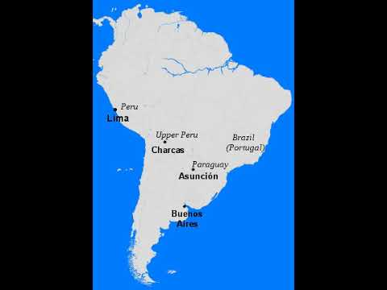
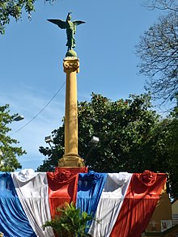
e. The Comunero Revolt early 18th C
Revolt by settlers in Paraguay against Spanish authorities
Cuases:
1717 Gov. Diego de los Reyes de Balmaceda
1721-25, Deep resentment built against Jesuits… Why?

Slide 17
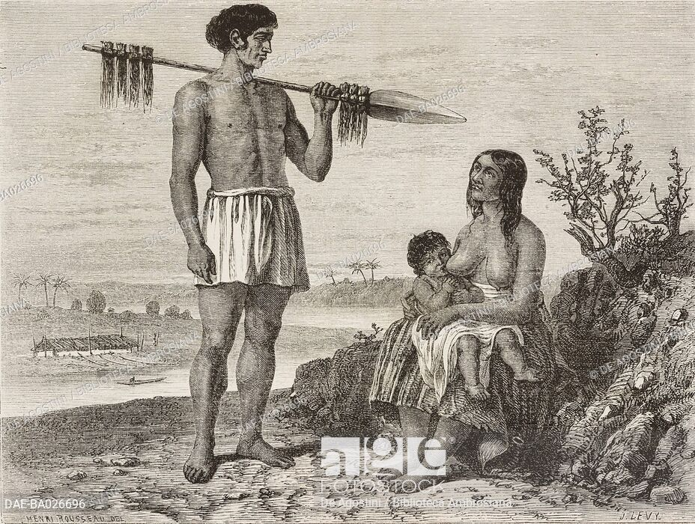
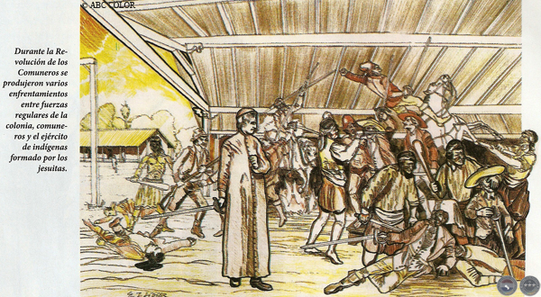
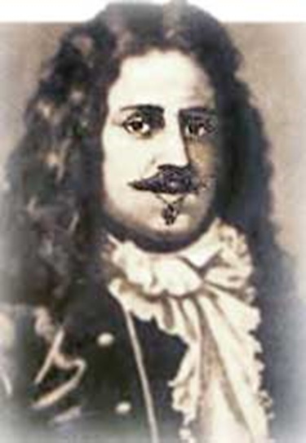
1730-1735 Comunero Revolt
Dislike for Gov. José de Antequera y Castro
who favored Jesuits, and used Natives for own yerba
Revolt from 1730-1735
Economic issues most important:
Settlers had lost encomienda labor to Jesuit Missions
Law forbid enslaving Chaco Indigenous peoples
Law gave riverine Payagua to the Jesuits
Fernando de Mompox led the movement
Results: defeated by army of 6000 mission Guarani

Slide 18
F. Conclusions and Assessment
What did you learn?
Here is what did I try to communicate
Assignment: prepare Third Degree (10 questions on Ines, chs. 5-6
Implications of Bourbon reforms for Southern Cone history?

