Slide 1
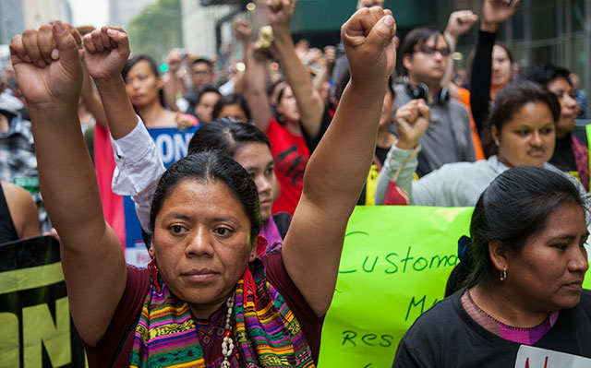
Indigenous Peoples of Latin America: an Introduction
His 2302 Spring 2020

Slide 2
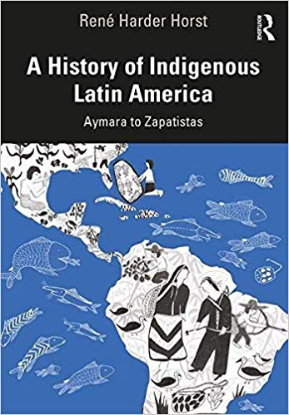
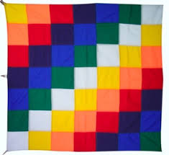
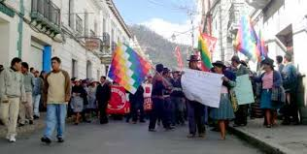
Indigenous
Abya Yala

Slide 3
A. How did they get here?
Science tells us that people first emerged in Africa, so how did they get here to the Americas?
What can we know?
Aboriginal accounts of origins
Emergence
Descent
Always been here
Great Migration
TP: What stories of origins do you share?

Slide 4
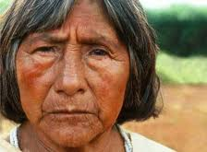
Guarani Creation Story
The First Father of the Guarani rose in darkness lit by reflections from his own heart and created flames and thin mist. He created love and had nobody to give it to. He created language and had no one to listen to him.
Then he recommended to the gods that they should construct the world and take charge of fire, mist, rain, and wind. And he turned over to them the music and words of the sacred hymn so that they would give life to women and to men.
So love became communion,
language took on life, and the
First Father redeemed his solitude.
Now he accompanies men and
women who sing as they go:
We’re walking this earth, We’re
walking this shining earth.

Slide 5
Hundreds of comparable origins stories
Strong relationship between creative force, local environment, and indigenous culture
Raven, Eagle, Turtle, Wind, Creator, other mysterious forces
Rich understanding of creation and history
from reading and awareness of natural setting
TP: Compare such stories with Judeo-Christian stories of origins that many of you are familiar with

Slide 6
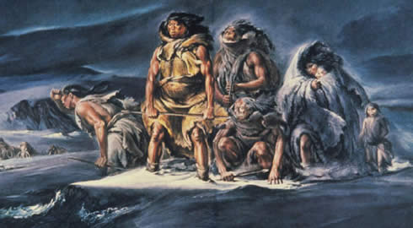
Western Science
Long operated on comparable explanations
The Great Migration Theory
Crossing Beringia 16,500 – 11,000 BCE?
Yet examples of earlier archaeological artifacts?

Slide 7
Historian Roxanne Dunbar-Ortiz
An Indigenous People’s History of the United States
Were the America’s really empty of humans until 12 or 13 thousand years ago?
Harvard Professor David Reich, when asked by Native journalist Simon Moya-Smith if Bering Strait was fact, answered:
“No, I don’t think it is considered fact. I think that it’s a hypothesis about history, but no, it’s not fact.”
The Bering Straight theory is only one possible scenario for peopling of the Americas.
Who has this story served and how?

Slide 8
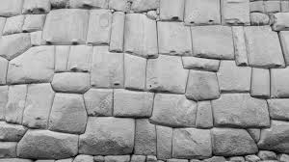
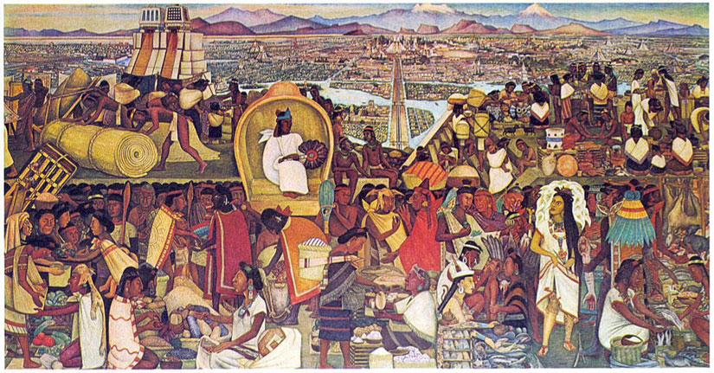
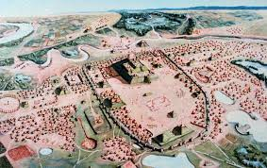
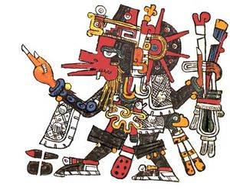
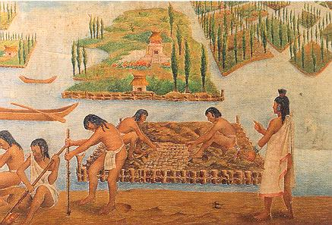

B. How were Indigenous People Organized? & Numbers
Indigenous Population before Colonization
    Empty land?
    As many as 75 million people in the Americas
    53,904,000 (William D. Denevan, 1984)
    Empires of Latin Amerca’s Central Areas:
        Maya Empire: 400-1500 CE
        Aztec Empire: 1200-1492 CE
        Inca Empire: 1438-1533 CE
      Indigenous Empires in North America
      Hopewell, Hohokan, Anasazi
      Eastern Woodland, Ohio Valley
      (Adena and Hopewellian), Cahokia
      Everywhere: Peripheral peoples

Slide 9
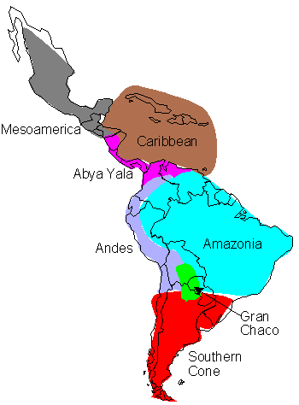
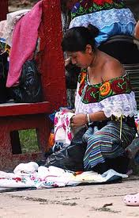
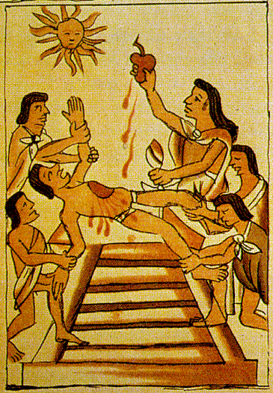
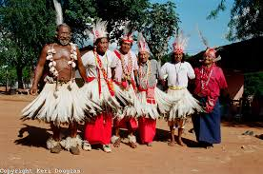
Indigenous People of Latin America Map

Slide 10
C. Class Activity 1: LA Scavenger Hunt
Find Someone Who…
0. Keep track of the names, turn in for participation credit
1. Find someone who likes to eat burritos…
2. Find someone who read B&F Ch. 1 for today…
3. Find someone who watched Apocalypto for today…
4. Find someone who believes that your president’s treatment of Latin Americans is misguided…
5. Find someone who thinks Trump’s policy is spot-on.
6. Find someone who is excited to learn about other cultures
7. Find someone who knows what Cochineal is…
8. Find someone who has been to Latin America… where?

Slide 11
Today’s Sources
SG Analysis:
Chasteen, Born in Blood and Fire, Ch. 1
Bartolomé de las Casas, Ch. 1
“Welcome to Latin America”
Films: Apocalypto, Warriors of the Amazon
Two sides of the room, discuss the following:
Group 1: Patterns of Indigenous Life
Group 2: Origins of a Iberian Crusading Mentality
Analysis from both sides on next slide:

Slide 12
Why begin with Indigenous cultures?
Analysis:
Why does culture make a difference to history?
How did Indigenous cultures shape their interactions with the Europeans?
Who were the Iberians? What was their culture?
What was their “Crusading Mentality”?
Where did it come from?
Given these characteristics, predict results of first meetings between these different groups…

Slide 13
C. Patterns of Cultures and Political Organizations
Empires
The Mayan Empire in the Yucatan Peninsula
Aztecs (Mexica), Incas (Quechua and Aymara)
Small Groups of Hunter and Gatherers
The Yanomami of Venezuela/Brazil as example
Analysis:
TP: How did native cultures make a difference in their interactions with Europeans?
Dynamics of Interaction with outsiders

Slide 14
Conclusions & Assessment
Indigenous People of Latin America
Did you remember to sign the attendance sheet?
Written exercise
What did you learn today?
For next Tuesday’s class:
Blood and Fire Ch. 2
Bring something to exchange for keeps in our Class Columbian Exchange

