Slide 1
Indigenous Peoples meet Europeans
Historical Analysis through documents and the Columbian Exchange

Slide 2
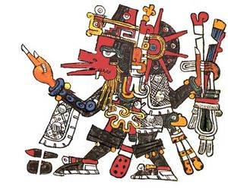
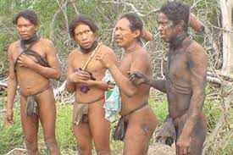
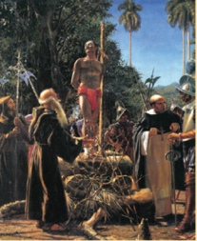
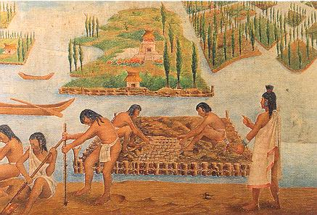
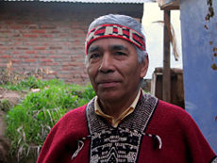
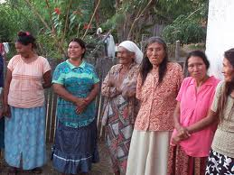
A. Both Sides of the Encounter
Who were the Indigenous People in Latin America?
Remind each other about them!

Slide 3
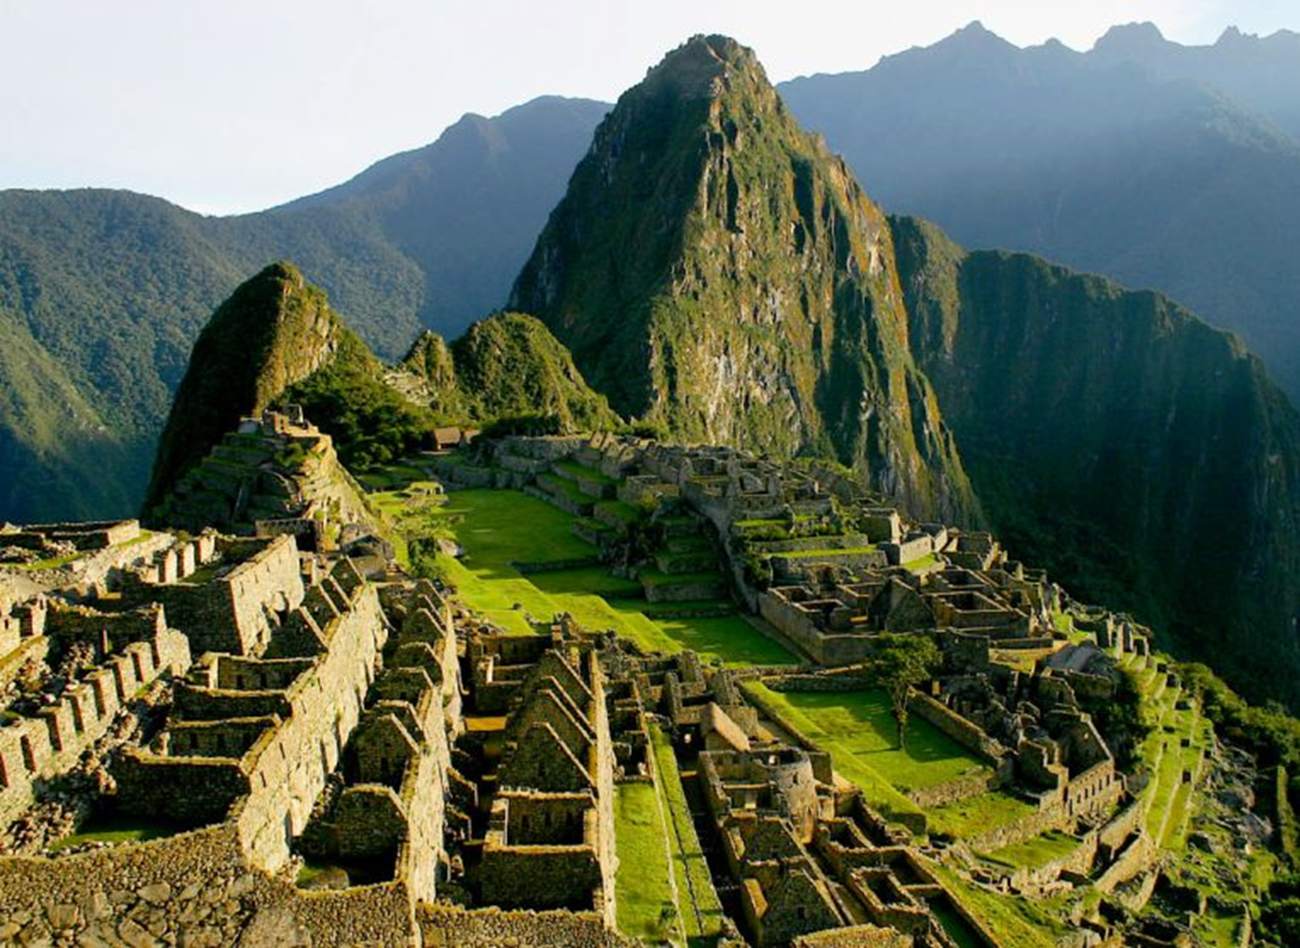

Slide 4
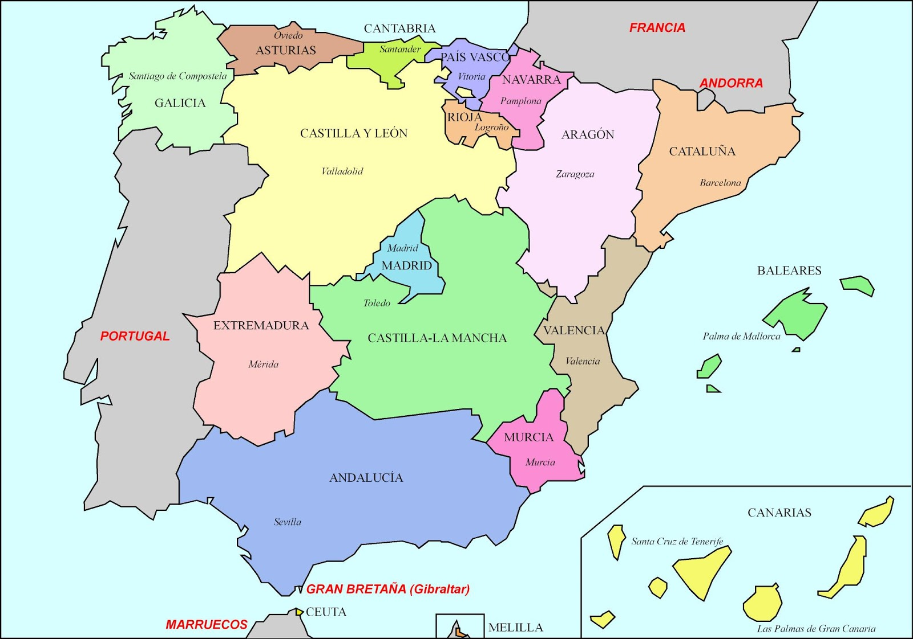

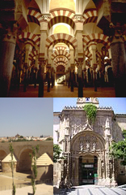
Who were the Europeans?
Roman Iberia after 201 BCE
Visigoths invaded Iberia early
5th Century
Muslim invasion in 711 CE
  Capital at Cordoba, Economic Intellectual Center
  700 year Holy Crusade to Expel Muslims
  Aragon and Castille united 1479
  March towards absolute power
  Religious and Economic Reforms
  Expulsion of Muslims and Jews 1492

Slide 5
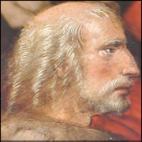
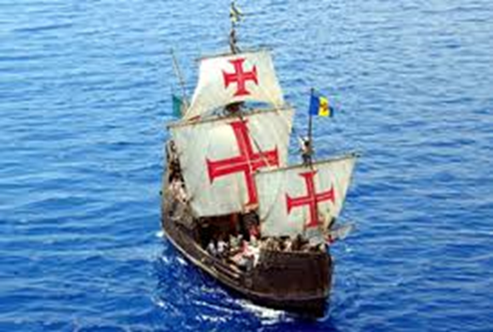
B. How did they first meet?
Columbus’ voyage of 1492, and subsequent exploration and settlement
Sailing the Ocean Blue
Pope Alexander VI Missionary Task
Inherent Contradiction of Journey?

Slide 6
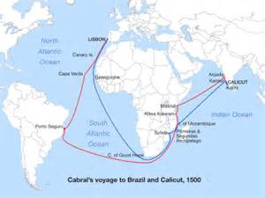
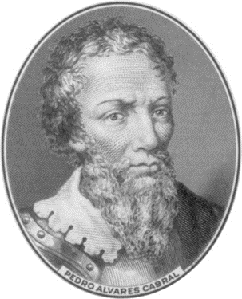
Discovery Brazil 1500
Cabral’s accidental voyage of 1500

Slide 7
The Tupinamba, along the coasts of central Brazil, met Europeans quite accidentally in April of 1500, when winds blew Portuguese Captain Pedro Cabral and his fleet off course on his voyage to trade in India. By the time that sailors reached the beach in what became the State of Bahia, twenty Native men were already waiting. They so carefully imitated the sailors, who erected a cross and celebrated mass, that the traders predicted easy conversion.
Pero Caminha, Cabral’s scribe, predicted that, “One can easily imprint on them any mark we choose, for Our Lord has given them good bodies and good faces as befit good men. If anyone is to come here, let a clergymen come along to baptize them.”

Slide 8
It was the Natives’ nakedness, though, that most intrigued the traders. Caminha noted that one girl was “all dyed [sic.] from head to foot in that paint; and indeed she was so well built and so well curved and her privy part (what a one she had!) was so gracious that many women of our country, on seeing such charms, would be ashamed that theirs were not like hers.” Sailors tried to dress them, but the people they described as “noble savages” quickly threw off the European clothing.
Along one river, sailors stumbled upon a Native dance and the Tupinamba welcomed them warmly to join in the fun. Another friendly group spent a day dancing to sailors’ tambourines. After trading feathers for paper, trinkets, and alcohol, the Tupinamba filled one of the ships with dyewood, a tree that produced a bright red dye, and Cabral sent the cargo back to Portugal when he left for India.

Slide 9
Discuss dynamics of early encounters in Brazil
Analyze goals on both sides
What do these first encounter accounts tell us about the people on both sides?

Slide 10
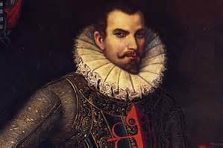
C. Exploration and Conquest
European waves settled Americas by 1550
1. From Cuba 1516-1518, Central America 1522
Herna’n Corte’z Veracruz March, 1519
Aztec Empire received with finery and gifts

Slide 11
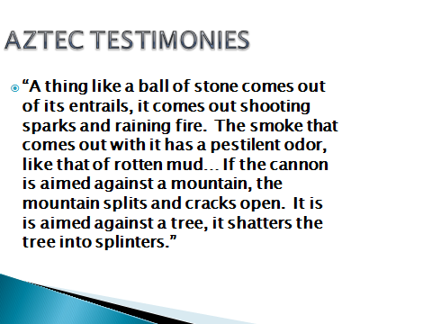

Slide 12
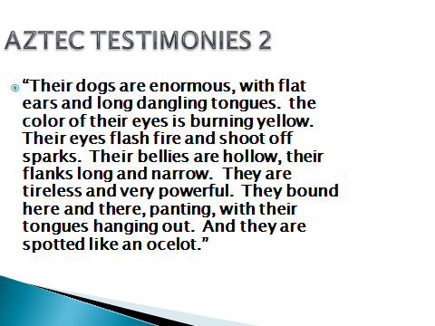

Slide 13
SG: Analysis of Aztec Testimonies
What surprised you?
What do these testimonies tell us about the Mexica people?

Slide 14
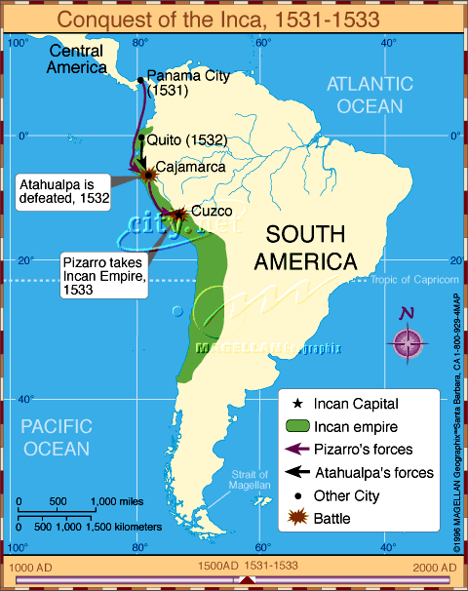
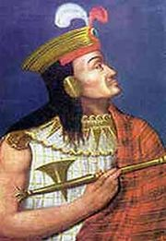
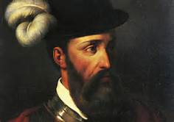
2. Second Wave of Conquest began in Andes 1531
Francisco Pizarro led expedition with 180 soldiers and horses
Conquered Inca Empire, Emperor Atahualpa
North to Quito (1534) Bogota (1536)

Slide 15
In the Andes, in a very different political and geographic context than the Caribbean, the death of Emperor Huayna-Capac in 1525 or 1527 plunged the Inca Empire into civil war. His son Huascar ruled in Cuzco with popular support, but a rival son, Atahualpa, was in charge of the army to the north in Quito, and they went to war against each other.
Atahualpa’s soldiers finally captured Huascar outside Cuzco and brutally repressed his supporters. As Pizarro’s forces marched south in search of Peru, the civil war was nearing its end: towns lay in ruins and dead soldiers hung from trees along the road.
Atahualpa learned of the invaders while camped at Cajamarca, high in the mountains, but the small force of outsiders could not have worried him much as he prepared for his triumphal entry into Cuzco. An envoy from Atahualpa’s camp invited Pizarro to visit as the invaders climbed along a barren savannah at 13,500 feet, probably nervous about the changing terrain.

Slide 16
Finally, on a Friday in mid-November, the Spanish came out of the hills and beheld the lush, flat valley of Cajamarca. Surprised, they must have stared nervously out across the city at the encamped Inca army. As one recorded:
“The Indians’ camp looked like a very beautiful city… So many tents were visible that we were truly filled with great apprehension. We never thought that Indians could maintain such a proud estate nor have so many tents in such good order. Nothing like this had been seen in the Indies up to then. It filled all us Spaniards with fear and confusion…” Putting on a brave front, the troops nevertheless grouped in the main square, surrounded on three sides by buildings, and invited the Incan Emperor to meet Pizarro.

Slide 17
The following day, Saturday, 16 November of 1532, the Inca army and their emperor in a richly decorated litter entered the city to meet the Europeans. Spanish soldiers --there were less than 170 of them— were hiding in empty buildings and streets along the main square. Pizarro’s younger brother noted that many of his men were so scared that they pissed on themselves out of sheer terror.
A Dominican friar approached Atahualpa with a cross and liturgical book, reciting the requerimiento. The emperor demanded to see the closed book. Finally opening it, Atahualpa blushed at not being able to understand what he saw and threw the book down to his troops.
The priest ran back to Pizarro, calling on the Spanish to attack the “enemy dogs” for throwing down God’s holy law. Soldiers in armor and chain mail charged their horses into the Native crowd, who panicked and ran. Within two hours, the conquerors captured the Inca, slaughtered six to seven thousand native troops and left others maimed and without limbs. Many Native soldiers fell under the horses or suffocated as they ran in panic to escape from the square.

Slide 18
D. European Conquest of the Americas
By 1550 all the cities that are today capitals in Latin America except for Brasilia were settled.
SG: How did Spain conquer and populate the Americas so rapidly?

Slide 19
Sources
Chasteen, Born in Blood and Fire Ch. 2
SG discussion on the following questions:
What is the crusading mentality?
Why was Brazil different?
How did Portugal make Brazil profitable?
Describe the African slave trade to the Americas
What was the “encomienda”?
How were women on both sides involved in the conquest?
Bartolomé: what happens in chs. 2-3?

Slide 20

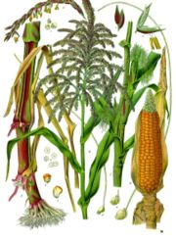
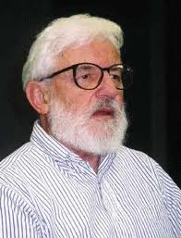
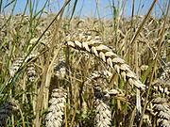
E. The Columbian Exchange
The Columbian Exchange in Early Modern P.
Alfred Crosby, Jr. Historian
What Plants and Animals came to Americas?
What types of sources used to describe the use of maize, wheat, potatoes, cattle, horses, swine?

Slide 21
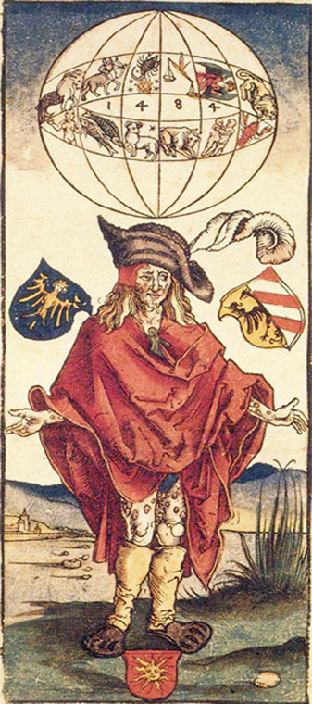
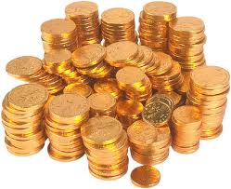
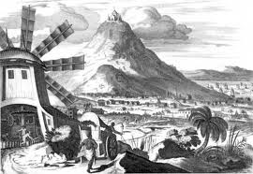
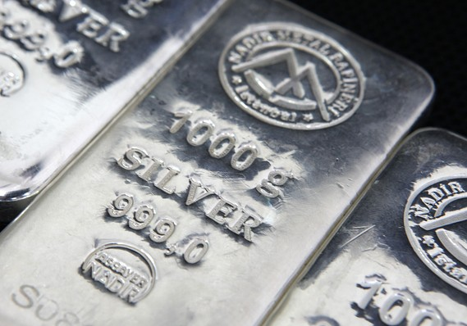
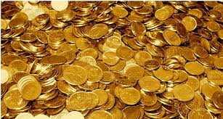
What went back to Europe?
Potosi Silver Mine
Etching by Alfred Durer 1496

Slide 22
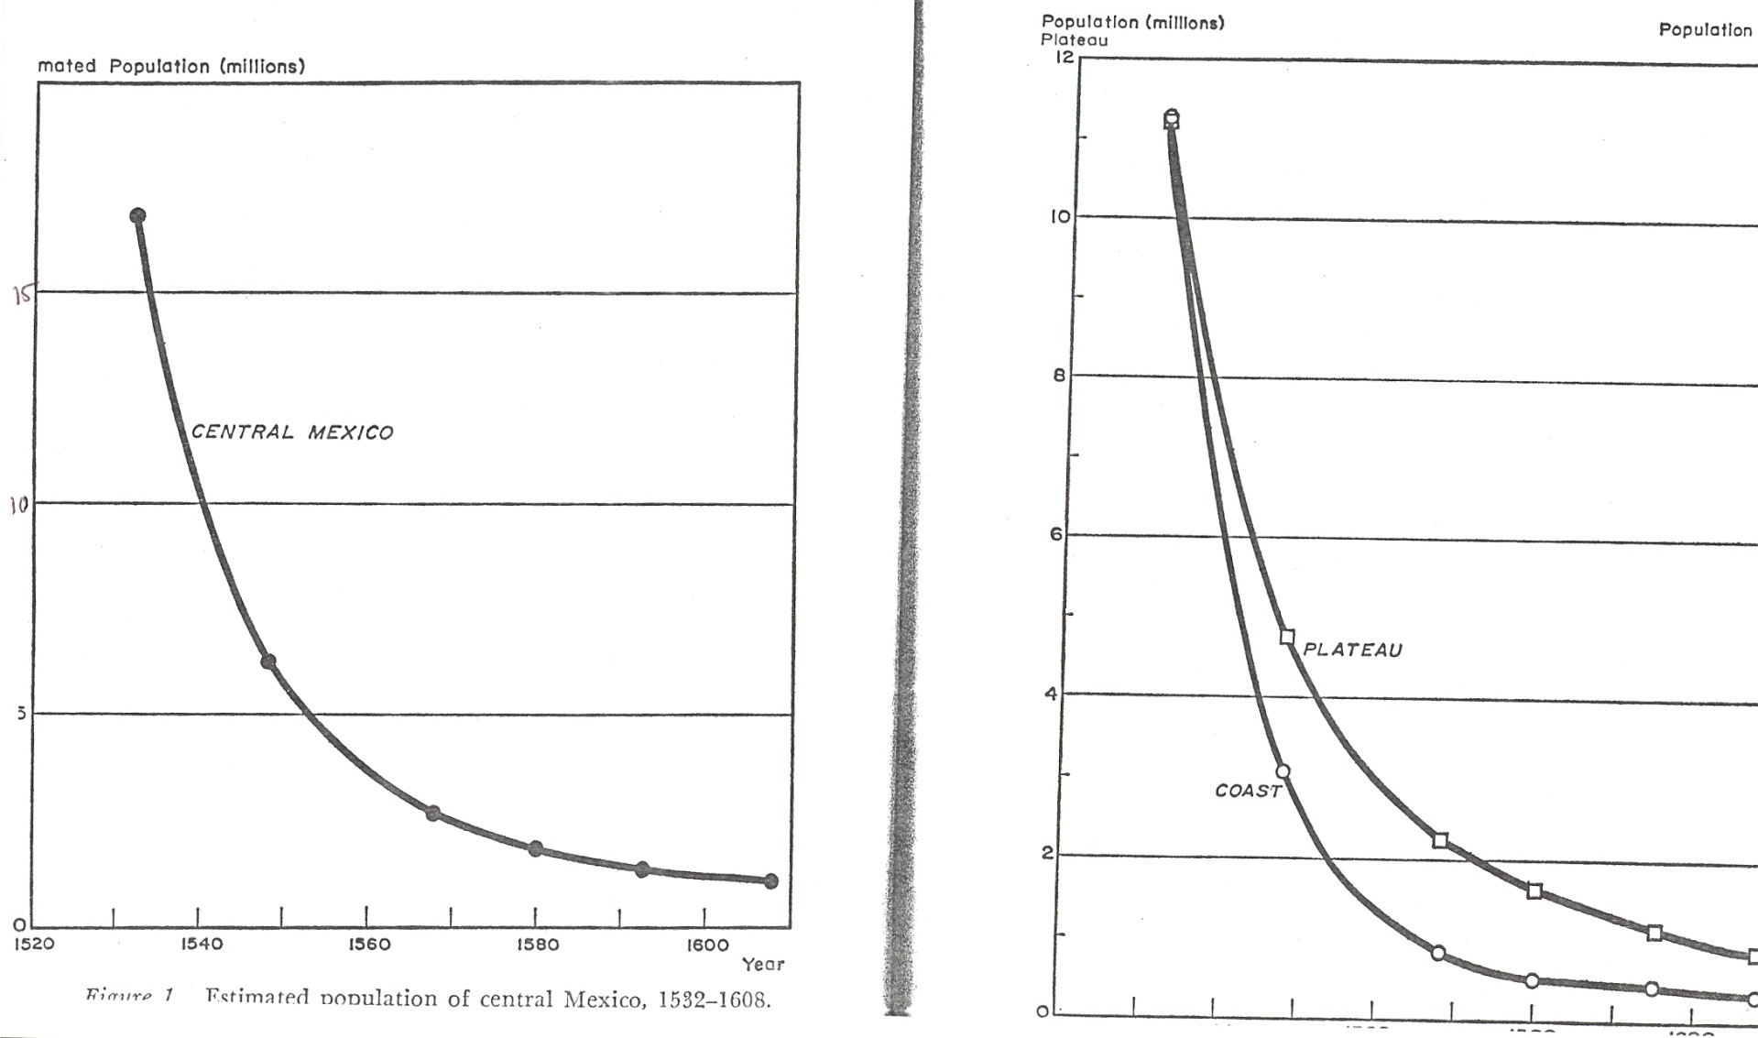
F. Results: Demographic Collapse
Woodrow Borah and Sherbourne Cook

Slide 23
G. Class Columbian Exchange
Move around the class
Meet someone and trade commodities
No talking, only gestures, you can’t understand each other’s language
As the captain of this ship, I have some goodies on my deck to trade
Analysis: Insights into the Columbian exchange

Slide 24
H. Conclusions and Analysis
SG: Analyze and Describe:
Indigenous Latin Americans meet Europeans
Dynamics of Encounter between different peoples and cultures
Given their background, what kind of world would they create between them?

