Slide 1
The Colonial Legacy : Settlement and Political
How did Spain settle and organize its colonies politically?

Slide 2
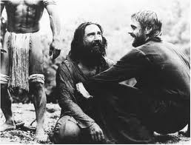
Homework for next class
Born in Blood and Fire, Ch. 3
See The Mission
in the history lab, library, or online

Slide 3
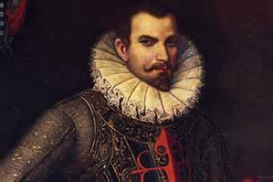
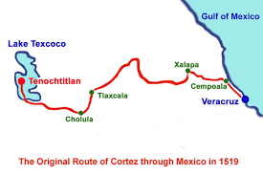
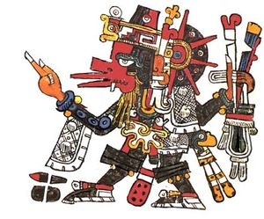
A. Settlement Patterns Review Conquest…
Two European waves settled the American continent by 1540
1. From Cuba (1516-1518) to Mexico (1519) Central America (1522)Hernan Cortés landed at Veracruz in March, 1519
-Aztec (Moctezuma) waiting for return of Quetzalcoatl, finery and gifts

Slide 4
Settlement Pattern 1

Slide 5
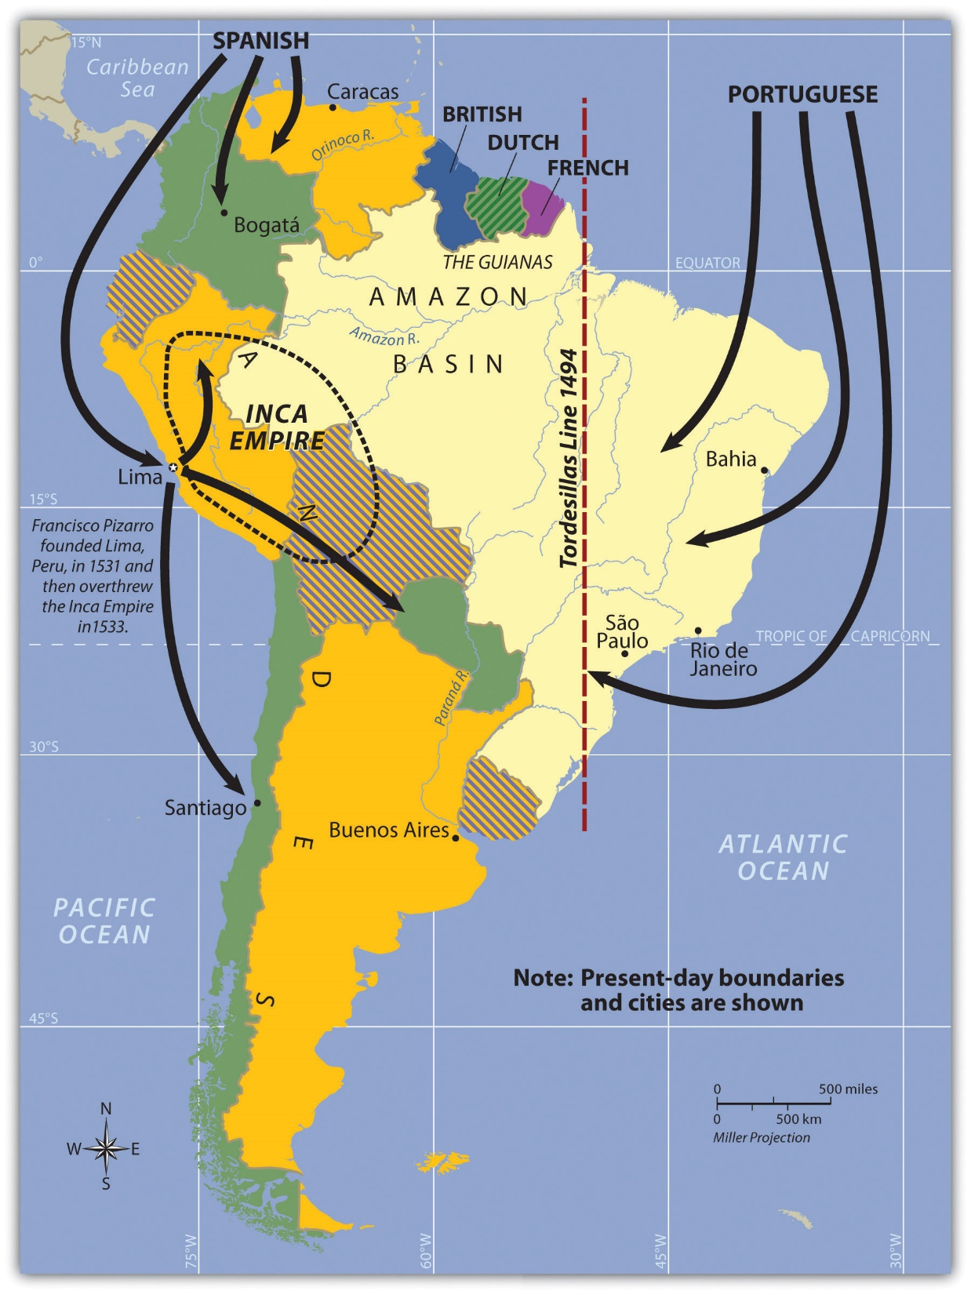
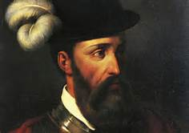
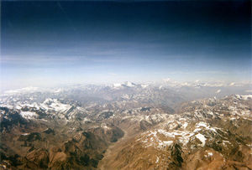
2. Second Wave began in Panama (1523), Andes 1531
Francisco Pizarro led expedition in 1531
TP: How did the Spanish search for commodities drive the settlement of the Americas?

Slide 6
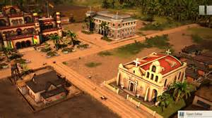
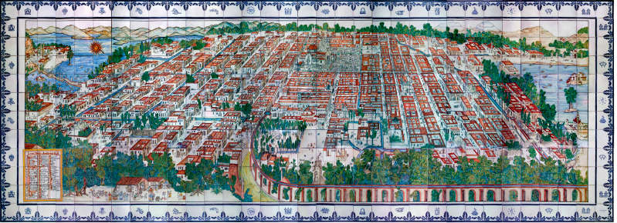
Settlement Patterns
What determined the place and patterns of settlements?
Mining Zones great focus of Spanish activities
Cities first, and closest to mines, then roads
Compare to “Settlers of Catan” or to settlement of the United States
Spanish Urban grid pattern: Political perspective SG: Why did Iberians adopt this settlement pattern??

Slide 7
Early Cities & Urban Centers 17th Century

Slide 8
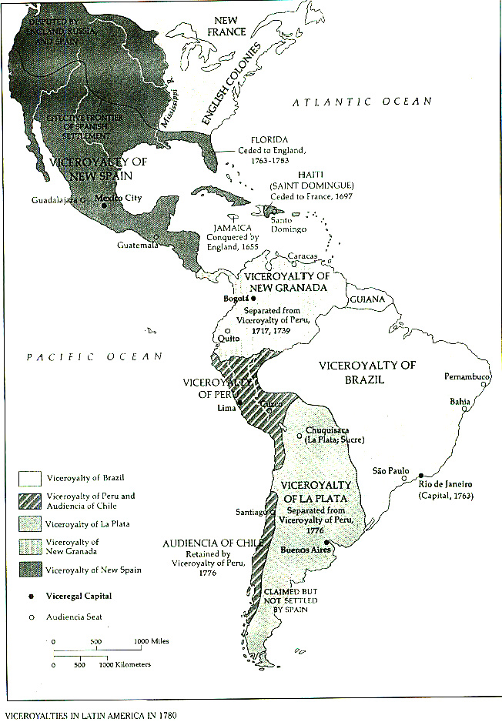
B. Colonial Political system
1. National:
Crown
Council of Indies (1523)
Government by Decree
Viceroyalties
New Spain 1521 Why first?
Peru 1542
La Plata 1776
New Granada 1717

Slide 9
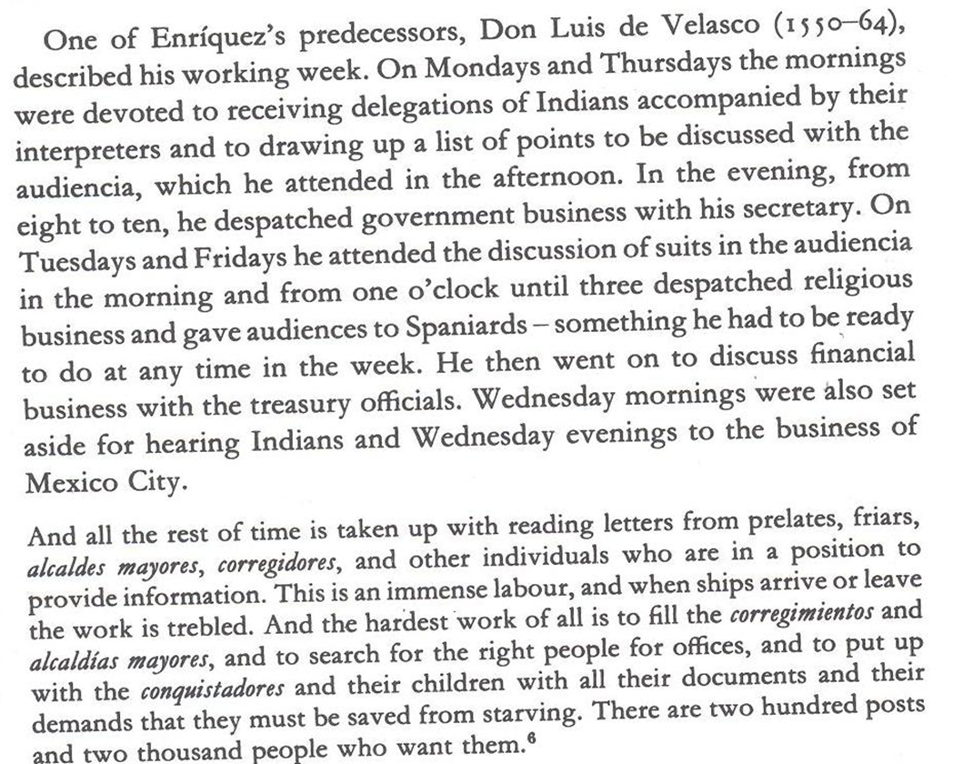
Viceroy: Don Luis de Velasco 1550-64 New Spain

Slide 10
2. Audiencias
Subdivisions of a Viceroyalty
Into High Courts of Appeals
Appelate Court
in the Viceroyalties
Santo Domingo 1511-1526
Audiencia of Mexico 1527
Audiencia of Panama 1535-42
Audiencia of Lima 1542
Audiencia of Guatemala 1543
Audiencia of New Galicia 1548
Audiencia of Bogota 1549

Slide 11
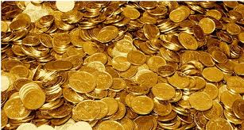
3. Visitas (Inspection)
Visita: Council of Indies sent officials called a Visitador General
To observe conditions in the Colony
Examination of indigenous town
And report them directly to the King
Why would the Viceroy have needed a Visita?
Cuenta:
Established the number of tribute payers
Goal of these measures in the Imperial context?

Slide 12
Revenue
Remember the Encomienda?
Gradual reversion of Encomiendas to crown… Why?
King wanted a Non-hereditary nobility in the Americas… Why?
Royal tribute in New Spain:
1550: 100,000 pesos
1790: well over 1,000,000 pesos
Demographic Collapse and Results
Decline of the Encomienda
By 1549: lost right to demand labor
lost fight to make it permanent

Slide 13
Third Degree or diss. Defense
Ten Questions on the reading: Las Casas chs. 4-6
Divide into groups of 5
Grill each other for two minutes per victim…
3 pts for a correct answer
2 pts for a correct bluff
4 pts for correctly calling a bluff
Keep track of your scores…
Recognize highest 2 scorers in the class…
Submit your questions for your participation grade.

Slide 14
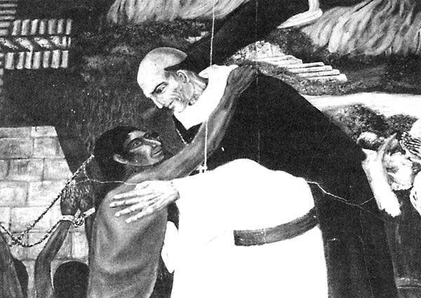
Sources
Lawrence Clayton
Bartolome de las Casas, Chs. 4-6

Slide 15
C. Local Governments:
Alcaldía Mayor or Corregimiento
Provincial Administrators
Intendants(Provincial Governors)
Cabildo
Town Council
República de Españoles
República de Indios
Government Social Control: Caste System

Slide 16
Conclusions
Settlement legacy?
Political Colonial Legacy?
How did the European Monarchs control their colonies?
What is your main takeaway today?
What will you prepare for next time?
Blood and Fire Ch.3
First Paper due: Using Bartolomé de las Casas and Born in Blood and Fire, argue whether the mandate to convert Native people to Christianity or the search for gold shaped Spanish imperial rule in the Americas more profoundly. See syllabus for details... (2 pages plus title page and bib page)

