Slide 1
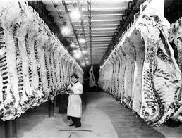
Immigration, Beef, ISI,
José Batlle of Uruguay
Early 20th Century

Slide 2
Short Paper 3 assignment for We:
Heroes on Horseback
Using Heroes and Horseback, explain
how Brazilian immigrants and gauchos
shaped the birth of modern Uruguay in
the late nineteenth and early twentieth
century.
Be sure to cite examples from the book
to support your argument. 2 pages, plus title page, notes, bibliography
Never cite class lectures: only printed sources are valid for course papers

Slide 3
Paper 2: Colonial Legacy of the Southern Cone
Review your paper

Slide 4
Kicking around our prose
Circle: “Kicking around our prose”
Why is it important for all of us to improve our writing and prose?
What issue will you improve for next time?
How can you address this issue?

Slide 5
A. Populism in the Southern Cone
Import Substitution in Action in the Southern Cone
Civil War, Social Legislation, Populist Governance

Slide 6
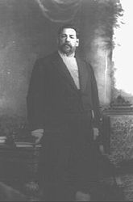
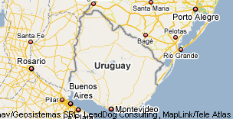
José Batlle y Ordoñez
President of Uruguay
1902-1907, 1911-1915

Slide 7
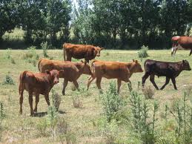

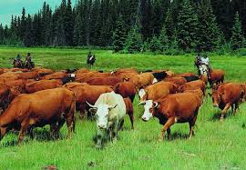
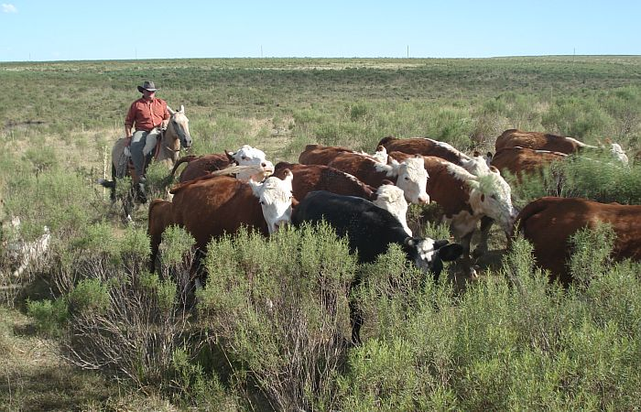
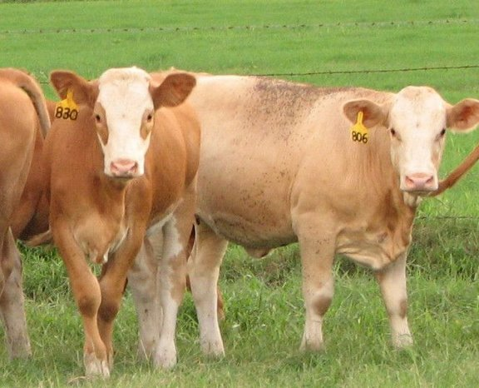
Immigration, Beef and José Batlle of Uruguay at beginning of 20th Century
Moving a nation towards Industry
Import Substitution Industrialization in the Southern Cone
Remind each other:
What was ISI? Where did it come from?
First Latin American application of theory in the Southern Cone

Slide 8
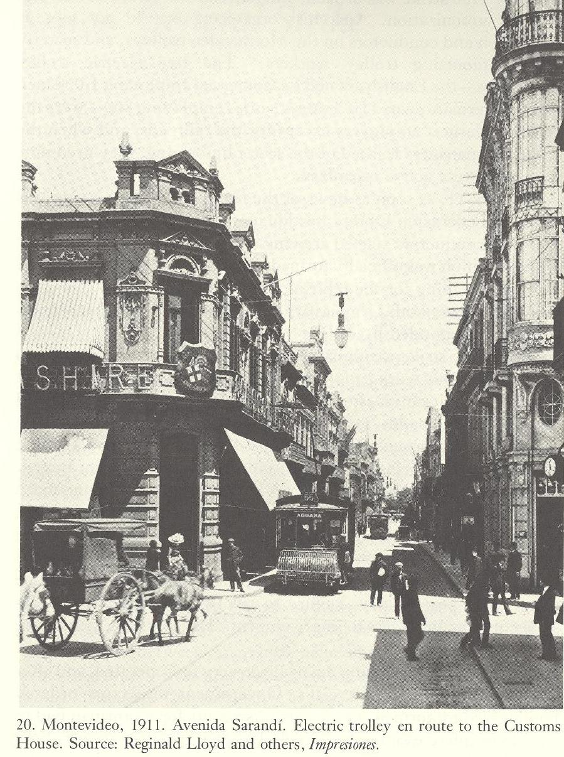
A. Uruguay in 1902
A Divided nation
Liberals (Colorados)
& Conservatives (Blancos)
Nation focused on Montevideo
Healthy population, high birth
rate, secular society, church-
state relations quiet
Aparicio Saravia (???) had restauro’ Nationalist Party
(Blancos) to importance
Led the army

Slide 9
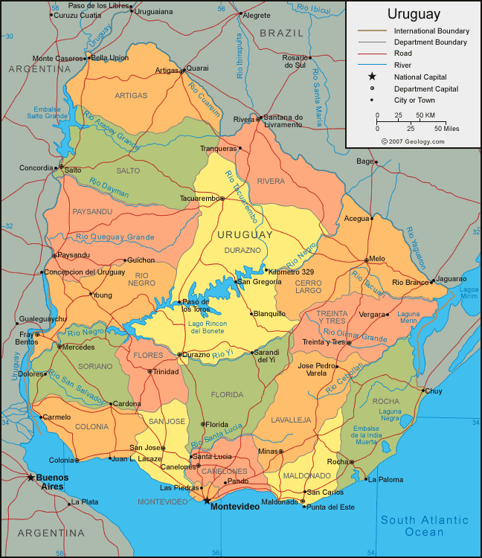
B. José Batlle y Ordoñez

Slide 10
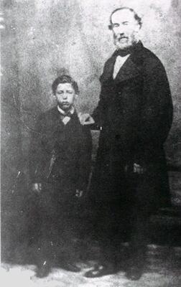
Batlle’s background
Son of Lorenzo Batlle y Grau, Spanish merchant
President 1868-1872, “politics ran in his blood”
Son, nephew, & son of nephew all presidents
Political family, all liberal politicians
Why???

Slide 11
C. First Battle Administration 1903-1907
“In the discharge of my functions I will do all I can to justify the confidence of those who voted for me, and to convince those who because of patriotic apprehensions-very respectable ones-have not desired to give me their votes, that they have incurred in error respecting my intentions and my ideas. If upon descending from this elevated position to which I now ascend, I descend with the affection and respect of all my fellow-citizens, regardless of party, I will have satisfied, so far as I am personally concerned, my greatest aspiration. I now toast—To the concord of the Uruguayan family.”
SG: analysis, what was most important in Uruguay?

Slide 12
Agenda for First Mandate
As candidate, Batlle promised to limit state action to non-controversial legislation
The Blancos thought that the Colorados owed them the elections, didn’t see the need to support his legislation and political mandate
Batlle’s legislation favored the middle and lower classes with progressive labor legialtion for the nation and especially industry, exports and infrastructure
First example of Populism and Populist political Agenda in the Southern Cone

Slide 13
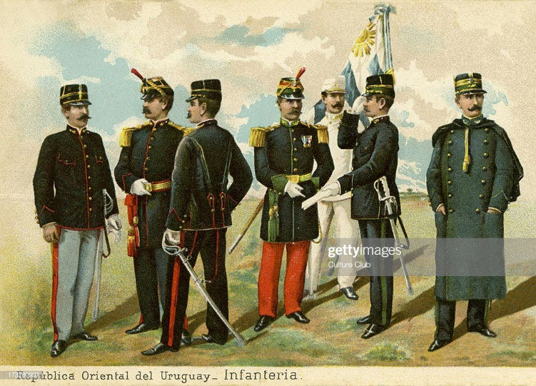
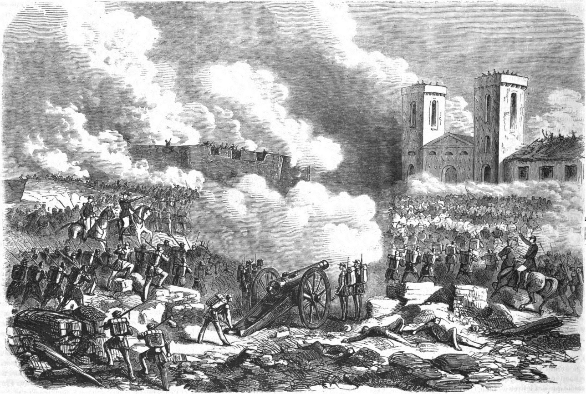

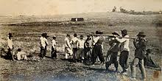

D. The Civil War of 1904
Civil War 1904
Political conflict between Reds and Whites, also conflict over border with Brazil, but mostly internal.
The Saravia brothers, gauchos, nacionalist-Whites revolted against liberal Reds and the Capital of Montevideo, defeated
Reds ratified their victory with general elections Jan. 1904
Post-war political agenda: constitutional reform
Nation destroyed/divided by civil war:
Sale of properties collapsed, marriages declined
4,787 in 1903 to 2,622 in 1904
Immigration declined from 9,880 in 1903 to 3,652 in 1904
Ranching exports, correspondence, everything declined
Batlle declared that future for Uruguay looked promising!
Foreign capital investment potential,
Refrigerator ships in 1904 ?Analyze importance to Uruguay…???

Slide 14
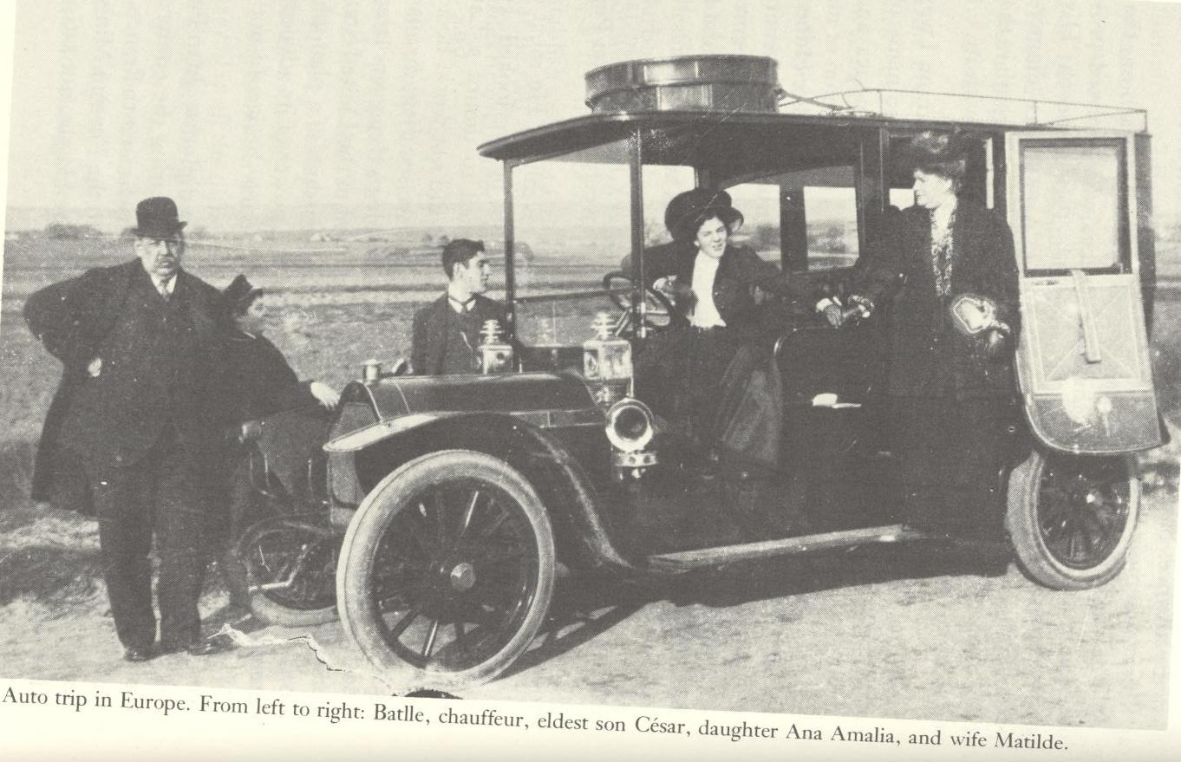
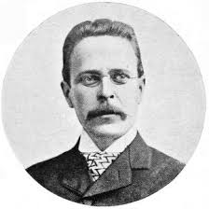
Interim Stage: Batlle family toured Europe 1908-1911
Pres. Claudio Williman, 1907-1911

Slide 15
Group Research Projects
Plan in groups
Questions, ideas, possibilities?

Slide 16
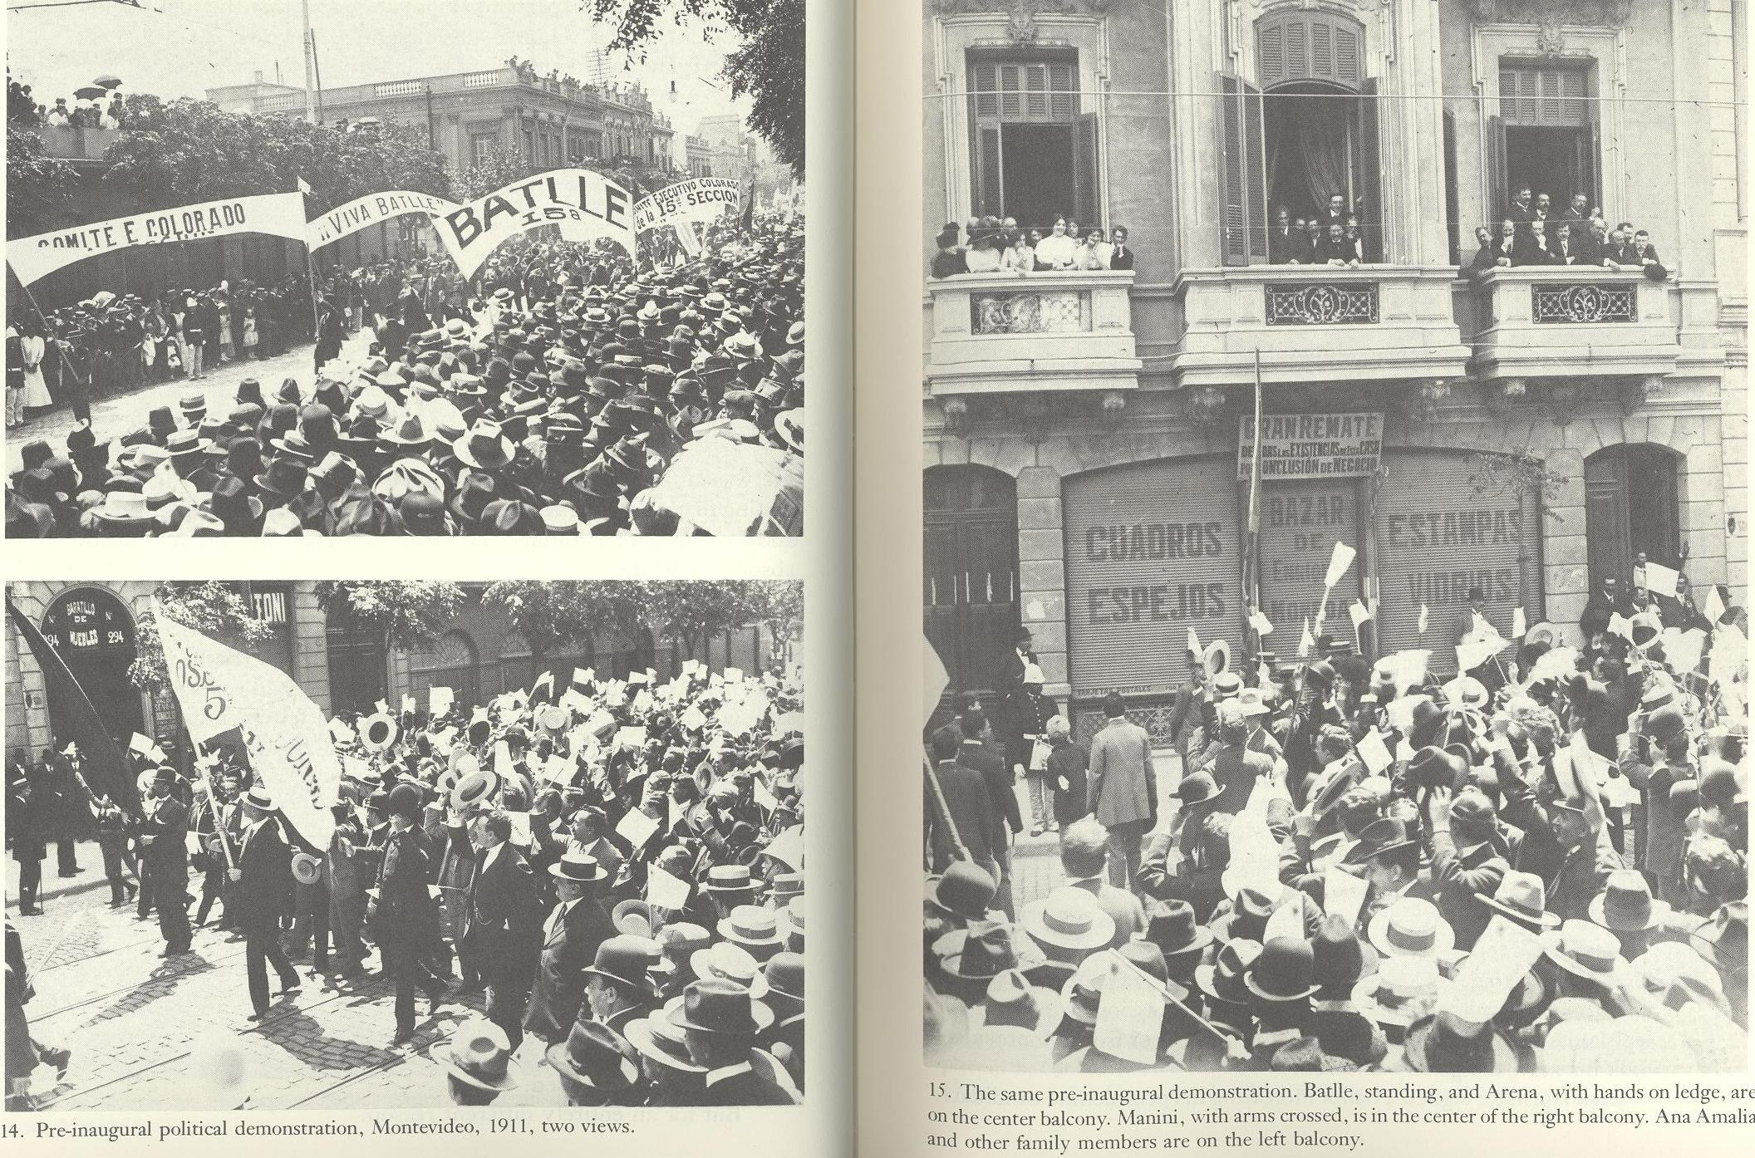
Elections 1811

Slide 17
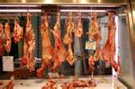
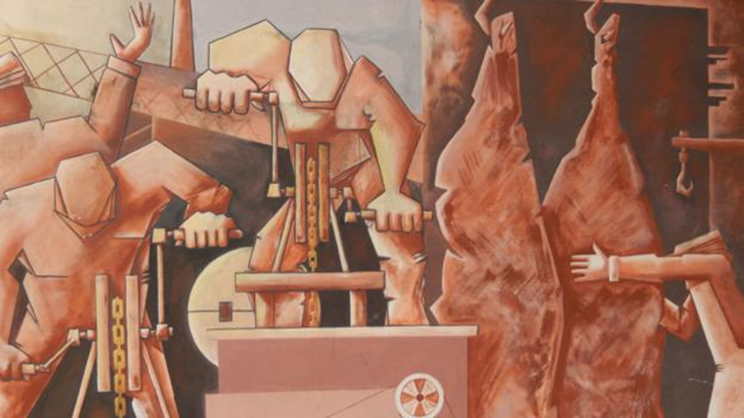
E. Second Term 1911-1915
Advanced Program Social Reforms: Uruguay becomes the
“main laboratory for social experimentation in the Americas and focus of world attention.”
8-hour work day
Retirement pensions
Minimum wage, social security, accidental death and injury insurance
Abolished death penalty
Separated Chruch and State
Education for women
Divorce
State capitalism controls banks, railroads, electrical grids, telegraph, trolleys, meat packing plants
Batlle supports labor strikes against foreign businesses
Yet did not address latifundia, nor extended social reforms to rural workers.
Analysis: why not?

Slide 18
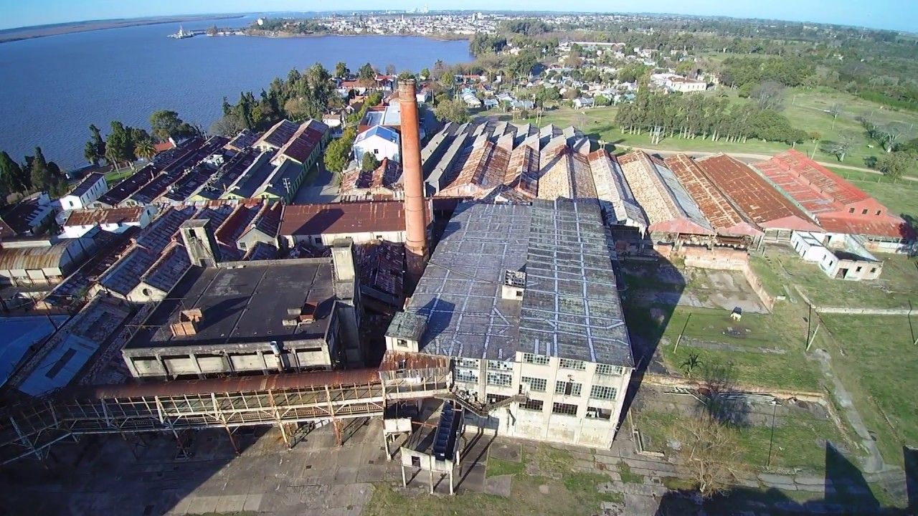
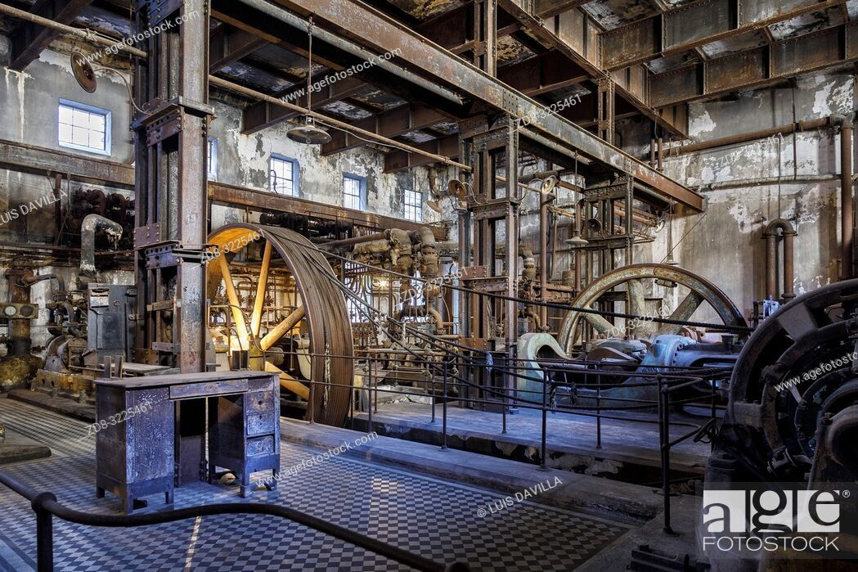
Ranching to meatpacking
ISI at Work

Slide 19
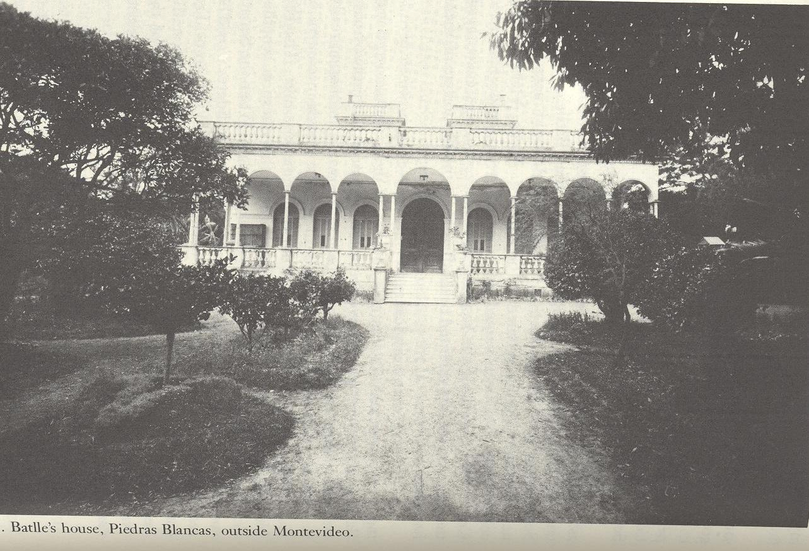

Slide 20
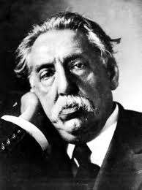

It is necessary for the poor to live better, to be content, not only to labor so that others enjoy the benefits of their work, that is what governments should be doing.

Slide 21
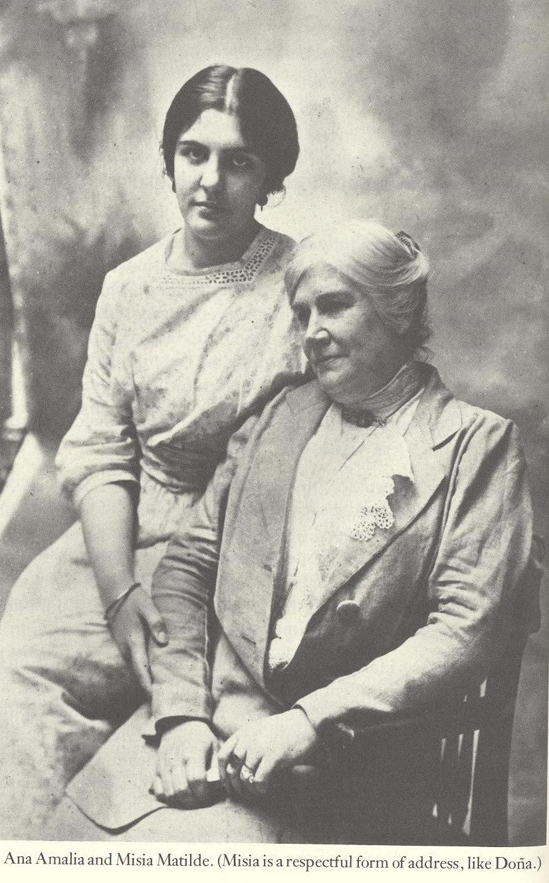

Slide 22
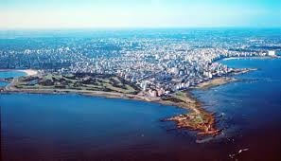
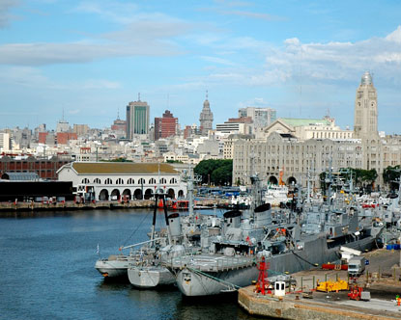
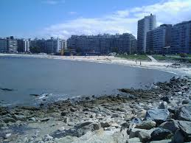
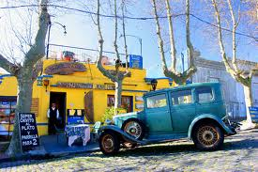
Uruguay today…

Slide 23
Class Activity: Synergetic Teaching
One table designs and explains lesson plan about Populism
One table designs and explains lesson plan about Uruguay
One table designs and explains lesson plan about Pres. Batlle
One table designs and explains lesson plan about Latin America before World War I
Five minutes of planning
Three minutes of presentation

Slide 24
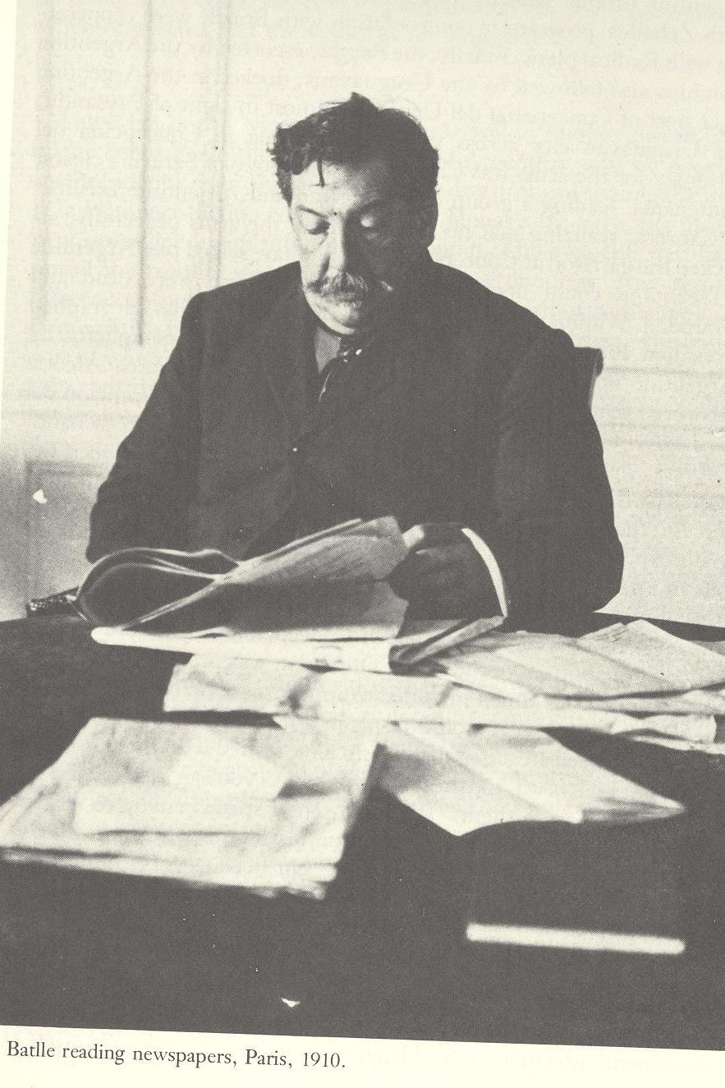
Conclusions
Importance of Battle’s administration?
For the Southern Cone?
Legacy of his populist rule?
What role do individuals play in
history?
Homework for Wednesday:
Read my chapter “Crossfire, Cactus and
Racial Construction, the Chaco War and
Indigenous Paper in Paraguay”
Short Paper 3: Using Heroes on Horseback,
Explain how Brazilian immigrants and
gauchos shaped the birth of modern
Uruguay in the early twentieth century.
Cite examples from the book to support
your argument.

