Slide 1
Radical Politics
Turn of the Century in the Southern Cone
What is the “Southern Cone”?

Slide 2
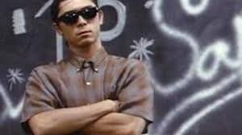
Fifth Latin American Film Festival
Tonight at 7 PM Greenbriar Theater
“Stand and Deliver”
HSA in attendance
5 pts. towards your participation grade in 2302
Give me a paragraph about the film after the film is finished, write name on paper to receive credit
Participation papers not accepted after tonight

Slide 3

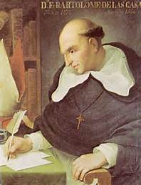
This Thursday, 27 Fe
Short Paper 3 due:
Explain the challenges Latin America faced in the nineteenth century. Thinking as an historian and drawing from Born in Blood and Fire and El Gaucho Juan Moreira, trace the colonial roots of these difficulties and assess what problems they posed for the future of the new modern nations in Latin America moving forward. How have Latin Americans themselves evaluated their situation and its historical causes? Be sure to use course sources and to cite them appropriately.

Slide 4
Radical Politics
Turn of the Century in the Southern Cone
How many of you identify with “Radical”?
TP: what does that mean?
SG: What are “Radical” Politics?
Contextualize concept in today’s politics
How do definitions and social norms change?
Why did Southern Nations see social tension by end of 19th Century?
Contrast Southern Cone to Central America
What political arrangement promised solutions?
How could urban workers improve their lives?

Slide 5
A. Radical Politics sweep the Southern Cone
Neocolonial boom to depression in 1890s: inflation rose
Urban middle classes tired of one-party rule
Protest movements gained ground
Remember huge influx of European migrants
Social results of migration to Brazil, Uruguay, Argentina, Paraguay
Official corruption alienated elite

Slide 6
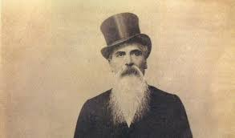
1. Argentina
Stock market collapse 1889, April cabinet resigned
Oligarchy revised state patronage, stabilized peso $
Dissident Leandro L. Além formed new party
Father had been chief of La Mazorca under Rosas
Radical Civic Union Party in Argentina 1890
Middle-class base for reforms
Além deported 1892, then revolted in 1893, then Suicide

Slide 7
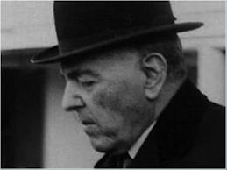
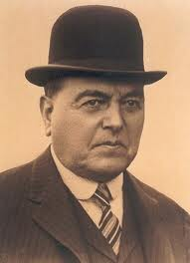
Hipólito Yrigoyen
Nephew Hipolito Yrigoyen president 1910
Yrigoyen once police superintendent in B. Aires
Vague political platform for diverse appeal
Represented dependent bourgeoisie (???)
Radical party did not champion industrialization
Cooperation landed aristocracy and urban sectors
Much more conservative than Batlle in Uruguay
Party grew due to children of immigrants
Universal and secret male suffrage 1912 to ally dependent working classes with landed aristocracy

Slide 8
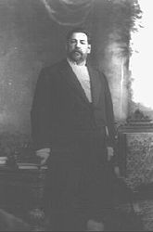
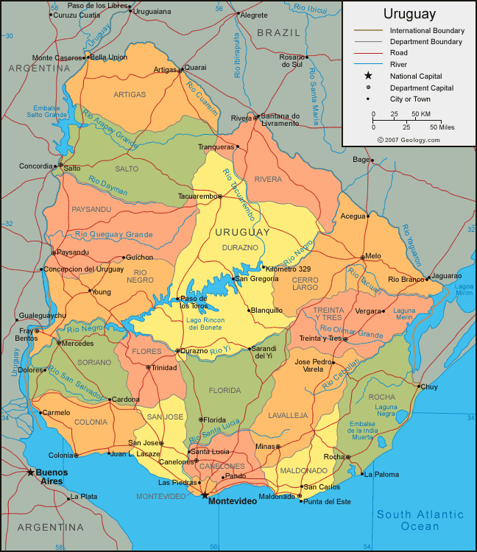
2. Uruguay
José Batlle y Ordoñez

Slide 9
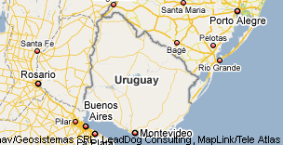
José Batlle y Ordoñez Radical Politics in the Southern Cone
President of Uruguay: 1902-1907, 1911-1915

Slide 10
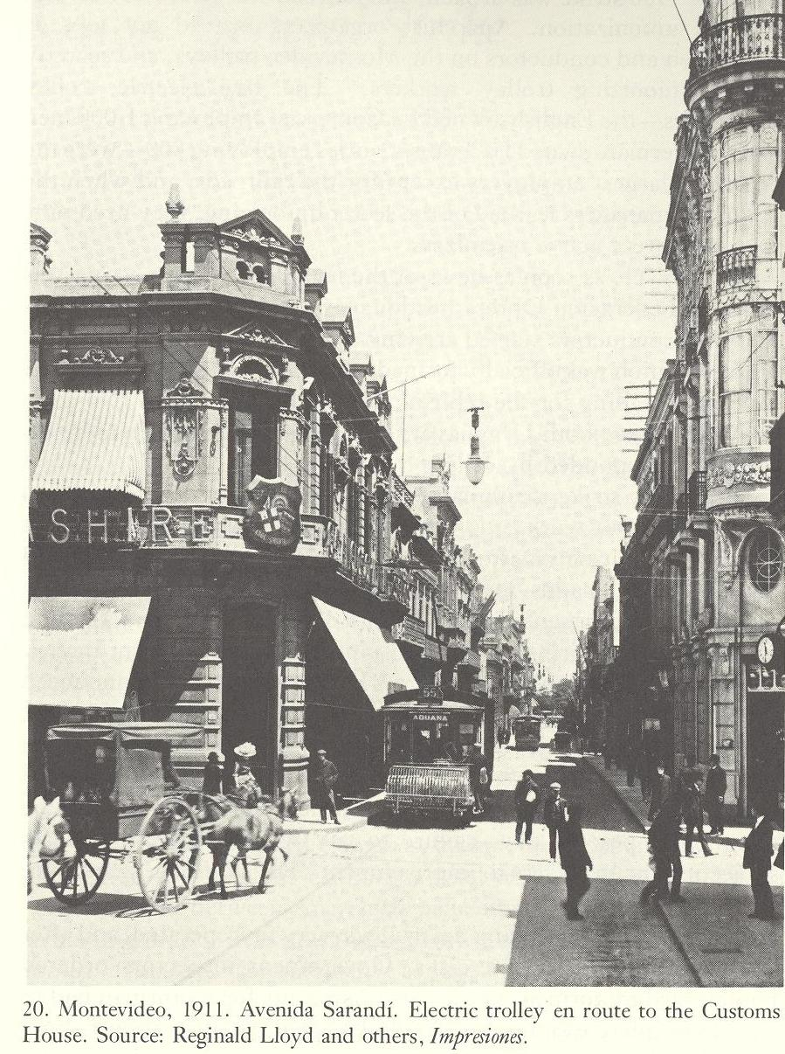
B. Uruguay in 1902
A Divided Nation
Colorados (Liberals)
& Blancos (Conservatives)
Nation focused on capital,
Montevideo
Healthy population, birth rate
high, secular society, but
Church-state relations quiet
Influence of Aparicio Saravia
Restored Nationalist Party
to prominence, commanded army

Slide 11
C. Batlle’s First Administration 1903-1907
“In the discharge of my functions I will do all I can to justify the confidence of those who voted for me, and to convince those who because of patriotic apprehensions-very respectable ones-have not desired to give me their votes, that they have incurred in error respecting my intentions and my ideas. If upon descending from this elevated position to which I now ascend, I descend with the affection and respect of all my fellow-citizens, regardless of party, I will have satisfied, so far as I am personally concerned, my greatest aspiration. I now toast—To the concord of the Uruguayan family.”
SG: analysis, what is most important in Uruguay?

Slide 12
First Term Legislative Agenda
As candidate, Batlle promised to limit government to non-controversial legislation
Colorados felt Blancos owed them elections
Contradiction between ideology and support base
Batlle’s progressive legislative policy favoring lower classes, progressive legislation for nation and especially for industry, infrastructure, export economy
Early example of Populist political agenda in S. Cone
Clearest early example of ISI
TP: What is ISI in Latin America?

Slide 13

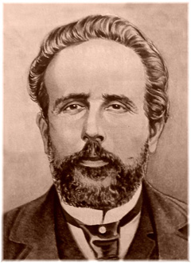
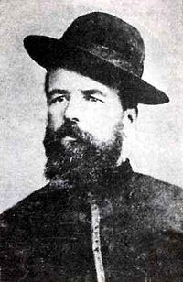

D. War of 1904
Civil War of 1904
Conflict b/w Colorados and Blancos, also conflict w Brazil
over borderland territory, but mostly an internal conflict
Saravia Brothers, Gumercindo & Aparicio gauchos, conservative nationalists-Blancos
revolution uprising against the Colorados (liberals) and capital of Montevideo
Colorados Ratify war victory through general elections in January 1904
Post-war agenda: Constitutional reform
But nation torn apart by the civil war:
property sales declined, marriages dropped 4,787 in 1903 to 2,622 in 1904
Immigration fell from 9,880 in 1903 down to 3,652 in 1904
Livestock, postal correspondence, all dropped
But forecast for future was promising.
Foreign capital available, refrigerated packing 1904

Slide 14
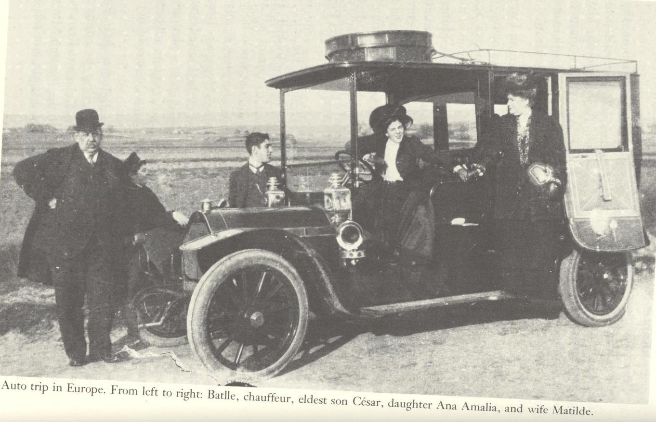
Batlle Family in Europe 1908-1911

Slide 15
F. Historical Sources
Chasteen: Blood and Fire, Ch. 7, Neocolonialism
Today’s Class Activity: “Everyone is a teacher here”
Receive an index card
Write down one question you had about the reading
Put your name on the back
Collect cards, shuffle, distribute one to each student
Read the question silently and think of a response
Volunteers read the question and give a response
Other students contribute to the answer given

Slide 16
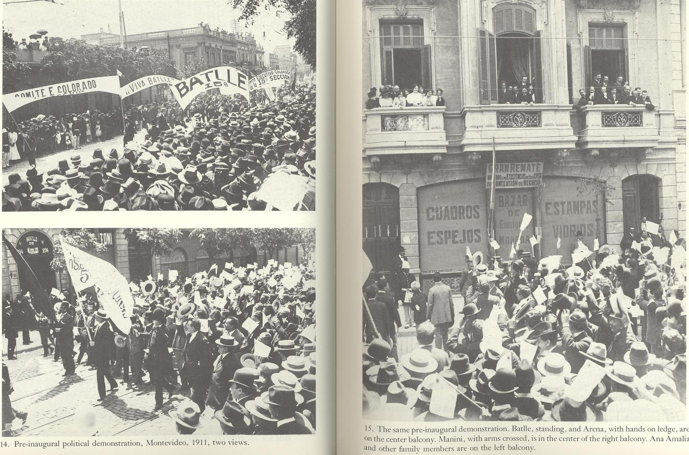
Election of 1911

Slide 17
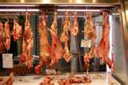
E. Second Term 1911-1915
Advanced Program of Social Reform that made Uruguay the
“Chief laboratory for social experimentation in the Americas and a focal point of world interest”
8-hour work day, -old-age pensions
Minimum wages. -accident insurance
Abolishment capital punishment
Separation of church and state
Education for women
Recognition of divorce
State capitalism that brought banks, railroads, electric systems, telephone & telegraph, street railways, meat-packing, all under state control
Batlle supported labor in its strikes against foreign-owned enterprises
Batlle did not challenge land monopoly of great ranchers, refused to apply social legislation to their peons TP: why not?

Slide 18
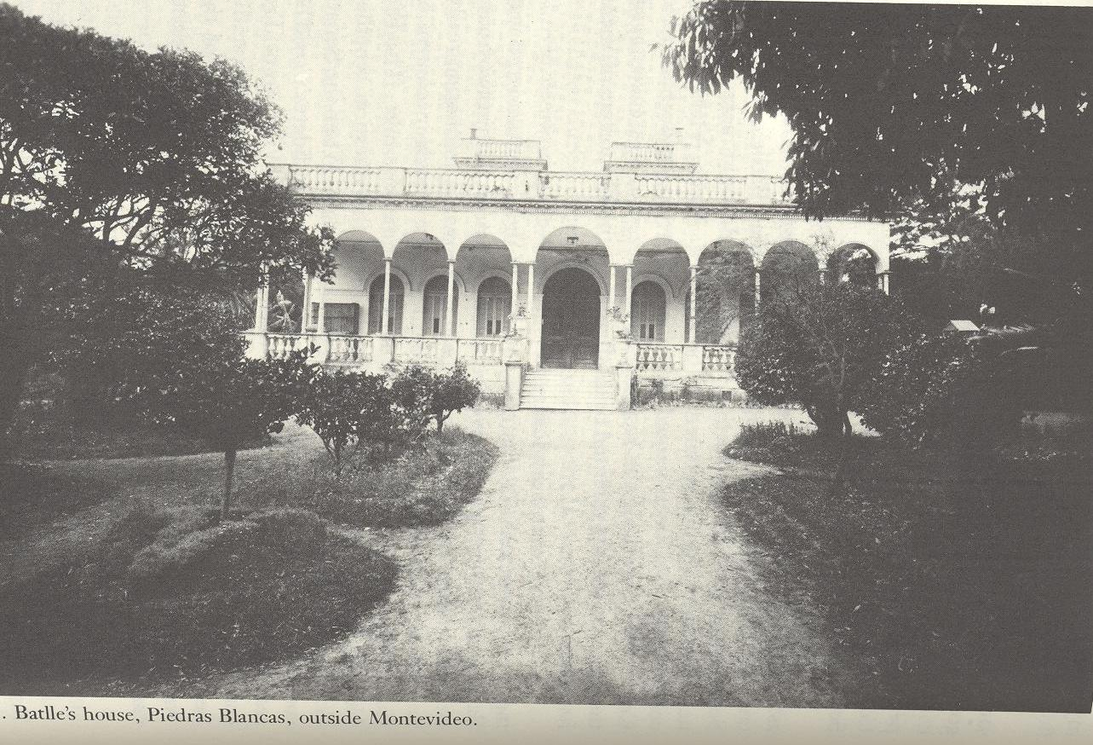

Slide 19
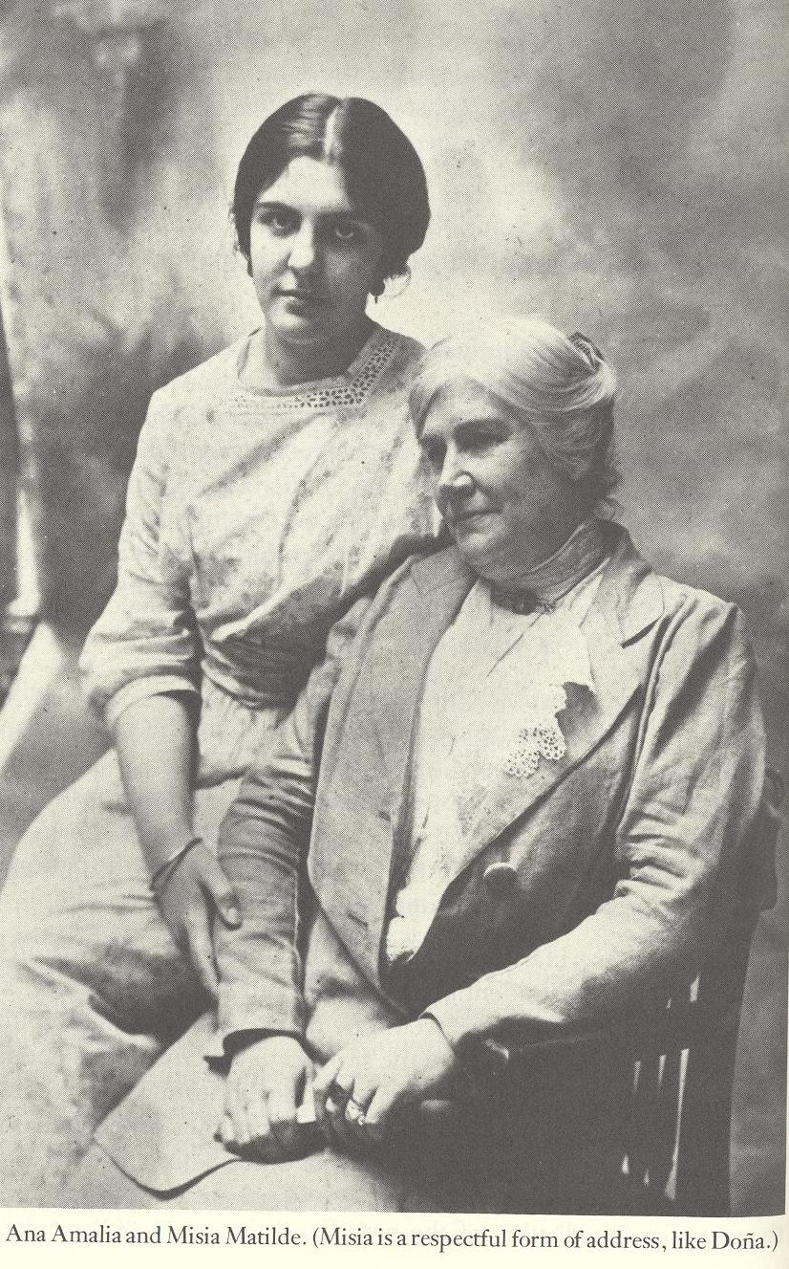

Slide 20
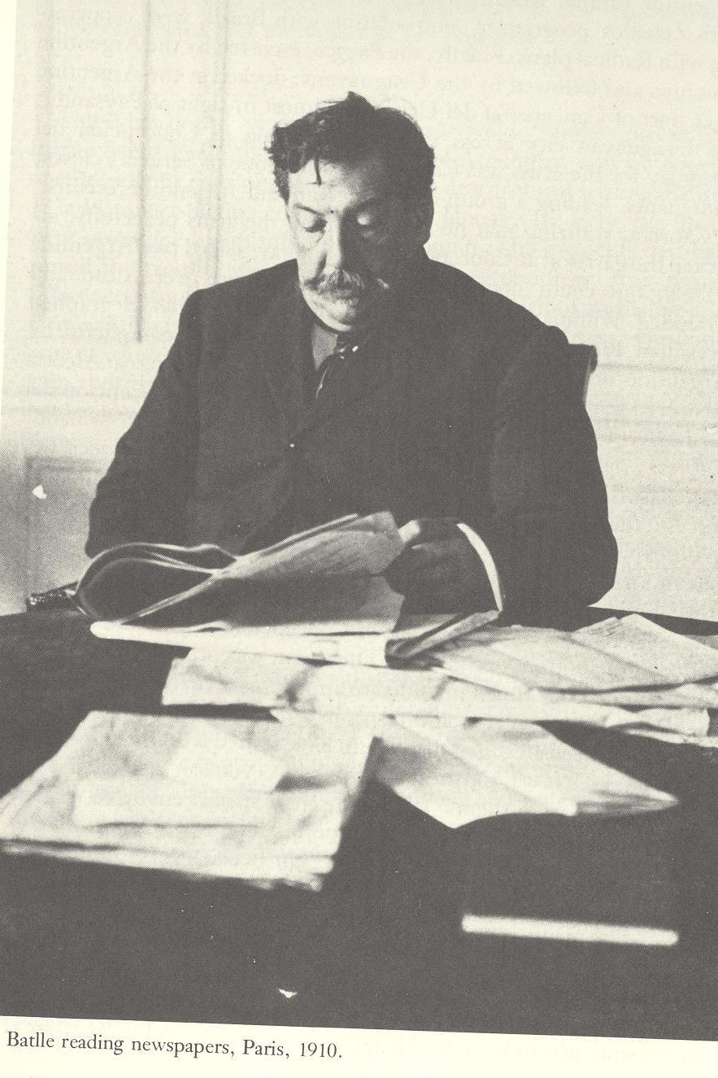
Conclusions and Assessment
What did you learn?
Significance of the Battle terms
Liberal rule in Uruguay and
Southern Cone?
Future of Populism?
Individuals in History?

