Slide 1
Modern Latin America
His 2302
Exam 1 Preparation
Sign Attendance Sheet Please

Slide 2
a. Preparation for Exam 1
1. Review of Source Reading Materials
2. Review of Course Content
3. Exam: bring exam booklet from bookstore and a pen
4. Information Sheet: Only One side of one/half sheet of paper: 8.5” x 5.5”
4. Three sections: Map items 20 pts., 5 of 6 Ids 30 pts., Essay 50 pts.
4. Review of Map content: Geographic features, Political Divisions posted on the Course Requirements Page on ASULEARN
Blank Map template is also on ASULEARN in block for Exams 1 & 2

Slide 3
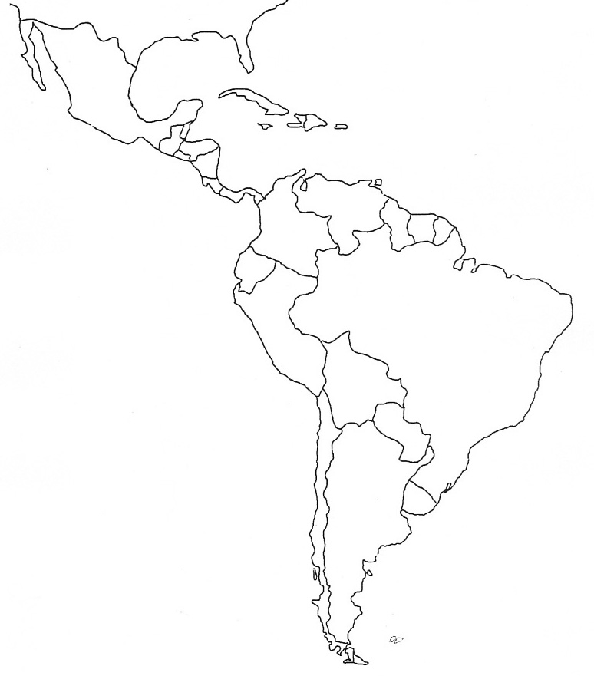
B. Map Features for Exam 1 2302 (Requirements) Physical
10 items in exact location… surround regions
Geographic Features
Rio Grande Amazon River The Bahamas
Orinoco River Paraná River Yucatan Peninsula
Andes Mts. Brazilian Highlands Panama Canal
Malvinas Is. Tierra del Fuego Lake Titicaca
Please learn exact course of the rivers (you will need to draw them on the exam map, so put them on your cheat sheet)
Modern Political Divisions
Mexico Belize Argentina Dominican Republic
Guatemala Nicaragua Costa Rica Chile Cuba
El Salvador Colombia Venezuela Ecuador Panama
Peru Guyana Surinam French Guiana
Bolivia Brazil Uruguay Paraguay Haiti

Slide 4
D. identifications
Exam 1 Prep Word Cloud Identifications
Create a Class Word Cloud with Id’s from our Classes, Readings, Films
Ids will include people, institutions, events, dates, theoretical concepts, ideas
SG of 4: Identify ten ids
Take turns contributing items to word cloud on whiteboard until all ID’s are listed and contour is revealed
Use the entire whiteboard please
The final shape must resemble Latin America!

Slide 5
e. Essays
Exam 1 will have one essay to answer. Use the keyhole essay format.
Clearly state your essay thesis argument at end of first paragraph: “This essay will argue that…”
In the main essay body provide historical evidence to support your thesis argument…
At the end of your exposition admit a counter argument and defeat it
Open the concluding paragraph with your thesis argument
Conclude with general statements…

Slide 6
Essay Practice
Small group of 5 people
Identify a subject of interest covered so far in class sessions and readings
Write an essay question about the subject.
Write your essay question on the board.
Create a thesis argument for one question of choice
Compile supportive evidence for argument
Admit and defeat counter-argument
Restate thesis argument and conclude with general statements

Slide 7
F. Class Assessment and Final questions
Did this class adequately inform you about Exam 1 content?
Any final questions about our exam on Thursday?

