Slide 1
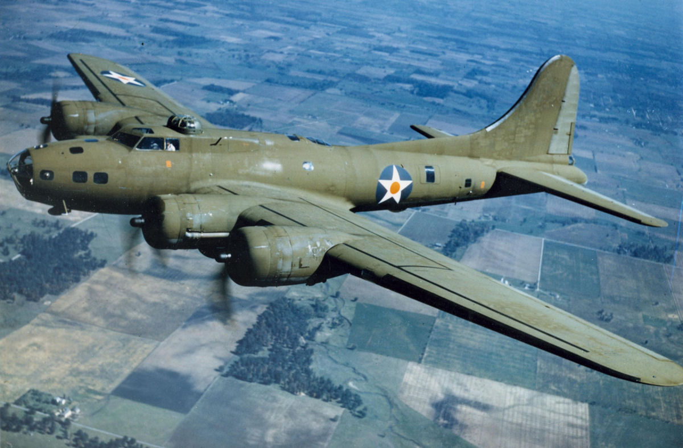
B-17 Flying Fortress

Slide 2
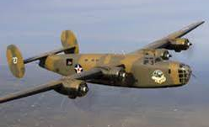
B-24 Liberator

Slide 3
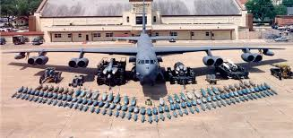
B-52 Stratofortress

