Slide 1
Coordination Chemistry – compounds made up of metals that are covalently bound to other molecules or ions
Ligands – molecules (or ions) that donate both electrons to the metal and form a coordinate covalent bond
coordinate covalent bond – covalent bond formed between a ligand and metal where both electrons in the covalent bond originate from the ligand

Slide 2
Typical representation of a coordination compound. The NH₃ are ligands that covalently bind to the transition metal ion. Brackets often designate the ligands that are covalently bound.
arrows represent the donation of lone pairs of electrons from the ligand metal ion in the formation of coordinate covalent bonds

Slide 3
Coordination Compound – compounds made up of ligands that are covalently bound to a transition metal
Coordination Number – number of covalent bonds to the central transition metal element
Coordination Sphere – area where the ligands are attached to the transition metal

Slide 4
inner sphere
Coordination Sphere

Slide 5
Cl⁻
Cl⁻
outer sphere
Cl⁻
complex – charged coordination compounds
[Co(NH₃)₆]³⁺
[Co(NH₃)₆]Cl₃

Slide 8
[Co(NH₃)₆]Cl₃
hexaamminecobalt(III) chloride
[Cu(NH₃)₄]Cl₂
tetraamminecopper(II) chloride
[Cr(NH₃)₄Cl₂] NO₃
tetraamminedichlorochromium(III) nitrate
[Ni(CO)₄]
tetracarbonylnickel(0)

Slide 10
[Co(en)₂Br₂]I
dibromobis(ethylenediamine)cobalt(III) iodide
[Ru(Cl)(CN)(H₂O)₂(NH₃)₂]Cl₃
diamminediaquachlorocyanoruthenium(V) chloride

Slide 11
When the coordination complex is negative, that is, [complex]⁻, the metal gets an “–ate” ending
Zn  zincate Ni  nickelate
V  vanadate (drop “–ium” ending)
Pt 
platinate
Co 
cobaltate
Cr 
chromate

Slide 12
Some metals get the historical Latin name with an “–ate” ending (complex is negative, [complex]⁻ )
Cu  cuprate Fe  ferrate
Ag  argentate Sn  stannate
Au  aurate Pb  plumbate

Slide 13
Na[CoCl₄]
sodium tetrachlorocobaltate(III)
tetraammineaquachloroiron(III) nitrate
[Fe(NH₃)₄(H₂O)Cl](NO₃)₂
Na₂[Sn(OH)₆]
sodium hexahydroxostannate(IV)

Slide 14
[Ir(en)₂(NH₃)₂](NO₃)₃
diamminebis(ethylenediamine)iridium(III) nitrate
tetraammineplatinum(IV) hexachloroplatinate(IV)
[Pt(NH₃)₄] [PtCl₆]₂

Slide 15
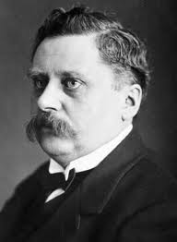
Alfred Werner
1866 - 1919

Slide 16
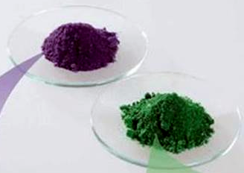
CoCl₃ ∙ 4NH₃
2 distinct compounds
CoCl₃ ∙ 4NH₃
+ 1 AgNO₃
1 AgCl
[Co(NH₃)₄Cl₂]Cl

Slide 17
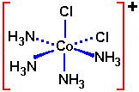
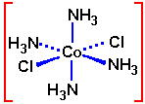


[Co(NH₃)₄Cl₂]Cl
green
purple

Slide 18
Various types of coordination compound isomers
1. Geometric isomers – ligands that differ only in spatial arrangement

Slide 19
MA₂B₄ octahedral exhibits two geometric isomers
cis and trans
tetraammine-cis-dichlorocobalt(III) chloride
tetraammine-trans-dichlorocobalt(III) chloride

Slide 20
MA₃B₃ octahedral exhibits two geometric isomers
facial (fac) and meridional (mer)

Slide 21
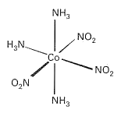
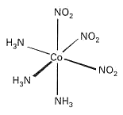
mer-triamminetrinitrocobalt(III)
fac-triamminetrinitrocobalt(III)

Slide 22
MA₂B₂ exhibits two geometric isomers when geometry is square planar

Slide 23

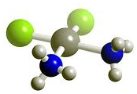
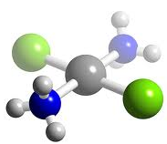

cis-diamminedichloroplatinum(II)
trans-diamminedichloroplatinum(II)

Slide 25
2. Coordination isomers – both cation and anion are coordination complexes but vary in ligands or central element
[Co(NH₃)₆] [Cr(CN)₆] vs. [Cr(NH₃)₆] [Co(CN)₆]
both have same empirical formula: CoCr(NH₃)₆(CN)₆
[Co(NH₃)₅(CN)] [Cr(NH₃)(CN)₅] vs. [Co(NH₃)₆] [Cr(CN)₆]

Slide 26
3. Hydrate isomers – water is interchanged from inner sphere to outer sphere
[Cr(H₂O)₆]Cl₃ - purple
[Cr(H₂O)₅Cl]Cl₂ · H₂O - blue-green
[Cr(H₂O)₄Cl₂]Cl · 2H₂O - dark green

Slide 27
[Cr(H₂O)₆]Cl₃
hexaaquachromium(III) chloride
[Cr(H₂O)₅Cl]Cl₂ · H₂O
pentaaquachlorochromium(III) chloride hydrate
[Cr(H₂O)₄Cl₂]Cl · 2H₂O
tetraaqua-cis-dichlorochromium(III) chloride dihydrate

Slide 29
4. Linkage isomers – a ligand can coordinate to a metal in more than one way
ambidentate – ligands that have the ability to coordinate to a metal through different atoms
thiocyanate, SCN ⁻ and nitrite, NO₂⁻
M-SCN named S-thiocyanato or thiocyanato
M-NCS named N-thiocyanato or isothiocyanato

Slide 30
nitrite, NO₂⁻
M
nitro
nitrito
M

Slide 31
[Co(NH₃)₅(ONO)]²⁺
[Co(NH₃)₅(NO₂)]²⁺
pentaamminenitritocobalt(III)
pentaamminenitrocobalt(III)

Slide 32
5. Optical isomers – complex is chiral and will rotate a plane of polarized light
all tris-chelates are D₃ and thus chiral

Slide 33
Both enantiomers
of [Co(en)₃]³⁺
Δ-tris(ethylenediamine)cobalt(III)
( look down C₃ axis; turn right, drills into ground - Δ )
λ-tris(ethylenediamine)cobalt(III)
( look down C₃ axis; turn left, drills into ground - λ )

