Slide 2
An ideal lattice structure
ΔH favored but ΔS is not favored

Slide 3
Lattice structure with a defect
ΔH is slightly less favored
but ΔS is slightly more favored

Slide 4
Lattice defects
1. Schottky defect - involves vacant cation and anion lattice sites

Slide 6
AgBr structure where Ag⁺ is gray and Br⁻ is gold
Ag⁺ in a lattice site
Ag⁺ in an interstitial site
interstitial site – a position that is NOT a normal lattice site
2. Frenkel defect – ion (usually a cation) found in an interstitial site

Slide 7
trapped electron
3. F-center defect – a trapped electron in an anion site
doping – intentionally introducing impurities

Slide 8
empirical formula of FeO is actually Fe_{0.95}O
A cationic lattice site is missing an Fe²⁺ while two other cationic lattice sites contain Fe³⁺ species. Note: Charge neutrality is maintained but Fe to O ratio is not 1:1.

Slide 9
4. Non-stoichiometric compounds – ions do NOT exist in whole number ratios
occurs frequently with metals that have 2 common oxidation states: Fe²⁺ / Fe³⁺

Slide 10
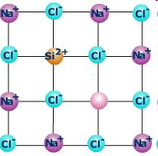
vacant lattice site
Another type of Non-stoichiometric crystal defect where a missing Na⁺ cation is charge balanced by a different, higher charged Si²⁺ cation. Note: Charge neutrality is maintained but Na⁺ and Cl⁻ are no longer in a 1:1 ratio.

Slide 11
Intrinsic silicon
silicon atoms are held together by an
extended network of covalent bonds
start with 99.9999999% pure silicon

Slide 12
Intrinsic silicon
doping – intentionally introducing impurities
introduce a small amount of As, arsenic impurity
(1 As per 1,000,000 Si)

Slide 13
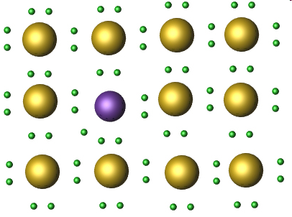
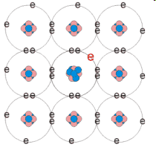
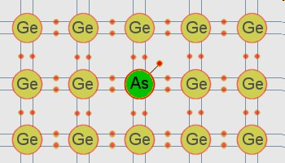
n-type semiconductor
As has 5 valence electrons vs. 4 valence electrons for Si
gold = Si; purple = As

Slide 14
n-type semiconductor – excess electrons move through the silicon network when a voltage is applied

Slide 15
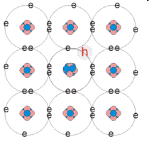
p-type semiconductor
B has 3 valence electrons vs.
4 valence electrons for Si
“positive hole” moves in opposite direction of electron flow
p-type semiconductor – “positive holes” move through the silicon network when a voltage is applied

Slide 16
metallic bonding – a lattice of metal cations held together by a “sea of electrons”
gray sphere = positively charged metal cation
yellow sphere with black line = delocalized valence electrons

Slide 17
e⁻ = delocalized electrons
+ = metal cations
“sea of valence electrons”
are delocalized and
somewhat mobile

