Slide 2
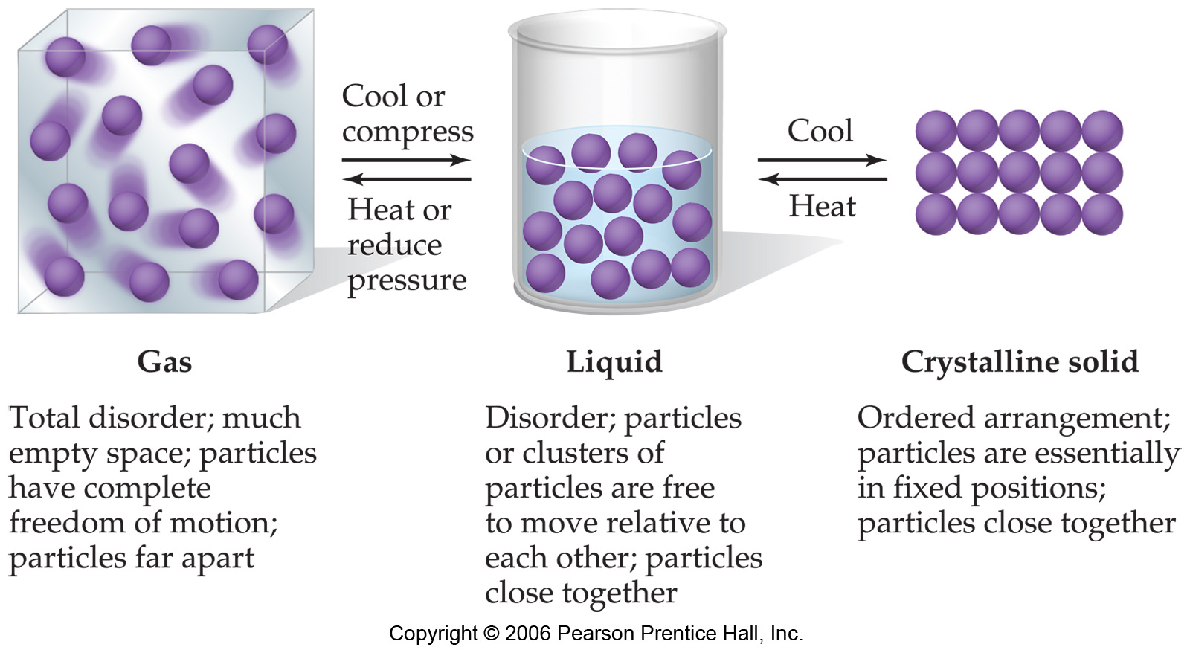
Notes:
Figure: 11-01
Title:
Molecular-level comparison of gases, liquids, and solids.
Caption:
The particles can be atoms, ions, or molecules. The density of particles in the gas phase is exaggerated compared with most real situations.

Slide 3
iron pyrite, FeS₂ fluorite, CaF₂ amethyst, SiO₂

Slide 4
ionic bonds – ions are held together by electrostatic attractions between unlike charges

Slide 5
3-dimensional crystal lattice structure – a repetitive sequence of ions in an extended array

Slide 6
ball and stick model Space filling model

Slide 7
crystalline solids – ions (or atoms) ordered in very well defined places
noncrystalline solids – ions (or atoms) exhibit less order than a crystalline solid
(amorphous solids)

Slide 8
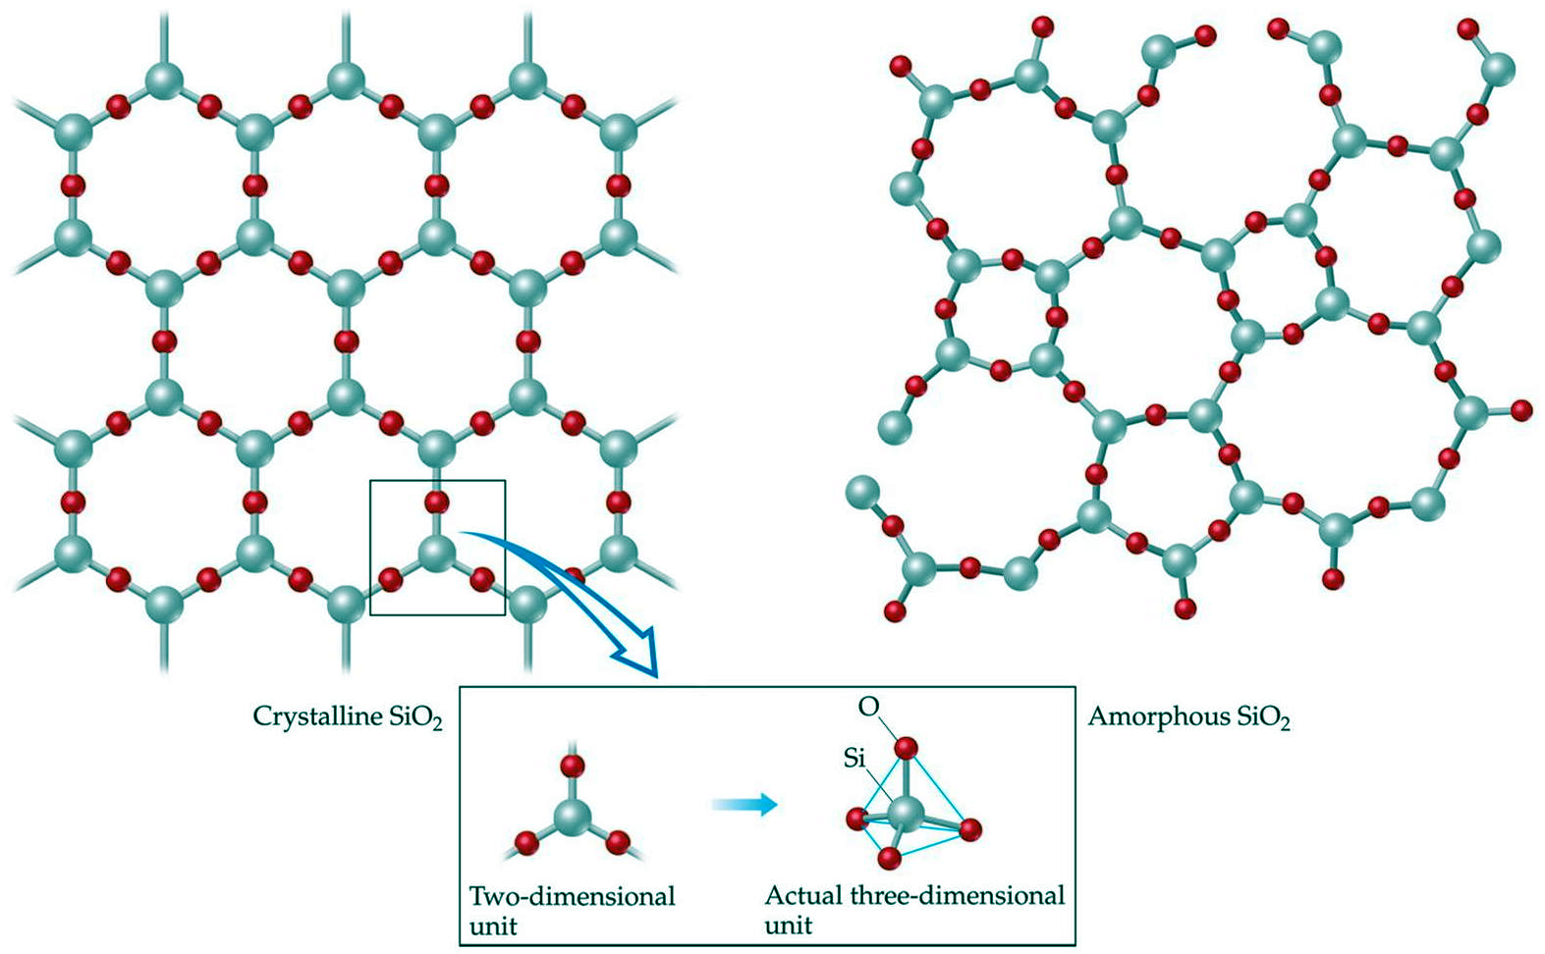

Slide 9
Unit Cell – The smallest part of a 3-d crystal lattice structure, when stacked together, reproduces the entire, macroscopic crystal

Slide 11
1. primitive cubic – unit cell has lattice points on the corners of a cube
(simple cubic)

Slide 12
2. Face centered cubic, FCC – unit cell has lattice points on the corners of a cube and center of each face
(rock-salt structure)

Slide 13
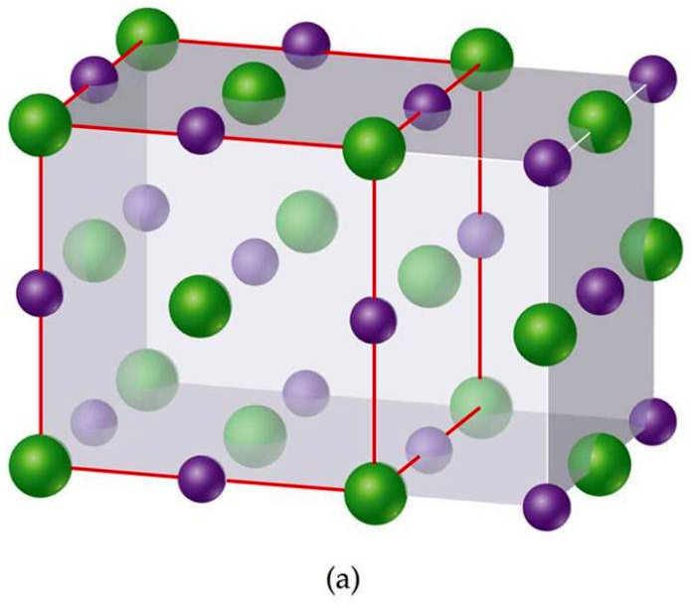
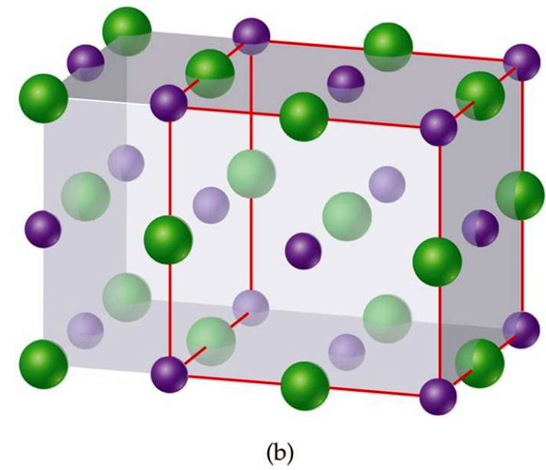
Two correct ways to identify a unit cell for NaCl
(a) Cl anions as lattice points
(b) Na cations as lattice points

Slide 14
Face-centered cubic (fcc)

Slide 15
Best representation of unit cell for NaCl (exhibits fcc)

Slide 16
3. body centered cubic, BCC – unit cell has lattice points on the corners of a cube and directly in the center
(cesium chloride structure)

Slide 17
Body-centered cubic (bcc)

Slide 18
Zinc Blende (or sphalerite) structure
4. zinc blende structure – unit cell has lattice points as FCC (black) and another lattice point with ½ tetrahedral holes occupied (gold)
(sphalerite)

Slide 19
Fluorite structure (MX₂)
5. fluorite structure – unit cell has lattice points as FCC (red-cation) and another lattice point with all tetrahedral holes occupied (green-anion)

Slide 20
Antifluorite structure (M₂X)
6. antifluorite structure – unit cell has lattice points as FCC (red-anion) and another lattice point with all tetrahedral holes occupied (green-cation)

Slide 21
Perovskite structure
7. perovskite structure – complicated unit cell with three different lattice points, often called ABX₃

Slide 22
Body-centered cubic
(cesium chloride)
Fluorite (or antifluorite)
Zinc Blende
(sphalerite)

Slide 23
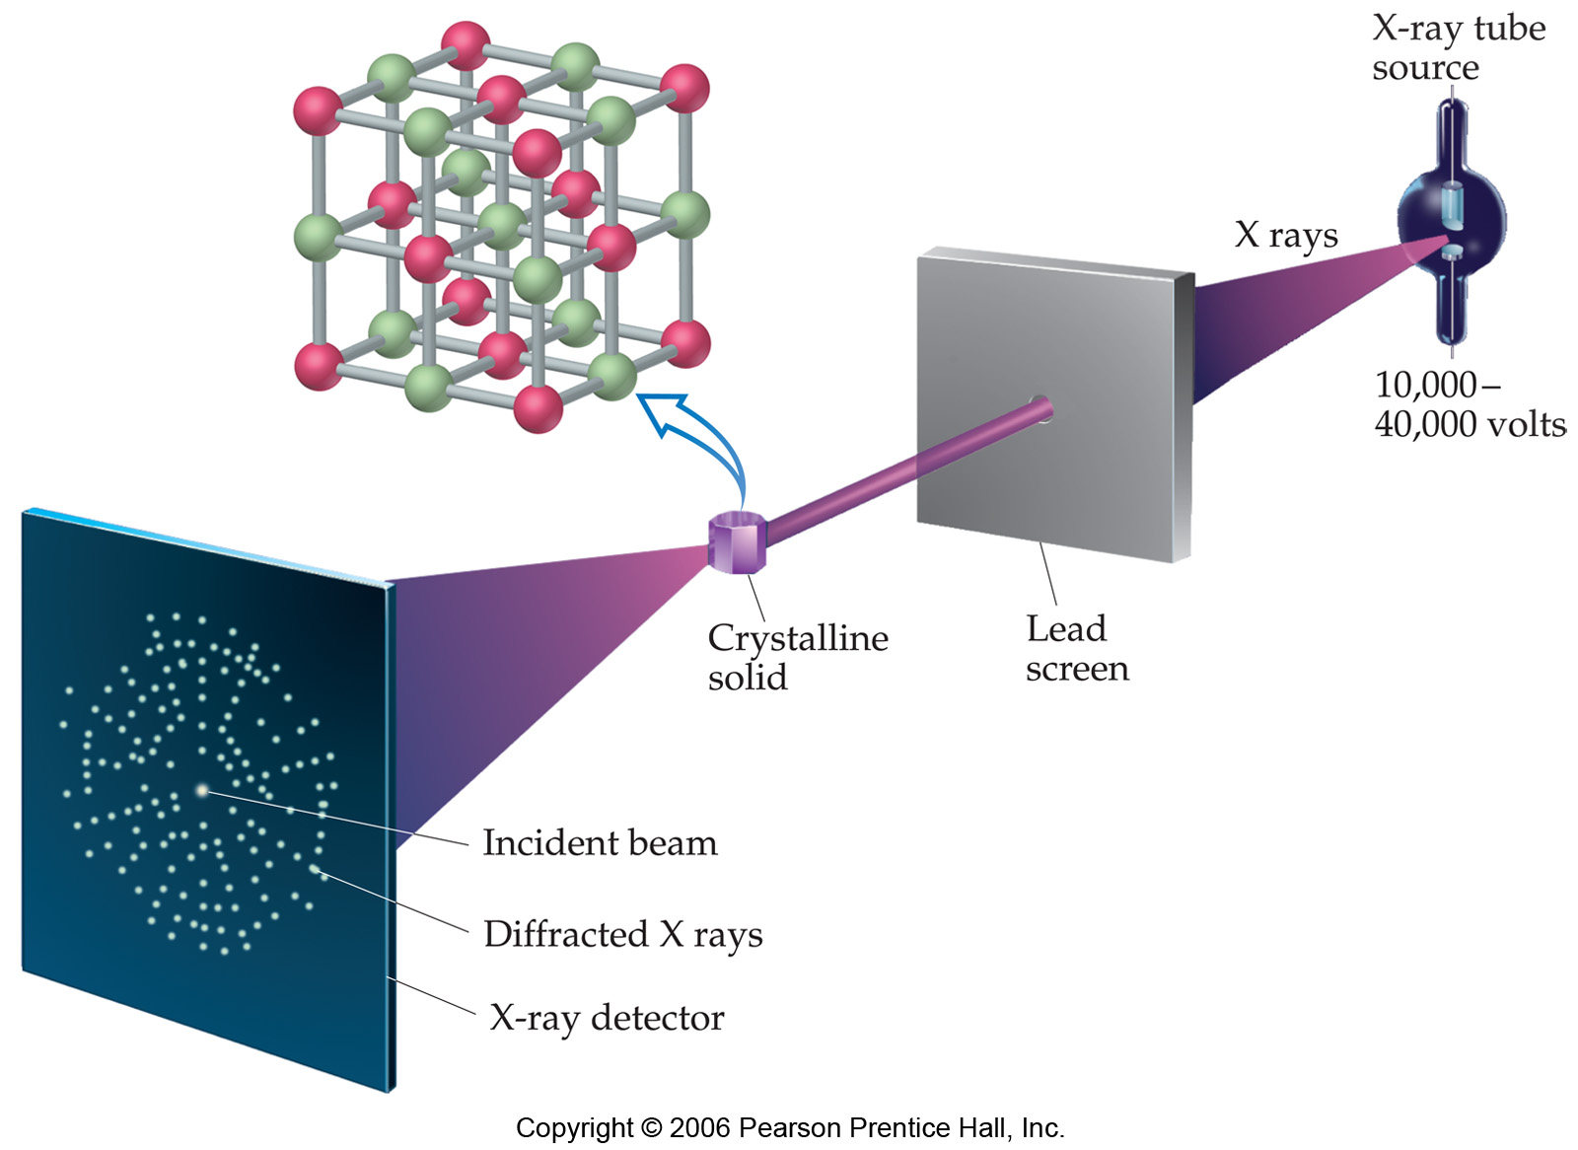
Notes:
Figure: 11-38
Title:
Diffraction of X rays by a crystal.
Caption:
In X-ray crystallography, an X-ray beam is diffracted by a crystal. The diffraction pattern can be recorded as spots where the diffracted X rays strike a detector, which records the positions and intensities of the spots.

Slide 24
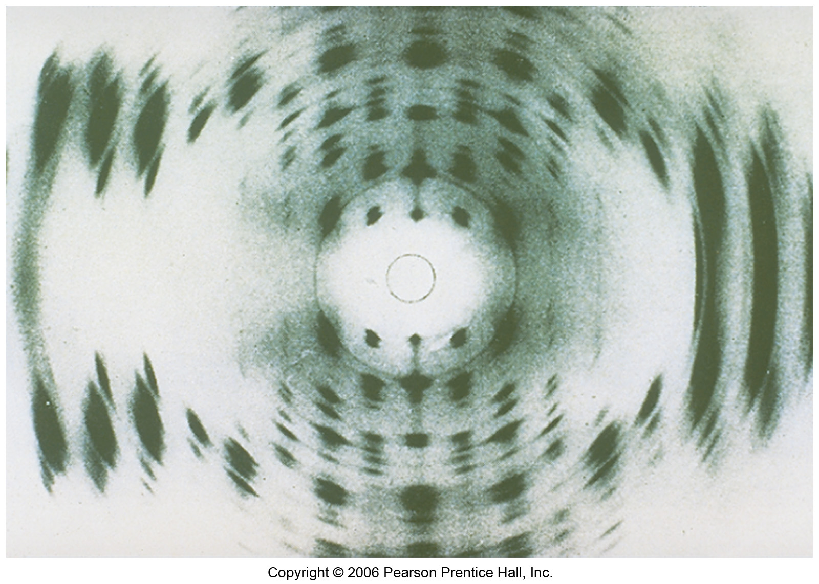
Notes:
Figure: 11-39
Title:
The X-ray diffraction photograph of one form of crystalline DNA.
Caption:
This photograph was taken in the early 1950s. From the pattern of dark spots, the double-helical shape of the DNA molecule was deduced.

Slide 25
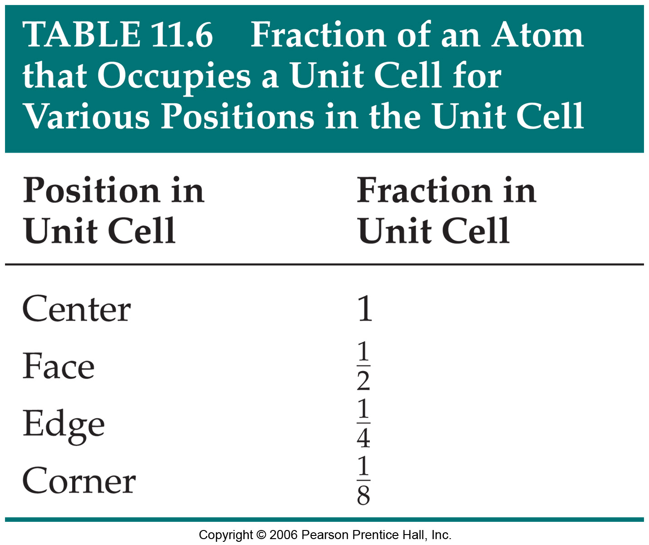
Notes:
Figure: 11-T06
Title:
Table 11.6
Caption:
Fraction of an Atom That Occupies a Unit Cell for Various Positions in the Unit Cell

Slide 26
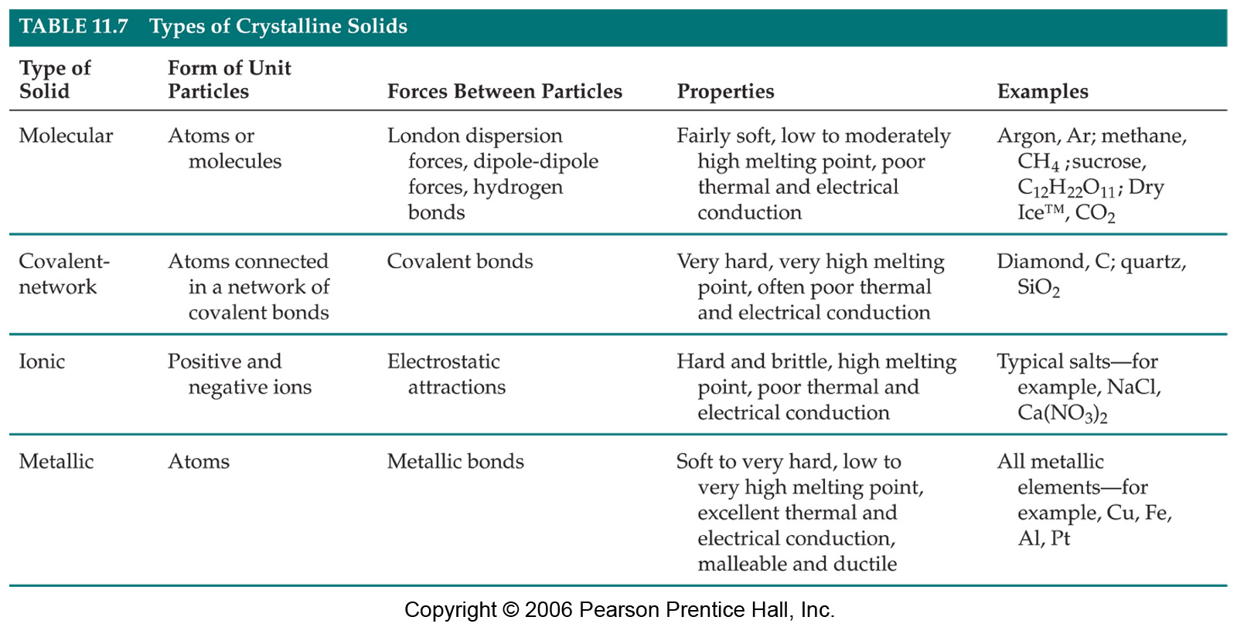
Notes:
Figure: 11-T07
Title:
Table 11.7
Caption:
Types of Crystalline Solids

