Slide 1
Valence Bond theory (VB theory) – atomic orbitals from different atoms overlap to form covalent bonds

Slide 2
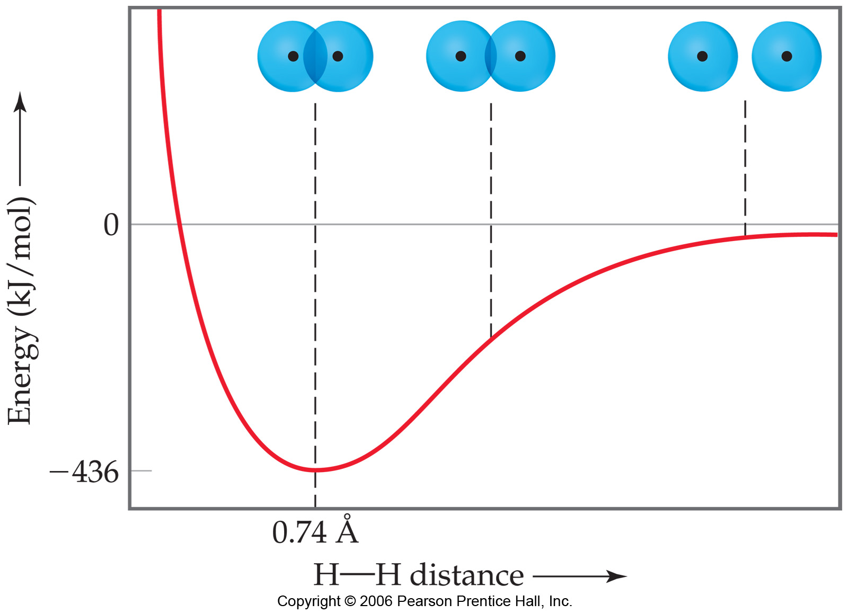
Notes:
Figure: 09-15
Title:
Formation of the H₂ molecule.
Caption:
Plot of the change in potential energy as two hydrogen atoms come together to form the H₂ molecule. The minimum in the energy, at 0.74 Å, represents the equilibrium bond distance. The energy at that point, -436 kJ/mol, corresponds to the energy change for the formation of the H—H bond.

Slide 3
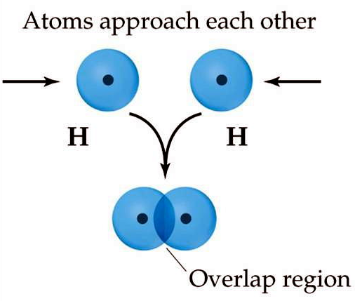
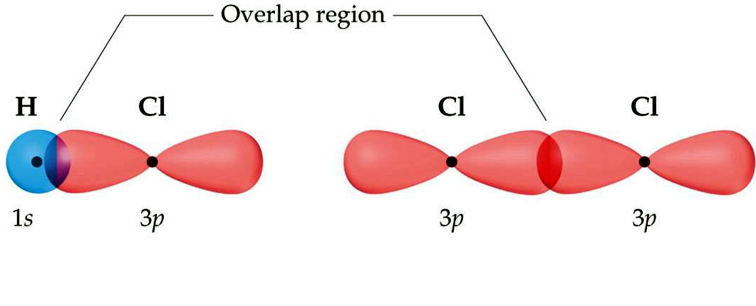

Slide 4
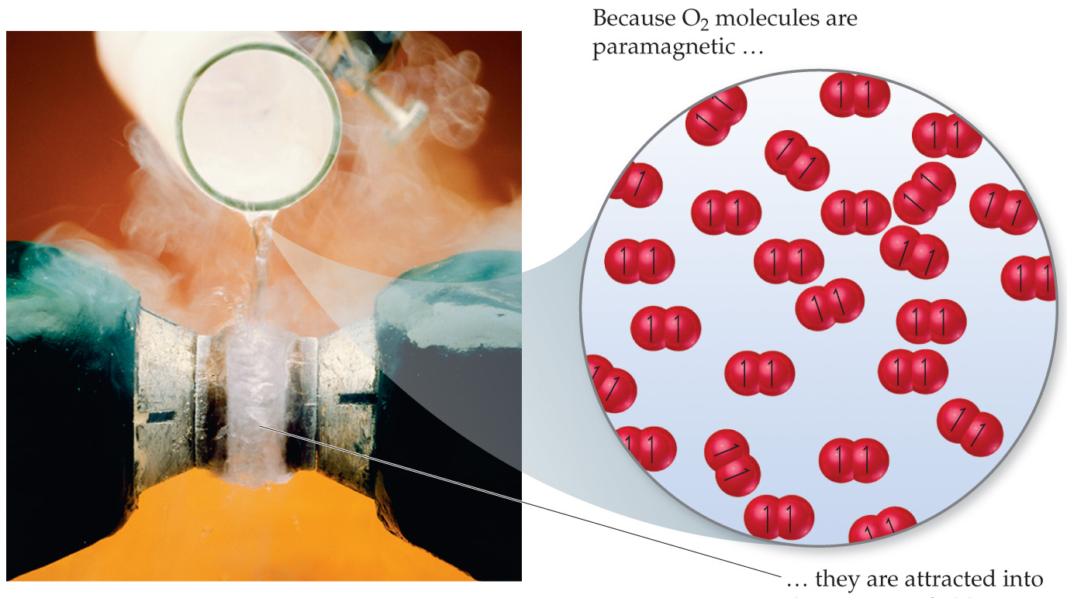

Slide 5
Molecular Orbital theory (MO theory) – the combination of purely atomic orbitals on different atoms form new, molecular orbitals which belong to the entire molecule
Advantages: Accurately describes many known chemical species
Disadvantages: Entirely quantum mechanical wave function mathematics. Thus, a simple conceptual picture is difficult to grasp.

Slide 6
Notes:
Figure: 09-14

Slide 7
When the H atoms are brought together, the wave functions, ψ, describing the atomic orbitals on each atom interact (or “mix”)…… they combine to form new wave functions, called molecular orbitals
The new wave functions, ψ, are no longer atomic in nature, but rather molecular and belongs to the molecule itself rather than individual atoms
The process of “mixing” the atomic wave functions to form new molecular wave functions is entirely mathematical
Linear Combination of Atomic Orbitals, LCAO

Slide 8
symmetry labels – the algebraic sum of the angular momentum part of the wavefunction of the orbital lobes
s-orbitals have same symmetry labels everywhere. Entire orbital is either + or – everywhere.
p-orbitals have different symmetry labels for each lobe.

Slide 11
When two hydrogen atoms are brought together, two possible scenarios occur:
1. symmetry labels on each H s-orbital are same
or
2. symmetry labels on each H s-orbital are different

Slide 12
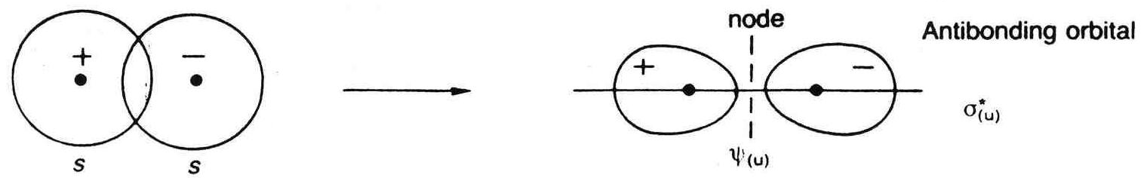
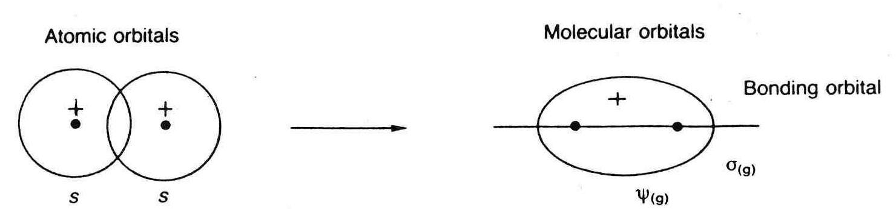
Antibonding MO – energetically unstable
Bonding MO – energetically stable

Slide 14
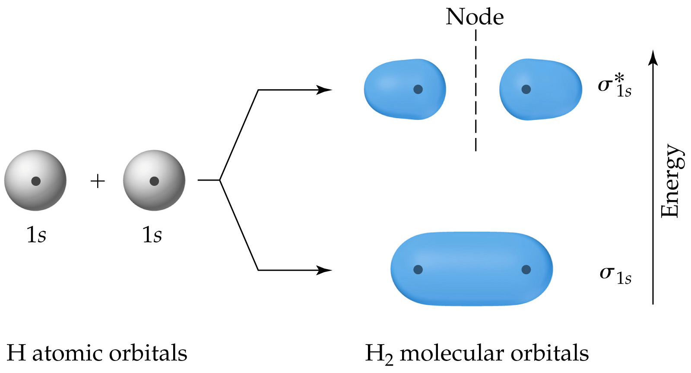
Notes:
Figure: 09-33

Slide 15
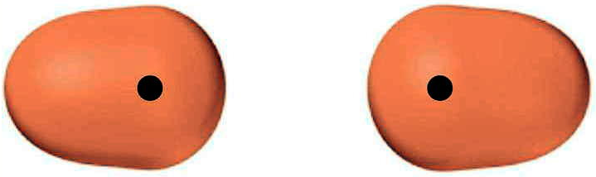
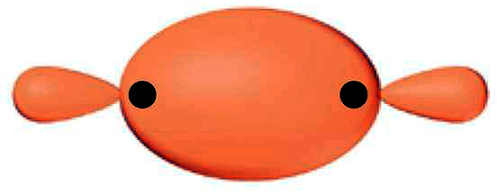
Electron density along the internuclear axis, but on either side of the nuclei = sigma antibonding orbital, σ*
Electron density between nuclei along the internuclear axis = sigma bonding orbital, σ

Slide 16
σ*, anti-
bonding
sigma, σ
bonding

Slide 17
LUMO
HOMO

Slide 18
Constructing Molecular Orbitals
1. Each atom involved in the bonding is listed at the top on each side. Molecule that forms is centered on top. Use blanks to represent orbitals and arrows to represent electrons.
2. Atomic orbitals that are of similar energy interact more strongly than orbitals of different energies.
3. Combine orbitals with dotted lines. (Actually represents the LCAO math to form new MO wave functions). Atomic orbitals no longer exist, only MO do.
4. Symmetry labels and shape of atomic orbitals determine the type of MO formed
5. Place electrons into the new MO via Hunds rule.

Slide 20
Bond order – number of covalent bonds between two atoms
bond order = ½ (# e⁻ in bonding MO - # e⁻ in antibonding MO)

Slide 21
Construct an MO diagram for N₂

Slide 22
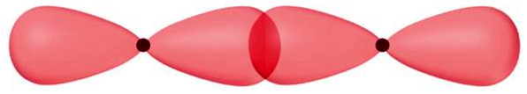
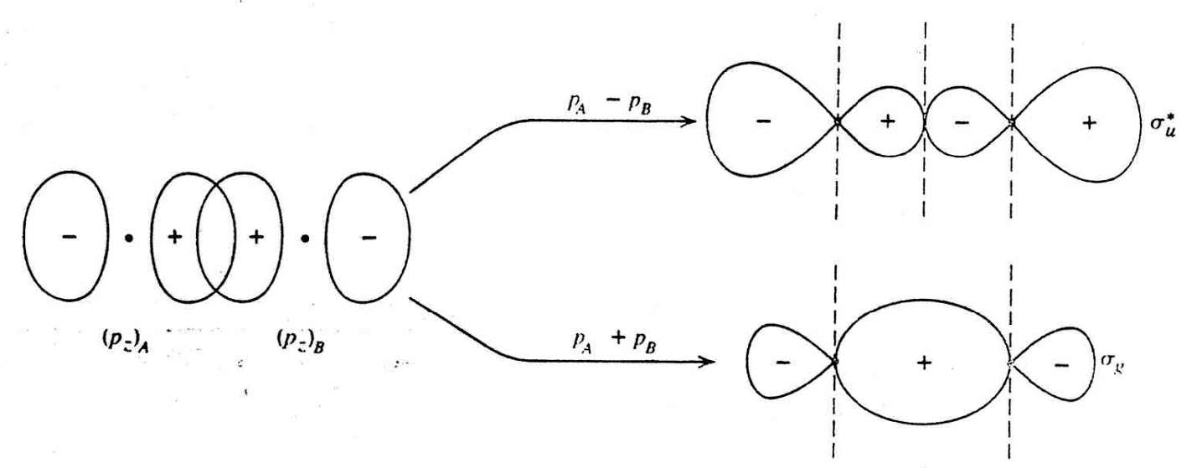
p_{z}
p_{z}
2 p_{z} - orbitals forming sigma, σ-bonding
and σ*-antibonding orbitals

Slide 23
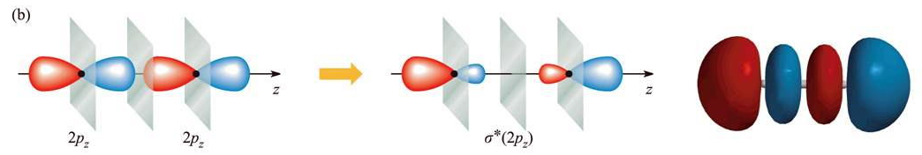
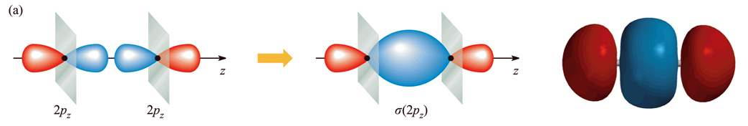
2 p_{z} - orbitals forming σ*-antibonding orbitals
2 p_{z} - orbitals forming sigma, σ-bonding orbitals

Slide 25
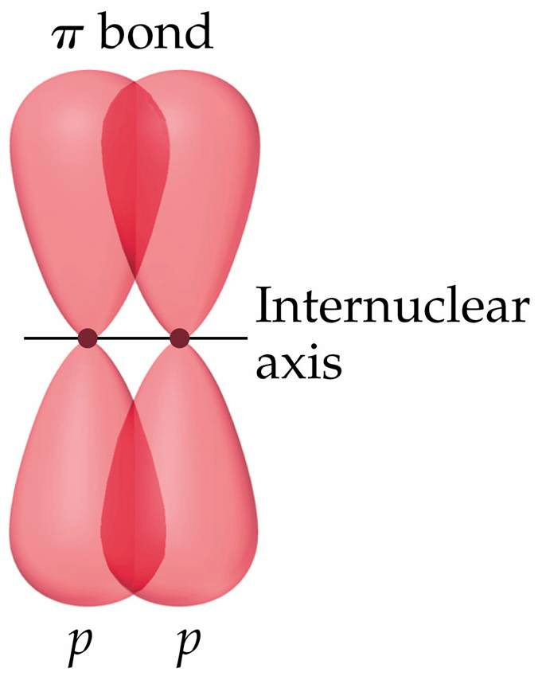
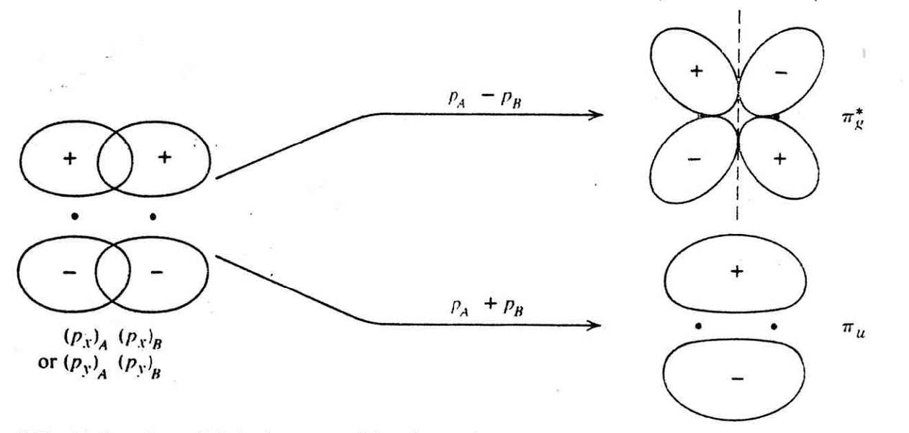
pi, π-bond – electron density lies above and below the internuclear axis
2 p_{x} (or p_{y}) orbitals forming pi, π-bonding
and π*-antibonding orbitals
Notes:
Figure: 09-22

Slide 26
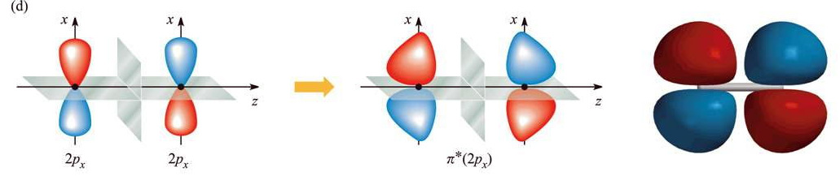
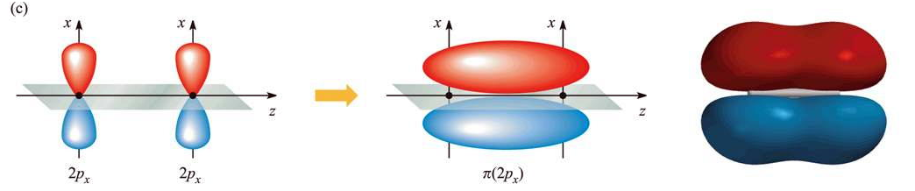
2 p_{x} (or p_{y}) orbitals forming pi, π*-antibonding orbitals
2 p_{x} (or p_{y}) orbitals forming pi, π-bonding orbitals

Slide 27
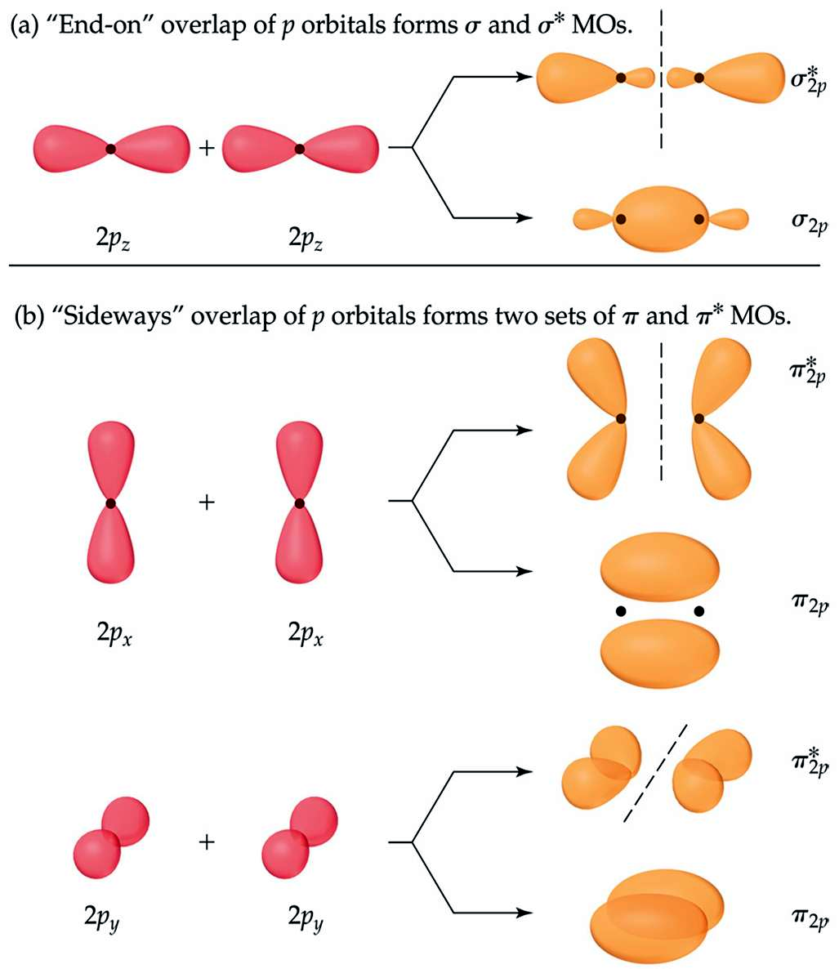
Notes:
Figure: 09-38
Title:
Contour representations of the molecular orbitals formed by the 2p orbitals on two atoms.
Caption:
Each time we combine two atomic orbitals, we obtain two MOs: one bonding and one antibonding.

Slide 30
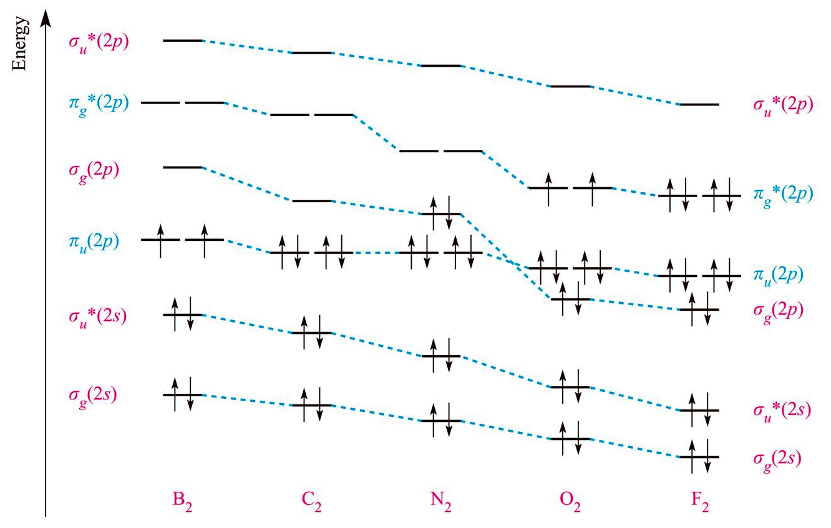
Drop in orbital energy results in a sigma-pi MO crossover

Slide 31
Li₂ through N₂
O₂ through Ne₂

Slide 32
Construct an MO diagram for O₂

Slide 34
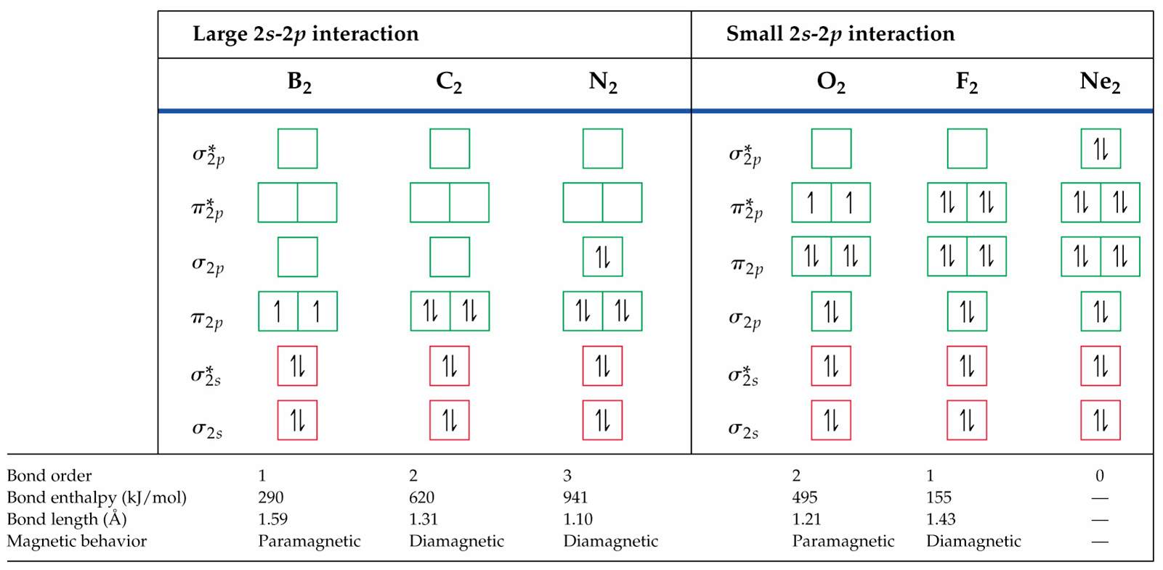
Notes:
Figure: 09-41

Slide 35
MO diagrams for heteronuclear diatomics
1. Each atom involved in the bonding is listed at the top on each side. The more electronegative element is on the right while the less electronegative element is on the left. Molecule that forms is centered on top. Use blanks to represent orbitals and arrows to represent electrons.
2. Atomic orbitals that are of similar energy interact more strongly than orbitals of different energies.
3. Combine orbitals with dotted lines. (Actually represents the LCAO math to form new MO wave functions). Atomic orbitals no longer exist, only MO do.
4. Symmetry labels and shape of atomic orbitals determine the type of MO formed
5. Place electrons into the new MO via Hunds rule.

Slide 38
Construct an MO diagram for HF

Slide 40
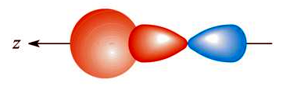
nonbonding MO - electrons are primarily localized on a particular atom and not involved in bonding
p_{z}
s
s and p_{z} orbitals forming a sigma, σ-bond

Slide 41
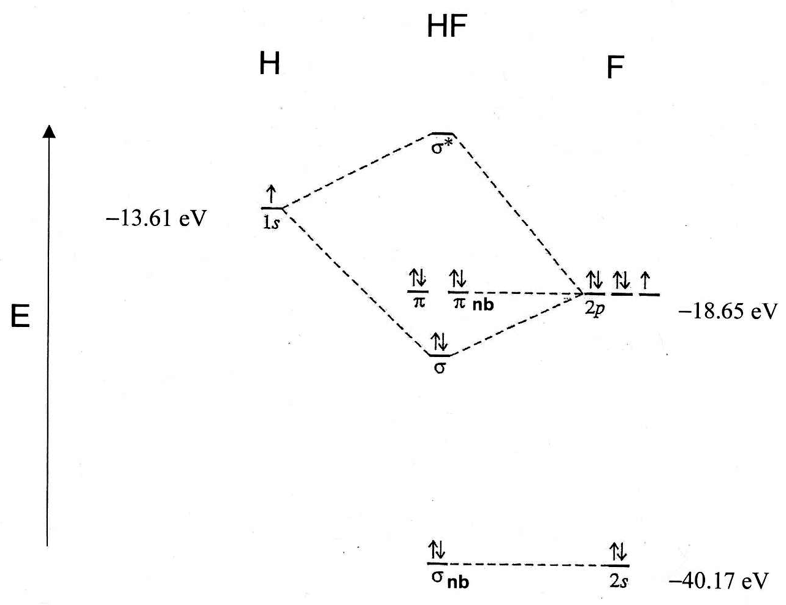

Slide 42
Construct an MO diagram for CO

Slide 43
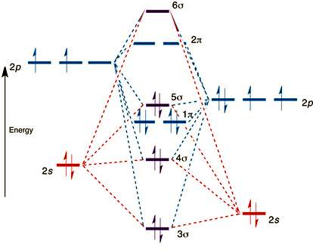
CO
C O
σ*
π*
π*
−10.66 eV
σ
−15.85 eV
π
π
σ*
−19.43 eV
−32.38 eV
σ

Slide 45
