Slide 2
Atomic Radii Trends
1. atomic radii Increase as move down  a group (or family)

Slide 3
2. atomic radii Decrease as move left to right ⇨ across a period

Slide 4
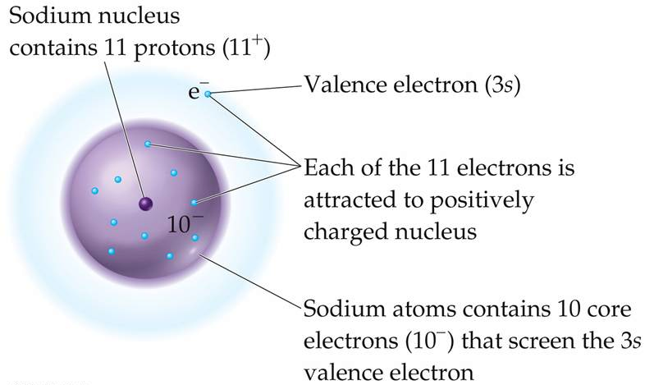
Effective Nuclear Charge, Z_{eff} – the positive charge an electron “feels” from the nucleus

Slide 8
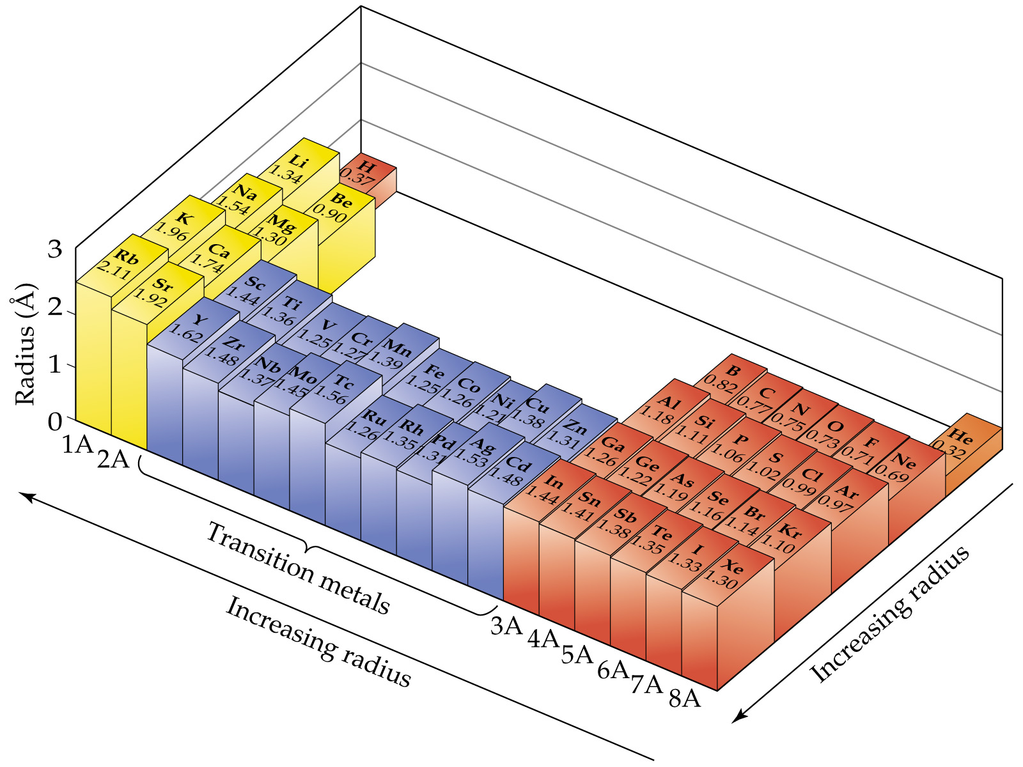
Notes:
Figure: 07-05

Slide 9
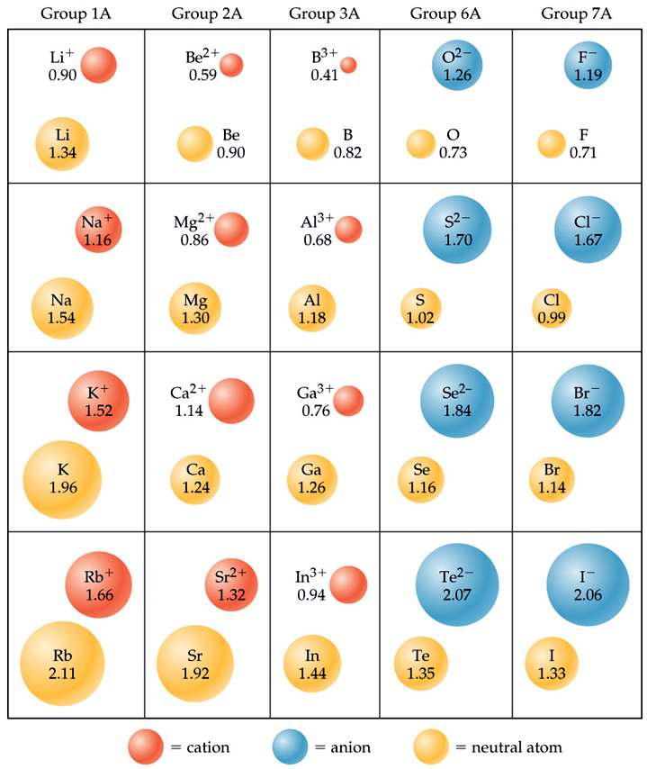
Notes:
Figure: 07-07
Title:
Cation and anion size.
Caption:
Comparisons of the radii, in Å, of neutral atoms and ions for several of the groups of representative elements. Neutral atoms are shown in gray, cations in red, and anions in blue.

Slide 10
Anions are always bigger than corresponding neutral species
Cations are always smaller than corresponding neutral species

Slide 12
Isoelectronic – ions with the same number of electrons

Slide 13
Ionization Energy, IE – amount of energy required to remove an electron from an atom

Slide 14
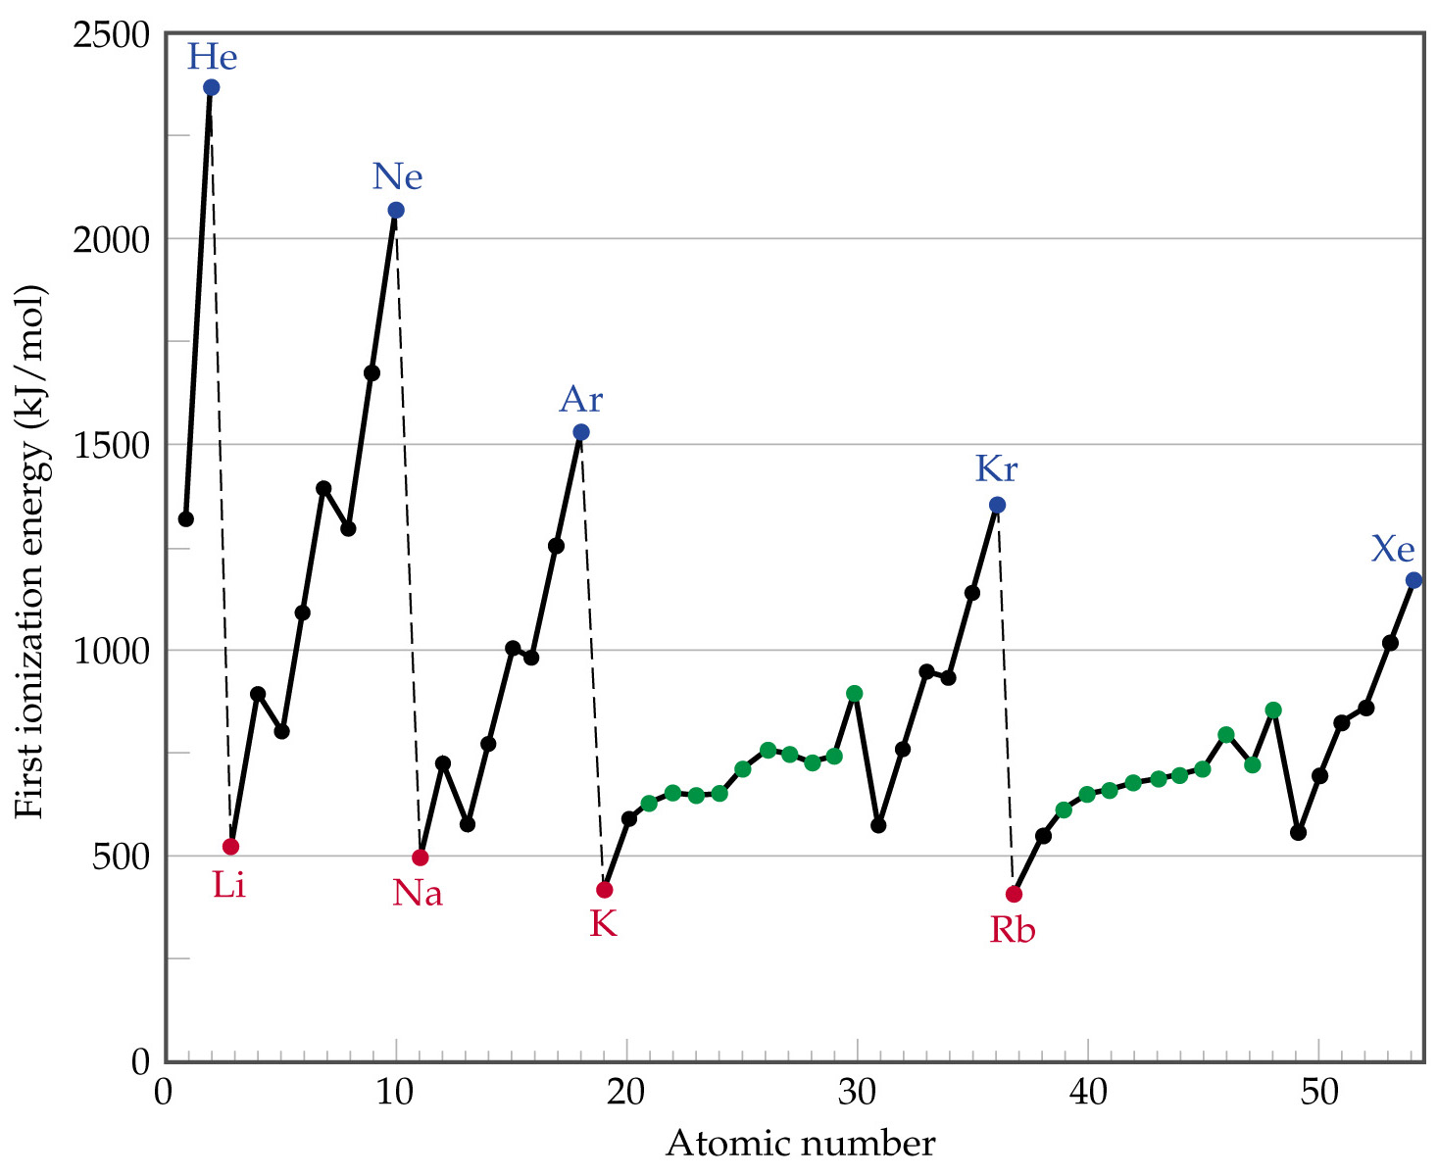
Notes:
Figure: 07-09

Slide 15
IE Increases as move left to right ⇨ across a period
IE Decreases as move down  a group (or family)

Slide 16
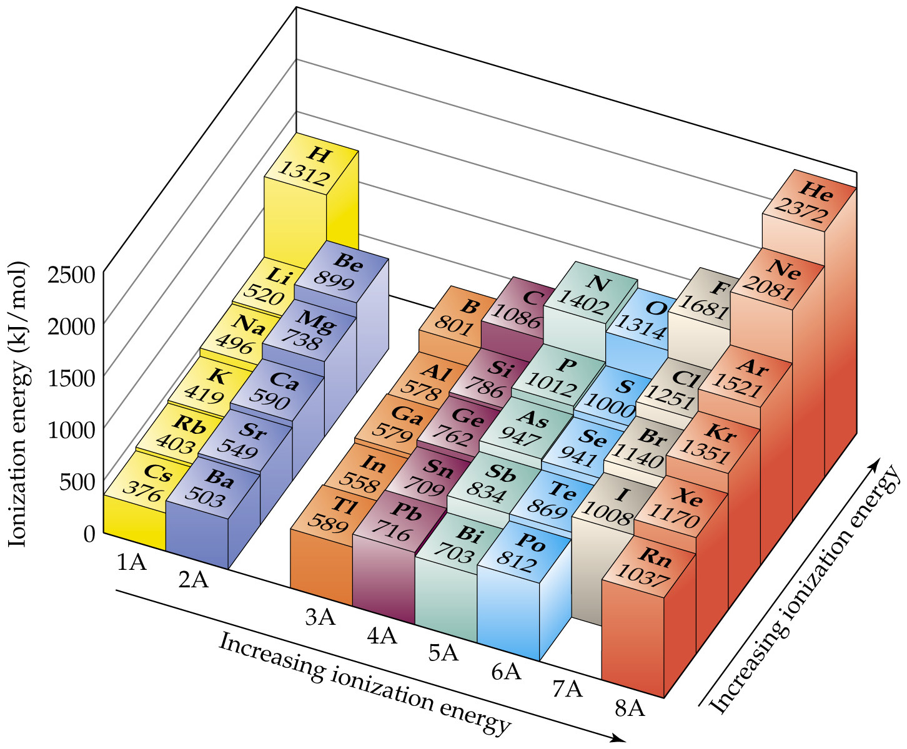
Notes:
Figure: 07-10

Slide 17
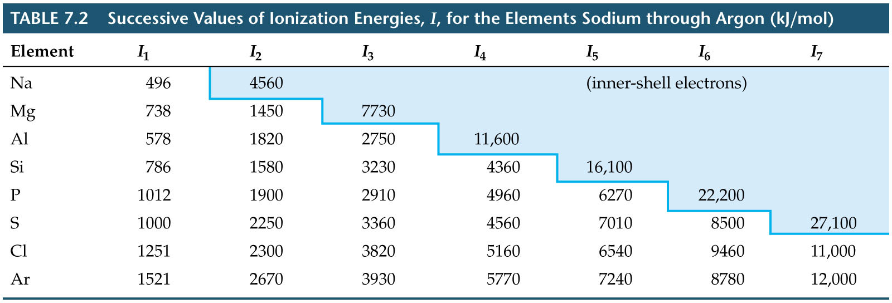
Notes:
Figure: TB07-T02

Slide 18
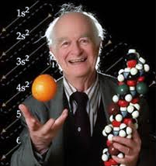
Linus Pauling
1901 – 1994
electronegativity – the ability of an element to attract electron density to itself in a molecule

Slide 19
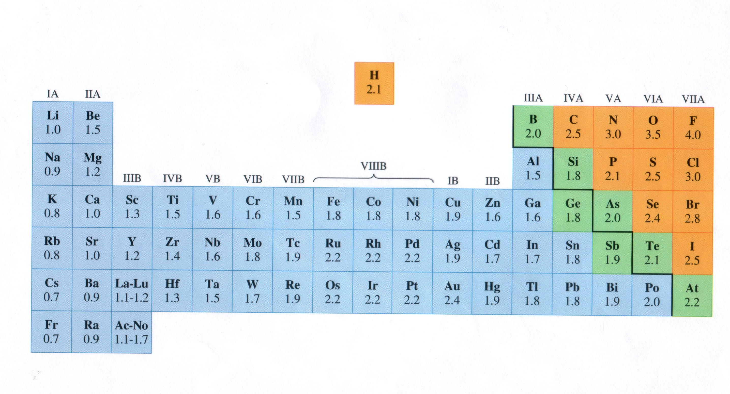
electronegativity increases from left right
electronegativity decreases from top bottom

Slide 20
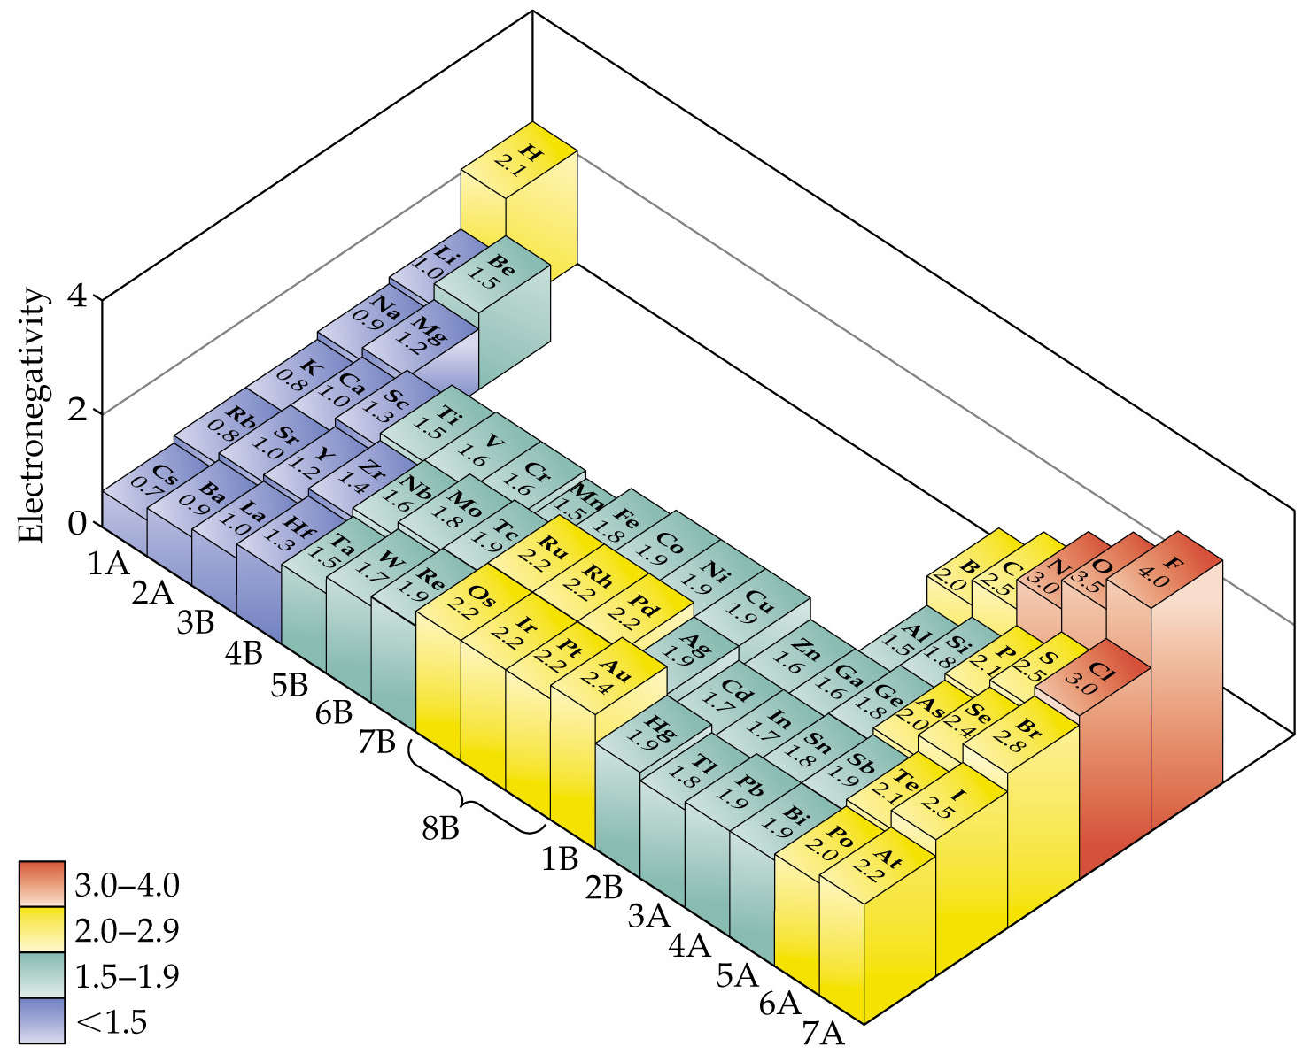
Notes:
Figure: 08-06

Slide 21
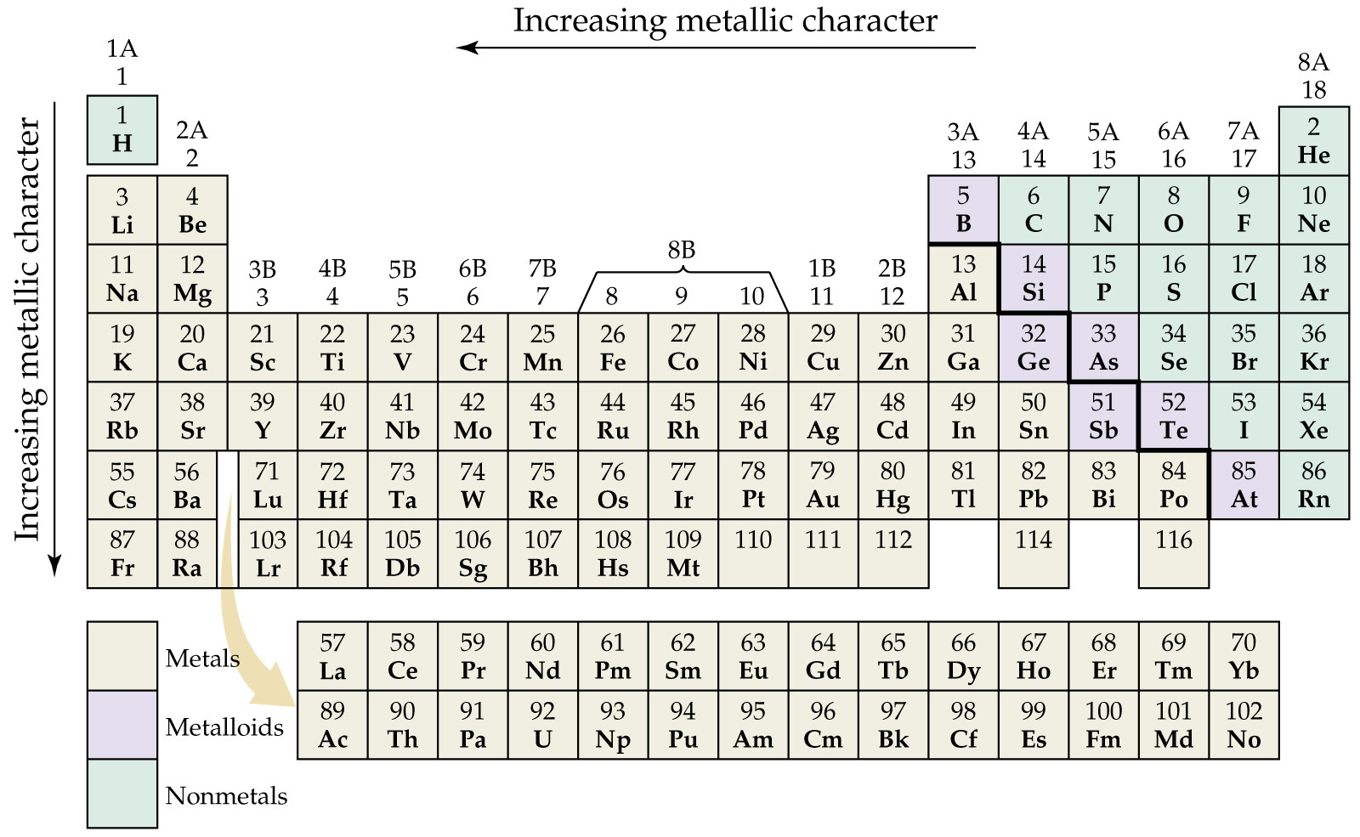
Notes:
Figure: 07-12

Slide 22
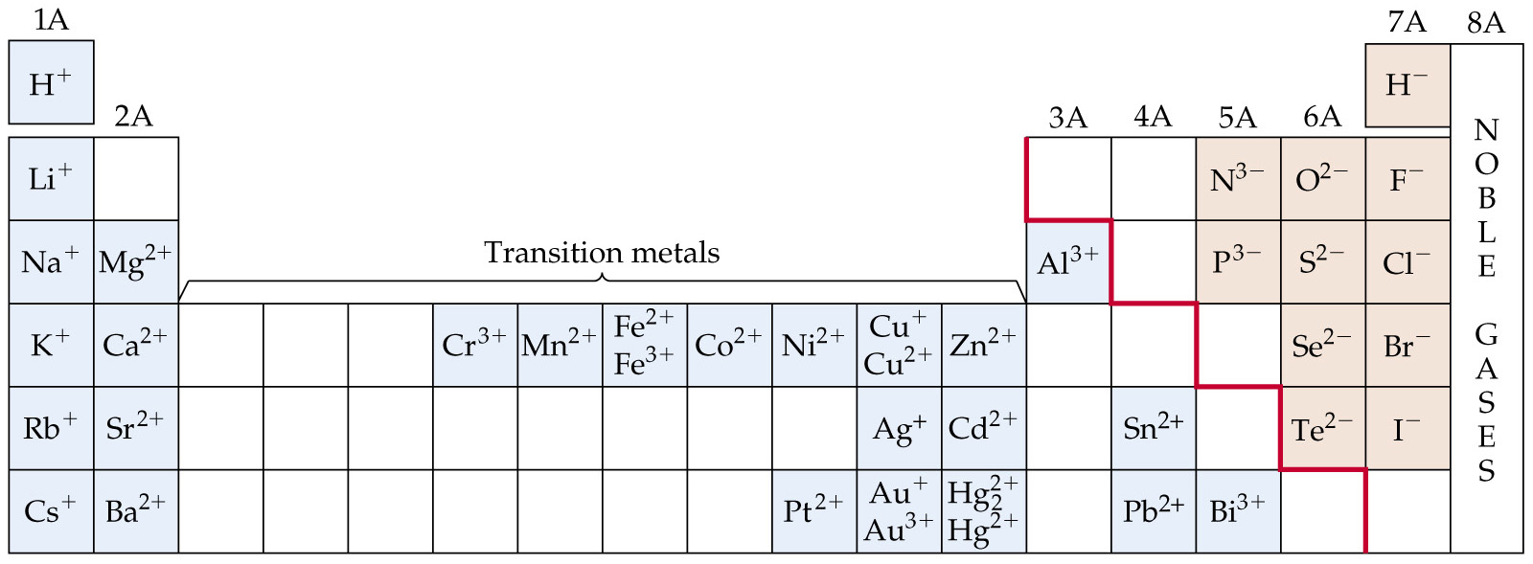
Notes:
Figure: 07-14

