Slide 1
when  = 2, m = -2, or -1, or 0, or +1, or +2

Slide 5
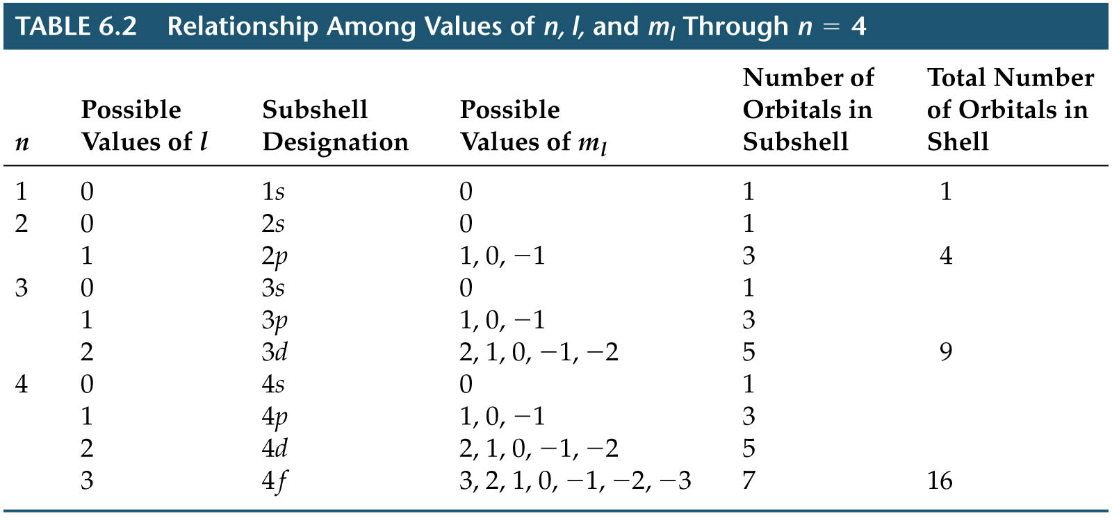
Notes:
Figure: TB06-T02

Slide 7
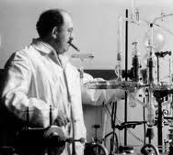
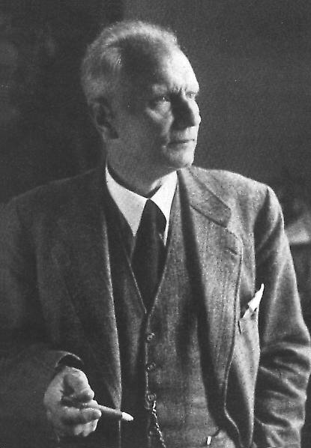
Otto Stern
1888 - 1969
Walter Gerlach
1889 - 1979

Slide 8
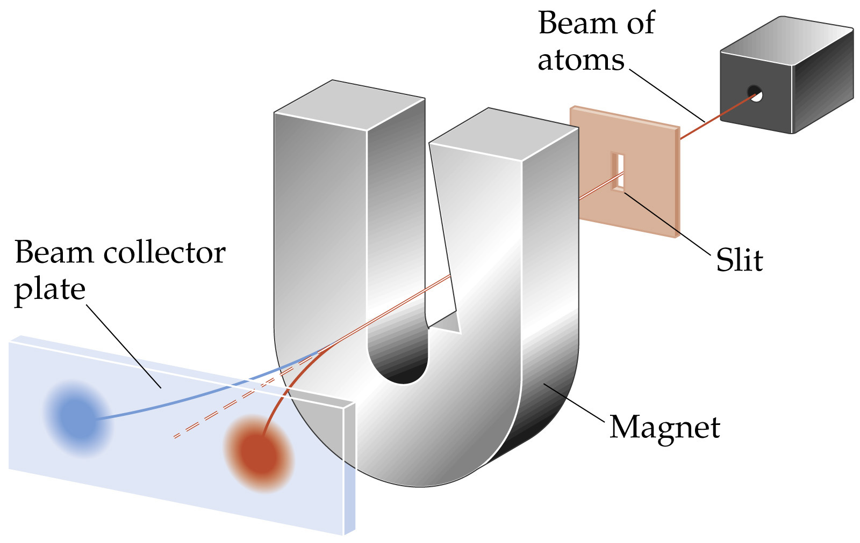
Notes:
Figure: 06-24

Slide 9
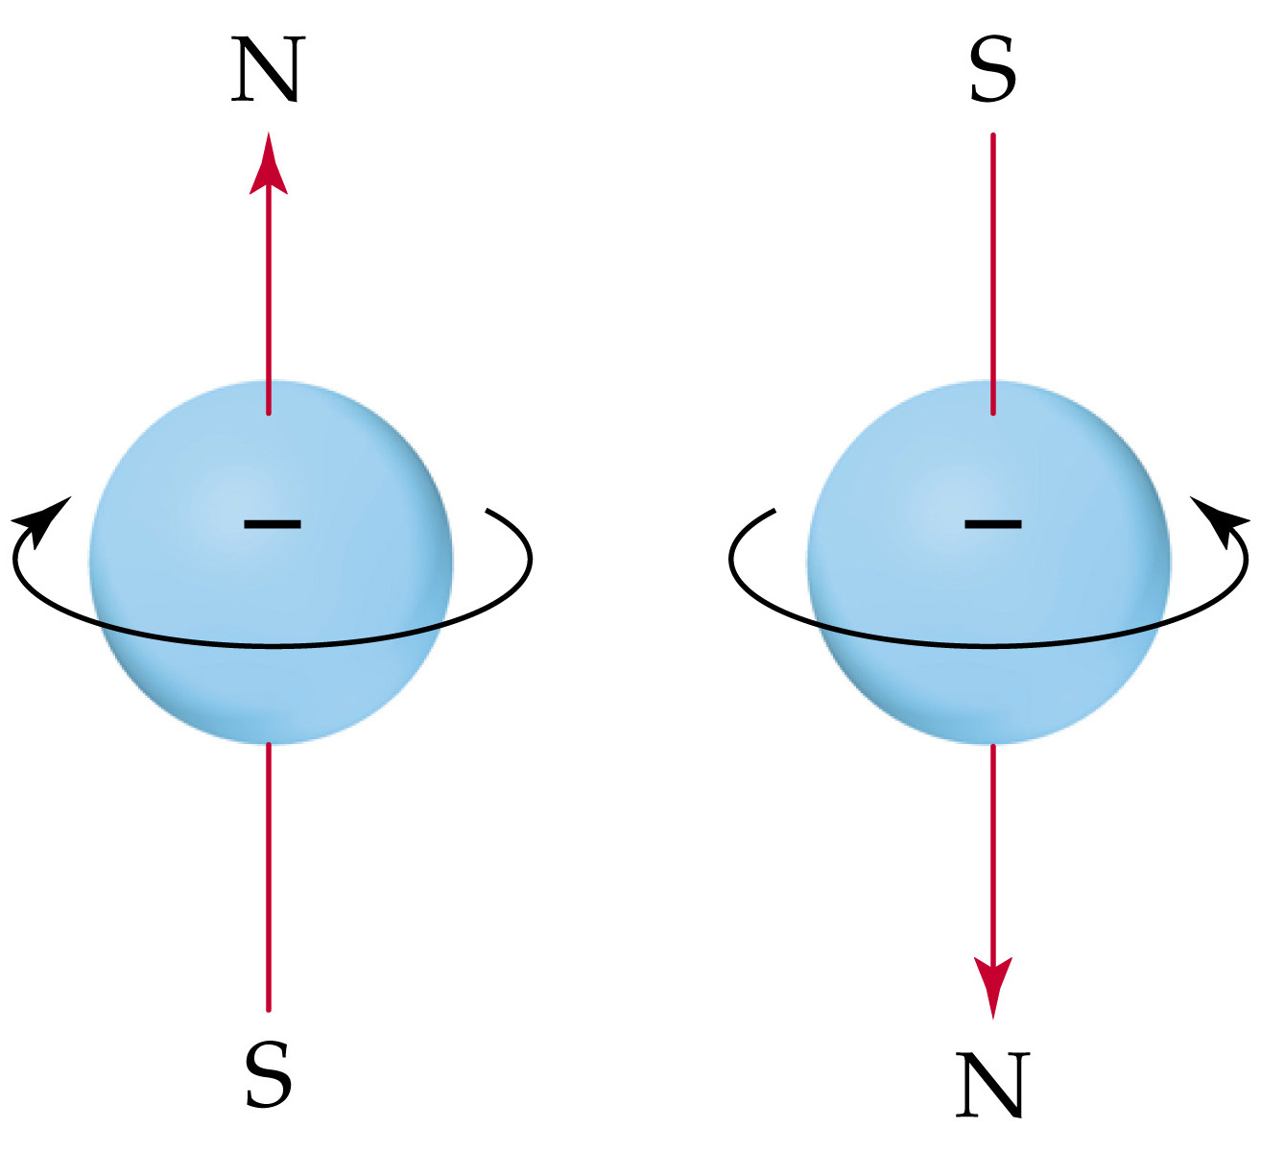
Notes:
Figure: 06-23

Slide 10
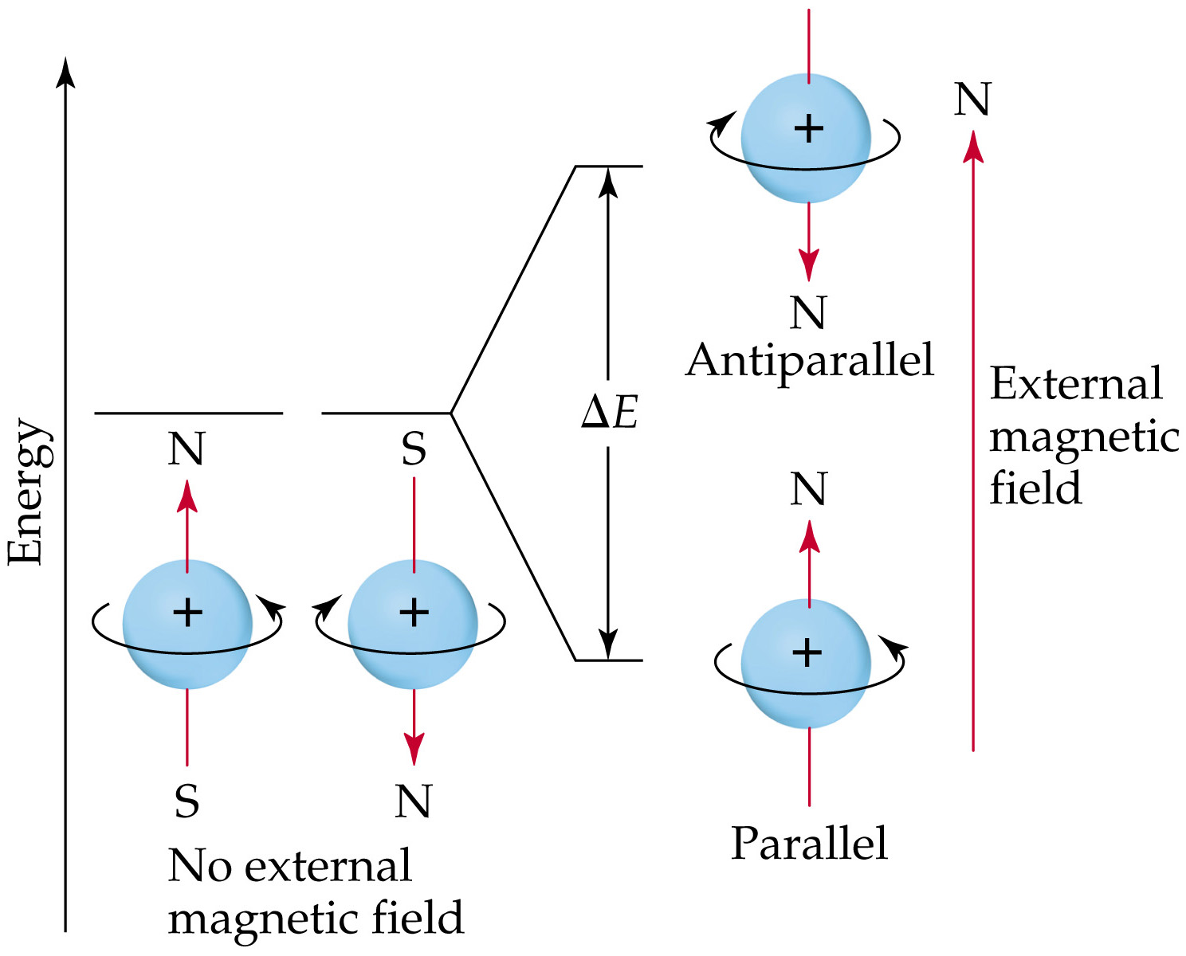
Notes:
Figure: 06-25

Slide 12
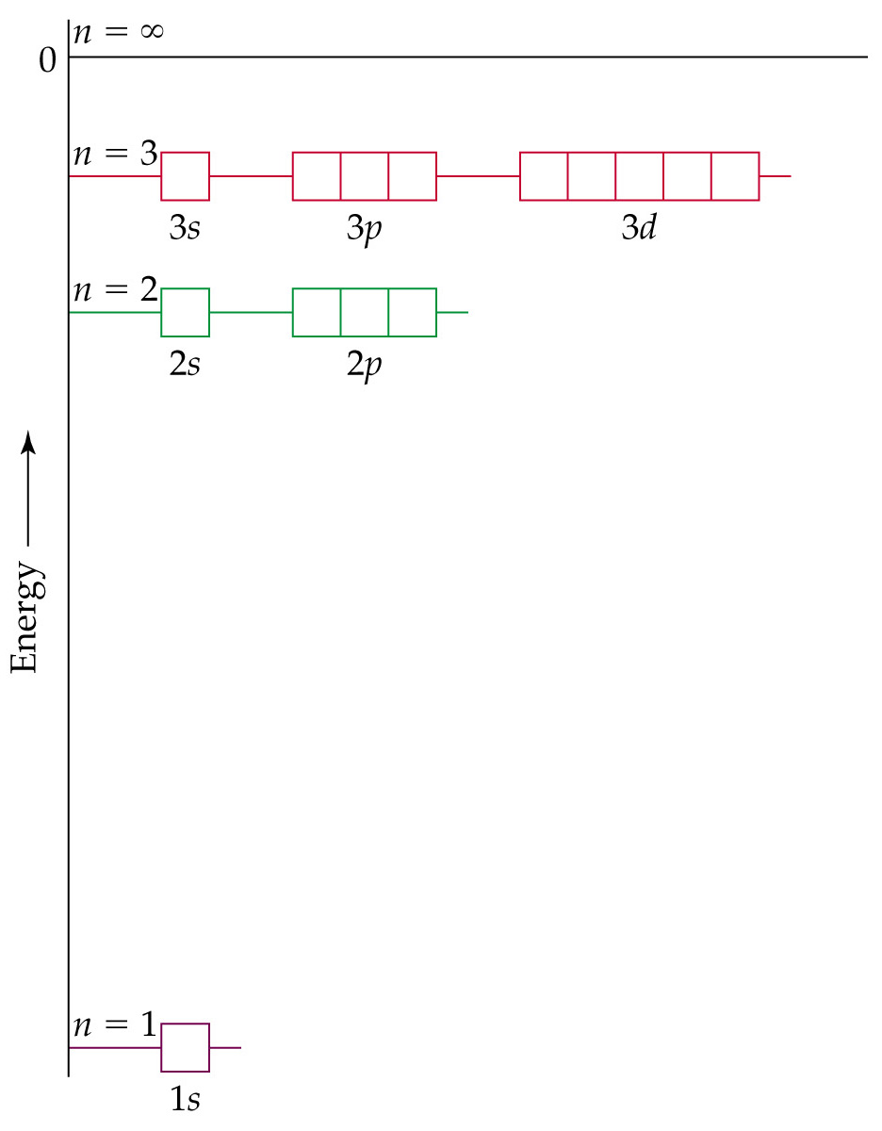
Notes:
Figure: 06-17

Slide 14
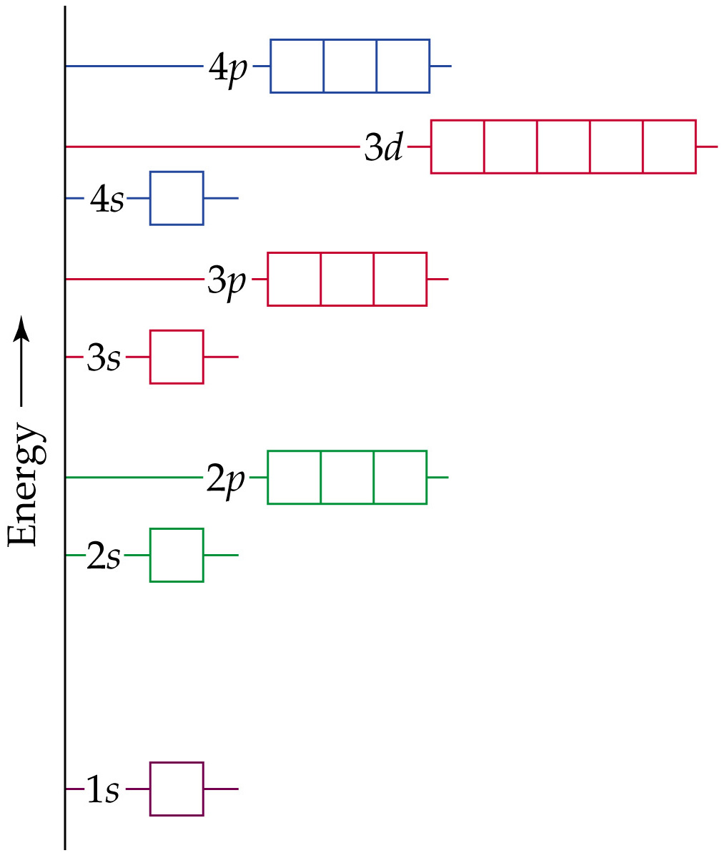
Notes:
Figure: 06-22

Slide 15
Determine the electron configuration for a neutral atom of vanadium, V

Slide 16
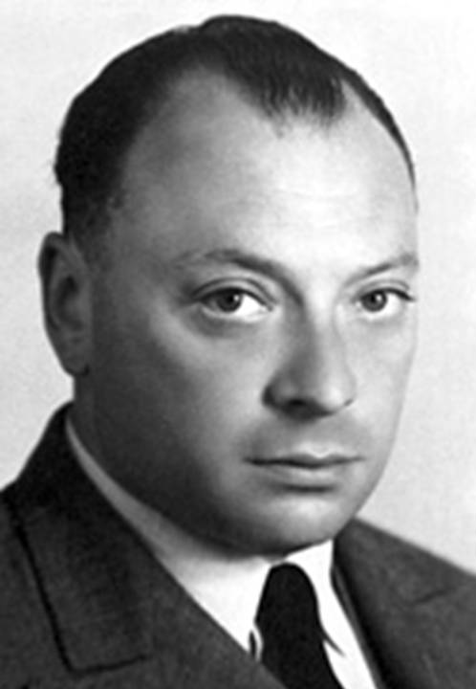
Wolfgang Pauli 1900-1958
Pauli Exclusion Principle – no two electrons in the same atom can have the same four quantum numbers
Notes:
Figure: 06-24
Title:
Orbital energy levels in many-electron atoms.
Caption:
In a many-electron atom, the energies of the subshells in each shell follow the order ns < np < nd < nf. As in Figure 6.17, each box represents an orbital.

Slide 17
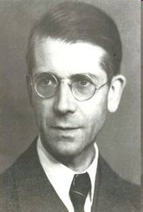
Friedrich Hund 1896-1997
Hund’s Rule – electrons fill unpaired in degenerate orbitals as long as possible

Slide 19
paramagnetic – atom contains one or more unpaired electrons
diamagnetic – all electrons in the atom are paired

Slide 20
Determine the electron configuration for a vanadium, V²⁺ cation

Slide 23
Notes:
Figure: 06-26-04UNT03

Slide 25
Notes:
Figure: 06-17

Slide 26
Determine the number of unpaired electrons in cobalt, Co²⁺ cation

Slide 27
Determine the electron configuration for a neutral atom of copper, Cu

Slide 28
Predict the electron configuration for a neutral atom of chromium, Cr

Slide 29
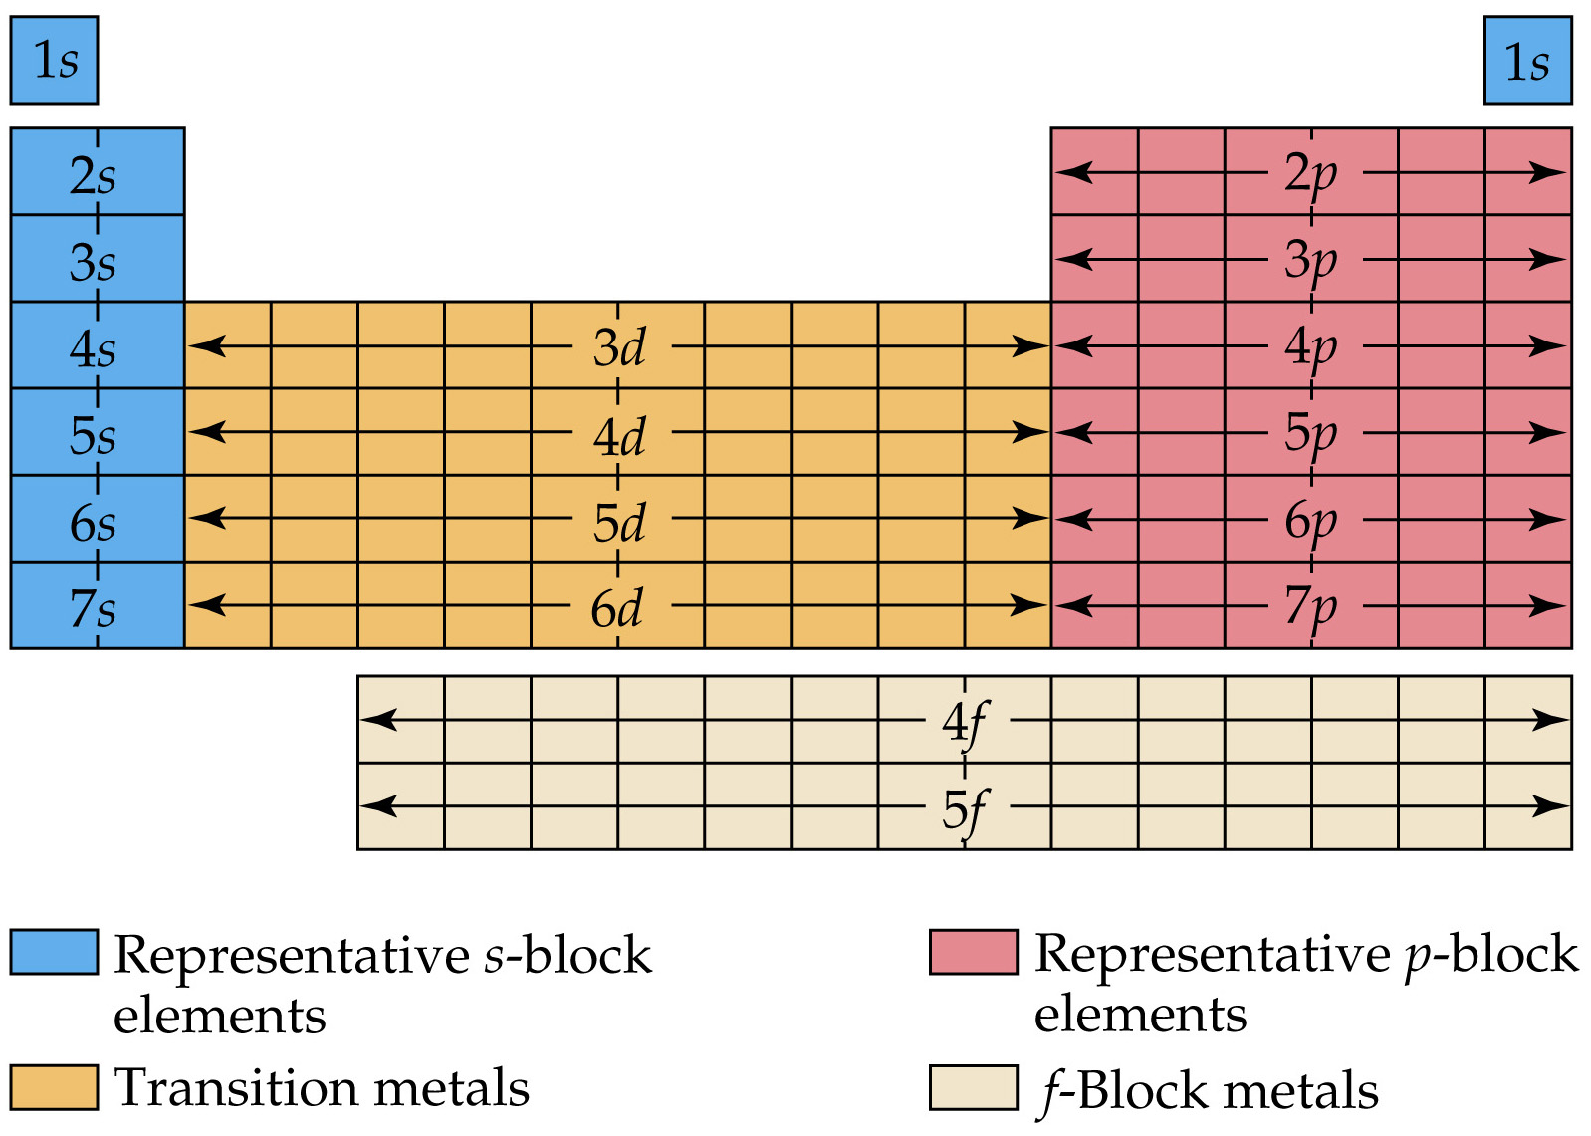
Notes:
Figure: 06-27

Slide 30
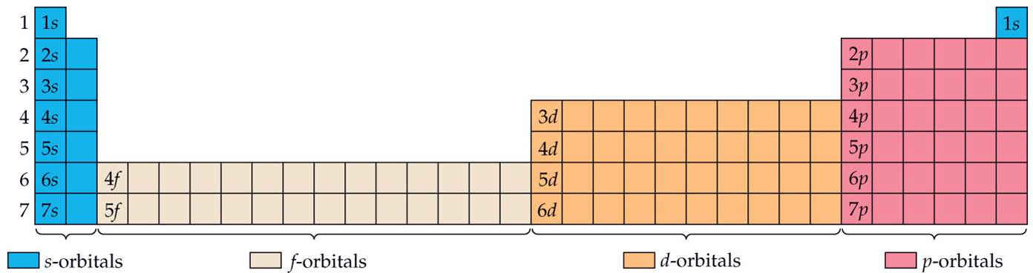

Slide 31
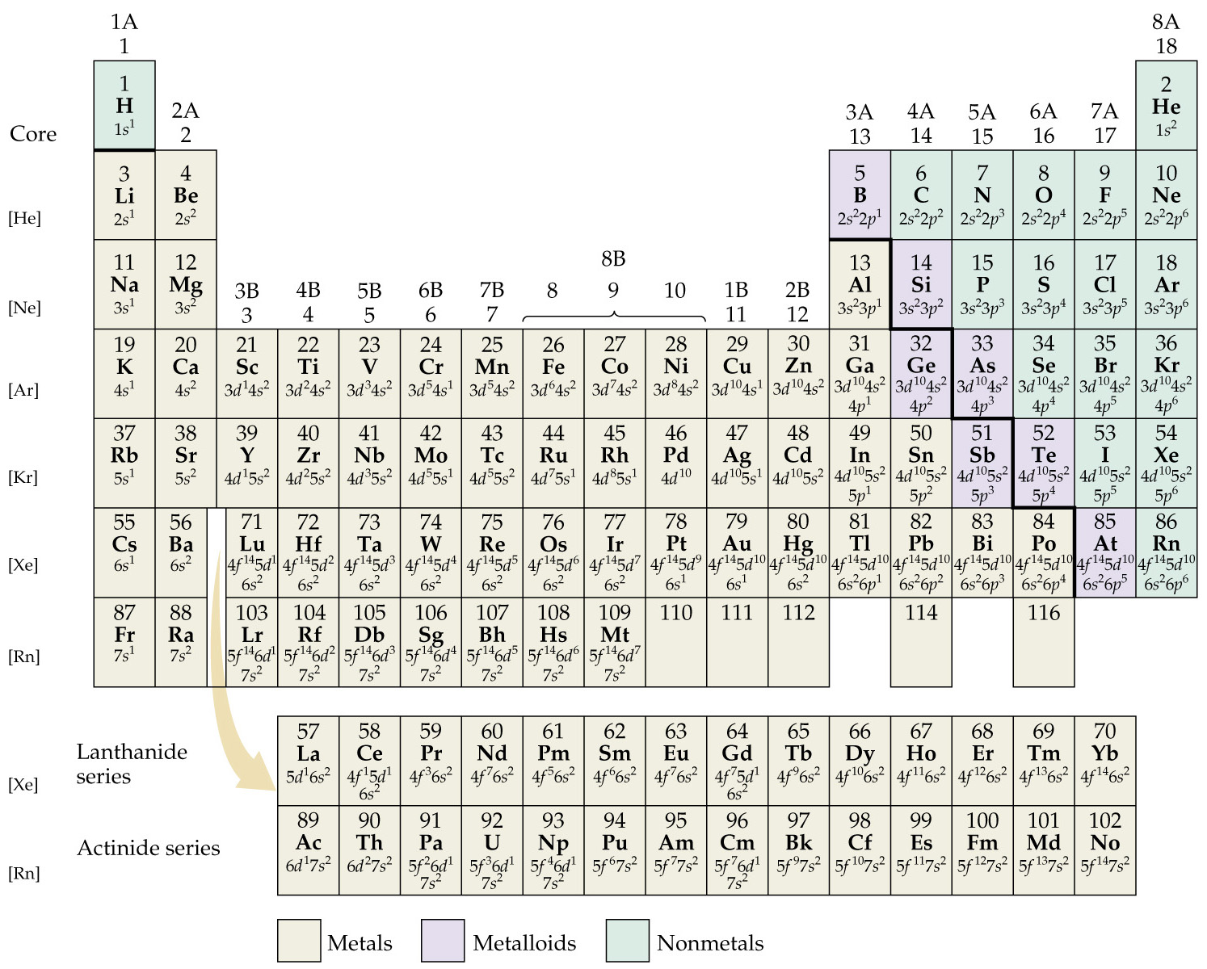
Notes:
Figure: 06-28

