Slide 1
The emission spectrum of hydrogen

Slide 2
resulting line spectrum
Hydrogen discharge tube

Slide 3
The line spectrum of hydrogen
410 nm
434 nm
486 nm
656 nm

Slide 4
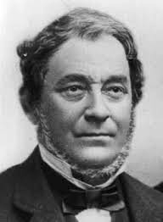
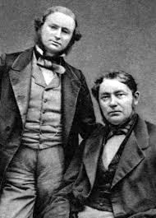
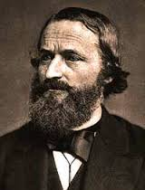
Robert Bunsen
1811 - 1899
Gustav Kirchhoff
1824 - 1887

Slide 5
The line spectrum of sodium
The line spectrum of neon
Ne

Slide 6
Johann Balmer
1885
where n = 3 or 4 or 5 or 6
where m = 1 or 2 or 3, etc.
where n = 2 or 3 or 4 , etc.
Johannes Rydberg
1888

Slide 7
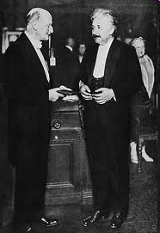
E = hν
E = energy of a photon
h = Planck’s constant
h = 6.626 x 10⁻³⁴ J·sec

Slide 8
1913 - Niels Bohr
n | distance from nucleus
1 | 53 pm
2 | 212 pm
3 | 476 pm
4 | 846 pm
5 | 1323 pm

Slide 9
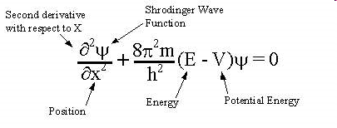
Erwin Schrodinger
1926

Slide 11
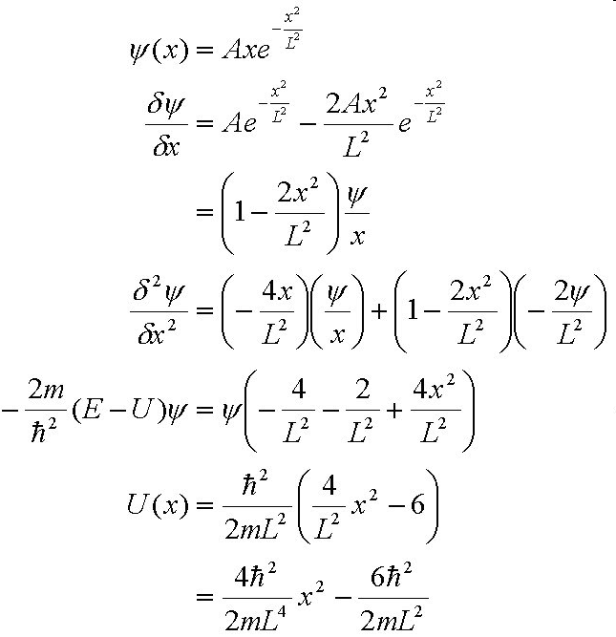

Slide 12
1913 - Niels Bohr
n | distance from nucleus
1 | 53 pm
2 | 212 pm
3 | 476 pm
4 | 846 pm
5 | 1323 pm
1. principle quantum number, n – determines the distance (and thus the energy) of electron from the nucleus

Slide 13
2. angular momentum quantum number,  – determines the shape of the orbital
for a given value of n,  has possible values 0 up to n-1 with all integers in between
when  = 0, e⁻ resides in an s-orbital (sphere)
when  = 1, e⁻ resides in an p-orbital (figure 8)
when  = 2, e⁻ resides in an d-orbital (four lobed)
when  = 3, e⁻ resides in an f-orbital (eight lobed)

Slide 14
● = 0 defines an s-orbital or sphere

Slide 15
Radial distribution for 1s, 2s and 3s orbitals of hydrogen

Slide 16
1s
n=1
● = 0
2s
n=2
● = 0
3s
n=3
● = 0
Notes:
Figure: 06-19

Slide 17
● = 1 defines a p-orbital or figure 8

Slide 18
2p
n=2
● = 1
3p
n=3
● = 1
electron density contour plots for p-orbitals

Slide 19
3. magnetic quantum number, m – describes the orientation of orbitals in space relative to each other
m values depend on 
possible m values = - to + (including all integers in between)
when  = 0, then m = 0 (only one value of m)
when  = 1, then m = -1, or m = 0, or m = +1 (three possible values of m)
when  = 2, then m = -2, or m = -1, or m = 0, or
m = +1, or m = +2 ( five possible values of m)

Slide 20
when  = 1, m = -1, or 0, or +1
m = −1 m = 0 m = +1

Slide 21
real p-orbitals are flatter and fatter

