Slide 1
Symmetry and Group Theory
What good is it ?
Governs electronic and vibrational levels
Determines the # of allowed IR stretches and Raman allowed transitions
Used in the construction of molecular orbitals
Useful for the determination of crystal structure from X-ray diffraction

Slide 2
Symmetry Operation – “doing something” to an object that results in an object that is indistinguishable from the original
360°
n
1. Proper Rotation – rotation about an axis by
(where n = integer)
Cn

Slide 3
Rotation of BF₃ by 120° generates a molecule that is indistinguishable from the original. The fluorine marked in red is simply a label.

Slide 6
The C₂ axis is coincident with the C₄ axis. The C₄ axis is a higher order and takes precedence over the C₂. The highest order axis, in this case the C₄, is called the principle axis

Slide 8
Note the three C₂ axis that are perpendicular to the principle axis, C₃.

Slide 10
This molecule contains four C₂ axis that are perpendicular to the principle C₄ axis. They are labeled C₂' and C₂'' to differentiate from each other.

Slide 11
Note: After establishing the principle axis, if you find a C₂ perpendicular, ⊥, to the principle axis, you will have n# (based on the principle axis) of the ⊥ C₂’s (every time) !

Slide 13
Successive rotations about the C₃ axis are distinguished from each other by the notation, C₃² and C₃³. The effect of the last operation produces a molecule that is identical to the first. This is defined as the Identity symmetry operation, or E.

Slide 14
2. Identity – any symmetry operation (or set of symmetry operations) that have NO affect. Molecule is identical from the initial.
E

Slide 15
Determine all the symmetry operations for H₂O
3. Mirror plane – reflection of all parts through a geometric plane that results in an indistinguishable object from the original.
σ

Slide 16
If the mirror plane, σ, completely contains the principle axis of proper rotation, σ becomes σ_{v}. Note that σ_{v} and σ_{v}' are used to distinguish from each other.

Slide 17
Determine all the symmetry operations for NH₃
NH₃ has three equivalent σ_{v} mirror planes

Slide 18
Note: If the object has a C_{n} axis of proper rotation and you find a σ_{v} , you will have n# σ_{v} (based on the principle axis) every time !

Slide 19
Determine all the symmetry operations for BF₃
σ_{h}
A mirror plane exists perpendicular to the principle axis, C₃ (highlighted in brown) and is defined as σ_{h} (where h refers to horizontal)

Slide 20
Determine all the symmetry operations for NH₂Cl

Slide 21
Determine all the symmetry operations for HCl
Linear molecules possess an infinite number of proper rotations called C∞ as well as an infinite number of
σ_{v} apply named, ∞σ_{v}

Slide 22
mirror plane complications (not too important)

Slide 23
mirror plane complications (not too important)
The molecule possesses four σ_{v}. To differentiate between the two different kinds of σ_{v}, two are called σ_{v} (gray) while the other two are called σ_{d} (purple). The d refers to “dihedral”. This occurs most often when the principle axis is either C₄ or C₆.

Slide 24
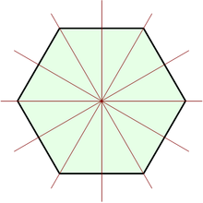
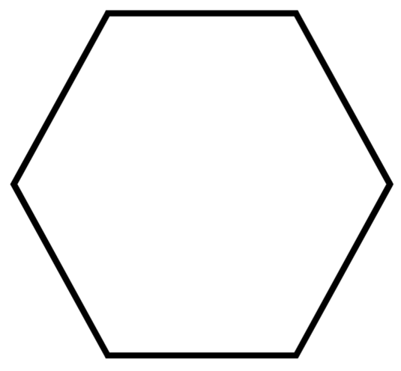
σ_{d}
σ_{v}
σ_{d}
σ_{v}
σ_{d}
σ_{v}
The object possesses 6 σ_{v}
To differentiate, three are σ_{v} while the other three are σ_{d}
Symmetry operations are: E, C₆ , C₃, C₂ (both C₃ and C₂ are coincidental with C₆), 6C₂ ⊥ C₆ , 6 σ_{v} (3 σ_{v} and 3 σ_{d}), σ_{h}

Slide 25
4. inversion – reflection of all parts through a centerpoint of equal distance generates an indistinguishable object from the original
i
Note: the inversion centerpoint of the molecule may not coincide with an atom in the molecule. When performing the inversion, each atom is moved along a straight line through the inversion center to a point of equal distance from the inversion centerpoint

Slide 26
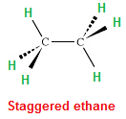
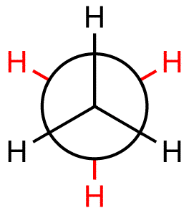
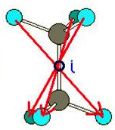
staggered ethane has an inversion, i

Slide 27
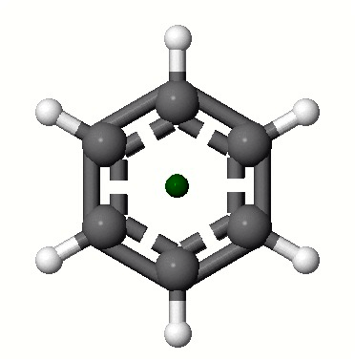
Does water possess an inversion, i ?
Does benzene possess an inversion, i ?

Slide 28
Do these molecules possess an inversion, i ?
B₂Cl₄ has a staggered structure
B₂H₆ has this structure

Slide 29
5. Improper Rotation – The combination of:
Sn
1) rotating a molecule 360°/n, followed by
2) reflection through a plane perpendicular, ⊥ to the “rotation axis”, generates an indistinguishable object
NOTE: rotation by itself does NOT produce indistinguishable object…….
reflection through a plane perpendicular, ⊥ to the “rotation axis” by itself does NOT produce indistinguishable object

Slide 30
The combination of the two together results in object that is indistinguishable from the original
1. rotate methane 90° (“C₄”), then
2. reflect in a mirror plane perpendicular to rotation axis
Neither 1. or 2. results in an object that is indistinguishable, but the combination of the two together do ….. that’s an
Improper Rotation, S₄

Slide 31
Point Groups – The complete set of symmetry operations that can be carried out on an object
Point Group Symmetry Operations

Slide 32
Point Group Symmetry Operations

Slide 33
Point Group Symmetry Operations

Slide 34
Determine point group of H₂O
Determine point group of CO

Slide 35
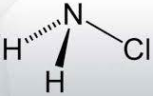
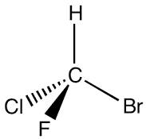
Determine point group of NH₂Cl
Determine point group of CHFClBr

Slide 36
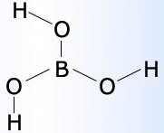

Determine point group of B(OH)₃
Determine point group of CBrClF-CBrClF (completely staggered)

Slide 37
Point Group Symmetry Operations

Slide 38
Point Group Symmetry Operations

Slide 39
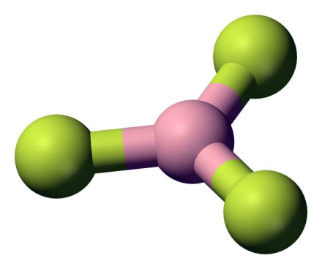

Determine point group of BF₃
Determine point group of B₂F₄ (planar)

Slide 40
Determine point group of B₂Cl₄ (90° staggered)
B₂Cl₄ staggered
Determine point group of B₂Cl₄ (45°staggered)

Slide 41
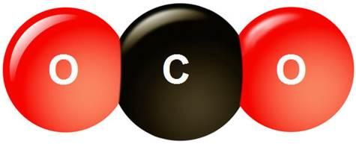
Determine point group of CO₂
σ_{h} and i are the same in this point group
Point Group Symmetry Operations

Slide 42
Point Groups for molecules with a high degree of symmetry (large number of symmetry operations)
Point Group Symmetry Operations

Slide 43
Boron exists as B₁₂ in an icosahedron geometry, I_{h}

Slide 44
T_{d} symmetry O_{h} symmetry I_{h} symmetry

Slide 45
Determining the Point Group
1. draw Lewis, get MG, make model, examine it
2. by inspection, look for T_{d}, O_{h}, I_{h} first
3. look for highest C_{n} (none?  C₁, C_{s} or C_{i})
4. look for C₂ ⊥ C_{n} (principle)
5. after axis rotation, then start σ, mirror planes
6. don’t spend much time searching for i or S_{n}

Slide 48
Chirality
A molecule is chiral (optically active) if:
Molecule does NOT have:
1. σ (mirror plane)
2. i (inversion)
3. S (improper rotation)
If all three are absent, the molecule is chiral !!!
Period !

Slide 50
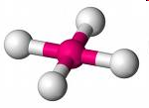

Determine point group of [PtCl₄]²⁻ (square planar)
Determine point group of trans-1,2-dichloroethene

Slide 51
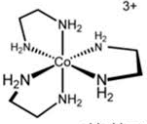
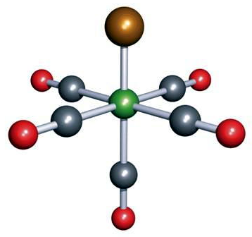
Determine point group of [Co(en)₃]²⁺
en = ethylenediammine, NH₂CH₂CH₂NH₂
Determine point group of Re(CO)₅Cl

Slide 52
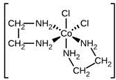
Determine point group of [Co(en)₂Cl₂]
en = ethylenediammine, NH₂CH₂CH₂NH₂

Slide 53
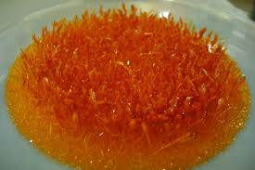
Determine point group of ferrocene, [Fe(C₅H₅)₂] (eclipsed conformation)
Ferrocene eclipsed

Slide 54

Determine point group of ferrocene, [Fe(C₅H₅)₂] (staggered conformation)
Top View
Ferrocene staggered

Slide 55
Some highly symmetric species for you to determine their point group

