Slide 5
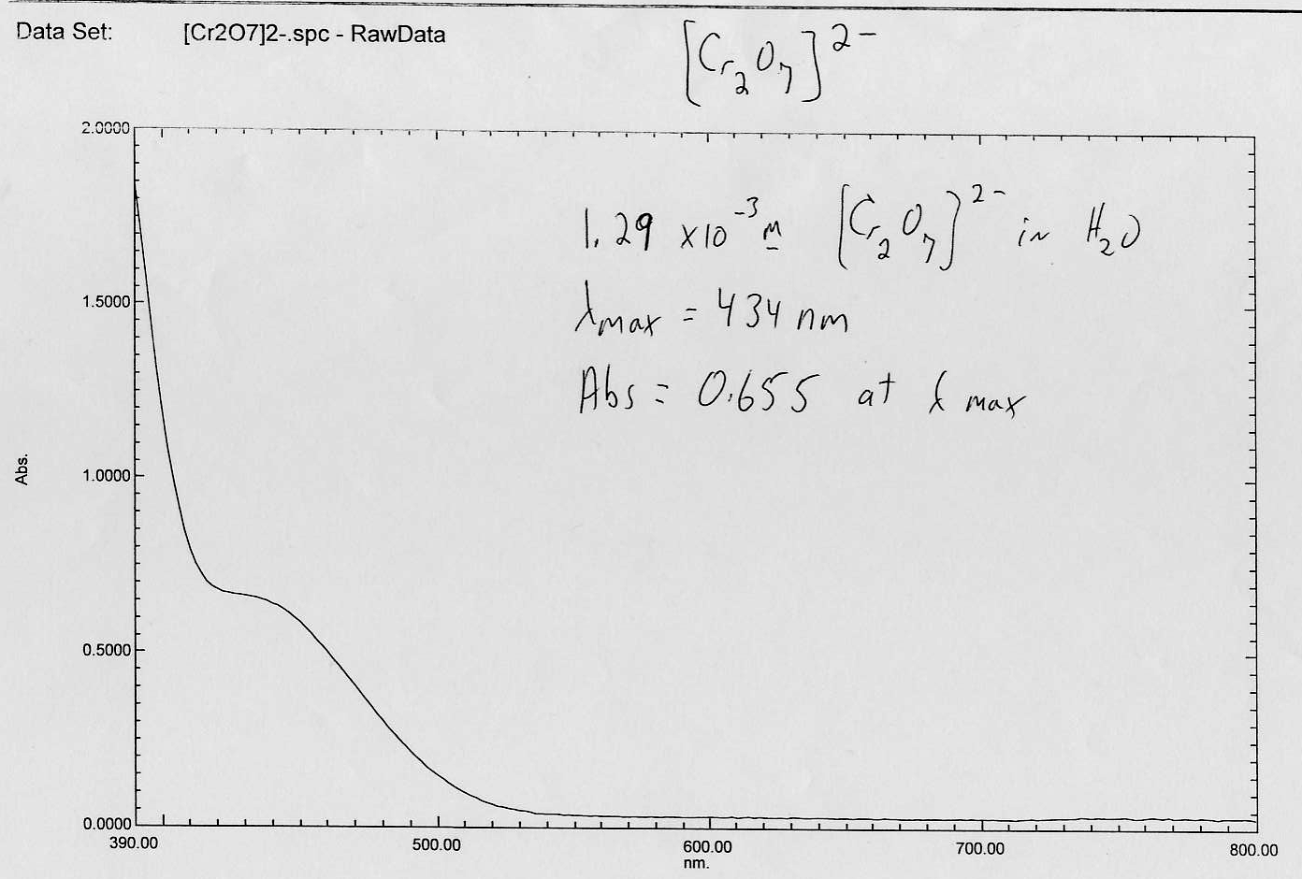

Slide 6
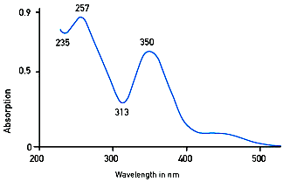
[Cr₂O₇]²⁻ in water

