Slide 1
End result is that solution phase absorptions at room temperature are almost always broad because of the various number of photons (with different energies) being absorbed. The energy of λ_{max} is usually taken as the reference point.

Slide 2
Absorbance intensity (height of the peak) depends on:
1. energy of incident photon
2. concentration
3. path length
4. ε, extinction coefficient
(or molar absorptivity)

Slide 3
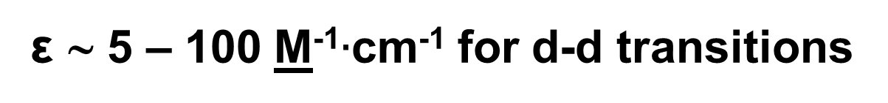
A closer look at extinction coefficients, ε,
(or molar absorptivities)
extinction coefficients (or molar absorptivities) for d-d transitions are typically small
ε ∼ 5 – 100 M⁻¹$∙$cm⁻¹ for d-d transitions
why ε so small ????

Slide 4
M ML₆ 6 ligands

Slide 5
valence atomic orbitals on transition metal include:
s, p and d orbitals
SALC’s – Symmetry Adopted Linear Combination of atomic orbitals; the quantum mechanical wavefunctions describing the Lewis base electrons on ligand being donated from
ligands transition metal
15 atomic orbitals go into the mix; 15 MO come out
t_{2g} orbitals primarily non-bonding and localized on M
e_{g} orbitals exhibit more mixing with the ligands and are more antibonding*

Slide 6
M ML₆ 6 ligands
Molecular orbital diagram of a typical octahedral complex. There are 6 bonding, 3 nonbonding and 6 antibonding orbitals.

Slide 7
Cr [Cr(NH₃)₆]³⁺ 6 NH₃
MO diagram for [Cr(NH₃)₆]³⁺ (a d³ octahedral complex)

Slide 8
A 0.0059 M solution of [Cr(NH₃)₆]³⁺ has a λ_{max} of 465 nm. Absorbance at λ_{max} = 0.302
1. What color is [Cr(NH₃)₆]³⁺ ?
2. What is the value of Δ_{o} in units of cm⁻¹ ?
3. What transition occurred in the complex upon absorption of a 465 nm photon ?

Slide 9
If the incident photon is of the correct energy (same as Δ_{o}), an electron can be promoted from t_{2g}e_{g}
d-d band
hν
⓿
⓿
⓿
465 nm
⓿❶
⓿❶
⓿❶
⓿❶
⓿❶
⓿❶

Slide 10
Selection Rules
1. Laporte selection rule – transitions between states of like symmetry labels are quantum mechanically forbidden while transitions between states of different symmetry labels are quantum mechanically allowed
g u
u g
g g
u u
 allowed ☺
 allowed ☺
 forbidden ☹
 forbidden ☹
2. spin selection rule – transitions that do not change electron spin are quantum mechanically allowed while transitions that change electron spin are quantum mechanically forbidden

Slide 11
d-d band
hν
⓿
⓿
⓿
465 nm
⓿❶
⓿❶
⓿❶
⓿❶
⓿❶
⓿❶

Slide 12
Example of a d-d band
d-d bands have low extinction coefficients (ε ∼ 5-100 M⁻¹·cm⁻¹) because they are Laporte forbidden
(g g)
⓿
⓿
⓿
⓿❶
⓿❶
⓿❶
⓿❶
⓿❶
⓿❶

Slide 13
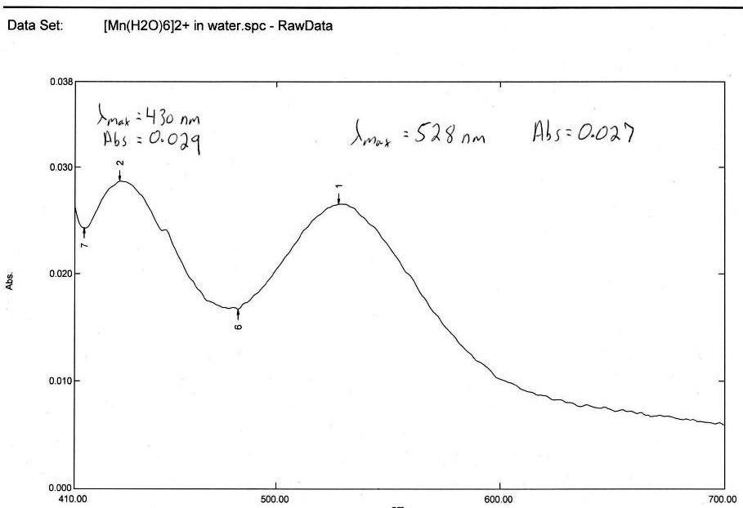
[Mn(H₂O)₆]²⁺ = 0.097 M

Slide 14
Spin-Orbit Coupling (SOC)
1. the electron is spinning on it’s axis thus generating a “spin magnetic moment”
2. at the same time, the electron is rotating about the nucleus thus generating an “orbital magnetic moment”
Quantum mechanically, total angular momentum (made up of the two components above) must be conserved
The nucleus and electron may interact “slightly” perturbing the electrons’ “orbital magnetic moment”. Since total angular momentum must be conserved, the slight change in the “orbital magnetic moment” must be exactly compensated by a “slight” change in “spin magnetic moment”

Slide 15
For this “exchange” of “spin” and “orbital” momentum to occur, the components of their wavefunctions must “slightly” interact
Reality of SOC: Once had rigorously pure t_{2g} and e_{g} states, SOC generates a “mixing of wavefunctions” such that the t_{2g} and e_{g} states are no longer 100% pure in nature. Thus, where a t_{2g} e_{g} transition was “rigorously forbidden”, (probability of transition = zero), SOC provides a means for forbidden transitions to be “a bit less forbidden”
The magnitude of SOC depends on the amount of interaction between the nucleus and electron

Slide 16
heavy atom effect – SOC increases as atomic number, Z, increases

Slide 17
Review of ML₄ tetrahedral complexes
d-d transition (e t₂) is NOT Laporte forbidden
d-d transition (e t₂) is NOT Laporte allowed
tetrahedral complexes display more intense d-d transitions than octahedral (ε ∼ 10 times greater for tetrahedral vs. octahedral)

Slide 18
Charge Transfer Bands
2. Ligand to Metal Charge Transfer (LMCT)
3. Metal to Ligand Charge Transfer (MLCT)
Both LMCT and MLCT are quantum mechanically allowed and thus are very intense. Extinction coefficients (or molar absorptivities) are large, ε ∼ 500-10,000 M⁻¹·cm⁻¹
LMCT – absorption of a photon promotes an electron localized on a ligand to an orbital localized on metal
MLCT – absorption of a photon promotes an electron localized in a d-orbital on a metal to a π* orbital localized on a ligand

Slide 19
If the incident photon is of the correct energy (same as split between orbitals), a primarily ligand e⁻ can be promoted to a d-orbital residing primarily on the metal
⓿
⓿
⓿
LMCT
hν
⓿❶
⓿❶
⓿❶
⓿❶
⓿❶
⓿❶

Slide 20
Example of an LMCT
LMCT = Ligand to Metal Charge Transfer
LMCT bands have large extinction coefficients (ε ∼ 500-10000 M⁻¹·cm⁻¹) because they are Laporte allowed (ug) and usually spin allowed.
⓿
❶
⓿
⓿
⓿❶
⓿❶
⓿
⓿❶
⓿❶
⓿❶

Slide 21
1. What is this ?
⓿
⓿
⓿
LMCT
⓿❶
⓿❶
hν
⓿❶
⓿❶
⓿❶
⓿❶

Slide 22
1. What is this ?
This is another example of an LMCT. Some complexes will reveal 2 LMCT peaks
❶
⓿
⓿
⓿
2. Do you expect this peak to be intense (large extinction coefficient) ?
LMCT
⓿❶
⓿❶
YES (ε ∼ 500-10000 M⁻¹·cm⁻¹) because LMCT are Laporte (ug) and spin allowed.
⓿❶
⓿
⓿❶
⓿❶

Slide 23
Example of an MLCT
MLCT = Metal to Ligand Charge Transfer
MLCT
hν
⓿
⓿
⓿
If the incident photon is of the correct energy (same as split between orbitals), an e⁻ localized primarily on the metal can be promoted to an empty orbital residing primarily on the ligand
⓿❶
⓿❶
⓿❶
⓿❶
⓿❶
⓿❶

Slide 24
⓿
Example of an MLCT
MLCT bands also have large extinction coefficients (ε ∼ 500-10000 M⁻¹·cm⁻¹) because they are quantum mechanically allowed.
MLCT
⓿
⓿
⓿❶
⓿❶
⓿❶
⓿❶
⓿❶
⓿❶

Slide 25
All three types of electronic transitions from the absorption of light that are typical of transition metal complexes represented in one diagram.
MLCT
d-d
band
⓿
⓿
⓿
All three types of transitions typically occur in the visible region of the electromagnetic spectrum, hence the spectacular colors observed for so many transition metal complexes !!!
LMCT
LMCT
⓿❶
⓿❶
⓿❶
⓿❶
⓿❶
⓿❶

Slide 26
Take Home Message for absorption (UV-Vis) spectra
d-d bands are usually Laporte forbidden and can sometimes also be spin forbidden. Thus, they are weak with small extinction coefficients (ε ≈ 5-100 M⁻¹·cm⁻¹)
LMCT bands (ligand to metal charge transfer) are quantum mechanically allowed and thus very intense. They exhibit large extinction coefficients (ε ≈ 500-10000 M⁻¹·cm⁻¹). LMCT’s are favored when the transition metal in the complex is higher valent (+4, +5, +6, +7)
MLCT bands (metal to ligand charge transfer) are quantum mechanically allowed and thus very intense. They exhibit large extinction coefficients (ε ≈ 500-10000 M⁻¹·cm⁻¹). MLCT’s are favored when the transition metal in the complex is lower valent (0, +1, +2). MLCT’s occur when a ligand has an empty π* orbital

