Slide 1
spectroscopy – interaction of light with matter

Slide 2
atoms and molecules “interact” with light by absorbing photons
absorb E
release E
ground state – e⁻ are in
the lowest energy state possible
excited state – e⁻ are promoted to higher energy states
photon
ground state molecule
photon
excited state molecule
absorbed
*
hv

Slide 3
interaction of light with molecules
exited state molecule
*
LUMO
Energy
HOMO
gs molecule

Slide 4
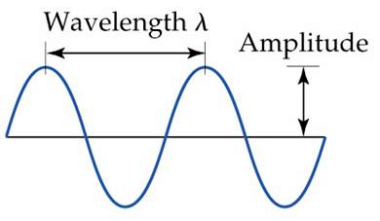
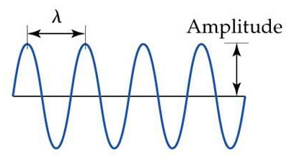
Review of light
wavelength, λ – distance between identical points on successive waves
frequency, ν – # times per second a wavelength moves past a point
Notes:
Figure: 06-03a-c

Slide 5

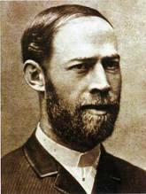
1
sec
ν = 1
ν = 1 Hz
0 1 2 (sec)
1
sec
units for v =
Heinrich Hertz
1857-1894
1
sec
= Hertz or Hz

Slide 6
c = λν
E = hν
hc
λ
E =
h = Planck’s constant
h = 6.626 x 10⁻³⁴ J·sec
c = 3.00 × 10⁸ m/sec

Slide 7
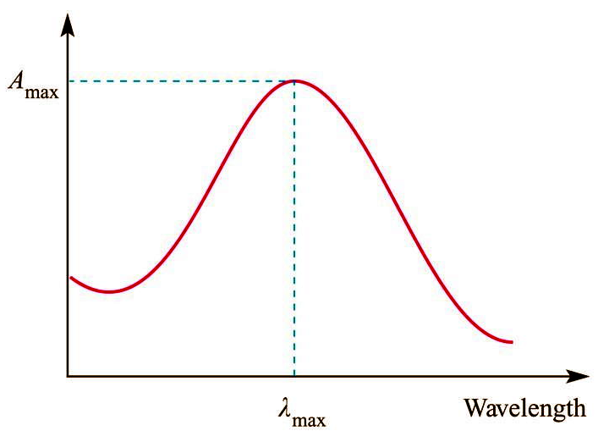
What instrumental technique specifically measures the absorption of light by molecules ?
UV-Vis

Slide 8
λ_{max} = 500 nm
UV-Vis absorption spectra measure the wavelength of light absorbed by the molecule (λ_{max}) as well as the number of photons absorbed (Abs_{max} or extinction coefficient, ε)

Slide 9
energy difference between HOMO and LUMO is indicative of the energy of absorbed photon
exited state molecule
*
LUMO
Energy
500 nm
HOMO
gs molecule

Slide 10
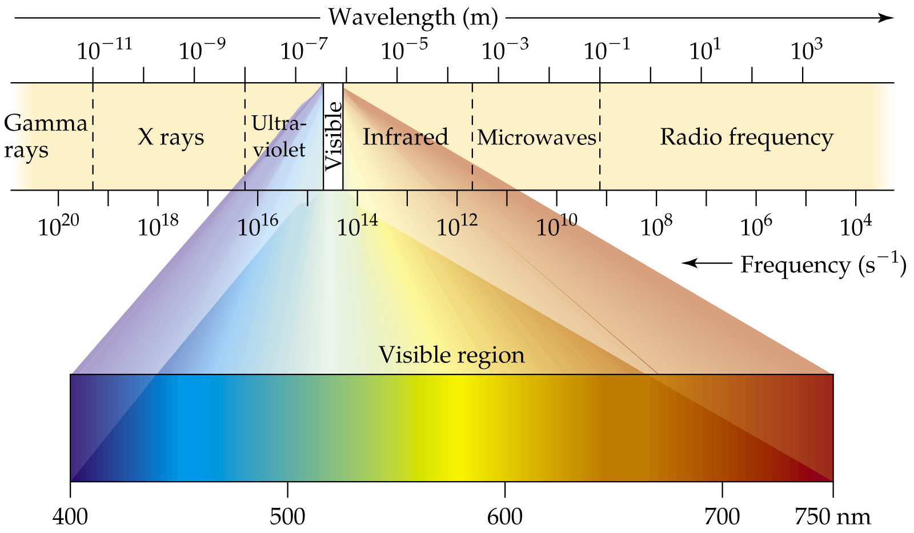
Notes:
Figure: 06-04

Slide 11
white organic compounds..….boring…..snore !

Slide 12
Notes:
Figure: 06-04

Slide 13
Inorganic Compounds ……. Colorful !!!!

Slide 14
Still ..….boring…..snore !

Slide 15
Some beautiful Wildcat Blue CuSO₄·5H₂O

Slide 16
Wake me when this organic stuff is over !

Slide 17
Inorganic compounds…. colorful…exciting…. hurray !

Slide 21
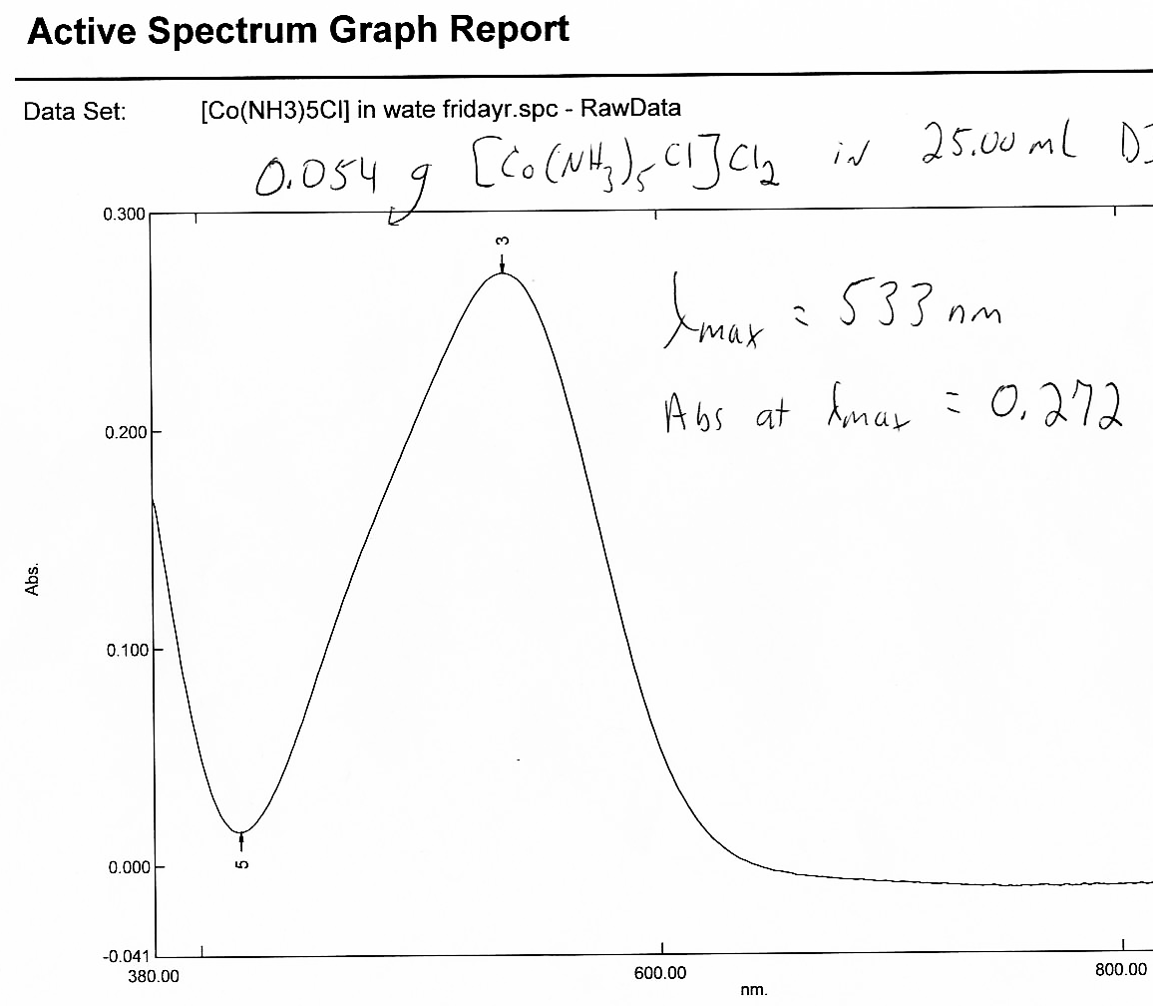
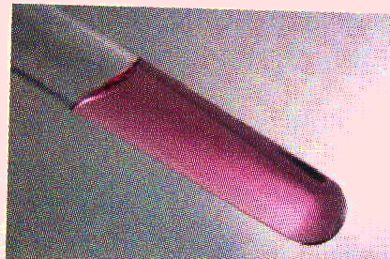
λ_{max} ≈ 533 nm
light purple
UV-Vis absorption spectrum of [Co(NH₃)₅Cl]²⁺

Slide 22
d-d transition – electron transition involves only d-orbitals
d-d transitions are also called: “d-d bands” or “ligand field bands”

Slide 23
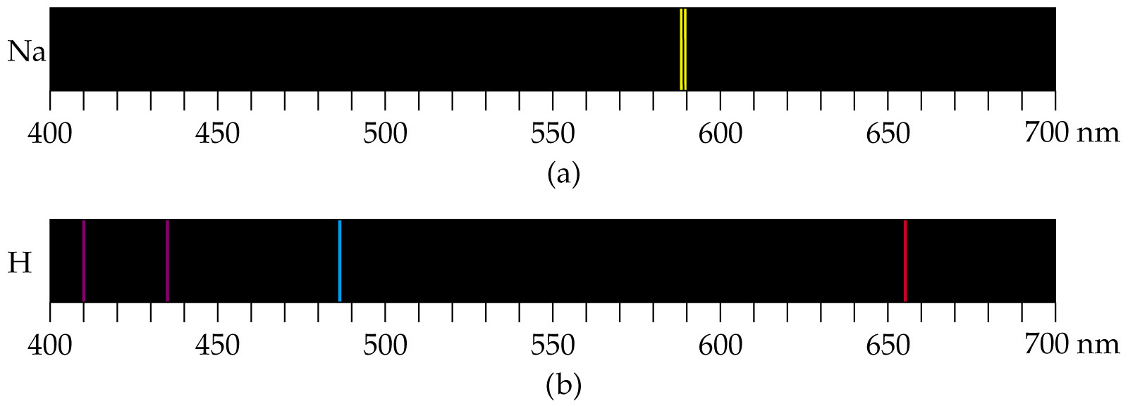
emission spectra of the transitions from atoms are quantized to a specific wavelength
Notes:
Figure: 06-12a,b

Slide 24
λ_{max} ≈ 533 nm
UV-Vis absorption spectrum of [Co(NH₃)₅Cl]²⁺

Slide 26
End result is that solution phase absorptions at room temperature are almost always broad because of the various number of photons (with different energies) being absorbed. The energy of λ_{max} is usually taken as the reference point.

