Slide 1
Hermann Jahn
1907-1979

Slide 2
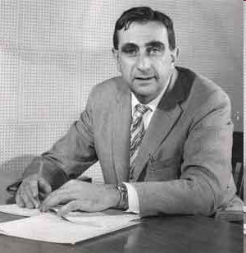
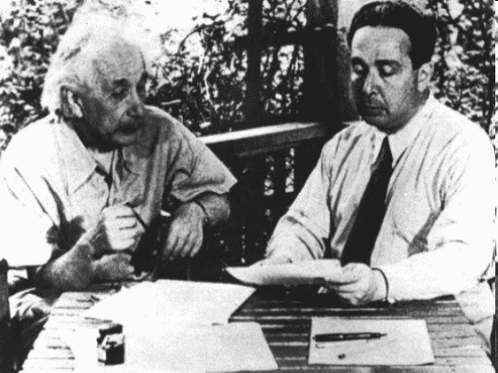

Edward Teller
1908-2003

Slide 3
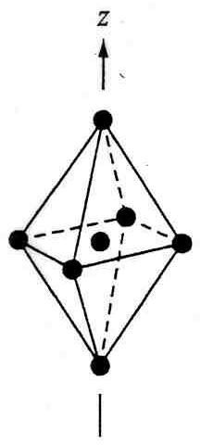
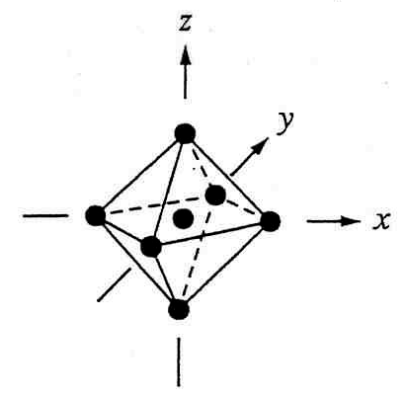
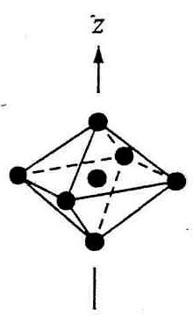
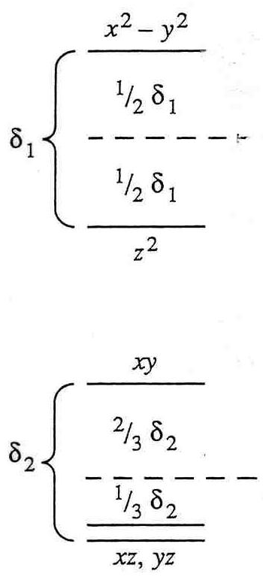
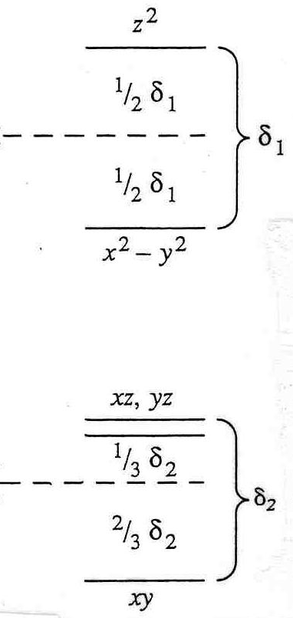
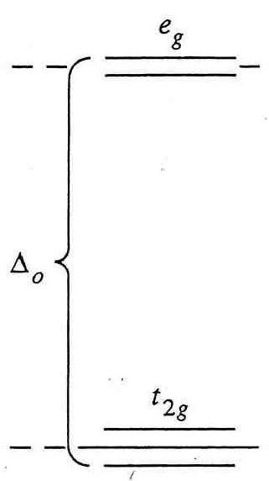
Jahn-Teller Distortions
Z-out (elongation)
Z-in
(compression)
pseudo
barycenter
Δ_{o}

Slide 4
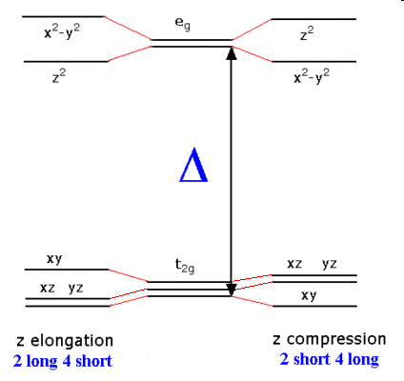
δ₁
δ₂ < δ₁
e⁻ in dz² drive JT distortions!
d⁴ weak field
d⁷ strong field
d⁹ (most prevalent)
Δ_{o}
δ₂

Slide 5
½ δ₁
δ₁
-½ δ₁
Energy levels in a Jahn-Teller distorted complex. Note the LFSE obtained by the distortion. J-T distortions are most prevalent in d⁴ (weak field), d⁷ (strong field) and d⁹ complexes.

Slide 8
square planar is most advantageous for
d⁸ species that possess strong field ligands

Slide 9
dxy, dxz, dyz are more directed toward ligands thus repelled by ligands more
dx² – y² , dz² are less directed toward ligands thus repelled by ligands less

Slide 10
ML₄ tetrahedral complex
virtually all tetrahedral complexes are Weak Field

Slide 11
ML₄ tetrahedral complex
common tetrahedral complexes are: d⁰, d⁵ and d¹⁰
other common tetrahedral complexes are: d² and d⁷

Slide 12
* * *
Ligand field splitting diagrams referenced to a common Barycenter

