Slide 1
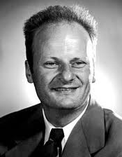
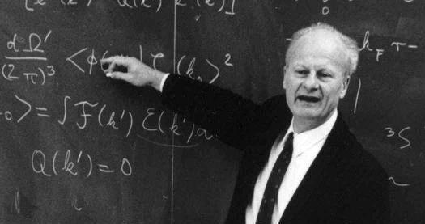
Hans Bethe
1906 - 2005

Slide 2
Crystal Field Theory – metal-ligand bonds are viewed as entirely electrostatic (ionic)
CFT
Ligand Field Theory – crystal field theory that is adjusted for covalency (metal-ligand bonds are more covalent than ionic)
LFT

Slide 3
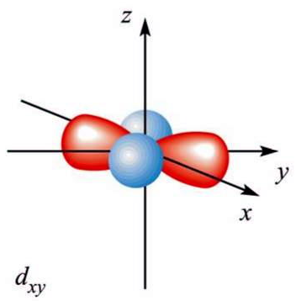
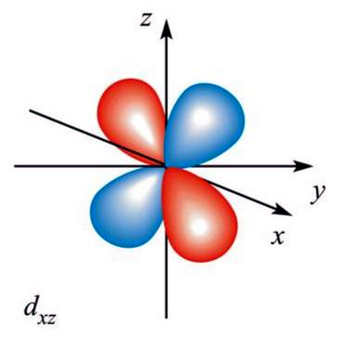
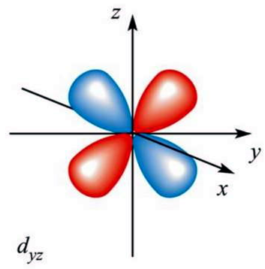
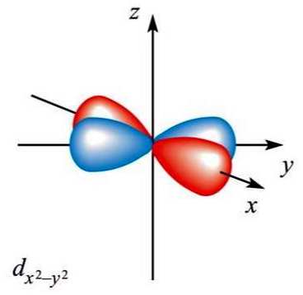
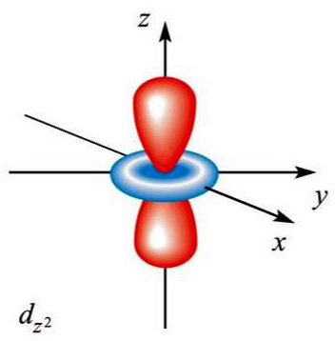

Slide 6
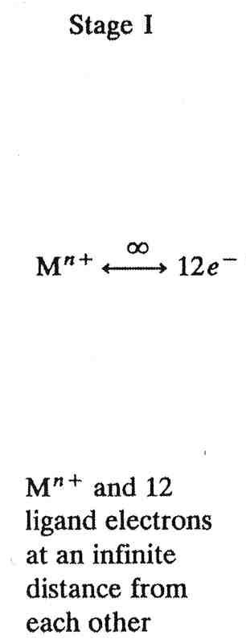
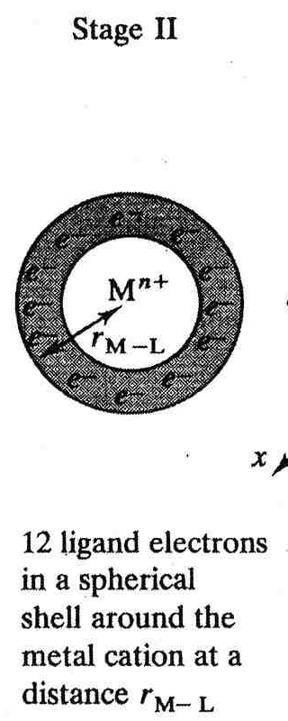
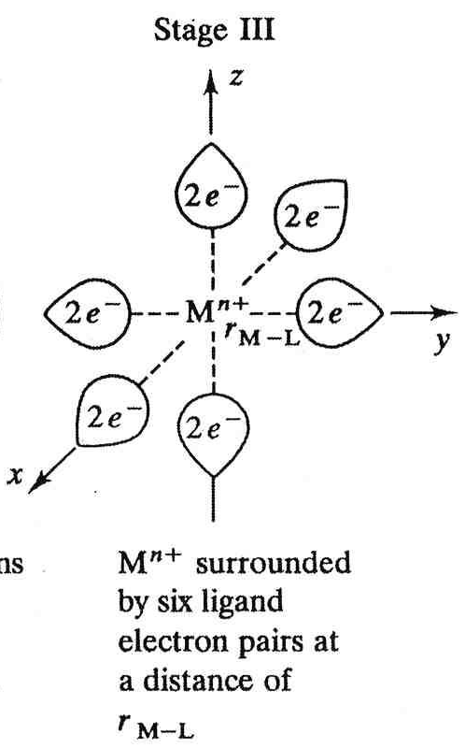
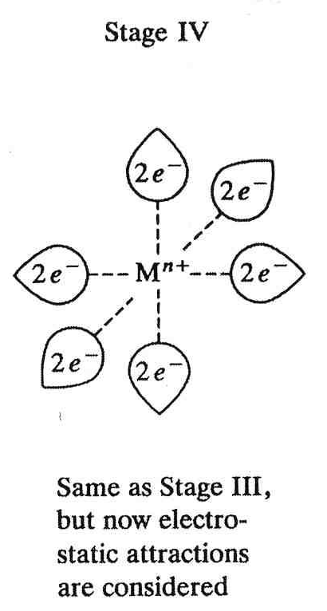
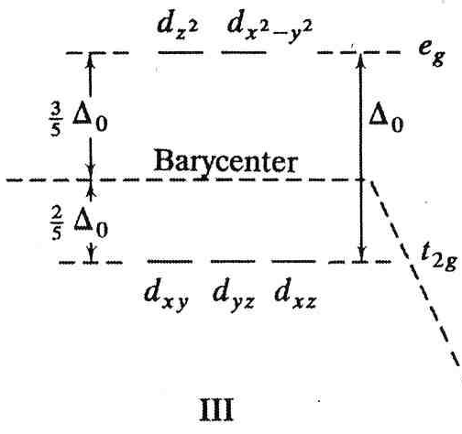
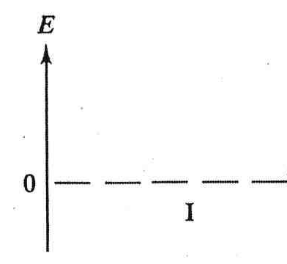
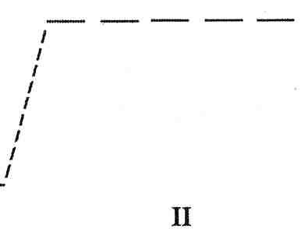
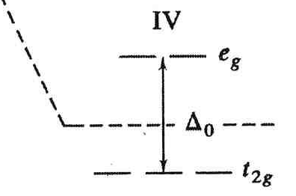

Slide 7
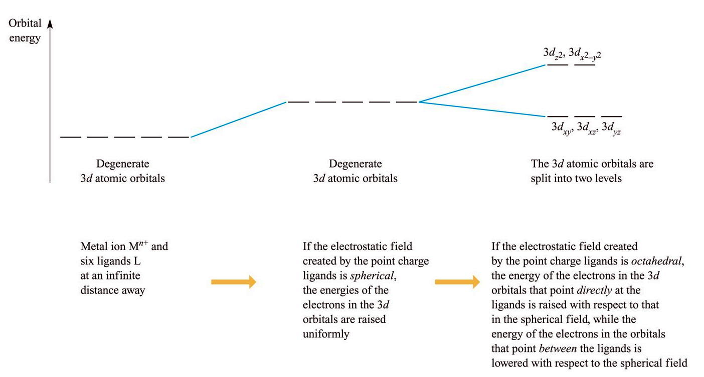

Slide 8
gerade – any orbital whose symmetry labels remain unchanged upon performing an inversion
ungerade – any orbital whose symmetry labels switch upon performing an inversion

Slide 9
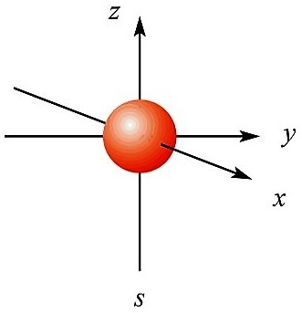
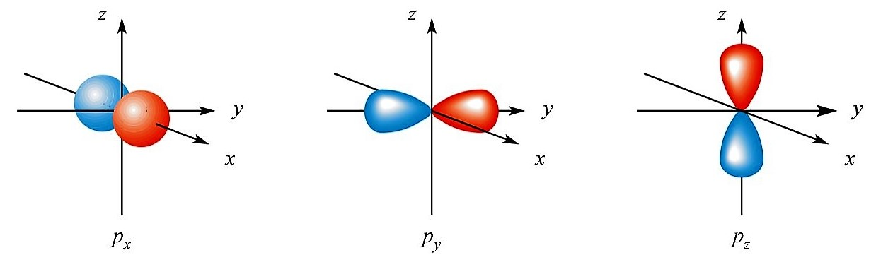
s-orbitals are gerade, g
p-orbitals are ungerade, u

Slide 10
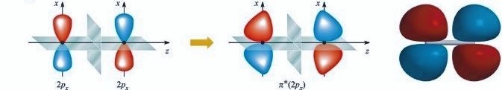
π*-orbitals are gerade, g

Slide 11
all 5 d-orbitals are gerade, g

Slide 12
Barycenter
Barycenter – zero point energy between t_{2g}
and e_{g} orbital sets. It is a
“center of gravity” energy reference point for complex

Slide 13
M
ML₆
Δ_{o}

Slide 15
3/5 Δ_{o}
Δ_{o}
-2/5 Δ_{o}

Slide 16
o
-

Slide 17
Consider the electron configuration of [Ti(H₂O)₆]³⁺
Ligand Field Stabilization Energy – decrease in energy gained (relative to the unsplit, degenerate state) due to d-orbital splitting
LFSE

Slide 18
Determine the LFSE (in units of Δ_{o} and 10Dq) for [Cr(NH₃)₆]³⁺

Slide 19
Determine the LFSE (in units of Δ_{o} and 10Dq) for [Zn(H₂O)₆]²⁺

Slide 20
Determine the LFSE (in units of Δ_{o} and 10Dq) for [Fe(NH₃)₆]³⁺

Slide 21
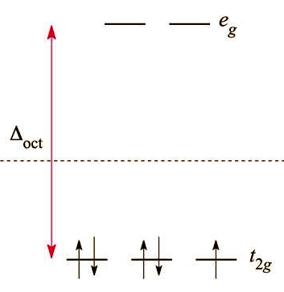
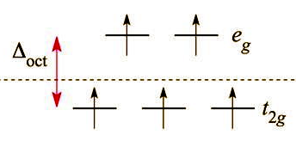
Weak field
(high-spin)
Strong field
(low-spin)
Δ_{oct} < pairing energy
Δ_{oct} > pairing energy

Slide 22
Magnitude of Δ_{o} (extent of d-orbital splitting) depends on three factors:
1. Identity of metal itself
2. Oxidation state of the metal in the complex
3. Identity and number of ligands attached to the transition metal
All three combine to determine if the complex goes strong or weak field

Slide 23
Trend of Δ_{oct} energies for [M(NH₃)₆]³⁺ where M= Co, Rh, Ir

Slide 24
The Spectochemical Series
I⁻ < Br⁻ < S²⁻ < -SCN⁻ (M attached to S) < Cl⁻ < F⁻ < C₂O₄²⁻ < H₂O
< -NCS⁻ (M attached to N) < CH₃CN < NH₃ < en
< bipyridine (bpy) < phenanthroline (phen) < NO₂⁻ < PPh₃ < CN⁻ < CO
I⁻ ◻ H₂O are known as weak field ligands. They cause a small split in Δo.
-NCS⁻ ◻ en is a gray area. The magnitude of Δo caused by these ligands are certainly larger than the weak field ligands above, but the identity and oxidation state of the metal will typically determine whether the complex goes strong field or weak field.
bipyridine (bpy) ◻ CO are known as strong field ligands. They tend create a large enough Δo to drive complexes to strong field.

Slide 25
Determine the number of unpaired electrons and LFSE (in units of Δ_{o} and 10Dq) for [IrCl₆]²⁻

Slide 26
Determine the number of unpaired electrons and LFSE (in units of Δ_{o} and 10Dq) for [CrCl₆]⁴⁻

Slide 27
Determine the number of unpaired electrons and LFSE (in units of Δ_{o} and 10Dq) for [Cr(CN)₆]⁴⁻

Slide 28
Determine the number of unpaired electrons and LFSE (in units of Δ_{o} and 10Dq) for [Fe(H₂O)₆]²⁺

Slide 29
Determine the number of unpaired electrons and LFSE (in units of Δ_{o} and 10Dq) for [Fe(H₂O)₆]³⁺

Slide 30
Is [Ti(H₂O)₆]³⁺ a strong or weak field complex ?

