Slide 2
Lewis Structures
Gilbert Lewis 1875 – 1946
Lewis structures – atoms form covalent bonds using valence electrons to achieve an octet (Noble gas configuration)

Slide 3
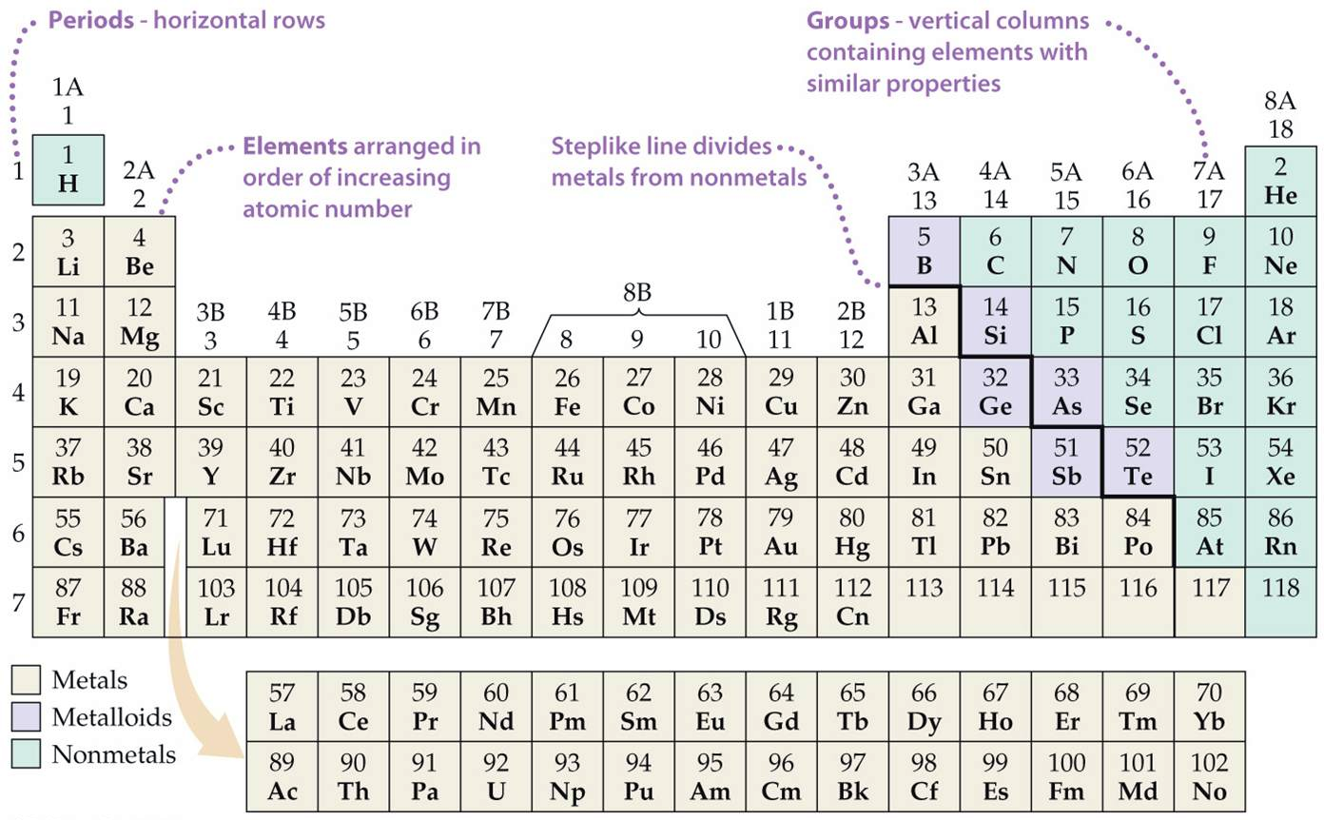
Notes:
Figure: 02-T03
Title:
Table 2.3
Caption:
Names of Some Groups in the Periodic Table

Slide 4
Drawing Lewis Structures
count the total number of valence electrons
make an intelligent guess as to the central element and connectivity
a) heavier element is often the central element
b) many molecules are symmetric
Add electron pairs to satisfy octet rule
start making multiple bonds (first double, then triple if single bonds not getting the job done.)
Do NOT (under any circumstance…..ever) form a multiple bond to a halogen or hydrogen

Slide 5
draw the Lewis structure of H₂O

Slide 6
bonding pair of e⁻ – e⁻ that hold two atoms
(bonding pair) together
nonbonding pair of e⁻ – e⁻ that are NOT holding
(lone pair) 2 atoms together

Slide 7
draw the Lewis structure of CO₂

Slide 8
draw the Lewis structure of CN⁻ (anion)

Slide 9
draw the Lewis structure of SF₅⁺ (cation)

Slide 10
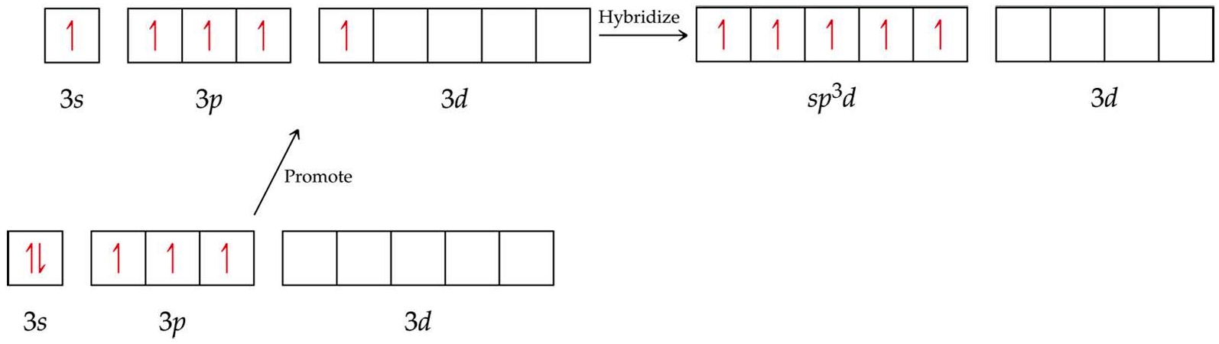
octet expansion – atoms with energetically accessible d-orbitals can exceed 8 valence electrons
Notes:
Figure: 09-20-01UN
Title:
Orbital diagram.
Caption:
Formation of sp³d hybrid orbitals.

Slide 11
Notes:
Figure: 02-T03
Title:
Table 2.3
Caption:
Names of Some Groups in the Periodic Table

Slide 12
draw the Lewis structure of BF₃

Slide 13
draw the Lewis structure of ClF₃

Slide 14
draw the Lewis structure of BrF₅

Slide 15
draw the Lewis structure of SF₄

Slide 16


Resonance – the “real” molecule can NOT be described by a single Lewis structure
Consider NO₂⁻

Slide 18

Barium + Cobalt + Nitrogen
Ba²⁺ + Co⁺ + N³⁻ → BaCoN
The only ionic compound you ever really need !!

Slide 19



Determine the Lewis structure for NO₂⁻
What are your bond expectations for nitrite ?
Notes:
Figure: 08-10

Slide 20
go to lab and measure the actual bond lengths in a real nitrite anion
The N-O bonds in nitrite are identical (in every sense; same length; same strength)
A single Lewis structure can NOT be drawn to describe the “real” nitrite species
Notes:
Figure: 08-10

Slide 21
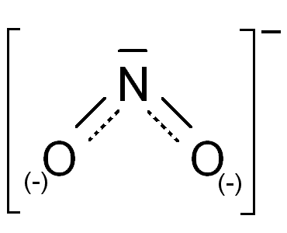
The Real molecule is somewhere in between these two extremes
Notes:
Figure: 08-10

Slide 23
molecular geometry – the orientation of atoms in space (how the atoms are arranged in a molecule)
VSEPR Theory – Valence Shell Electron Pair Repulsion theory
VSEPR is a simple, yet powerful technique to predict the molecular geometry of molecules
e⁻ pairs (bonding or nonbonding) repel each other. Thus, they attempt to get as far apart from each other as possible to maximize separation

Slide 24
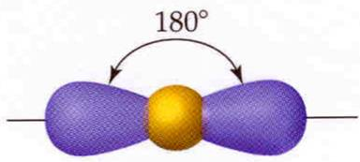
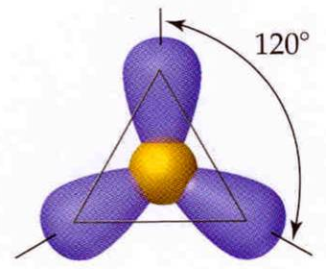
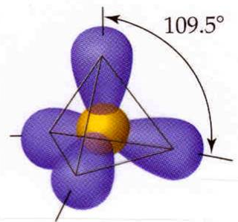
# e⁻ pairs around central element
geometry
name
shape
angles
2 pairs
linear
180°
trigonal
planar
120°
3 pairs
4 pairs
tetrahedral
109.5°

Slide 25
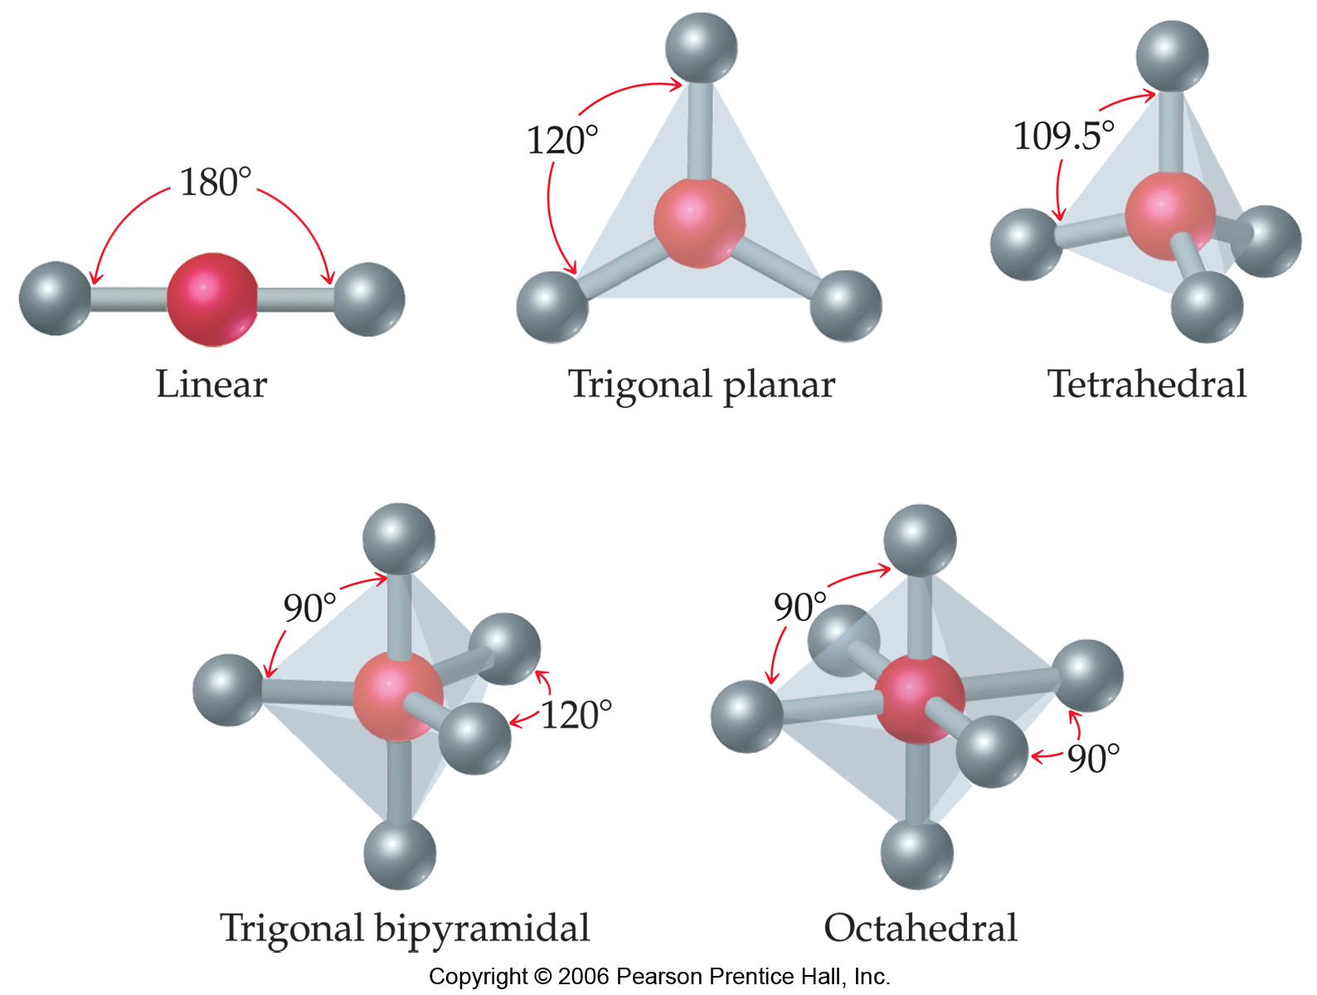
Notes:
Figure: 09-03
Title:
Shapes of AB_{n} molecules.
Caption:
For molecules whose formula is of the general form AB_{n}, there are five fundamental shapes.

Slide 26
electron pair geometry must be known before molecular geometry can be predicted
To determine molecular geometry (MG)
draw the correct Lewis structure
determine # of electron pairs around the central element
determine how those electron pairs orient
attach terminal atoms
the orientation of the atoms in space determine the molecular geometry

Slide 27
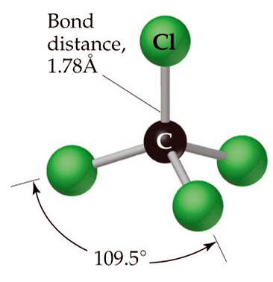
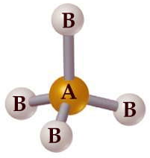
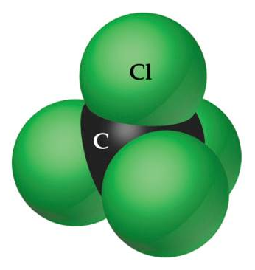
determine the molecular geometry and bond angles of CCl₄
MG = tetrahedral

Slide 28
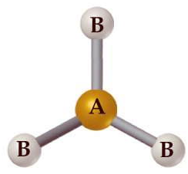
determine the molecular geometry and bond angles of BCl₃
MG = trigonal planar

Slide 29
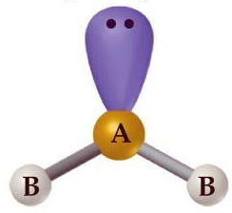
determine the molecular geometry and bond angles of SnCl₂ (molecular species)
MG = bent
bent = 3 atoms that are NOT linear
determine the bond angles of SnCl₂

Slide 30
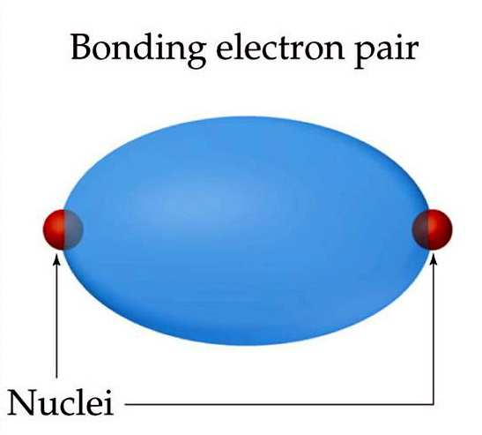
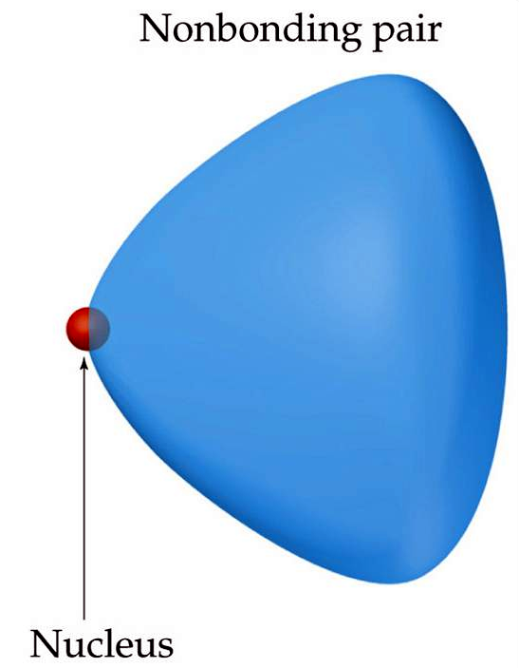
electron repulsion
LP-LP > LP-BP > BP-BP

Slide 31
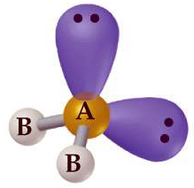
determine the molecular geometry and bond angles of H₂O
MG = bent

Slide 32
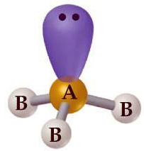
determine the molecular geometry and bond angles of NH₃
MG = pyramidal

Slide 33

The effect of nonbonding (lone pair) electrons on distortions
electron repulsion
LP-LP > LP-BP > BP-BP
Notes:
Figure: 09-06-07UN
Title:
Bond angles of CH₄, NH₃, and H₂O.
Caption:
VSEPR models of methane, ammonia, and water.

Slide 34
compare the bond angles of NCl₃ vs NF₃
The more electronegative the terminal atom, the more it draws electron density toward itself and away from the covalent bond
The smaller the covalent bond, the less repulsion between bonding pairs, decreasing the angle between the respective bonding atoms

Slide 35
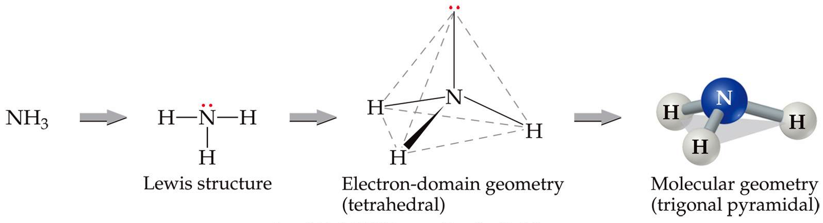
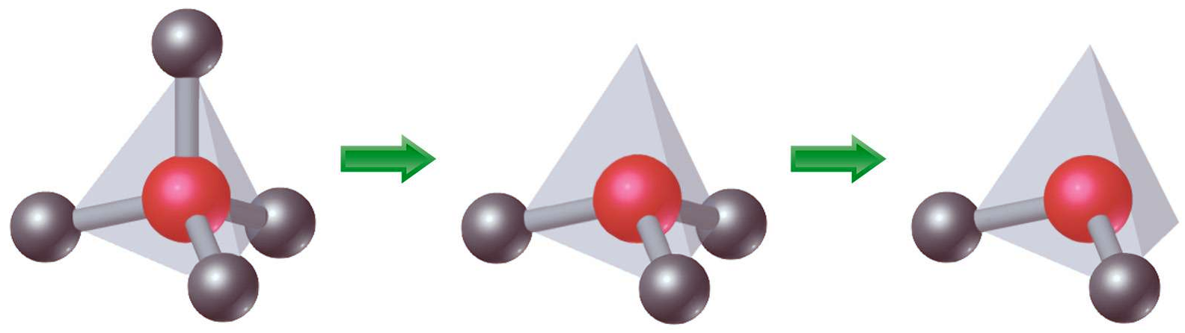
tetrahedral pyramidal bent

Slide 36
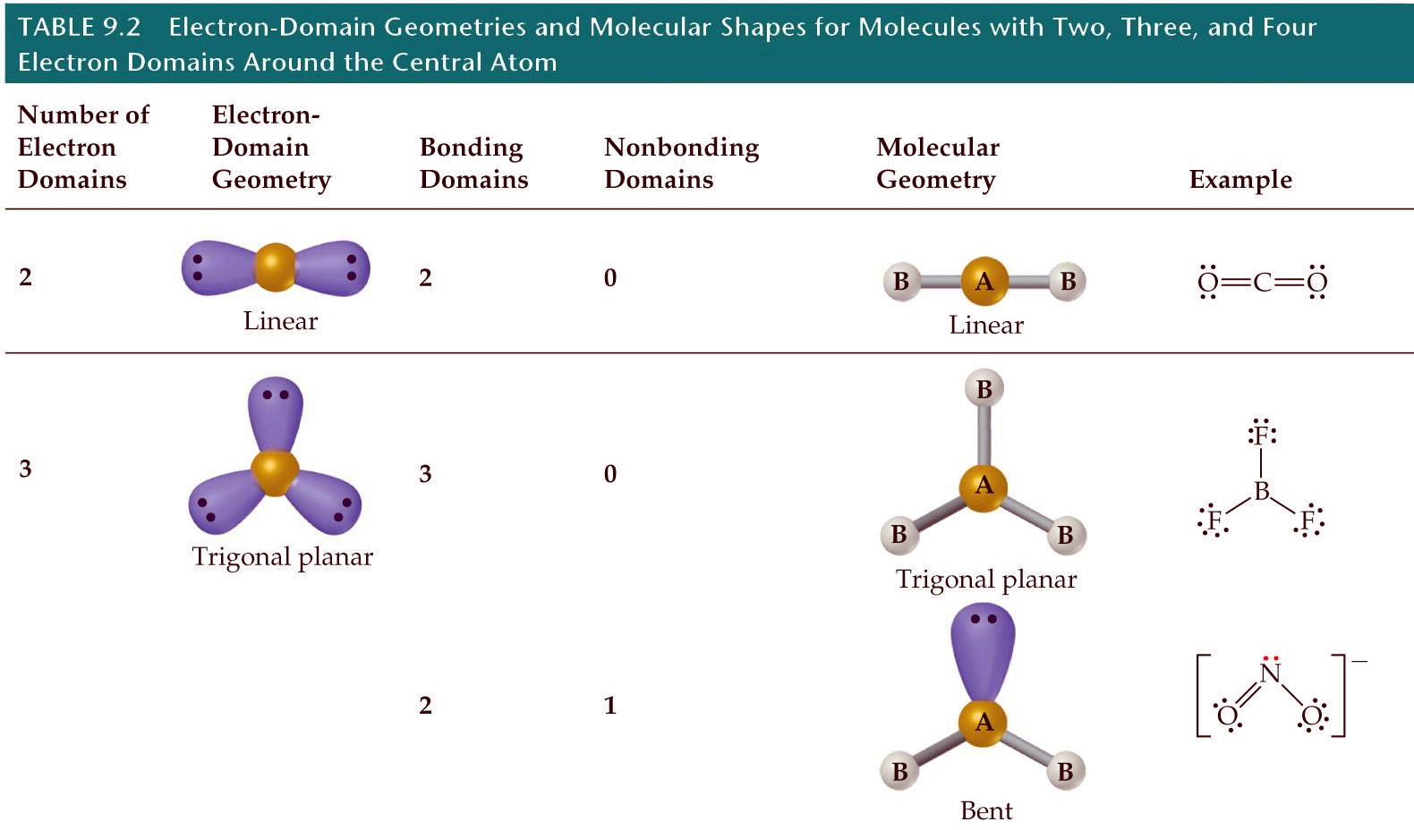
Notes:
Figure: 09-04
Title:
Derivatives from the AB_{n} geometries.
Caption:
Additional molecular shapes can be obtained by removing corner atoms from the basic geometries shown in Figure 9.3. Here we begin with a tetrahedron and successively remove corners producing first a trigonal-pyramidal geometry and then a bent one, each having ideal bond angles of 109.5º. Molecular shape is meaningful only when there are at least three atoms. If there are only two, they must be arranged next to each other, and no special name is given to describe the molecule.

Slide 37
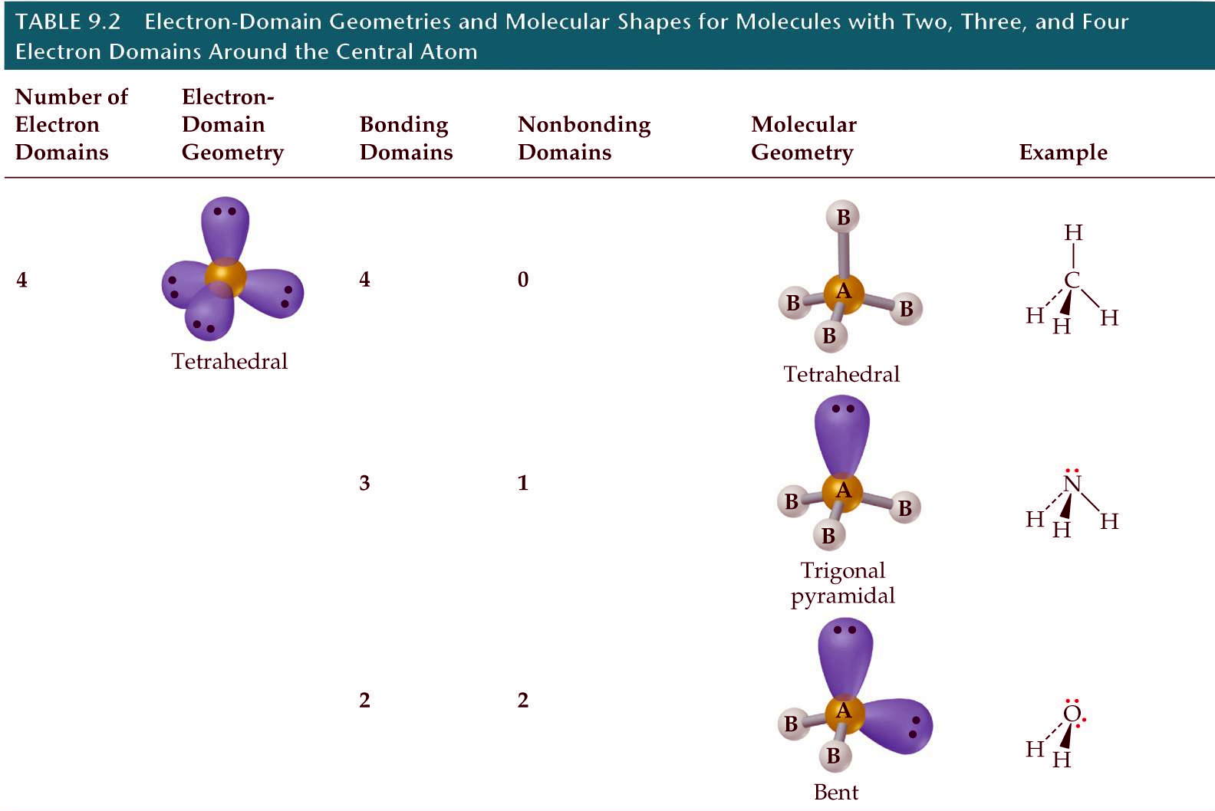
Notes:
Figure: 09-06-02UNT02a
Title:
Table 9.2
Caption:
Electron-Domain Geometries and Molecular Shapes for Molecules with Two, Three, and Four Electron Domains Around the Central Atom.

Slide 38
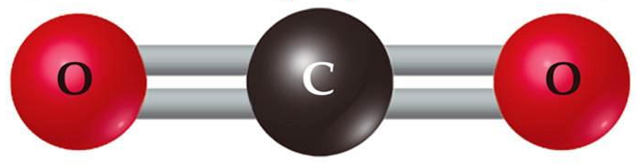
multiple bonds in VSEPR theory
* treat a double or triple bond as if it were a “single bond” from a VSEPR standpoint
determine the molecular geometry of CO₂
MG = linear
Notes:
Figure: 09-07
Title:
Bonding and nonbonding electron pairs.
Caption:
Relative "sizes" of bonding and nonbonding pairs of electrons.

Slide 39


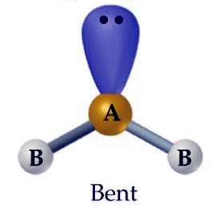
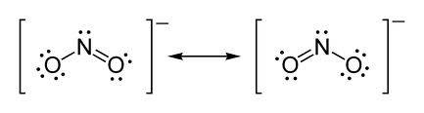
determine the molecular geometry of NO₂⁻ (anion)
MG = bent

Slide 40
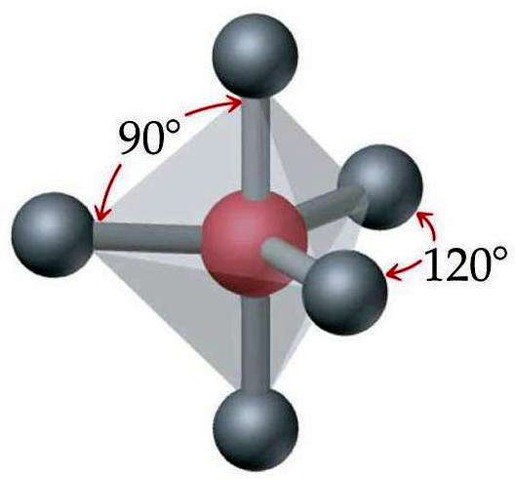
determine the molecular geometry and bond angles of PF₅
MG = triganol bipyramidal

Slide 41
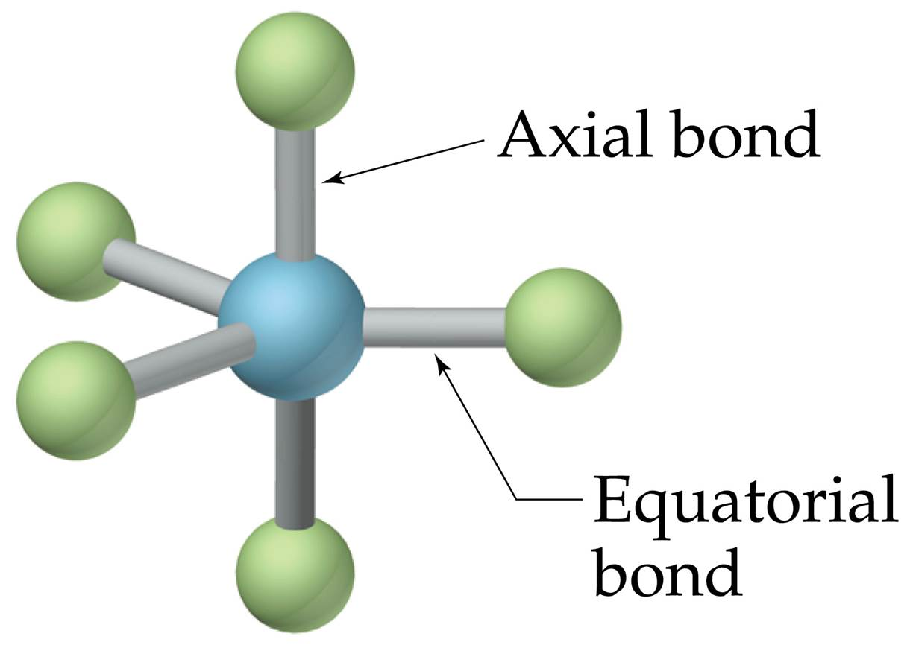
Notes:
Figure: 09-08

Slide 42
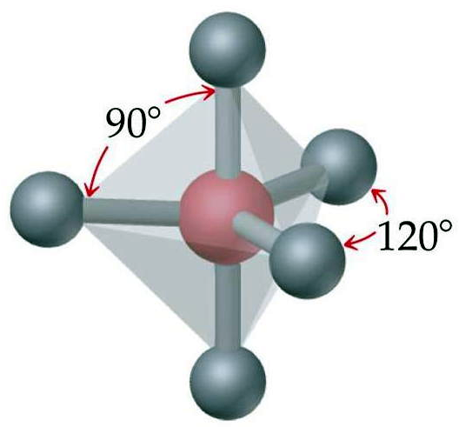
MG = triganol bipyramidal

Slide 43

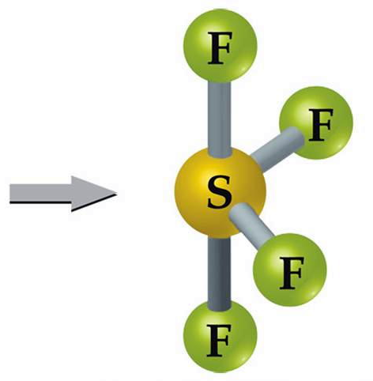
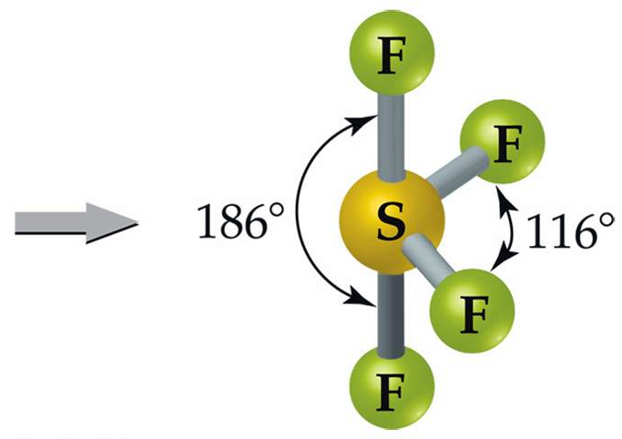
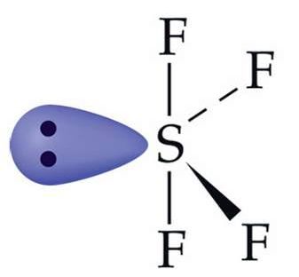
determine the molecular geometry and bond angles of SF₄
MG = see-saw

Slide 44
determine the molecular geometry and bond angles of SOF₄

Slide 45
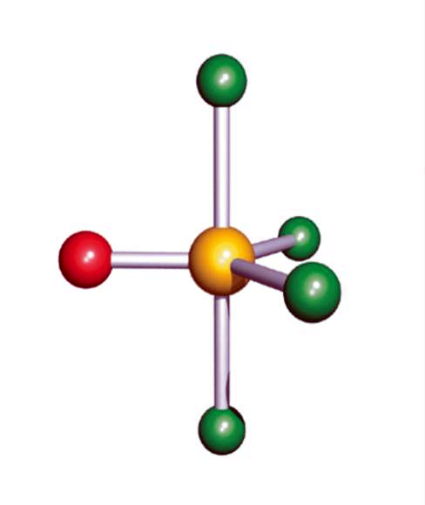
determine the molecular geometry and bond angles of SOF₄
red = oxygen
green = fluorine
Structure of SOF₄
MG = “pseudo” triganol bipyramidal

Slide 46
VSEPR complications in
triganol bipyramidal geometry
1. multiple bonds (double and triple bonds) are bigger and take up more room than single bonds
therefore, if given a choice, a multiple bond goes equatorial (in triganol bipyramidal geometry)
2. The more electronegative the terminal atom, the smaller the resulting bond
therefore, if given a choice, the less electronegative terminal atom goes equatorial (in triganol bipyramidal geometry)

Slide 47
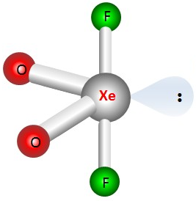


determine the molecular geometry and bond angles of XeO₂F₂
ax
eq
eq
ax
lone pair electrons always takes precedence for the equatorial position
MG = “pseudo” see-saw

Slide 48
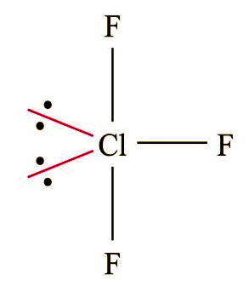
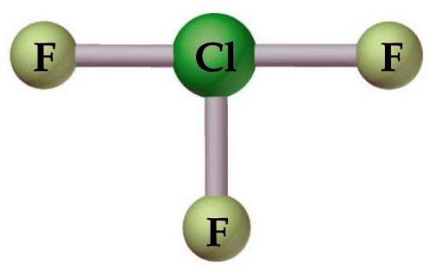
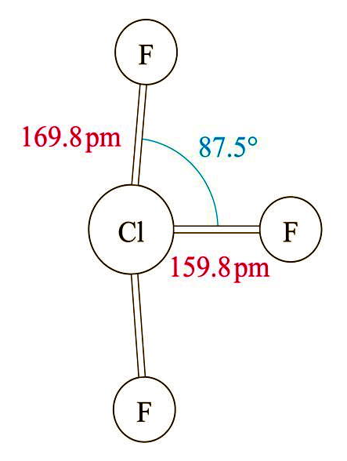
determine the molecular geometry and bond angles of ClF₃
MG = T-shape
or
MG = bent T

Slide 49
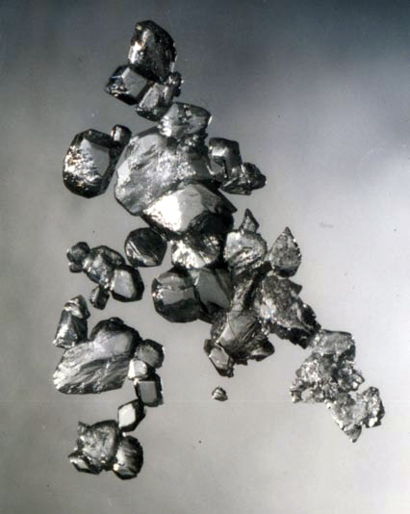
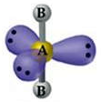
determine the molecular geometry and
bond angles of XeF₂
MG = linear

Slide 51
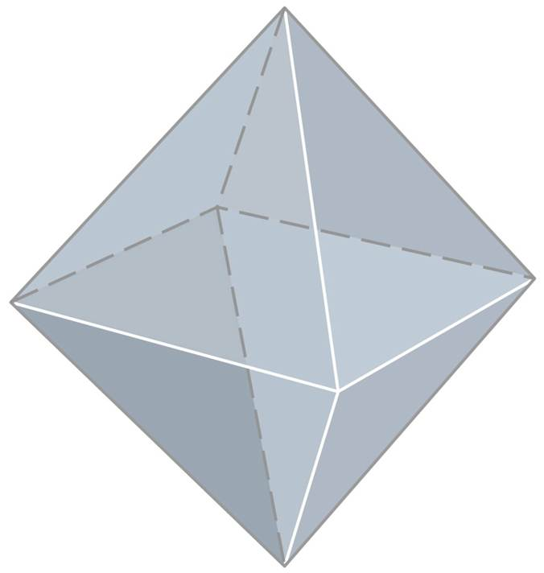
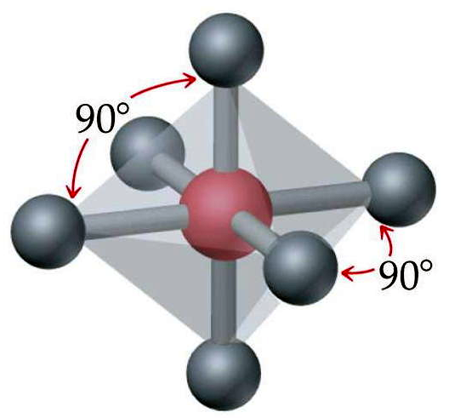
determine the molecular geometry and
bond angles of SF₆
MG = octahedral

Slide 52

determine the molecular geometry and
bond angles of IF₅
ax
ba
ba
ba
ba = basal
ba
MG = Square Pyramidal

Slide 53
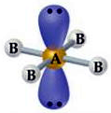
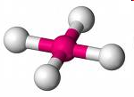
determine the molecular geometry and
bond angles of ICl₄⁻ (anion)
MG = square planar

Slide 55
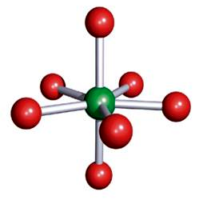
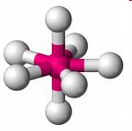
determine the molecular geometry and
bond angles of IF₇
ax
eq
eq
eq
eq
eq
ax
7-Coordinate
MG = pentagonal bipyramidal

Slide 56
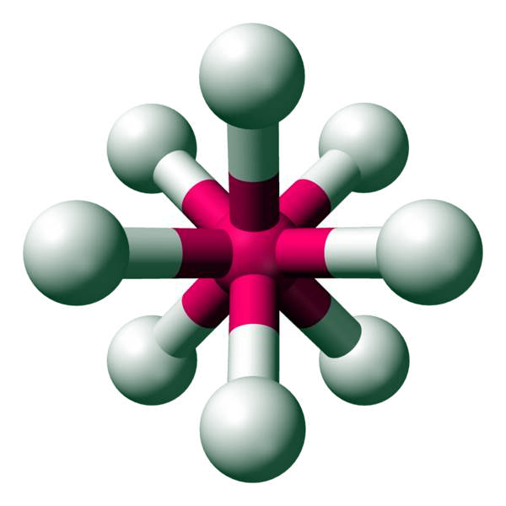
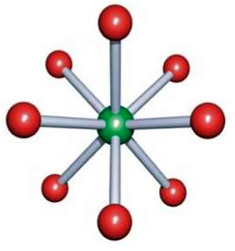
determine the molecular geometry and
bond angles of IF₈⁻ (anion)
8-Coordinate
MG = square antiprismatic

Slide 57

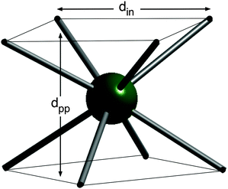
MG = square antiprismatic
Notes:
Figure: 09-09-03UNEx.2
Title:
Sample Exercise 9.2
Caption:
Lewis structure.

Slide 59
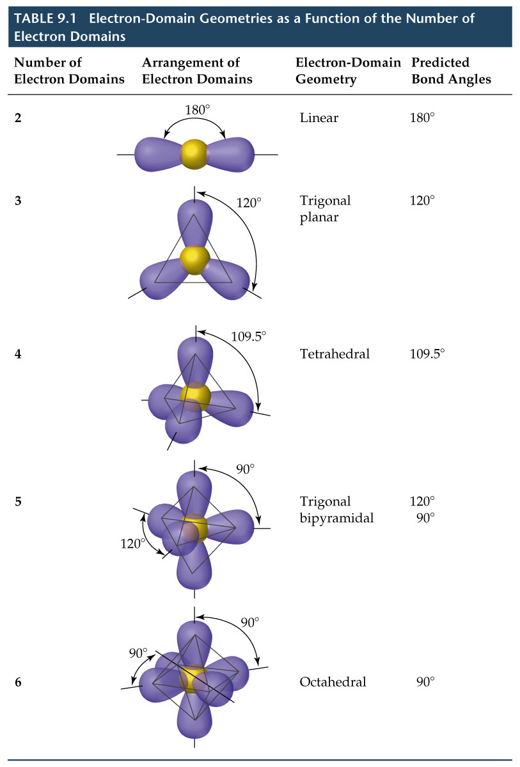
Notes:
Figure: 09-05-01TO1

