Slide 1
thermochemistry – energy or heat changes during chemical reactions
energy – the capacity to do work or transfer heat
1. kinetic energy, KE = ½ mv²
2. potential energy – energy possessed by position or chemical composition

Slide 2
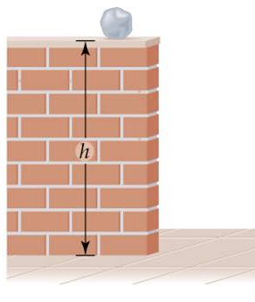
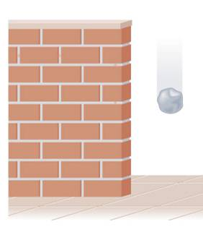
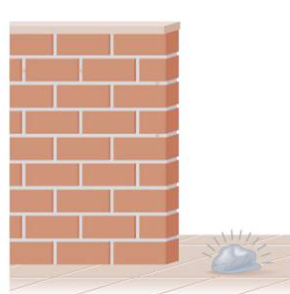
rock has potential energy due to it’s position but no KE
PE decreasing while
KE increasing
traded PE for KE
Notes:
Figure: 05-05

Slide 3
Joule, J – SI unit of energy
1000 J = 1 kJ
calorie, cal = 4.184 J (exactly)
system – stuff directly involved in the process
surroundings – the environment the system affects
Heat lost by the system is equal to
the heat gained by the surroundings

Slide 4
1st Law of Thermodynamics – energy cannot be created or destroyed, only transferred from one place to another
heat, q – the energy transferred between objects of different temperatures
exothermic – system liberates heat. q = – #
endothermic – system absorbs heat. q = + #

Slide 5
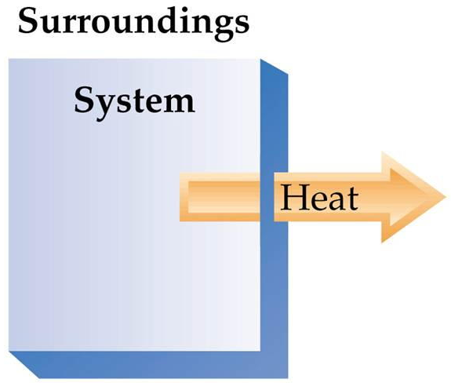
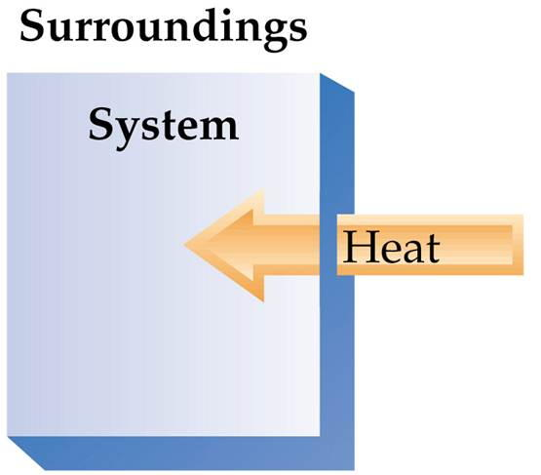
exothermic
endothermic
q = – #
q = + #
Notes:
Figure: 05-12

Slide 6
calorimetry – the science of measuring heat changes
specific heat – the heat required to raise
1 g of substance by 1 °C
units for specific heat are: J/g·°C
q = (specific heat) (mass) (ΔT)
heat sp. ht. g
ΔT = T_{final} - T_{initial}
Notes:
Figure: 05-07

Slide 7
How much heat is required to raise 16.93 g H₂O from 18.2 °C to 84.3 °C ?
Two methods for measuring heat changes
1. Constant pressure calorimetry
(coffee cup calorimetry)
2. Constant volume calorimetry
(bomb calorimetry)

Slide 8
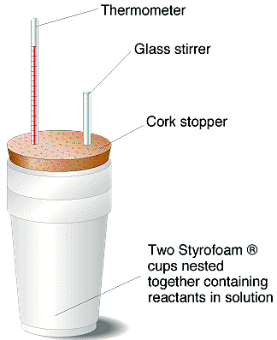
1. Constant pressure calorimetry (coffee cup calorimetry)
15.049 g Al (s) was heated to 97.2 °C then dumped into 81.432 g H₂O at 21.3 °C. The temperature of the H₂O rose to 24.2 °C. What is the specific heat of Al (s) ?

Slide 9
Heat lost by the system is equal to
the heat gained by the surroundings
Heat lost by the Al (s) is equal to
the heat gained by the H₂O ()
-q_{met} = q_{w}
-q_{met} = q_{w} = 988 J
-q_{met} = 988 J
q_{met} = -988 J

Slide 10
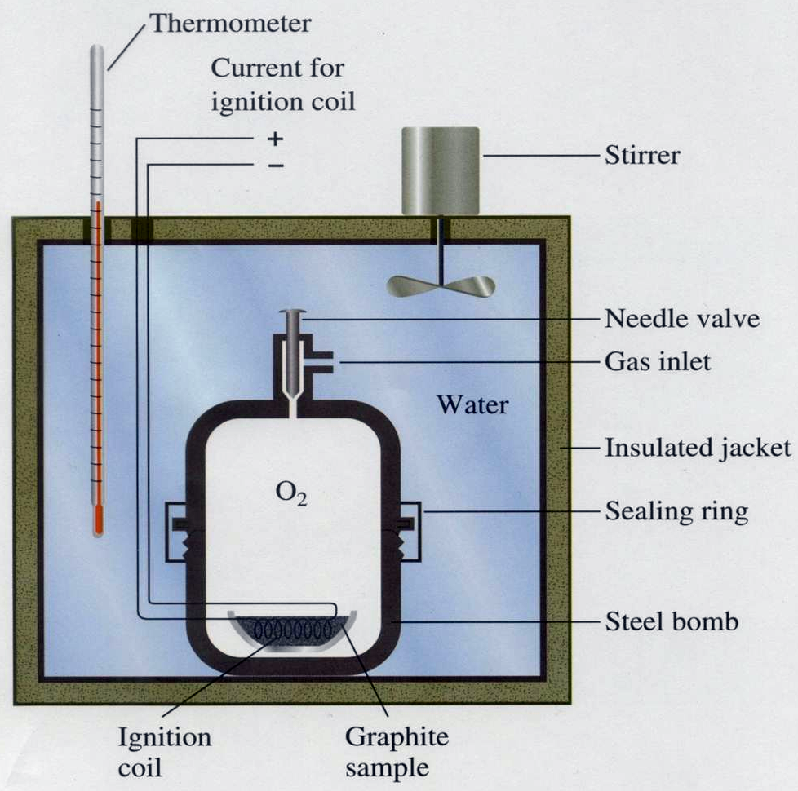
2. Constant volume calorimetry (bomb calorimetry)
put in material to burn
pump in lots of oxygen, O₂
put “bomb” in a container of water
combust it and measure the temperature increase
Notes:
Figure: 05-06

Slide 11
heat capacity, C – the ΔT experienced by an object when heat is absorbed
units for heat capacity are J/°C (or kJ/°C)
1.236 g C₃H₈ and excess O₂ was placed into a bomb calorimeter and submerged in H₂O then combusted. The temperature rose from 21.13 °C to 33.49 °C. The heat capacity, C_{bomb} = 5.03 kJ/°C. How much heat in kJ, kJ/g and kJ/mole did the combustion reaction liberate ?

Slide 12
Heat liberated by the system is equal to
the heat gained by the surroundings
Heat liberated by the combustion reaction is equal to the heat gained by the bomb calorimeter apparatus
-q_{rxn} = q_{bomb}
-q_{rxn} = q_{bomb} = 62.1708 kJ
-q_{rxn} = 62.1708 kJ
q_{rxn} = -62.1708 kJ

Slide 13
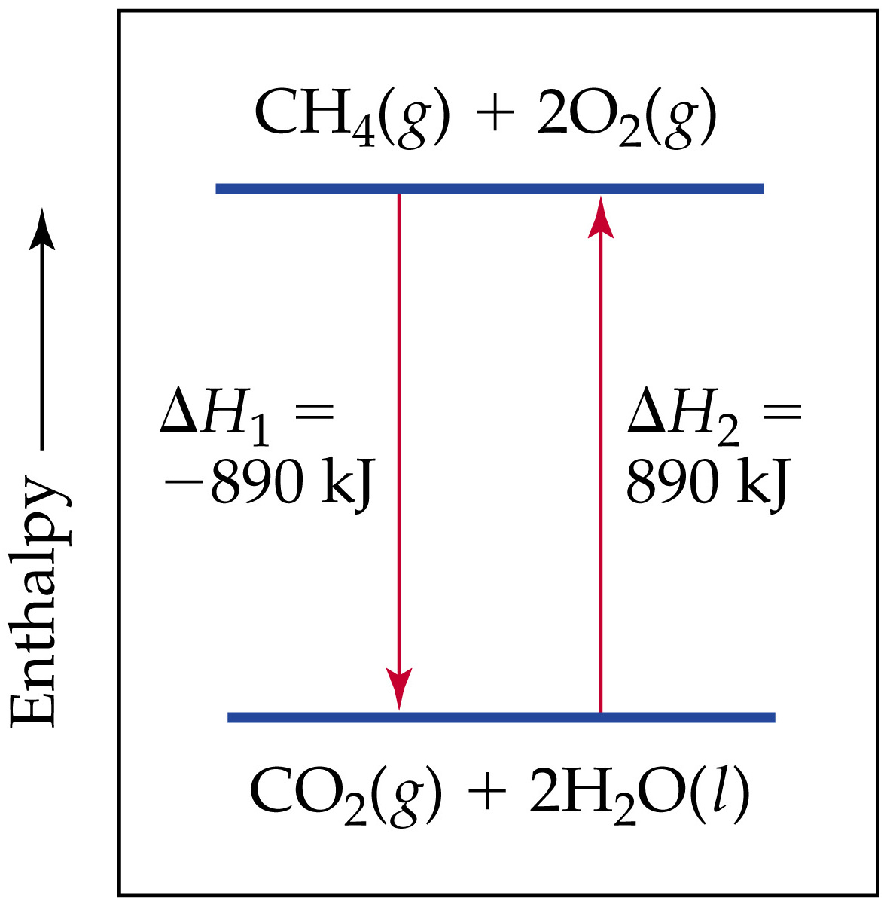
enthalpy, H – heat content measured when the pressure remains constant
Notes:
Figure: 05-16

Slide 14
standard heat of formation – the ΔH (heat) that accompanies the formation of 1 mole of anything from it’s free, uncombined elements at standard conditions
standard conditions – 25 °C and 1 atm pressure
units for are kJ/mole
coefficients represent number of moles
product must be formed from free, uncombined elements

Slide 15
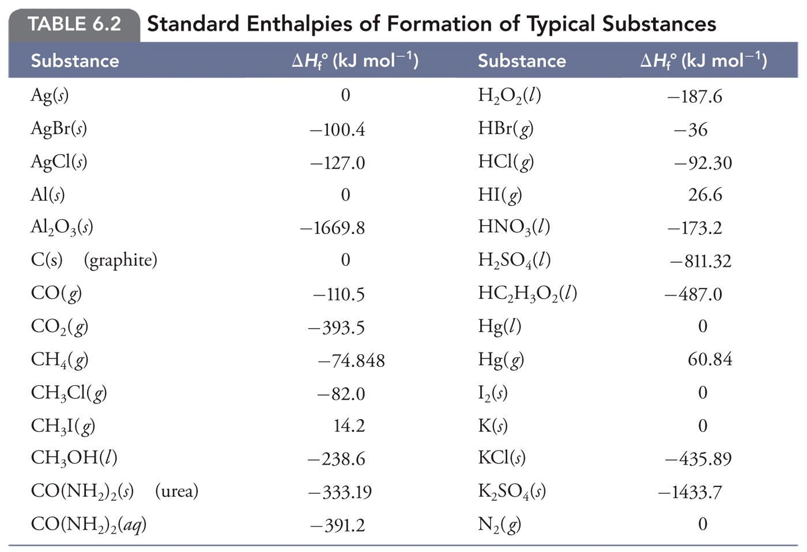

Slide 16
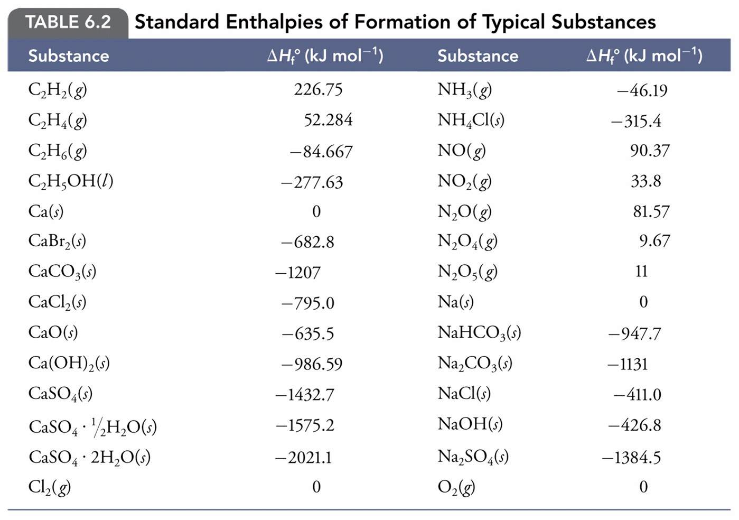
Write the reaction describing the of NaCl (s)

Slide 17
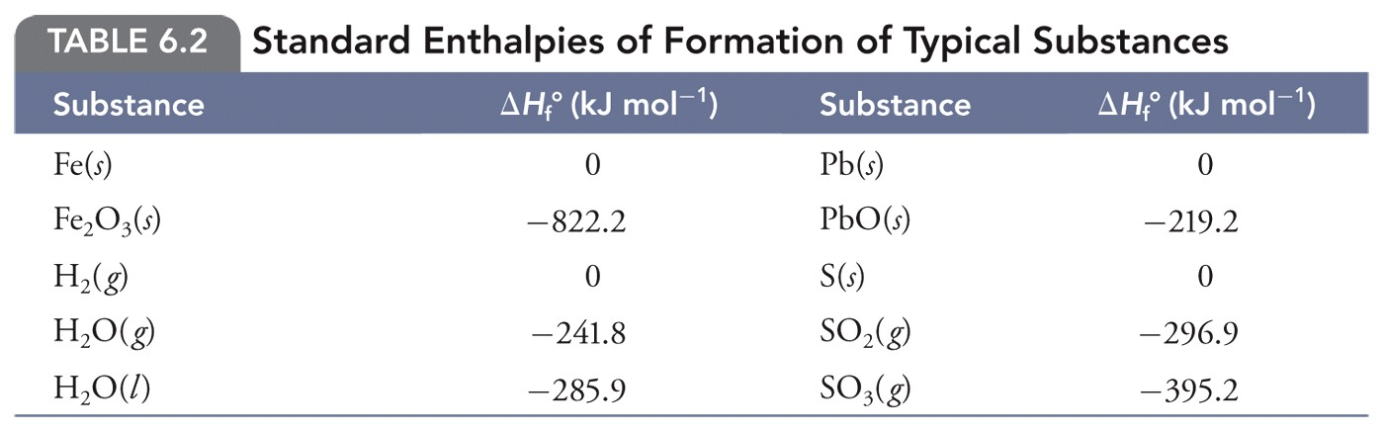

Slide 18
standard heat of reaction – the ΔH (heat) that accompanies ANY reaction under standard conditions
(units are kJ)
= [(sum products) – (sum reactants)]
1. write and balance the reaction
2. use table of thermodynamic data of to calculate

Slide 19
Determine the for the combustion of ammonia
4
3
6
NH₃ (g) + O₂ (g) N₂ (g) + H₂O (g)
2

Slide 23
Determine the for the following reaction at
84 °C and 0.79 atm
P₄O₁₀ (s) + H₂O () H₃PO₄ ()
6
4

