Slide 1
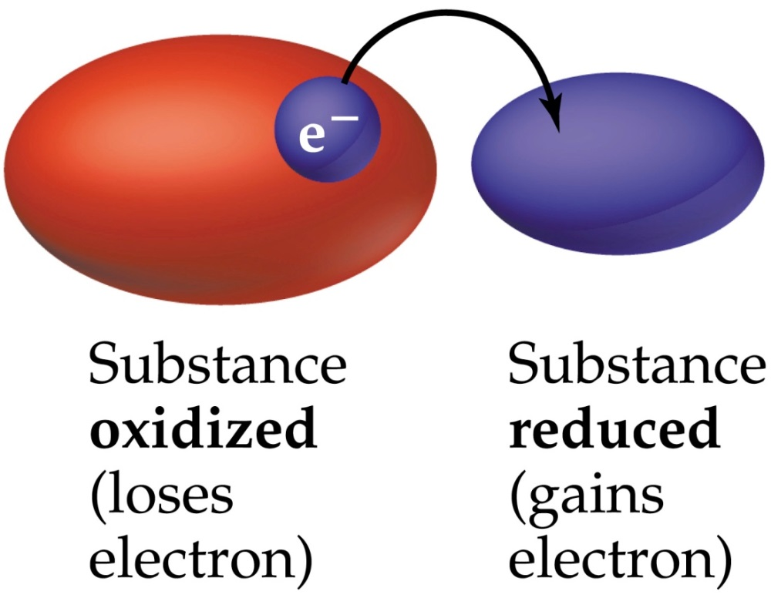
Oxidation-Reduction reactions
oxidation – something loses electrons (gets oxidized)
reduction – something gains electrons (gets reduced)
redox reactions – reactions where electrons are transferred from one species to another
oxidation and reduction always occur together

Slide 2
Mg (s) + ½ O₂ (g)
MgO (s)
Mg Mg²⁺
Mg lost 2 e⁻
Mg got oxidized
O O²⁻
Oxy gained 2 e⁻
Oxy got reduced
oxidizing agent – reactant which removes electrons from another species (causes another species to get oxidized)
reducing agent – reactant which gives electrons to another species (causes another species to get reduced)

Slide 3
Balancing Redox Reactions via the “Method of ½ Rxns”
For an acidic solution
1. Break the unbalanced reaction up into ½ reactions
2. For each ½ rxn, add coefficients to balance all elements, except hydrogen, H and oxygen, O
3. For each ½ rxn, balance oxygen by adding H₂O
4. For each ½ rxn, balance hydrogen by adding H⁺
5. For each ½ rxn, balance charges by adding e⁻
6. Multiply one (or both) ½ rxns by integers so that e⁻ will cancel when ½ rxns are added

Slide 4
Balancing Redox Reactions via the “Method of ½ Rxns”
For a basic solution
1. Balance the reaction in an acidic solution
2. Add same amount of OH⁻ to both sides to cancel H⁺

Slide 5
Electrochemistry - The relationship between chemical processes and electricity
Two fundamental types of electrochemical processes
1. Electrolytic processes – (nonspontaneous)
2. Voltaic (or galvanic) processes – (spontaneous)
Electrolytic process – an electrochemical process that requires the continual, external input of electrical energy to drive a nonspontaneous redox reaction

Slide 6
electrolytic cells – the containers in which the electrolysis occurs
electrodes – the actual surfaces where oxidation and reduction physically occur
anode – electrode where the process of oxidation occurs
cathode – electrode where the process of reduction occurs

Slide 7
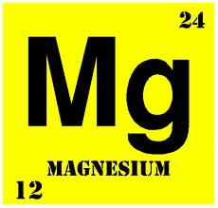
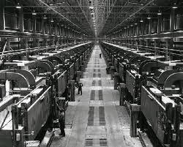
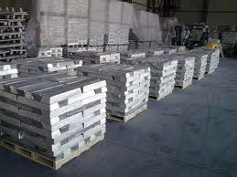

Slide 8
B-36 Peacemaker
gross weight = 410,000 lbs
each B-36 had 22,000 lbs Mg

Slide 9
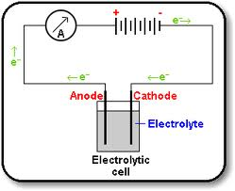
voltage source
anode
cathode
+ + +
- - -
+ + +
- - -
positively charged
negatively charged
cell contains molten MgCl₂ (l)…. (which is Mg²⁺ and 2 Cl⁻)
Mg²⁺ migrates toward the cathode
Cl⁻ migrates toward the anode
Notes:
Figure: 20-28

Slide 10
voltage source
anode
cathode
+ + +
- - -
positively charged
negatively charged
cathode:
Mg²⁺
+ 2 e⁻
Mg
(reduction)
anode:
2
Cl⁻
Cl₂
+ 2 e⁻
(oxidation)
2 e⁻ +
Mg²⁺
+ 2 Cl⁻
Mg + Cl₂ + 2 e⁻
Notes:
Figure: 20-28

Slide 11
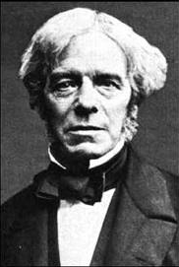
Michael Faraday 1791 – 1867
“The amount of chemical change that occurs during electrolysis is directly proportional to the amount of electricity that passes through the cell”

Slide 12
Coulomb, C – SI unit of charge
C = (amps) (sec)
ampere, amp – SI unit of electrical current
1 mole e⁻ = 96,485 C

Slide 13
How many grams of elemental magnesium, Mg (s) can be produced by the electrolysis of molten MgCl₂ (l) with an electrical current of 6.00 amps for 2222 seconds ?
1. Write the ½ reaction of interest
2. If possible, get Coulombs, C

Slide 14
What current, in amps, is required to produce 45.5 g of elemental chlorine, Cl₂ (g) from a melt of NaCl (l) if electrolyzed for 2 hours, 15 minutes and 25 seconds ?

Slide 15
Two fundamental types of electrochemical processes
1. Electrolytic processes – (nonspontaneous)
2. Voltaic (or galvanic) processes – (spontaneous)
Voltaic process – an electrochemical cell which generates an electrical current from a spontaneous chemical redox process

Slide 16
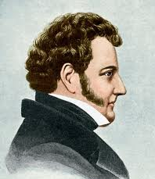
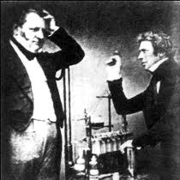
John Daniell 1790 – 1845
Daniell and Faraday

Slide 17
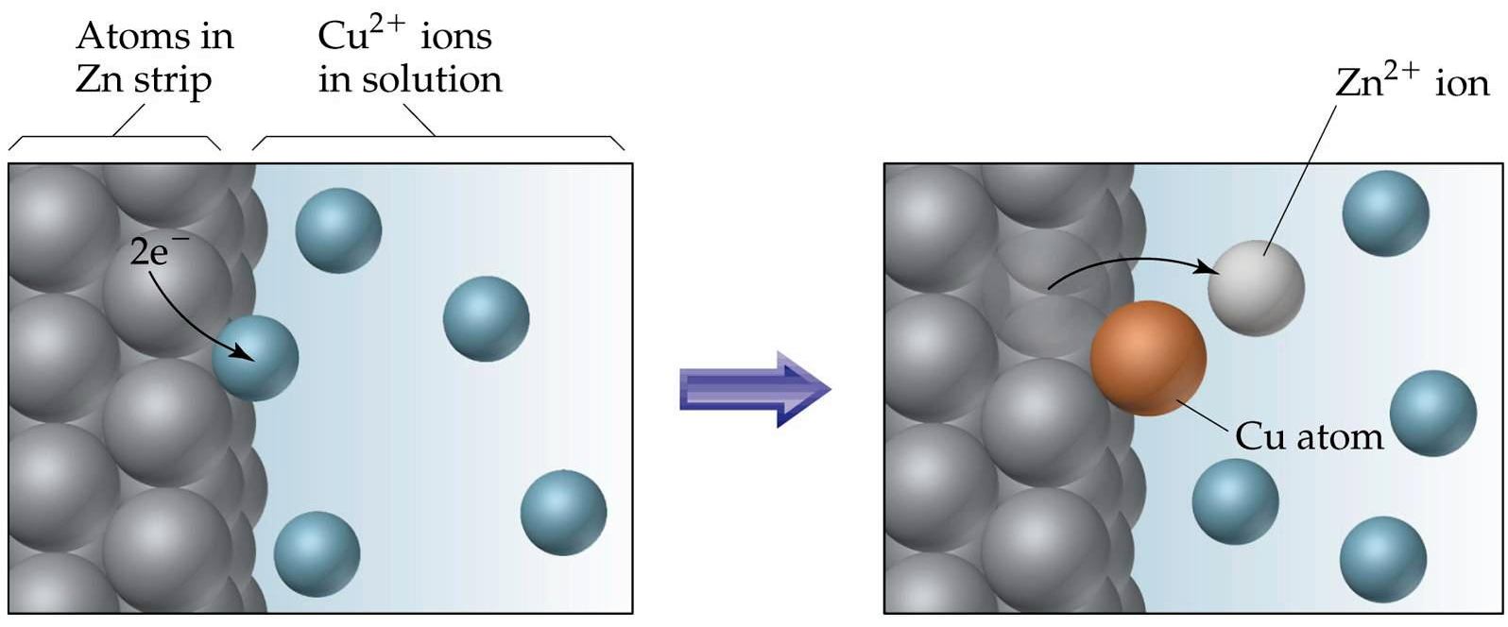
Zn + Cu²⁺ Zn²⁺ + Cu
(spontaneous)

Slide 18
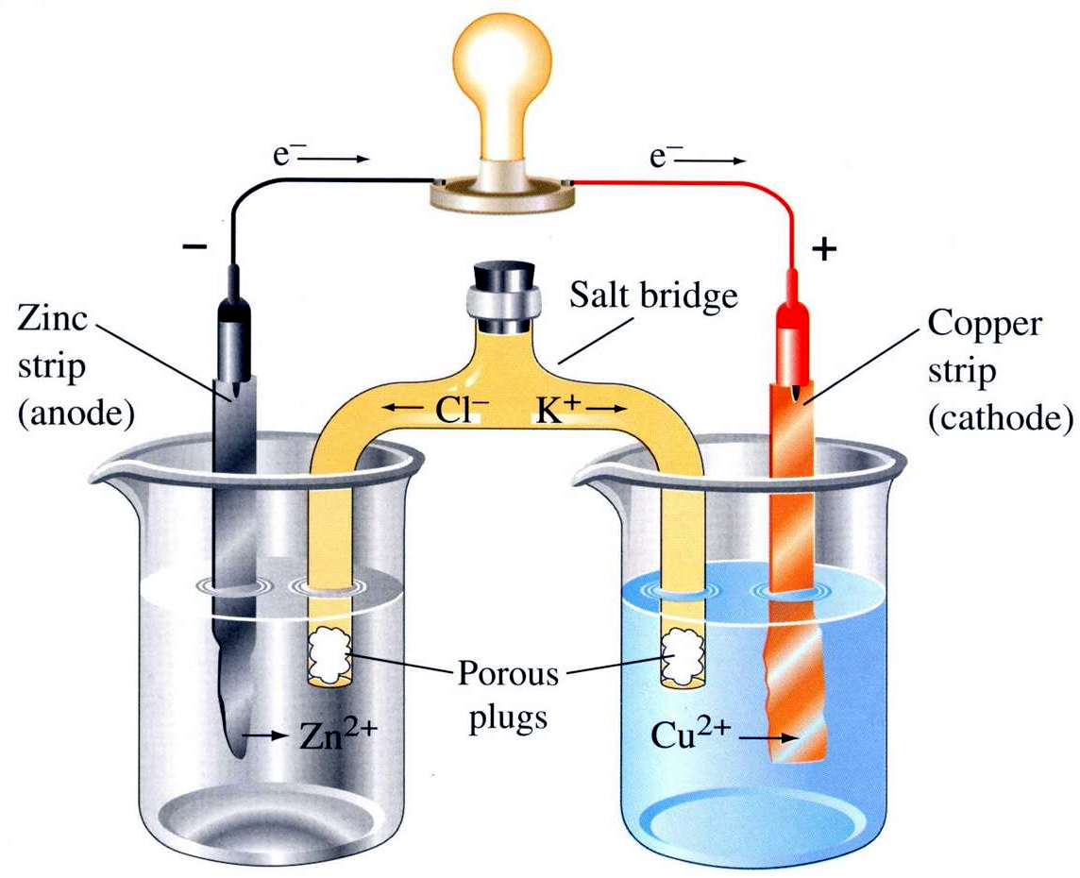
Zn + Cu²⁺ Zn²⁺ + Cu
Zn Zn²⁺ + 2 e⁻
Cu²⁺ + 2 e⁻ Cu
salt bridge – any medium that allows the flow of ions but prevents the direct mixing of solutions

Slide 19
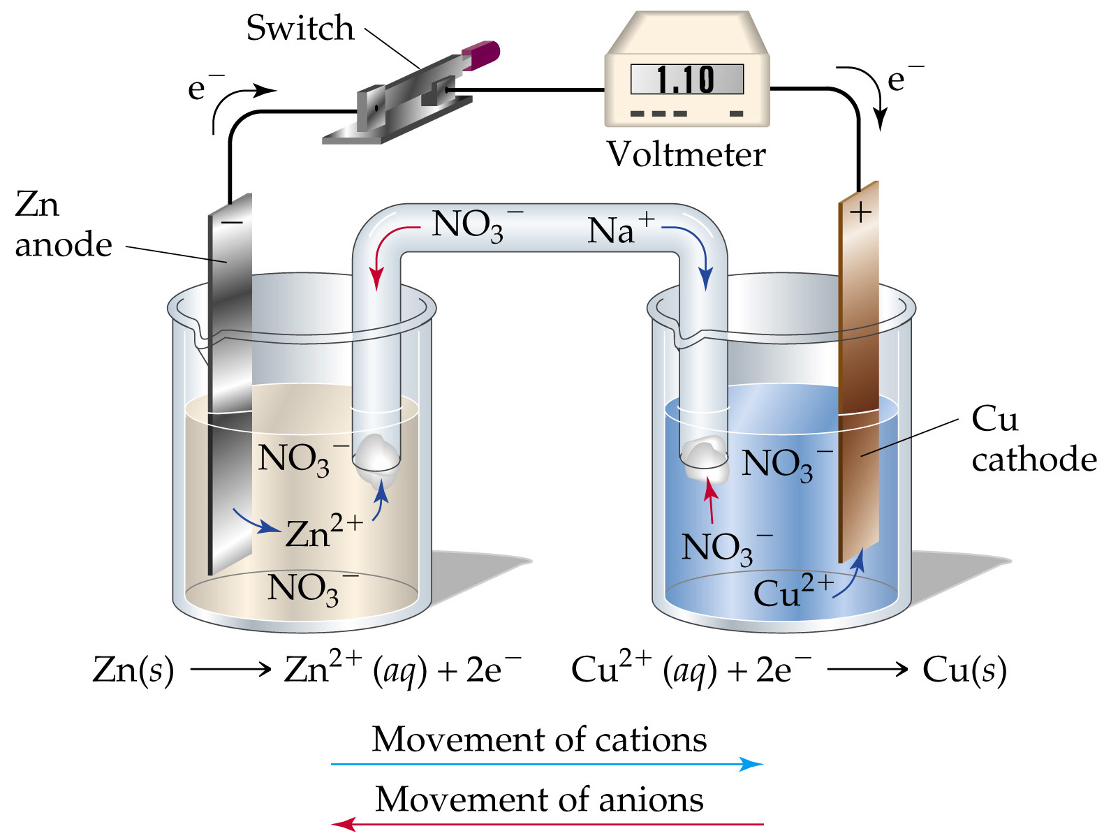
Notes:
Figure: 20-05

Slide 20
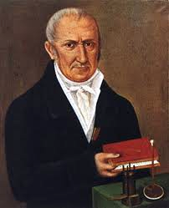
Voltage (or Potential) – the force pushing the electrons
Alessandro Volta 1745 – 1827

Slide 21
Zn + Cu²⁺ Zn²⁺ + Cu
standard half-cell potential – voltage required to undergo a ½ reaction redox process
E°_{red} – voltage of “reduction ½ reaction” process
E°_{ox} – voltage of “oxidation ½ reaction” process
standard conditions – 25 °C and 1 atm and all solutions are 1 M

Slide 22
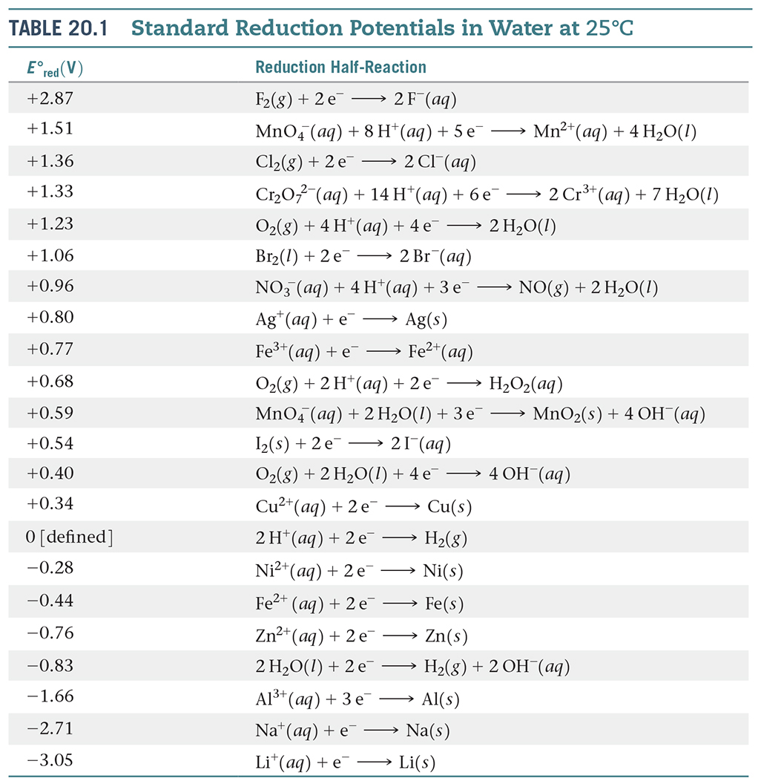
Notes:
Figure: 20-T01

Slide 23
Zn + Cu²⁺ Zn²⁺ + Cu
Cu²⁺ + 2 e⁻ Cu
E°_{red} =
+ 0.34 V
Zn Zn²⁺ + 2 e⁻
E°_{ox} =
+ 0.76 V
2 e⁻ + Zn + Cu²⁺ Zn²⁺ + Cu + 2 e⁻
Overall Cell Potential, E°_{cell} – sum of the ½ cell reaction potentials
E°_{cell} = (E°_{red} + E°_{ox})

Slide 24
Cu²⁺ + 2 e⁻ Cu
E°_{red} =
+ 0.34 V
Zn Zn²⁺ + 2 e⁻
E°_{ox} =
+ 0.76 V
Zn + Cu²⁺ Zn²⁺ + Cu
E°_{cell} = (E°_{red} + E°_{ox})
E°_{cell} = 0.34 V + 0.76 V
E°_{cell} = + 1.10 V
E°_{cell} is often called “standard overall cell potential” or “electromotive force” or “EMF”

Slide 25
E°_{cell} is very significant as it is the thermodynamic driving force for electrochemical processes
When E°_{cell} is positive (E°_{cell} = + # V), electrochemical process is spontaneous
When E°_{cell} is negative (E°_{cell} = – # V), electrochemical process is nonspontaneous

Slide 26
Fe²⁺ + Al Fe + Al³⁺
1. Determine the E°_{cell} for the reaction and
2. Can a Voltaic cell be constructed using the reaction ?
Voltage is an Intensive property

Slide 27
Relationship between E°_{cell} and ΔG°_{rxn}
ΔG°_{rxn} = – (n) (F) (E°_{cell})
ΔG°_{rxn} is the standard Gibbs free energy
n = smallest integer number of electrons transferred in the overall, balanced redox rxn
F = Faraday constant = 96,485 C
E°_{cell} = the standard overall cell potential or EMF

Slide 28
Determine ΔG°_{rxn} for the following reaction
3 Fe²⁺ + 2 Al 3 Fe + 2 Al³⁺
E°_{cell} = +1.22 V

Slide 29
ΔG°_{rxn} = – RT (ln K)
R = 8.314 J/mole∙K
T = Temperature in Kelvin
K = the equilibrium constant at standard conditions
Determine E°_{cell} , ΔG°_{rxn} and K for the following rxn
Fe³⁺ + Pt Fe²⁺ + Pt²⁺

Slide 30
Fe³⁺ + Pt Fe²⁺ + Pt²⁺
[
]
2
Fe³⁺ + e⁻ Fe²⁺
E°_{red} =
+ 0.77 V
Pt Pt²⁺ + 2 e⁻
E°_{ox} =
- 1.19 V
2 Fe³⁺ + 2 e⁻ 2 Fe²⁺
E°_{red} =
+ 0.77 V
2 e⁻ + 2 Fe³⁺ + Pt 2 Fe²⁺ + Pt²⁺ + 2 e⁻
E°_{cell} = -0.42 V
This electrochemical process is nonspontaneous

Slide 31
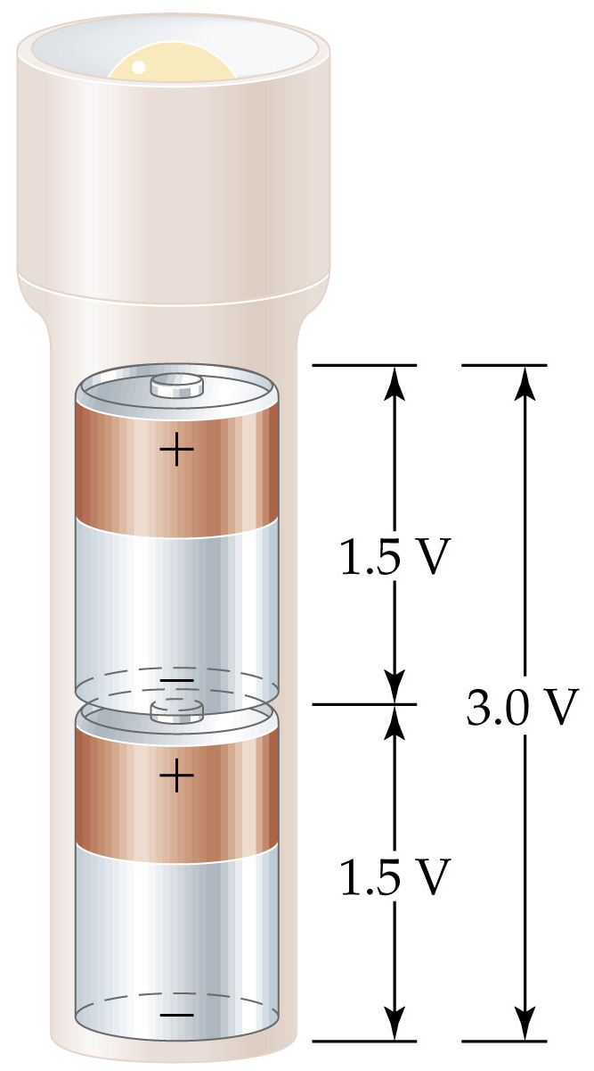
Notes:
Figure: 20-20

Slide 32
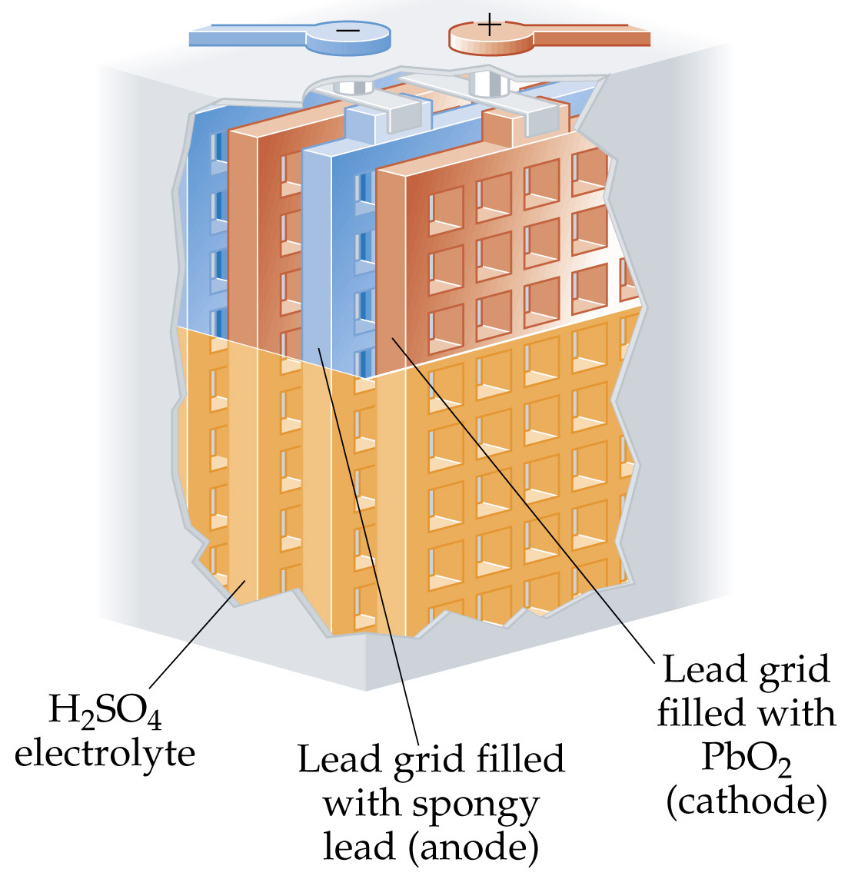
Notes:
Figure: 20-21

Slide 33
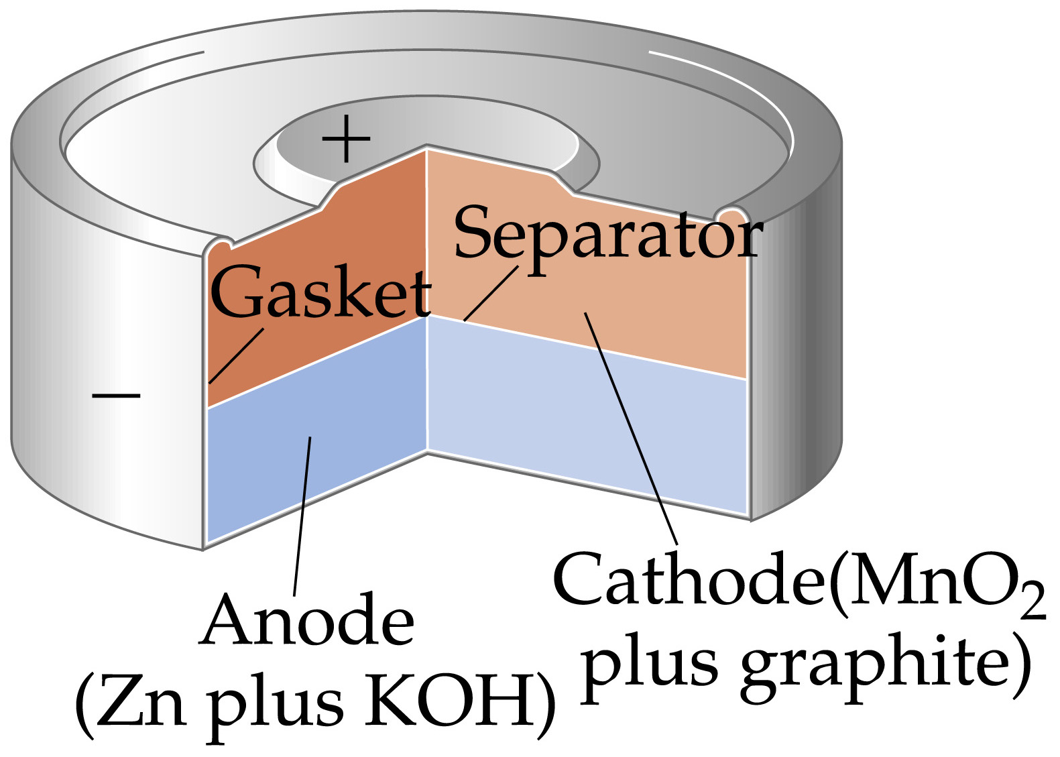
Notes:
Figure: 20-22

Slide 34
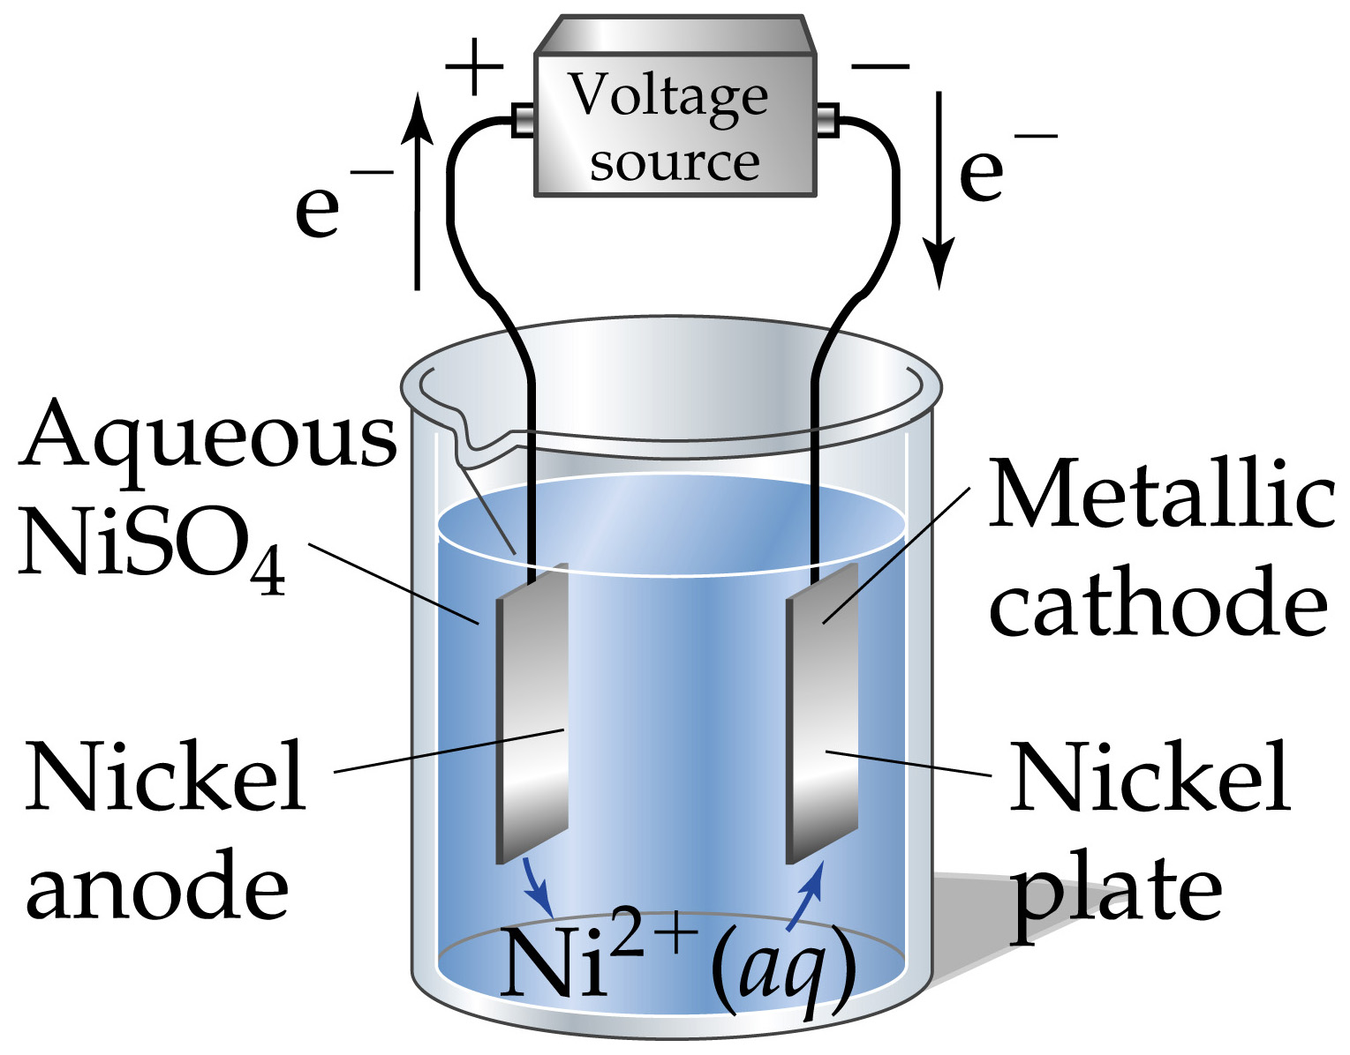
Notes:
Figure: 20-30

Slide 35
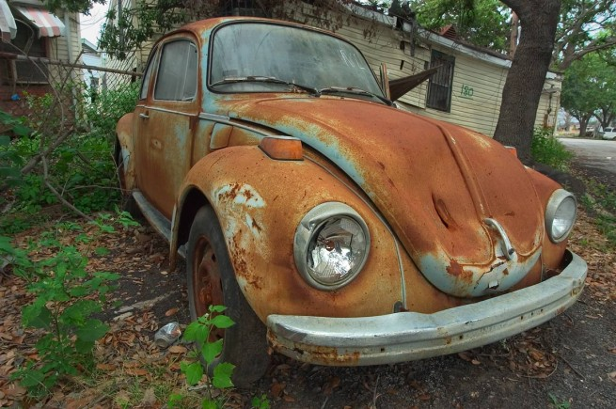
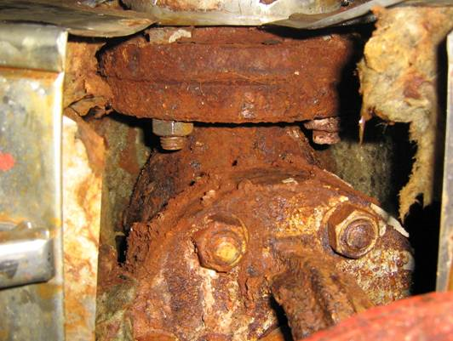
corrosion – the spontaneous, destructive oxidation of a metal (usually iron)

Slide 36
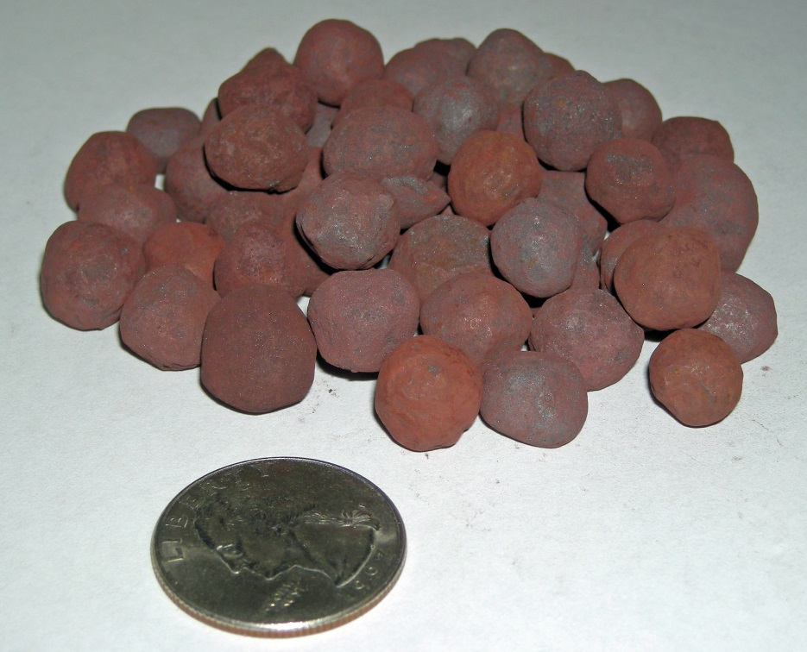
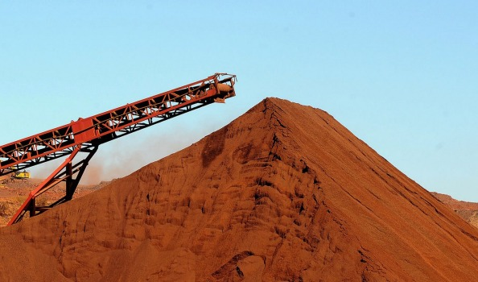
taconite (Fe₂O₃)

Slide 37
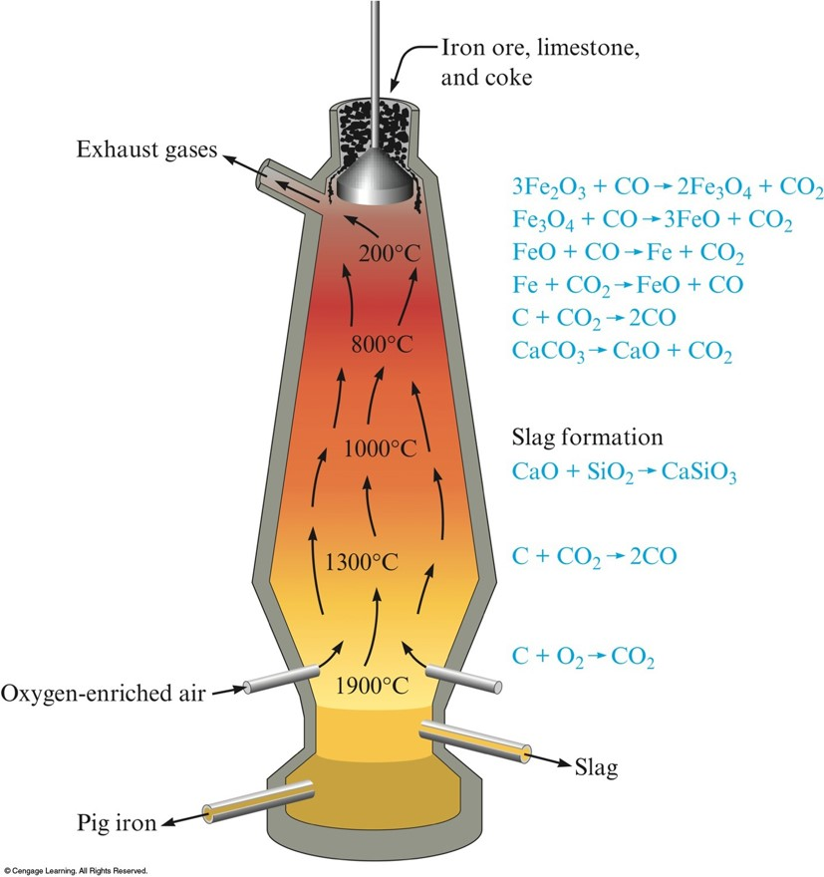
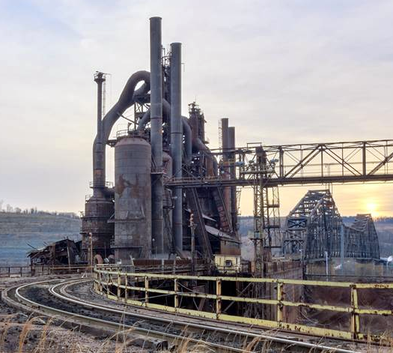
Fe₂O₃ Fe
nonspontaneous

Slide 38
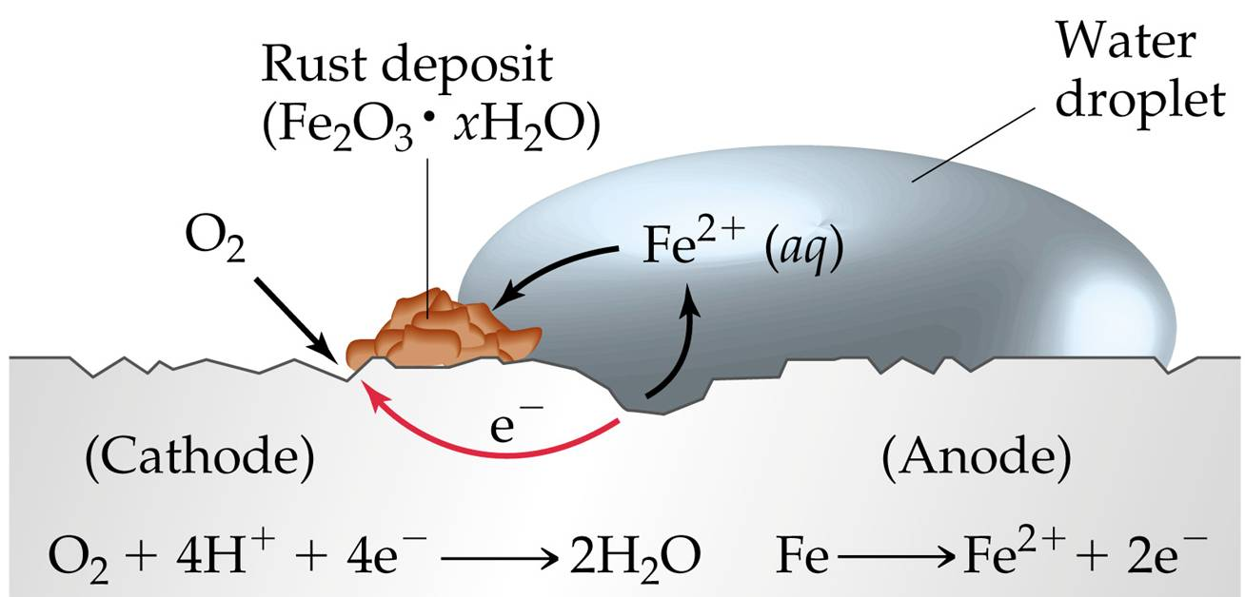
corrosion (or rusting)
Fe Fe₂O₃
spontaneous

Slide 39
1. O₂
and
2. H⁺ (aq)
2
[
]
+ 2 e⁻
Fe Fe²⁺
E°_{ox} =
+ 0.44 V
O₂ + 4 H⁺ + 4 e⁻ 2 H₂O
E°_{red} =
+ 1.23 V
2 Fe 2 Fe²⁺ + 4 e⁻
E°_{ox} =
+ 0.44 V
2 Fe + O₂ + 4 H⁺ + 4 e⁻ 2 Fe²⁺ + 4 e⁻ + 2 H₂O
2 Fe + O₂ + 4 H⁺ 2 Fe²⁺ + 2 H₂O
E°_{cell} = + 1.67 V
This redox process is spontaneous

Slide 40
2 Fe + O₂ + 4 H⁺ 2 Fe²⁺ + 2 H₂O
E°_{cell} = + 1.67 V
E°_{cell} =
4 Fe²⁺ + O₂ + 4 H⁺ 4 Fe³⁺ + 2 H₂O
+ 0.46 V
E°_{cell} =
+ 2.13 V
This redox process is spontaneous
ΔG°_{rxn} = - 822 kJ
2 Fe³⁺ + 4 H₂O Fe₂O₃ · H₂O + 6 H⁺
Can you stop this ??

Slide 41
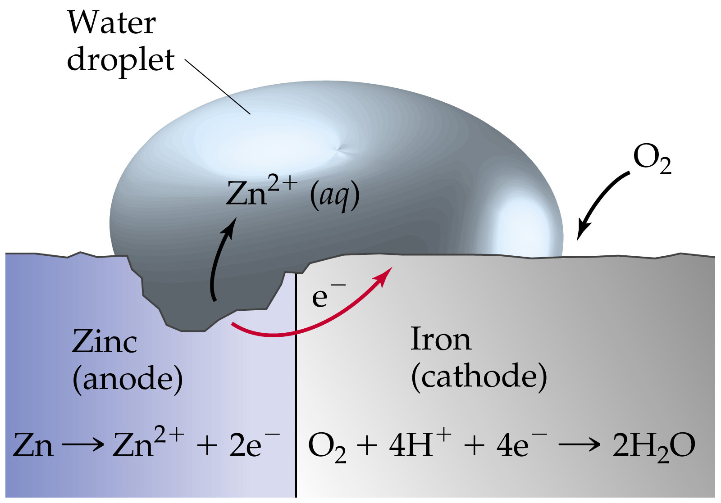
Notes:
Figure: 20-26

Slide 42
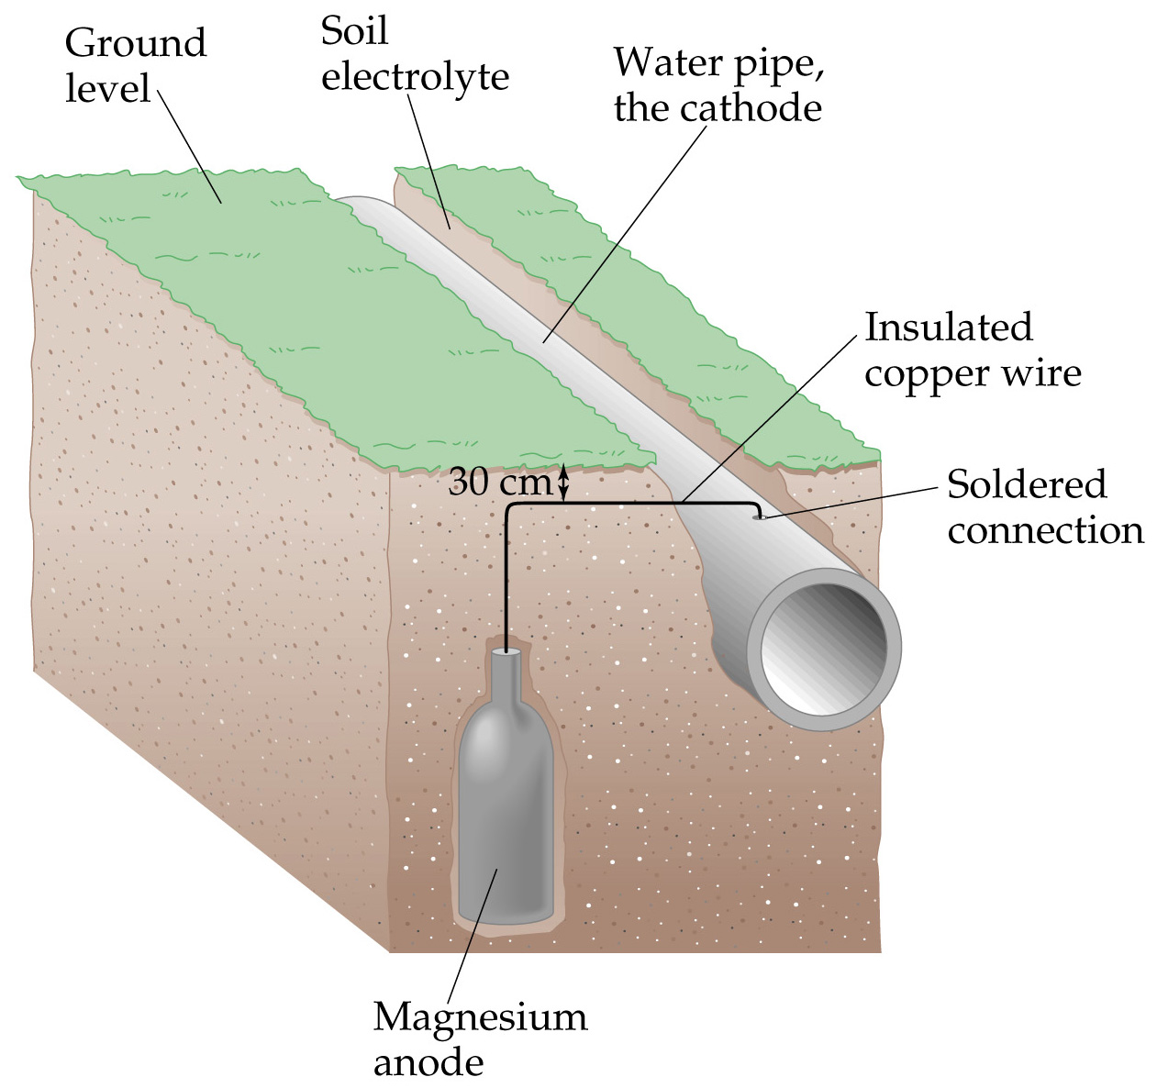
Notes:
Figure: 20-27

