Slide 2
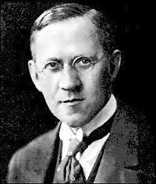
Brønsted–Lowry acid/base definition
Johannes Brønsted
1879 – 1947
Thomas Lowry
1874 – 1936

Slide 3
Brønsted–Lowry acid – chemical substance that acts as a proton donor (species that produces H⁺)
Brønsted–Lowry base – chemical substance that acts as a proton acceptor (species that takes in H⁺)
H₂O
HCl H⁺ (aq) + Cl⁻ (aq)
HCl + H₂O H₃O⁺ (aq) + Cl⁻ (aq)
H⁺ = H₃O⁺
hydronium ion

Slide 4
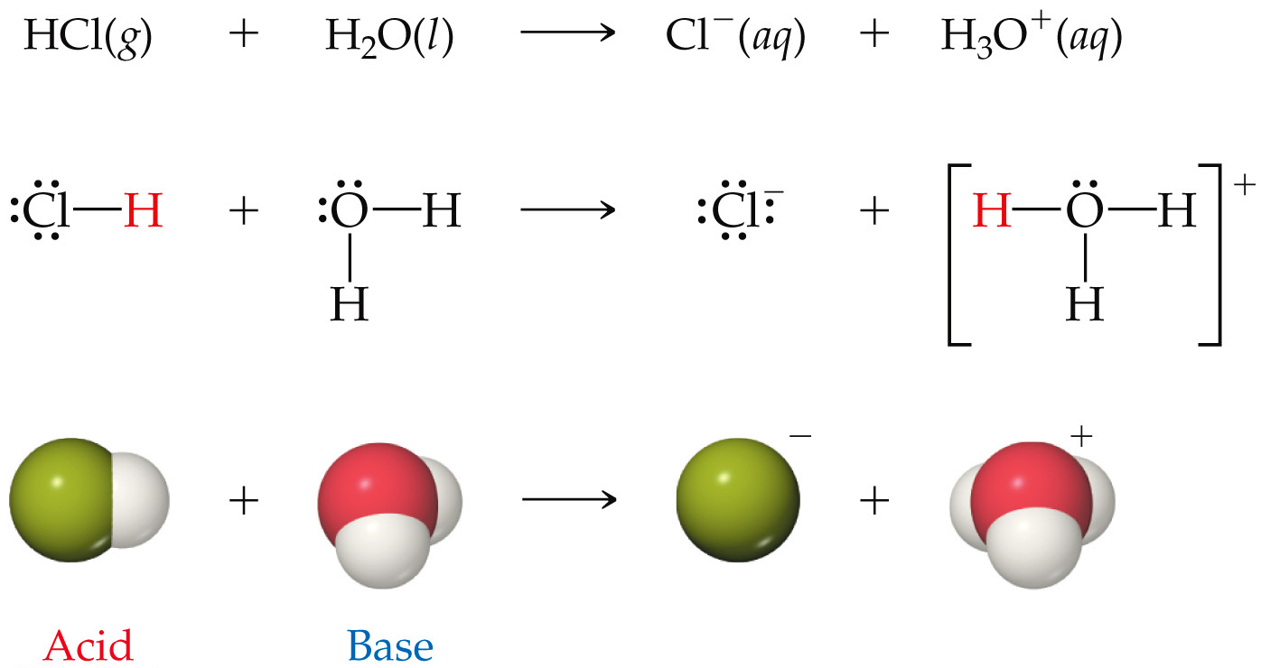
Notes:
Figure: 16-02

Slide 5
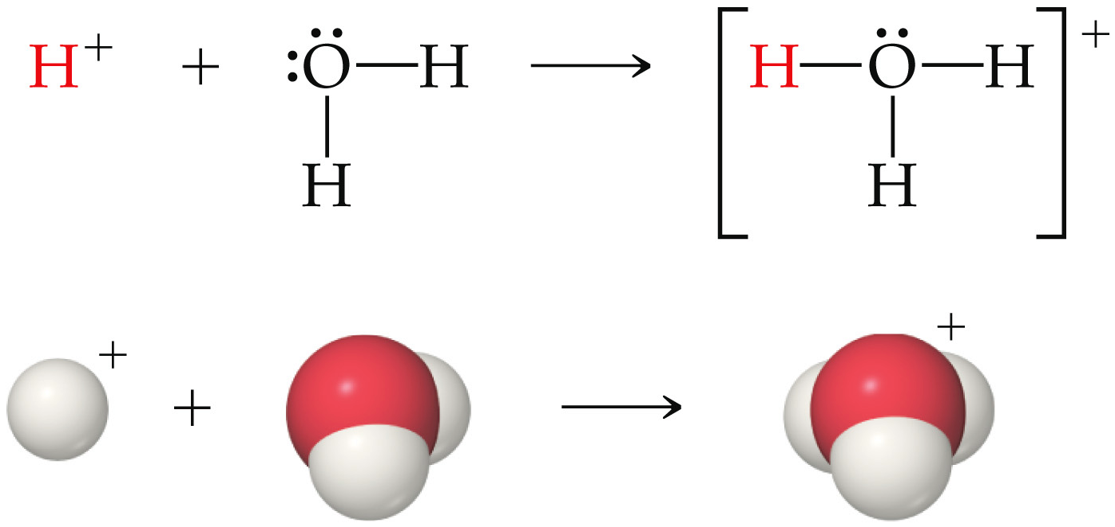
H⁺ = H₃O⁺
proton = hydronium ion

Slide 6
H₂O
NaOH (s) Na⁺ (aq) + OH⁻ (aq)
H⁺ (aq) + OH⁻ (aq) H₂O
H⁺ + NH₃ NH₄⁺

Slide 7
strong electrolyte – substance that completely dissociates into ions in aqueous solution
H₂O
NaCl (aq) Na⁺ (aq) + Cl⁻ (aq)

Slide 8
strong acid – an acid that completely, 100% dissociates into ions in aqueous solution
H₂O
HCl H⁺ (aq) + Cl⁻ (aq)
6 common strong acids: HCl, HBr, HI,
HNO₃, H₂SO₄, HClO₄

Slide 9
strong base – a base that completely, 100% dissociates into ions in aqueous solution
H₂O
NaOH (s) Na⁺ (aq) + OH⁻ (aq)
6 common strong bases: LiOH, NaOH, KOH, RbOH, CsOH, Ba(OH)₂

Slide 10
weak acid – an acid that only slightly dissociates into ions in aqueous solution
H₂O
CH₃COOH CH₃COO⁻ (aq) + H⁺ (aq)

Slide 11
weak base – a base that only slightly dissociates into ions in aqueous solution
H₂O
NH₄OH
NH₄⁺ (aq) + OH⁻ (aq)

Slide 12
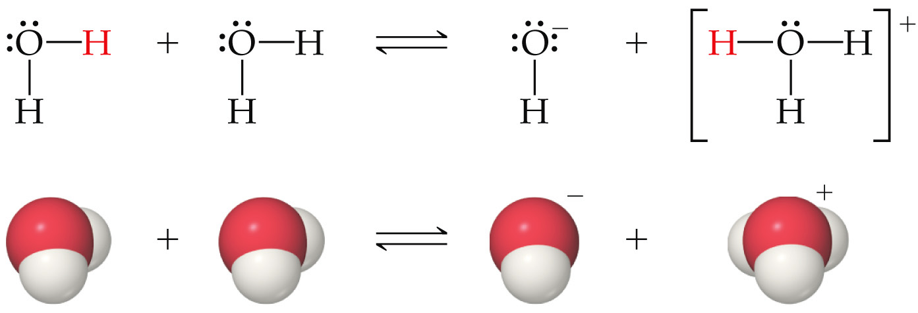
self-ionization – when a substance reacts with itself to form ions
(auto-ionization)
H₂O () H⁺ (aq) + OH⁻ (aq)
H₂O () + H₂O () H₃O⁺ (aq) + OH⁻ (aq)

Slide 13
H₂O () H⁺ (aq) + OH⁻ (aq)
K = [H⁺] [OH⁻]
w
K_{w} is called the ion-product constant for water
K_{w} is just another equilibrium constant
K_{w} = [H⁺] [OH⁻] = 1.0 x 10⁻¹⁴ (at 25 °C)

Slide 14
H₂O () H⁺ (aq) + OH⁻ (aq)
in pure DI water at 25 °C
[H⁺] = 1.0 x 10⁻⁷ M
and
[OH⁻] = 1.0 x 10⁻⁷ M

Slide 15
when [H⁺] = [OH⁻]
solution is neutral
when [H⁺] > [OH⁻]
solution is acidic
when [H⁺] < [OH⁻]
solution is basic
K_{w} = [H⁺] [OH⁻] = 1.0 x 10⁻¹⁴ (at 25 °C)
K_{w} expression is valid for ALL aqueous solutions (acidic, basic or neutral) at 25 °C

Slide 16
an aqueous solution at 25 °C has
[H⁺] = 0.000423 M. What is the [OH⁻] ?

Slide 17
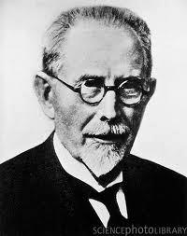
the pH scale
pH = -log [H⁺]
Søren Sørensen
1868 – 1939

Slide 18
for any aqueous solution at 25 °C
when pH = 7 the solution is neutral
when pH < 7 the solution is acidic
when pH > 7 the solution is basic
pH scale range is from 0 - 14

Slide 19
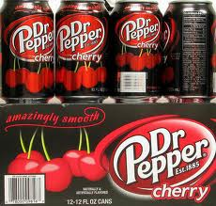
Dr. Pepper Cherry (it’s amazingly smooth) has [H⁺] = 1.2 x 10⁻³ M. What is the pH of this pop ?

Slide 20
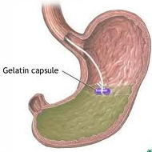
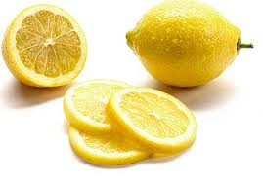
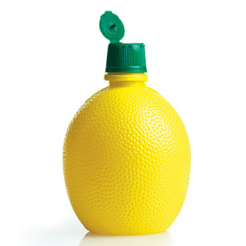
Lemon juice has a pH = 2.41
Stomach juice has a pH = 2.09
vs.
pH = 2.41
pH = 2.09
Which one is more acidic ? Calculate, specifically by how much more acidic is one (vs. the other)

Slide 21
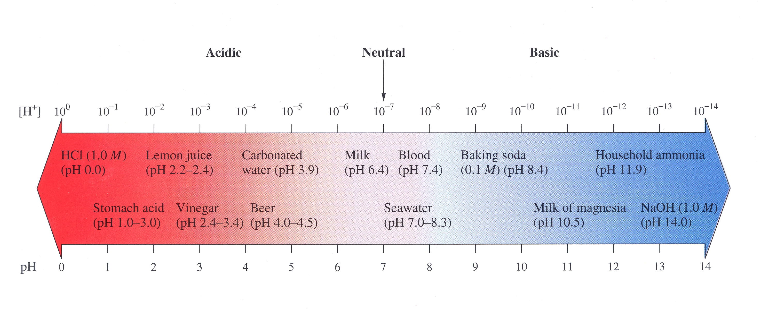

Slide 22
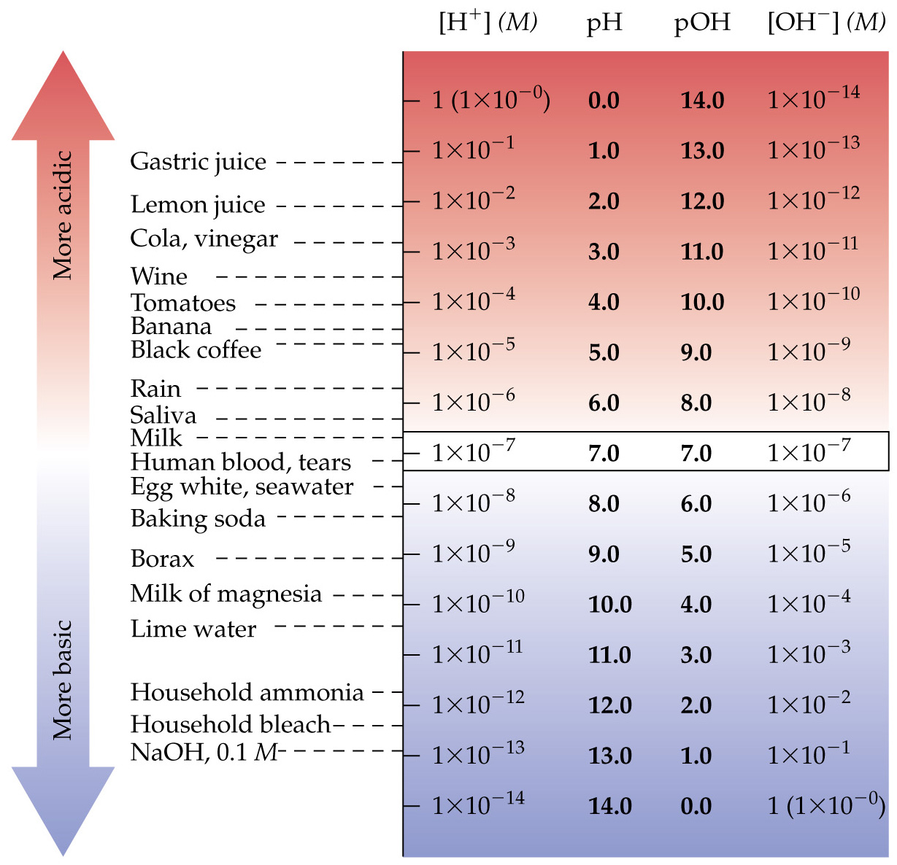
Notes:
Figure: 16-05

Slide 23
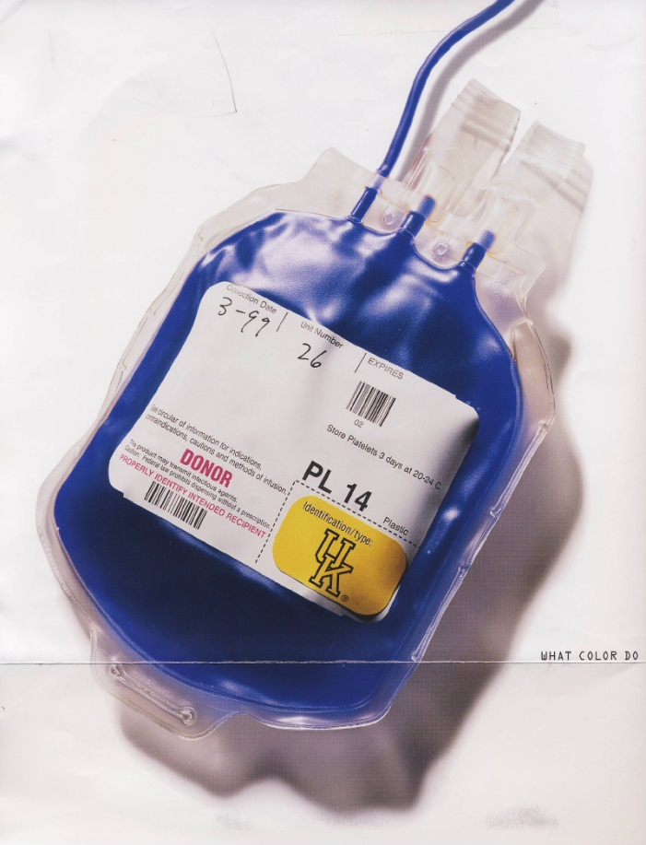
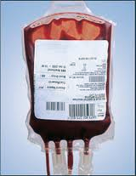

blood has a [OH⁻] = 2.69 x 10⁻⁷ M at 25 °C. What is the pH of blood ?

Slide 24
there is another scale analogous to pH
pOH = -log [OH⁻]
pH + pOH = 14.00 (at 25 °C)
above expression is valid for ALL aqueous solutions (acidic, basic or neutral) at 25 °C
blood has a [OH⁻] = 2.69 x 10⁻⁷ M at 25 °C. What is the pH of blood ?

Slide 25
calculations for strong acids/bases
Determine the pH of a 0.15 M HBr (aq) soln

Slide 26
14.2 g Ba(OH)₂ (s) is dissolved in enough H₂O to form 500.0 mL soln. What’s the resulting pH of the solution ?

Slide 27
H₂O
CH₃COOH (aq) CH₃COO⁻ (aq) + H⁺ (aq)
or
H₂O
CH₃COOH (aq) H⁺ (aq) + CH₃COO⁻ (aq)
[ H⁺] [CH₃COO⁻]
[CH₃COOH]
Ka =
Ka is called the acid-dissociation constant
Ka is just an equilibrium constant that is specific for a weak acid

Slide 28
a 0.050 M aqueous acetic acid solution has a
pH = 3.03. What is the Ka for acetic acid ?

Slide 29
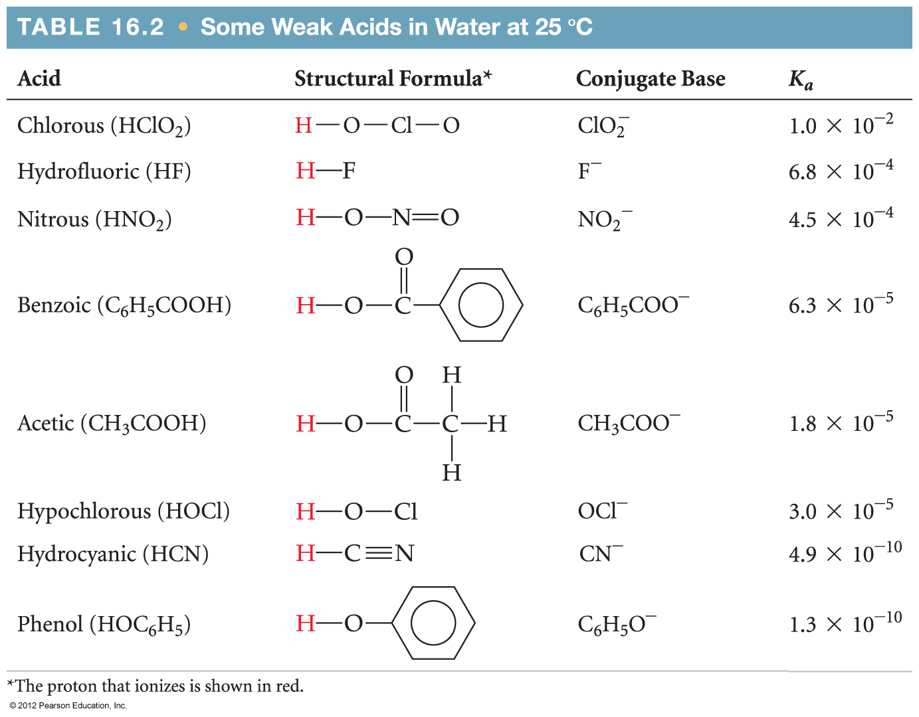

Slide 30
pKa = -log Ka
What is the pKa of acetic acid ?
What is the percentage of ionization of acetic acid ?

Slide 31
What is the pH of a 0.60 M HNO₂ (aq) ?

Slide 32
When can you legitimately disregard “X” in the denominator to avoid quadratic equation ?
perform 5% check
1. disregard the “X” in the denominator
2. solve the equality with that approximation
“value obtained for X”
[original]
3.
x 100
If value < 5%, approximation OK
If value > 5%, approximation is NOT OK and must go back and use quadratic equation ☹

Slide 33
Weak bases
K_{b} is called the base-dissociation constant
K_{b} is just an equilibrium constant that is specific for a weak base
weak bases undergo hydrolysis
hydrolysis – a substance reacts with H₂O leaving either H⁺ or OH⁻

Slide 34
NH₃ (aq) + H₂O ()
NH₄⁺ (aq) + OH⁻ (aq)
[ NH₄⁺] [OH⁻]
[NH₃]
K_{b} =
= 1.8 x 10⁻⁵
equilibrium favors the reactants (left)

Slide 35
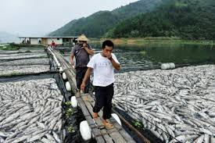
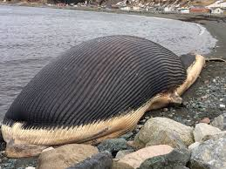
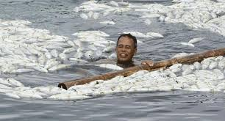
trimethylamine, (CH₃)₃N has a lovely, putrefying smell (like rotting dead fish☹). What is the pH of a 0.145 M aqueous solution of trimethylamine ?
hydrolysis
(CH₃)₃N (aq) + H₂O ()
(CH₃)₃NH⁺ (aq) + OH⁻ (aq)

Slide 36
pKb = -log Kb
The pKb of methylamine is 3.38. What is the Kb ?

Slide 37
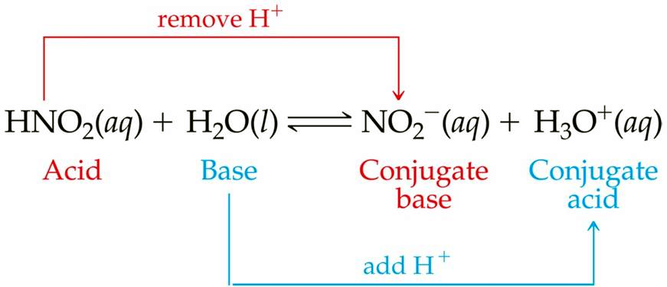
conjugates – an acid/base pair that differs only by a single H⁺
HNO₂ / NO₂⁻ are conjugate acid/base pair
H₃O⁺ / H₂O are conjugate acid/base pair

Slide 38
What is the conjugate base of HCl ?
H₂O
HCl H⁺ (aq) + Cl⁻ (aq)
HCl / Cl⁻ are conjugates
(acid/base)
What is the conjugate acid of NH₃ ?
NH₃ (aq) + H₂O
NH₄⁺ (aq) + OH⁻ (aq)
NH₃ / NH₄⁺ are conjugates
(base/acid)

Slide 39
What is the conjugate acid of HS⁻ ?
HS⁻ / H₂S are conjugates
(base/acid)
What is the conjugate base of HS⁻ ?
HS⁻ / S²⁻ are conjugates
(acid/base)
Is SO₄²⁻ the conjugate base of H₂SO₄ ?
No way……
HSO₄⁻ is the conj base

Slide 40
The conjugate base of a strong acid exhibits NO basic properties whatsoever
The conjugate acid of a strong base exhibits NO acidic properties whatsoever
The conjugate base of a weak acid exhibits
weak basic properties
The conjugate acid of a weak base exhibits
weak acidic properties

Slide 41
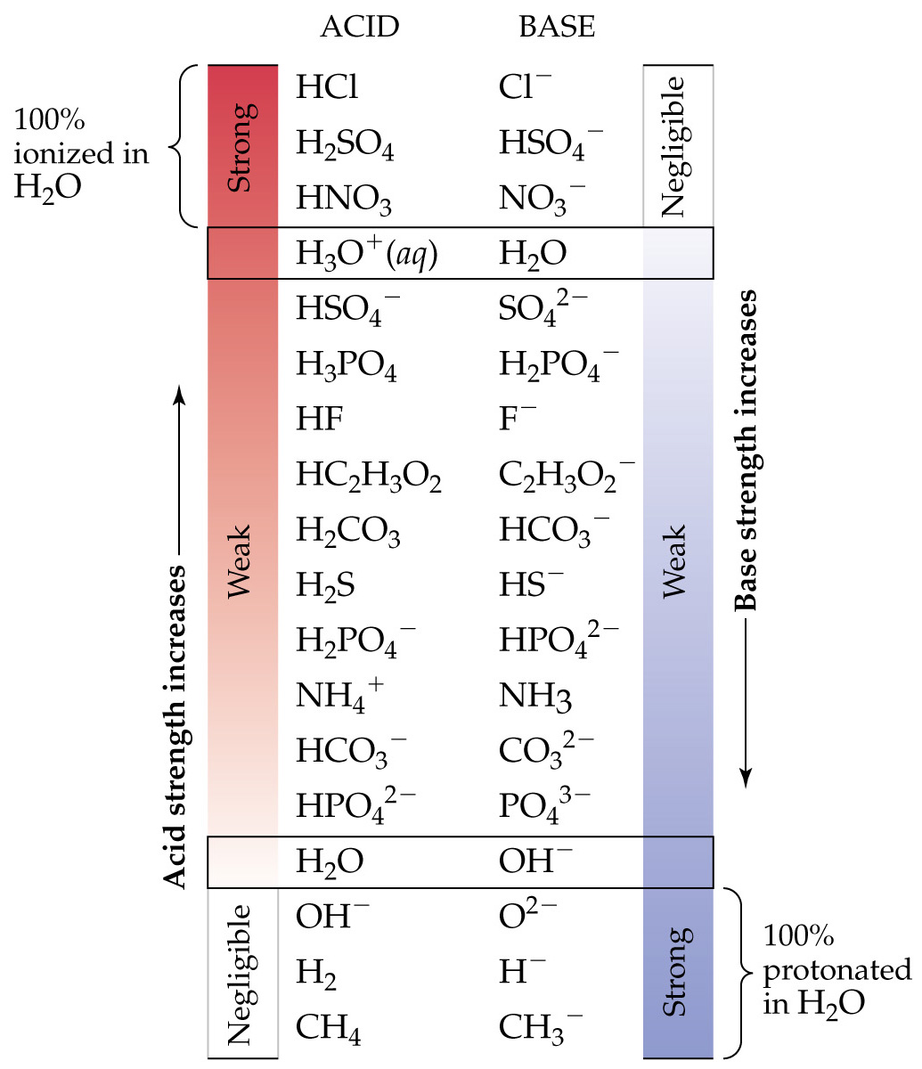
Notes:
Figure: 16-04

Slide 42
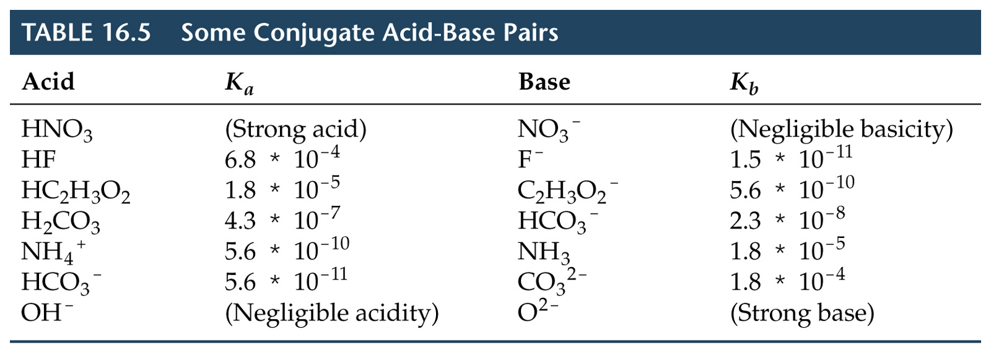
Notes:
Figure: 16-09-03T05

Slide 43
NO₂⁻ + H₂O
HNO₂ + OH⁻
[ HNO₂] [OH⁻]
[NO₂⁻ ]
K =
b
H₂O
HNO₂
H⁺ + NO₂⁻
[ H⁺] [NO₂ ⁻]
[HNO₂]
K =
a

Slide 44
[H⁺] [NO₂⁻]
[HNO₂]
[HNO₂] [OH⁻]
[NO₂⁻]
K_{a} =
K_{b} =
[H⁺] [NO₂⁻]
[HNO₂]
[HNO₂] [OH⁻]
[NO₂⁻]
(Ka) (Kb) =
(Ka) (Kb) = [H⁺] [OH⁻]
= Kw = 1.0 x 10⁻¹⁴
(at 25 °C)
for any conjugate acid/base pair at 25 °C
(Ka) (Kb) = 1.0 x 10⁻¹⁴

Slide 45
What is the K_{b} for NO₂⁻ ?

Slide 46
Household bleach is a 0.65 M NaOCl (aq) solution. What is the pH of bleach ?

Slide 47
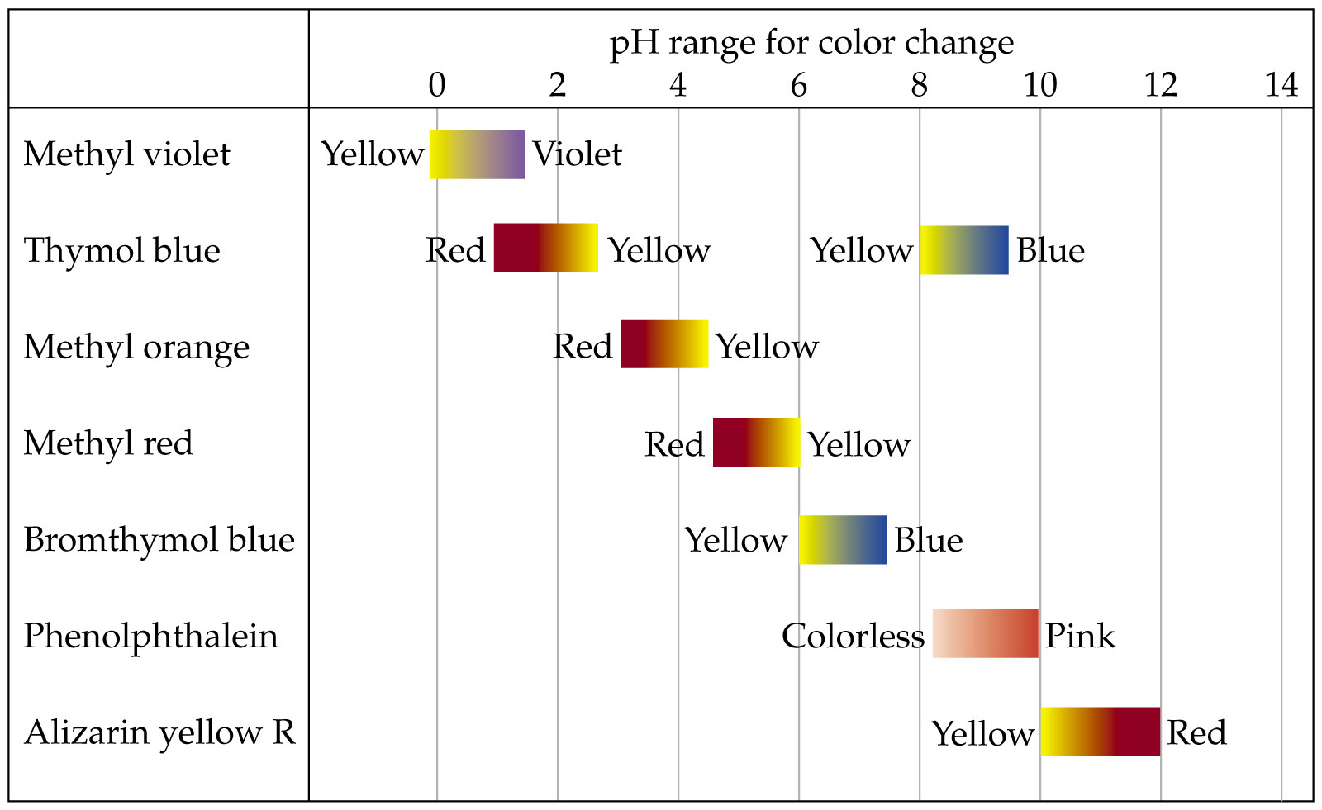
Notes:
Figure: 16-07

Slide 48
Buffers – solutions which resist changes in pH
1. A mixture of a weak acid + soluble salt of the conjugate base of that weak acid
or
2. A mixture of a weak base + soluble salt of the conjugate acid of that weak base
buffer capacity – the amount of acid or base that can be added before the buffer is overwhelmed and pH dramatically changes

Slide 49
H₂O
CH₃COOH (aq) H⁺ (aq) + CH₃COO⁻ (aq)
large amount
small amount
small amount
H₂O
NaCH₃COO (s) Na⁺ (aq) + CH₃COO⁻ (aq)
CH₃COOH
NaCH₃COO

Slide 50
H₂O
CH₃COOH (aq) H⁺ (aq) + CH₃COO⁻ (aq)
large amount
small amount
large amount
H₂O
NaCH₃COO (s) Na⁺ (aq) + CH₃COO⁻ (aq)
CH₃COOH
NaCH₃COO

Slide 51
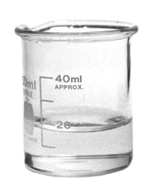
H₂O
CH₃COOH (aq) H⁺ (aq) + CH₃COO⁻ (aq)
large amount
small amount
large amount
Common ion effect – 2 different sources generate the same ion in solution
[ H⁺] [CH₃COO⁻]
[CH₃COOH]
Ka =
= 1.8 x 10⁻⁵
H⁺
Na⁺
CH₃COOH
CH₃COO⁻

Slide 52


Henderson-Hasselbalch equation
Lawrence Henderson
1878 – 1942
Karl Hasselbalch
1874 – 1962

Slide 53
Henderson-Hasselbalch equation
[base]
[acid]
pH = pKa + log
pH = pH of the buffered solution
pKa = pKa of the weak acid
[base] and [acid] are initial [ ]’s of the conjugate acid/base pair

Slide 54
Steps to working any buffer problem
1. determine how all species exist in solution
2. write the equilibrium reaction describing the species
3. leave out spectator ions such as Na⁺ and Cl⁻ because they don’t affect the pH
Suppose 3.398 g NaCHO₂ (s) is dissolved into 305 mL of 0.45 M HCHO₂ (aq). What is the pH of the resulting solution ?

Slide 55
Henderson-Hasselbalch equation for base
[acid]
[base]
pOH = pKb + log
pOH = pOH of the buffered solution
pKb = pKb of the weak base
[acid] and [base] are initial [ ]’s of the conjugate acid/base pair

Slide 56
Determine the pH of a solution of 0.30 M NH₃ (aq) and 0.18 M NH₄Cl (aq).
1. Work this problem using the “base” form of Henderson-Hasselbalch
2. Work this problem using the “acid” form of Henderson-Hasselbalch

Slide 57
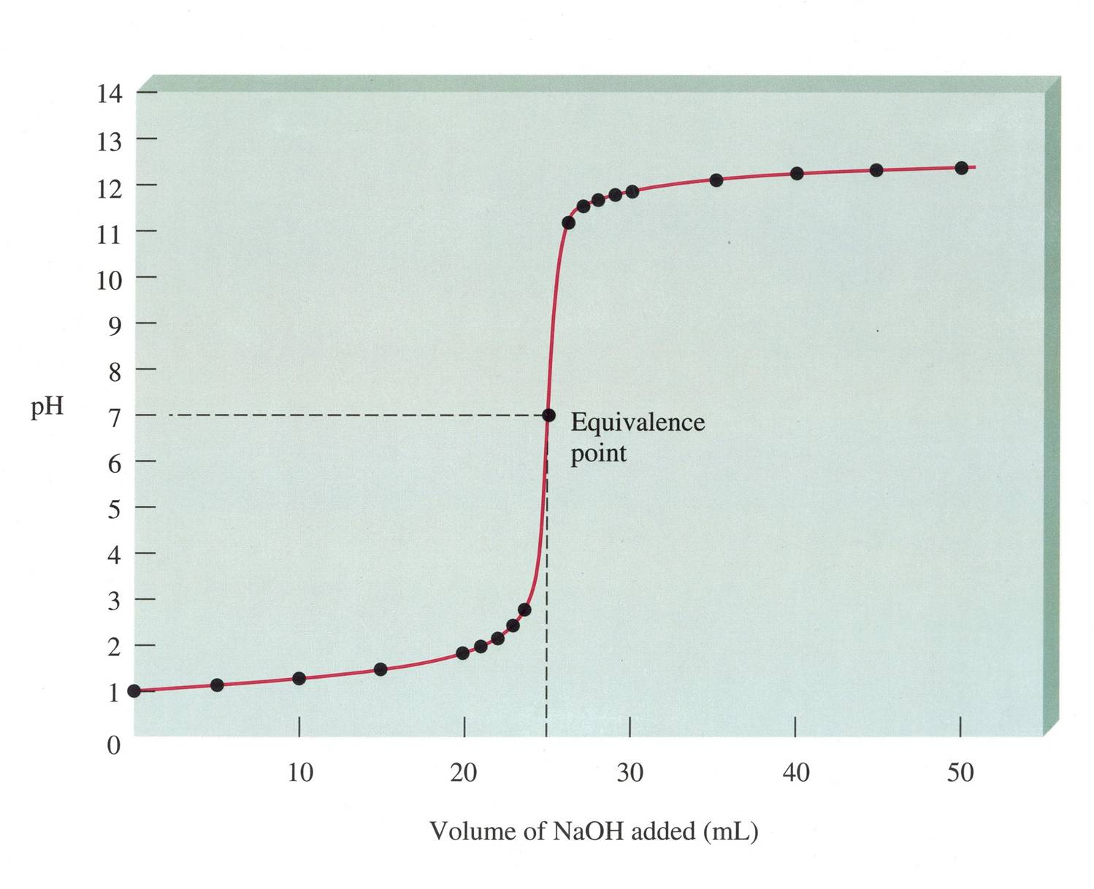

Slide 58
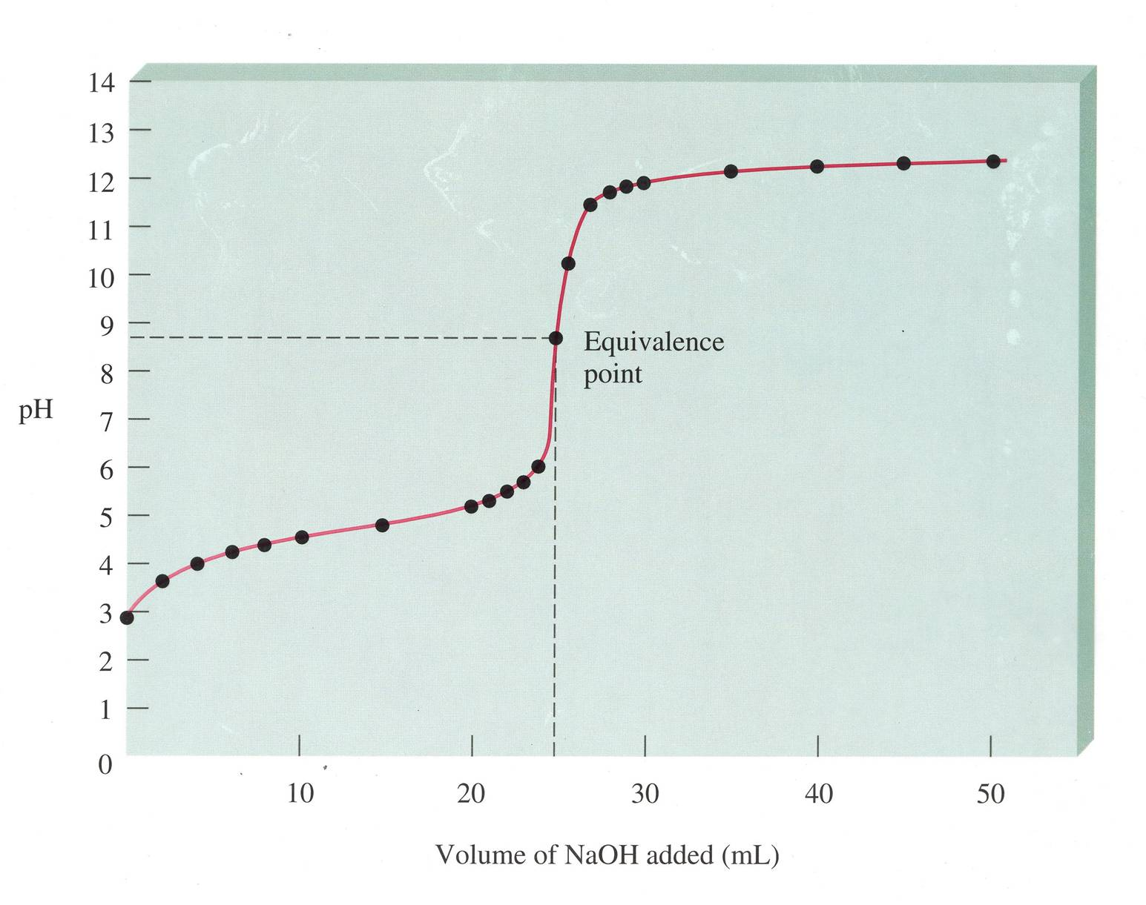

Slide 59
