Slide 1
chemical equilibrium – 2 opposing reactions occur simultaneously at the same rate
⇌
D E
E D
when the rate D E is equal to rate E D, the condition of equilibrium has been established
⇌
D E

Slide 2
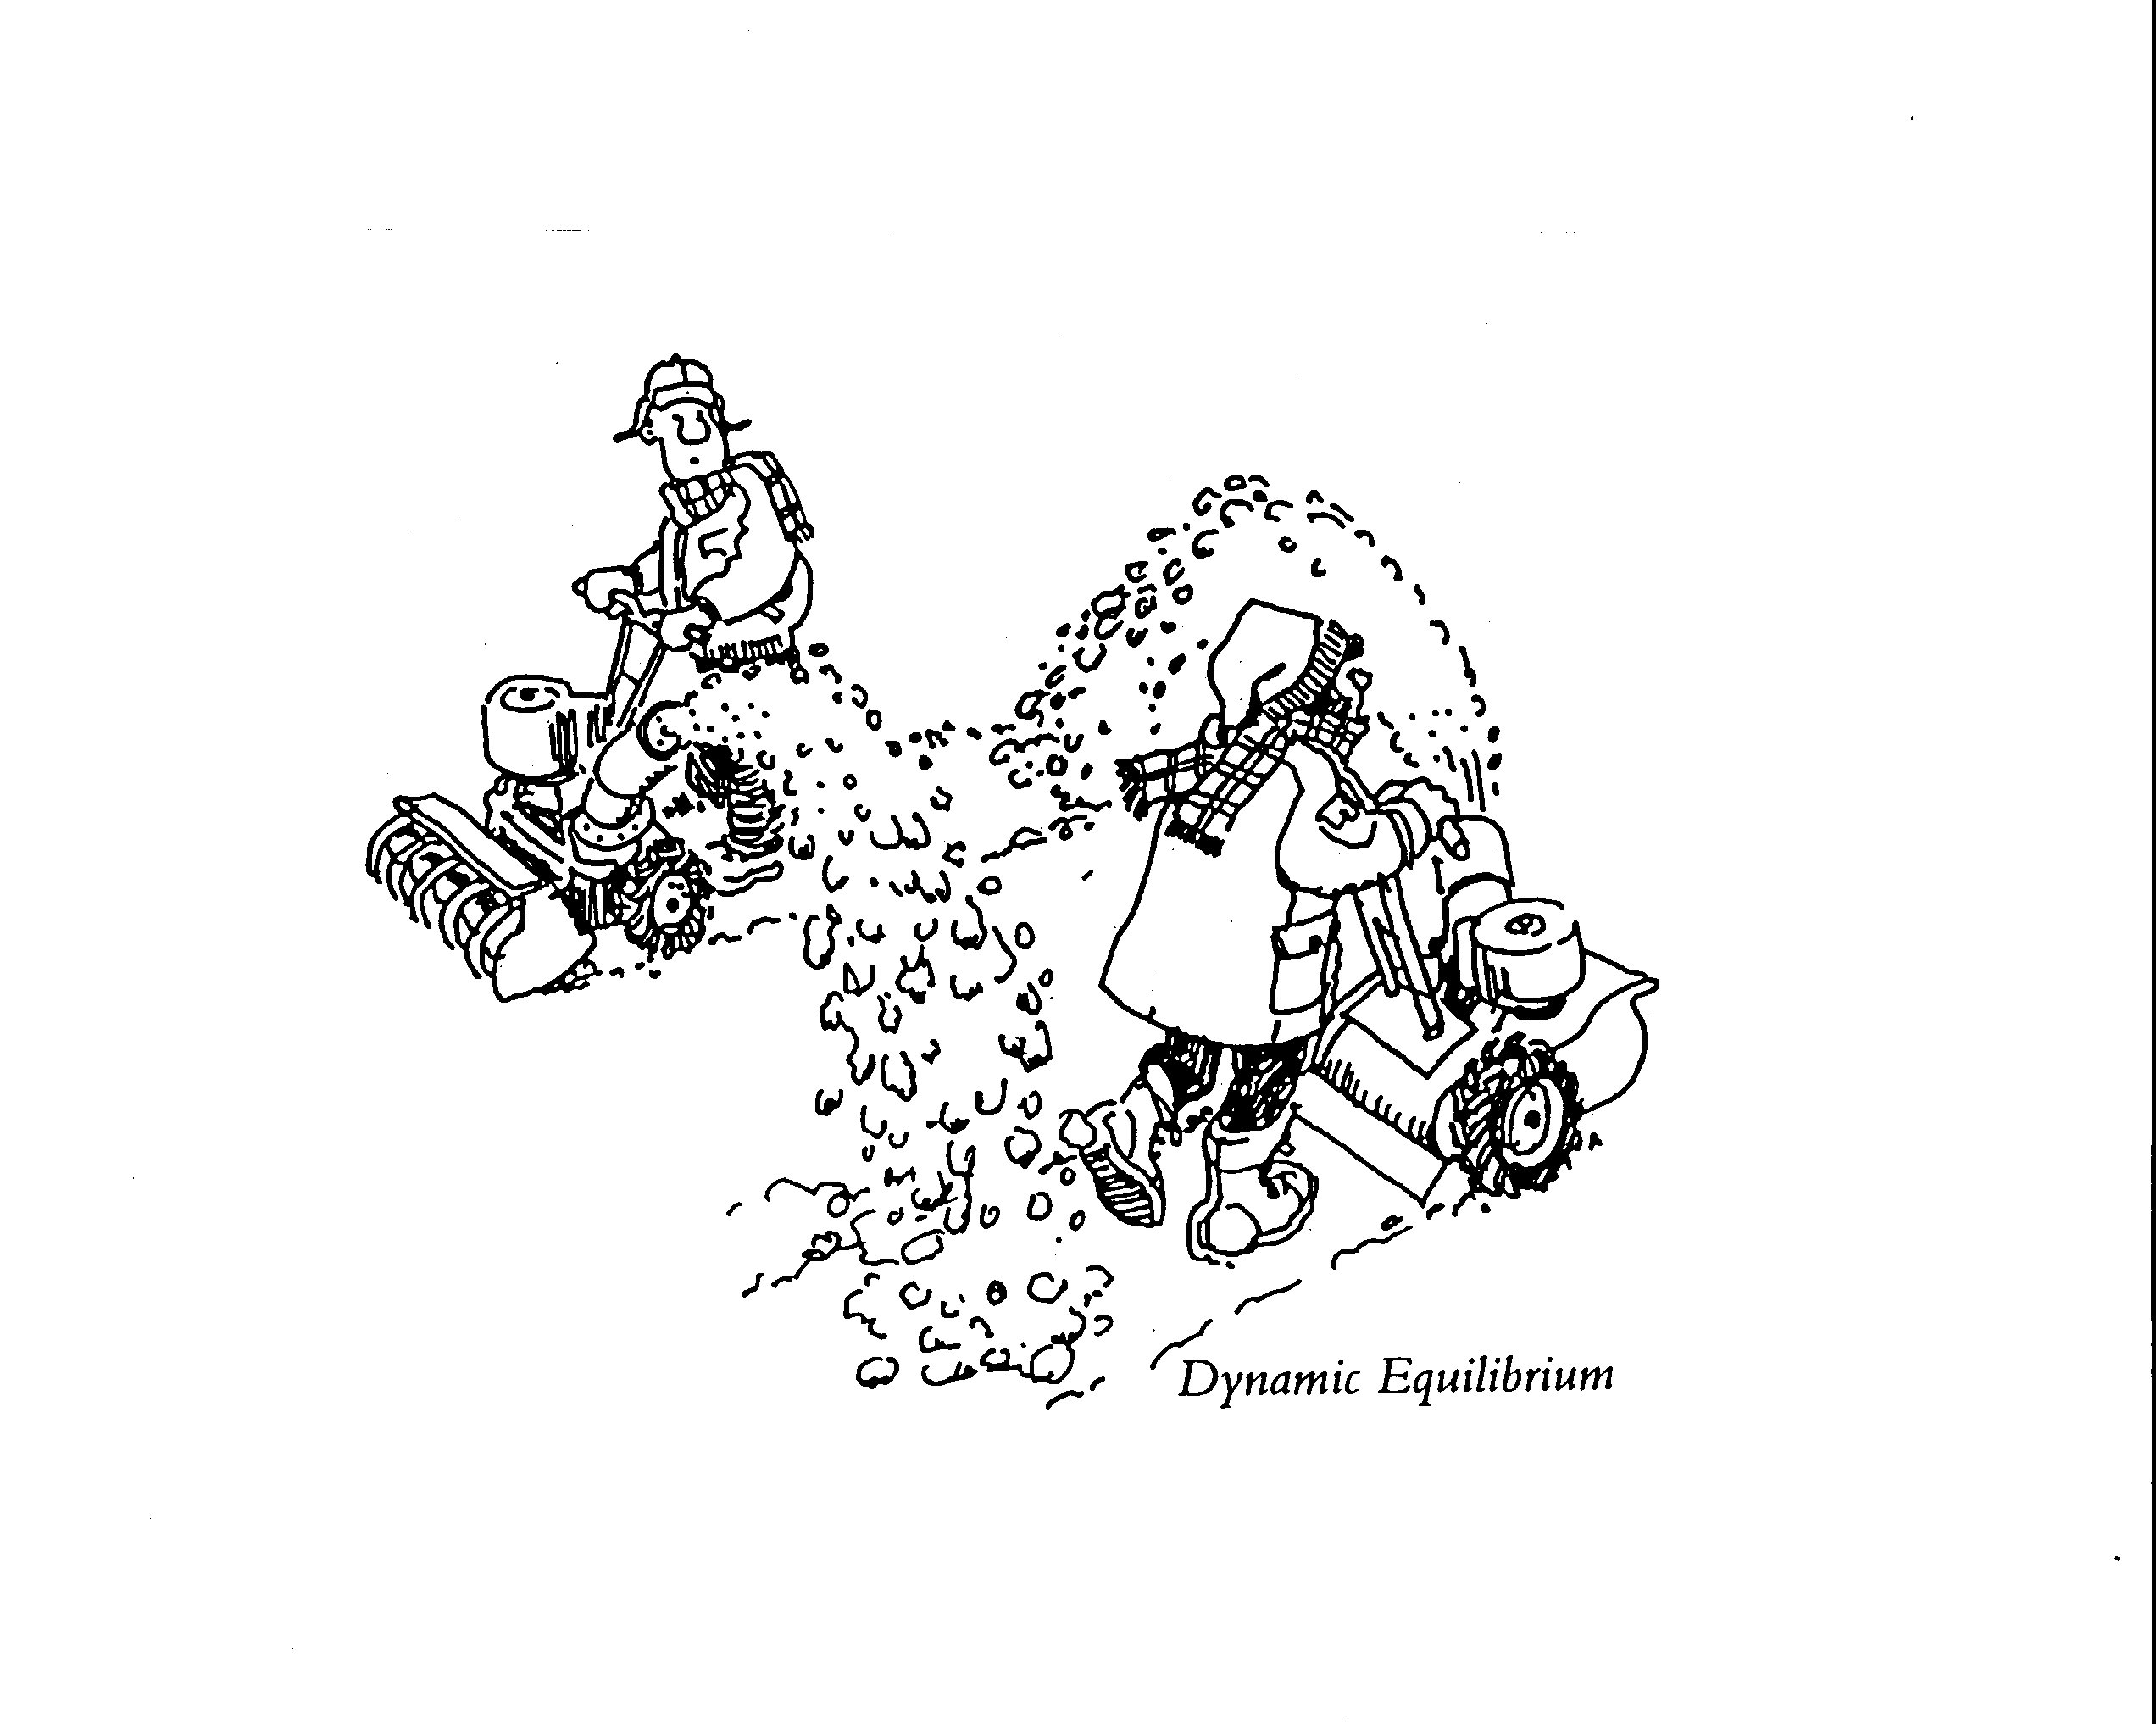

Slide 3
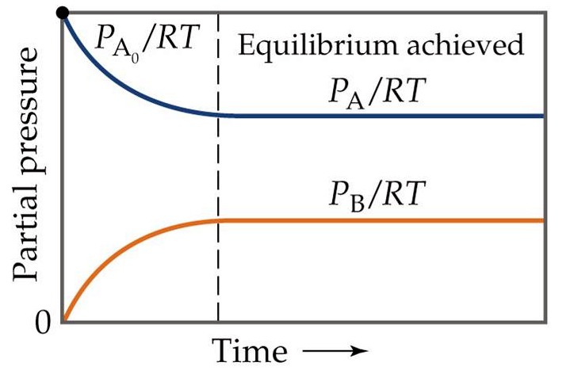
2 NO (g) + O₂ (g) 2 NO₂ (g)
2 NO₂ (g) 2 NO (g) + O₂ (g)
⇌
2 NO (g) + O₂ (g) 2 NO₂ (g)

Slide 4
when a process is at equilibrium, it has been found experimentally, for all processes, that the ratio of products to reactants is constant !
equilibrium constant, K
[Products]
[Reactants]
K =
Kc = for [ ] in molar, M
Kp = for [ ] in partial pressure
in atm for gases
Notes:
Figure: 15-03

Slide 5
⇌
2 NO (g) + O₂ (g) 2 NO₂ (g)
[NO₂]²
[NO]² [O₂]
K =

Slide 6
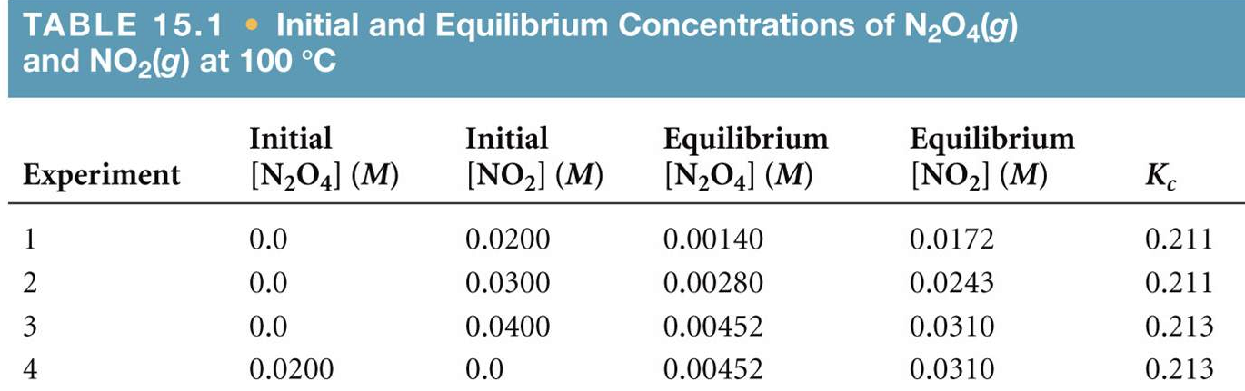
⇌
N₂O₄ (g) 2 NO₂ (g)
[NO₂]²
[N₂O₄]
Kc =
When equilibrium is established, the concentration of reactants
and products vary….but the RATIO of P/R remains CONSTANT !
Notes:
Figure: 15-T01

Slide 7
⇌
2 NO (g) + O₂ (g) 2 NO₂ (g)
[NO₂]²
[NO]² [O₂]
Kc =
At equilibrium, the following [ ]’s are found:
[NO₂] = 0.896 M
[NO] = 0.0126 M
[O₂] = 0.00413 M
Determine the equilibrium constant, Kc

Slide 8
By convention, equilibrium constants, Kc
are always UNITLESS !!

Slide 9
Determine the equilibrium constant, Kc for the reverse process
⇌
2 NO₂ (g) 2 NO (g) + O₂ (g)
This equilibrium expression
is the reciprocal of the
previous example
[NO]²[O₂]
[NO₂]²
Kc =
1
1.22 x 10⁶
Kc =
= 8.17 x 10⁻⁷
The value of the equilibrium constant, K, for a reaction in one direction is the reciprocal of the equilibrium reaction written in the reverse direction

Slide 10
⇌
2 NO (g) + O₂ (g) 2 NO₂ (g)
Kc = 1.22 x 10⁶
reverse reaction
reciprocal
⇌
2 NO₂ (g) 2 NO (g) + O₂ (g)
Kc = 8.17 x 10⁻⁷

Slide 11
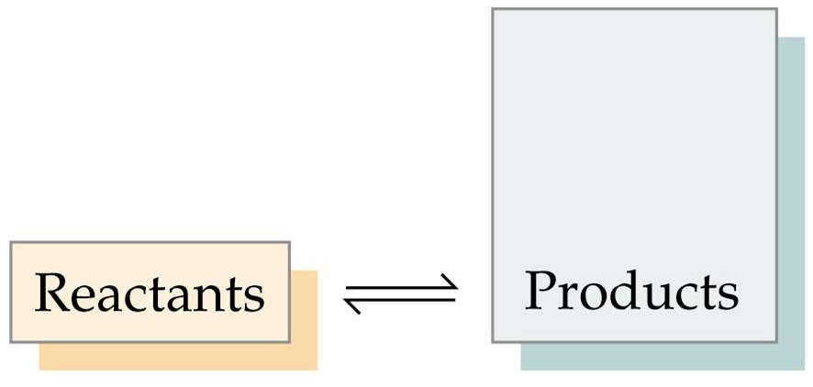
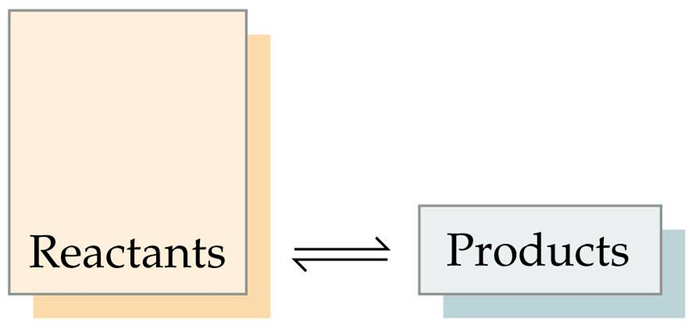
when K >> 1
(bigger than 1000)
[products] > [reactants]
P
R
K =
“Equilibrium lies to the right”
“Equilibrium lies to the left”
when K << 1
(smaller than 0.001)
[reactants] > [products]
P
R
K =

Slide 12
If K ≈ 1 (0.001 – 1000)
The equilibrium mixture will have similar (or comparable) amounts of reactants and products
K is constant and does NOT vary with [ ]
K does vary with temperature

Slide 13
Kc and Kp are related
Kp = Kc (RT) ^{Δn}
R = 0.08206 L·atm/mole·K
T = temperature in Kelvin
Δn = (sum of coefficients of gaseous products)
− (sum of coefficients of gaseous reactants)

Slide 14
A container is initially charged with
2.00 M phosgene, COCl₂ (g) at 395 °C. An equilibrium with carbon monoxide and
chlorine gas is established. The equilibrium concentration of chlorine gas was found to be 0.0398 M. What is Kc for this reaction ?
1. Write the balanced chemical reaction
2. Build a chart under the reaction
3. Fill in the appropriate information (this is hard !!!)
4. Solve the problem that is presented

Slide 15
A container is initially charged with
0.260 atm Cl₂ (g) and 0.520 atm Br₂ (g)
at 75 °C. The reactants combine to produce BrCl (g). Kp = 56.9 at this temperature. What are the partial pressures of all species at equilibrium ?

Slide 16
A container is initially charged with
0.18 M CH₄ (g) and 0.18 M CCl₄ (g) at 455 °C. The reactants combine to produce CH₂Cl₂ (g).
Kc = 0.559 at this temperature. What are the molarities of all species at equilibrium ?

Slide 17
reaction quotient, Q – an equilibrium expression for a reaction NOT necessarily at equilibrium
When Q < K, the reaction will proceed to the right
(toward products) to establish equilibrium
When Q > K, the reaction will proceed to the left
(toward reactants) to establish equilibrium
When Q = K, the reaction is at equilibrium

Slide 18
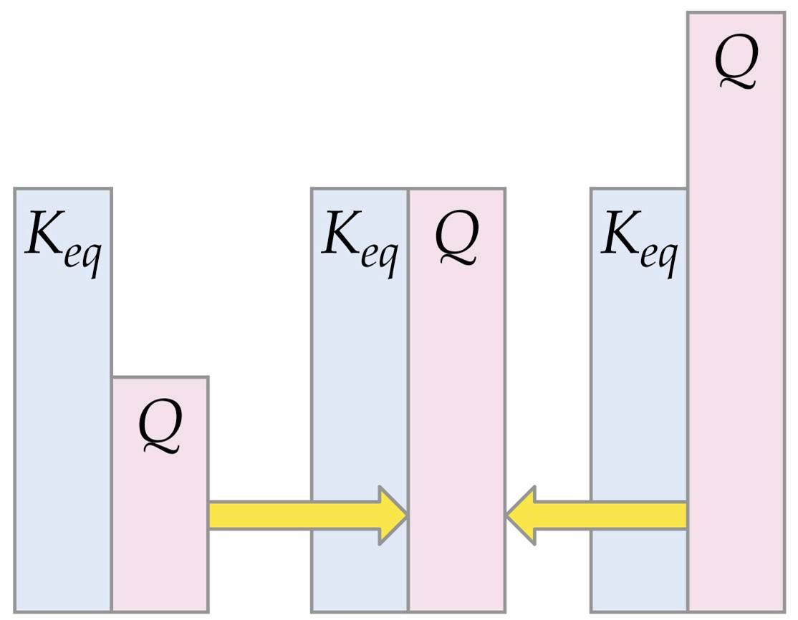
Q < K
rxn forms products
Q = K
rxn at equilibrium
Q > K
rxn forms reactants

Slide 19
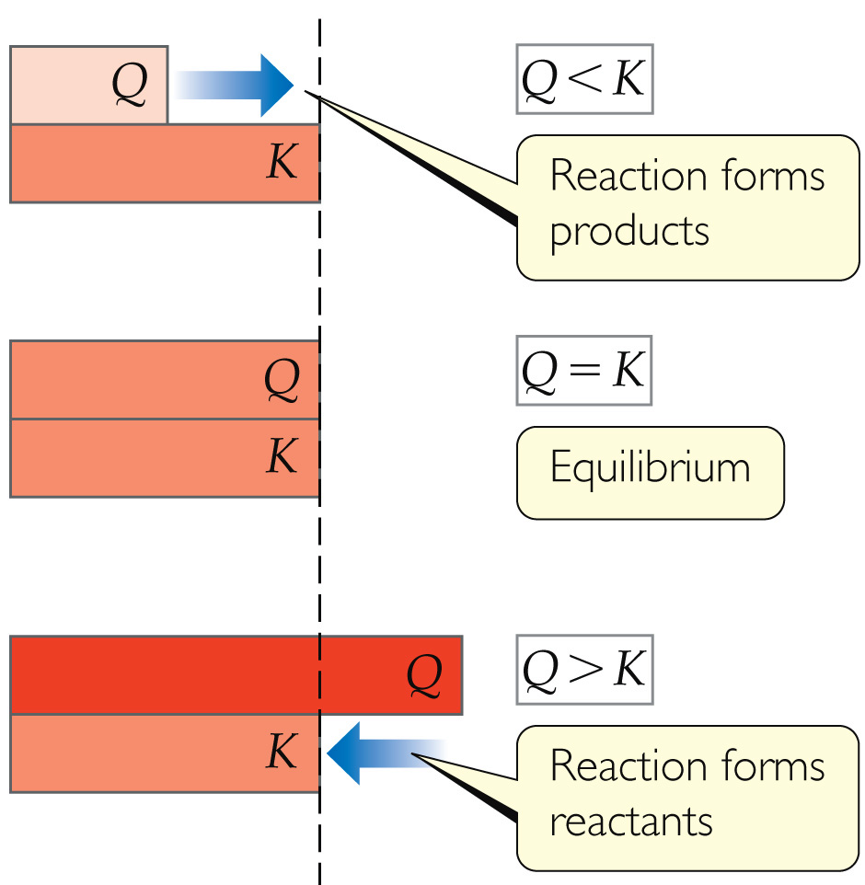

Slide 20
homogeneous equilibrium – all species are in the same phase
heterogeneous equilibrium – all species are NOT in the same phase
* ALL pure liquids and solids are left out of the equilibrium expression
aqueous solutions, ex. NaCl (aq), are always included in the equilibrium expression

Slide 21
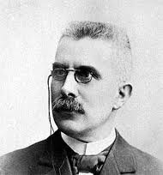
Fact: When a system is at equilibrium, it will remain at equilibrium forever, unless disturbed by some outside force.
outside force: - change in concentration
- change in temperature
- change in pressure (gas phase)
Le Châtelier’s Principle – when a “stress” is applied to
a system at equilibrium, the reaction “shifts” to relieve
the stress, and re-establish the condition of equilibrium
Henry Le Chatelier 1850 – 1936

Slide 22
N₂ (g) + 3 H₂ (g) ⇌ 2 NH₃ (g)
Notes:
Figure: 15-06

Slide 23
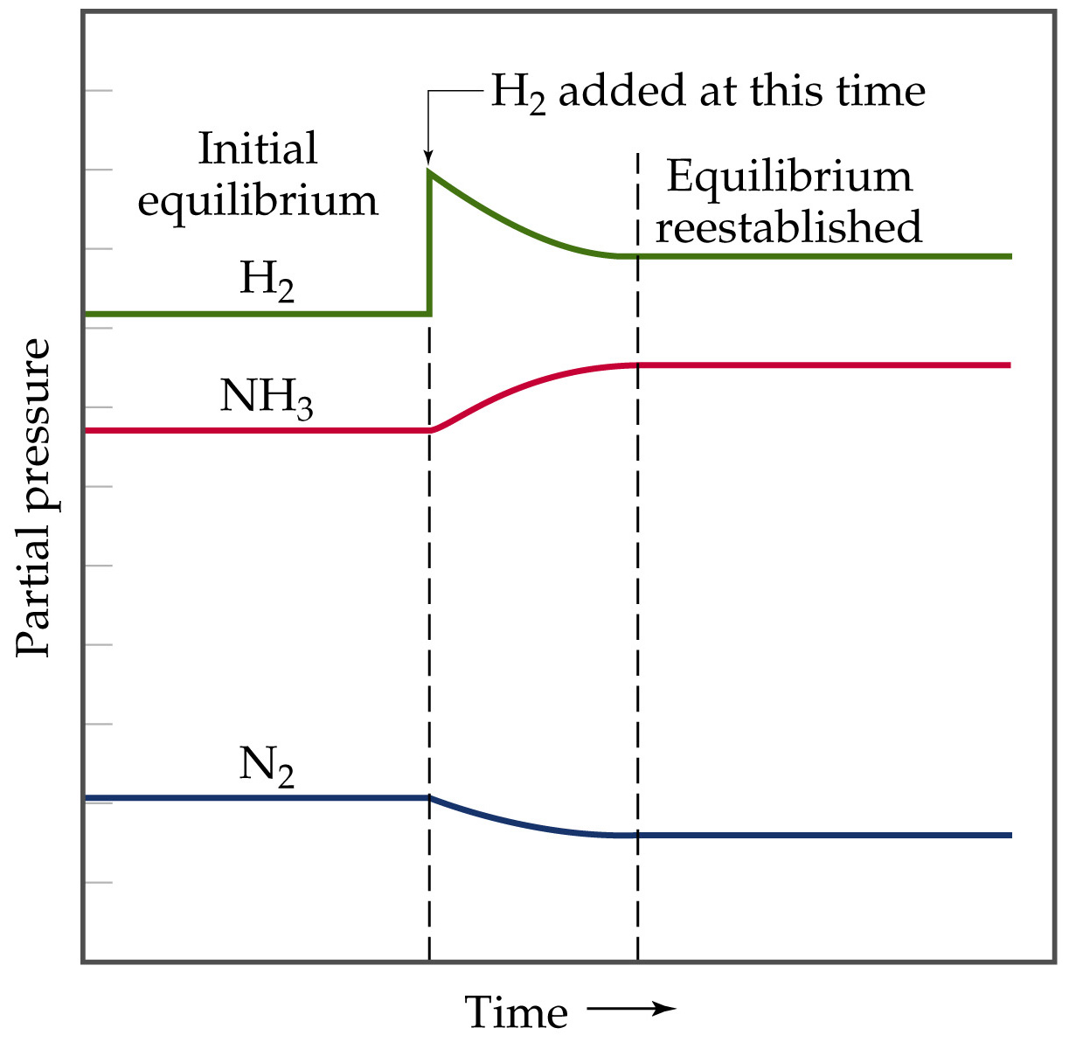
Notes:
Figure: 15-12

Slide 24
Le Châtelier states, “if a system is at equilibrium, and you…
1. add reactant, the reaction shifts to the Right,
to consume the excess reactant and restore equilibrium”
2. add product, the reaction shifts to the Left,
to consume the excess product and restore equilibrium”
3. remove reactant, the reaction shifts to the Left,
to replace the lost reactant and restore equilibrium”
4. remove product, the reaction shifts to the Right,
to replace the lost product and restore equilibrium”

Slide 25
Changes in applied pressure affects gas phase reactions
N₂ (g) + 3 H₂ (g) ⇌ 2 NH₃ (g)
increase in pressure results in the reaction shifting toward the side with the fewest number of gas particles
decrease in pressure results in the reaction shifting toward the side with the largest number of gas particles

Slide 26
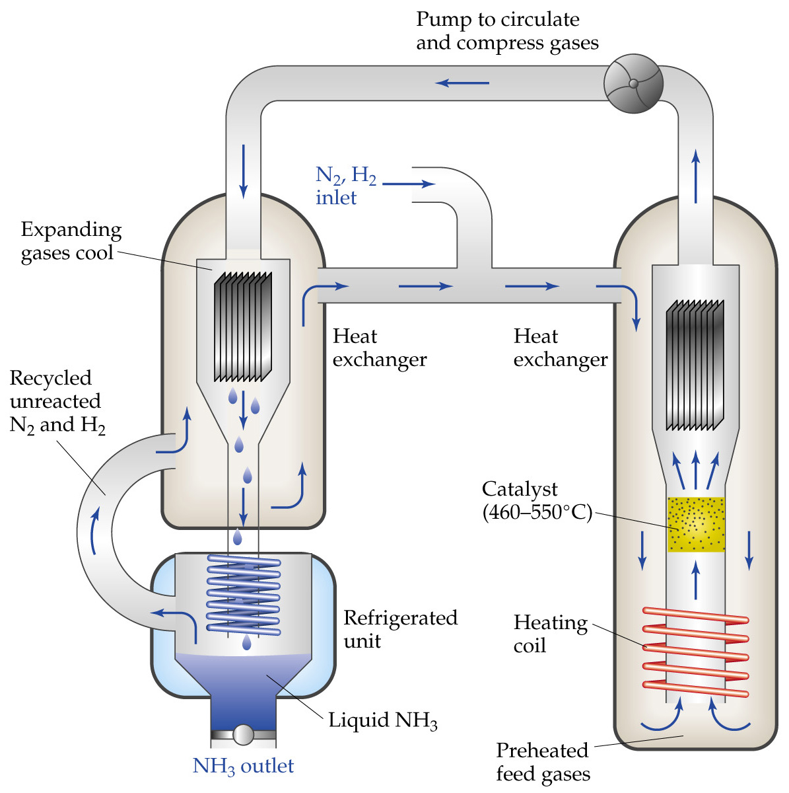
N₂ (g) + 3 H₂ (g) ⇌ 2 NH₃ (g)
Notes:
Figure: 15-13

Slide 27
Changes in concentration or pressure results in reactions shifting but does NOT affect the numerical value of the equilibrium constant, K
Changes in temperature also results in reactions shifting and DOES affect the numerical value of the equilibrium constant, K
Changes in Temperature affects equilibrium
predicting how temperature affects equilibria requires thermodynamic knowledge of the equilibrium reaction
heat is a reactant for an endothermic reaction and
heat is a product for an exothermic reaction

Slide 28
ΔG_{rxn} or Gibbs Free Energy, is the ultimate, final deciding factor as to whether a reaction will occur spontaneously, anywhere in the universe
Recall:
When ΔG_{rxn} = – #, the reaction is spontaneous.
When ΔG_{rxn} = + #, the reaction is nonspontaneous.
When ΔG_{rxn} = 0, the reaction is at equilibrium (has no tendency to go one way or the other)

Slide 29
ΔG_{rxn}
°
of a reaction at standard conditions is related to equilibrium constant, K of that reaction.
= – RT(ln K)
ΔG_{rxn}
°
R = 8.314 J/mole·K
T = temperature in Kelvin
at 25 °C and 1 atm, a gas phase reaction exhibits an equilibrium constant, Kp = 8.4 x 10⁷ at standard conditions. Determine (in units of kJ/mole).
ΔG_{rxn}
°

