Slide 1
kinetics – the speed (or rate) at which a reaction takes place
2 H₂O₂ (aq) 2 H₂O () + O₂ (g)
2 ways to measure the rate of any reaction
1. measure the Increase in [Products] over time
2. measure the Decrease in [Reactants] over time
How do you measure this ?
measure a change in concentration per change in time

Slide 2
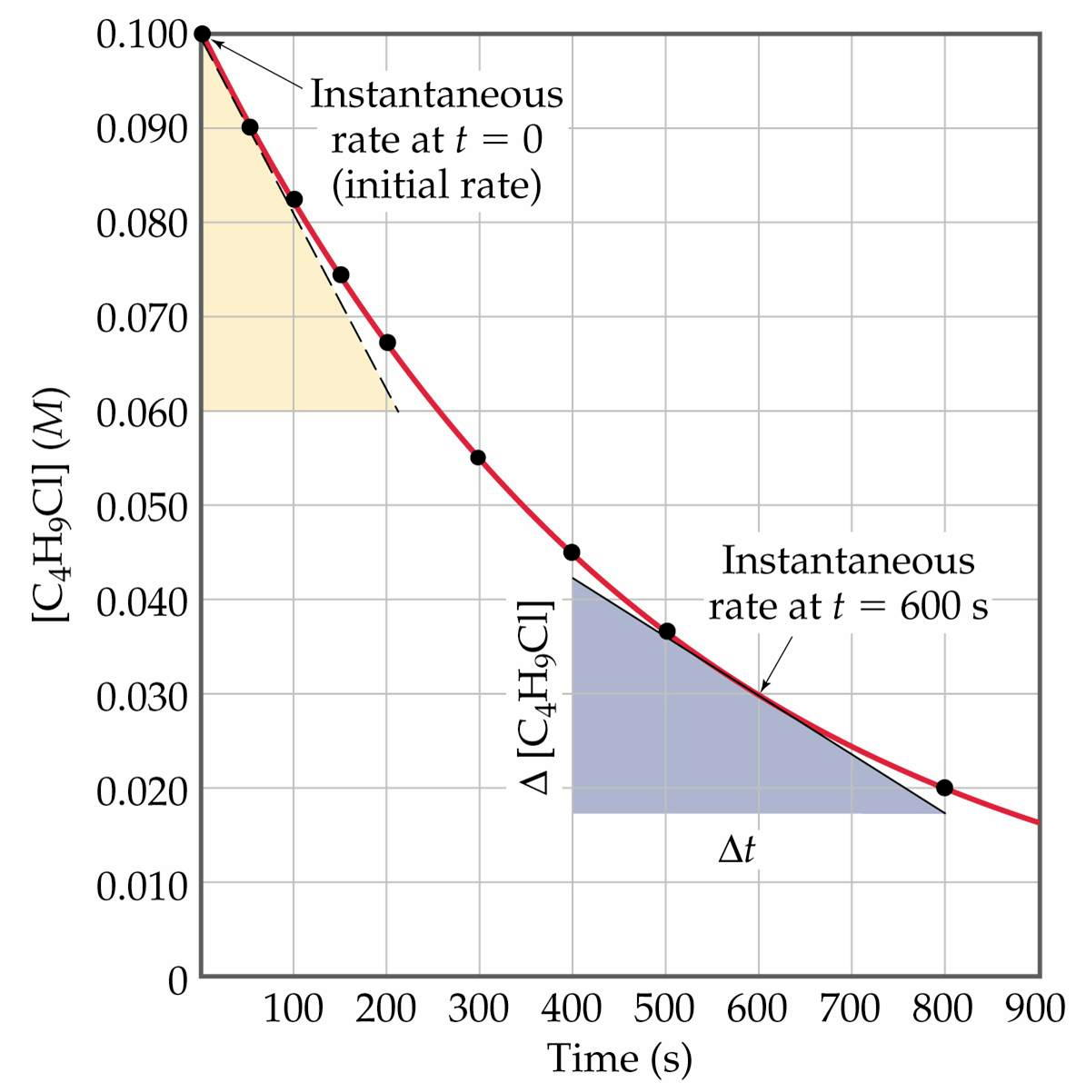
Δ y
Δ x
slope =
Δ [ ]
Δ t
Rate =
slope = Rate
Notes:
Figure: 14-04

Slide 3
Δ [ Products ]
Δ t
when
slope = + #
Δ [ Products ]
Δ t
Rate =
Δ [ Reactants ]
Δ t
when
slope = - #
* By convention, all rates are reported as positive values
Δ [ Reactants ]
Δ t
Rate = -

Slide 4
instantaneous rate – rate of rxn at a particular instant of time
Notes:
Figure: 14-04

Slide 5
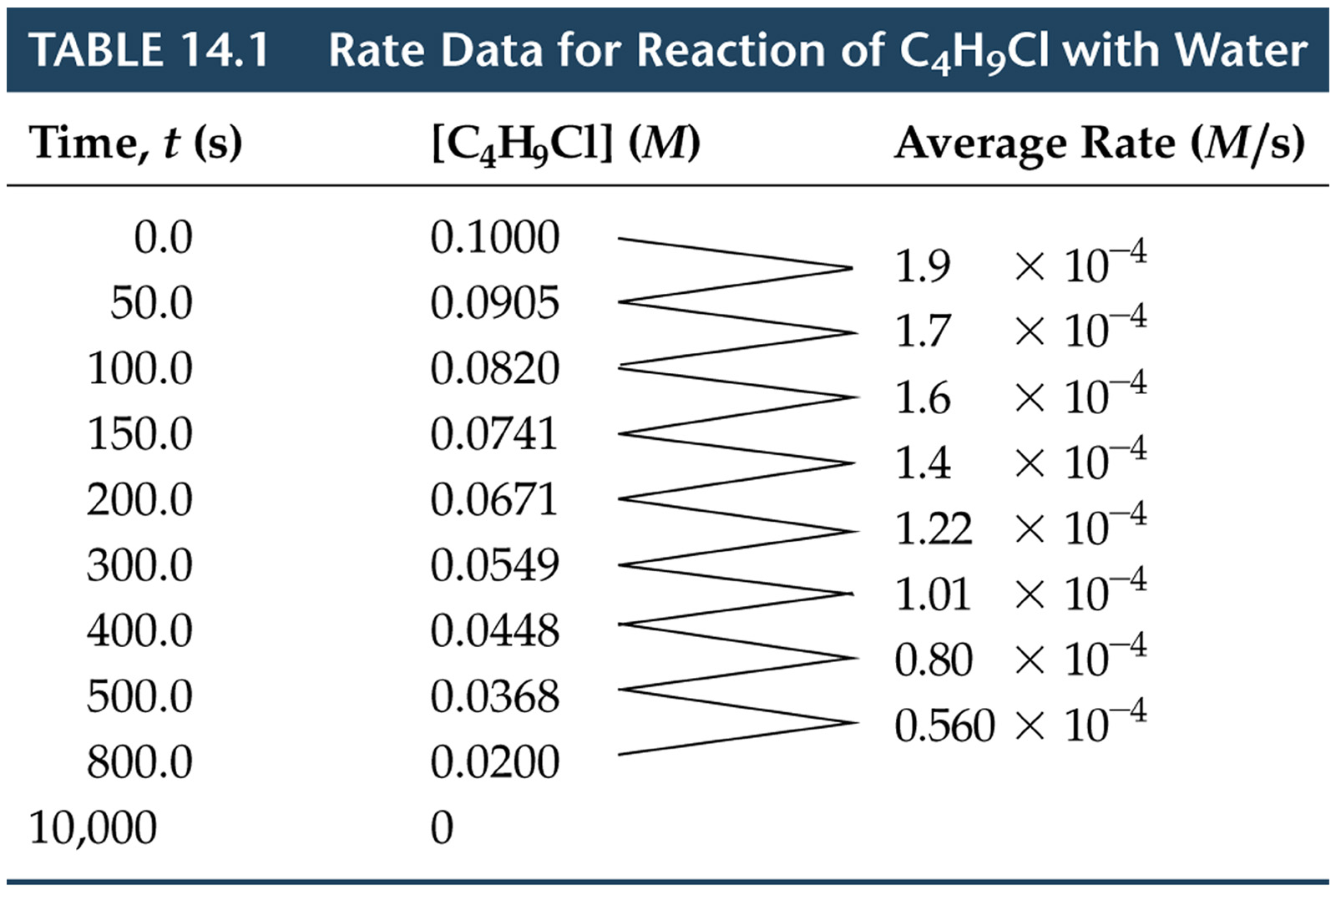
Notes:
Figure: 14-T01

Slide 6
initial rate – instantaneous rate at t = 0 (very beginning)
Notes:
Figure: 14-04

Slide 7
2 H₂O₂ (aq) 2 H₂O () + O₂ (g)
slope of tangent line at t = 0 is -2.0 x 10⁻⁴ M/sec
Δ [H₂O₂ ]
Δ t
Rate = -
= - (-2.0 x 10⁻⁴ M/sec)
Rate =
2.0 x 10⁻⁴ M/sec

Slide 8
Can the rate of H₂O₂ being consumed be related to the rate of products being generated ?
2 H₂O₂ (aq) 2 H₂O () + O₂ (g)
[H₂O] increases at a rate of 2.0 x 10⁻⁴ M/sec as [H₂O₂] decreases at a rate of 2.0 x 10⁻⁴ M/sec
What is the rate that O₂ forms when the [H₂O₂] is decreasing at a rate of 2.0 x 10⁻⁴ M/sec ?
[O₂] increases at a rate of 1.0 x 10⁻⁴ M/sec as [H₂O₂] decreases at a rate of 2.0 x 10⁻⁴ M/sec

Slide 9
The rate of any rxn depends of four things:
1. physical state of the reactants (usually means surface area)
2. concentration of the reactants
3. temperature of the reactants
4. presence of a catalyst

Slide 10
Rate vs. [Reactants]
2 H₂O₂ (aq) 2 H₂O () + O₂ (g)
rate law expression takes the form:
rate = k [H₂O₂]^{x}
rate = rate of the reaction
k = rate constant
[H₂O₂] = concentration of reactant
x = order of the reactant (usually an integer)

Slide 11
what if the rxn has multiple reactants ?
2 HgCl₂ + C₂O₄²⁻ Hg₂Cl₂ + 2 CO₂ + 2 Cl⁻
Rate = k [HgCl₂]^{x} [C₂O₄²⁻]^{y}
k = rate constant indicative of this rxn
x = order wrt [HgCl₂]
x and y must be determined experimentally
y = order wrt [C₂O₄²⁻]

Slide 12
Trial | [HgCl₂] | [C₂O₄²⁻] | initial rate, M/sec
1 | 0.10 M | 0.30 M | 7.65 x 10⁻⁵
2 | 0.20 M | 0.30 M | 1.53 x 10⁻⁴
3 | 0.20 M | 0.10 M | 1.70 x 10⁻⁵
Method of Initial Rates
- to determine the numerical value for x and y, examine the data and find 2 trials where [reactant] of interest is varied, while all other reactants are held constant. Compare rate law expressions for these two trials to determine the order of that reactant

Slide 13
Rate = k [HgCl₂]^{x} [C₂O₄²⁻]^{y}
Trial | [HgCl₂] | [C₂O₄²⁻] | initial rate, M/sec
1 | 0.10 M | 0.30 M | 7.65 x 10⁻⁵
2 | 0.20 M | 0.30 M | 1.53 x 10⁻⁴
3 | 0.20 M | 0.10 M | 1.70 x 10⁻⁵
examine trials 1 and 2
[HgCl₂] varies while the [C₂O₄²⁻] is held constant
Use trials 1 and 2 to obtain the numerical value for the order wrt [HgCl₂] (which is x)
x = 1
unitless

Slide 14
Rate = k [HgCl₂]^{x} [C₂O₄²⁻]^{y}
Trial | [HgCl₂] | [C₂O₄²⁻] | initial rate, M/sec
1 | 0.10 M | 0.30 M | 7.65 x 10⁻⁵
2 | 0.20 M | 0.30 M | 1.53 x 10⁻⁴
3 | 0.20 M | 0.10 M | 1.70 x 10⁻⁵
examine trials 2 and 3
[C₂O₄²⁻] varies while the [HgCl₂] is held constant
Use trials 2 and 3 to obtain the numerical value for the order wrt [C₂O₄²⁻] (which is y)
y = 2
unitless

Slide 15
rxn is 1st order wrt HgCl₂
x = 1
y = 2
rxn is 2nd order wrt C₂O₄²⁻
Rate = k [HgCl₂]^{x} [C₂O₄²⁻]^{y}
Rate = k [HgCl₂]¹ [C₂O₄²⁻]²
or
Rate = k [HgCl₂] [C₂O₄²⁻]²
x and y do NOT vary under any circumstances !

Slide 16
Determine the numerical value for the rate constant, k
Rate = k [HgCl₂] [C₂O₄²⁻]²
Rate [HgCl₂] [C₂O₄²⁻]²
= k
1
M²·sec
k =
8.5 x 10⁻³
units are very important
k is constant and does NOT vary with [ ]
k does vary with temperature

Slide 17
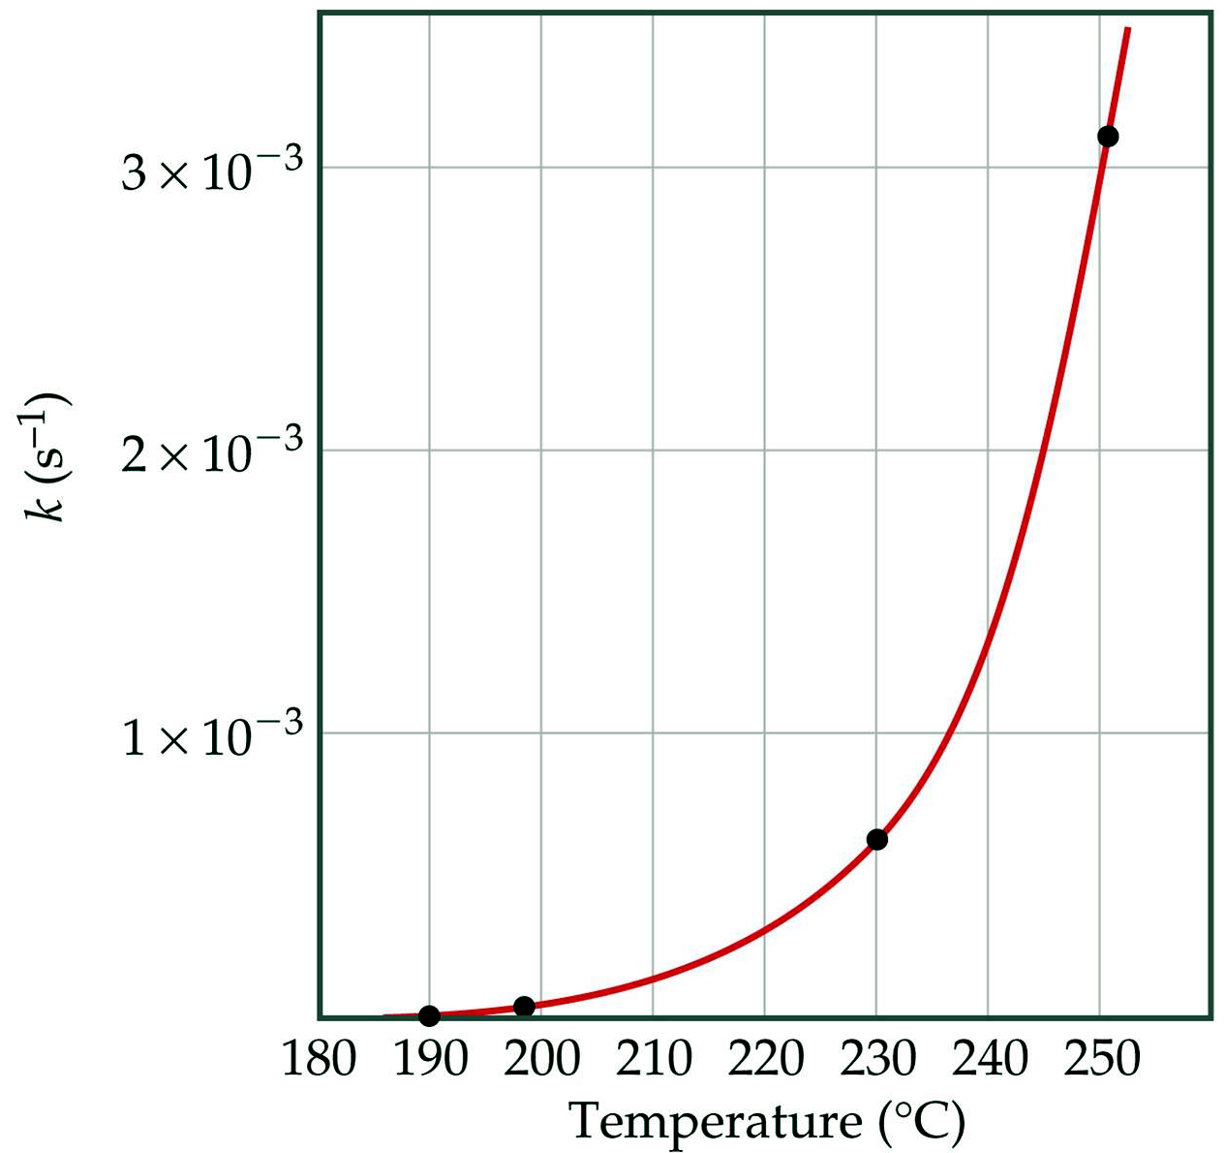
rate constant,
Notes:
Figure: 14-12

Slide 18
overall reaction order – sum of the individual reaction orders
x + y = 1 + 2 =
3
reaction is overall 3rd order

Slide 19
Δ
[ ] vs. time
aA
bB + jJ
if Rate = k[A]¹
rxn is overall 1st order
[A]_{o}
[A]_{t}
ln
= kt
[A]_{o} = initial [A] at t = 0
[A]_{t} = [A] at some time later, t
k = rate constant
t = time from t = 0

Slide 20
SO₂Cl₂ decomposes as follows: SO₂Cl₂ SO₂ + Cl₂ The rate constant, k = 2.2 x 10⁻⁵ at 300 °C. Suppose 0.30 M SO₂Cl₂ is placed in a container at 300 °C and allowed to decompose. What is the [SO₂Cl₂] after 75 minutes ?
1
sec
whenever the rate constant, k has units of 1/time ( or time⁻¹), the reaction is overall 1st order !
1
t

Slide 21
half-life – time required to convert exactly ½ reactants into products
abb. for half-life is t_{1/2}
for rxn is overall 1st order
0.693
k
t_{1/2} =

Slide 22
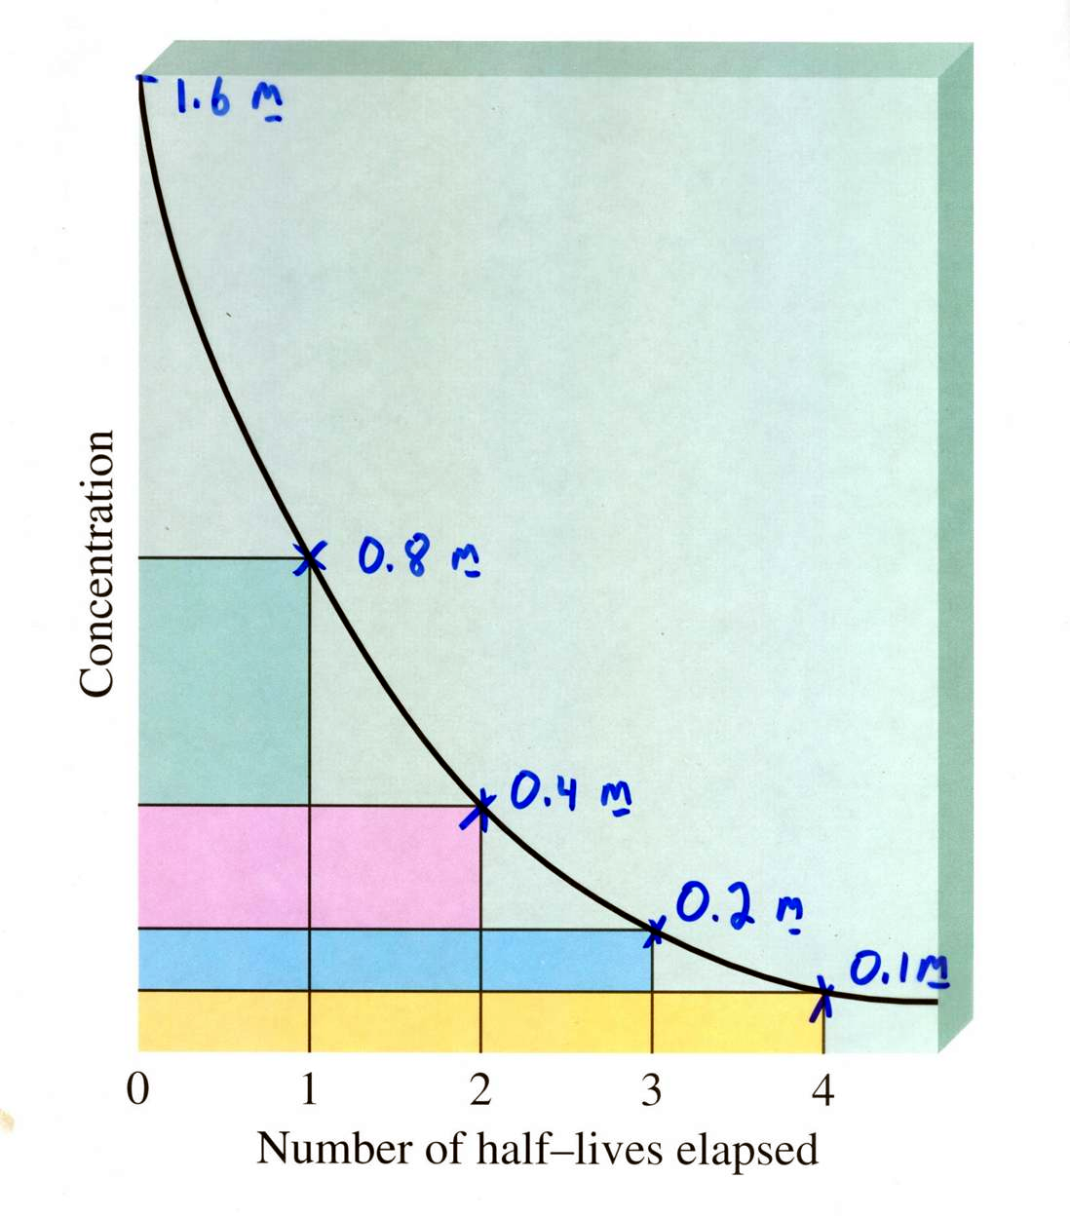

Slide 23
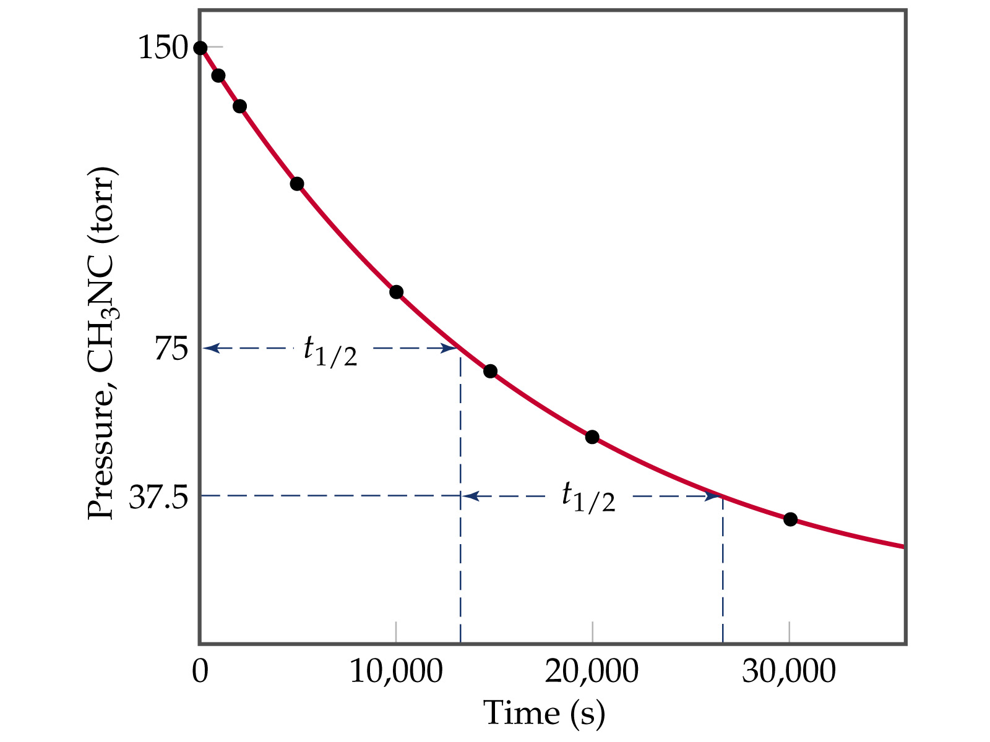
Notes:
Figure: 14-09

Slide 24
Prozac is a prescription drug which is metabolically eliminated from the body by overall first order kinetics. Prozac has a body clearance half-life of 1.835 x 10⁵ sec. If a patient is given a 20.0 mg dose, how many hours until only 13.8 mg Prozac remains in the body ?

Slide 25
Δ
[ ] vs. time
aA
uU + kK
if Rate = k[A]²
rxn is overall 2nd order
1
[A]_{t}
1
[A]_{o}
= kt
1
k [A]_{o}
t_{1/2} =

Slide 26
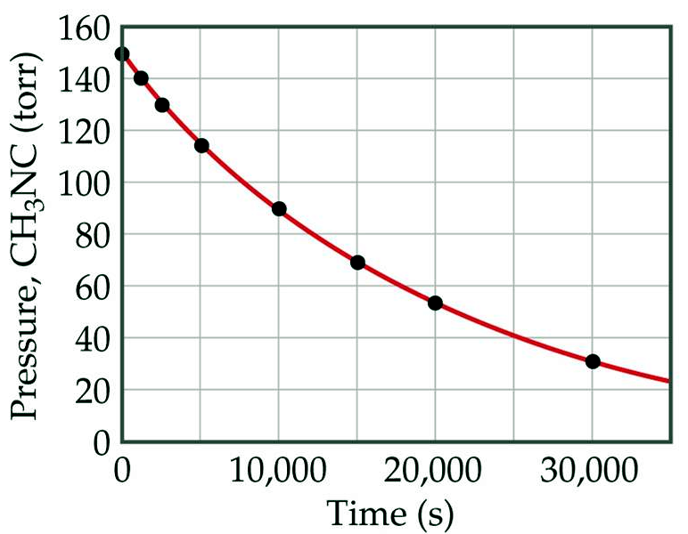
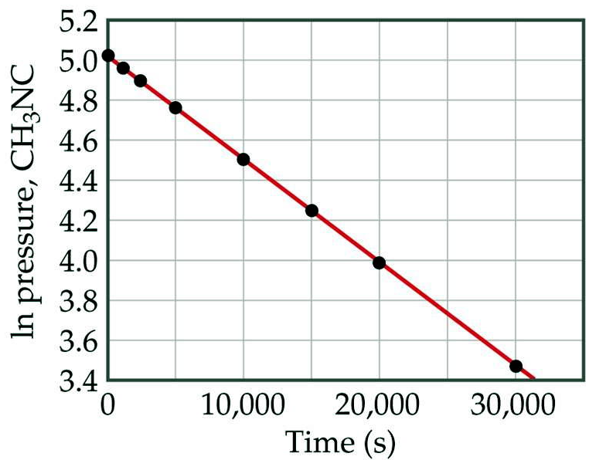
CH₃NC CH₃CN
[ ] vs. time is NOT linear
slope = - k
ln [ ] vs. time is linear
only occurs when the rxn is overall 1st order

Slide 27
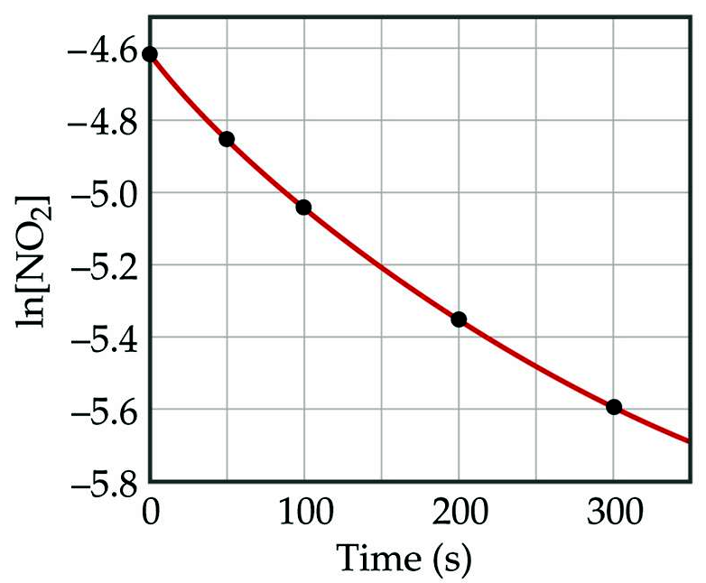
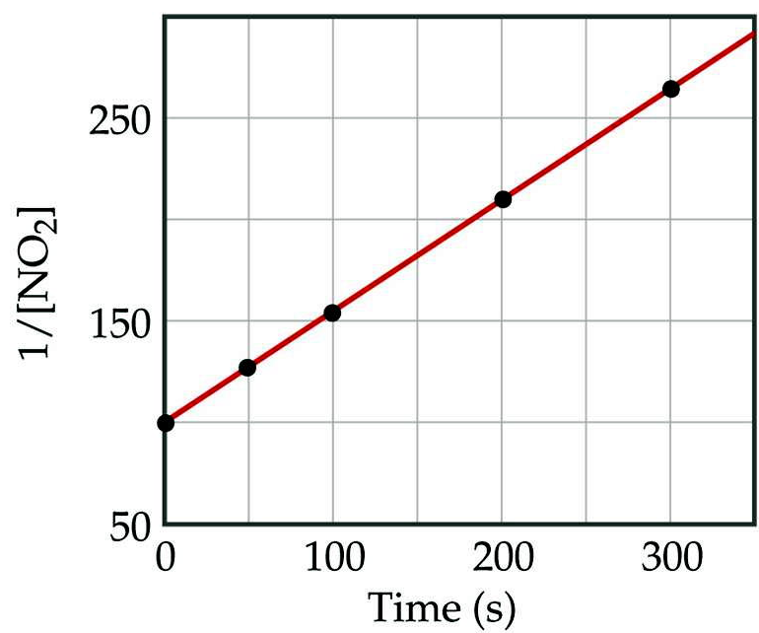
NO₂
NO + ½ O₂
This rxn is NOT 1st order
slope = k
1
[ ]
vs. time is linear
only occurs when the rxn is overall 2nd order
Notes:
Figure: 14-07a,b

Slide 28
Temperature vs. Rate
An increase in temperature results in an increase in the rate of a reaction
collision theory – for a reaction to occur, reacting species must first collide
1. collision must possess enough energy to react
2. collision must have reactants in the proper orientation to react
Notes:
Figure: 14-08a,b

Slide 29
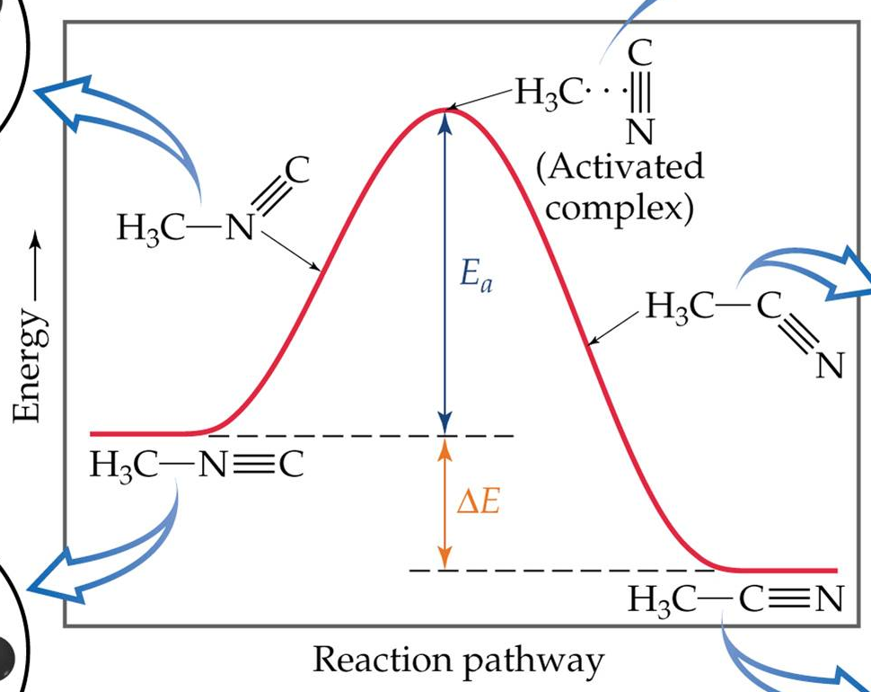
activation energy – the minimum energy reactants must attain to react to form products
Ea
Reactants
ΔH
Products

Slide 30
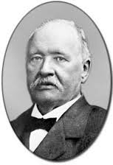
how is activation energy, Ea, determined ?
In lab, keep [reactants] constant and vary the temperature. Calculate values of the rate constant, k at each temperature.
Svante Arrhenius 1859 – 1927
Notes:
Figure: 14-15

Slide 31
Arrhenius equation
k = (A) (e^{(−Ea/RT)})
take ln of both sides
-Ea
RT
ln k = + ln A
y = mx + b
1
T
a plot of ln k vs. gives a straight line
-Ea
R
slope =

Slide 32
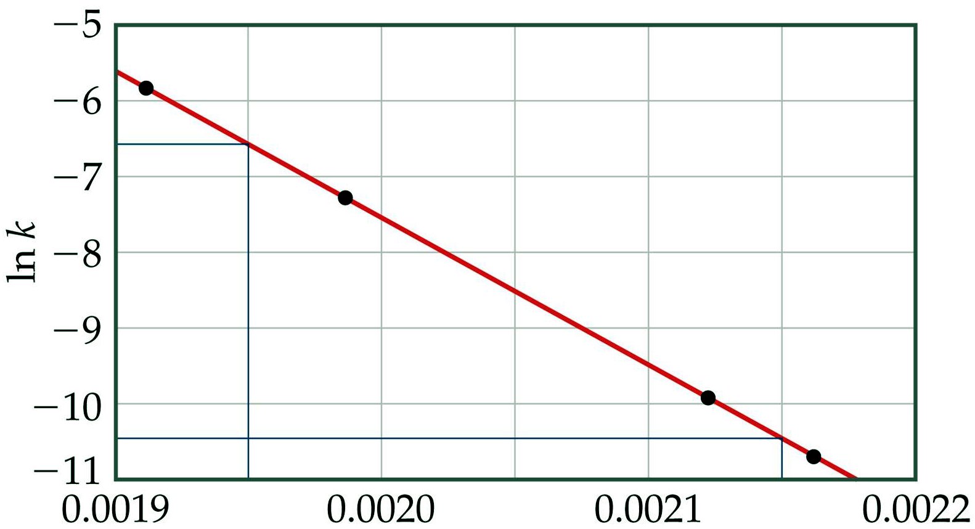
1
T
ln k vs.
K⁻¹
slope = -19,000 K
1
T
K⁻¹

Slide 33
slope = -19,000 K
-Ea
R
slope =
Ea = - (slope) (R)
Ea = - (-19,000 K) (8.314 J/mole·K)
Ea = 157,966 J/mole
Ea = 158 kJ/mole
Ea must be positive
Notes:
Figure: 14-17

Slide 34
Arrhenius equation (again)
k₁
k₂
Ea
R
1
T₂
1
T₁
ln
=
2 HI
H₂ + I₂
Trial | k, 1/M·sec | Temp
1 | 8.38 x 10⁻⁴ | 400 °C
2 | 7.65 x 10⁻² | 500 °C
given the data above, determine the Ea of the rxn

Slide 35
catalysts – increase the rate of rxn without being consumed
1. decrease the Ea by providing a different pathway to products
2. provide the correct orientation for the reactants to react

Slide 36
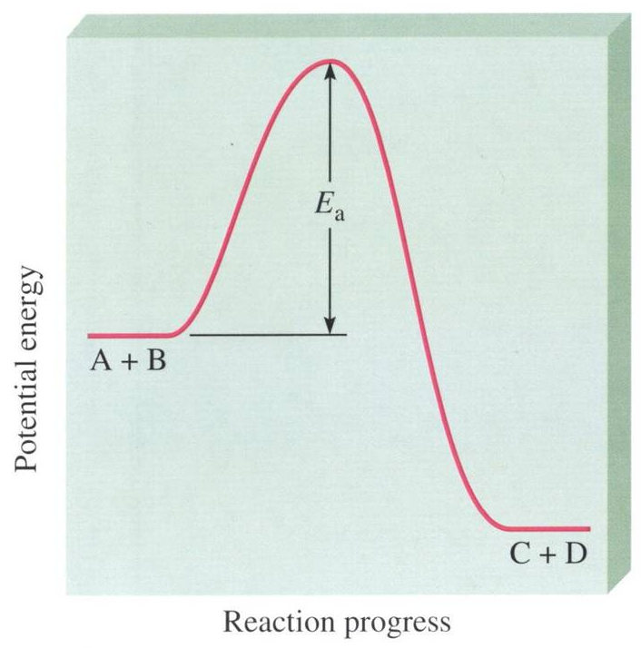
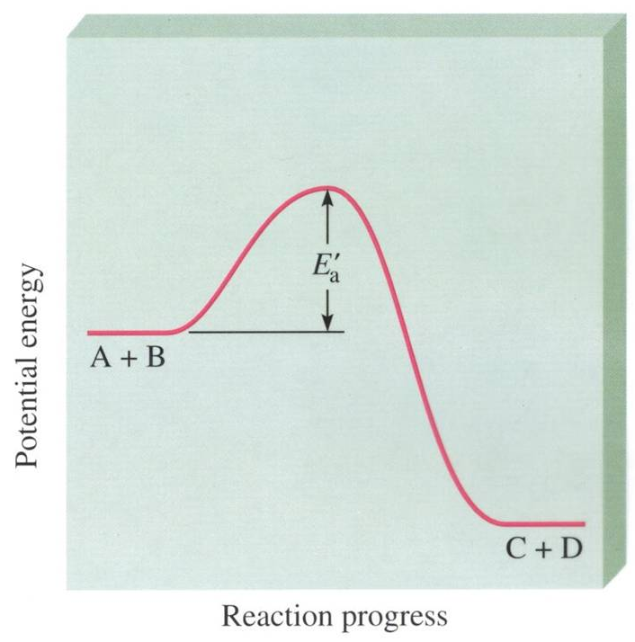
uncatalyzed rxn
catalyzed rxn

Slide 37
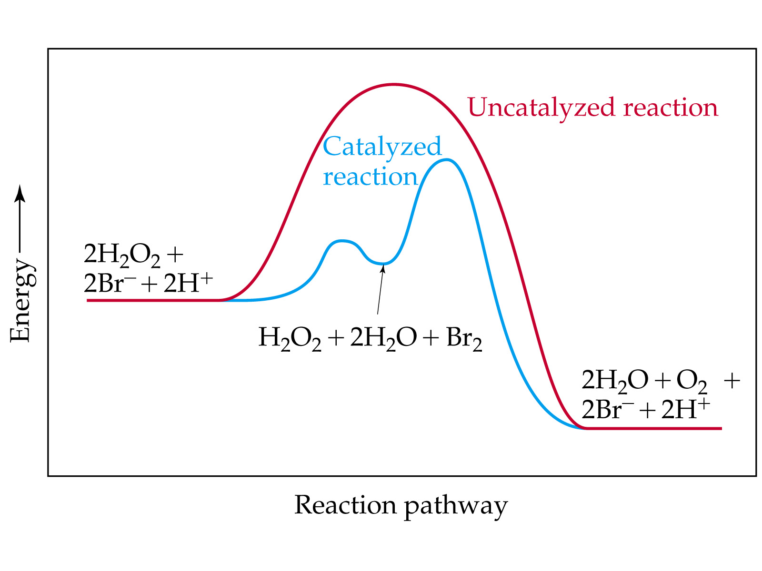
Notes:
Figure: 14-20

Slide 38
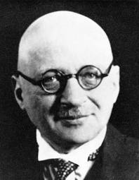
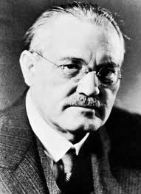
correct orientation
N₂ + 3 H₂ 2 NH₃
Haber-Bosch process
Fritz Haber 1868 – 1934
Karl Bosch 1874 – 1940

Slide 39
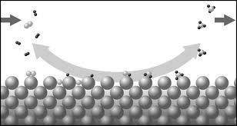
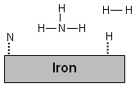
catalyst is primarily Fe & Fe₂O₃
H₂ and N₂ continuously added
H₂ and N₂ adsorb on the surface of the iron
3 H and N react on surface of the iron
NH₃ has no affinity to absorb on surface

Slide 40
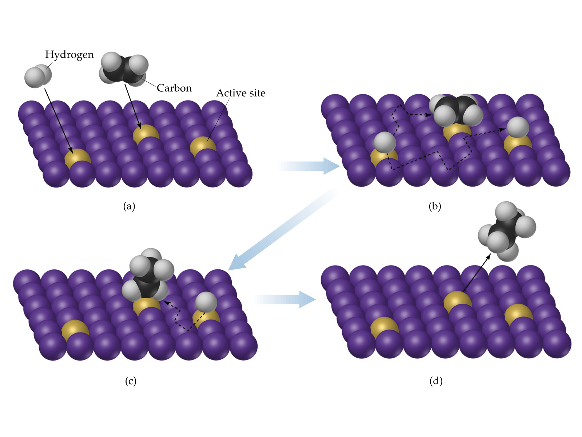
Notes:
Figure: 14-21

Slide 41
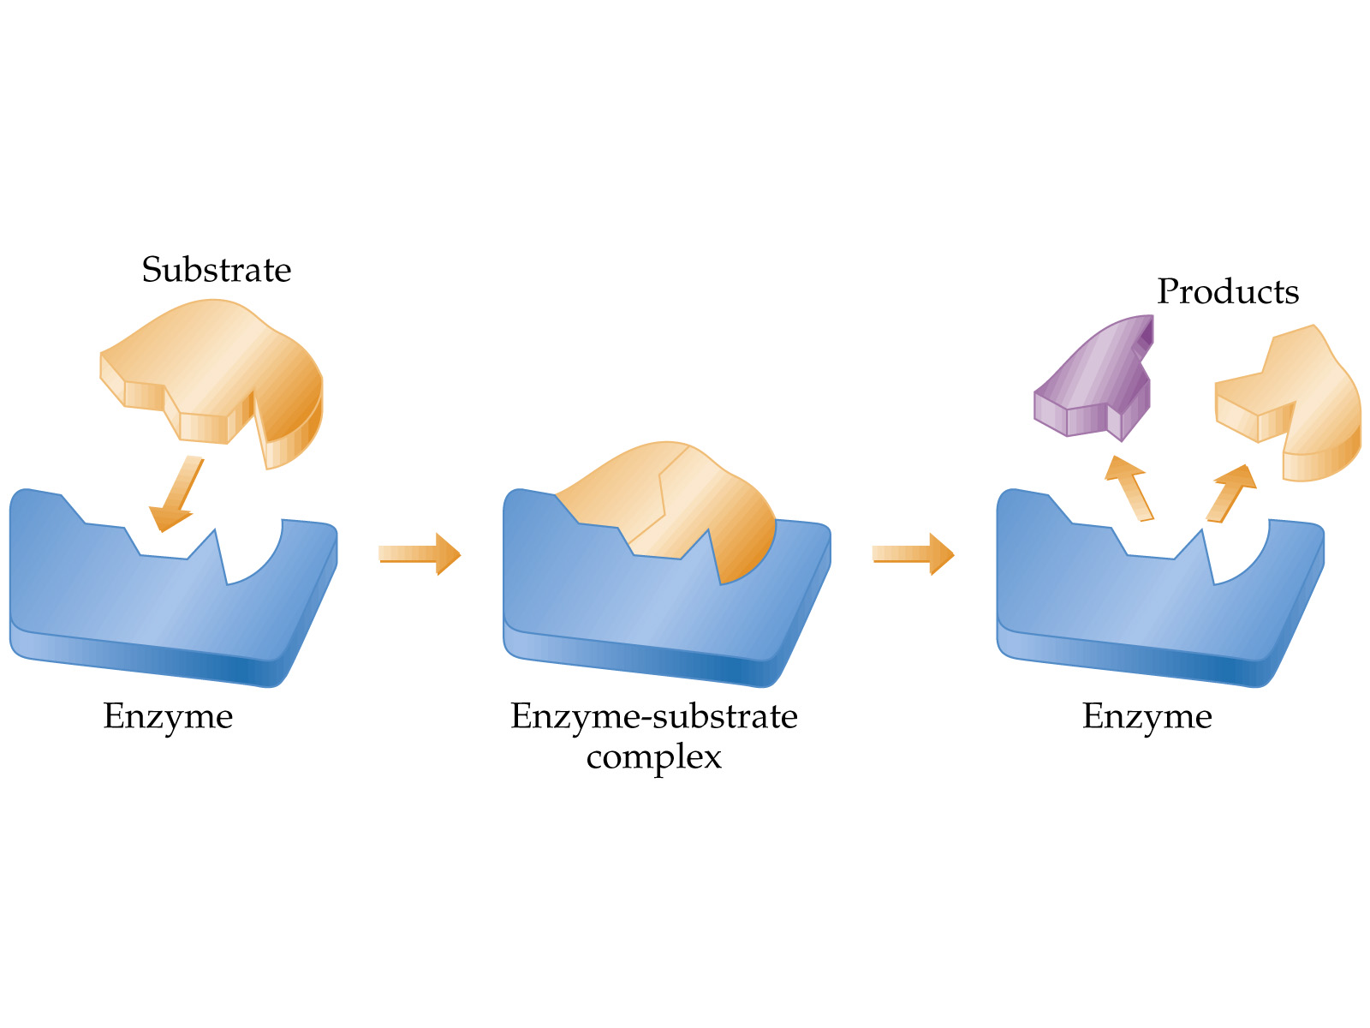
Notes:
Figure: 14-24

