Slide 1
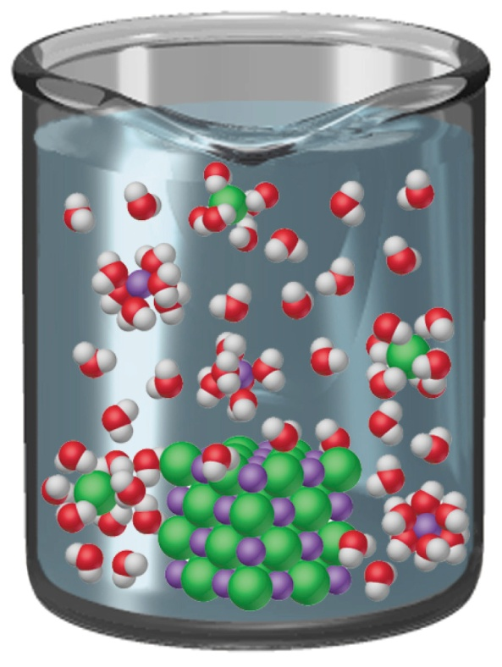
solution – homogeneous mixture of 2 or more substances
solvent – greatest component of the solution
solute – lesser components of the solution

Slide 2
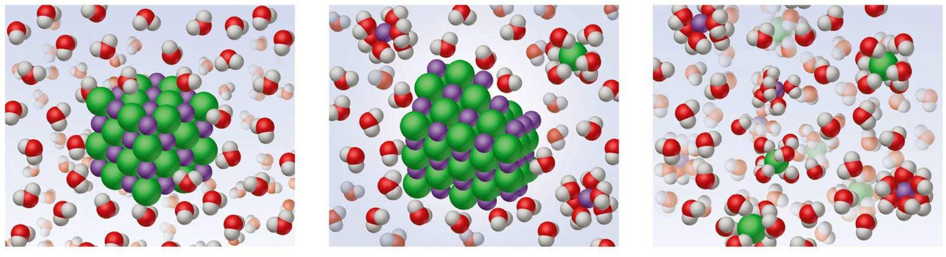
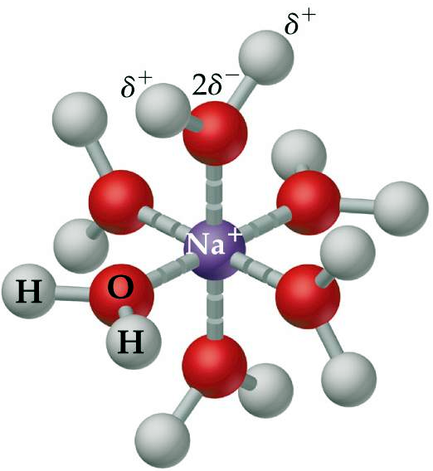
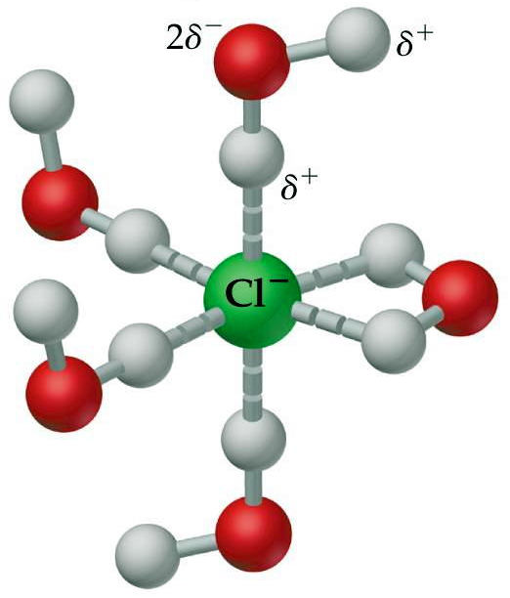
1. solvation – interaction between solute and solvent
hydration – solvation when water is the solvent
Notes:
Figure: 13-09

Slide 3
2. entropy – dissolution always results in an increase in disorder
Notes:
Figure: 13-09

Slide 4
solubility – the extent to which a solute dissolves
saturated solution – no more solute will dissolve
temperature dramatically affects solubility
Notes:
Figure: 13-01

Slide 5
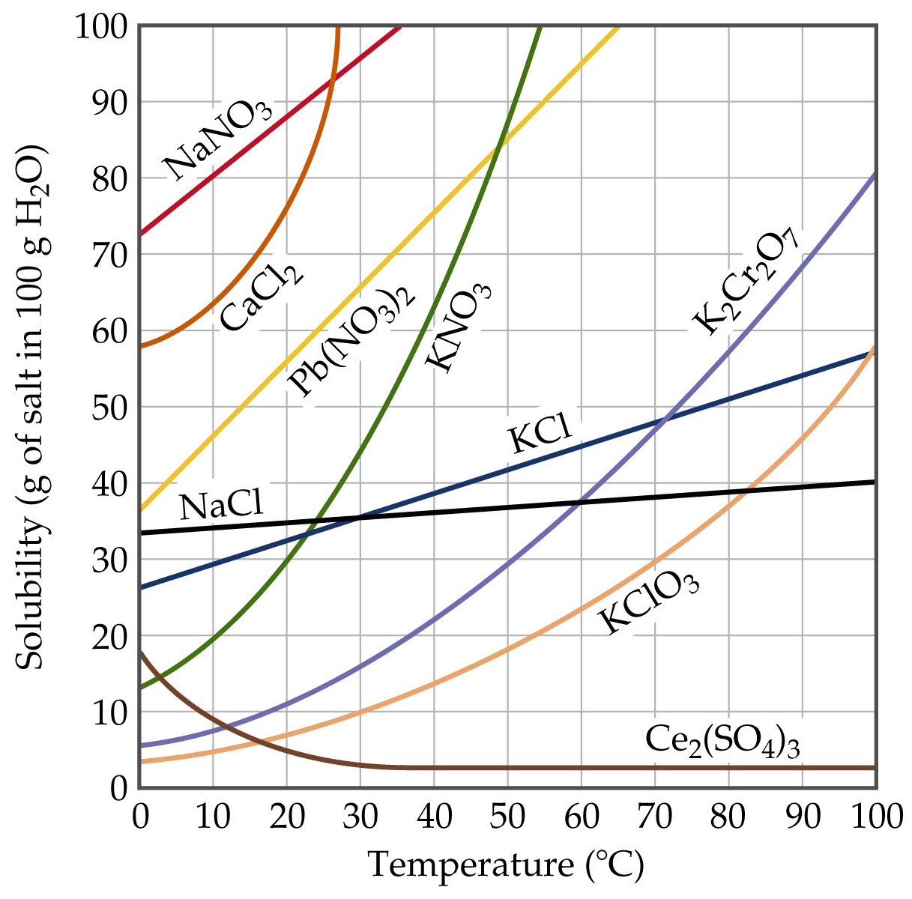
For solids and liquids, an increase in temperature generally results in an increase in solubility
Notes:
Figure: 13-17

Slide 6
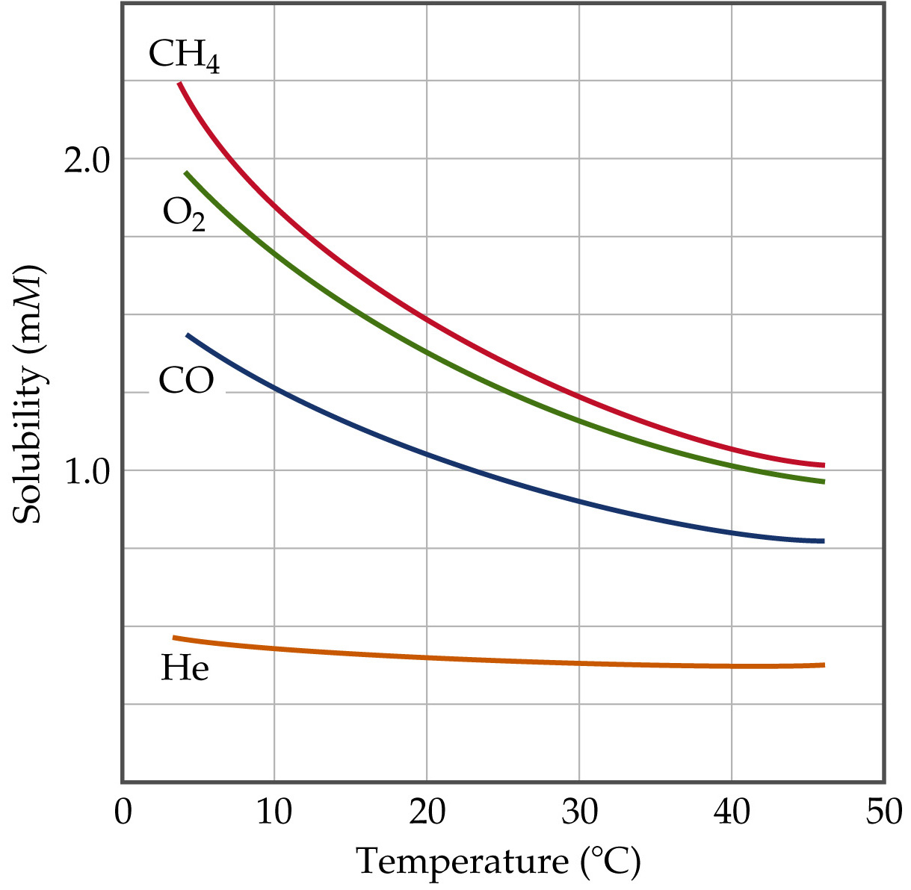
For gases, an increase in temperature generally results in a decrease in solubility
Notes:
Figure: 13-18

Slide 7
Solubility
miscible – liquids that are soluble in each other in all proportions
immiscible – liquids that are NOT soluble in each other
soluble – solids that are soluble in a liquid
insoluble – solids that are NOT soluble in a liquid
Notes:
Figure: 13-02

Slide 8
In general ….“Like dissolves Like”
Polar species tend to be miscible/soluble with other polar species
Nonpolar species tend to be miscible/soluble with other nonpolar species
Polar and Nonpolar species tend to be immiscible/insoluble with each other

Slide 9
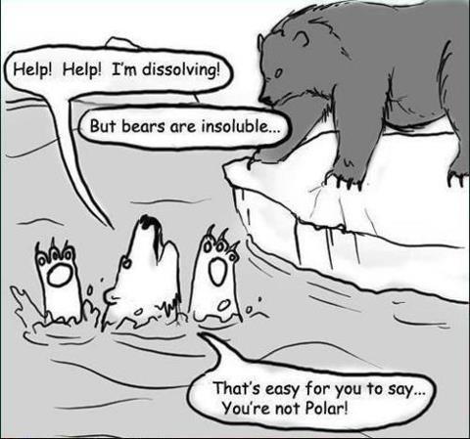

Slide 10
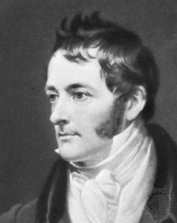
William Henry
1774 – 1836
Henry’s Law – the amount of gas that can be dissolved into a liquid is directly proportional to the pressure applied to the solution

Slide 11
ways of expressing concentration of solutions
moles of solute
L solution
1.
molarity, M =
mass of solute
total mass of solution
2.
mass % =
× 100
1.92 g NaCl (s) is dissolved into 50.0 g H₂O. What is the mass % NaCl (aq) ?

Slide 12

ways of expressing concentration of solutions
parts per million, ppm
mass of solute
total mass of solution
3.
ppm =
× 1,000,000
OSHA mandates a limit of 35 ppm for CO gas exposure in the workplace. The tunnel through the Cumberland Gap (on 25E) was found to contain 0.23 g CO in a 3.25 kg sample of air. Is the air in the tunnel legal ?

Slide 13


Slide 14



Slide 15
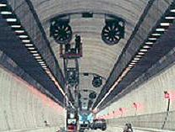

Slide 16
ways of expressing concentration of solutions
moles of solute
kg of solvent
4.
molality, m =
18.5 g Na₂SO₄ (s) is dissolved into
221.1 g H₂O. What is the molality of the resulting solution ?

Slide 17
ways of expressing concentration of solutions
moles of substance
total moles of mixture
5.
mole fraction, X =
10.27 g glucose, C₆H₁₂O₆ (s) is dissolved into 22.62 g ethanol, CH₃CH₂OH. What is the mole fraction of glucose ?

Slide 18
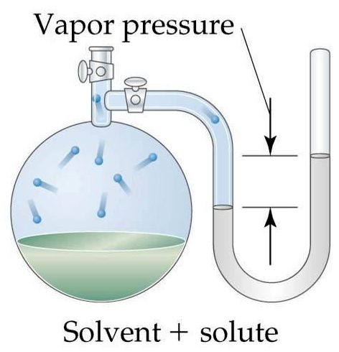
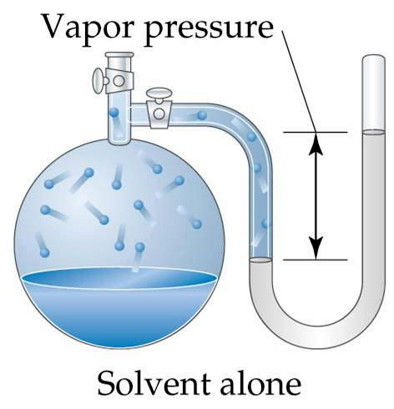
colligative properties – properties which depend on solute concentration, not on the identity of the solute
VP_{solution} < VP_{pure solvent}

Slide 19
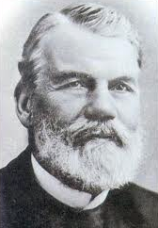
Francois-Marie Raoult
1830 – 1901
Raoult’s Law – VP of a solution is lower than
VP of pure solvent

Slide 20
when solute is nonvolatile and nonionic, the extent the VP is lowered depends on mole fraction of the solvent, X_{solvent}
your text book
P_{A} = X_{A}P°_{A}
me
VP_{soln} = (VP°_{solvent}) (X_{solvent})
VP_{soln} = vapor pressure of resulting solution
VP°_{solvent} = vapor pressure of pure solvent
X_{solvent} = mole fraction of solvent in solution

Slide 21
38.4 g urea, CH₄N₂O (s) is dissolved into
102.3 g water at 25 °C. What is the vapor pressure of the resulting solution ?

Slide 22
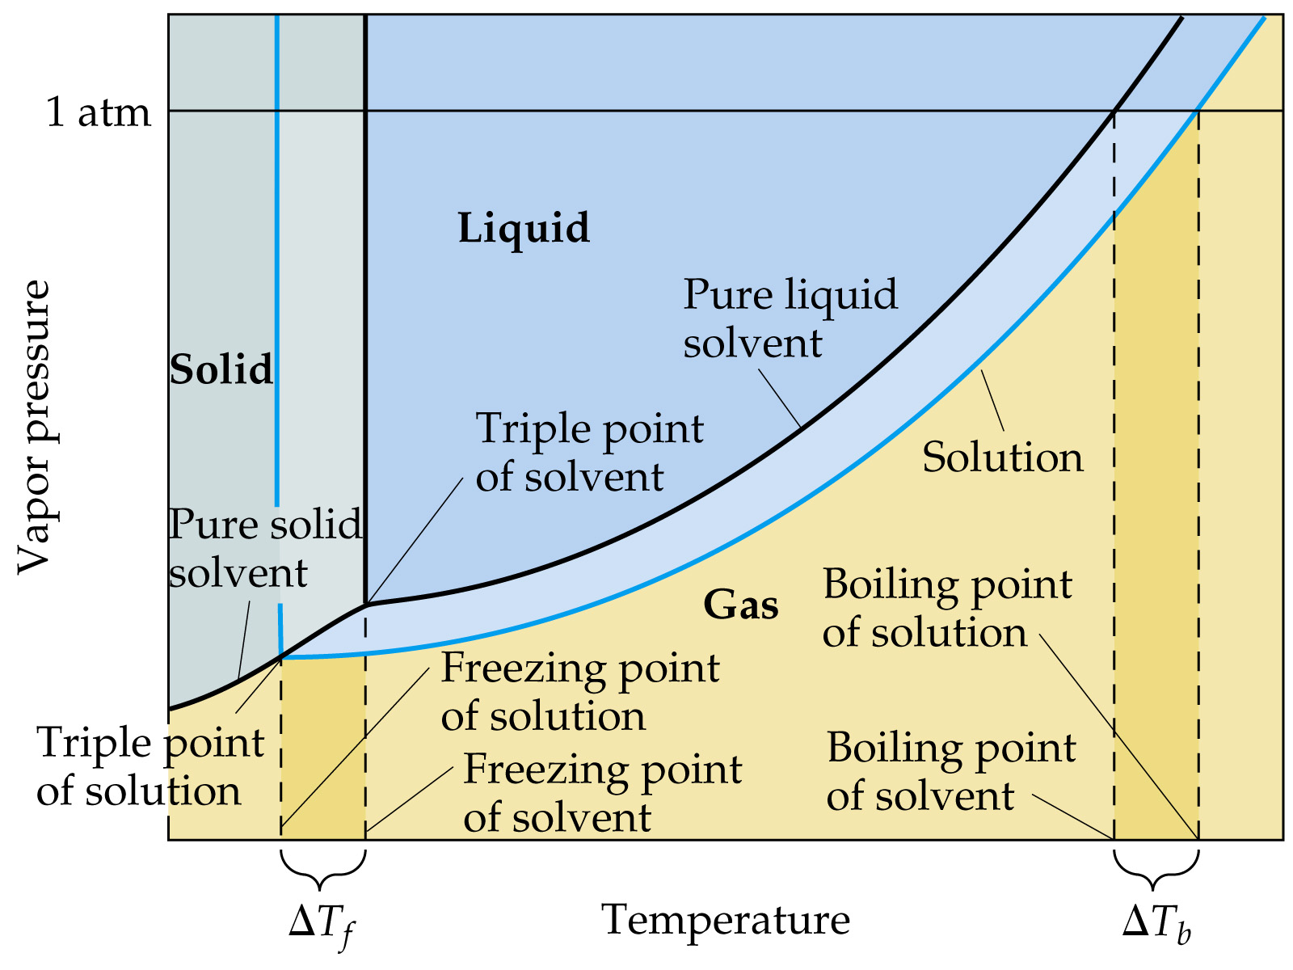
addition of solute lowers the VP of resulting solution
Notes:
Figure: 13-22

Slide 23
boiling point elevation – BP of a solution is higher than BP of pure solvent
BP of solution > BP of pure solvent
if the solute is nonvolatile, nonionic then:
ΔT_{b} = (K_{b} ) ( m)
ΔT_{b} = (BP_{solution} – BP_{pure solvent})
always +#
K_{b} = BP elevation constant
m = molality of solute in solution

Slide 24
76.01 g sugar, C₁₂H₂₂O₁₁ (s) is dissolved into 95.510 g water. What temperature will this solution boil at ? (P = 1 atm)

Slide 25
addition of solute lowers the VP of resulting solution
Notes:
Figure: 13-22

Slide 26
freezing point depression – FP of a solution is lower than FP of pure solvent
FP of solution < FP of pure solvent
if the solute is nonvolatile, nonionic then:
ΔT_{f} = (K_{f} ) ( m)
ΔT_{f} = (FP_{pure solvent} – FP_{solution})
always +#
K_{f} = FP depression constant
m = molality of solute in solution

Slide 27
3.461 g of an unknown compound was dissolved into 85.022 g benzene, C₆H₆. The resulting solution froze at 4.08 °C. What is the MW of the unknown compound ?

Slide 28
osmosis – the movement of solvent molecules but NOT solute particles through a semipermeable membrane
semipermeable membrane – a barrier with very tiny holes that selectively allow only small molecules such as solvent molecules to pass through

Slide 29
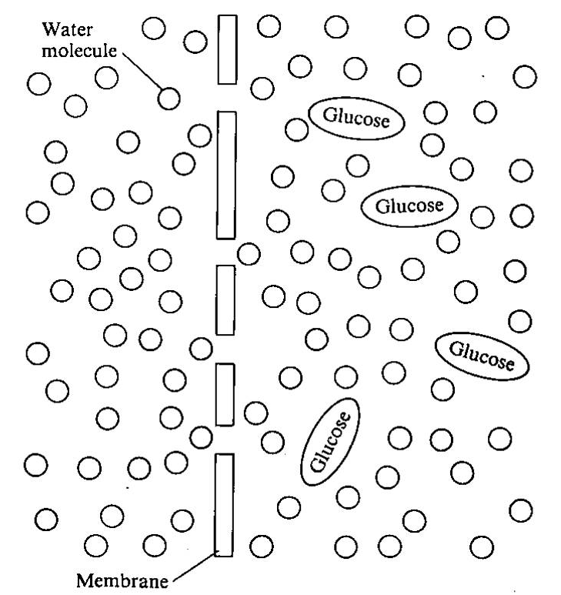
Notes:
Figure: 13-22

Slide 30
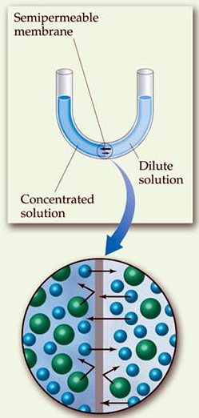
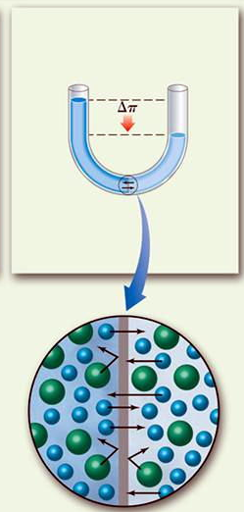
solvent molecules always move through membrane toward side with the largest solute concentration

Slide 31
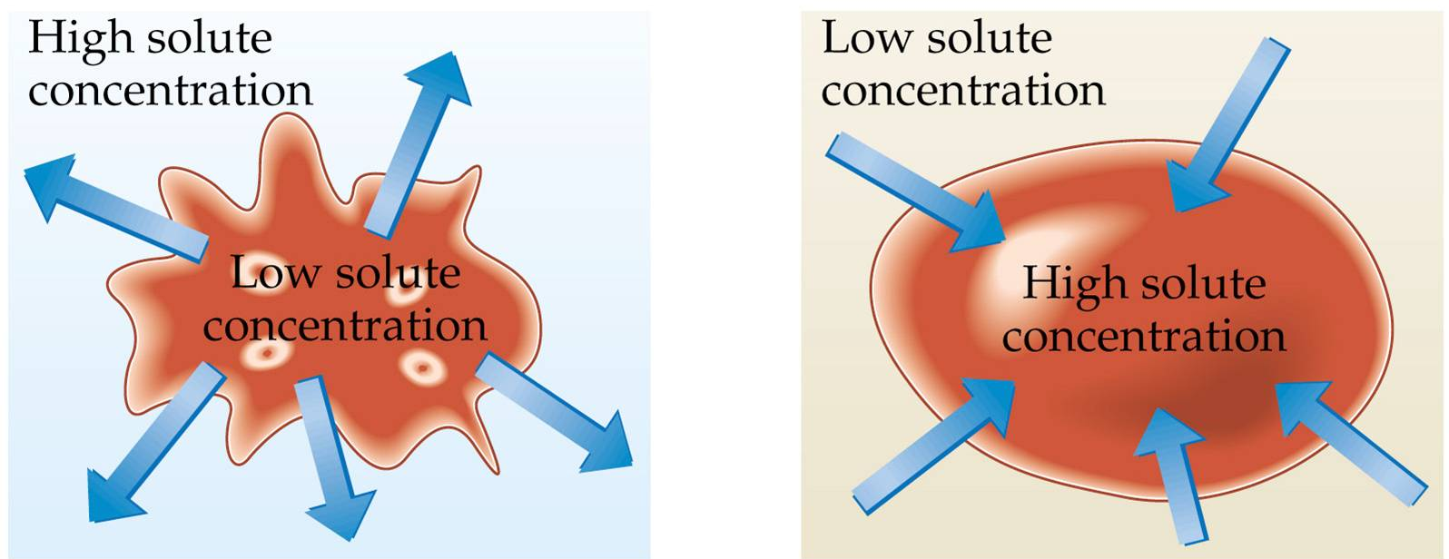
hypertonic - solute concentration outside the cell is greater than that inside the cell
hypotonic - solute concentration outside the cell is less than that inside the cell
Notes:
Figure: 13-23

Slide 32
colloids – a homogeneous mixture where the solute is dispersed in the solvent
solute particles of a colloid are larger than individual ions or molecules, but too small to be settled out by gravity
Notes:
Figure: 13-25

Slide 33
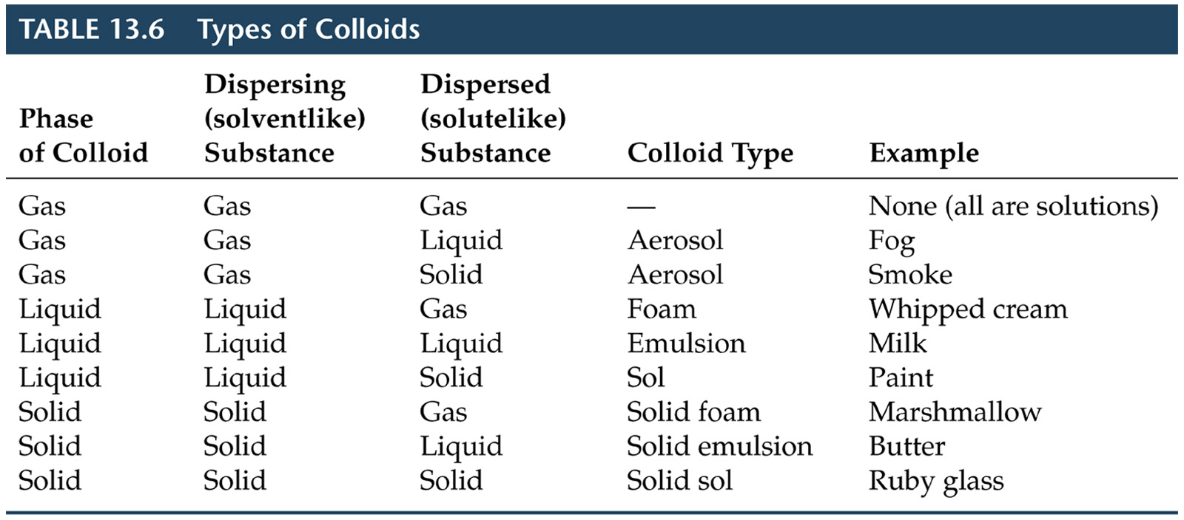
Notes:
Figure: 13-T06

