Slide 1
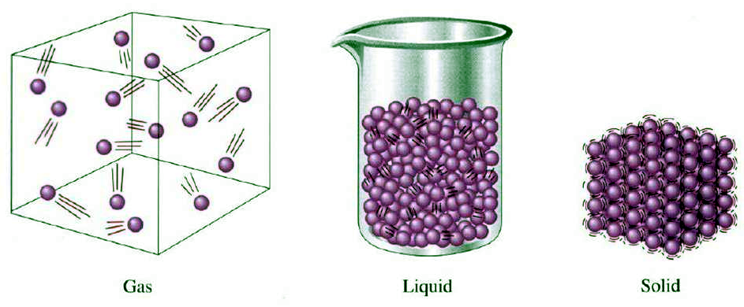
Gases vs. solids & liquids
gases are compressible
gases uniformly expand to fill a container
gases form homogeneous mixtures regardless of identity

Slide 2
All gases can be described in terms of 4 variables
1. pressure P
2. volume V
3. temperature T
4. moles n
Force
Area
F
A
Pressure =
or
P =

Slide 3
- gases are compressible and gases exert a pressure on any surface they are in contact with
- atmosphere is made up of gases and thus exerts a pressure
- pressure the atmosphere exerts is called ……. “atmospheric pressure” (or barometric pressure)

Slide 4
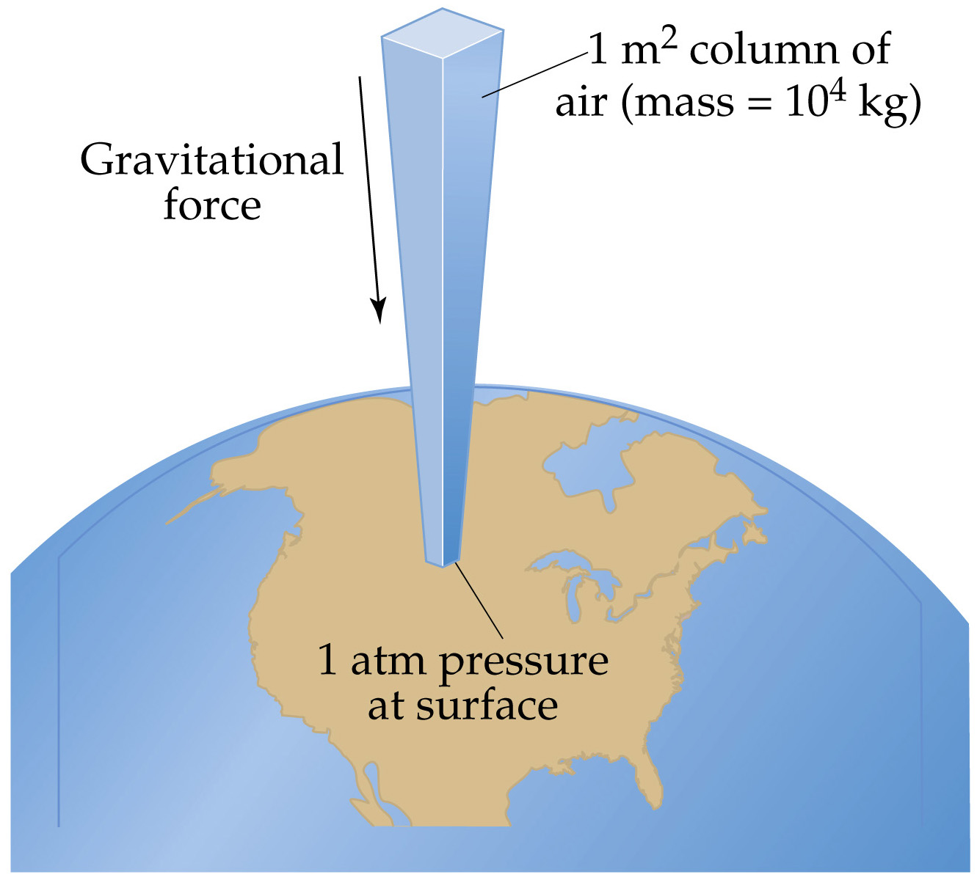
Notes:
Figure: 10-01

Slide 5




barometer – instrument that measures atmospheric pressure

Slide 6
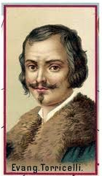
Evangelista Torricelli
1608 – 1647

Slide 7
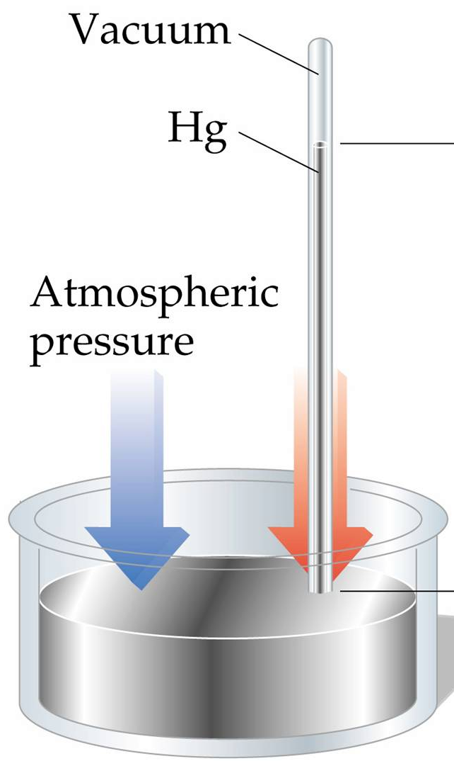

2 opposing forces
1. wt. of Hg in tube being pulled down and out by gravity (red arrow)
2. atm. pressure exerts on liq Hg (blue arrow) which results in pushing the Hg back up the tube
when the weight of the Hg left in the tube equals the pressure exerted by the atmosphere, the Hg stops flowing out

Slide 8
h = the distance from top of the Hg in tube down to the top of the pool of Hg
at sea level, h = 76 cm
at sea level, h = 760 mm
at sea level, h = 30 inches
atmospheric pressure
(or barometric pressure) is often given units of
mm Hg
Notes:
Figure: 10-02

Slide 9
A standard reference point for pressure measurements was agreed to be sea-level
by definition
1 atm pressure = 760 mm Hg
1 atm pressure = 29.92 inches Hg
by definition
1 torr = 1 mm Hg
1 atm pressure = 760 torr
1 atm pressure = 14.7 lbs/in² = 14.7 psi
1 atm pressure = 101,325 Pa = 101.325 kPa

Slide 10
A pop can is under 3906 mm Hg pressure. What is this pressure in atmospheres ?

Slide 11


Ray Russell (…weatherman extraordinaire) reports the barometric pressure as
26.64 inches Hg. What is this pressure in atmospheres ?

Slide 12
A car tire is inflated to 35.25 psi. What is this pressure in torr ?

Slide 13
There are 3 individual gas law equations that are typically taught in succession
….except for us…….😐
Combined gas law equation
P₁V₁
T₁
P₂V₂
T₂
provided amount of moles (n), remains constant throughout
=
one set of P, V, T conditions
a different set of
P, V, T conditions
P and V must be same units on both sides
T must always be in Kelvin ( °C + 273.15 = K )

Slide 14
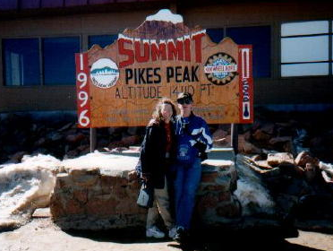
A balloon has a volume of 552 mL at
sea level. What volume does the balloon occupy at the top of Pikes Peak in Colorado, where the atmospheric pressure is
475 mm Hg ? Assume constant temperature.

Slide 15
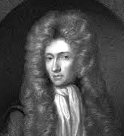
Boyle’s Law
P₁V₁ = P₂V₂
provided T and n
remain constant
Robert Boyle
1627 – 1691
volume is inversely proportional to pressure

Slide 16
A cylinder with a movable piston has 38.2 in³ of air trapped at 22.4 °C. What volume would the air occupy if the temperature is increased to 175.9 °C ? Assume constant pressure.

Slide 17
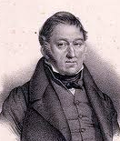
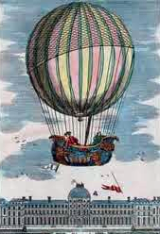
Charles’s Law
V₁
T₁
V₂
T₂
provided P and n
remain constant
=
Jacques Charles
1746 – 1823
Volume is directly proportional to temperature

Slide 18
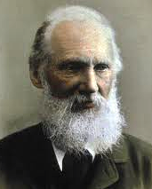
William Thomson
(Lord Kelvin)
1824 – 1907

Slide 19
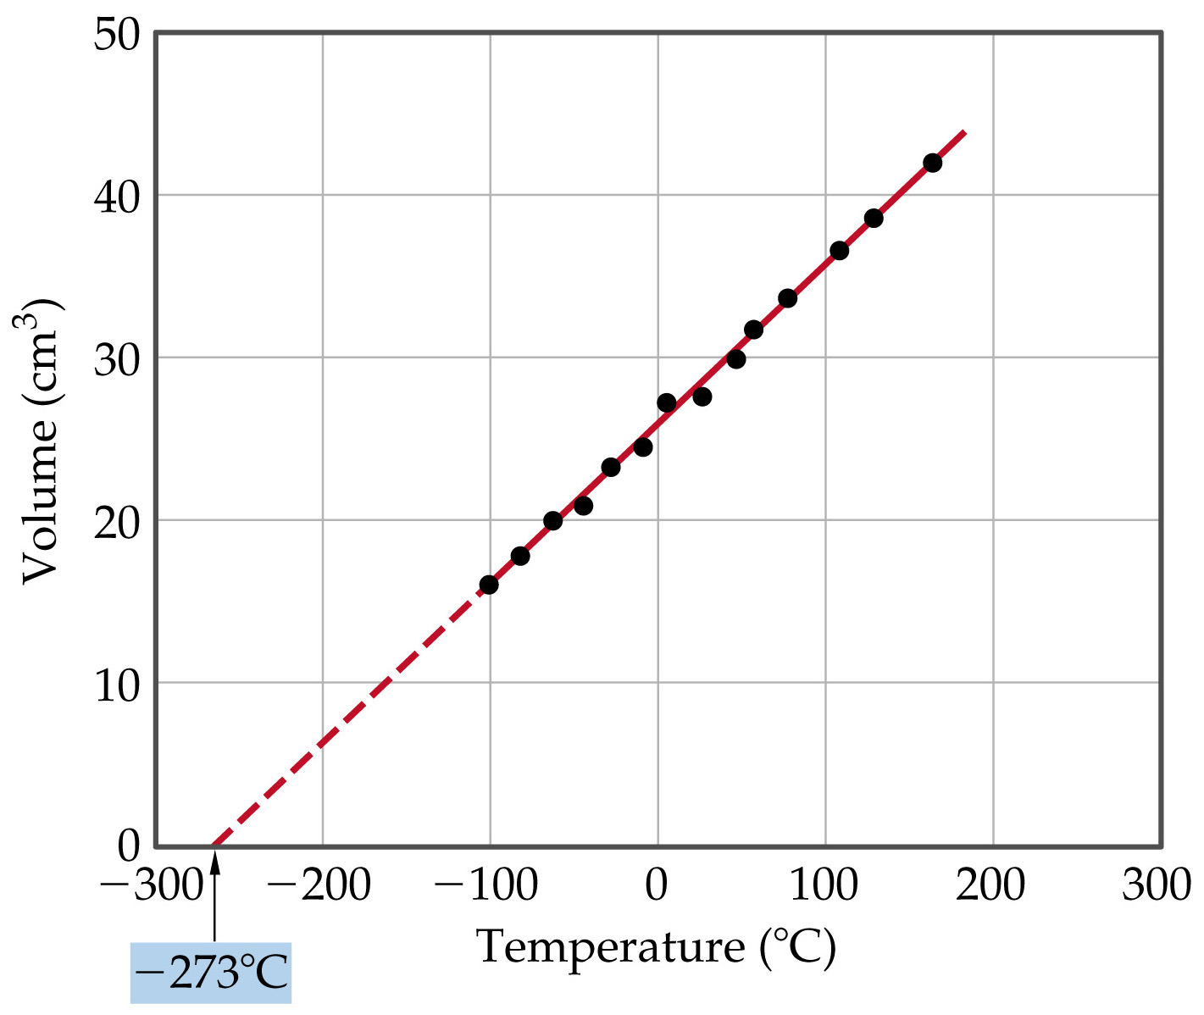
Notes:
Figure: 10-09

Slide 20
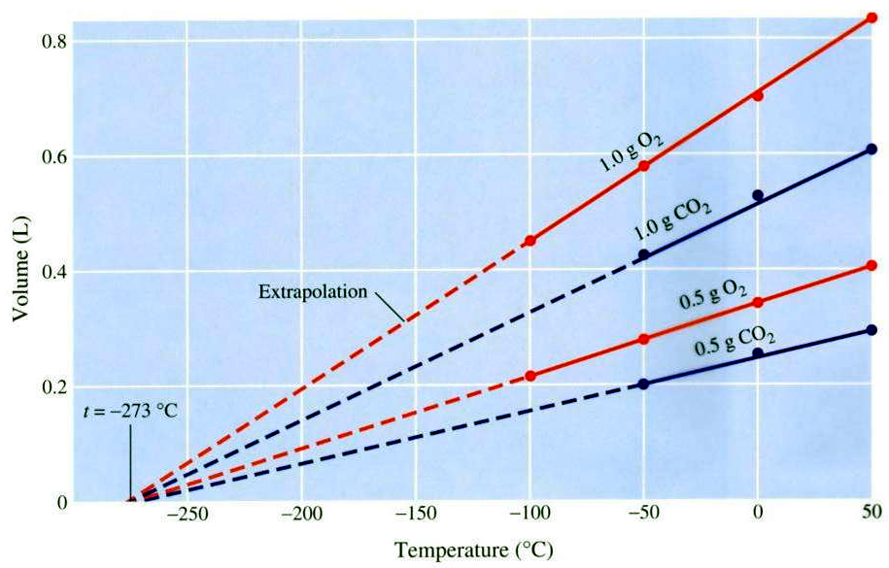

Slide 21
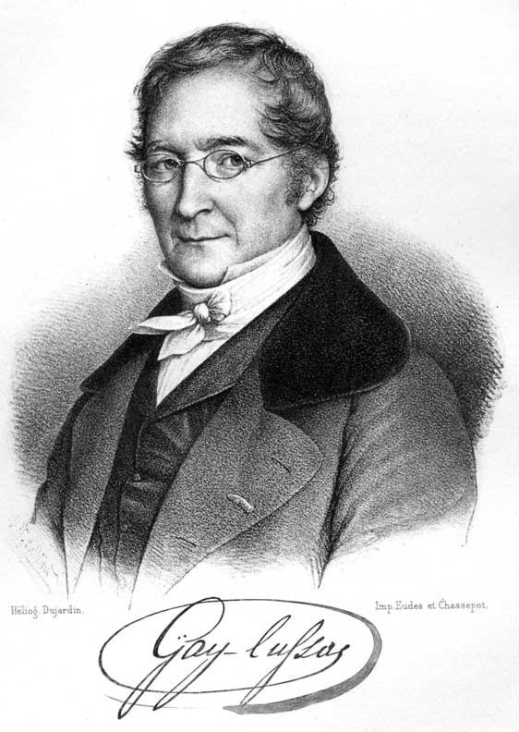
Gay-Lussac’s Law
P₁
T₁
P₂
T₂
provided V and n
remain constant
=
Joseph Gay-Lussac
1778 – 1850
Pressure is directly proportional to temperature

Slide 22

Pressure is directly proportional to temperature

Slide 23
A balloon is filled with hydrogen gas, H₂ and occupies a volume of 799.8 mL at 8.62 °C in Boone where the atmospheric pressure is 681.6 mm Hg. Let the balloon go and it ascends up to an altitude of 9525 feet where the pressure is 0.590 atm. Assuming a temperature drop of 2.00 °C per 1000 feet of altitude gained, determine the volume of the balloon at 9525 feet. Elevation of Boone is 3228 feet.

Slide 24
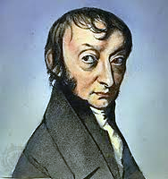
Amedeo Avogadro
1776 – 1856
Avogadro’s Law – equal volumes of different gases contain the same number of gas particles (if the T & P remains constant)

Slide 25
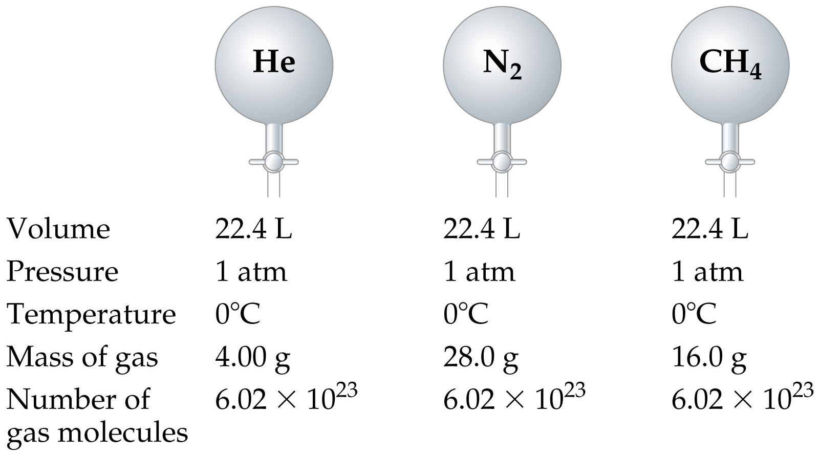
molar volume – 1 mole of any gas occupies 22.4 L at
0 °C and 1 atm pressure
standard temperature and pressure (STP) = 0 °C & 1 atm
Notes:
Figure: 10-11

Slide 26
PV = nRT
The ideal gas equation
P must be in atmospheres
V must be in Liters
n moles of gas
T must be in Kelvin
L·atm
mole·K
R = 0.08206

Slide 27
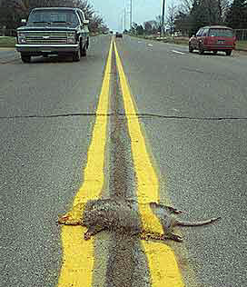
1.403 g of gas evolving from rotting road kill was collected and found to contain only carbon and oxygen. At 727.1 mm Hg and
20.1 °C, the gas occupied a volume of 802 mL. What is the identity of the gas ?

Slide 28
gas densities
g
mL
d =
for solids and liquids
g
L
d =
for gases
P(MW)
RT
density is proportional to P
d =
density is proportional to MW
density is inversely proportional to T

Slide 29
Reactions involving gases
NH₄NO₃ (s) will explode when heated producing N₂ (g), O₂ (g), and H₂O (g). How many liters of H₂O (g) will form if 3.55 kg of NH₄NO₃ (s) is detonated ? The temperature of the resulting gases are 425 °C and the atmospheric pressure is 0.945 atm.
Write the reaction then balance it
Incorporate stoichiometry to solve the problem

Slide 30
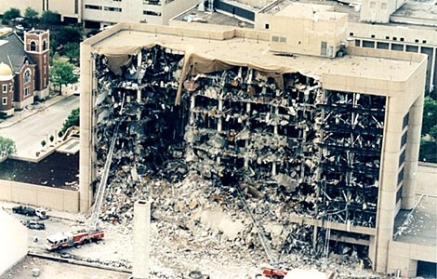
Oklahoma City, 1995
168 people killed

Slide 31
Gas mixtures
air 78% N₂ (g) + 21% O₂ (g) + 1% Ar (g)
Partial Pressure – the pressure an individual component exerts in a gas mixture
PP
The partial pressure exerted by a particular gas in a mixture is proportional to the number of moles present of that particular gas
78% molecules in air are N₂ so 78% of pressure in air is due to N₂
21% molecules in air are O₂ so 21% of pressure in air is due to O₂
1% molecules in air are Ar so 1% of pressure in air is due to Ar

Slide 32
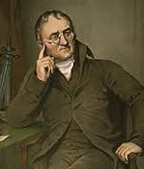
John Dalton
1766 – 1844
Daltons Law of Partial Pressure – The total pressure exerted by a mixture of gases is the sum of the individual partial pressures exerted by each component of the mixture.
P_{tot} = PP_{a} + PP_{b} + PP_{c} …. etc.

Slide 33
12.3 g CH₄ and 16.1 g O₂ are sealed in a
750.0 mL container at 15.0 °C. What is the partial pressure exerted by each component and what is the total pressure of the mixture ?

Slide 34
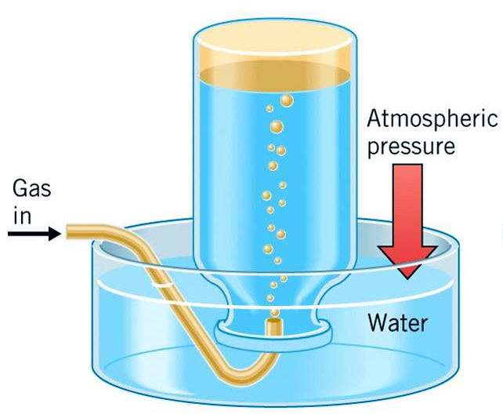
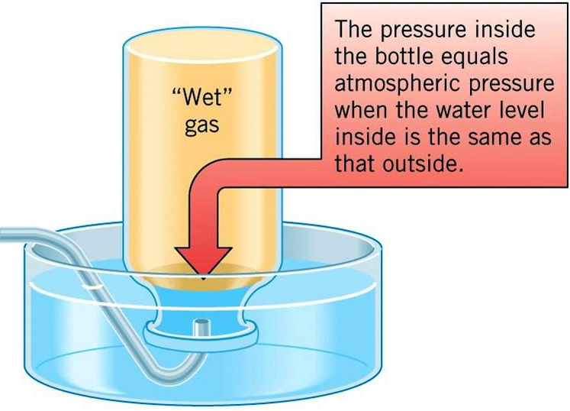
collecting a gas over water
Notes:
Figure: 10-16

Slide 35
How many g of CO₂ exist in a container if collected over water at 30.0 °C into a 319 mL flask at 685.5 mm Hg ?

Slide 36

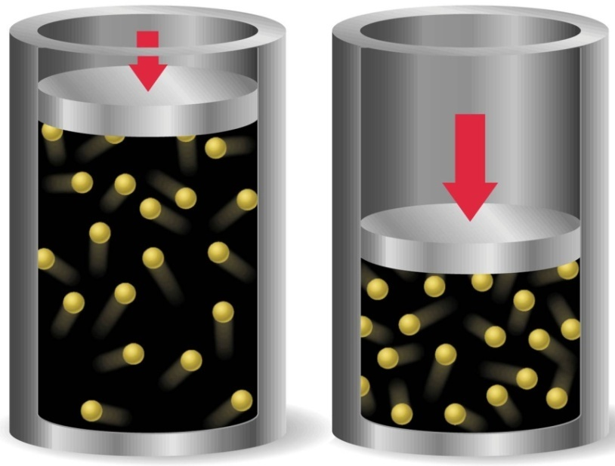
Kinetic – Molecular Theory
Gases are in continuous motion
with varying velocities
Individual gas particles are so far apart, the volume between particles is mostly empty space
Gas particles are not attracted
or repulsed by each other
Collisions are elastic
The average kinetic energy
of molecules is proportional
to temperature.

Slide 37
diffusion – spontaneous dispersion of gases
Rate of diffusion depends on 2 things
1. temperature of a gas
– increase in temperature results in an increase in KE; and an increase in KE results in an increase in velocity; thus an increase in temperature results in an increase in diffusion rate
2. MW of a gas
– rate of diffusion is inversely proportional to square root of the MW; thus an increase in MW results in a decrease in diffusion rate
Notes:
Figure: 10-17

Slide 38
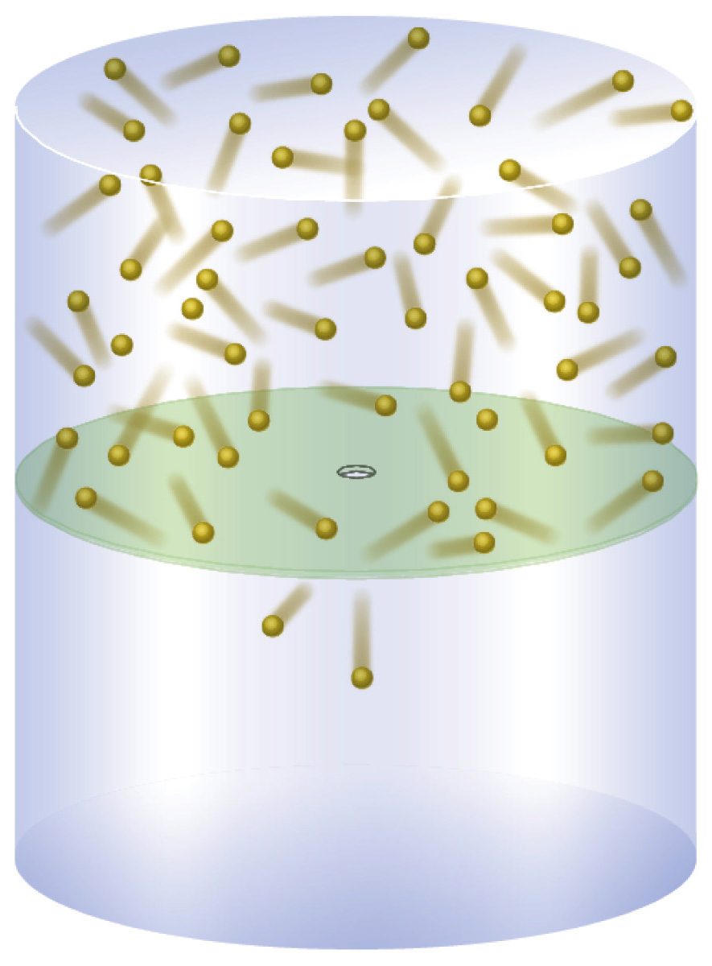
effusion
Notes:
Figure: 10-20

Slide 39
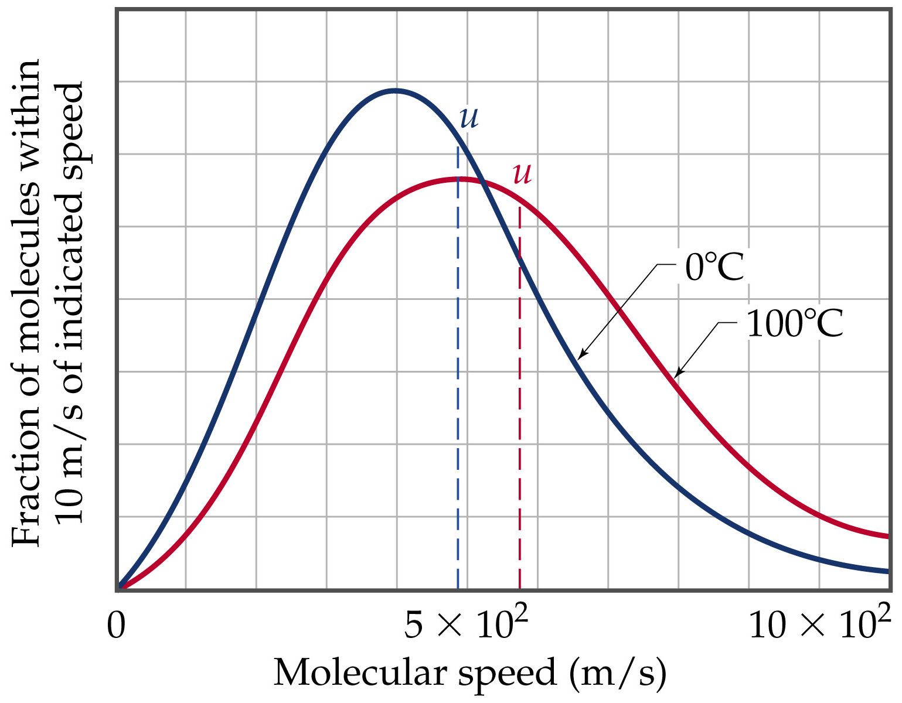
Notes:
Figure: 10-18

Slide 40
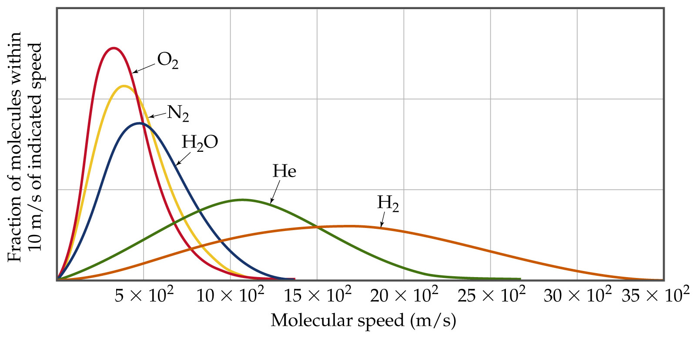
Notes:
Figure: 10-19

