Slide 1
molecular geometry – the orientation of atoms in space (how the atoms are arranged in a molecule)
VSEPR Theory – Valence Shell Electron Pair Repulsion theory
VSEPR is a simple, yet powerful technique to predict the molecular geometry (or shapes) of molecules
e⁻ pairs (bonding or nonbonding) repel each other. Thus, they attempt to get as far apart from each other as possible to maximize separation

Slide 2
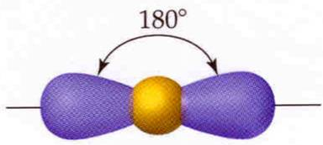
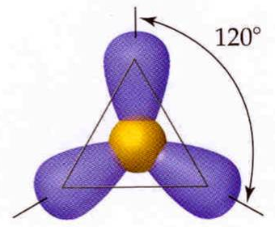
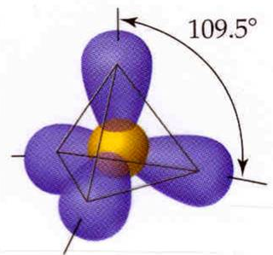
# e⁻ pairs around central element
geometry
name
shape
angles
2 pairs
linear
180°
trigonal
planar
120°
3 pairs
4 pairs
tetrahedral
109.5°

Slide 3
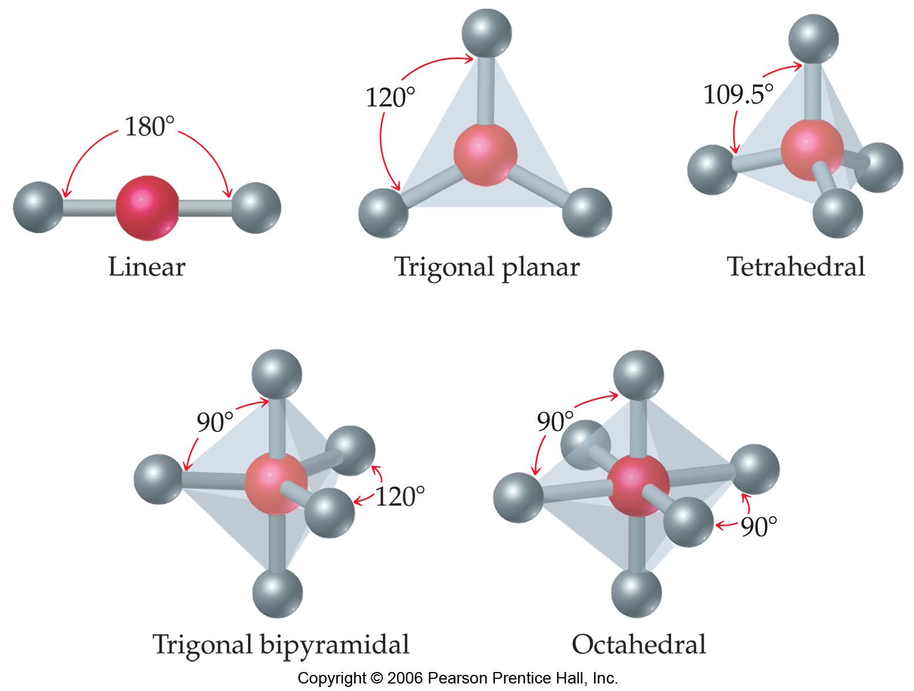
Notes:
Figure: 09-03
Title:
Shapes of AB_{n} molecules.
Caption:
For molecules whose formula is of the general form AB_{n}, there are five fundamental shapes.

Slide 4
electron pair geometry must be known before molecular geometry can be predicted
To determine molecular geometry (MG)
draw the correct Lewis structure
determine # of electron pairs around the central element
determine how those electron pairs orient around the central element
attach terminal atoms to the central element
the orientation of the atoms in space determine the molecular geometry

Slide 5
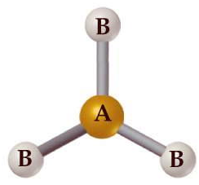
determine the molecular geometry of BCl₃
MG = trigonal planar

Slide 6
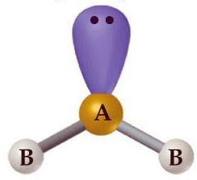
determine the molecular geometry
of BCl₂⁻ (anion)
MG = bent
bent = 3 atoms that are NOT linear

Slide 7
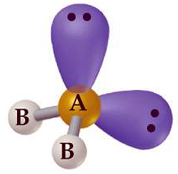
determine the molecular geometry of H₂O
MG = bent

Slide 8
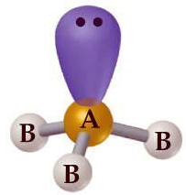
determine the molecular geometry of NH₃
MG = pyramidal

Slide 9
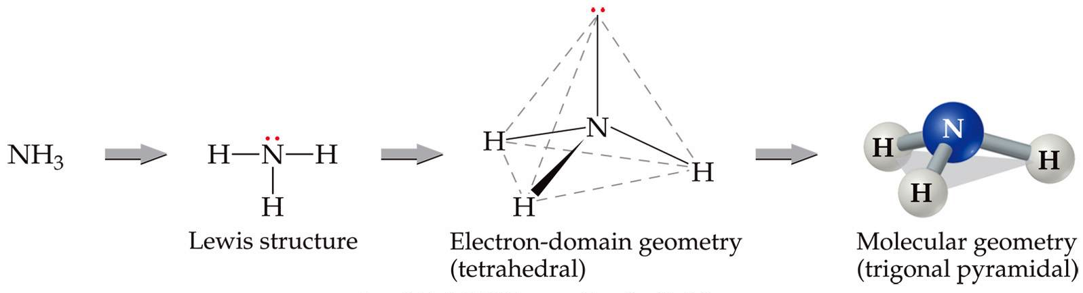

Slide 10
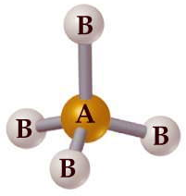
determine the molecular geometry of CH₄
MG = tetrahedral

Slide 11
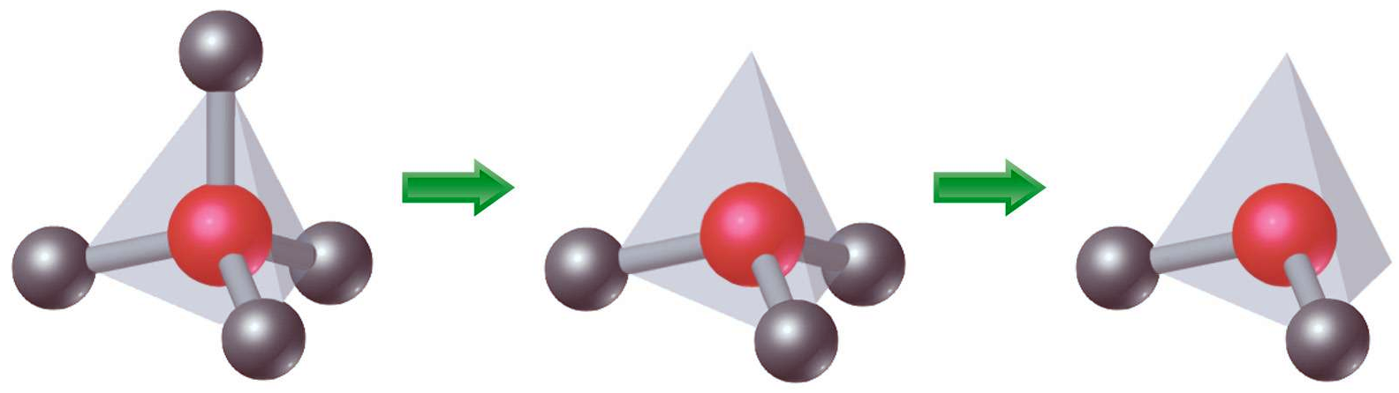
tetrahedral pyramidal bent
Notes:
Figure: 09-06
Title:
The molecular geometry of NH₃.
Caption:
The geometry is predicted by first drawing the Lewis structure, then using the VSEPR model to determine the electron-domain geometry, and finally focusing on the atoms themselves to describe the molecular geometry.

Slide 12
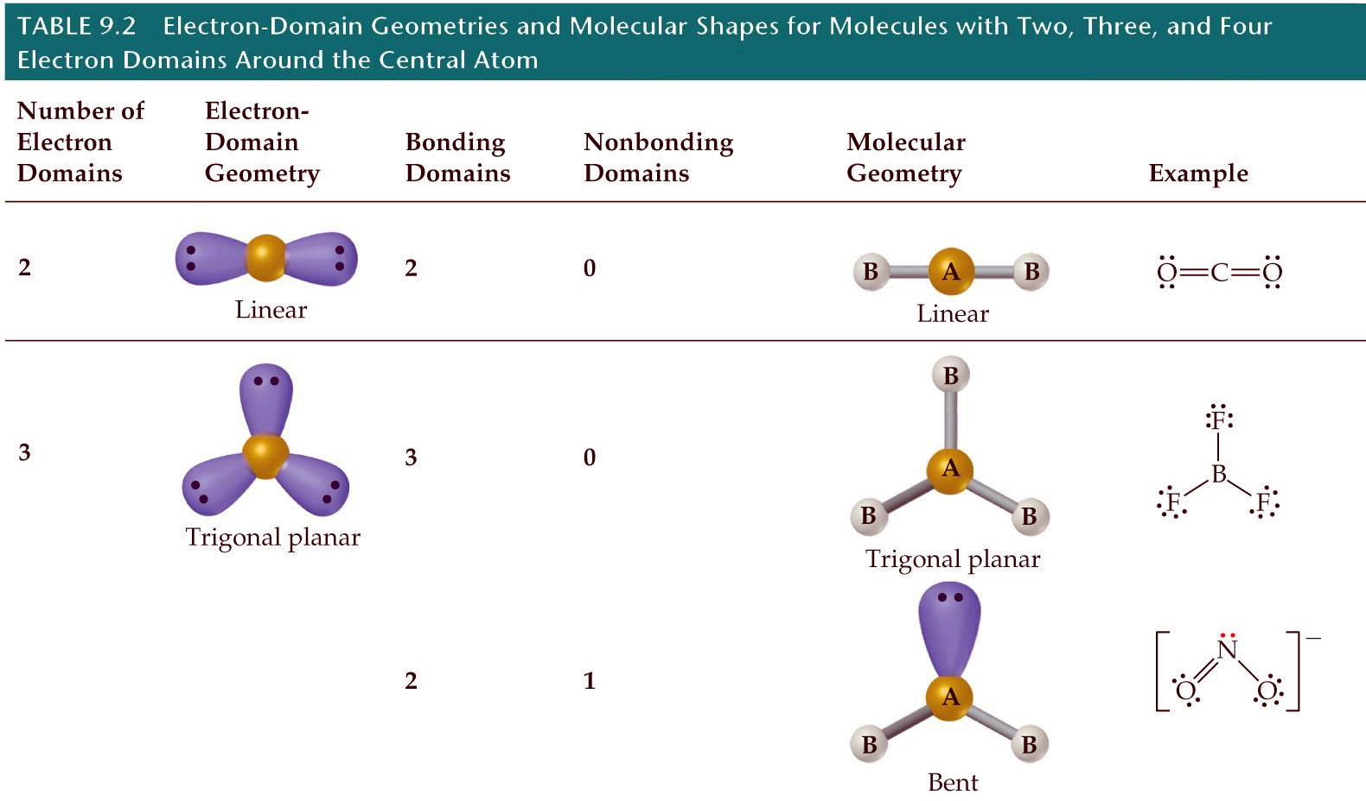
Notes:
Figure: 09-04
Title:
Derivatives from the AB_{n} geometries.
Caption:
Additional molecular shapes can be obtained by removing corner atoms from the basic geometries shown in Figure 9.3. Here we begin with a tetrahedron and successively remove corners producing first a trigonal-pyramidal geometry and then a bent one, each having ideal bond angles of 109.5º. Molecular shape is meaningful only when there are at least three atoms. If there are only two, they must be arranged next to each other, and no special name is given to describe the molecule.

Slide 13
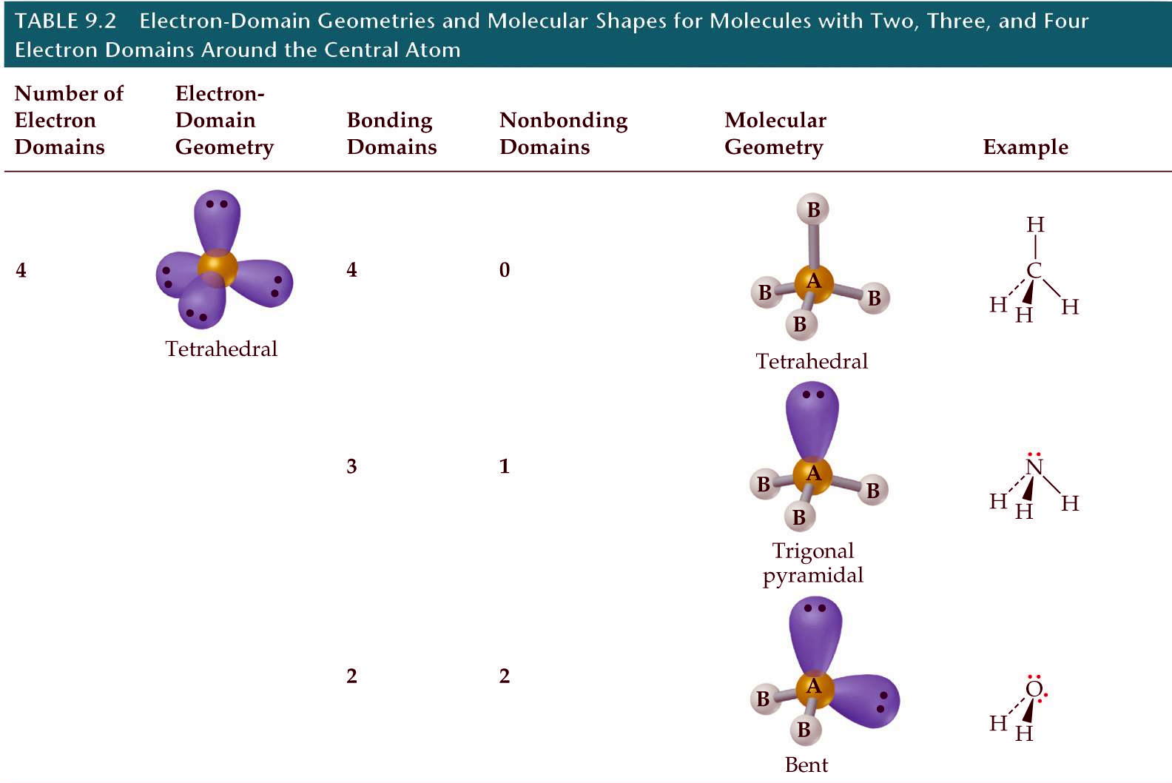
Notes:
Figure: 09-06-02UNT02a
Title:
Table 9.2
Caption:
Electron-Domain Geometries and Molecular Shapes for Molecules with Two, Three, and Four Electron Domains Around the Central Atom.

Slide 14
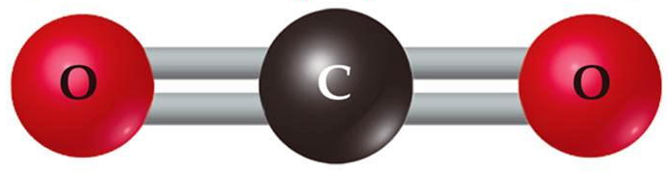
multiple bonds in VSEPR theory
* treat a double or triple bond as if it were a “single bond” from a VSEPR standpoint
determine the molecular geometry of CO₂
MG = linear
Notes:
Figure: 09-07
Title:
Bonding and nonbonding electron pairs.
Caption:
Relative "sizes" of bonding and nonbonding pairs of electrons.

Slide 15


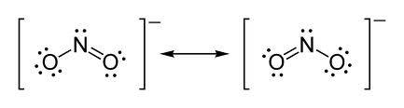
determine the molecular geometry of NO₂⁻ (anion)
MG = bent

Slide 16
Cl₂
HCl
nonpolar bond – electrons are shared equally in the bond
polar bond – electrons are NOT shared equally

Slide 17


δ⁺
δ⁻
Br-Cl has a polar bond
dipole moment – quantitative extent to which polarity is measured
Notes:
Figure: 09-13-01UNEx9.4
Title:
Sample Exercise 9.4
Caption:
Polarity of Br—Cl.

Slide 18

Is Br-Cl a polar molecule ?
Consider the covalent bond as a rope with each atom “pulling electrons to itself” based on electronegativities of each atom
Br-Cl is a polar molecule
If the entire molecule moves during the “tug’O’war”….. the molecule is POLAR
If the entire molecule does NOT move during the “tug’O’war”….. the molecule is NONPOLAR
Notes:
Figure: 09-10-01UNEx9.3
Title:
Sample Exercise 9.3
Caption:
Lewis structure.

Slide 19
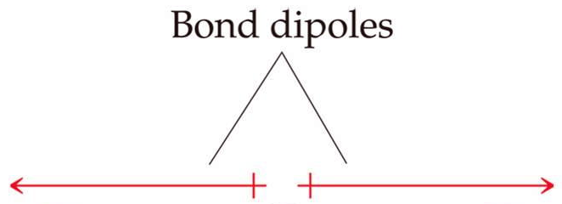
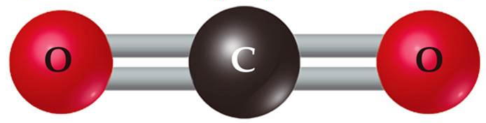
Is CO₂ a polar or nonpolar molecule ?
the individual dipoles cancel such that the overall dipole moment = 0
CO₂ is a nonpolar molecule
Notes:
Figure: 09-10-02UN
Title:
Practice Exercise
Caption:
Chemical structure of propyne.

Slide 20

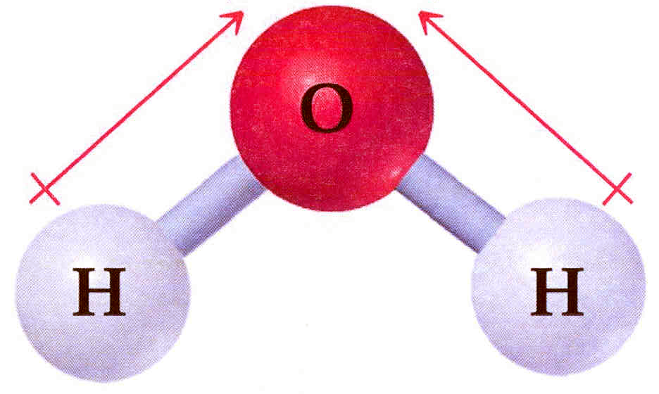
Is H₂O a polar or nonpolar molecule ?
MG = bent
H₂O is a polar molecule
Notes:
Figure: 09-11
Title:
CO₂, a nonpolar molecule.
Caption:
(a) The overall dipole moment of a molecule is the sum of its bond dipoles. In CO₂ the bond dipoles are equal in magnitude, but exactly oppose each other. The overall dipole moment is zero, therefore, making the molecule nonpolar. (b) The electron-density model shows that the regions of higher electron density (red) are at the ends of the molecule while the region of lower electron density (blue) is at the center.

Slide 21
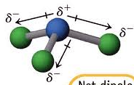

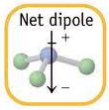
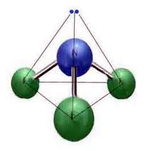
Is NF₃ a polar or nonpolar molecule ?
MG = pyramidal
NF₃ is a polar molecule

Slide 22
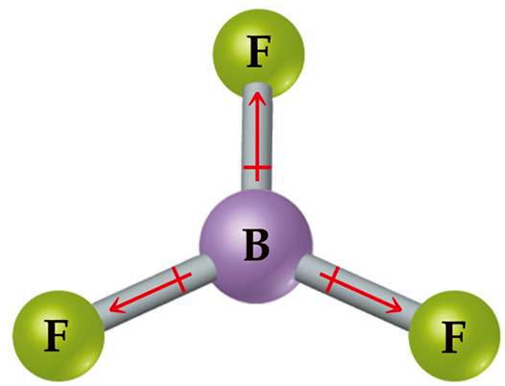
Is BF₃ a polar or nonpolar molecule ?
MG = trigonal planar
the individual dipoles cancel such that the overall dipole moment = 0
BF₃ is a nonpolar molecule

Slide 23
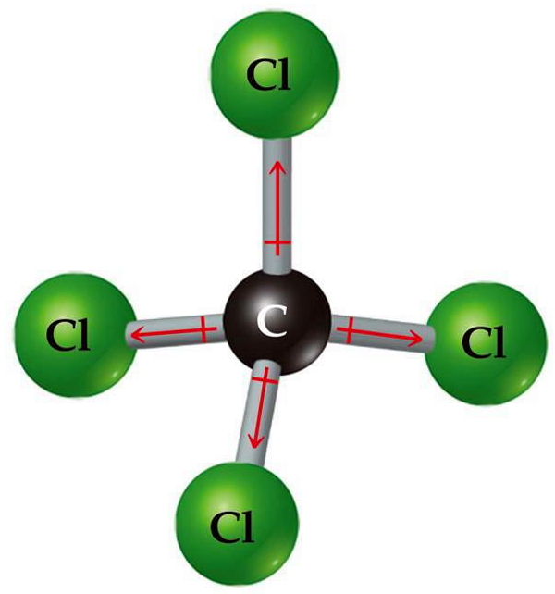
Is CCl₄ a polar or nonpolar molecule ?
MG = tetrahedral
the individual dipoles cancel such that the overall dipole moment = 0
CCl₄ is a nonpolar molecule

Slide 24
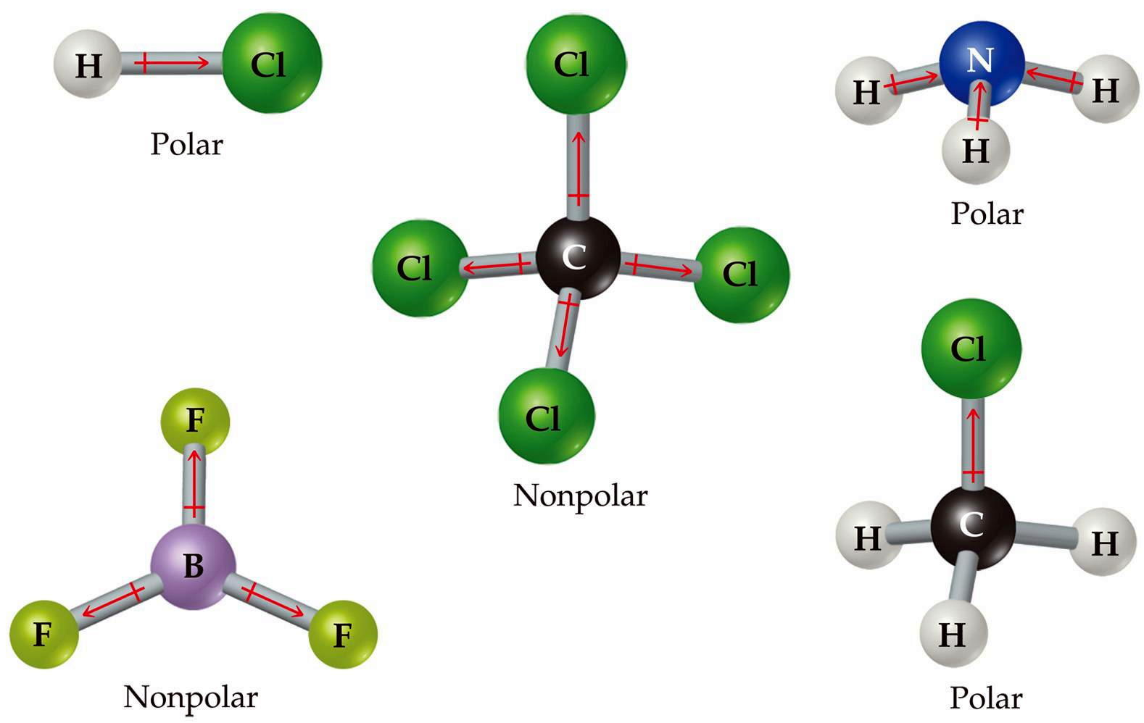
Notes:
Figure: 09-13
Title:
Molecules containing polar bonds.
Caption:
Two of these molecules have a zero dipole moment because their bond dipoles cancel one another, while the other molecules are polar.

Slide 25
valence bond theory – describes how atomic (VB theory) orbitals form bonds

Slide 26
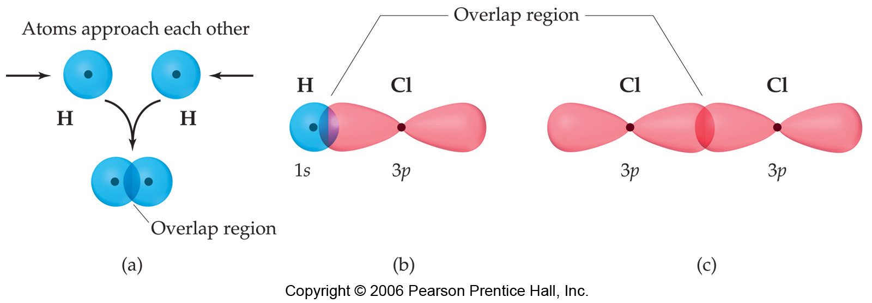
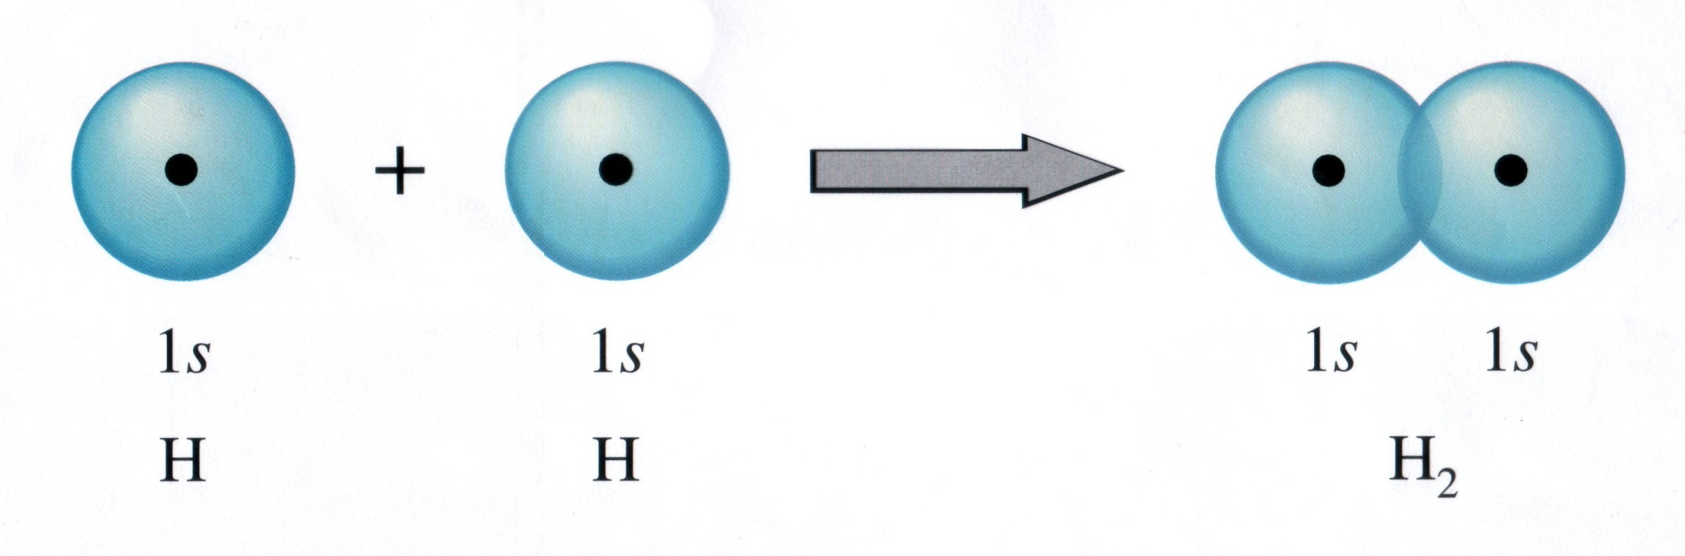
valence bond theory – describes how atomic (VB theory) orbitals form bonds
open valency – unpaired electron in a valence orbital available for bonding

Slide 27
F
F
2p
2p

Slide 28
electron promotion – electron is removed from one orbital and placed in an orbital of higher energy
hybridization – simple atomic orbitals on the central atom “mix” to form new “hybrid” orbitals
hybrid – something of a mixed origin

Slide 29
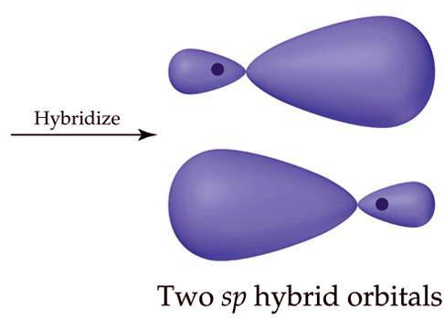
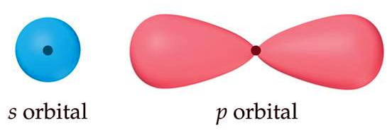
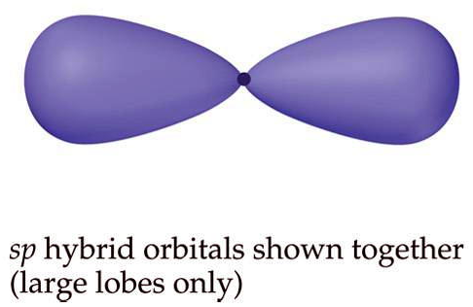
the two new sp hybrid orbitals are 50% s-character and 50% p-character

Slide 30
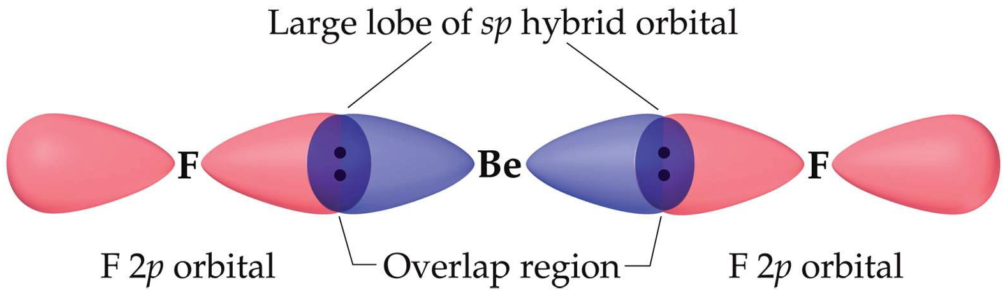
Notes:
Figure: 09-16
Title:
Formation of sp hybrid orbitals.
Caption:
One s orbital and one p orbital can hybridize to form two equivalent sp hybrid orbitals. The two hybrid orbitals have their large lobes pointing in opposite directions, 180º apart.

Slide 31
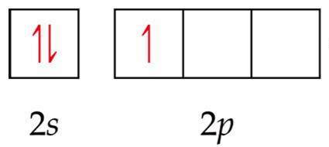
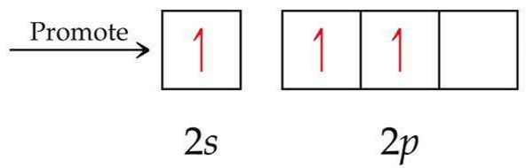
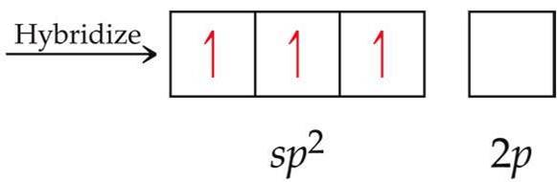
Determine the hybridization of boron, B in BF₃
Remember, this process is occurring only on the central element of boron, B
Notes:
Figure: 09-18
Title:
Formation of sp² hybrid orbitals.
Caption:
One s orbital and two p orbitals can hybridize to form three equivalent sp² hybrid orbitals. The large lobes of the hybrid orbitals point toward the corners of an equilateral triangle.

Slide 32
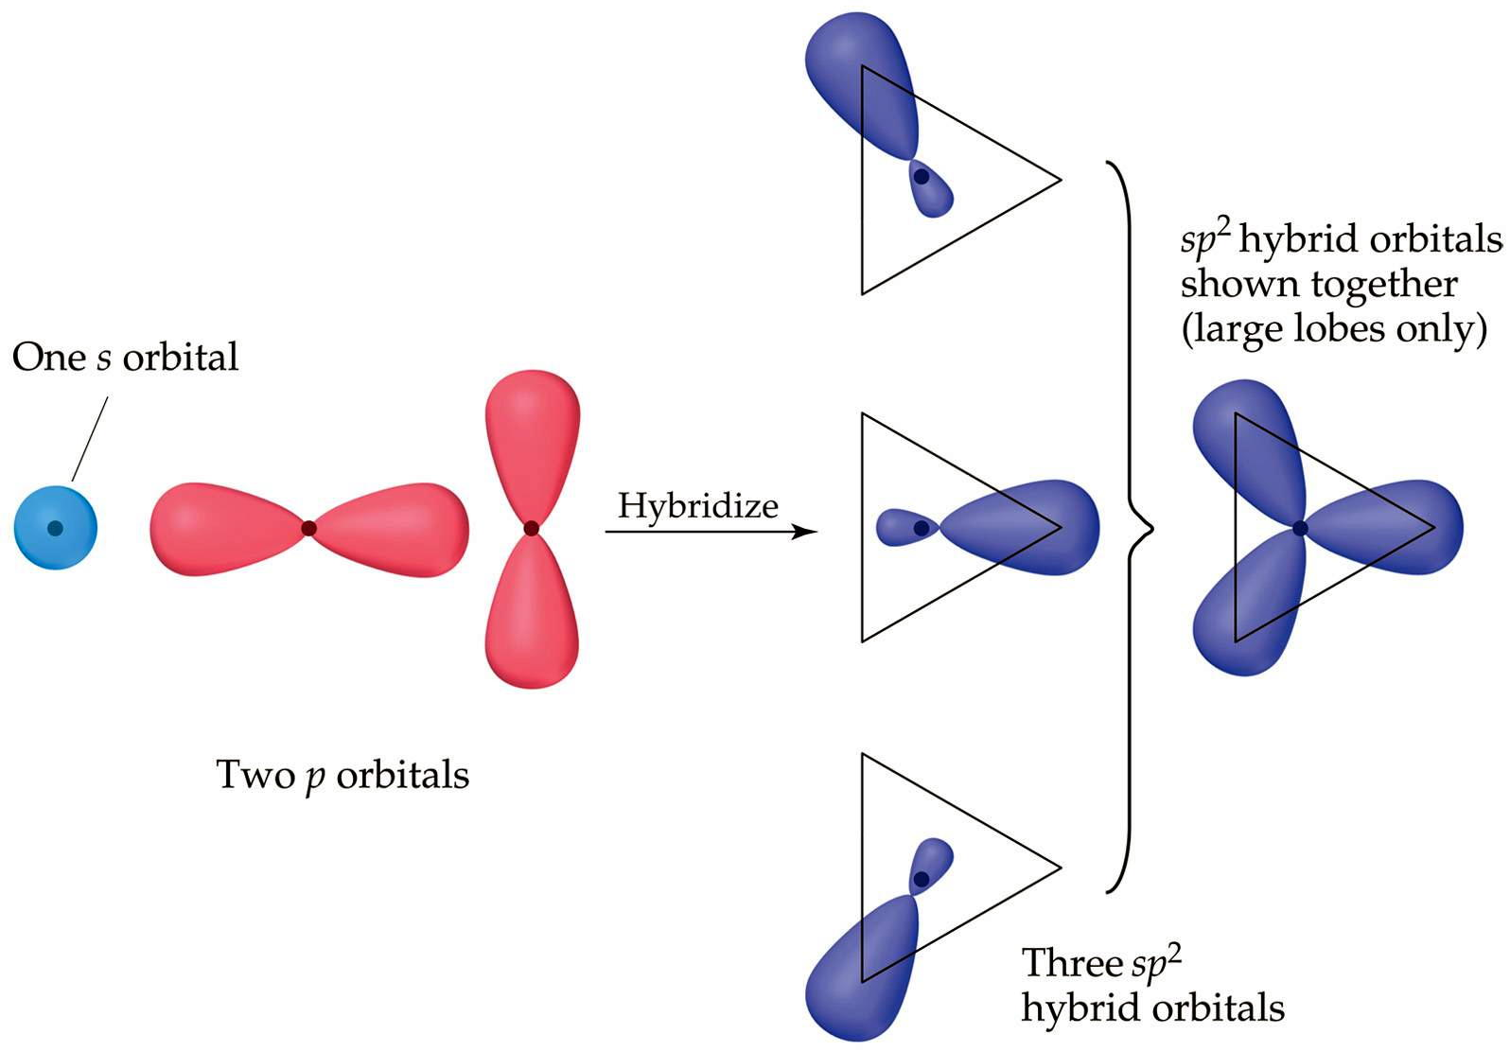
the 3 new sp² hybrid orbitals are 33.3% s-character and 66.7% p-character

Slide 33
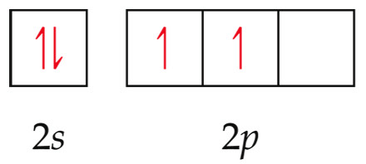
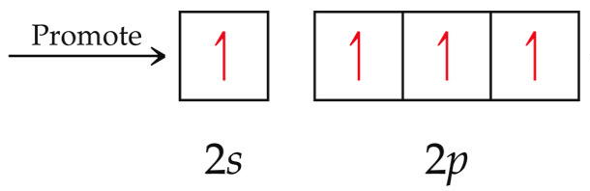
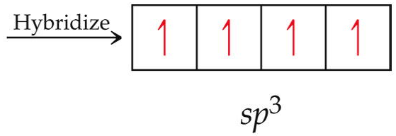
Determine the hybridization of carbon, C in CH₄
Remember, this process is occurring only on the central element of carbon, C
Notes:
Figure: 09-18
Title:
Formation of sp² hybrid orbitals.
Caption:
One s orbital and two p orbitals can hybridize to form three equivalent sp² hybrid orbitals. The large lobes of the hybrid orbitals point toward the corners of an equilateral triangle.

Slide 34
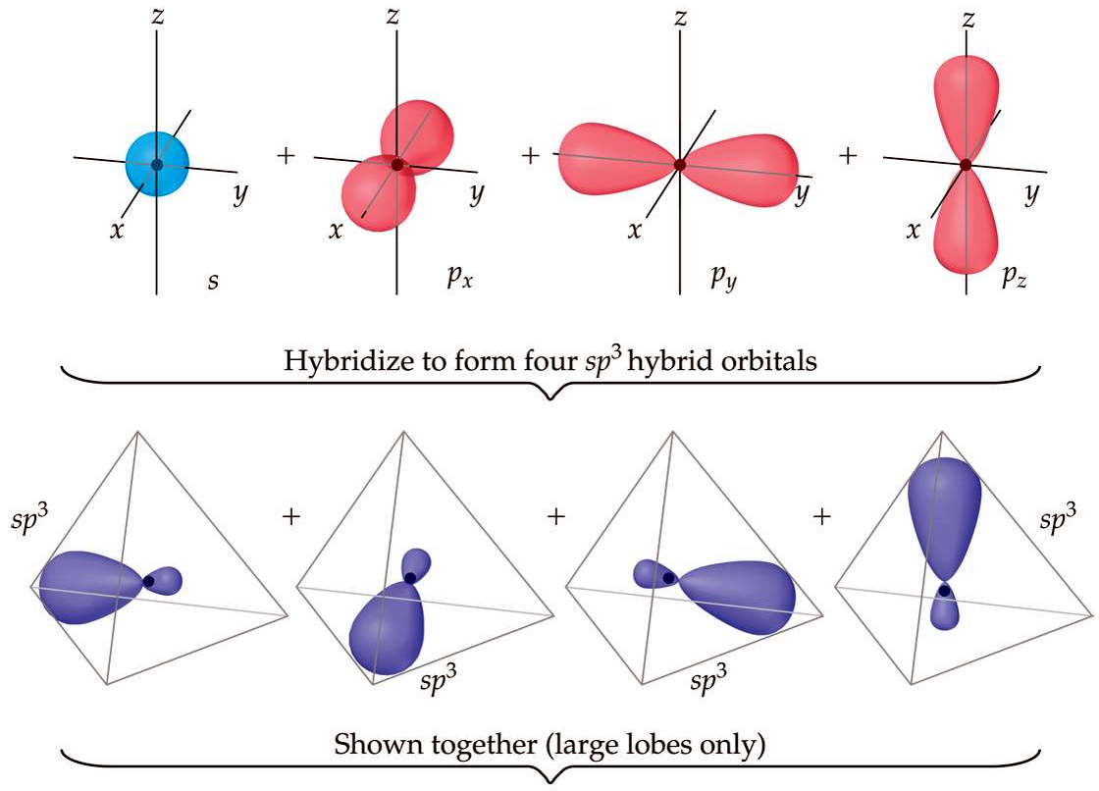
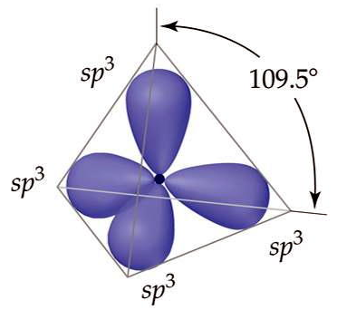
the 4 new sp³ hybrid orbitals
are 25% s-character and
75% p-character
Notes:
Figure: 09-19
Title:
Formation of sp₃ hybrid orbitals.
Caption:
One s orbital and three equivalent p orbitals can hybridize to form four equivalent sp³ hybrid orbitals. The large lobes of the hybrid orbitals point toward the corners of a tetrahedron.

Slide 35
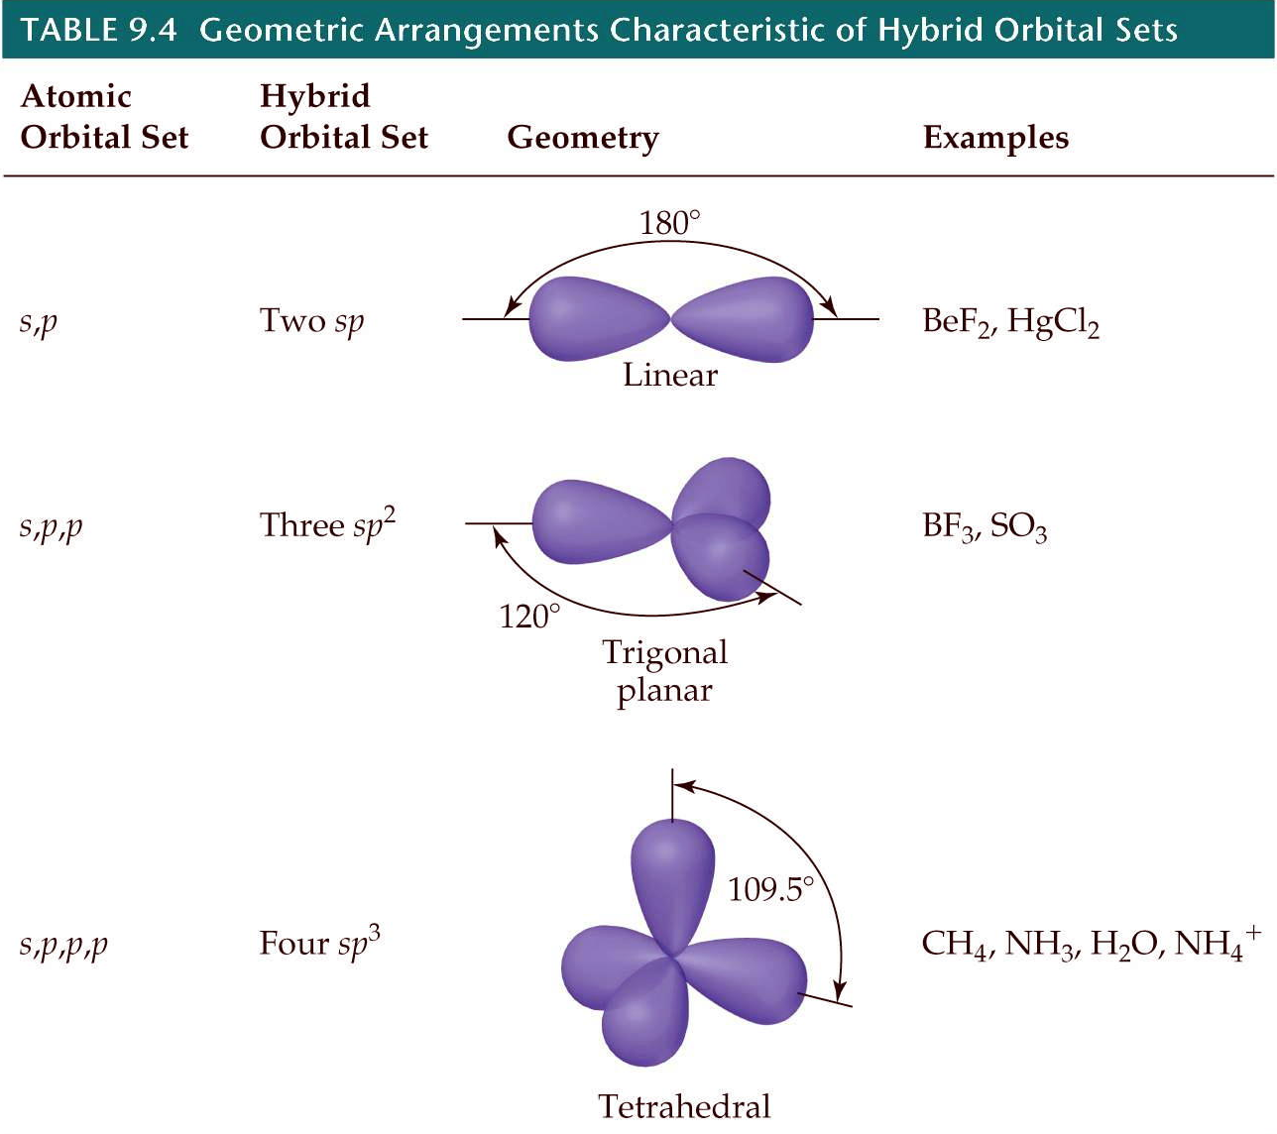
Notes:
Figure: 09-18-01UN
Title:
Orbital diagram.
Caption:
sp₃ Hybrid orbital formation.

Slide 36
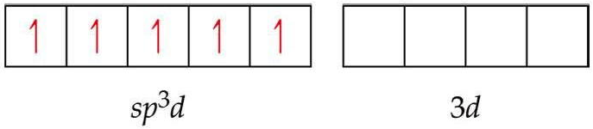
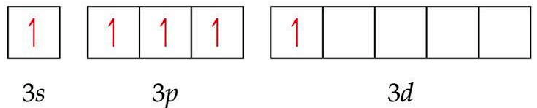
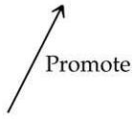
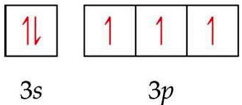
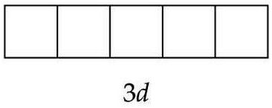
Determine the hybridization of P in PF₅
hybridization
octet expansion requires the central atom to have empty d-orbitals
Notes:
Figure: 09-23-01UN
Title:
Orbital diagram.
Caption:
Hybridization of carbon.

Slide 37


sigma bond – electron overlap that forms all single bonds
σ
pi bond – electron overlap that forms all double and triple bonds
π
H H
one σ bond
one σ bond
and two π bonds
one σ bond
and one π bond
Notes:
Figure: 09-20-01UN
Title:
Orbital diagram.
Caption:
Formation of sp³d hybrid orbitals.

Slide 38
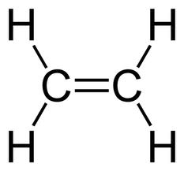
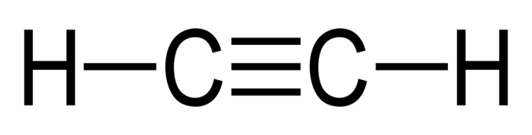

three σ bonds and
two π bonds
five σ bonds and
one π bond
seven σ bonds and
one π bond
Notes:
Figure: 09-20-01UN
Title:
Orbital diagram.
Caption:
Formation of sp³d hybrid orbitals.

Slide 39
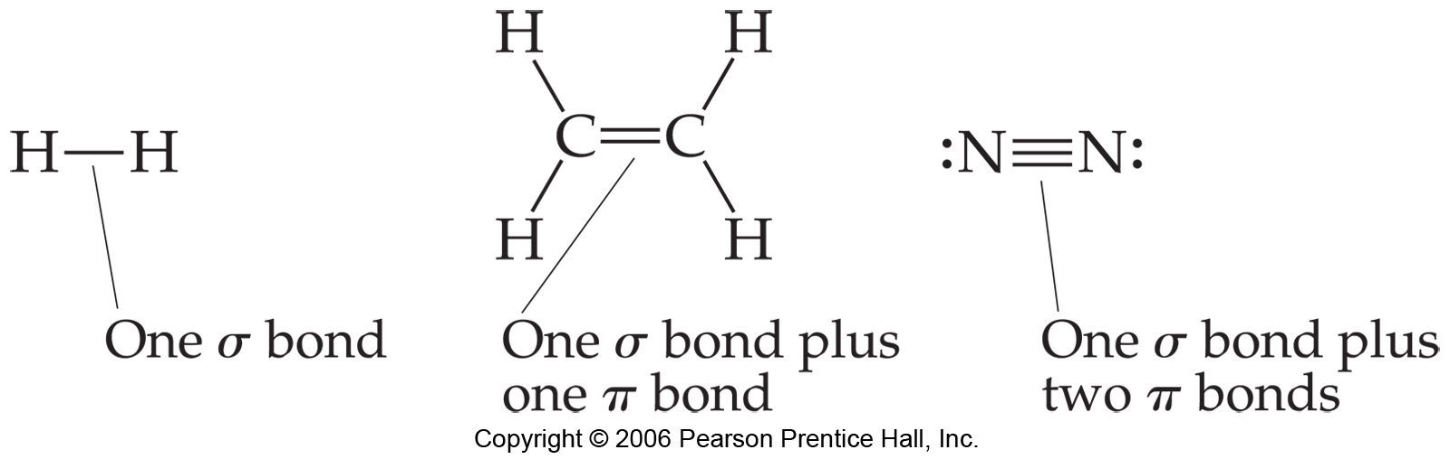
Notes:
Figure: 09-22-01UN
Title:
Lewis structures.
Caption:
Examples of a single, double, and triple bond.

Slide 40
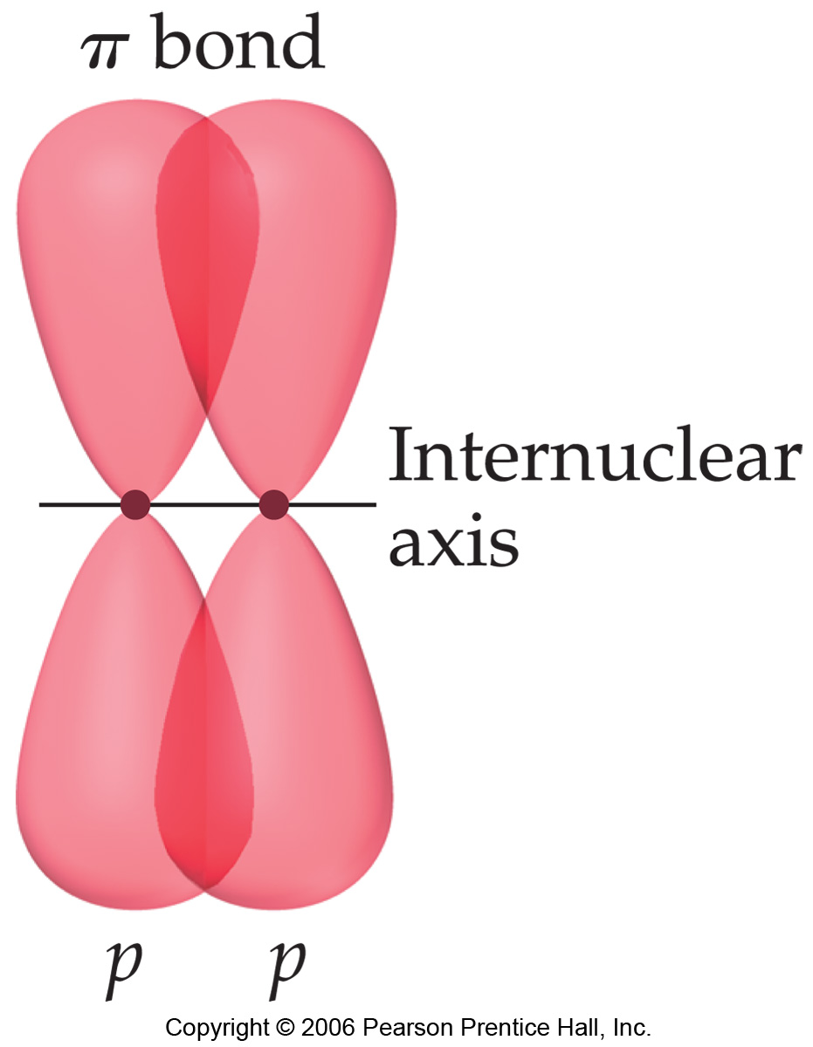
Notes:
Figure: 09-22
Title:
Formation of a π bond.
Caption:
When two p orbitals overlap in a sideways fashion, the result is a π bond. Note that the two regions of overlap constitute a single π bond.

Slide 41
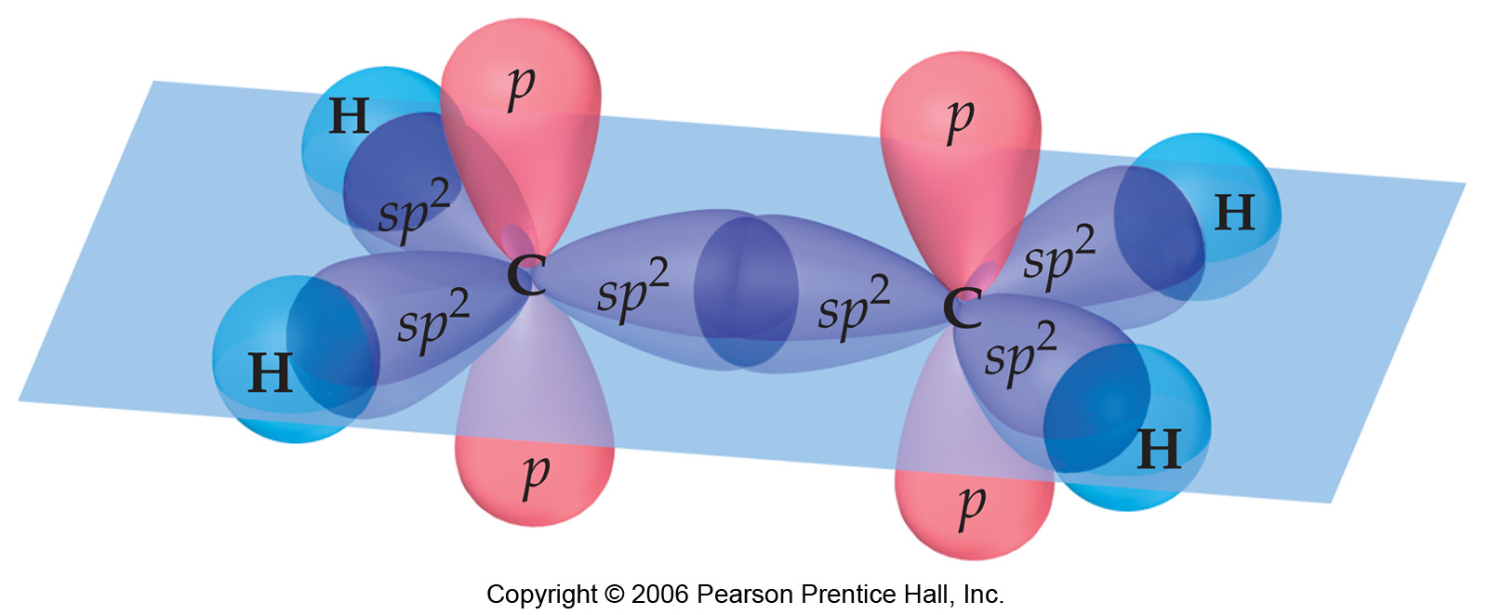
Notes:
Figure: 09-24
Title:
Hybridization in ethylene.
Caption:
Hybridization of carbon orbitals in ethylene. The σ bonding framework is formed from sp² hybrid orbitals on the carbon atoms. The unhybridized 2p orbitals on the C atoms can be used to make a π bond.

Slide 42

Notes:
Figure: 09-25
Title:
Formation of a π bond in ethylene.
Caption:
The unhybridized 2p orbitals on each C atom overlap to form a π bond. The electron density in the π bond is above and below the bond axis, whereas in the σ bonds, the electron density lies on the bond axis. The two lobes constitute one π bond.

Slide 43

Notes:
Figure: 09-26
Title:
Formation of two π bonds in acetylene.
Caption:
In acetylene, C₂H₂, the overlap of two sets of unhybridized carbon 2p orbitals leads to the formation of two π bonds.

Slide 44

Notes:
Figure: 09-27Ex9.6
Title:
Bond formation in formaldehyde.
Caption:
Formation of σ and π bonds in formaldehyde, H₂CO.

