Slide 1
bonding – forces that hold atoms together
ionic
covalent
metallic
ionic bonding – ions that are held together via unlike charges

Slide 2
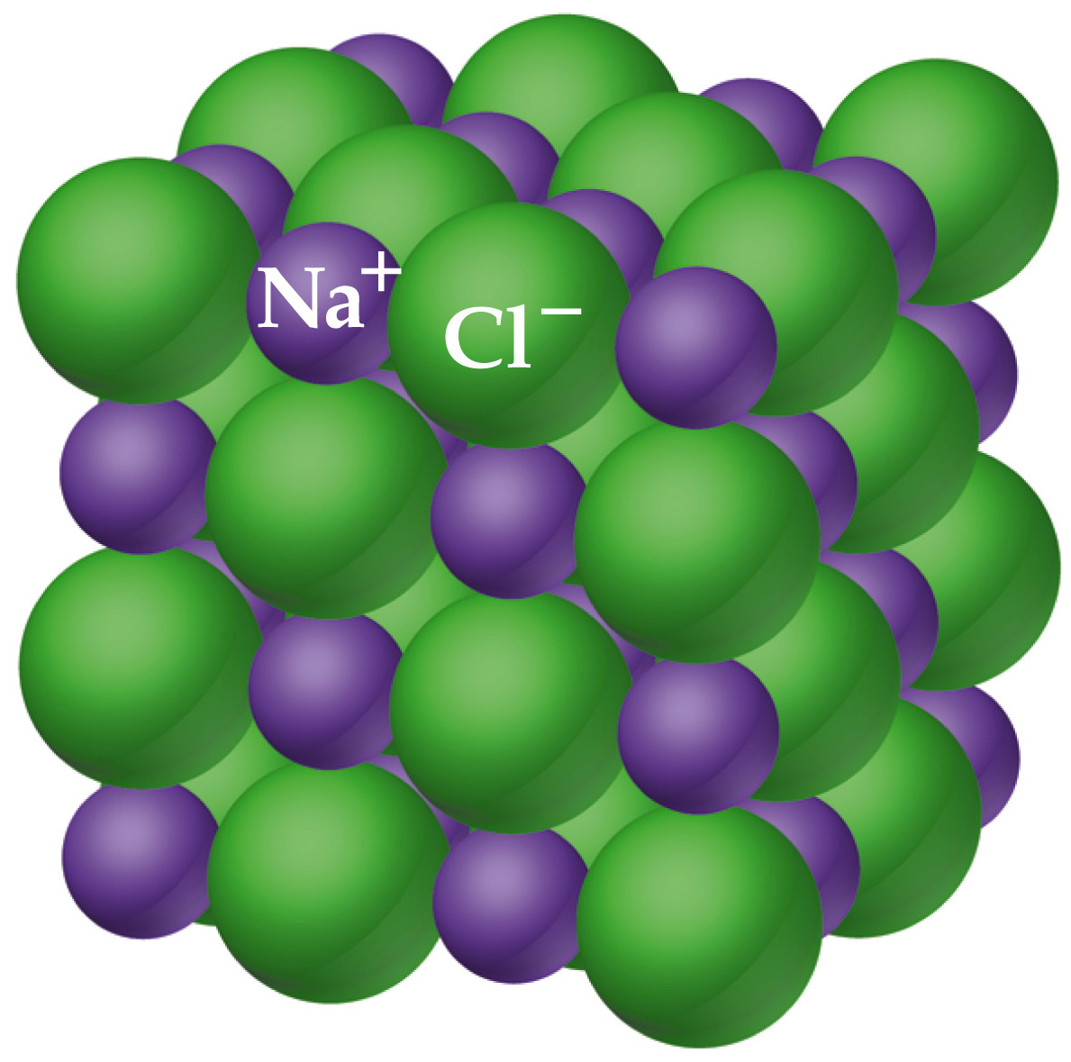
Notes:
Figure: 08-03

Slide 3
Gilbert Lewis 1875 – 1946
Lewis dot symbol – shorthand method of showing the number of valence electrons available for bonding in atoms

Slide 4
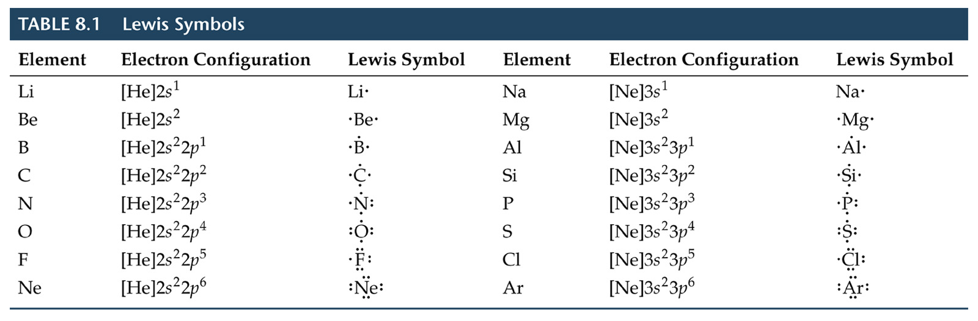
Notes:
Figure: 08-T01

Slide 5
octet rule – atoms gain or lose or share electrons in an effort to obtain
8 valence electrons
What is so special about 8 valence electrons ?
8 valence electrons = noble gas configuration
noble gas configuration is energetically stable !

Slide 6
Determine the empirical formula expected for a compound containing Ca and F.

Slide 7
covalent bonding – 2 electrons are “shared” between 2 atoms.
Covalently bound species are different than ionic
exist as individual, discrete species (vs. 3-D crystal lattice structure for ionic)
tend to exhibit much lower melting and boiling points (vs. ionic)

Slide 8
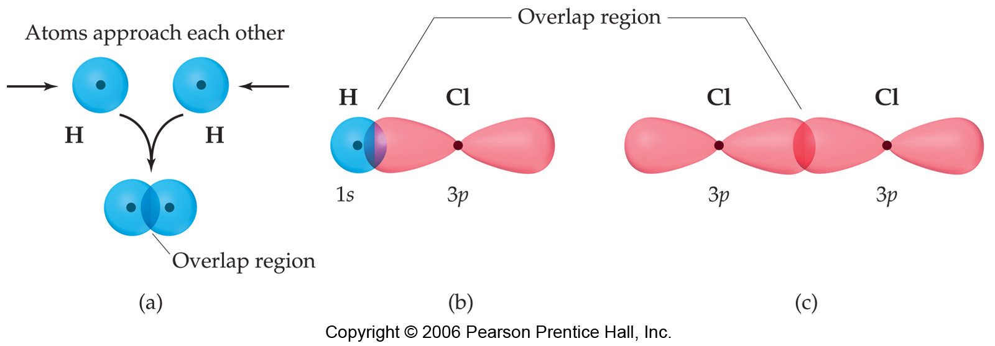
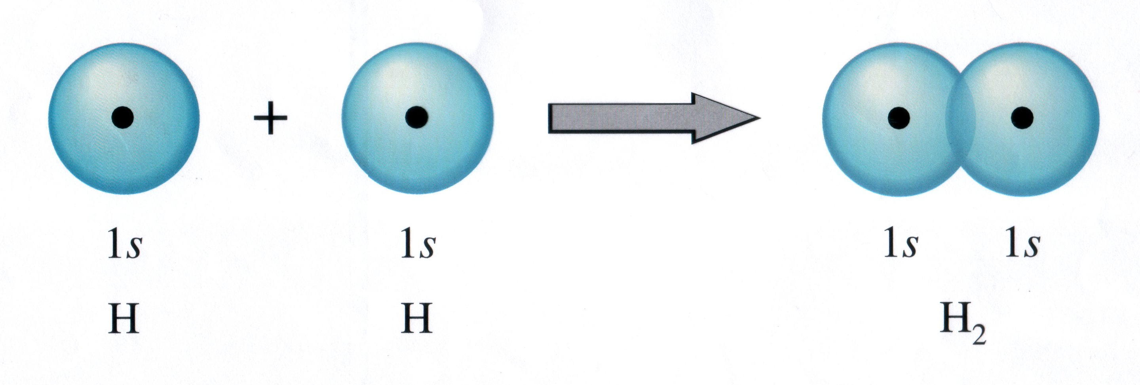

Slide 9
single bond – 2 electrons (1 pair of electrons) are shared between 2 atoms
double bond – 4 electrons (2 pairs of electrons) are shared between 2 atoms
triple bond – 6 electrons (3 pairs of electrons) are shared between 2 atoms

Slide 10
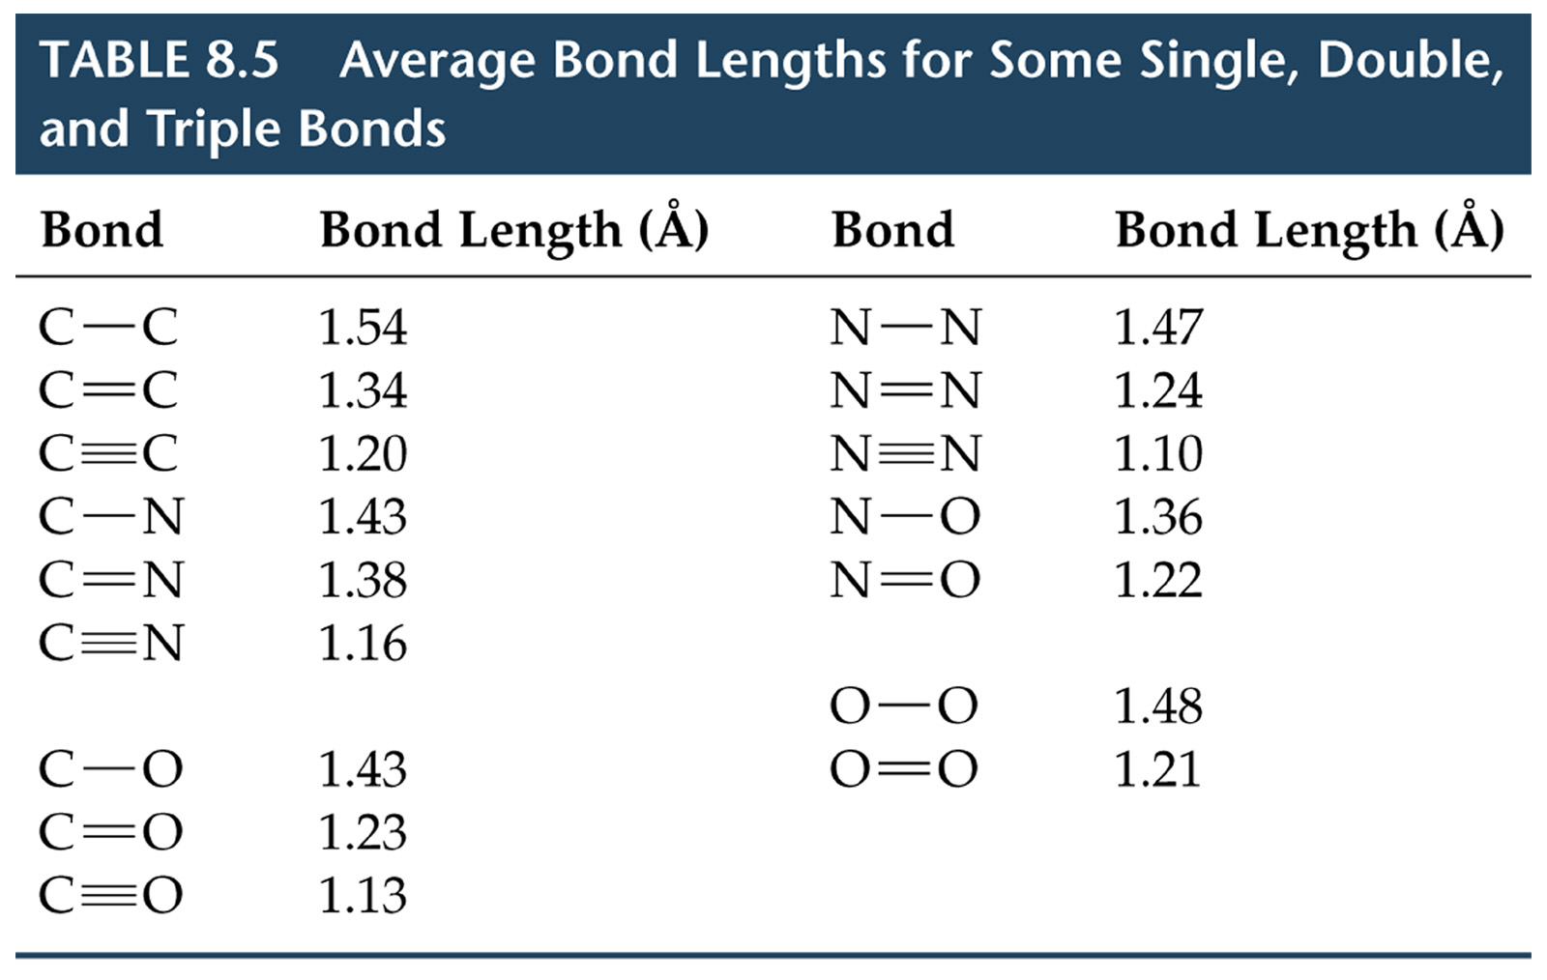
Notes:
Figure: 08-T05

Slide 11
a double bond is shorter and stronger than a single bond
a triple bond is shorter and stronger than a double bond
Notes:
Figure: 08-05

Slide 12
Cl₂
HCl
nonpolar bond – electrons are shared equally in the bond
polar bond – electrons are NOT shared equally

Slide 13
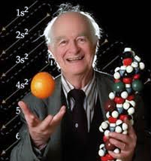
Linus Pauling
1901 – 1994
electronegativity – the ability of an element to attract electron density to itself in a molecule

Slide 14
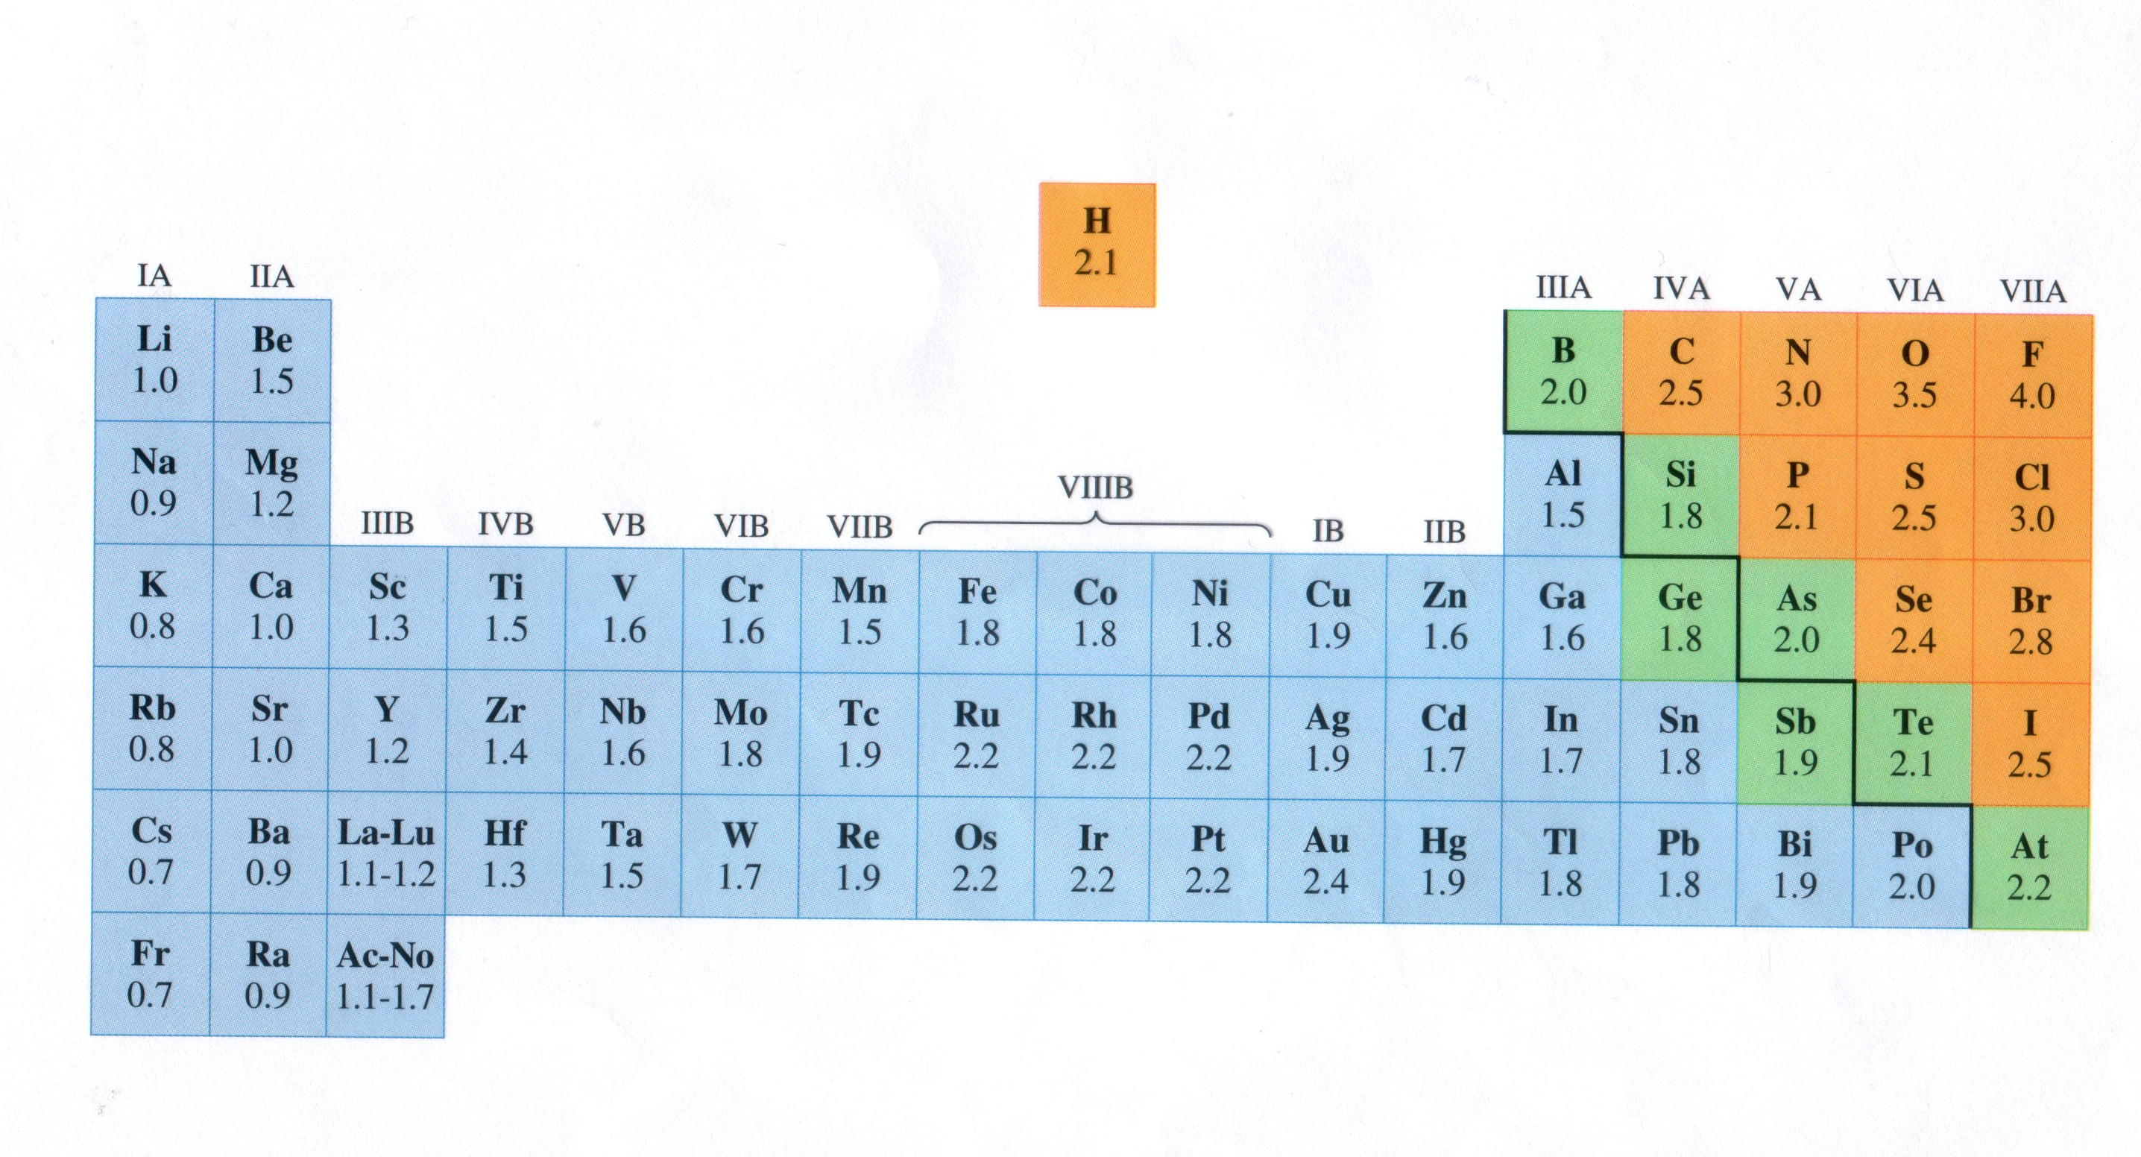
electronegativity – the ability of an element to attract electron density to itself in a molecule
electronegativity increases from left right
electronegativity decreases from top bottom

Slide 15
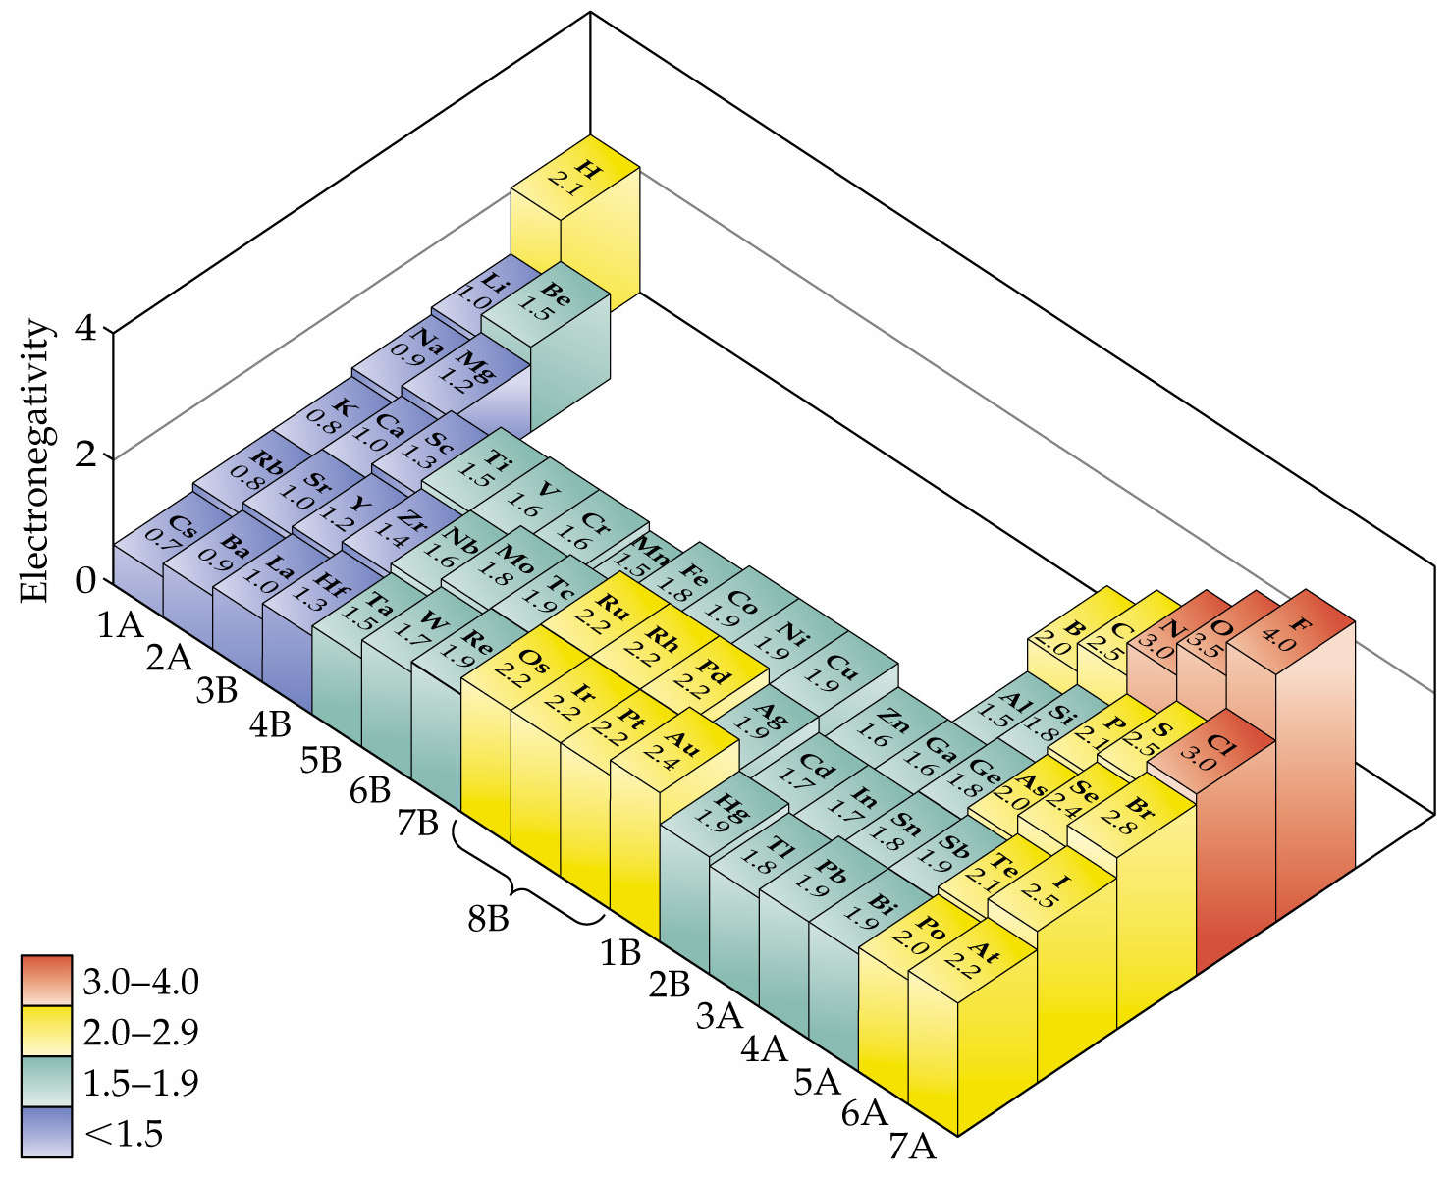
Notes:
Figure: 08-06

Slide 16
Arrange the following in order of increasing electronegativity: Na, F, O, K, Al, Si, Mg
Notes:
Figure: 08-07

Slide 17
Drawing Lewis Structures
count the total number of valence electrons
make an intelligent guess as to the central element and connectivity
a) heavier element is often the central element
b) many molecules are symmetric
Add electron pairs to satisfy octet rule
start making multiple bonds (first double, then triple if single bonds not getting the job done.)
Do NOT (under any circumstance…..ever) form a multiple bond to a halogen or hydrogen

Slide 18
Draw the Lewis structure for F₂
bonding pair of e⁻ – e⁻ that hold two atoms
(bonding pair) together
nonbonding pair of e⁻ – e⁻ that are NOT holding
(lone pair) 2 atoms together

Slide 19
Draw the Lewis structure for H₂O

Slide 20
Draw the Lewis structure for ethene, C₂H₄

Slide 21
Draw the Lewis structure for PO₄³⁻

Slide 22
Draw the Lewis structure for NO⁺

Slide 23
Draw the Lewis structure for PF₅
octet expansion – some atoms can exceed
8 valence electrons
(usually P & S)

Slide 24
Draw the Lewis structure for BCl₃

Slide 25


Resonance – the “real” molecule can NOT be described by a single Lewis structure
Consider NO₂⁻

Slide 27

Barium + Cobalt + Nitrogen
Ba²⁺ + Co⁺ + N³⁻ → BaCoN
The only ionic compound you ever really need !!

Slide 28



Determine the Lewis structure for NO₂⁻
What are your bond expectations for nitrite ?
Notes:
Figure: 08-10

Slide 29
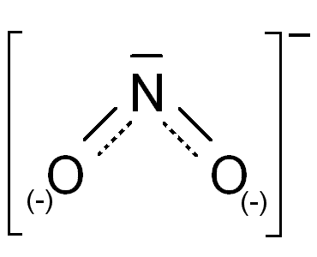
go to lab and measure the actual bond lengths in a real nitrite anion
The N-O bonds in nitrite are identical (in every sense; same length; same strength)
A single Lewis structure can NOT be drawn to describe the “real” nitrite species
Notes:
Figure: 08-10

Slide 30
The Real molecule is somewhere in between these two extremes
Notes:
Figure: 08-10

