Slide 2
Atomic Radii Trends
1. atomic radii Increase as move down  a group (or family)

Slide 3
2. atomic radii Decrease as move left to right ⇨ across a period

Slide 4
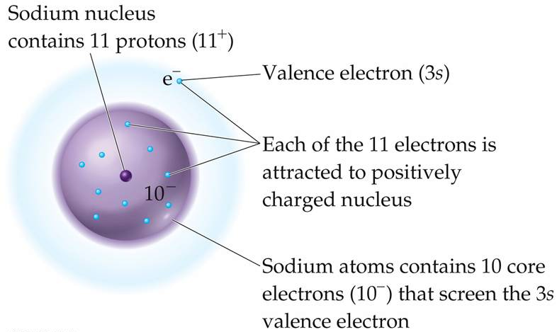
Effective Nuclear Charge, Z_{eff} – the positive charge an electron “feels” from the nucleus

Slide 6
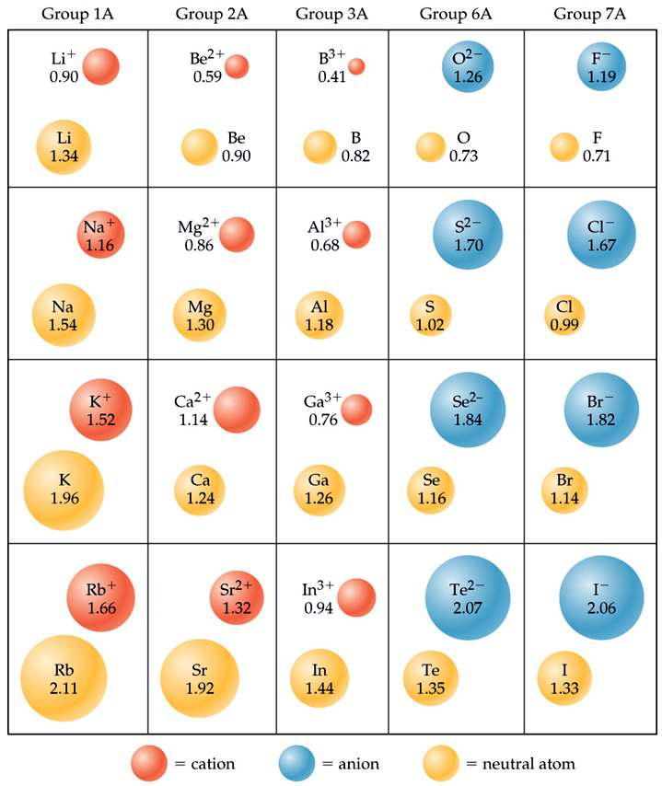
Notes:
Figure: 07-07
Title:
Cation and anion size.
Caption:
Comparisons of the radii, in Å, of neutral atoms and ions for several of the groups of representative elements. Neutral atoms are shown in gray, cations in red, and anions in blue.

Slide 7
Anions are always bigger than corresponding neutral species
Cations are always smaller than corresponding neutral species

Slide 8
Isoelectronic – ions with the same number of electrons

Slide 9
Ionization Energy, IE – amount of energy required to remove an electron from an atom

Slide 10
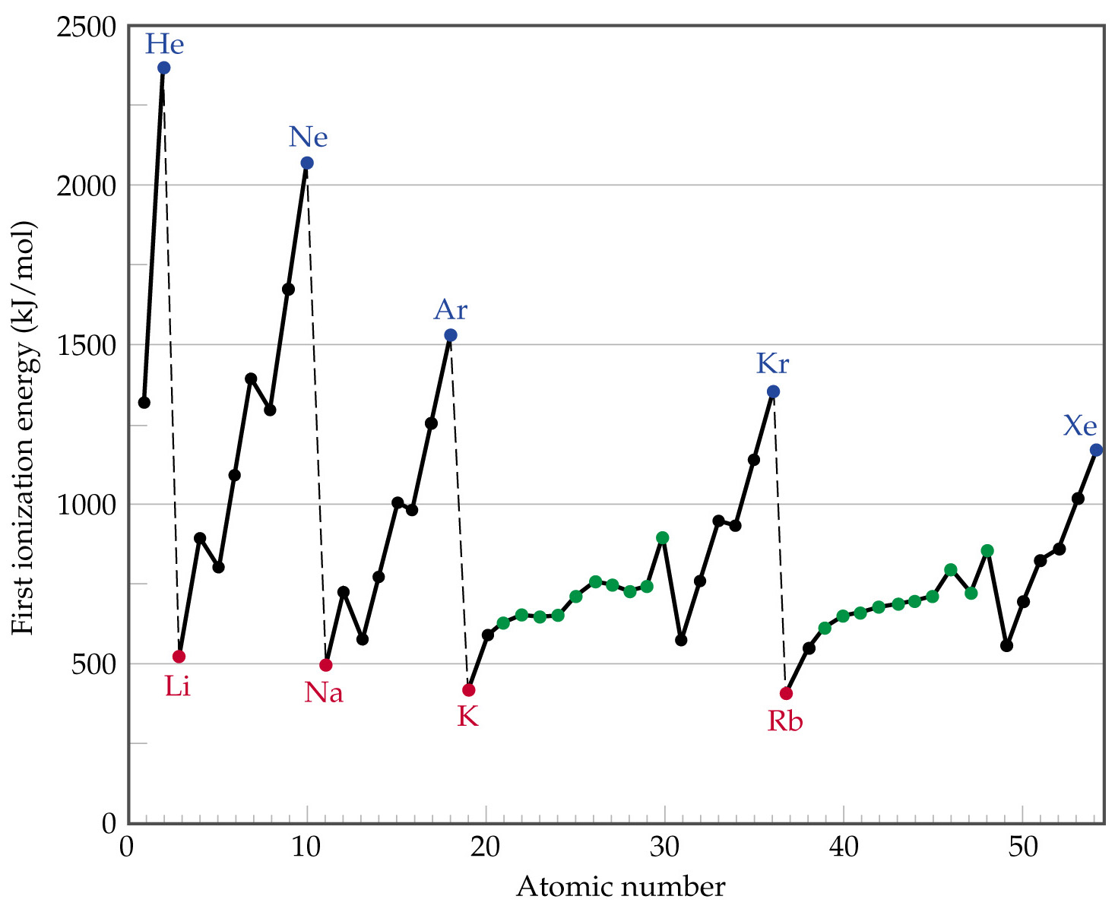
Notes:
Figure: 07-10
Title:
First ionization energy versus atomic number.
Caption:
The red dots mark the beginning of a period (alkali metals), the blue dots mark the end of a period (noble gases), and the black dots indicate other representative elements. Green dots are used for the transition metals.

Slide 11
IE Increases as move left to right ⇨ across a period
IE Decreases as move down  a group (or family)

Slide 12
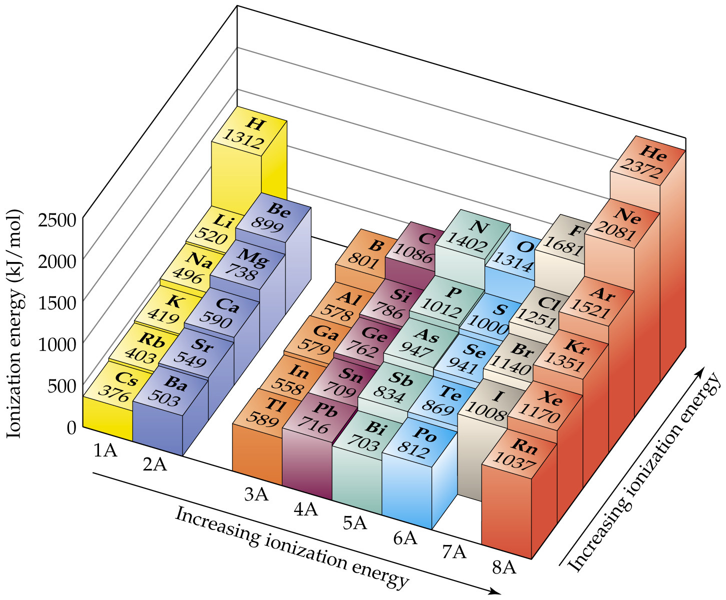
Notes:
Figure: 07-11
Title:
Trends in first ionization energy.
Caption:
First ionization energies for the representative elements in the first six periods. The ionization energy generally increases from left to right and decreases from top to bottom. The ionization energy of astatine has not been determined.

Slide 13
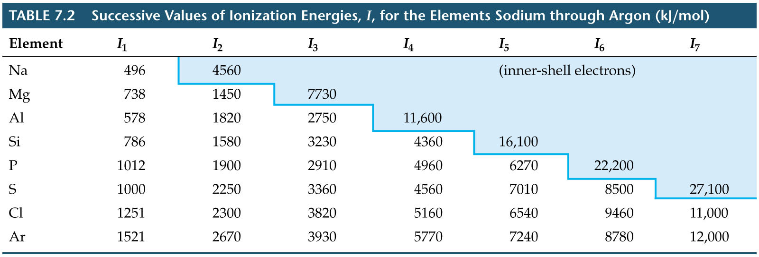
Notes:
Figure: 07-T02
Title:
Table 7.2
Caption:
Successive Values of Ionization Energies, I, for the Elements Sodium Through Argon (kJ/mol).

Slide 14
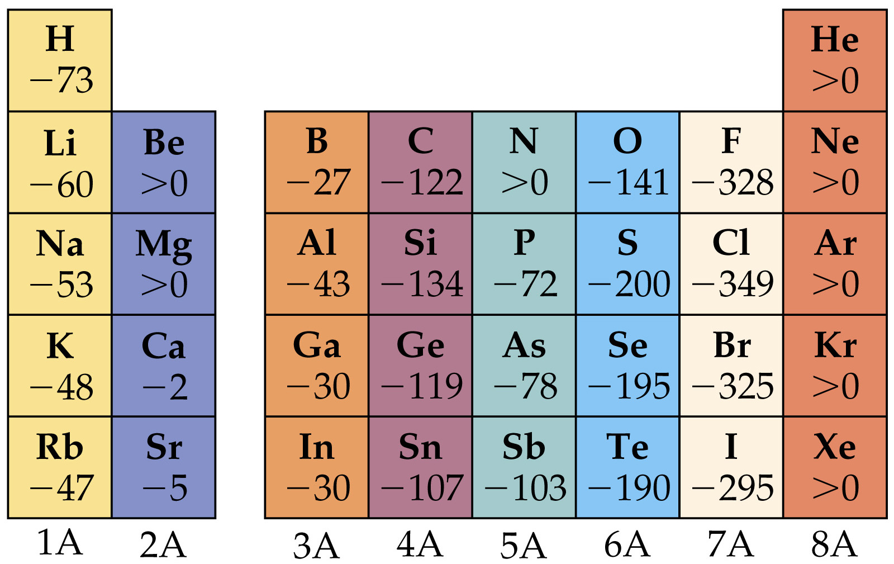
Notes:
Figure: 07-12
Title:
Electron affinity.
Caption:
Electron affinities in kJ/mol for the representative elements in the first five periods of the periodic table. The more negative the electron affinity, the greater the attraction of the atom for an electron. An electron affinity > 0 indicates that the negative ion is higher in energy than the separated atom and electron.

