Slide 1
Quantum numbers – values which describe the energy, shape, orientation and spin of the electron in an atom
1. principle quantum number, n – determines the distance & thus the energy of an e⁻ from nucleus
n has possible integer values
ex. n=1 or n=2 or n=3 or n=4 etc.

Slide 2
1913 - Niels Bohr
n | distance from nucleus
1 | 53 pm
2 | 212 pm
3 | 476 pm
4 | 846 pm
5 | 1323 pm
The energy of the electron increases as n increases

Slide 3
2. angular momentum quantum number,  – determines the shape of the orbital
for a given value of n,  has possible values 0 up to n-1 with all integers in between
when  = 0, e⁻ resides in an s-orbital (sphere)
when  = 1, e⁻ resides in an p-orbital (figure 8)
when  = 2, e⁻ resides in an d-orbital (four lobed)
when  = 3, e⁻ resides in an f-orbital (eight lobed)

Slide 4
1s
n=1
● = 0
2s
n=2
● = 0
3s
n=3
● = 0
Notes:
Figure: 06-19

Slide 5
when  = 0, e⁻ resides in an s-orbital (sphere)
when  = 1, e⁻ resides in an p-orbital (figure 8)
when  = 2, e⁻ resides in an d-orbital (four lobed)
when  = 3, e⁻ resides in an f-orbital (eight lobed)
● = 1, p-orbital
● = 2, d-orbital

Slide 6
3. magnetic quantum number, m – describes the orientation of orbitals in space relative to each other
m values depend on 
possible m values = - to + (including all integers in between)
when  = 0, then m = 0 (only one value of m)
when  = 1, then m = -1, or m = 0, or m = +1 (three possible values of m)
when  = 2, then m = -2, or m = -1, or m = 0, or
m = +1, or m = +2 ( five possible values of m)

Slide 7
when  = 1, m = -1, or 0, or +1
m = −1 m = 0 m = +1

Slide 8
when  = 2, m = -2, or -1, or 0, or +1, or +2

Slide 9
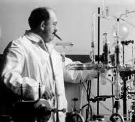
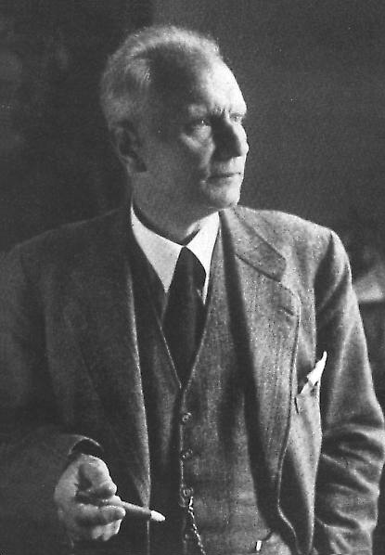
Otto Stern
1888 - 1969
Walter Gerlach
1889 - 1979

Slide 10
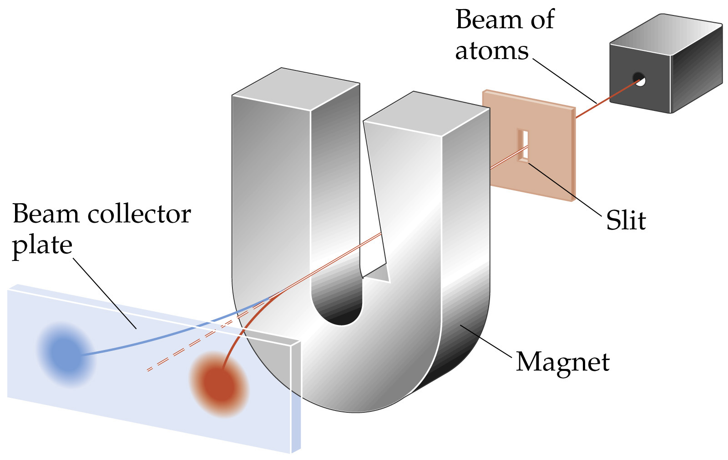
4. electron spin quantum number, m_{s} – comes directly from experiment
m_{s} values = +½ or –½

Slide 11
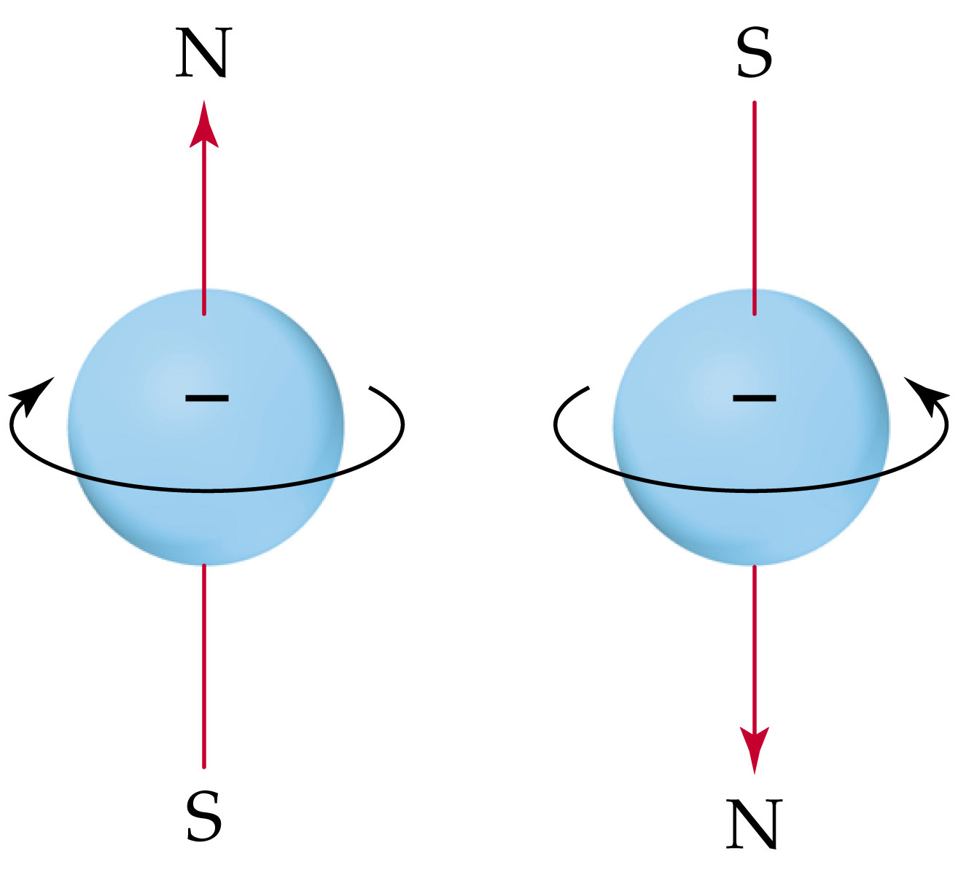

Slide 12
electrons always arrange (or fill) into orbitals of lowest energy possible

Slide 13
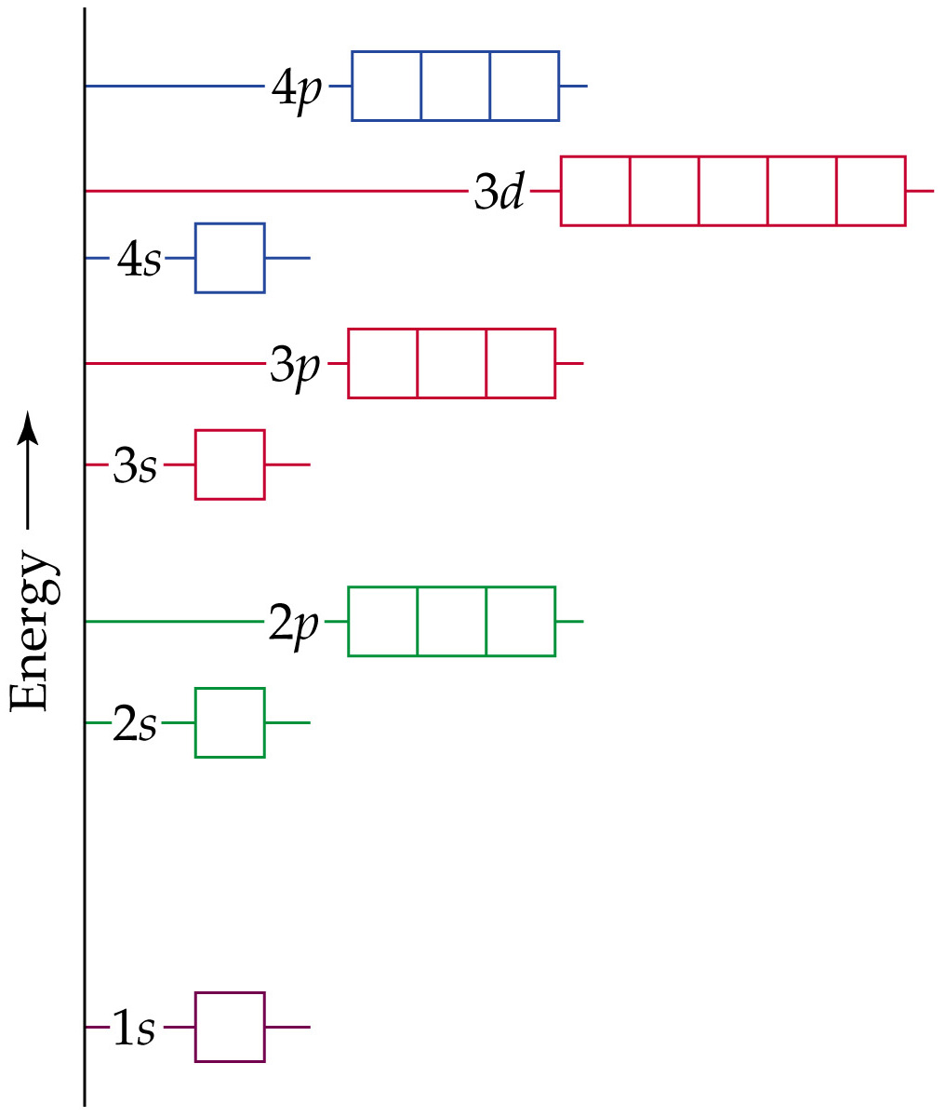
degenerate – electrons have
the same energy
each orbital subshell can contain a maximum of 2 electrons

Slide 14
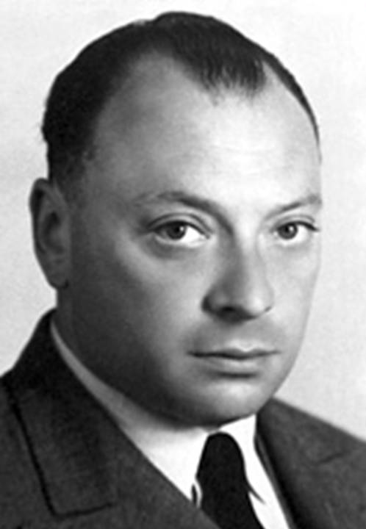
Wolfgang Pauli 1900-1958
Pauli Exclusion Principle – no two electrons in the same atom can have the same four quantum numbers
Notes:
Figure: 06-24
Title:
Orbital energy levels in many-electron atoms.
Caption:
In a many-electron atom, the energies of the subshells in each shell follow the order ns < np < nd < nf. As in Figure 6.17, each box represents an orbital.

Slide 15
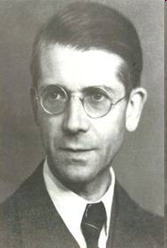
Friedrich Hund 1896-1997
Hund’s Rule – electrons fill unpaired in degenerate orbitals as long as possible

Slide 17
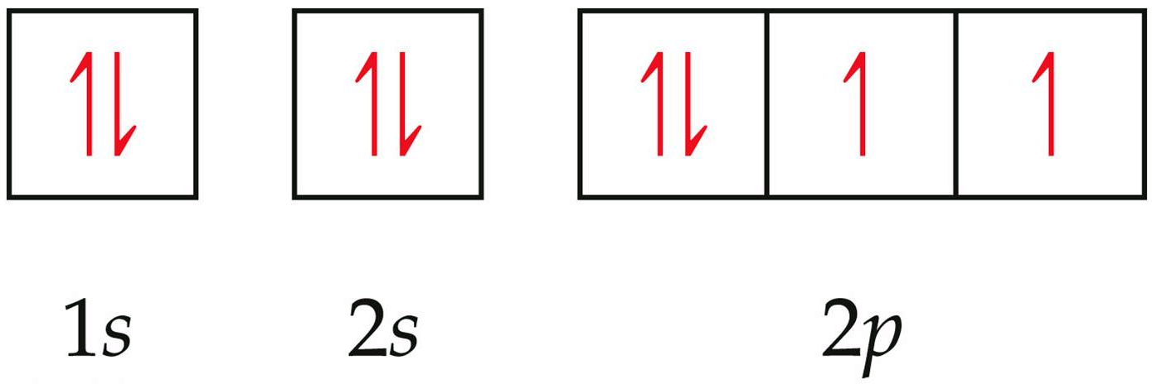
the electron configuration of oxygen is :
1s²2s²2p⁴
Notes:
Figure: 06-28-05UN
Title:
Sample Exercise 6.7
Caption:
Electron configuration for oxygen.

Slide 18
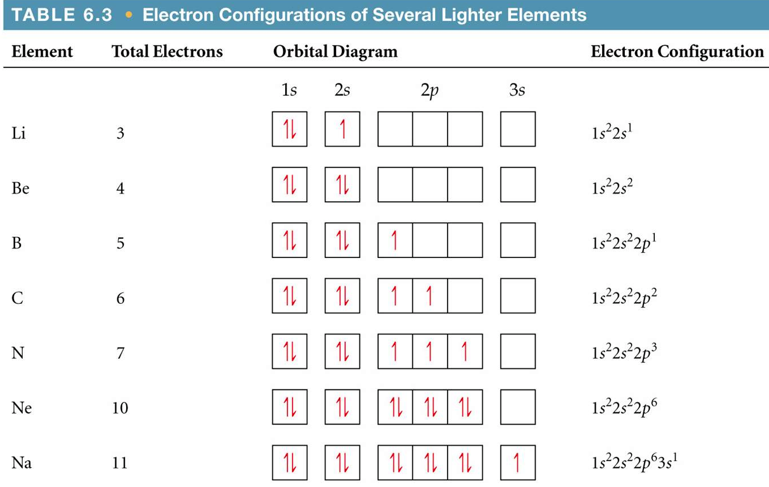
Notes:
Figure: 06-T03
Title:
Table 6.3
Caption:
Electron Configurations of Several Lighter Elements.

Slide 19
paramagnetic – atom contains one or more unpaired electrons
diamagnetic – all electrons in the atom are paired

Slide 20
Determine the electron configuration of Mg using arrows and blanks

Slide 21
Determine all 4 quantum numbers describing the 24th electron added to cobalt

Slide 22
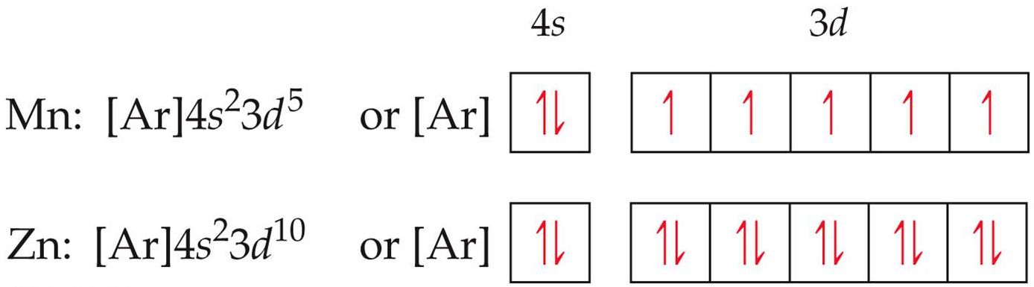
Notes:
Figure: 06-28-06UN
Title:
Orbital diagrams of Mn and Zn.
Caption:
Electron configurations for Mn and Zn.

Slide 23
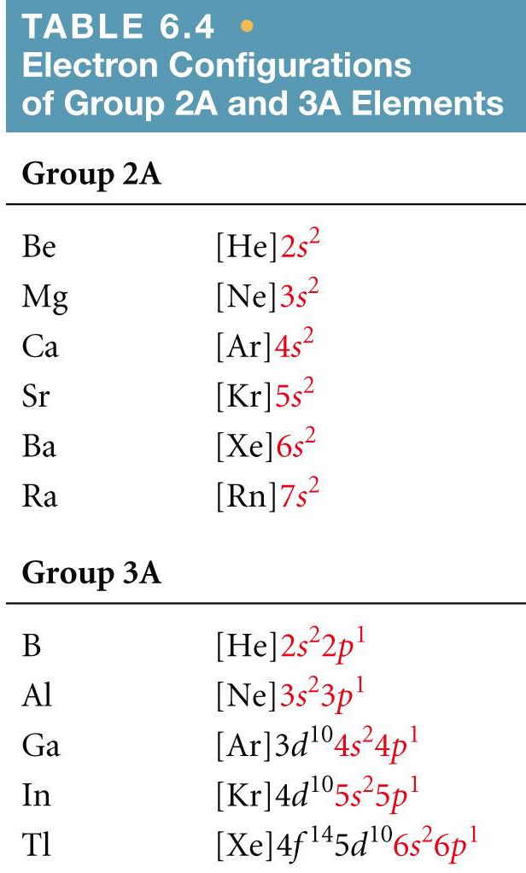
Notes:
Figure: 06-T04
Title:
Table 6.4
Caption:
Electron Configurations of the Group 2A and 3A Elements.

Slide 24
core electrons – electrons in the inner atomic orbitals
valence electrons – electrons in the outer atomic orbitals

Slide 25
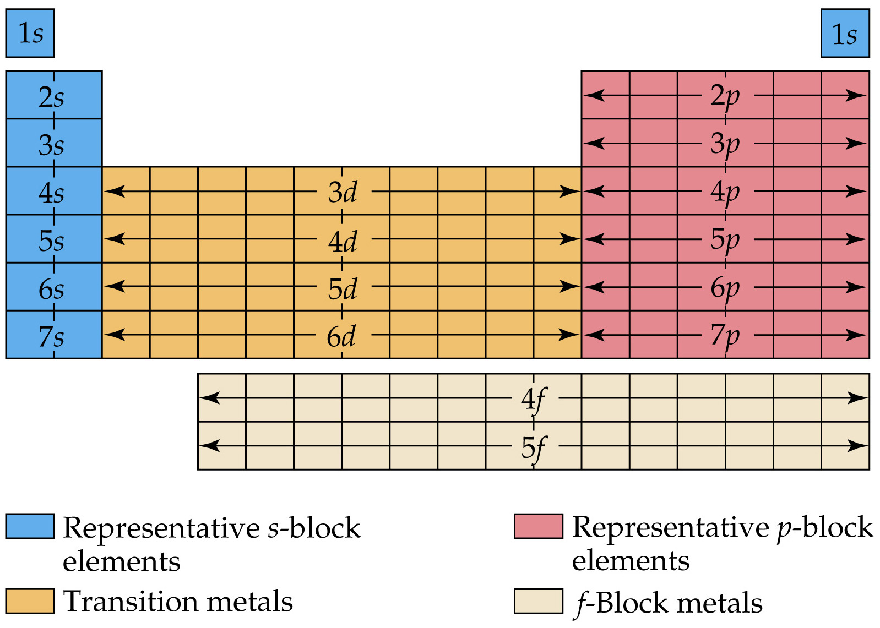
Notes:
Figure: 06-30-01UN
Title:
Sample Integrative Exercise
Caption:
Orbital diagram of boron.

Slide 26
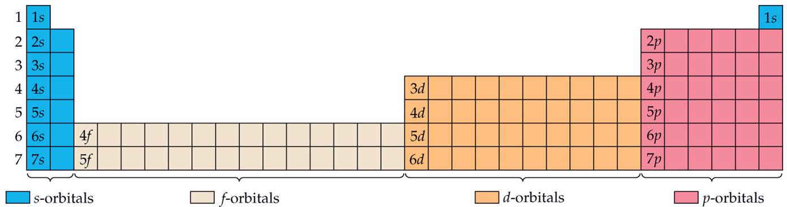

Slide 27
