Slide 1
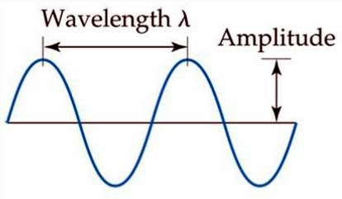
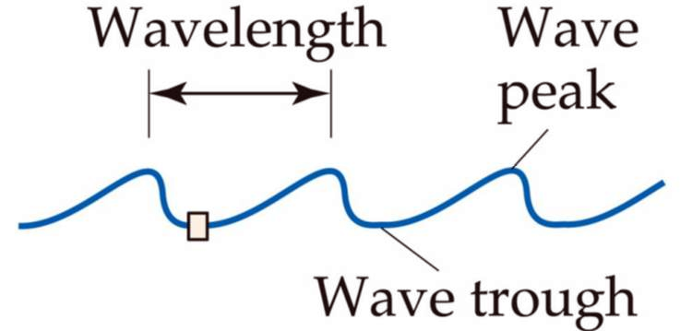
electromagnetic radiation – transmission of energy through space in the form of oscillating waves
wavelength, λ – distance between identical points on successive waves

Slide 3

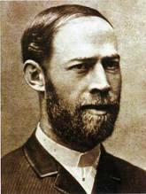
frequency, ν – # times per second a wavelength moves past a point
1
sec
ν = 1
ν = 1 Hz
0 1 2 (sec)
1
sec
units for v =
Heinrich Hertz
1857-1894
1
sec
= Hertz or Hz

Slide 4

0 1 2 (sec)
1
sec
ν = 5
or 5 Hz

Slide 5
λ·ν
(m) · (1/sec) = m/sec
All electromagnetic radiation travels at the same velocity: the speed of light, or c.
c = 3.00 × 10⁸ m/sec
c = λ·ν
Notes:
Figure: 06-03a-c
Title:
Characteristics of electromagnetic waves.
Caption:
Radiant energy has wave characteristics; it consists of electromagnetic waves. Notice that the shorter the wavelength, λ, the higher the frequency, ν. The wavelength in (b) is half as long as that in (a), and its frequency is therefore twice as great. The amplitude of the wave relates to the intensity of the radiation. It is the maximum extent of the oscillation of the wave. In these diagrams amplitude is measured as the vertical distance from the midline of the wave to its peak. The waves in (a) and (b) have the same amplitude. The wave in (c) has the same frequency as that in (b), but its amplitude is lower.

Slide 6
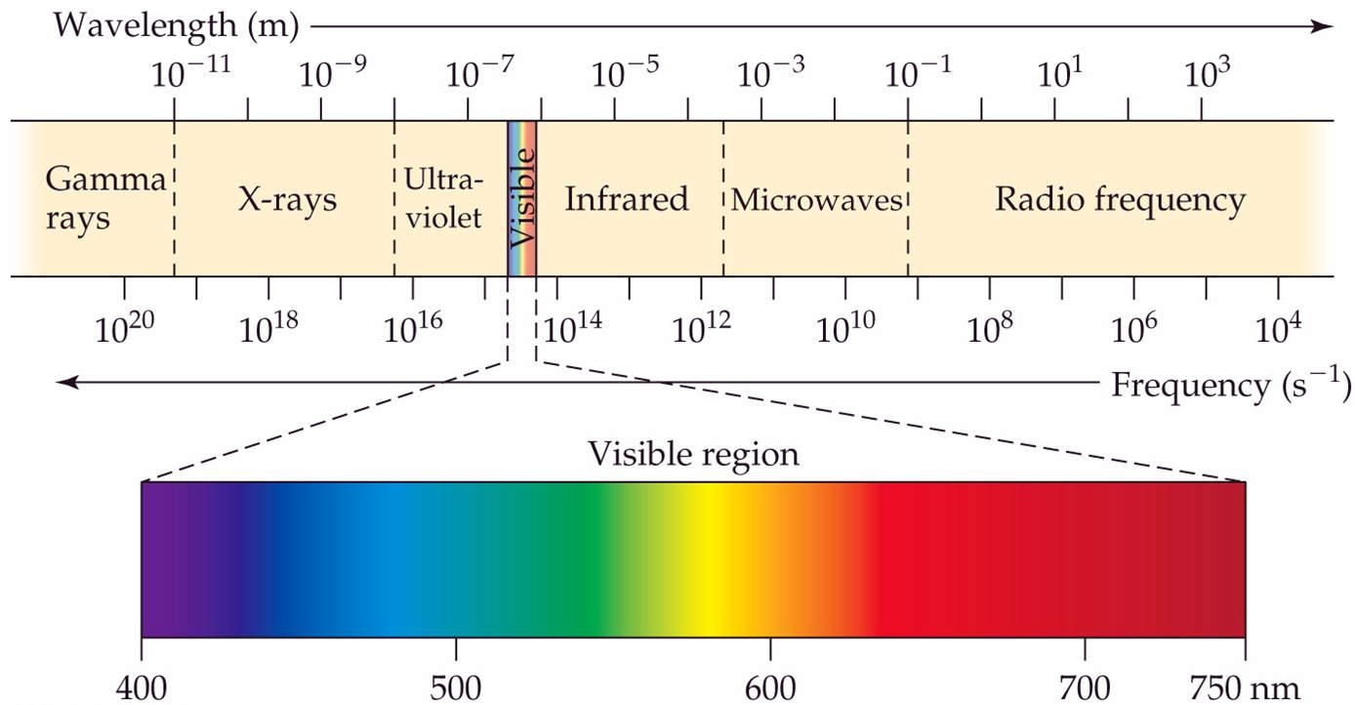
The entire electromagnetic spectrum

Slide 7
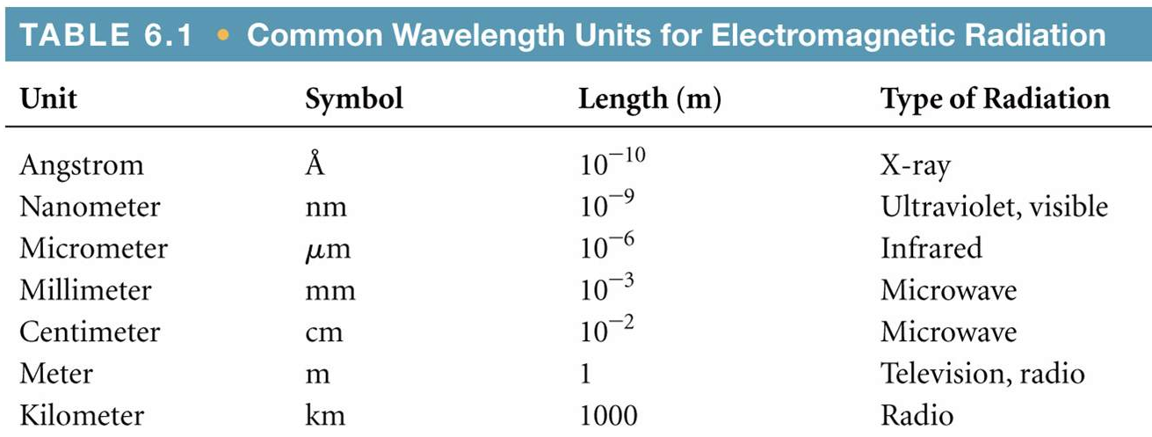
Notes:
Figure: 06-T01
Title:
Table 6.1
Caption:
Common Wavelength Units for Electromagnetic Radiation.

Slide 8
The wavelength of an ASU blue safety light is 443 nm. What is the frequency of that blue light ?
1 m = 1 x 10⁹ nm

Slide 9
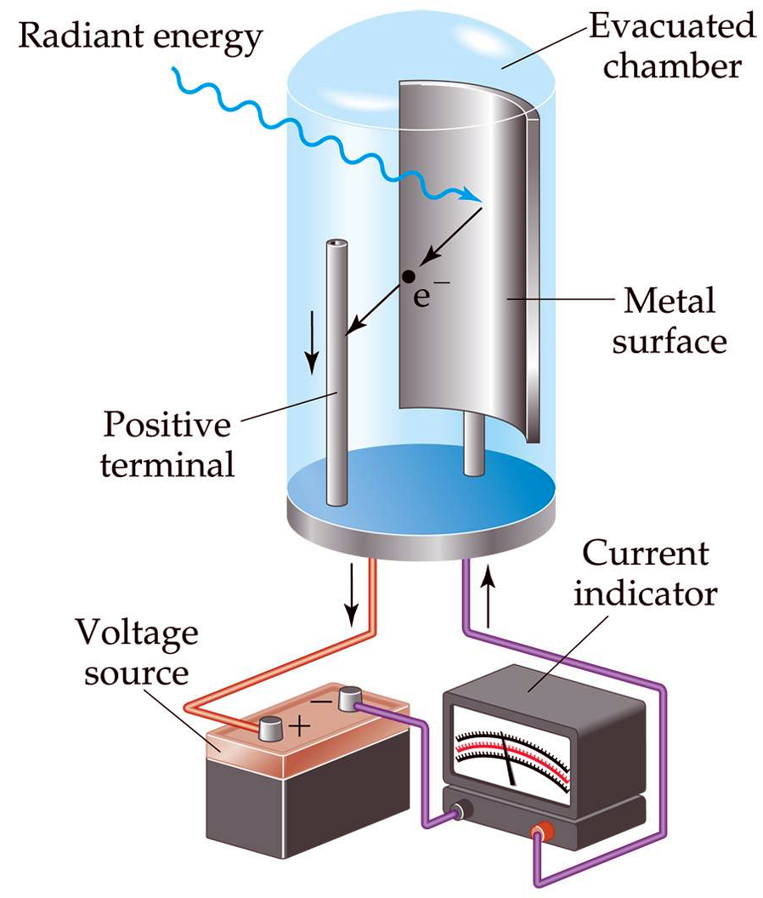
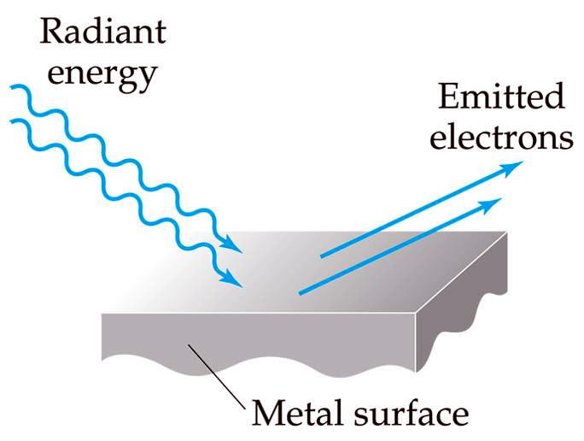
the photoelectric effect – ability of light to knock e⁻ out of a metal
Notes:
Figure: 06-07a, b
Title:
The photoelectric effect.
Caption:
When photons of sufficiently high energy strike a metal surface, electrons are emitted from the metal, as in (a). The photoelectric effect is the basis of the photocell shown in (b). The emitted electrons are drawn toward the positive terminal. As a result, current flows in the circuit. Photocells are used in photographic light meters as well as in numerous other electronic devices.

Slide 10
If light is a wave, the prediction of the photoelectric effect is:
1) # electrons ejected and….
2) kinetic energy which the e⁻ ejected …. should depend on the intensity of the light wave.
Photoelectric Effect facts
# electrons ejected are indeed dependent on the intensity of the light wave ☺
kinetic energy which the e⁻ ejected do NOT depend on the intensity of the light wave ☹

Slide 11
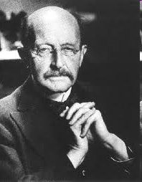
Max Planck 1858-1947
1900 Planck: “atoms absorb or release energy in ‘discrete’ (or fixed) amounts”.
quantum – the smallest amount of energy an atom can absorb or release

Slide 12


quantized – only certain, fixed energies are allowed
continuous – any energy is allowed
continuous
quantized

Slide 13
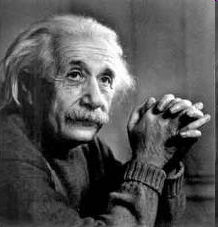
Albert Einstein 1879-1955
1905 Einstein: “light exists as a tiny particles”
photon – the smallest particle of electromagnetic radiation (or light)

Slide 14
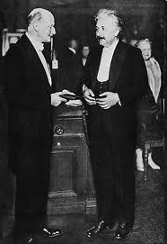
E = hν
E = energy of a photon
h = Planck’s constant
h = 6.626 x 10⁻³⁴ J·sec

Slide 15
What is light ?
Is light a wave ?
YES !
Is light a particle ?
YES !
wave-particle duality theory – sometimes light exhibits properties of a wave, and at other times it exhibits properties of a particle
c = λν
E = hν

Slide 16
c = λν
E = hν
hc
λ
E =
How much energy (in Joules) does a photon of 555.4 nm possess ?

Slide 17

continuous spectrum – all colors in the visible spectrum where one color bleeds into the next with no discontinuity

Slide 18
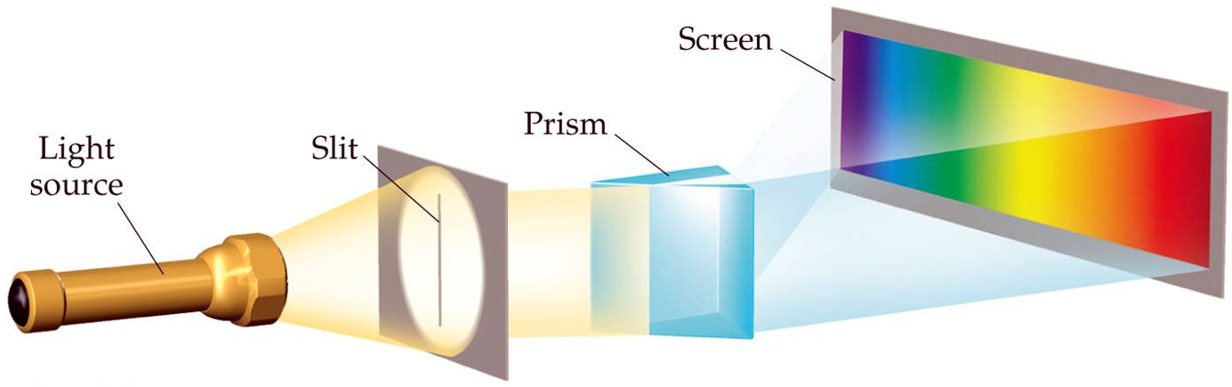
Notes:
Figure: 06-10
Title:
Creating a spectrum.
Caption:
A continuous visible spectrum is produced when a narrow beam of white light is passed through a prism. The white light could be sunlight or light from an incandescent lamp.

Slide 19
emission spectrum – light emitted from an excited species
Notes:
Figure: 06-11a
Title:
Atomic emission.
Caption:
Different gases emit light of different characteristic colors upon excitation by an electrical discharge. Hydrogen is in this tube.

Slide 20
resulting line spectrum
Hydrogen discharge tube
line spectrum – light of only certain wavelengths (or colors) are observed

Slide 21
The line spectrum of hydrogen
The line spectrum of sodium
The line spectrum of neon

Slide 22
Niels Bohr 1885-1962
quantized – restricted to certain, fixed values or places
n | distance from nucleus
1 | 53 pm
2 | 212 pm
3 | 476 pm
4 | 846 pm
5 | 1323 pm

Slide 23
The Bohr Model of the Atom
- electrons are found at specific, fixed distances from nucleus
- the energy the electron possesses is defined by this distance

Slide 24
n = 2 (or higher)
n = 1
absorb E
n = 1
release E
ground state – e⁻ in atom are in the lowest energy state possible (closest to the nucleus)
excited state – e⁻ in atom are promoted to higher energy states (further from the nucleus)

Slide 25
when an electron returns from the excited state back down to the ground state, it releases (or emits) energy in the form of a photon of light
the wavelength (or color) of the photon is indicative (or representative of) the energy difference (or gap) between the orbitals where the transition occurred

Slide 26
Electron transitions between quantized orbitals
n = 2
absorb E
release E
n = 1
excitation
emission

Slide 27
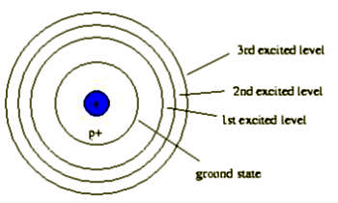
but why different photons ?
ex. hydrogen has 4 different lines
red photon with λ= 656 nm
turquoise photon with λ= 486 nm
purple photon with λ= 434 nm
Notes:
Figure: 06-12a, b
Title:
Line spectra.
Caption:
Spectra obtained from the electrical discharge from (top) Na, (bottom) H. Light of only a few specific wavelengths are produced, as shown by colored lines in the spectra.

Slide 28
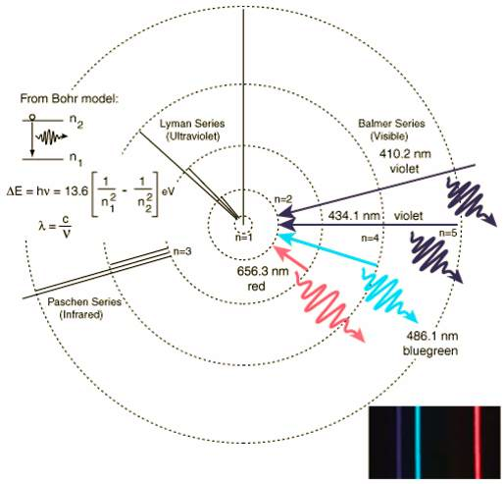
Real Story !

