Slide 1
solution – homogeneous mixture of 2 or more substances
solvent – largest component of mixture
solute – smaller component of mixture
aqueous solution – a solution where H₂O is the solvent

Slide 2
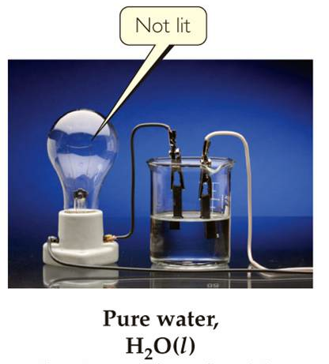
Pure water does NOT conduct electricity

Slide 3
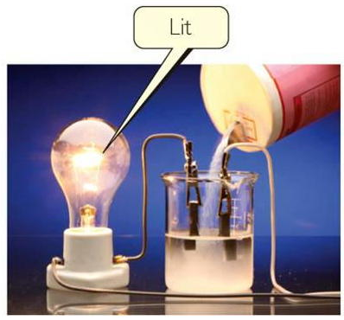
An aqueous solution of NaCl DOES conduct electricity
electrolyte – substance whose aqueous solution
conducts electricity

Slide 4
dissociation – when a compound separates into ions in solution
H₂O
NaCl (s) Na⁺ (aq) + Cl⁻ (aq)

Slide 5
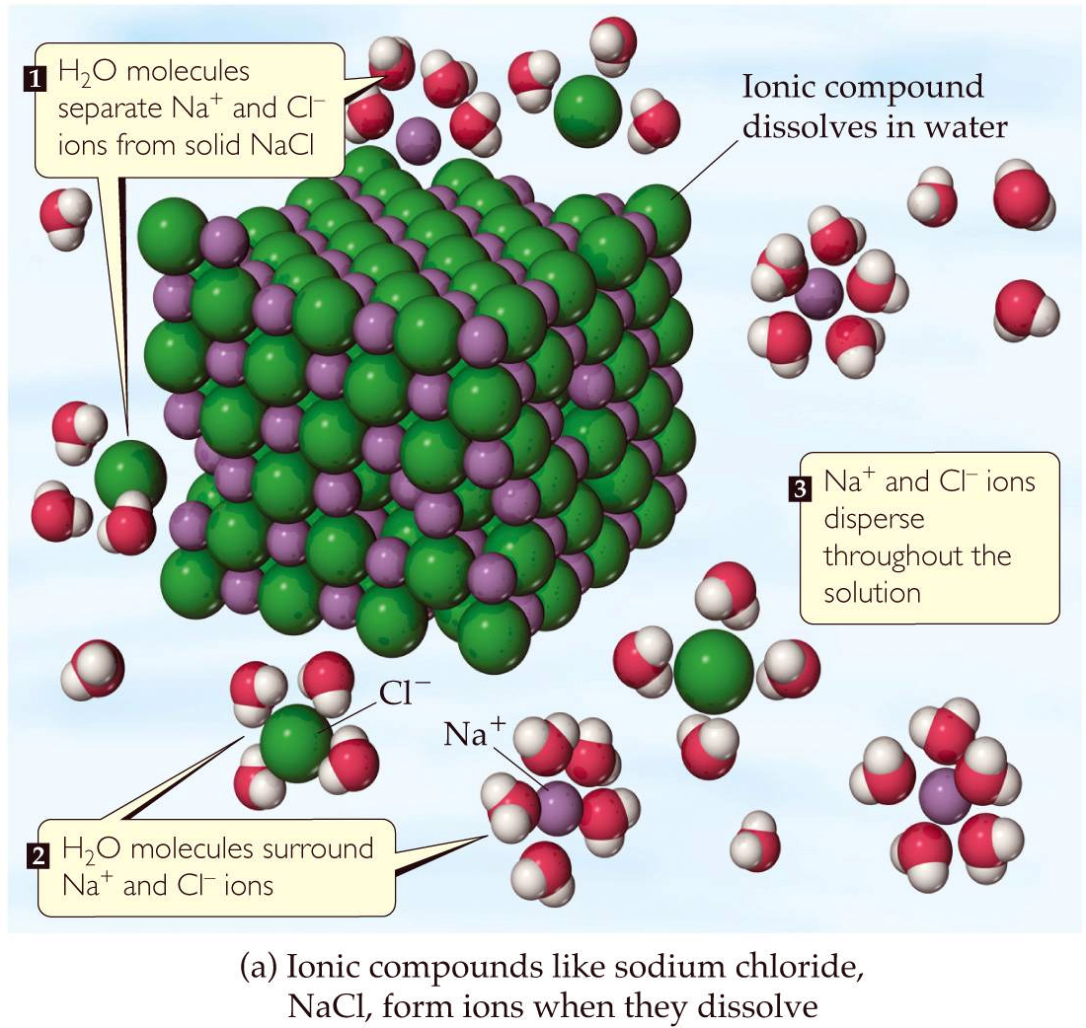

Slide 6
hydration – when water surrounds and interacts with charged ions in solution

Slide 7
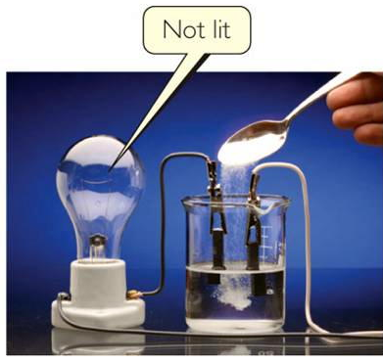
An aqueous solution of sugar, C₁₂H₂₂O₁₁ (aq)
Does Not conduct electricity
nonelectrolyte – substance whose aqueous solution does NOT conduct electricity

Slide 8
- most soluble ionic species act as electrolytes
- most soluble molecular species act as nonelectrolytes

Slide 9
precipitation reactions – solid precipitate forms during the reaction
precipitate – insoluble solid
molecular equation – substances are written as if they are complete, molecular species, even though they may exist as ions in solution
complete ionic equation – substances are written showing how they actually exist in solution

Slide 10
spectator ions – ions which remain “unchanged” on both sides of the arrow. They do NOT take part in the precipitation portion of the reaction
net ionic equation – reaction where spectator ions are cancelled
All reactions must mass balance and charge balance

Slide 11
1. Soluble compounds contain:
alkali metals: Li⁺, Na⁺, K⁺, Rb⁺, Cs⁺
ammonium: NH₄⁺
nitrates: NO₃⁻
acetates: C₂H₃O₂⁻ or CH₃COO⁻
halides: Cl⁻, Br⁻ , I⁻ (except when the halide
is attached to Ag⁺ or Pb²⁺, then it’s insoluble)
sulfates: SO₄²⁻ (except when the sulfate is attached to Ag⁺, Pb²⁺, Ca²⁺, Sr²⁺, or Ba²⁺,
then it’s insoluble)

Slide 12
2. Insoluble compounds contain:
carbonates: CO₃²⁻
phosphates: PO₄³⁻
sulfides: S²⁻
except when attached to an alkali metal or ammonium, then it’s soluble
hydroxides: OH⁻ (except when the hydroxide is attached to an alkali metal or Ba²⁺, then it’s soluble)

Slide 13
precipitation reactions often undergo an exchange reaction
AX + BY AY + BX
A and B are cations
X and Y are anions
AgNO₃ + KBr
AgBr + KNO₃

Slide 14
Determine the products and write the:
1. Complete ionic equation;
2. Net ionic equation;
3. Molecular equation for:
Pb(NO₃)₂ + KI
???

Slide 15
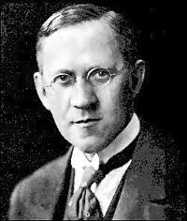
Brønsted–Lowry acid/base definition
Johannes Brønsted
1879 – 1947
Thomas Lowry
1874 – 1936

Slide 16
Brønsted–Lowry acid – chemical substance that acts as a proton donor (species that produces H⁺)
H₂O
HCl H⁺ (aq) + Cl⁻ (aq)
Brønsted–Lowry base – chemical substance that acts as a proton acceptor (species that takes in H⁺)
H⁺ (aq) + OH⁻ (aq) H₂O

Slide 17
strong acid – an acid that completely, 100% dissociates into ions in aqueous solution
H₂O
HCl H⁺ (aq) + Cl⁻ (aq)
6 common strong acids: HCl, HBr, HI,
HNO₃, H₂SO₄, HClO₄

Slide 18
HCl (aq)
hydrochloric acid
HBr (aq)
hydrobromic acid
HI (aq)
hydroiodic acid
HNO₃ (aq)
nitric acid
H₂SO₄ (aq)
sulfuric acid
HClO₄ (aq)
perchloric acid

Slide 19
strong base – a base that completely, 100% dissociates into ions in aqueous solution
H₂O
NaOH (s) Na⁺ (aq) + OH⁻ (aq)
6 common strong bases: LiOH, NaOH, KOH, RbOH, CsOH, Ba(OH)₂

Slide 20
LiOH
lithium hydroxide
NaOH
sodium hydroxide
KOH
potassium hydroxide
RbOH
rubidium hydroxide
CsOH
cesium hydroxide
Ba(OH)₂
barium hydroxide

Slide 21
neutralization reaction – acid and base neutralize each other and form a salt and water
acid + base salt + water

Slide 22
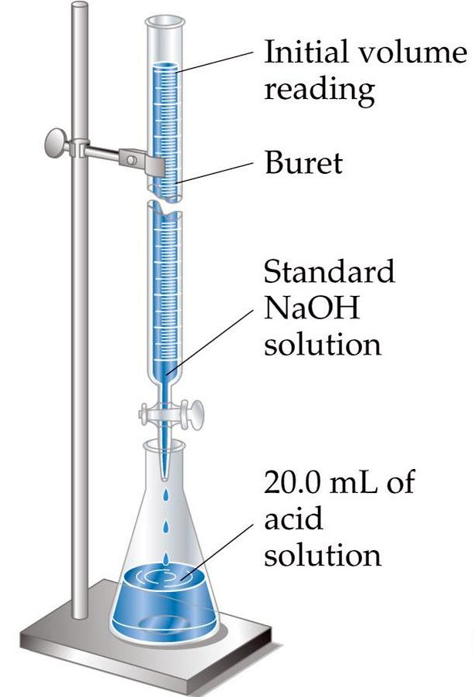
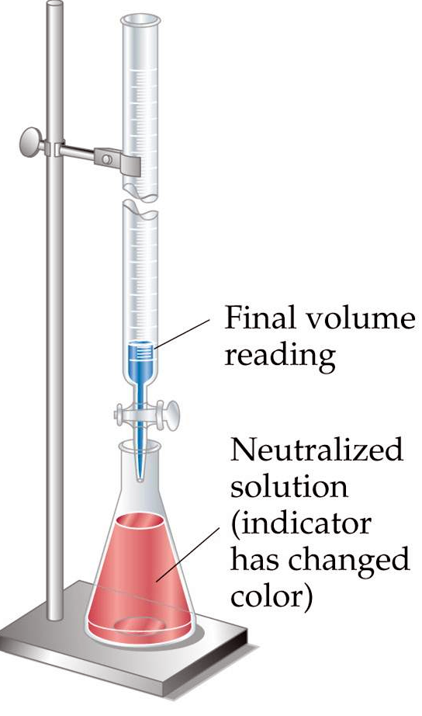
endpoint
Notes:
Figure: 04-20

Slide 23
concentration, [ ] – specific ratio of solute to solvent
moles solute
L solution formed
molarity, M =
* denominator is NOT liters of solvent…..
but rather liters of solution formed

Slide 24
Describe the preparation of a 1.00 M C₁₂H₂₂O₁₁ (aq) solution
Weigh out 342.296 g C₁₂H₂₂O₁₁ (sugar) and dissolve in enough DI water to form a 1.00 L C₁₂H₂₂O₁₁ (aq) solution.
Mix well and serve !

Slide 25
3.870 g of calcium chloride is dissolved in enough water to make a 125.0 mL aqueous solution. What is the molarity of this aqueous calcium chloride solution ?

Slide 26
A highly useful manipulation of molarity, M
( M ) (volume in L) = moles
or
M x V = moles
M x L = moles
moles
L
M =
moles
L
(L)
= moles
Notes:
Figure: 04-06

Slide 27
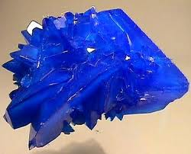
copper(II) sulfate pentahydrate is a beautiful blue compound that is highly water soluble. Describe the preparation of 225.0 mL of 0.345 M aqueous copper(II) sulfate solution ?
M x L = moles

Slide 28
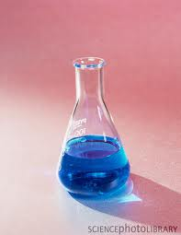
Weigh out 19.4 g CuSO₄∙5H₂O and dissolve in enough DI water to form a total of 225.0 mL of solution. Mix well and serve. The resulting solution is 0.345 M CuSO₄ (aq)

Slide 29
A patient requires 2.06 g KCl (s) to stabilize potassium levels in the blood. A standard aqueous KCl IV bag contains 0.0602 M KCl (aq). How many mL of IV fluid does the patient need ?
M x L = moles
moles
M
L =

Slide 30
dilute – make a solution less concentrated by adding solvent
(M _{conc}) (V_{conc}) = (M _{dil}) (V_{dil})
M _{conc} = molarity of the more concentrated solution
(initial concentration)
V _{conc} = volume of M _{conc}
M _{dil} = molarity of the less concentrated solution
(final, diluted concentration)
V _{dil} = volume of M _{dil} (final, total volume of diluted solution)

Slide 31
Describe the preparation of 400.0 mL of
0.220 M C₁₂H₂₂O₁₁ (aq) solution from a
1.00 M C₁₂H₂₂O₁₁ (aq) stock solution.
obtain 88.0 mL of 1.00 M C₁₂H₂₂O₁₁ (aq)
add enough water to form a total, final volume of 400.0 mL (that is, add 312.0 mL of water to the 88.0 mL of 1.00 M C₁₂H₂₂O₁₁ (aq)
mix well….. and serve !

Slide 32
Water runoff from an abandon mine is suspected of containing Cr³⁺ (a serious heavy metal carcinogenic toxin). A 402.95 mL sample of this mine drainage solution was titrated with NaOH (aq) . 29.54 mL of 0.384 M NaOH (aq) was required to precipitate out all of the Cr³⁺ from the solution in the form of Cr(OH)₃ (s).
1. Determine the molar [Cr³⁺] in the mine drainage solution.
2. Determine the mass (in grams) of the
Cr(OH)₃ (s) that precipitated out of solution.

Slide 33
A container containing an aqueous solution is found on the shelf and is labeled “KOH (aq)”.
26.52 mL of 0.383 M H₂SO₄ (aq) is required to completely neutralize 35.17 mL of the KOH solution. What is the molarity of the KOH (aq) solution ?

