Slide 1
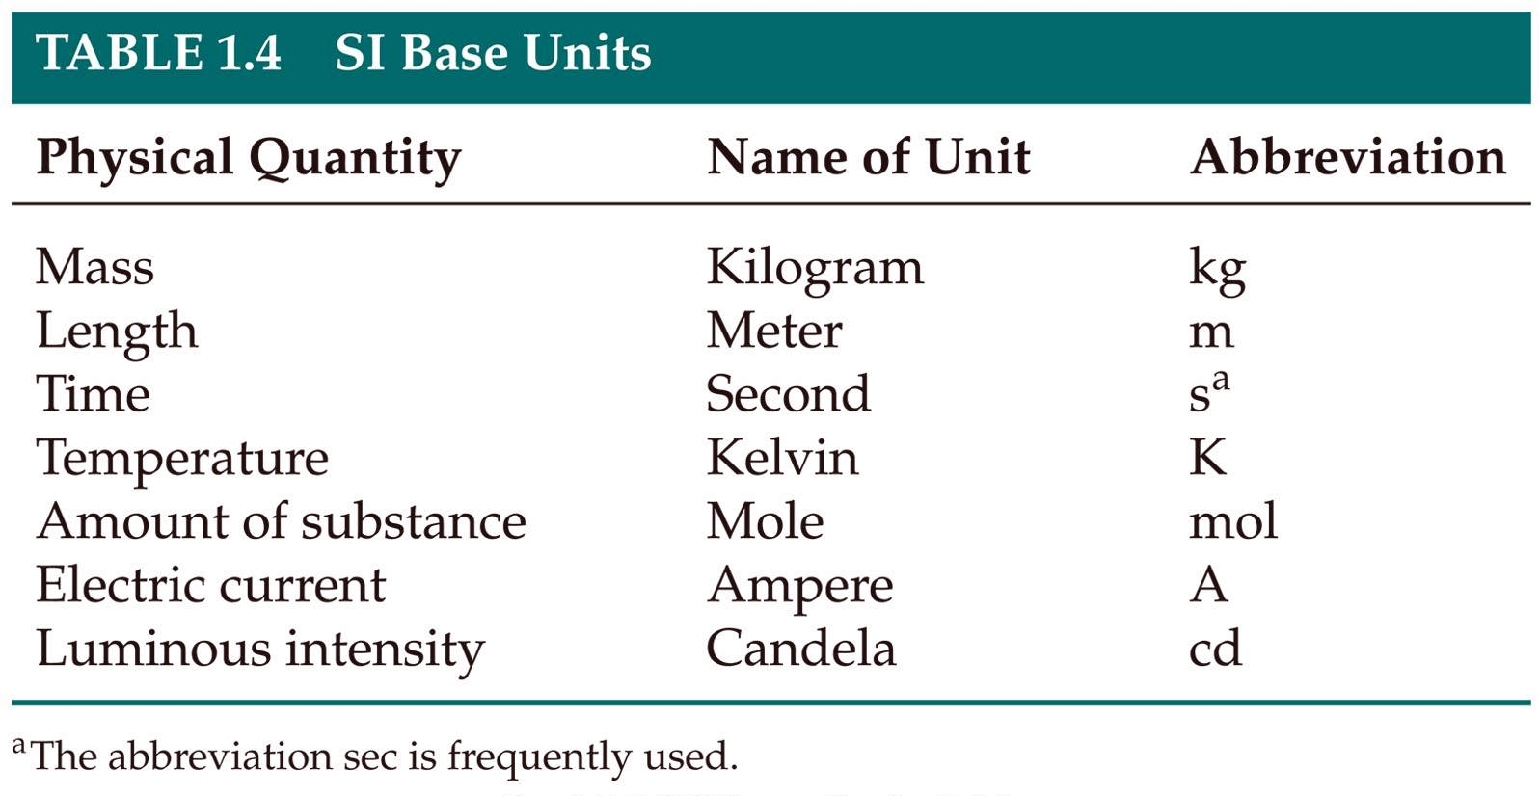
base units – defined units (by definition)
derived units – units obtained from the manipulation of base units
Notes:
Figure: 01-T04
Title:
Table 1.4
Caption:
SI Base Units

Slide 2
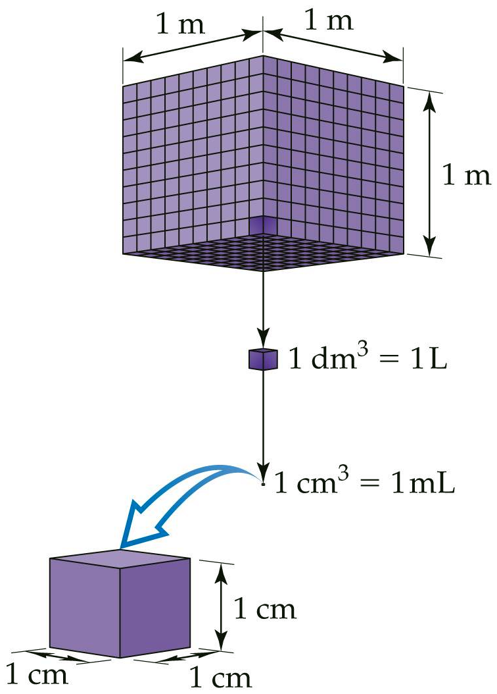
Notes:
Figure: 01-19
Title:
Volume relationships.
Caption:
The volume occupied by a cube that is 1 m on each edge is a cubic meter, 1 m³ (top). Each cubic meter contains 1000 dm³ (middle). A liter is the same volume as a cubic decimeter, 1 L = 1 dm³. Each cubic decimeter contains 1000 cubic centimeters, 1 dm³ = 1000 cm³. Each cubic centimeter equals a millimeter, 1 cm³ = 1 mL (bottom).

Slide 3
Notes:
Figure: 01-T05
Title:
Table 1.5
Caption:
Selected Prefixes Used in the Metric System

Slide 4
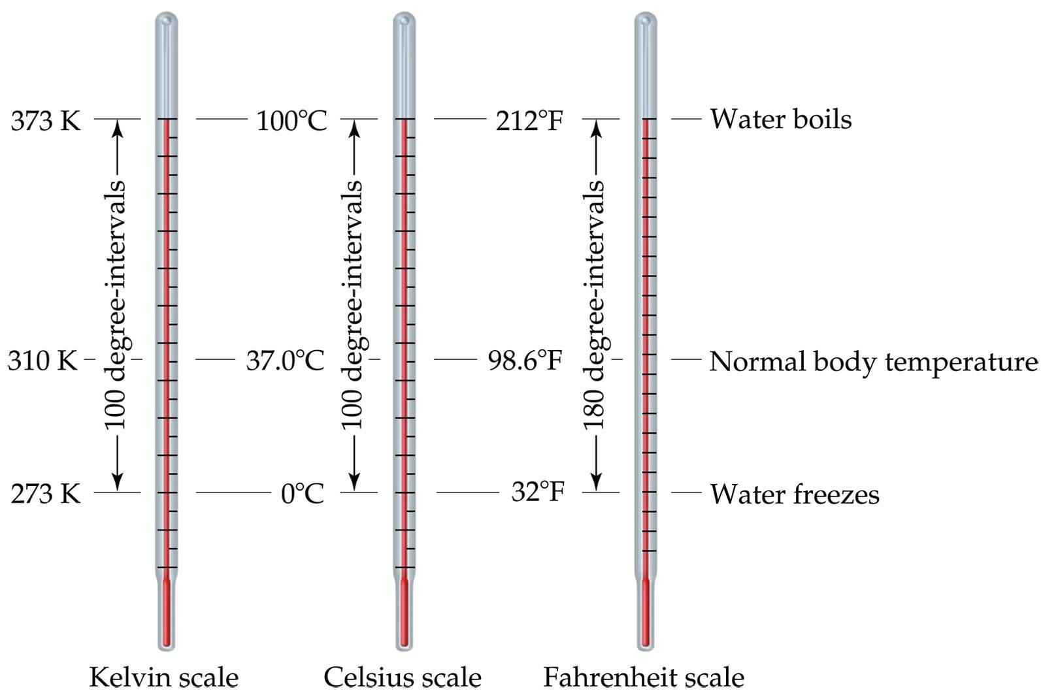
temperature - measure of heat content
Notes:
Figure: 01-18
Title:
Comparison of the Kelvin, Celsius, and Fahrenheit temperature scales.
Caption:
The freezing point and boiling point of water as well as normal human body temperature is indicated on each of the scales.

Slide 5
Fahrenheit ºF Celsius ºC Kelvin K

Slide 6
K = ºC + 273.15
ºF = 9/5 (ºC) + 32

Slide 7
*Every physical measurement has some degree of uncertainty
Significant Figure – a numerical value whose digits are known “for sure” but whose last digit has some degree of “uncertainty”
When rounding numbers after calculations, must pay attention to sig figs so that you don’t overstate the accuracy of the final answer

Slide 8
Significant figure rules
Non-zero digits are always significant
Zero’s that are imbedded in-between significant digits are always significant
Zero’s at the beginning of a number (called leading zero’s) are NOT significant
Zero’s at the end of a number (called trailing zero’s) are only significant if the number has a decimal point specified
Exact numbers (things that are easily counted or are defined by definition) have an infinite number of significant figures

Slide 9
Significant Figures in calculations
addition & subtraction – final answer must have the same number of decimal places as the number with the least significant decimal place used in the calculation
multiplication & division – final answer must have the same number of significant figures as the number with the least amount of sig figs used in the calculation

Slide 10
When performing a series of calculations, do NOT round each step to the correct number of sig figs. Keep ALL numbers in your calculator and adjust the FINAL answer to the correct number of sig figs at the very end !

Slide 11
Density – mass of an object per unit volume of that object
m
V
m = grams
d =
V = mL or cm³
What is the density of an iron bar that weighs 64.201 g and occupies a volume of 8.16 mL ?

Slide 12
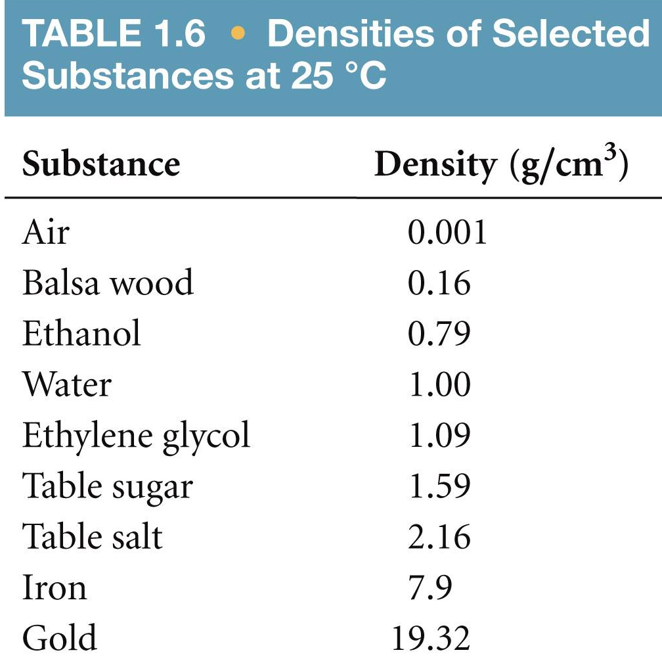
intensive property – independent of amount
extensive property – dependent on amount

Slide 13
Dimensional Analysis or Unit Analysis or Factor-label method
This is the single most important concept for YOUR success in this course !!!!!!!
☺

Slide 14
☹  


Slide 15
How many cm are in 2.64 meters ?
2.64 m ? cm
conversion factor – ratio that equals one

Slide 16
I weigh 168 lbs. How many kg do I weigh ?

Slide 17
The density of corn syrup is 1.38 g/mL. How many pounds (lbs) does 872.4 mL of corn syrup weigh ?

Slide 18
How many seconds are in 2.340 years ?

Slide 19
On September 25, 2010, relief pitcher Aroldis Chapman (with the Cincinnati Reds) threw a fastball that was clocked at 105.1 miles per hour. How many seconds did it take the baseball to travel the 60.5 feet to home plate ?

Slide 20
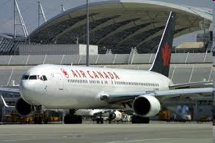
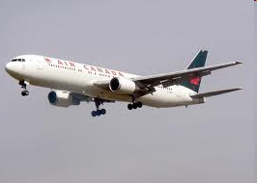
Air Canada flight 143 from Montreal to Edmonton in a Boeing 767 requires 49172 lbs of Jet-A fuel for the flight. How many gallons of fuel are required for this flight ? The density of Jet-A fuel is 0.803 g/mL.

Slide 21
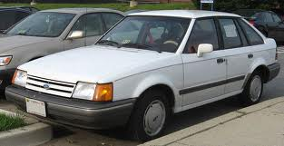
The engine size of a 1988 Ford Escort is 1.86 liters. What is this engine size in units of cubic inches, in³ ?

