Slide 1
atom – a tiny, neutral particle that makes up all matter
Particle | Charge | Discovered
electron, e⁻ | 1- (or -1) | 1897 J.J. Thomson
proton, p⁺ | 1+ (or +1) | 1911 E. Rutherford
neutron, nº | 0 | 1932 J. Chadwick

Slide 2
Ernest Rutherford
1871 - 1937

Slide 3
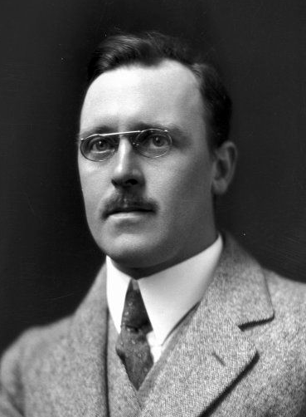
Hans Geiger
1882 - 1945
Ernest Marsden
1889 - 1970

Slide 4
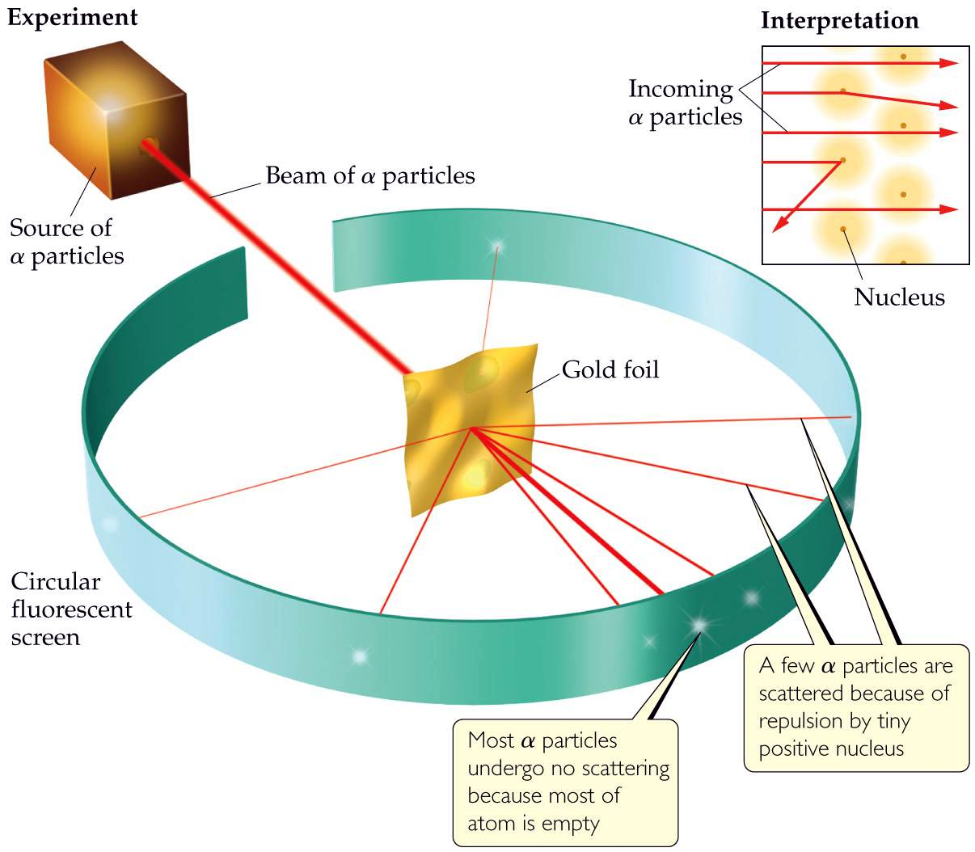
Notes:
Figure: 02-10
Title:
Rutherford's experiment on the scattering of α particles.
Caption:
The red lines represent the paths of the α particles. When the incoming beam strikes the gold foil, most particles pass straight through the foil but some are scattered.

Slide 6
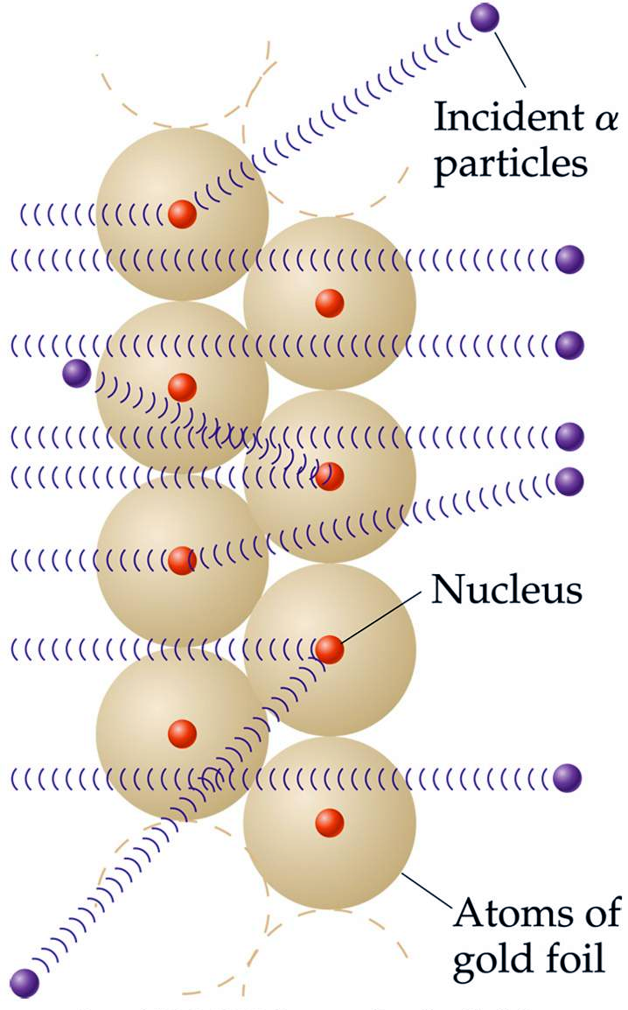
Notes:
Figure: 02-11
Title:
Rutherford's model explaining the scattering of α particles.
Caption:
The gold foil is several thousand atoms thick. Because most of the volume of each atom is empty space, most α particles pass through the foil without deflection. When an α particle passes very close to a gold nucleus, however, it is repelled, causing its path to be altered.

Slide 7
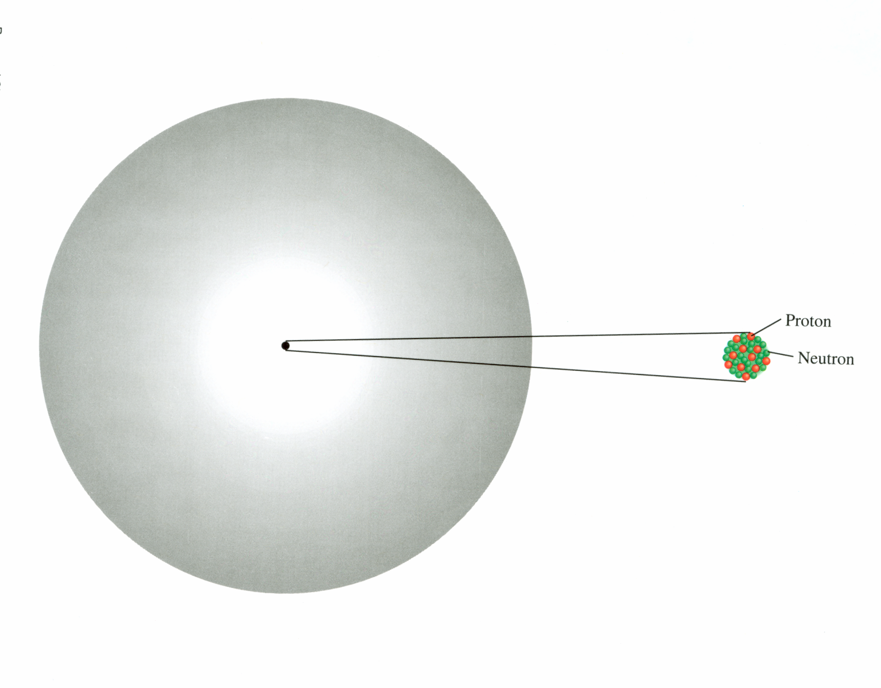
nucleus – tiny, dense core of an atom made up of p⁺ and nº

Slide 8
element – a type of matter made up of the same kind of atoms
compounds – stuff made up of different elements
atomic number, Z# – # of p⁺ in nucleus
mass number, A# – # p⁺ + # nº in nucleus

Slide 9
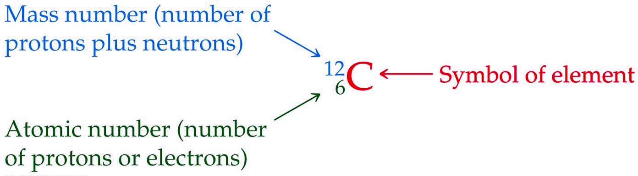
Notes:
Figure: 02-12-01un
Title:
Symbol of an element.
Caption:
Symbol of carbon showing the mass number and atomic number.

Slide 10
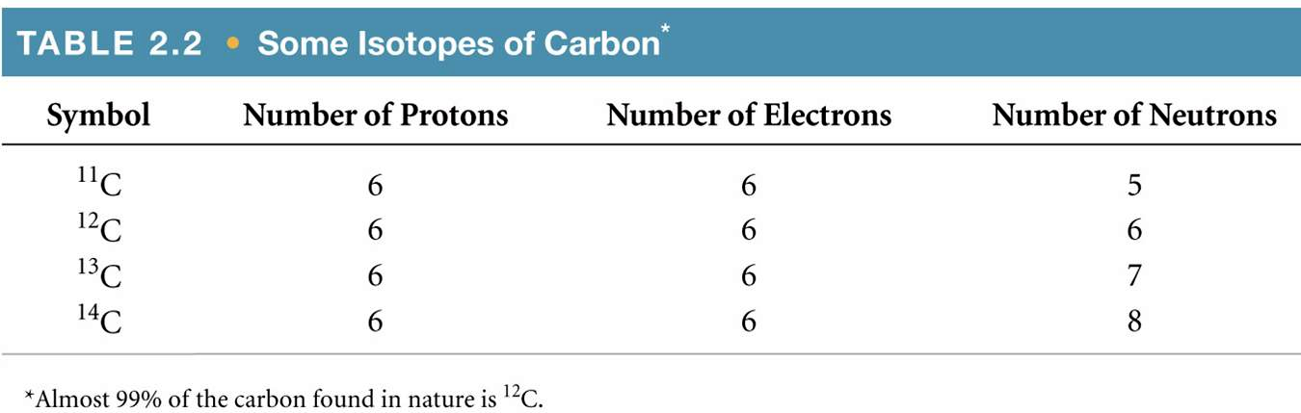
isotopes – atoms of same element
(same Z#) but different # nº
Notes:
Figure: 02-T02
Title:
Table 2.2
Caption:
Some Isotopes of Carbon

Slide 11
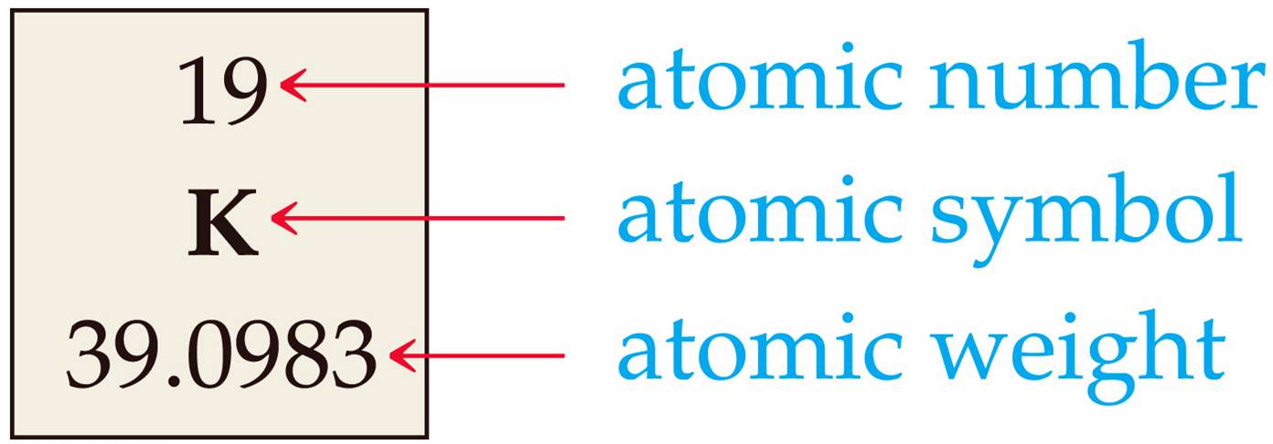
atomic weight – measure of an atom’s mass
(at. wt.)
atomic mass unit – 1 amu = 1.66 x 10⁻²⁴ g
(amu)

Slide 12
atomic weights (found on PT) are actually an “overall weighted average of existing isotopes”
There are two naturally occurring isotopes of lithium found in nature
atom | at. wt. | natural abundance
⁶Li | 6.0151 amu | 7.525 %
⁷Li | 7.0160 amu | 92.475 %

