Slide 1
UNITS !!!
Air Canada Flight 143 on July 23, 1983
Montreal to Edmonton

Slide 2
Facts
Boeing 767 had an inoperative electronic fuel gauge
Pilots knew needed 22,300 kg fuel for flight
Checked fuel with a dipstick-calibrated in liters
12,601 liters of fuel on board
How many kg does 12,601 L fuel weigh ?
Pilot asked the co-pilot for conversion factor
Co-pilot asked fuel guy … “What is the conversion factor from volume to mass?”
Fuel guy stated “1.77”

Slide 3
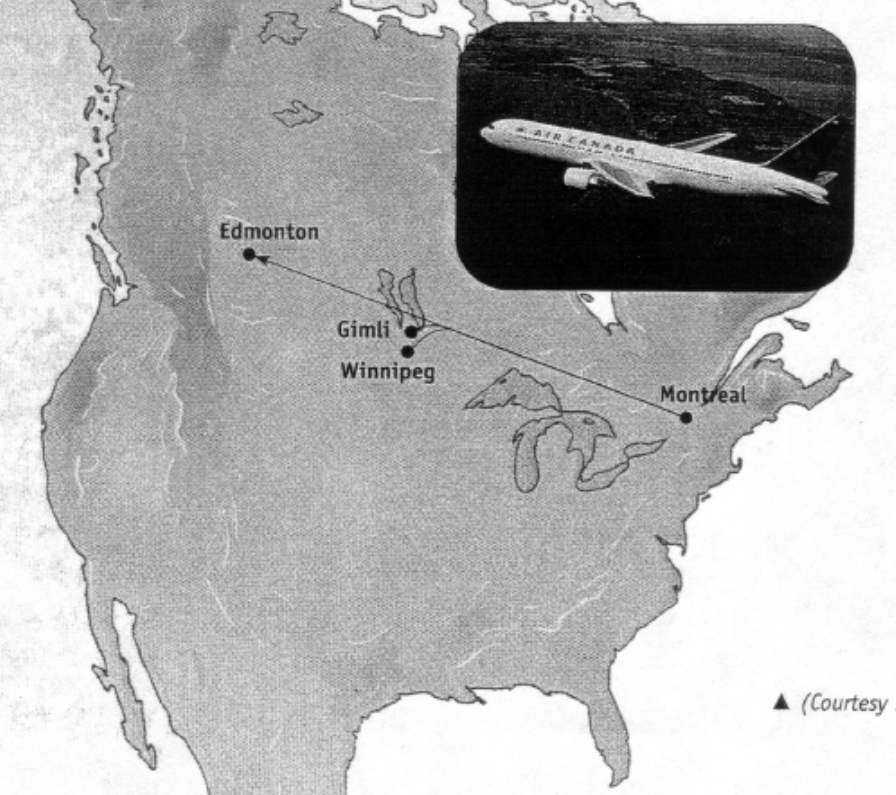
12,601 L x “1.77” = 22,304 kg
Recall 22,300 kg fuel needed for flight

Slide 4
At 28,000 feet, both engines quit
Closest large airport was Winnipeg
About 10 minutes into the glide, realized they were NOT going to make Winnipeg
Old abandoned air force base at Gimli turned into a race track
Pilots managed to muscle the 132 ton glider to Gimli
“Landed” at Gimli

Slide 5
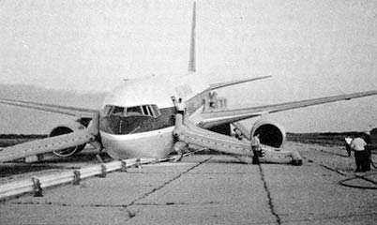
Main Gear locked but nose gear collapsed
No Major Injuries !!!

Slide 6
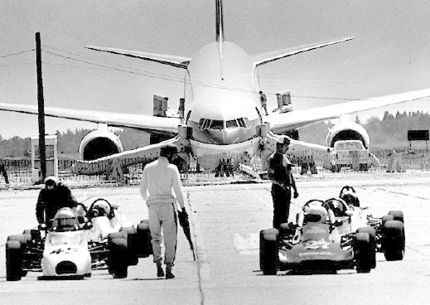

Slide 7
What Happened ?
The UNITS for the conversion factor was
1.77 lbs/L
Fight left

Slide 8
Flight required 22,304 kg fuel
Aircraft left with 10,115 kg fuel on board because of incorrect units

Slide 9
Pay Attention to
Units !!

