Slide 1
spontaneous process – any process, once started, proceeds without the external input of energy
nonspontaneous process – any process which requires the continual, external input of energy to keep the process going
any process that is spontaneous in one direction will be nonspontaneous in the reverse direction !

Slide 2
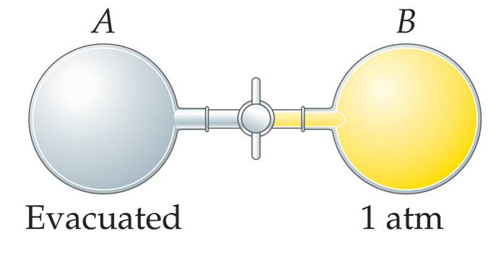
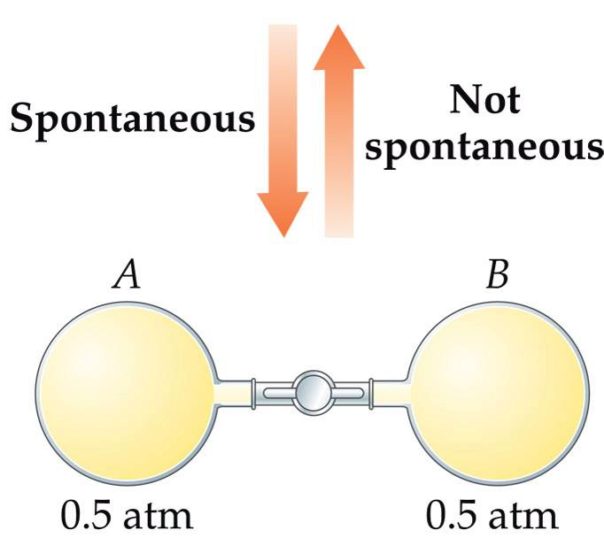
Notes:
Figure: 19-05

Slide 3
Spontaneous process tend to favor:
1. Decrease in Energy
2. Increase in Disorder

Slide 4
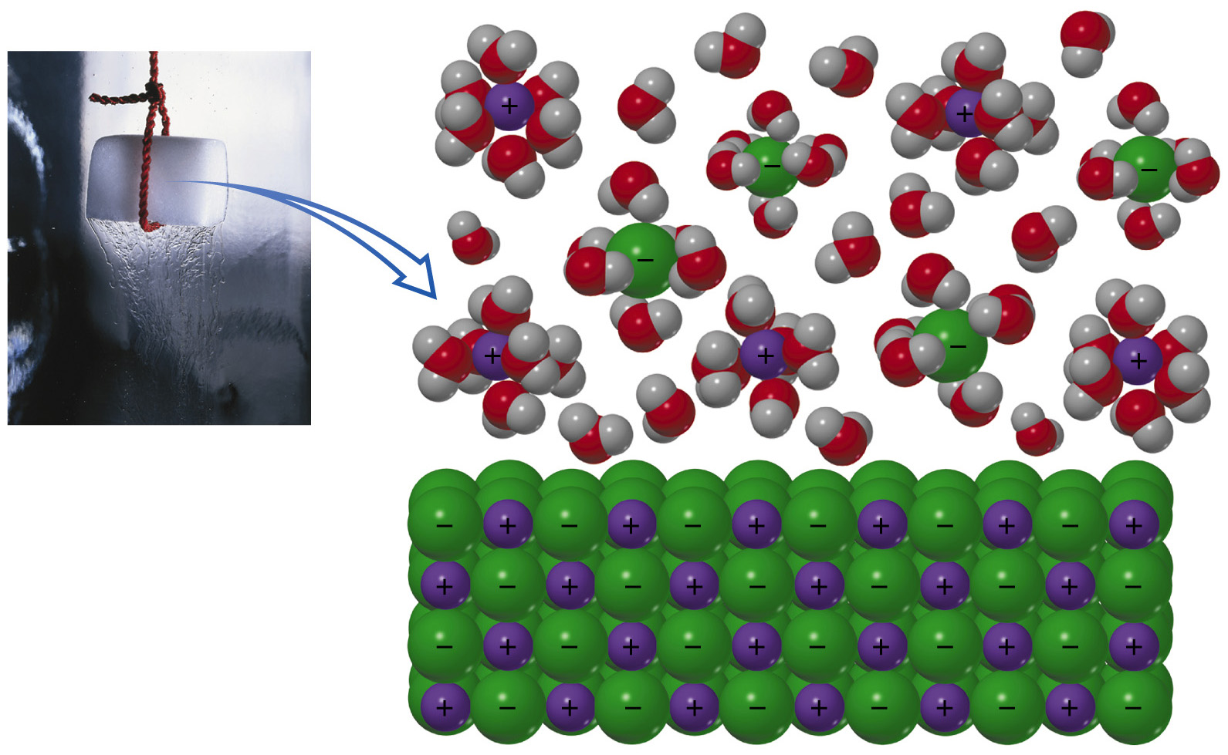
Notes:
Figure: 19-08

Slide 5
disorder is driven by statistical probability
statistical probability – refers to the number of possible arrangements of a system
a disordered state is more probable because it can be achieved in more statistical ways
the larger the number of different possible combinations, the greater the probability of getting a disordered state

Slide 6
there are 2,598,960 possible five-card poker hands

Slide 7
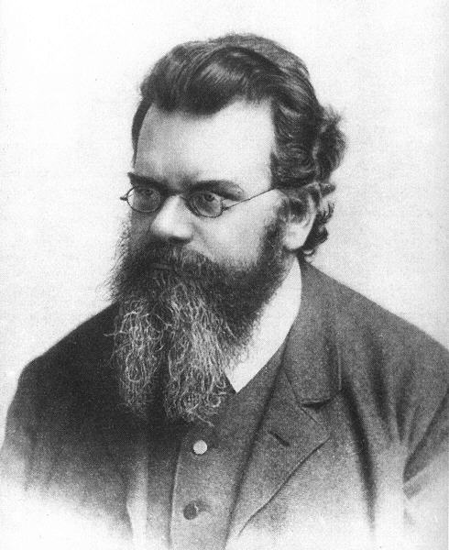
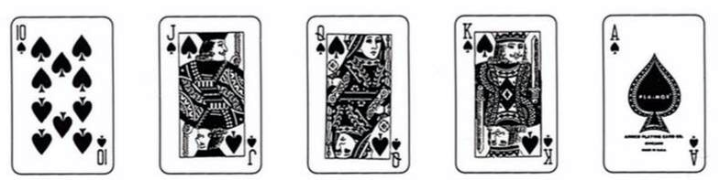
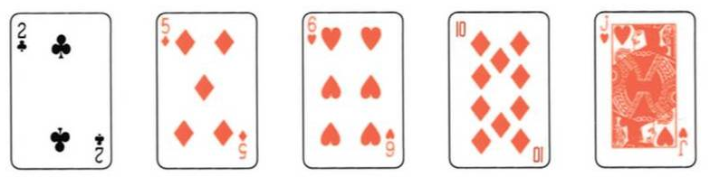
entropy, S – quantitative measure of disorder
Ludwig Boltzmann
1844 – 1906
less disorder
S = smaller #
more disorder
S = larger #

Slide 8
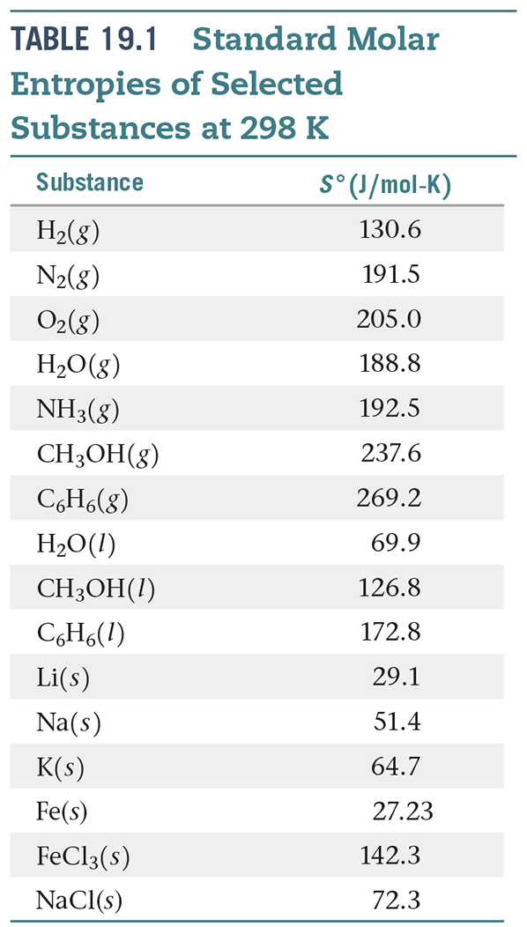
Notes:
Figure: 19-T02

Slide 9
order disorder is favored to occur spontaneously
order disorder
ΔS = + #
disorder order
ΔS = - #
2nd Law of Thermodynamics – the entropy of the universe is increasing over time

Slide 10
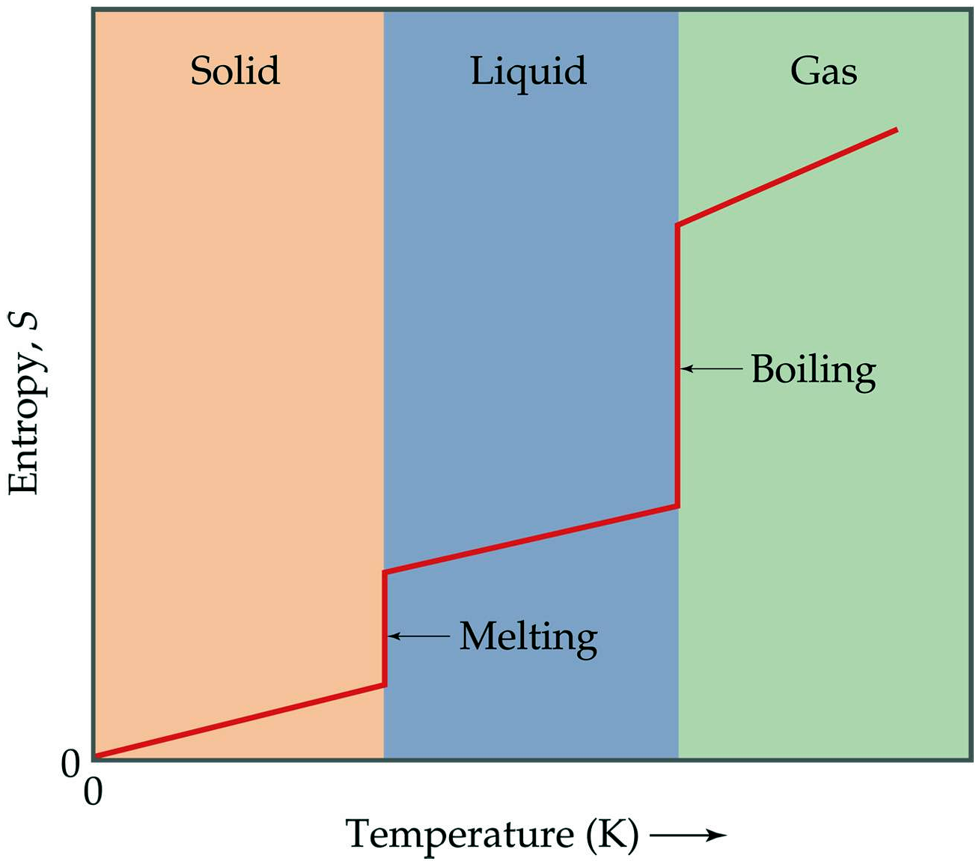
3rd Law of Thermodynamics – entropy decreases as temperature decreases (and vice-versa)

Slide 11
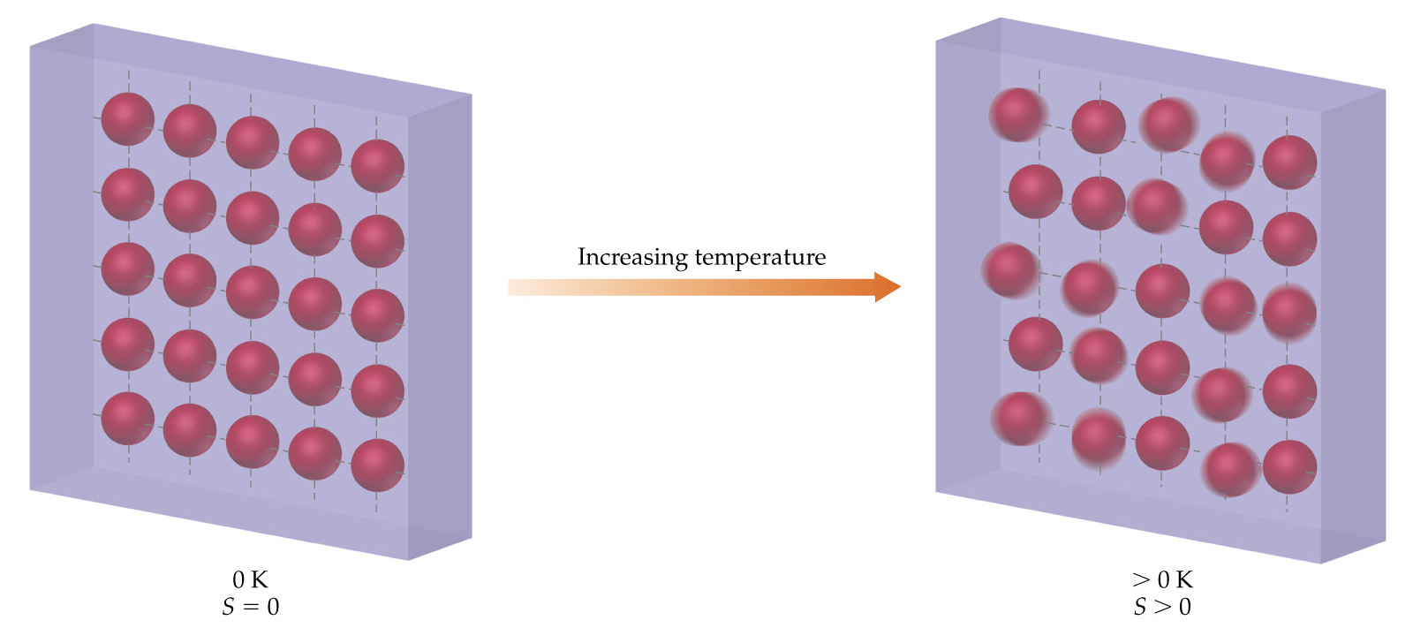

Slide 12
standard entropy of reaction – the ΔS (entropy, or disorder) that accompanies ANY reaction under standard conditions (units are J/K)
= [(sum S° products) – (sum S° reactants)]
1. write and balance the reaction
2. use table of thermodynamic data of S° to calculate
standard entropy, S° – disorder of a substance at standard conditions
(units are J/mole·K)
Notes:
Figure: 19-13

Slide 13
Determine the standard entropy of reaction,
2
N₂O (g) + O₂ (g) NO₂ (g)
3
4
= – 93.0 J/K
= – #, suggests the reaction is nonspontaneous

Slide 14
ΔH_{rxn} only slightly varies with temperature
ΔS_{rxn} is highly dependent on temperature
Recap: 2 forces in nature which drive processes to occur spontaneously
1. Decrease in energy ΔH_{rxn} = – # (exo)
2. Increase in disorder ΔS_{rxn} = + # (disorder)

Slide 15
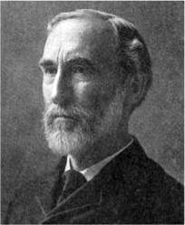
Willard Gibbs
1839 – 1903
ΔG_{rxn} = ΔH_{rxn} – T ΔS_{rxn}
ΔH_{rxn} is the heat of reaction
T is the temperature in Kelvin
ΔS_{rxn} is the entropy of reaction
ΔG_{rxn} is the Gibbs Free Energy

Slide 16
ΔG_{rxn} or Gibbs Free Energy, is the ultimate, final deciding factor as to whether a reaction will occur spontaneously, anywhere in the universe
Bottom Line:
When ΔG_{rxn} = – #, the reaction is spontaneous.
When ΔG_{rxn} = + #, the reaction is nonspontaneous.
When ΔG_{rxn} = 0, the reaction is at equilibrium (has no tendency to go one way or the other)

Slide 17
Is the following reaction spontaneous at 175 °C ?
N₂O (g) + O₂ (g) NO₂ (g)
2
3
4
= – 28.0 kJ
favors spontaneous
= – 93.0 J/K
favors nonspontaneous
Who wins ??
ΔG_{rxn} = ΔH_{rxn} – T ΔS_{rxn}
ΔG_{rxn} = +13.7 kJ
ΔG_{rxn} = + #, the reaction is nonspontaneous

Slide 18
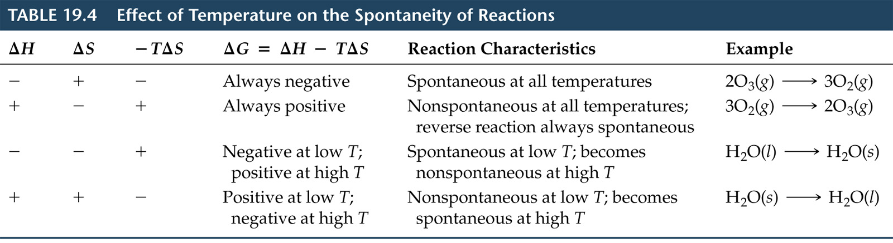
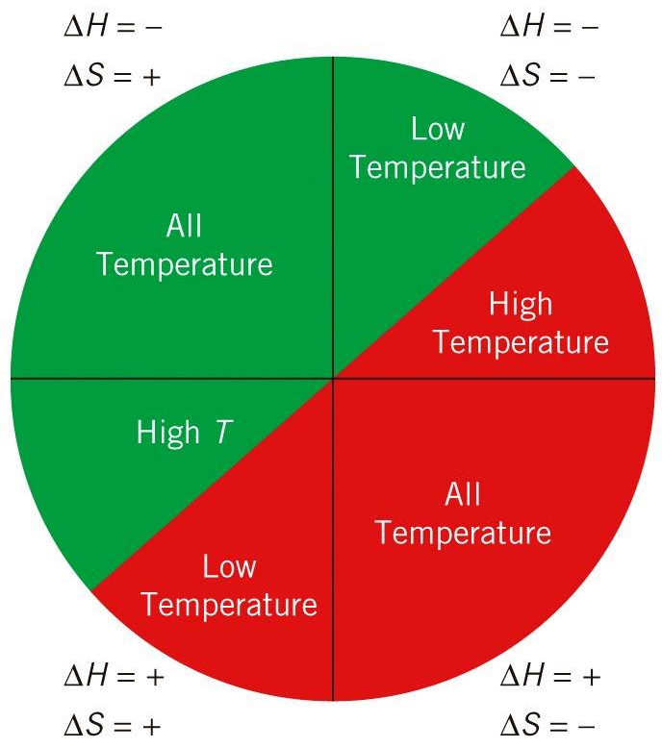






Notes:
Figure: 19-T04

