Slide 1
Land Snails of Africa University
Robert Wayne Van Devender

Slide 2
Major types of snails
Giant snails – 1 species
Euconulid snails – 4 species
Punctum-like snails – 1 species
Subulinid snails – 1 species not illustrated
Pupillid snails – 2 species
Bulimulid snails – 1 species
Gulella-like snail – 1 species
Leather slugs – 2? species
Normal slugs – 3 species
Total of 16 species

Slide 3
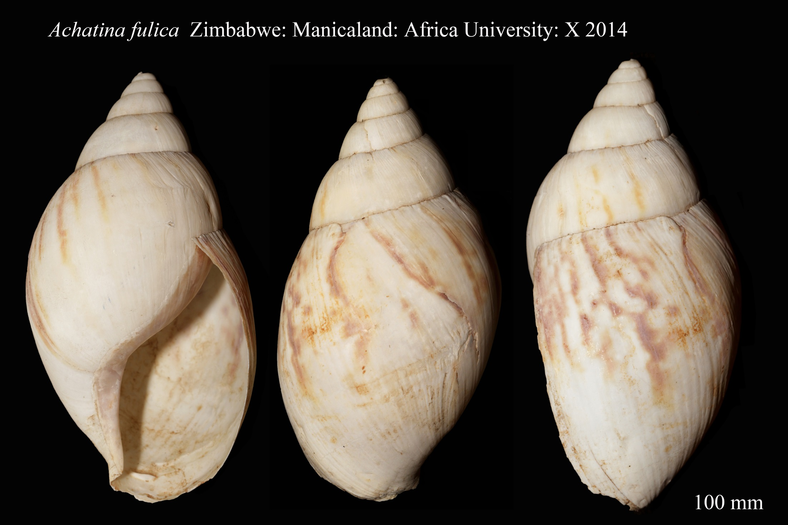
African Giant Snails
Notes:
100 mm in shell height
Bleached shell of moderate size

Slide 4
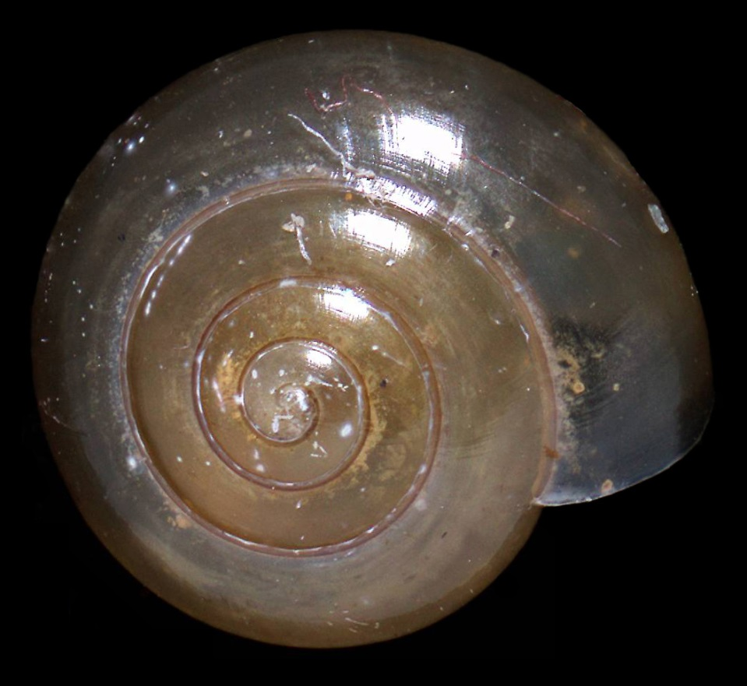
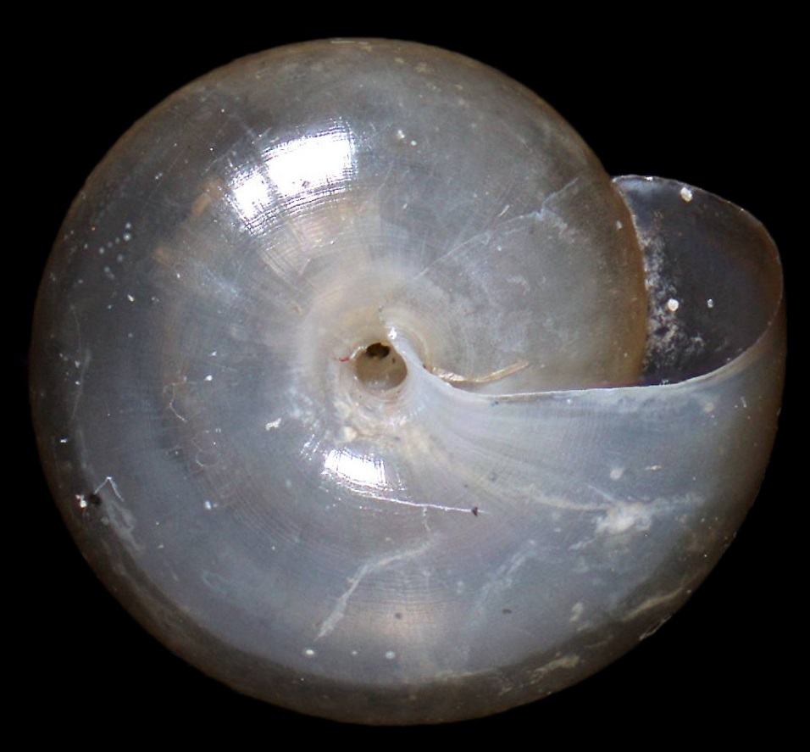
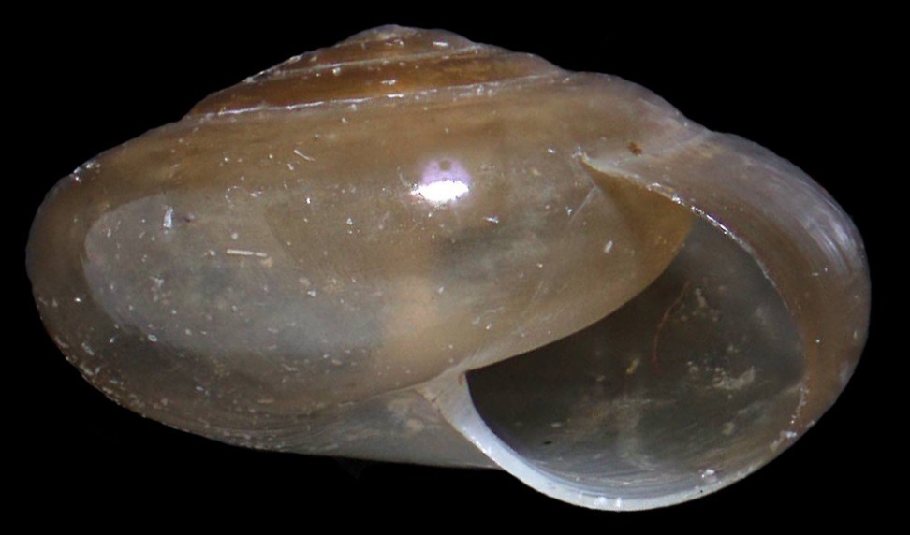
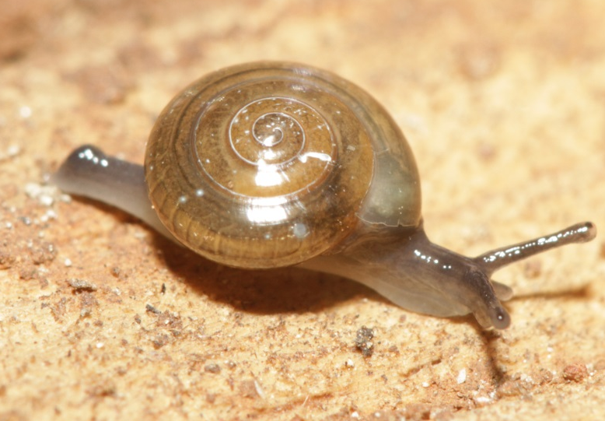
Euconuliid Snails
Shell width = 5 mm; 4.5 whorls
Notes:
Small snails with deeply incised grooves
Umbilicus deep and 7-8% of shell diameter
Shell height is about 60% of shell diameter

Slide 5
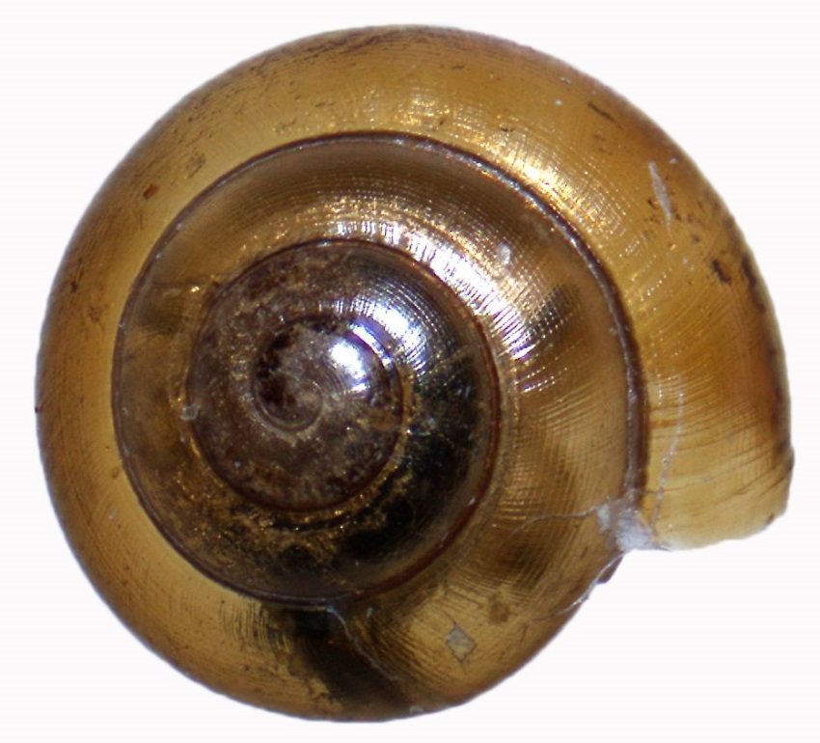
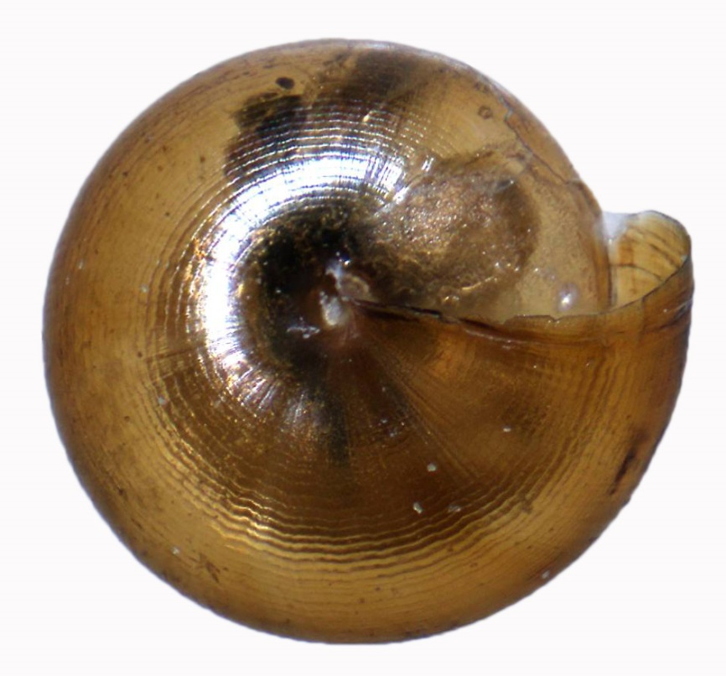
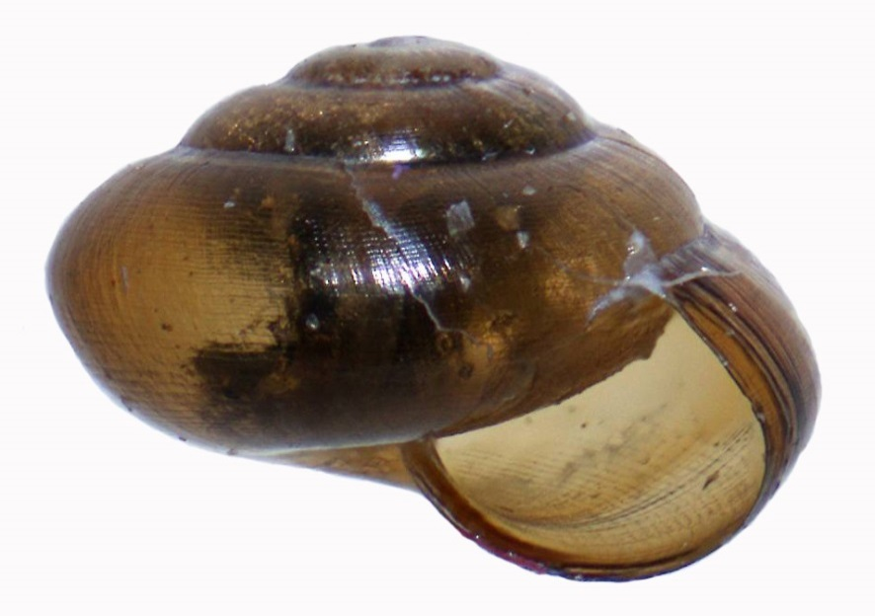
Euconuliid Snails
Shell width = 2 mm; 4 whorls
Notes:
Small snails with deeply incised grooves
Umbilicus about 3% of shell diameter
Shell height is about 70% shell diameter
Incised lines large and wavy on venter and smaller on dorsum

Slide 6
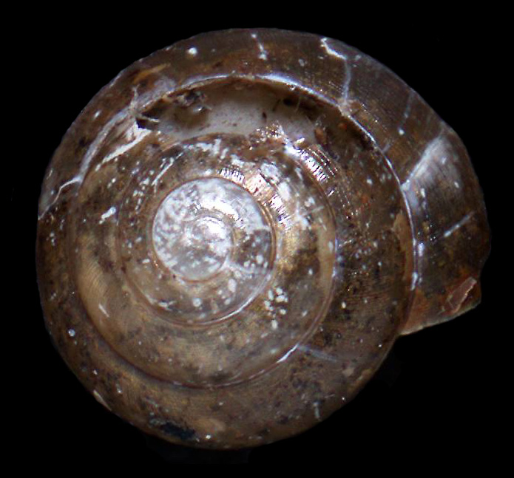
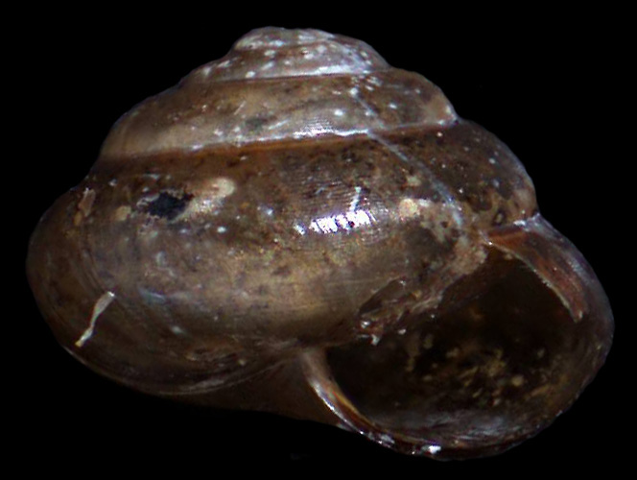
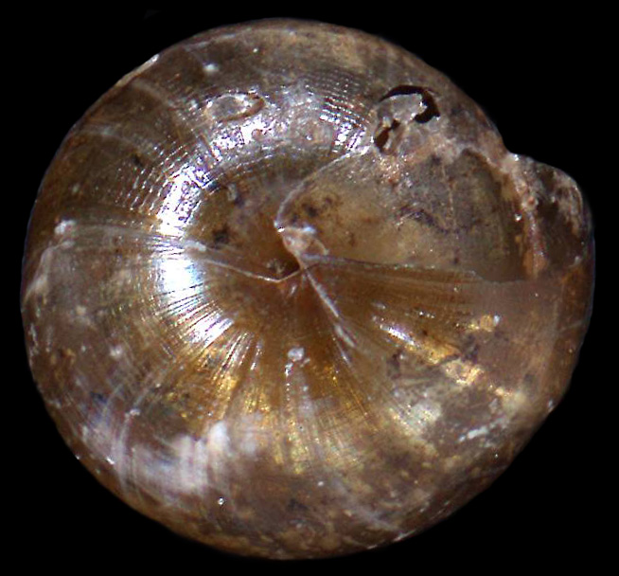
Euconuliid Snails
Shell width = 2.4 mm
4.5 whorls
Notes:
Small snails with deeply incised grooves
Umbilicus about 5% of shell diameter
Shell height is about 76% shell diameter
Incised lines large and wavy on venter and smaller on dorsum

Slide 7
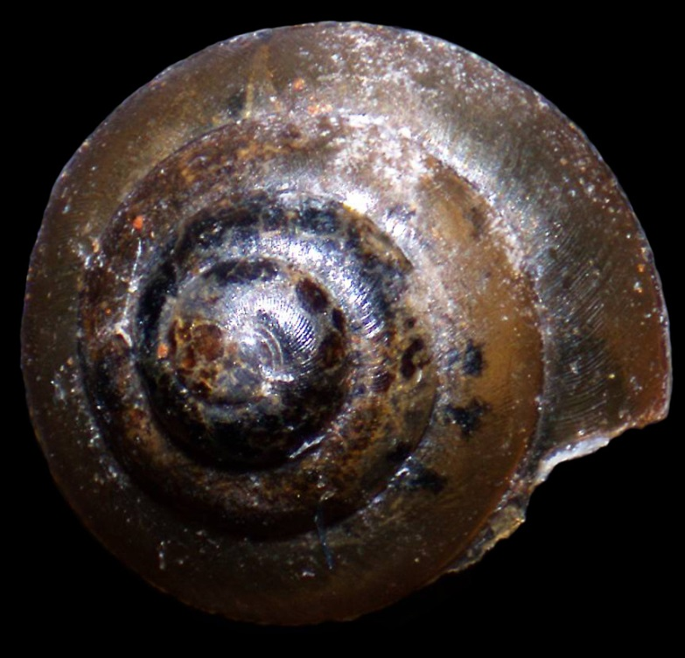
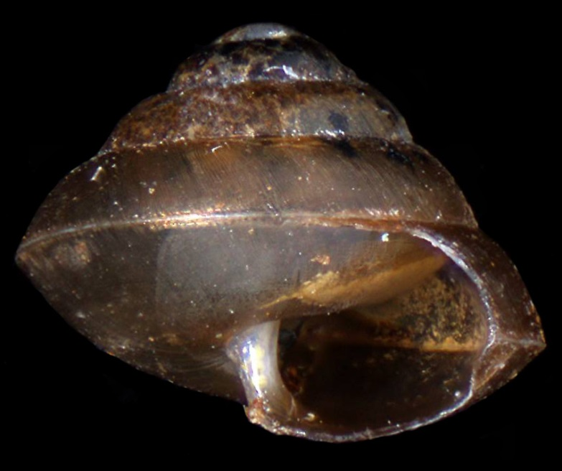
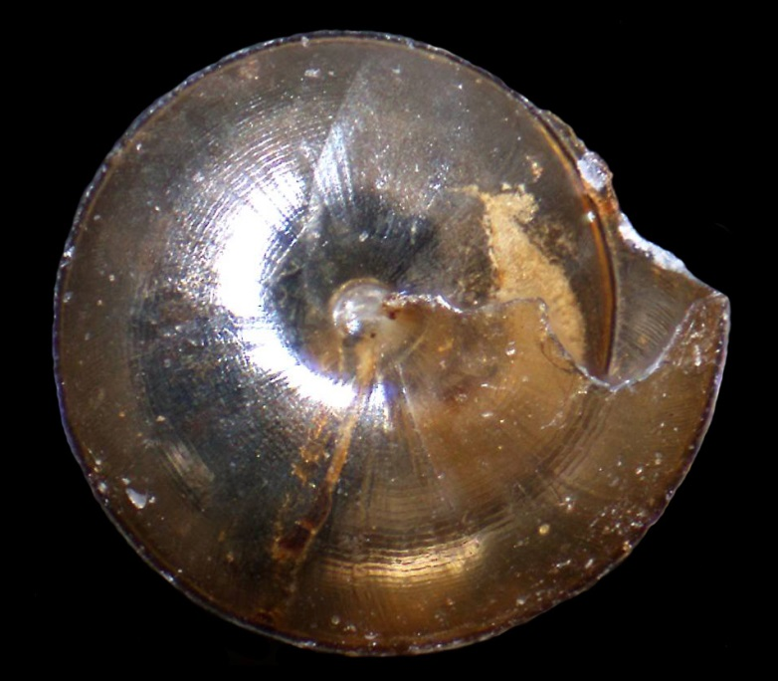
Euconuliid Snails
Immature
Shell width = 2.3 mm
4.3 whorls
Notes:
Small snails with deeply incised grooves
Umbilicus closed but about 7% of shell diameter
Periphery angular
Shell height is about 80% of shell diameter
Incused lines on venter large and wavy
Dorsal sculpture includes transverse striations as well as incised lines

Slide 8
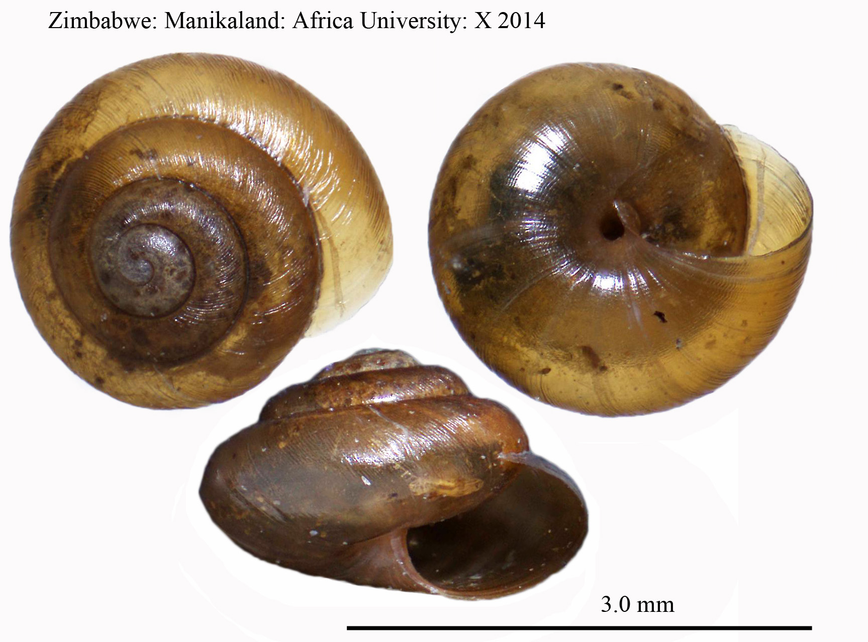
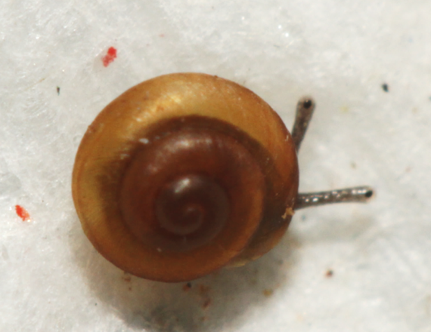
Punctum-like Snails
Notes:
Small snails with deeply incised grooves
Umbilicus closed but about 7% of shell diameter
Periphery angular
Shell height is about 80% of shell diameter
Incused lines on venter large and wavy
Dorsal sculpture includes transverse striations as well as incised lines

Slide 9
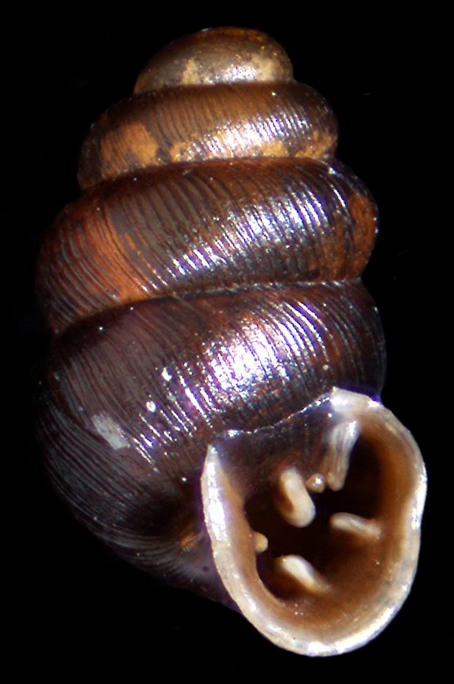
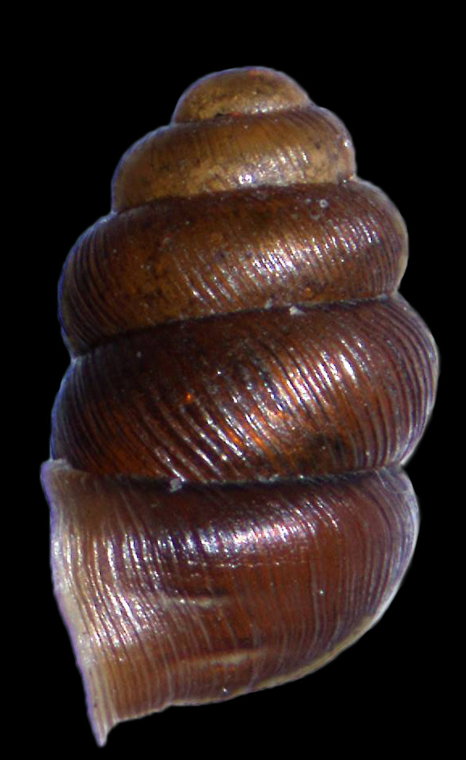
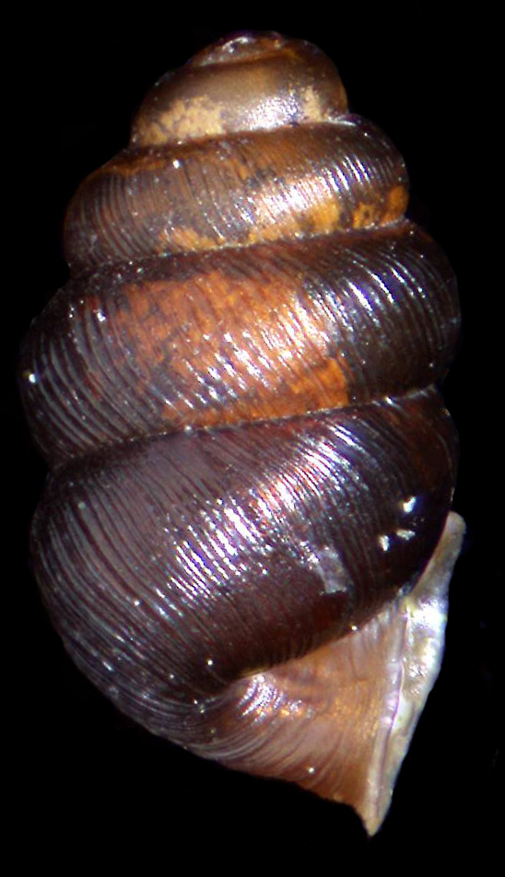
Pupillid Snails
Shell height = 1.7 mm
Shell width = 0.94 mm
4 whorls
Notes:
Shell dark brown with distinct ribbing
Angular lamella at an angle from corner of aperture towards parietal lamella
Two lamellae in palatal wall

Slide 10
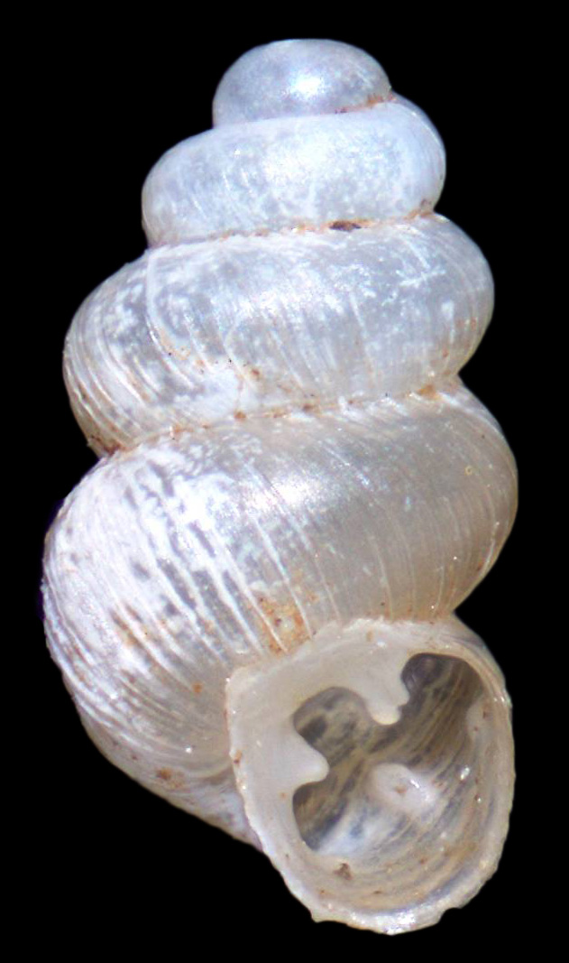
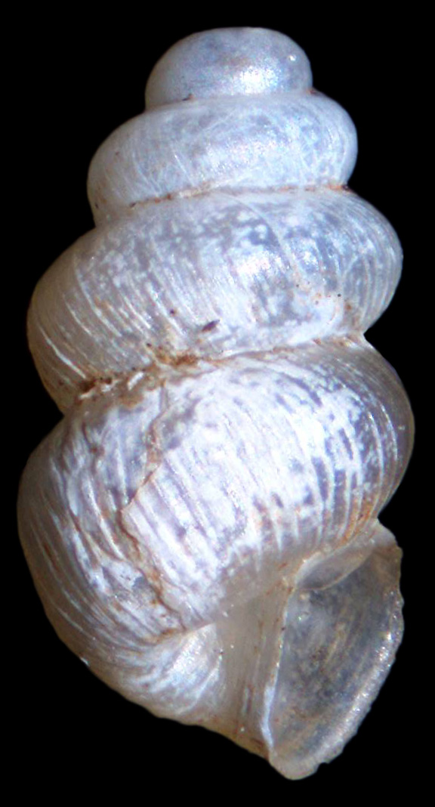
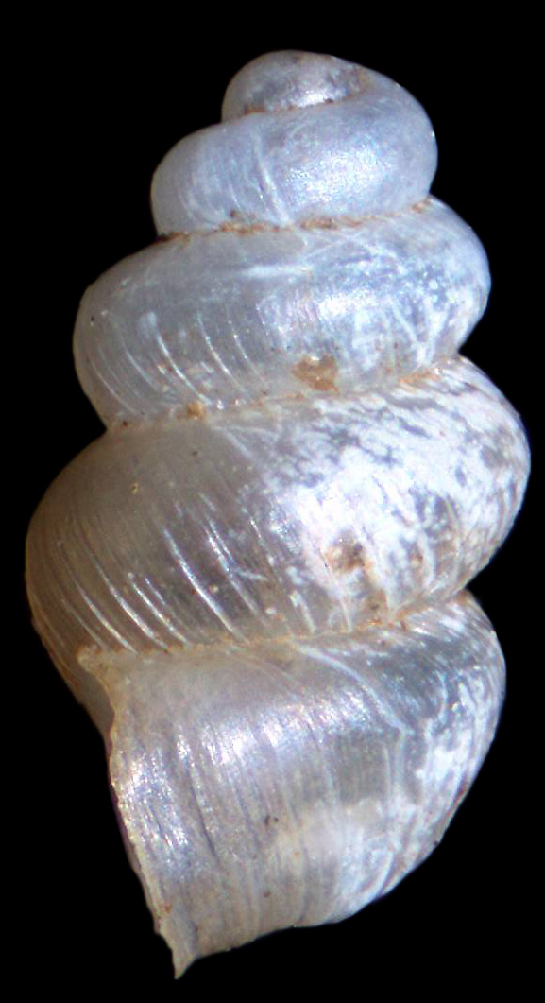
Pupillid Snails
Shell height = 2.0 mm
Shell width = 1.05 mm
4 whorls
Notes:
Shell white with distinct ribbing
Whorls loosely coiled
Angular and parietal lamellae joined
Upper palatal lamella represented only by a small nodule

Slide 11
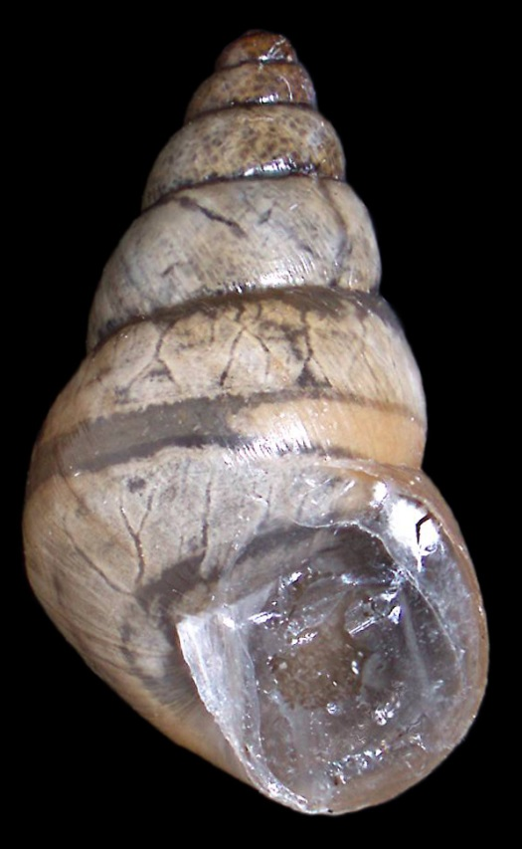
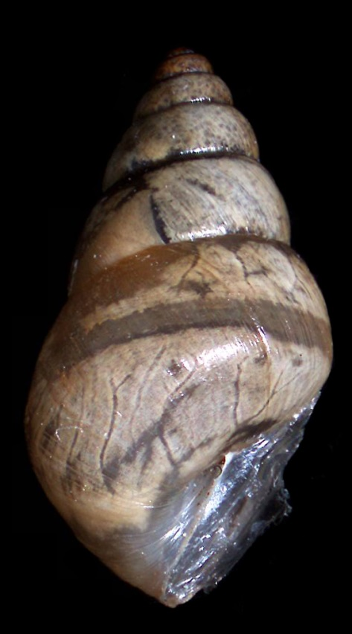
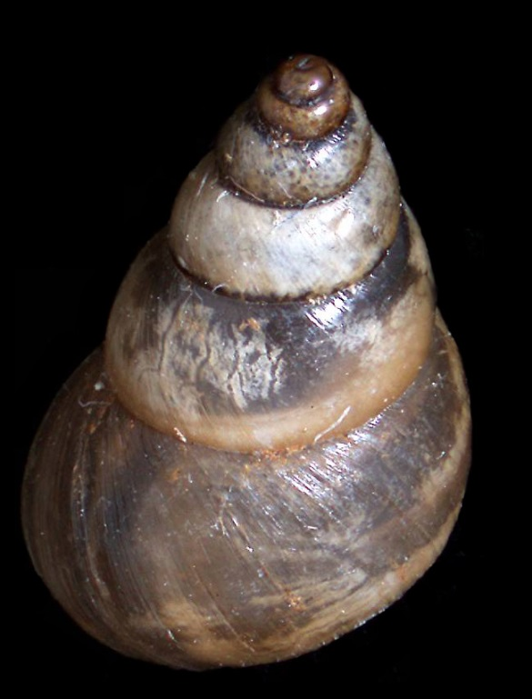
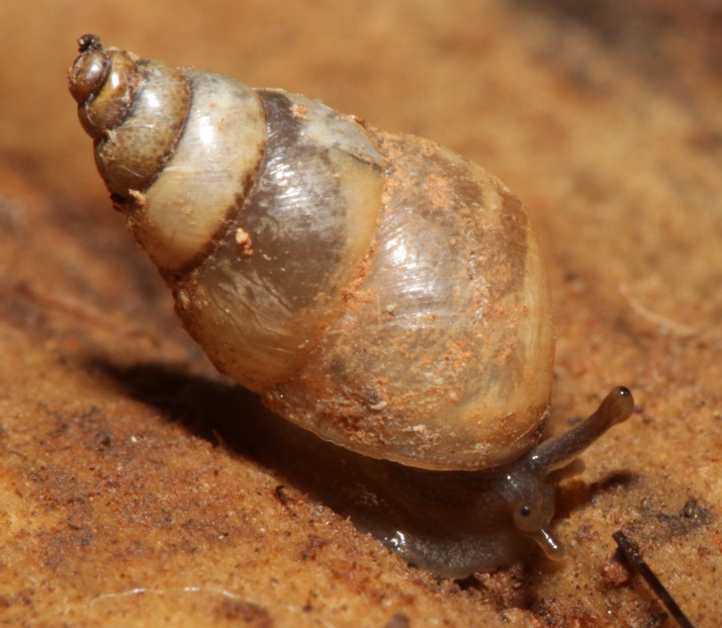
Bulimulid Snails
Shell height = 8.5 mm
Shell width = 5.0 mm
5.5 whorls

Slide 12
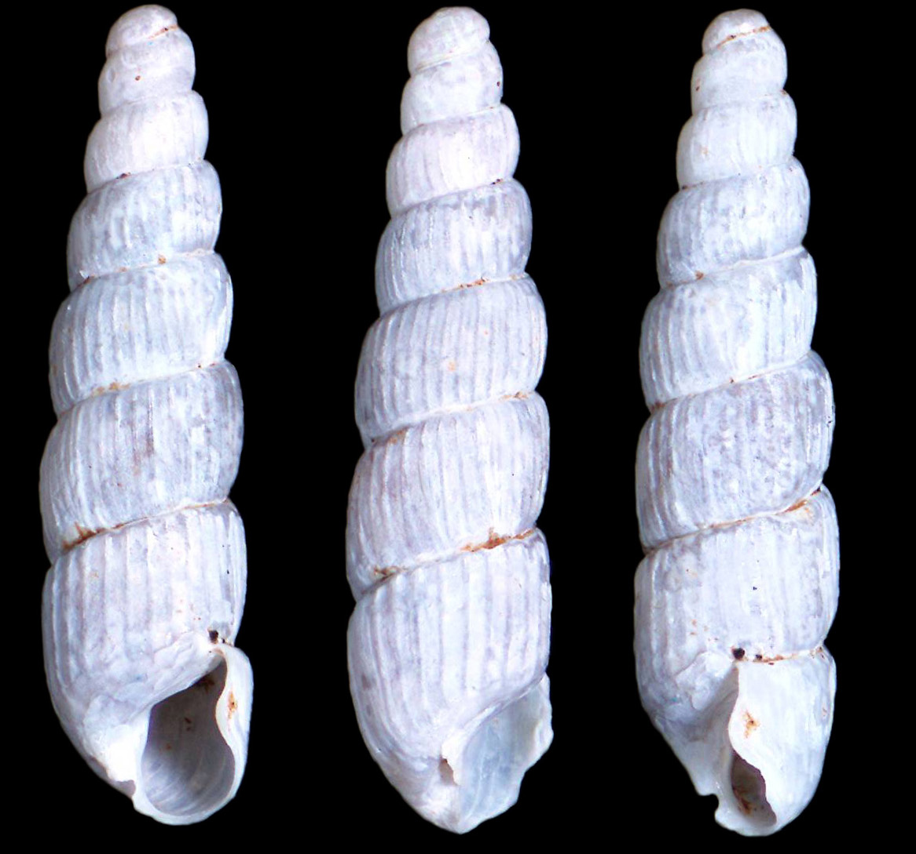
Streptaxid ? Snail
Shell heigth = 4 mm
Shell width = 1.0 mm
7 whorls

Slide 13
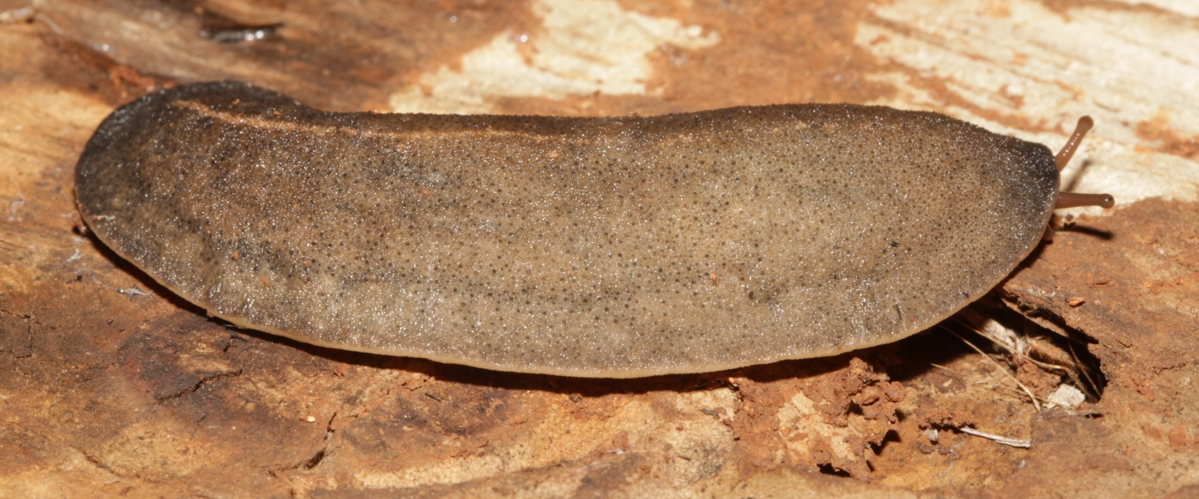
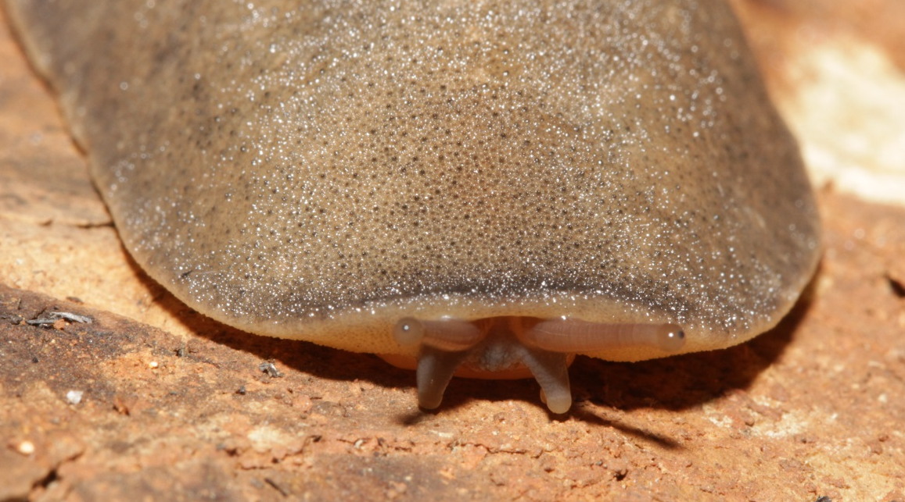
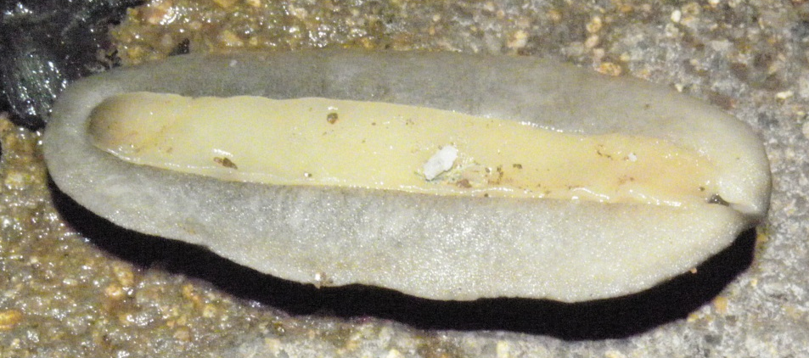
Leather Slugs - Veronicellidae
67 mm extended

Slide 14
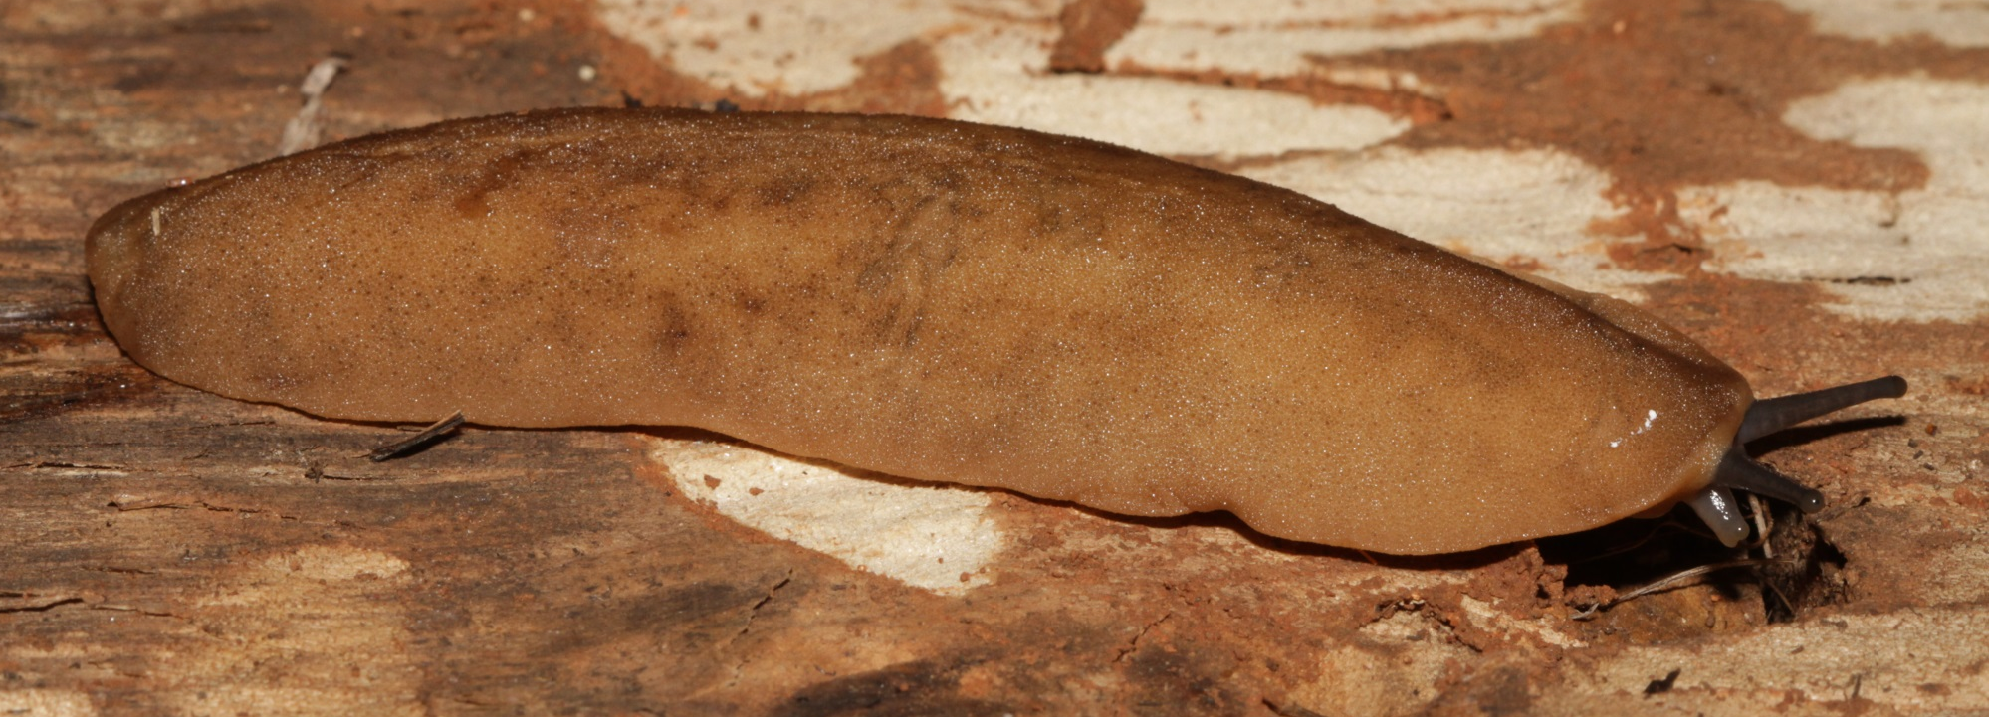
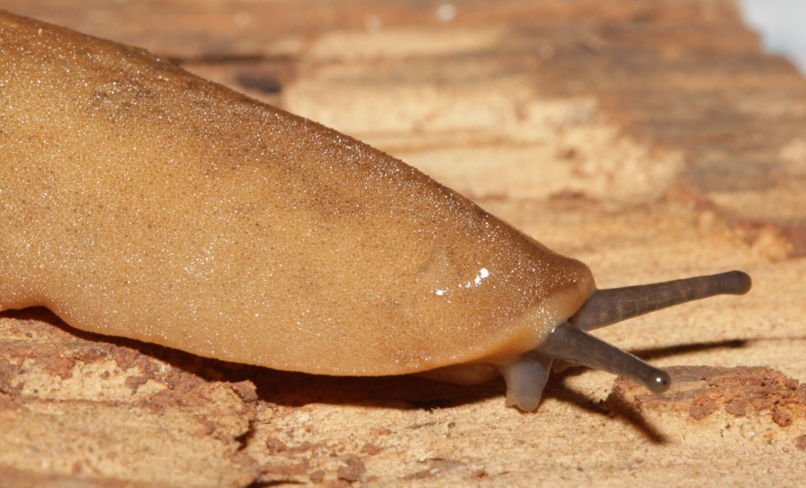
Leather Slugs - Veronicellidae
85 mm extended

Slide 15
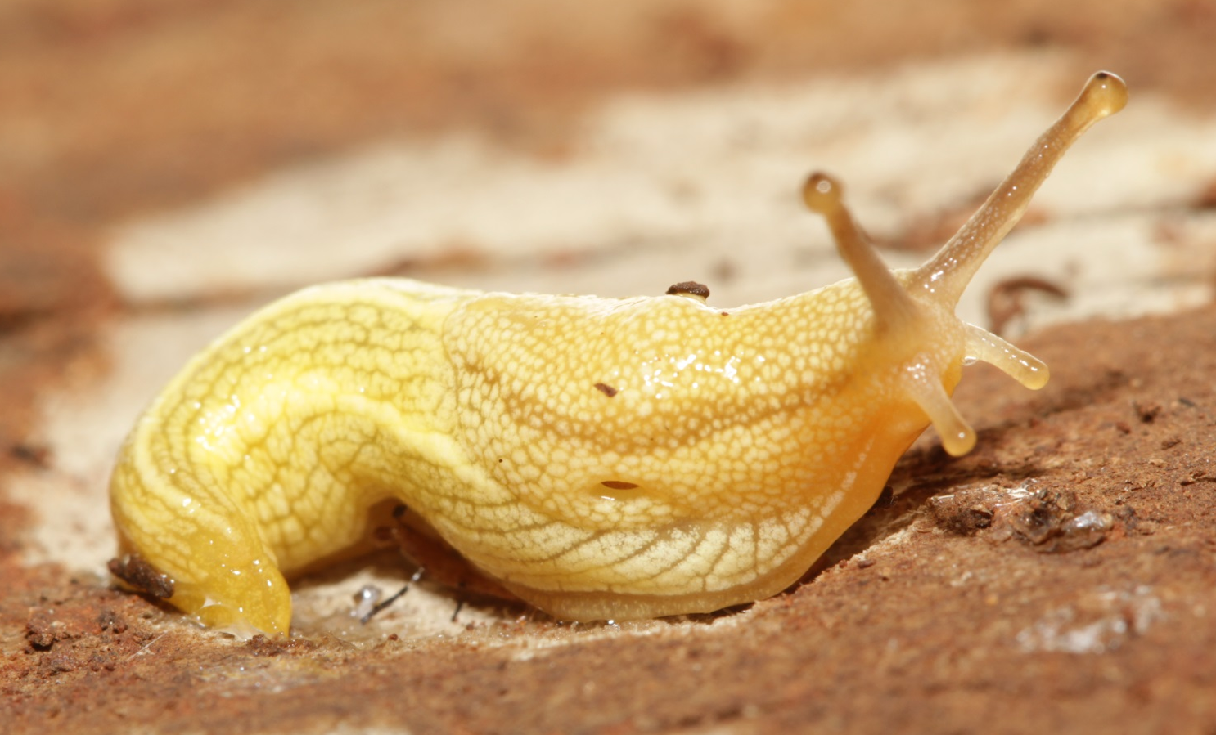
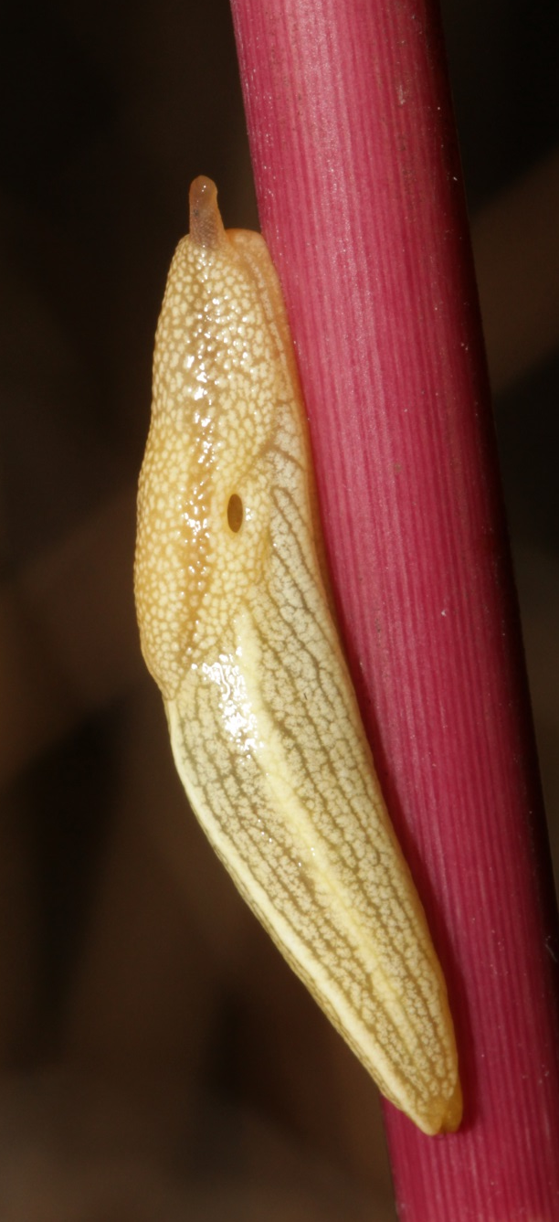
Normal Slugs
25 mm extended

Slide 16
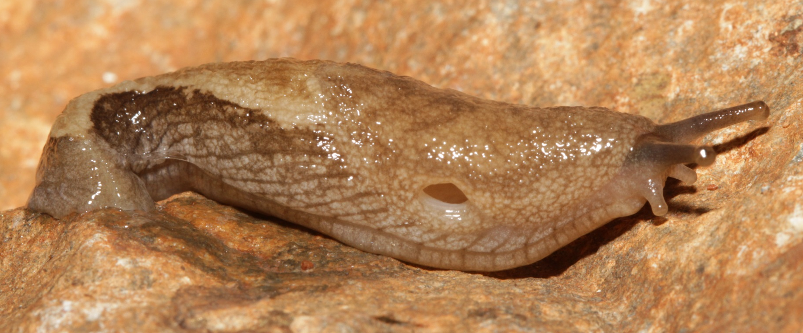
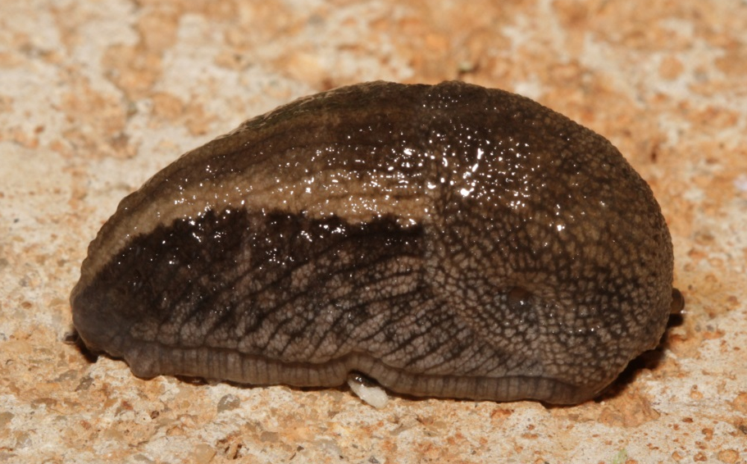
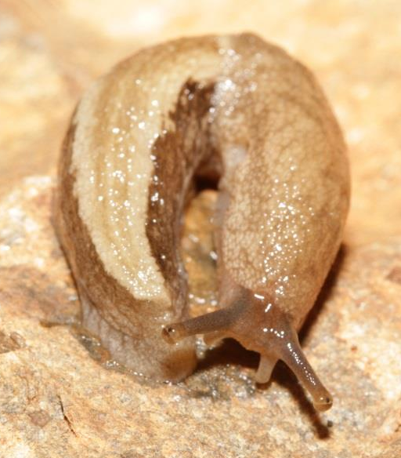
Normal Slugs
25-35 mm extended

Slide 17
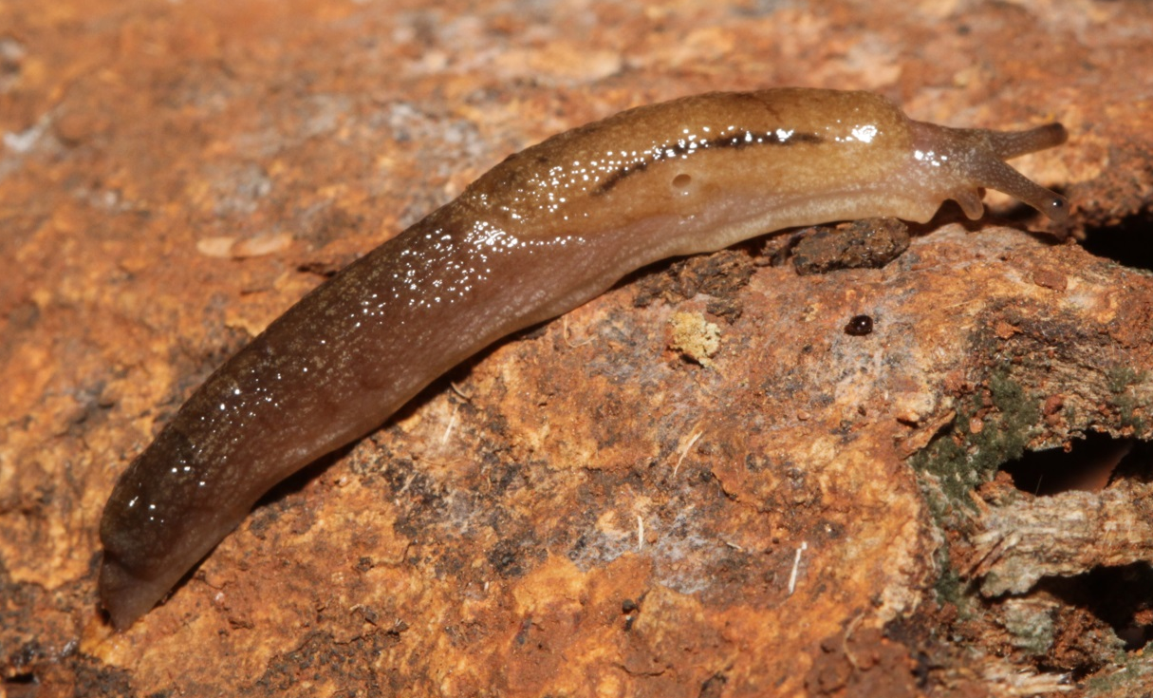
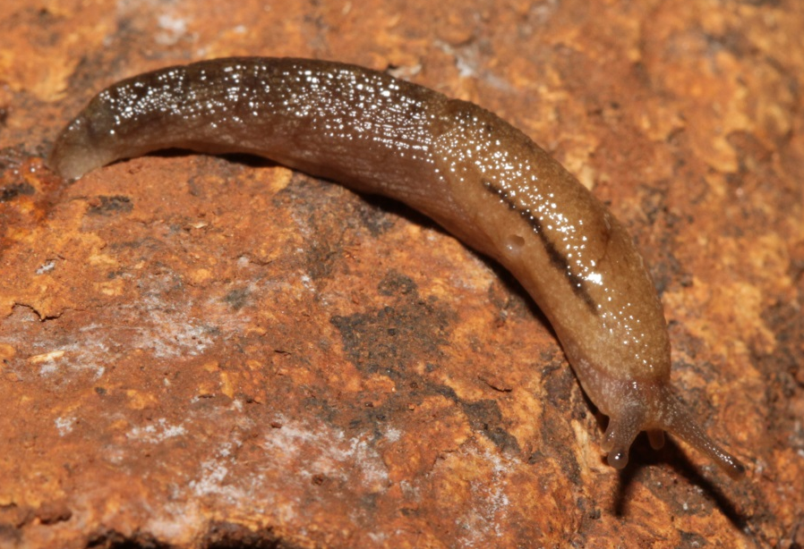
Normal Slugs
20 mm extended

