Slide 1
Land Snails of a cave area in Cao Bang Province, Vietnam
Robert Wayne Van Devender
Department of Biology
Appalachian State University
Boone, North Carolina

Slide 2
Methods
Visited cave area for about 1.5 hours
Collected ca. 1 liter of soil samples from under vegetation at base of limestone outcrops
Dried soil and passed it through a two-stage soil sieve
Picked snail shells from all samples
Sorted, cleaned and imaged representatives of all “species”

Slide 3
Results
Operculate snails – 3 species
Carychium – 1 species
Trochomorphus – 1 species
Bradybaenidae – 1 species
Plectopylidae – 1 species
White, toothed cone – 1 species
High spire snails – 11 species
Flat brown snails – 5-6 species
Flat white species – 3-4 species
Taller brown snails – 3 species
Snails with deep incised lines – 3 species
Ariophantidae – 1 species alive
TOTAL – 34 species

Slide 4
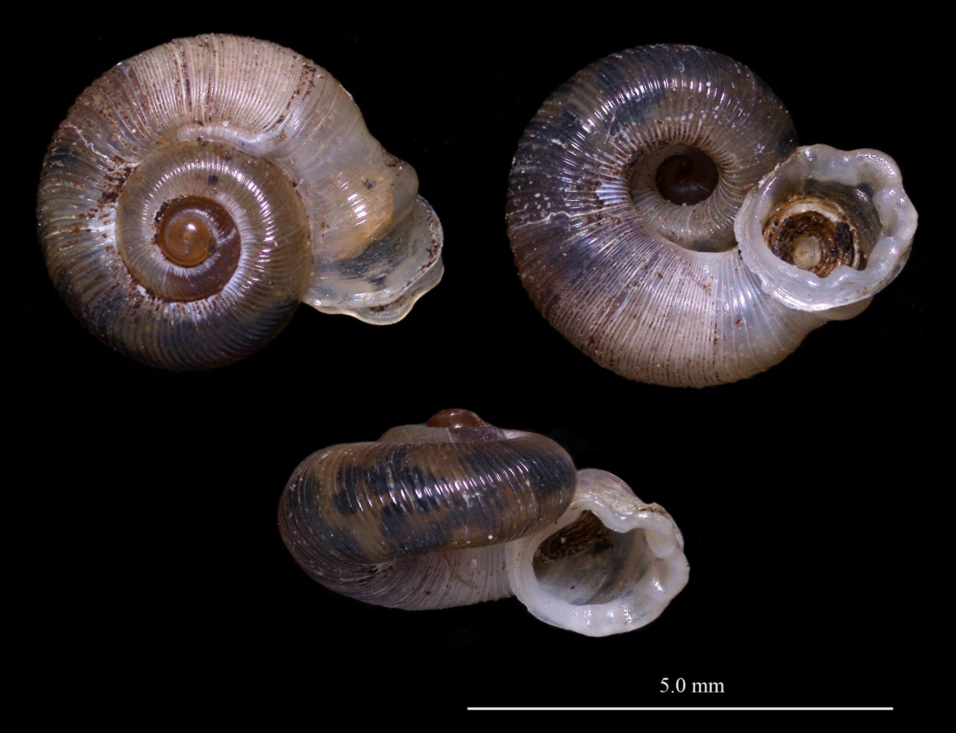
Snail 8
Cyclophoridae - Chamalcaeus
Notes:
Operculate
Rippled apertural lip
Complex ribbing
3.5 whorls
< 5 mm

Slide 5
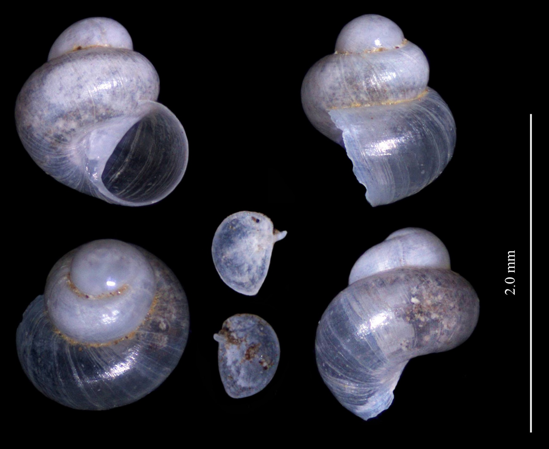
Snail 9
Cyclophoridae -
Notes:
Operculate
2 whorls
< 2 mm
Tall
Closed umbilicus

Slide 6
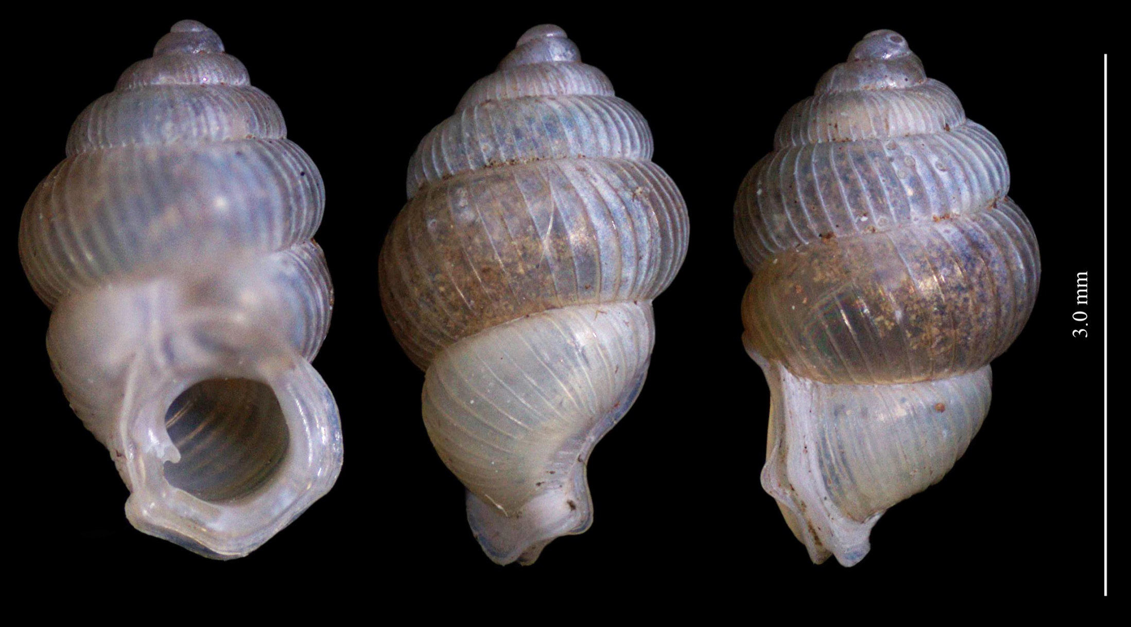
Snail 10
Diplommatinidae - Diplommatina
Notes:
Operculate
6 whorls
> 3 mm, obese
Sharply pointed columella lamella

Slide 7
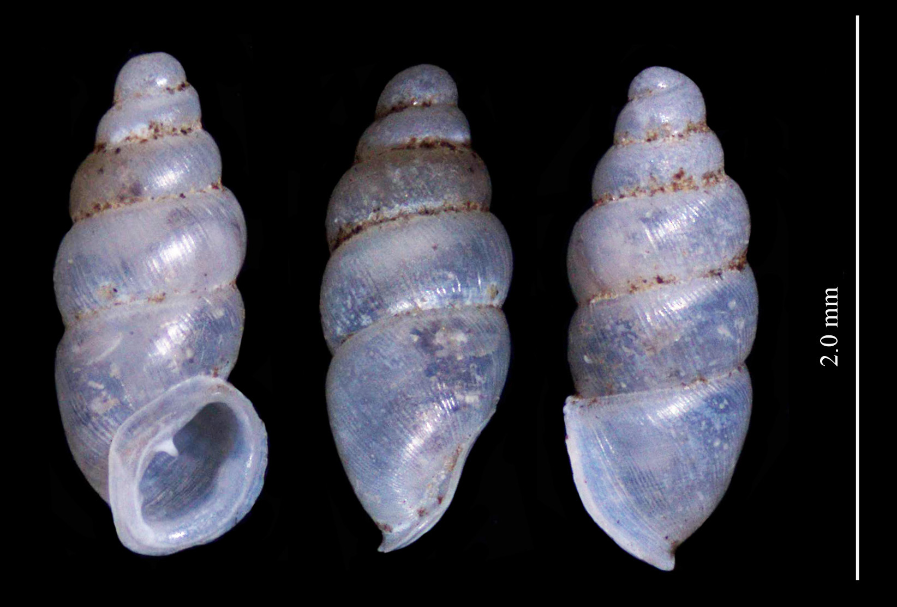
Snail 7
Ellobiidae - Carychium
Notes:
< 2 mm
White and tall
Reflected lip
Two lamellae in aperture
Ribbing evident

Slide 8
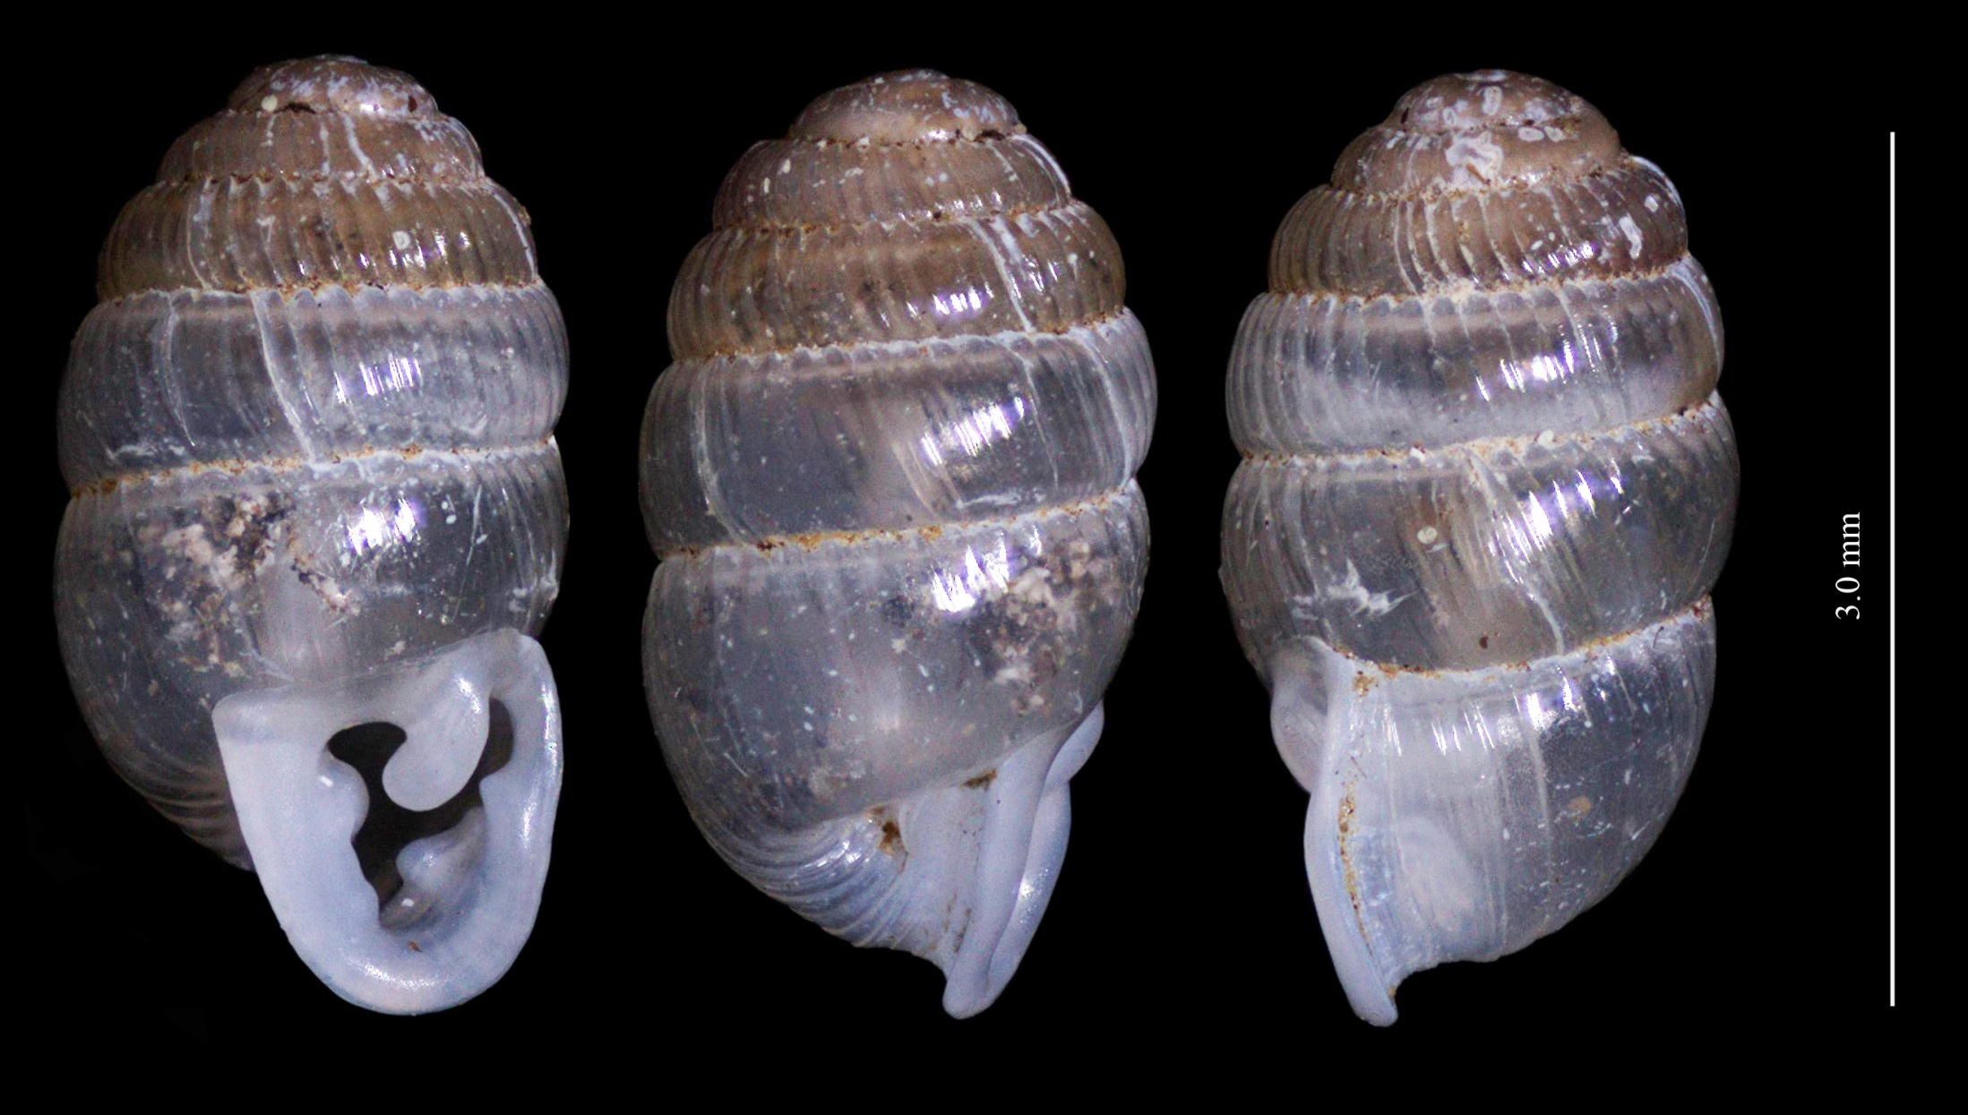
Snail 11
Streptaxidae - Enneinae?
Notes:
Shiny surface with rib striations
5-5.5 whorls
> 3 mm
Reflected lip
Complex group of lamellae

Slide 9
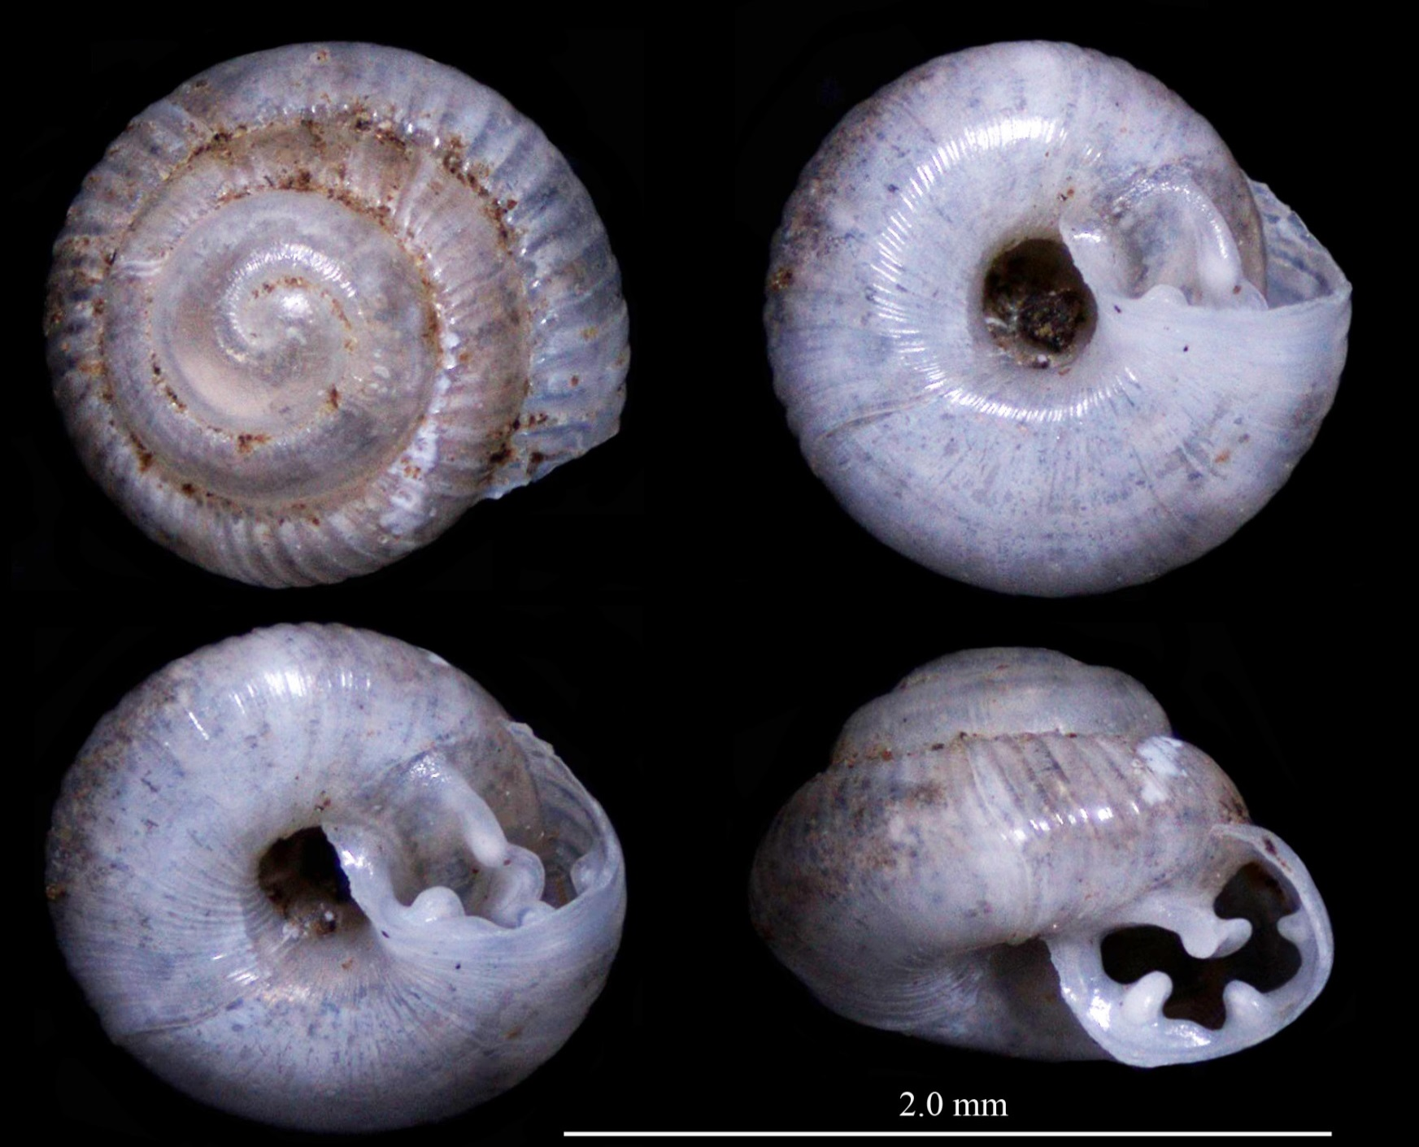
Snail 17
Notes:
3.5 whorls
About 1.3 mm
Ribbing begins after 1.5 whorls
Umbilicus wide
Complex array of lamellae
Possibly, but not probably, juvenile of species 11

Slide 10
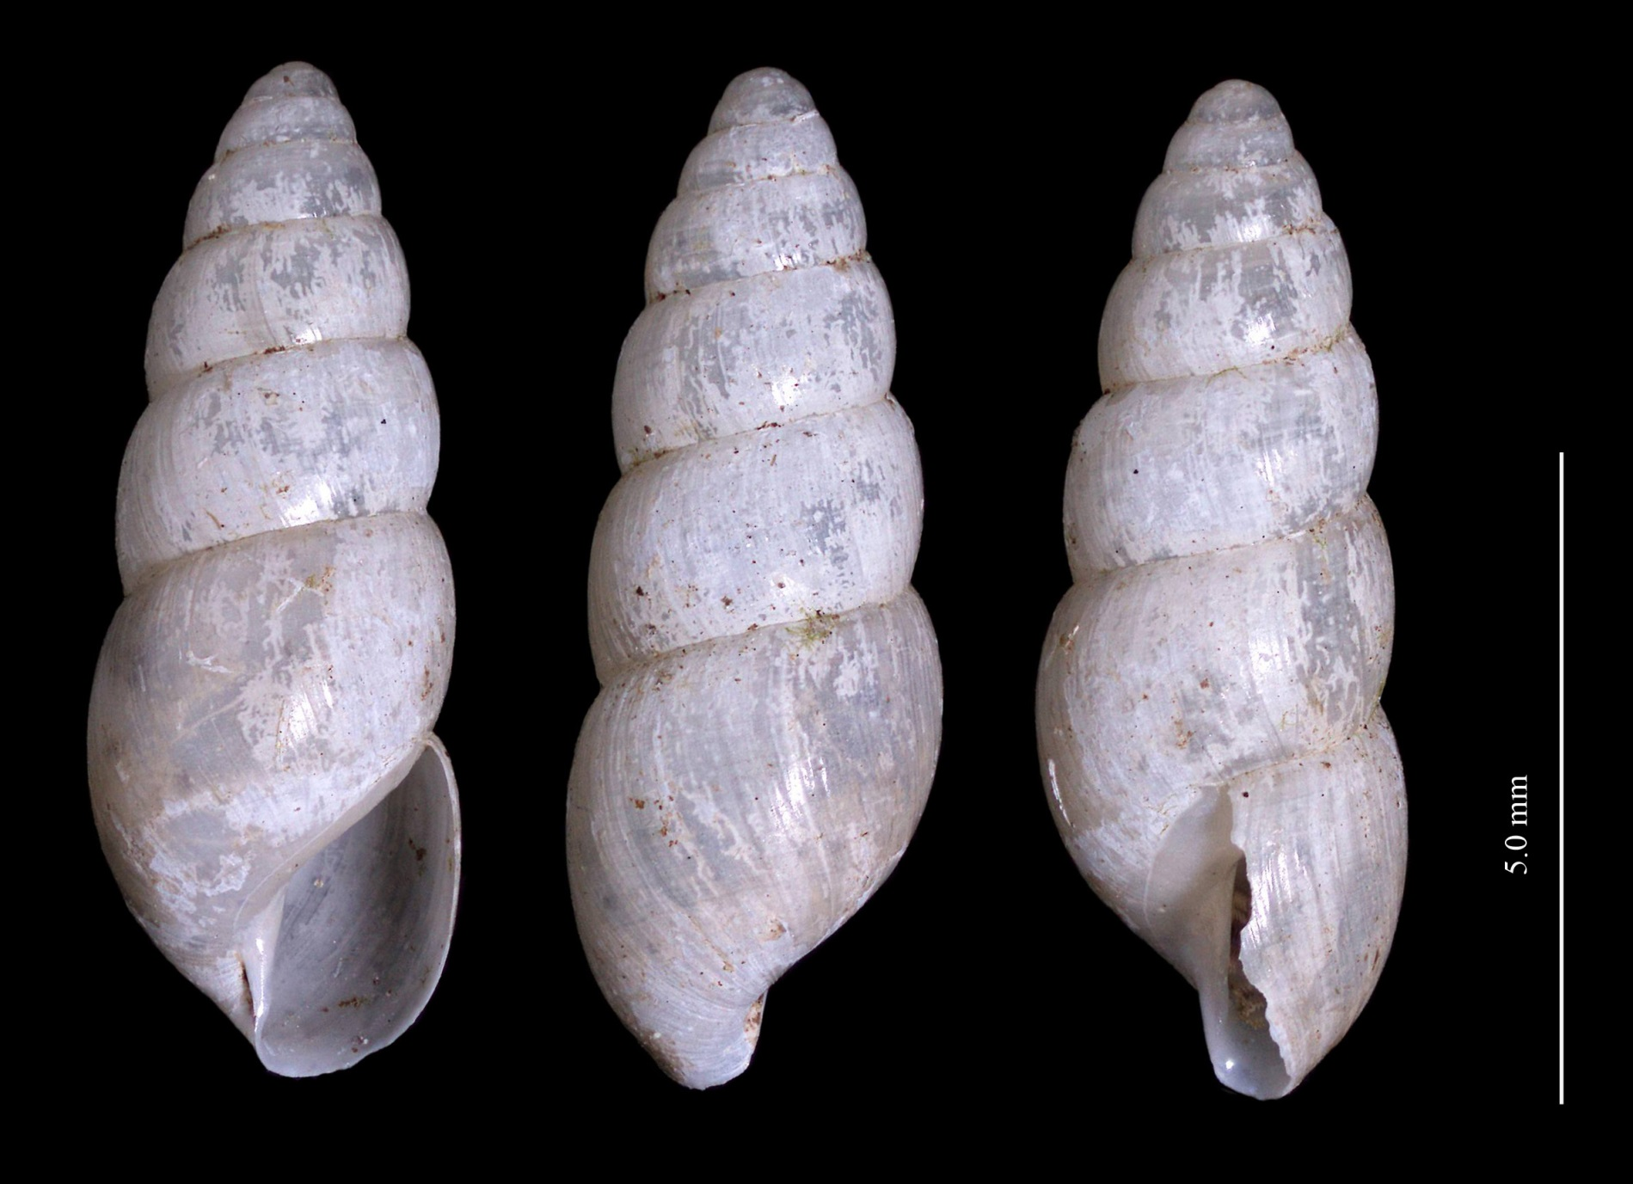
Snail 21
Subulinidae -
Notes:
About 8 mm
6 whorls
Umbilicus close
Columellar fold merges smoothly with aperture
Sutures not crenulated

Slide 11
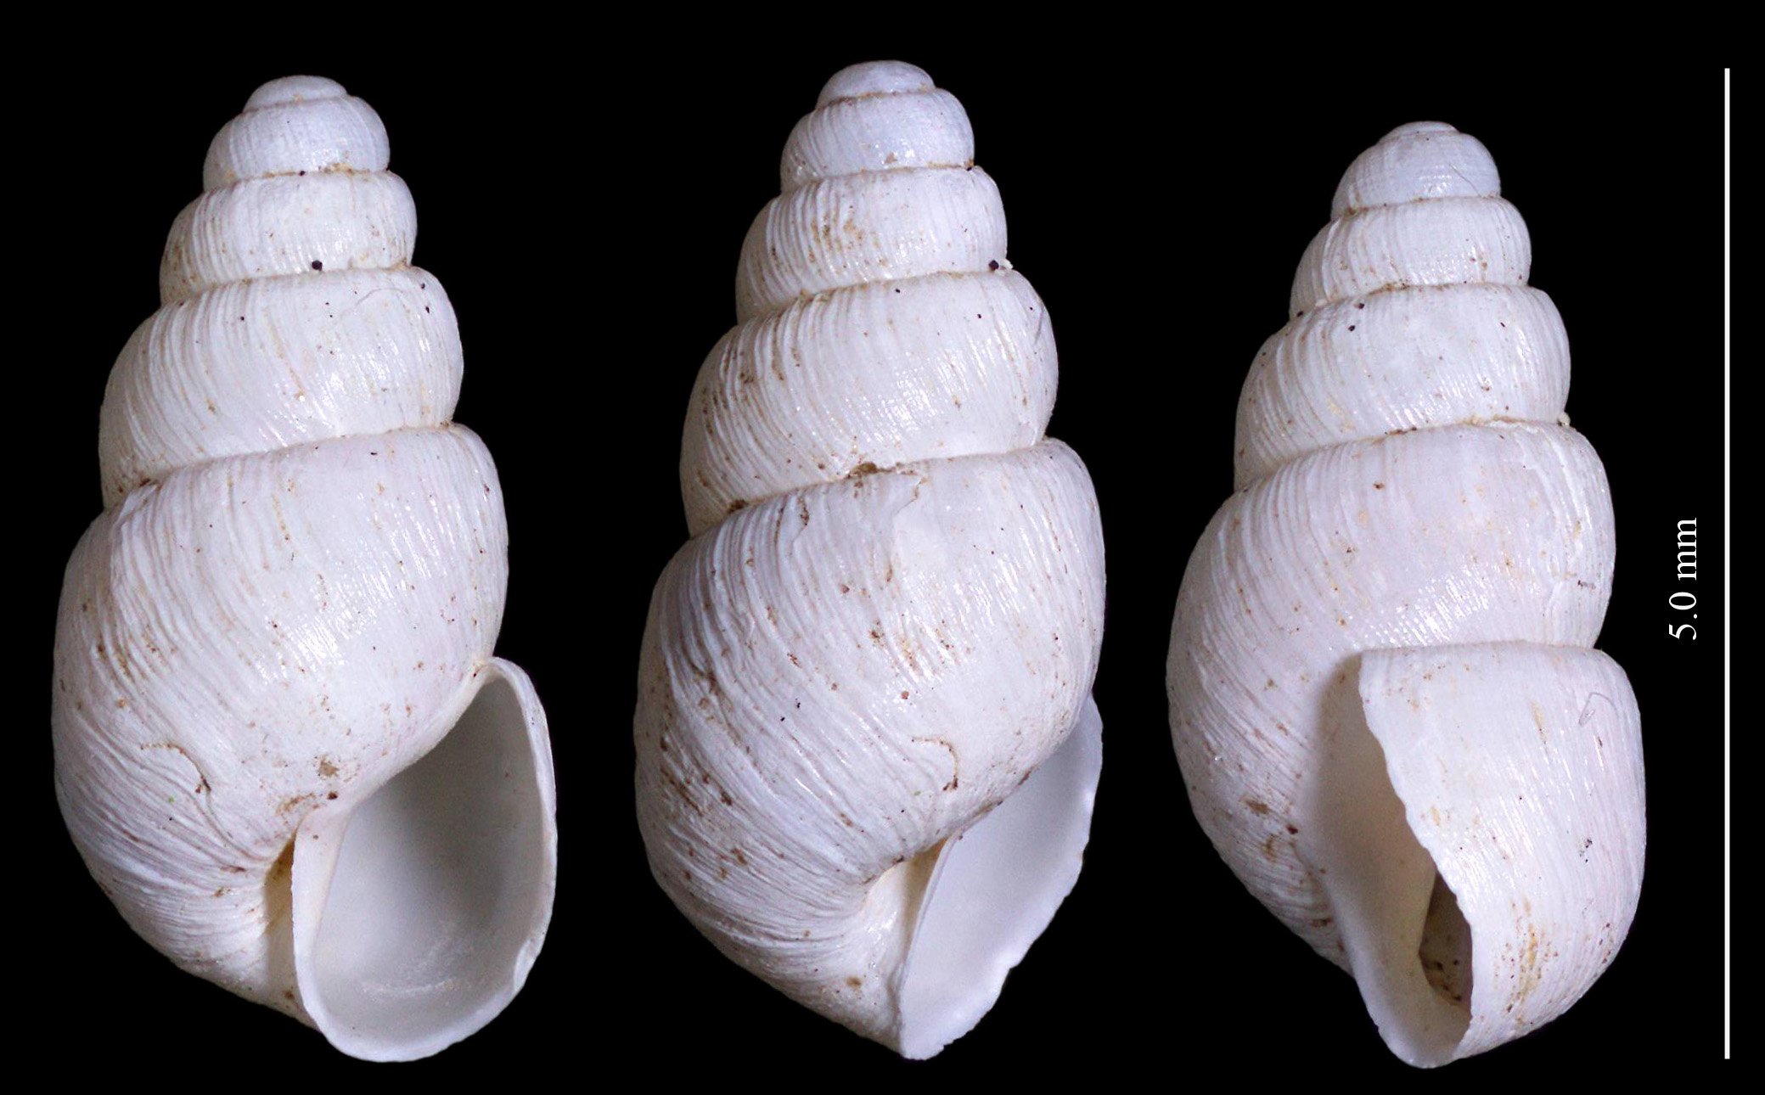
Snail 22
Subulinidae -
Notes:
5 whorls
Almost 5 mm
Growth wrinkles well developed
Umbilicus open
Columellar fold continuous with outer lip

Slide 12
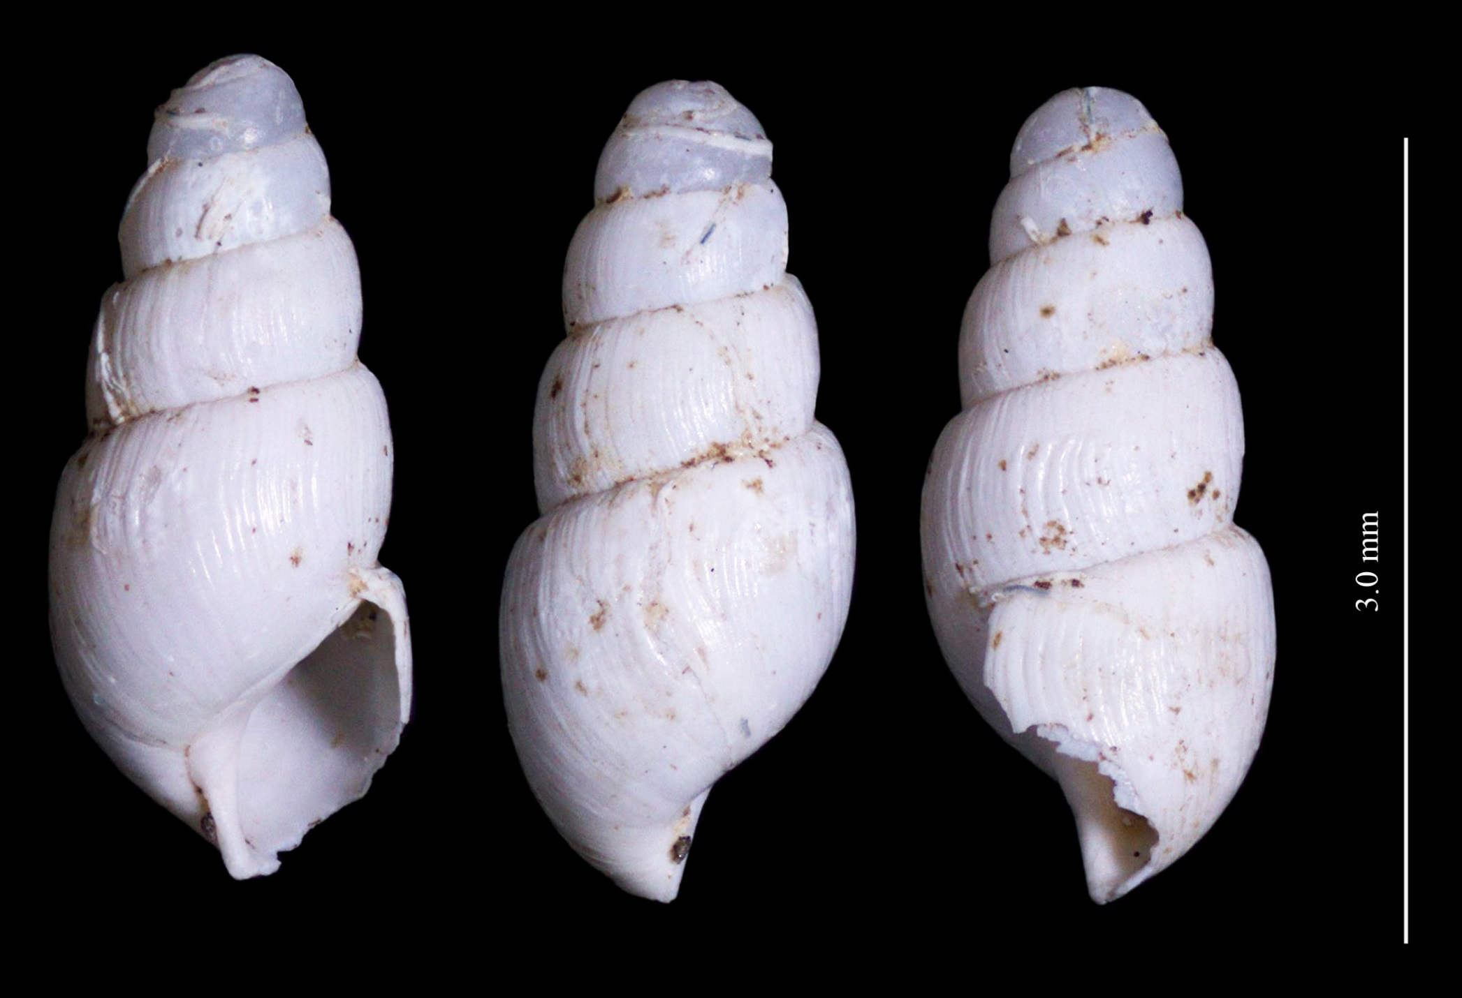
Snail 30
Notes:
White, tall shell with conspicuous growth wrinkles
About 4.5 whorls
A bit over 3 mm

Slide 13
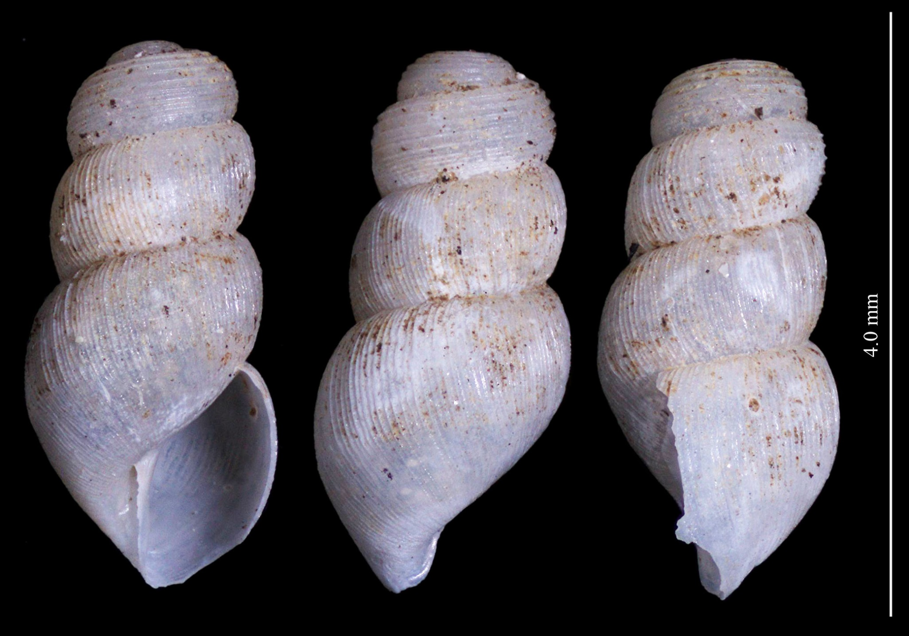
Snail 31
Notes:
White, tall shell with conspicuous growth transverse ribbing on later whorls
First two whorls with bold, longitudinal ribbing
About 3.5 whorls
A bit under 4 mm

Slide 14
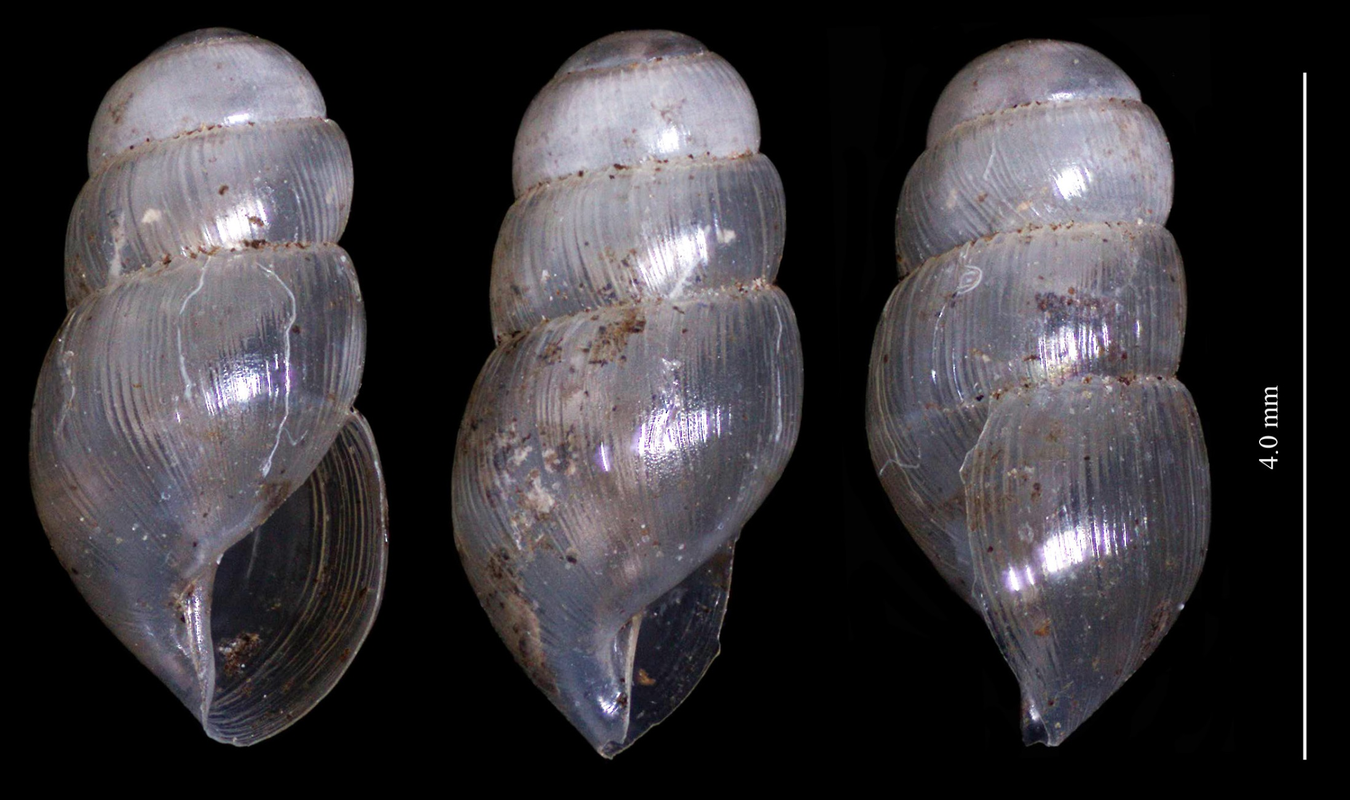
Snail 23
immature
Notes:
3-5 whorls at > 4 mm
Shell transparent, shiny, and transversely ribbed
Suture crenulated
Umbilicus open but covered by reflection of columellar lip
Not the same as snail 29

Slide 15
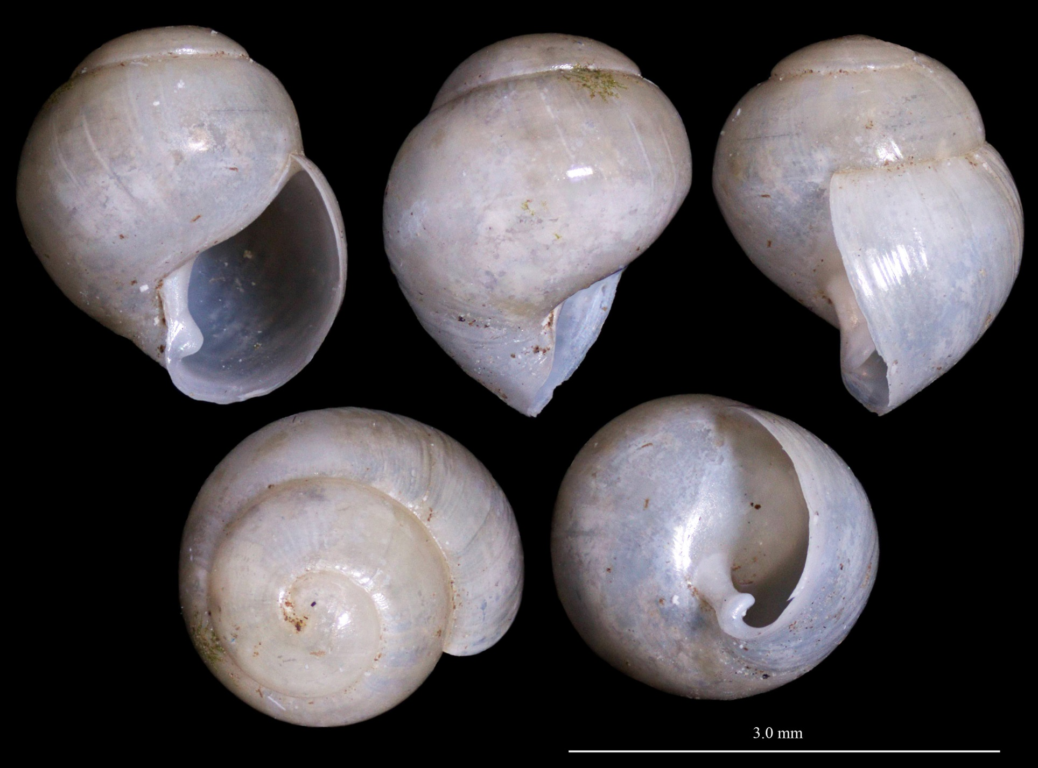
Snail 29
Notes:
Immature shell of high spired species
About 2.5 x 3 mm
Distinct columellar fold
Shell thick and shiny with some growth wrinkles
Sutures smooth, without crenulations
Not the same as snail 23

Slide 16
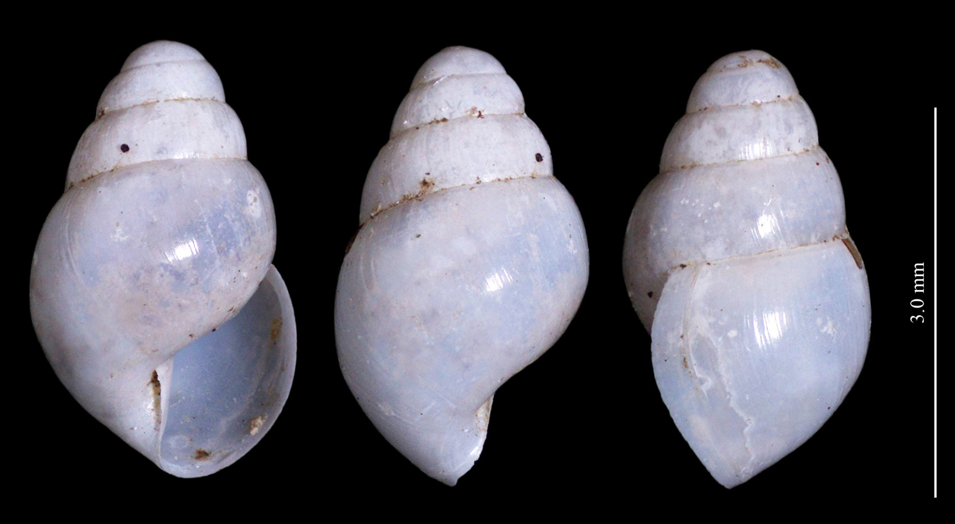
Snail 24
Notes:
4 whorls at 3.5 mm
Surface shiny and white (may be translucent in fresher shells)
Obese body whorl
Umbilicus open but covered by reflected columellar lip
Reflection of columellar lip merges smoothly with outer lip
Sutures not crenulated

Slide 17
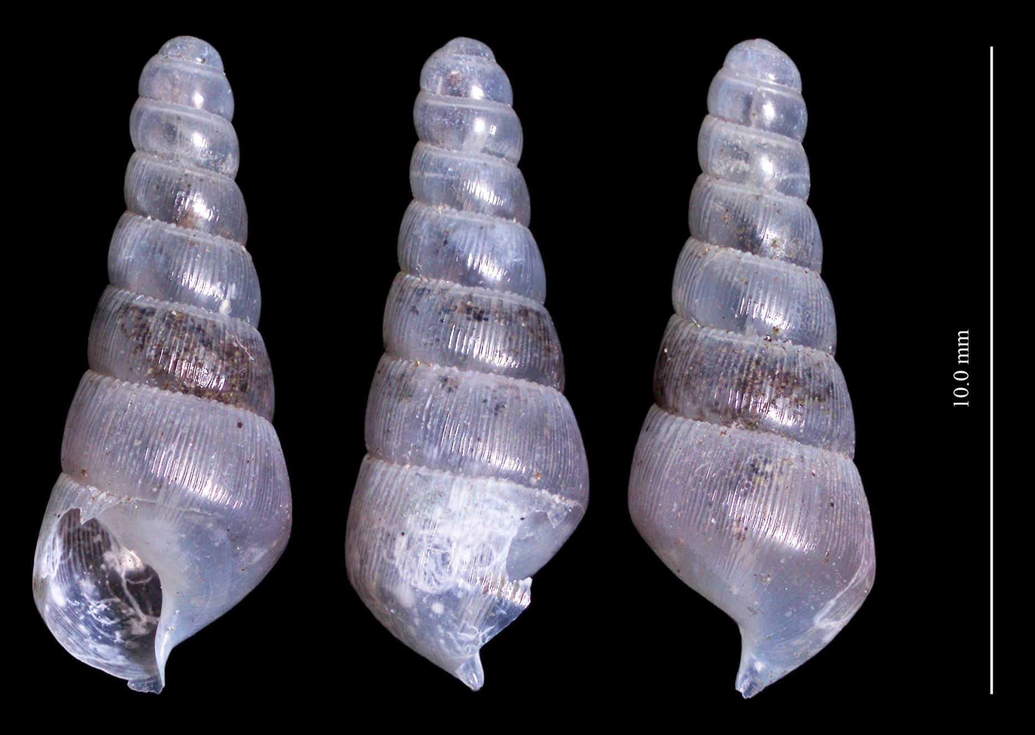
Snail 25
Notes:
7 whorls at 10 mm
Shell shiny and transparent to translucent
First three whorls without ribbing
Sinistral
Umbilicus invisible
Columella S-shaped and may merge smoothly with outer lip

Slide 18
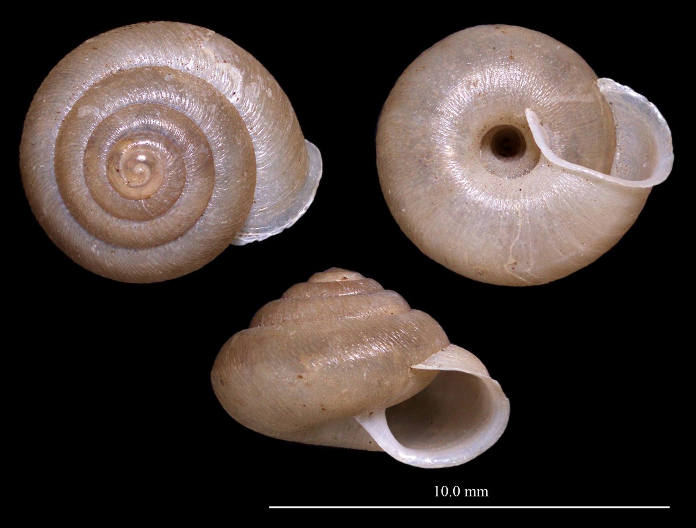
Snail 1
Bradybaenidae?
Notes:
5.5 whorls
7-8 mm
Surface with transverse growth wrinkles and papillae
Umbilicus wide
Shell relatively tall
Aperture round with reflected lip best developed near columella

Slide 19
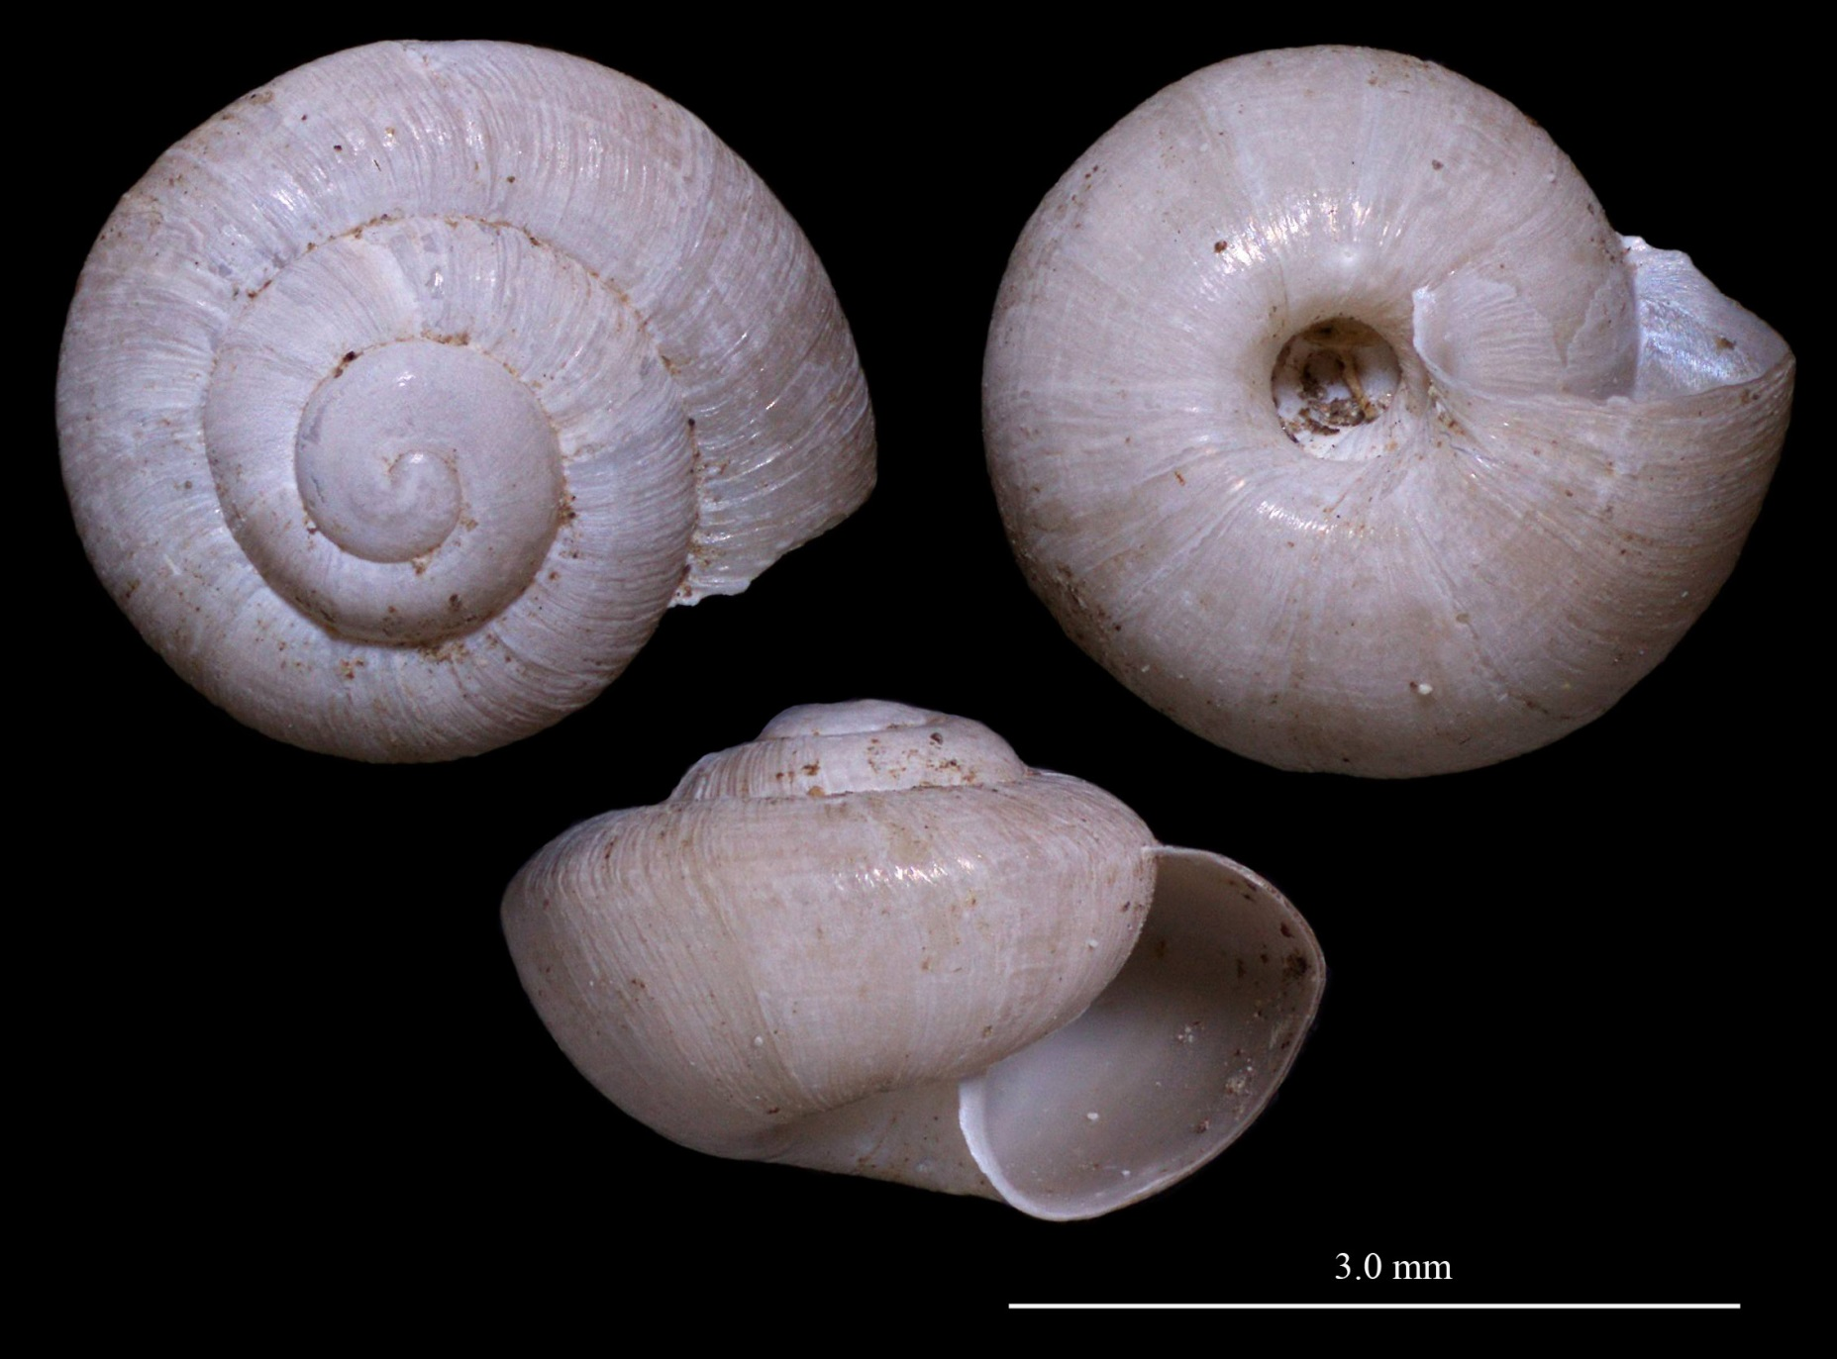
Snail 18
Bradybaenidae immature?
Notes:
3.4 whorls
Angular body whorl
Umbilicus open and moderately large
Transverse growth wrinkles well developed
Aperture oblique and flattened
May be immature of snail 1

Slide 20
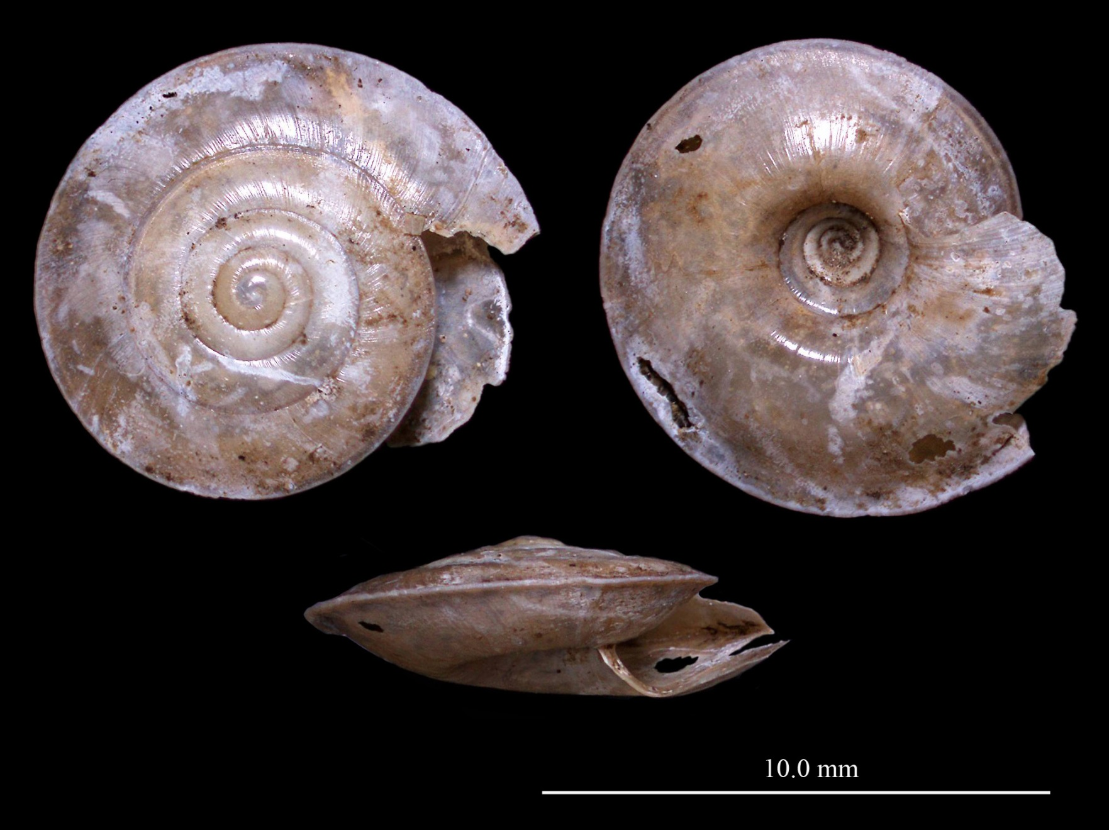
Snail 2
Trochomorphidae - Trochomorphus

Slide 21
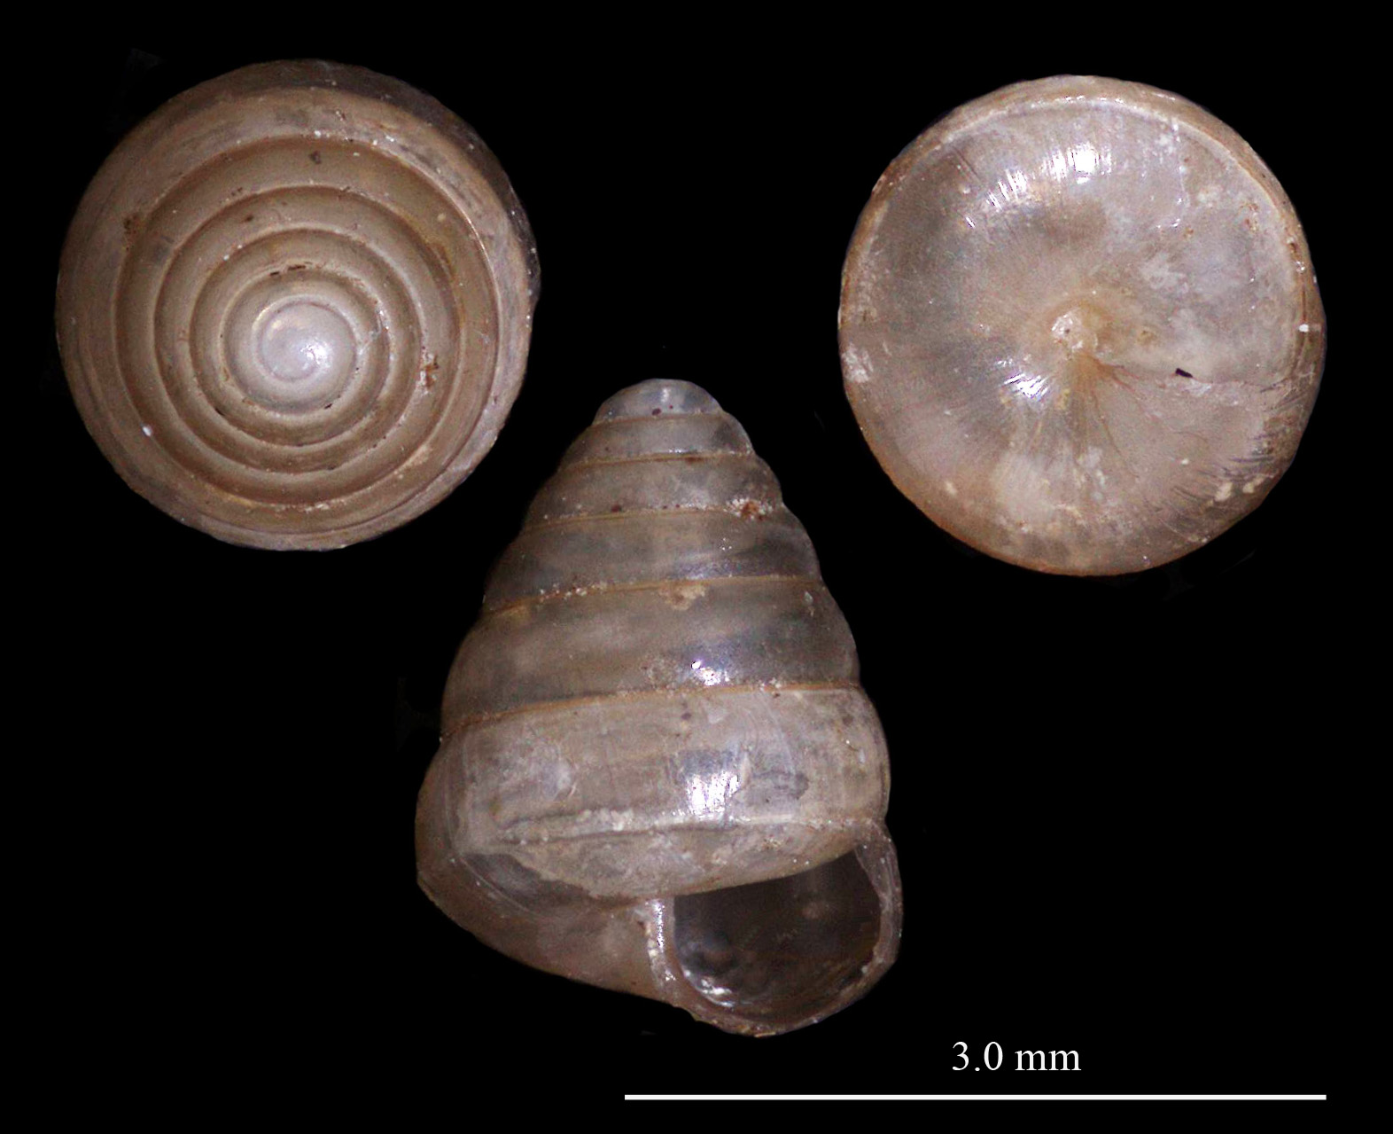
Snail 15
Notes:
Tall, conic form
About 6 whorls
Closed umbilicus
Weak transverse lines
About 2 x 3 mm

Slide 22
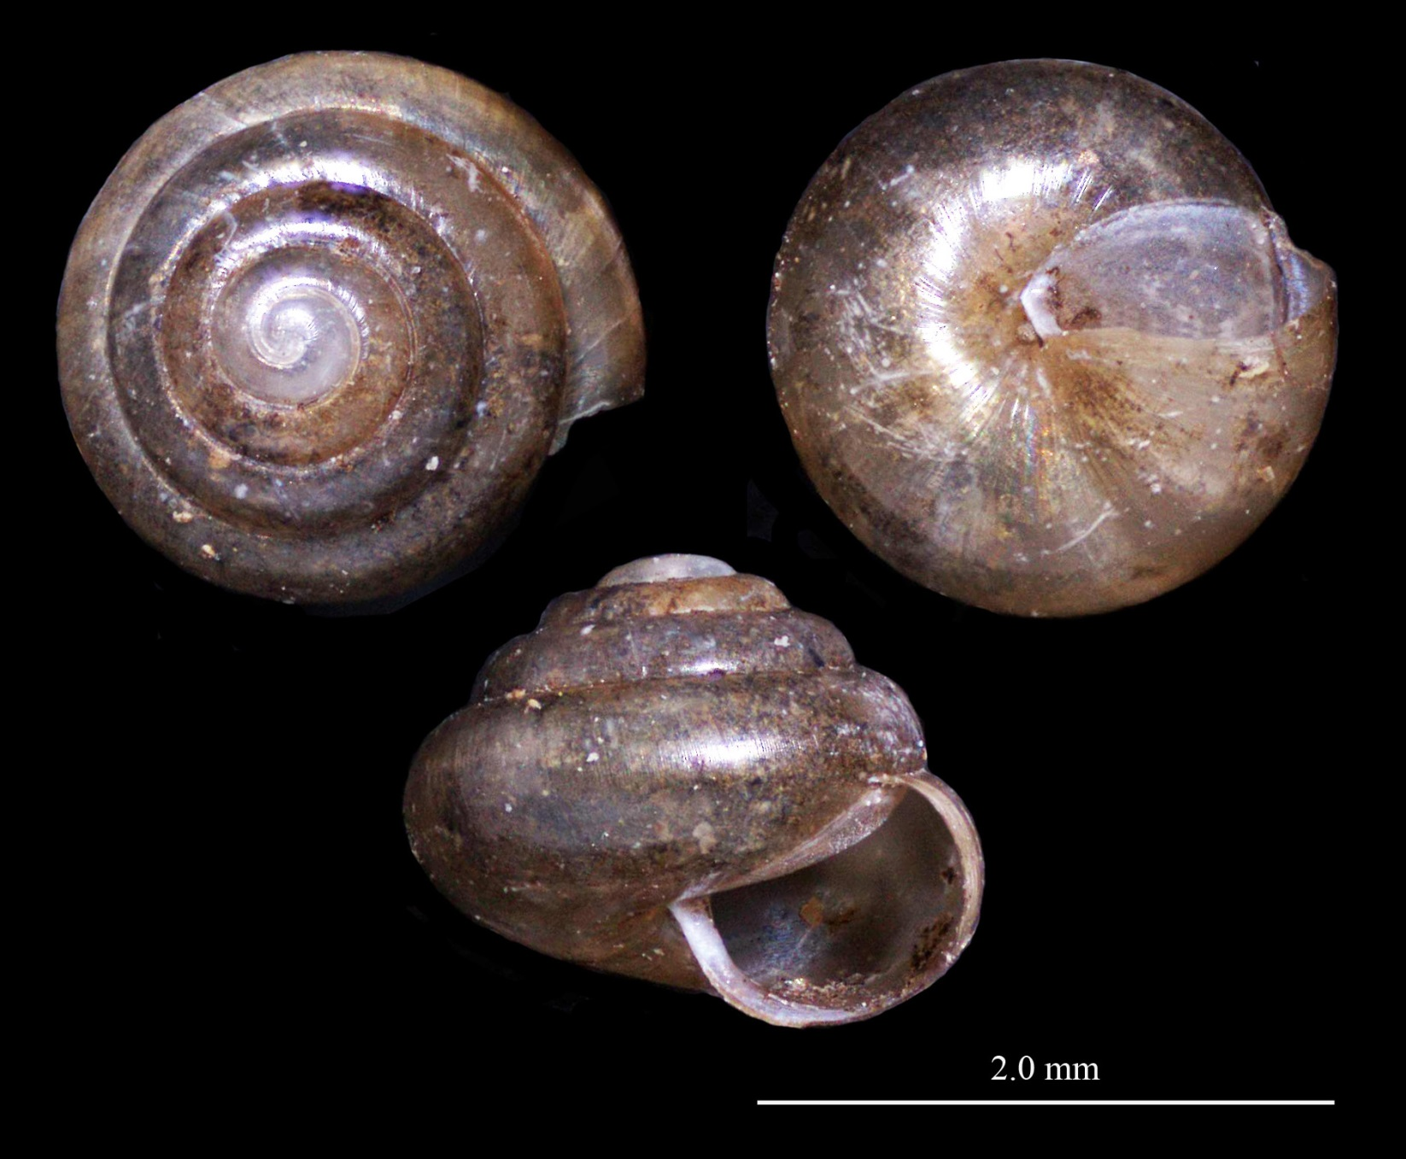
Snail 4
Notes:
< 2 mm
Relatively tall
Without incised lines

Slide 23
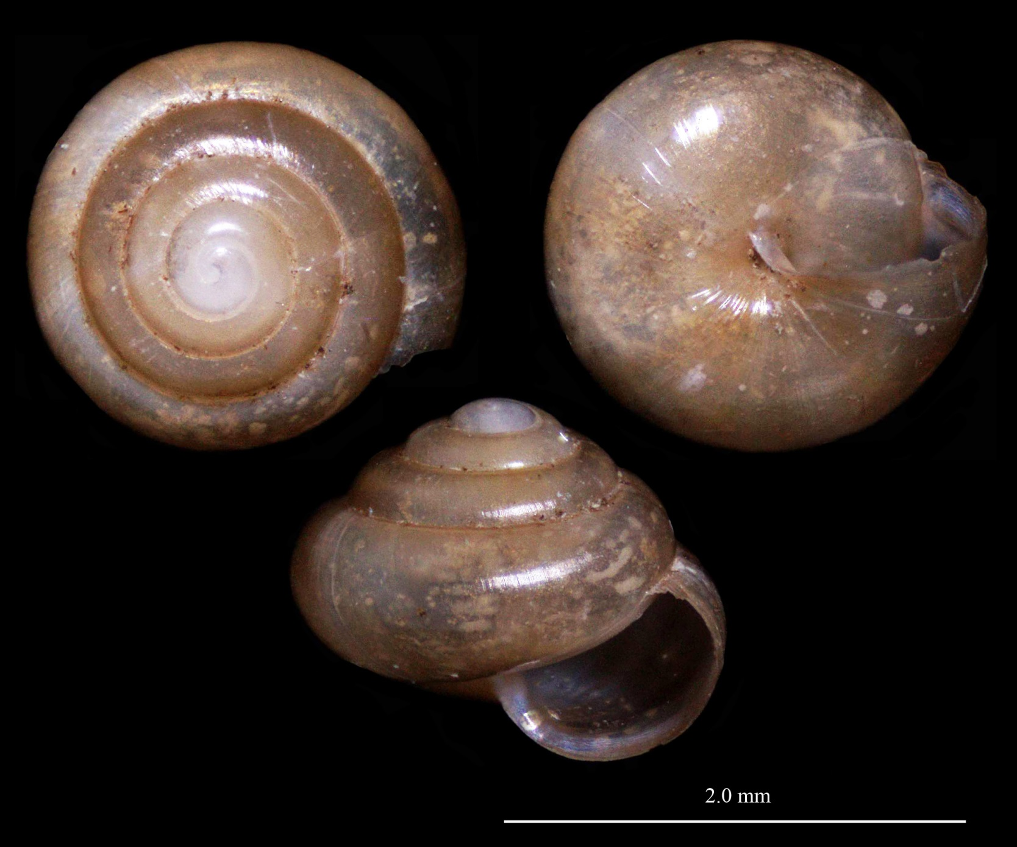
Snail 20
Notes:
Almost 5 whorls
Relatively tall and shiny
< 2 mm
Transverse lines present
Umbilicus small and partly covered by reflection of the lip
May be same as snail 4

Slide 24
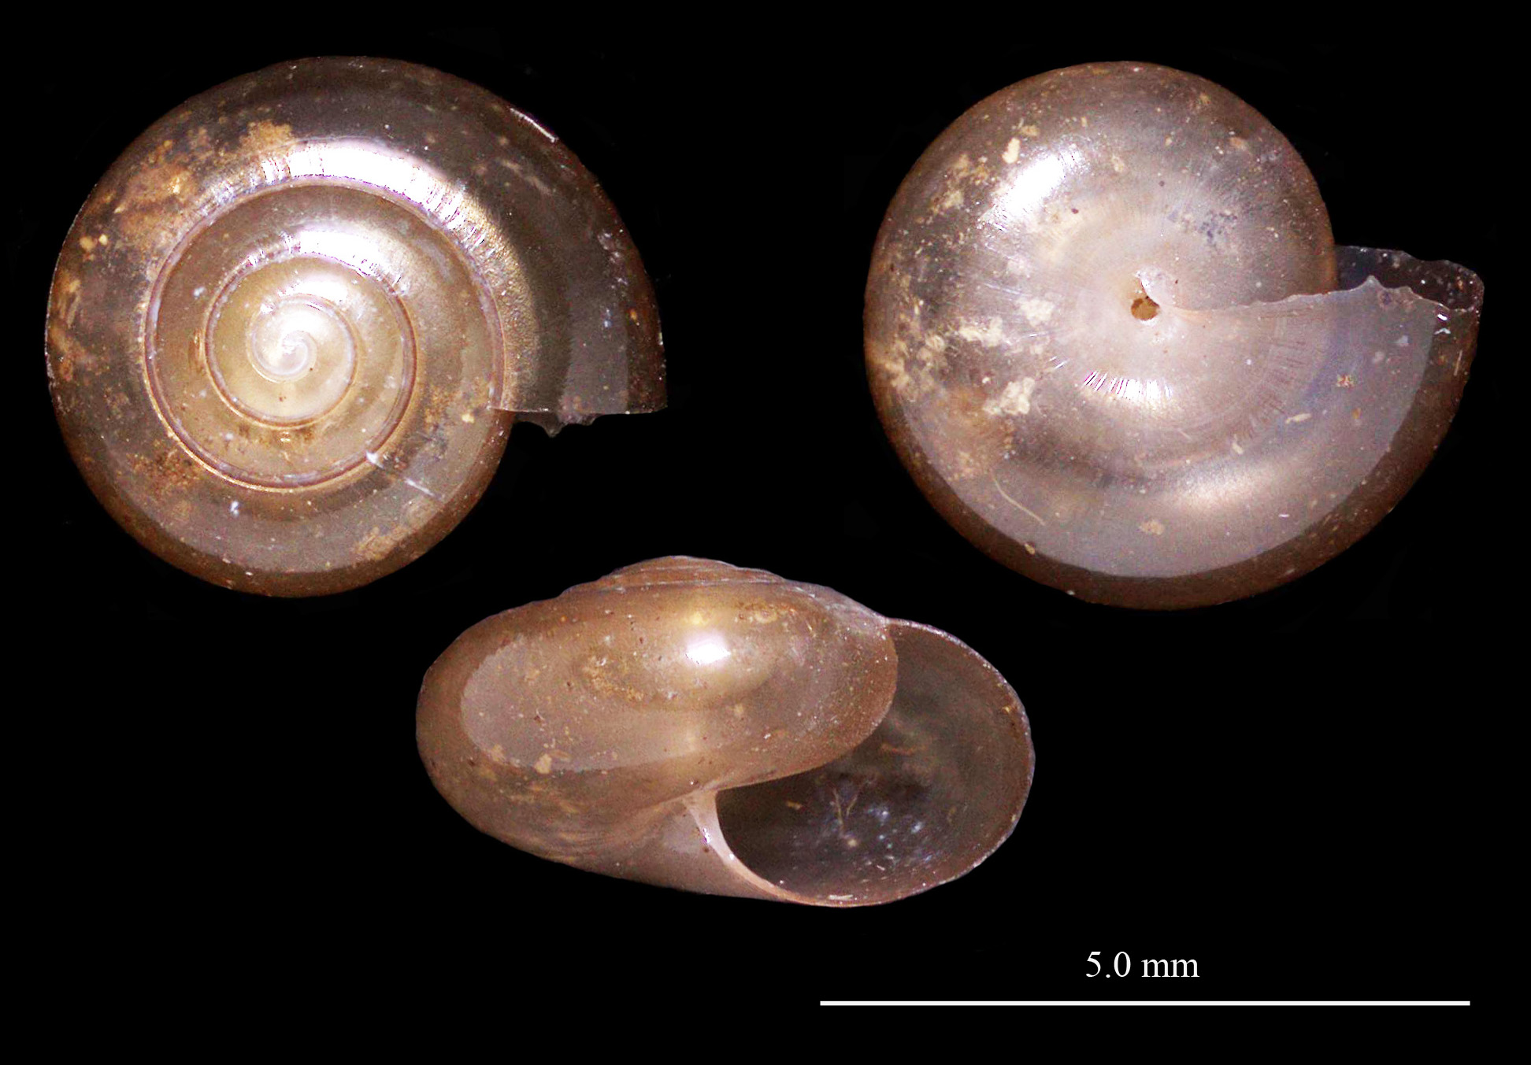
Snail 5
Notes:
Many, very small transverse ribs/grooves
Small umbilicus
Relatively flat
4.5 whorls
About 4 mm

Slide 25
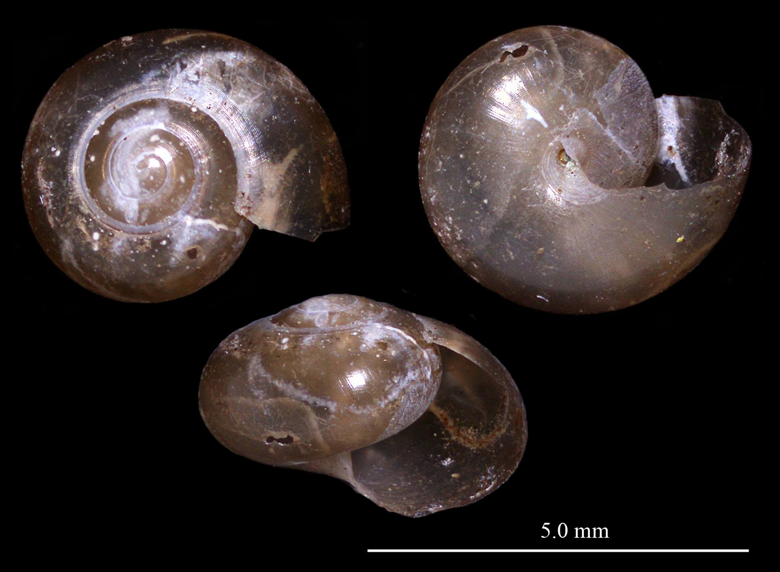
Snail 6
Notes:
Many, very small transverse ribs/grooves
Small umbilicus
Relatively thick
3.5 whorls
About 4 mm

Slide 26
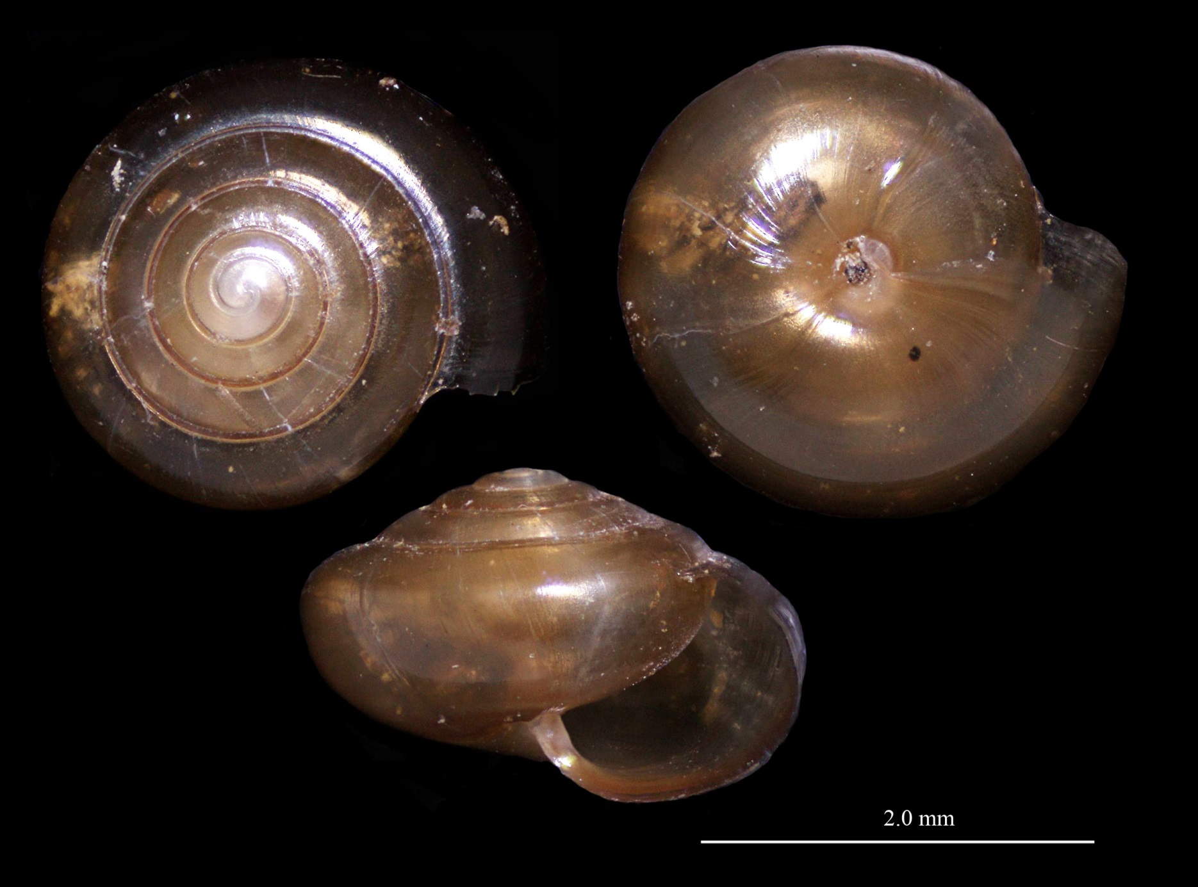
Snail 12
Notes:
Almost 5 whorls
About 2 mm
Small umbilicus
Surface smooth but lustrous

Slide 27
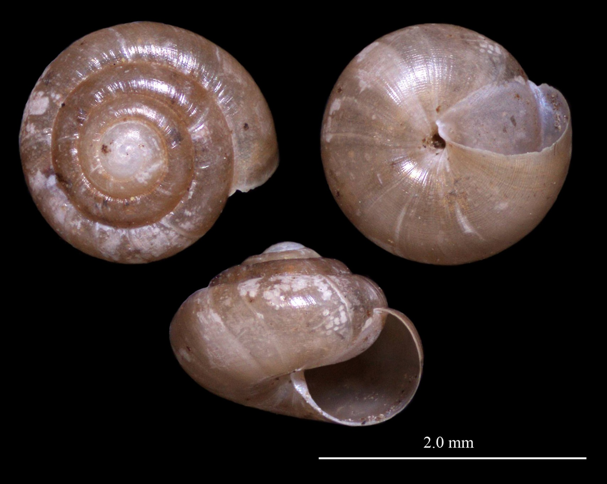
Snail 3
Notes:
Incised lines
4.5 whorls
< 2 mm

Slide 28
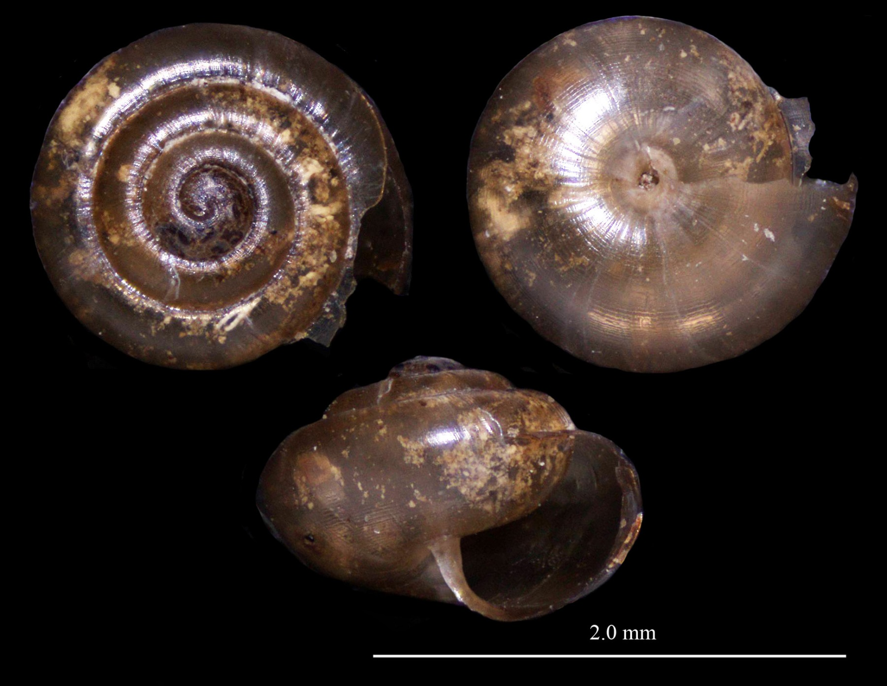
Snail 13
Notes:
< 2 mm
About 4 whorls
Incised lines
Transverse ribbing weakly developed
Umbilicus small

Slide 29
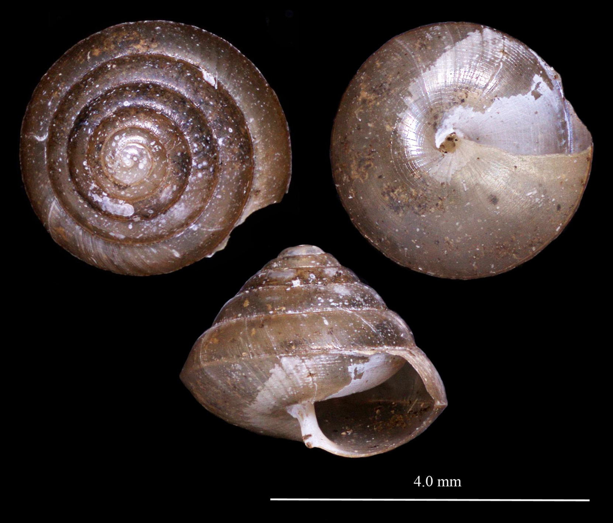
Snail 32
Notes:
> 3 mm
Almost 6 whorls
Incised lines
Body whorl angular
Umbilicus small

Slide 30
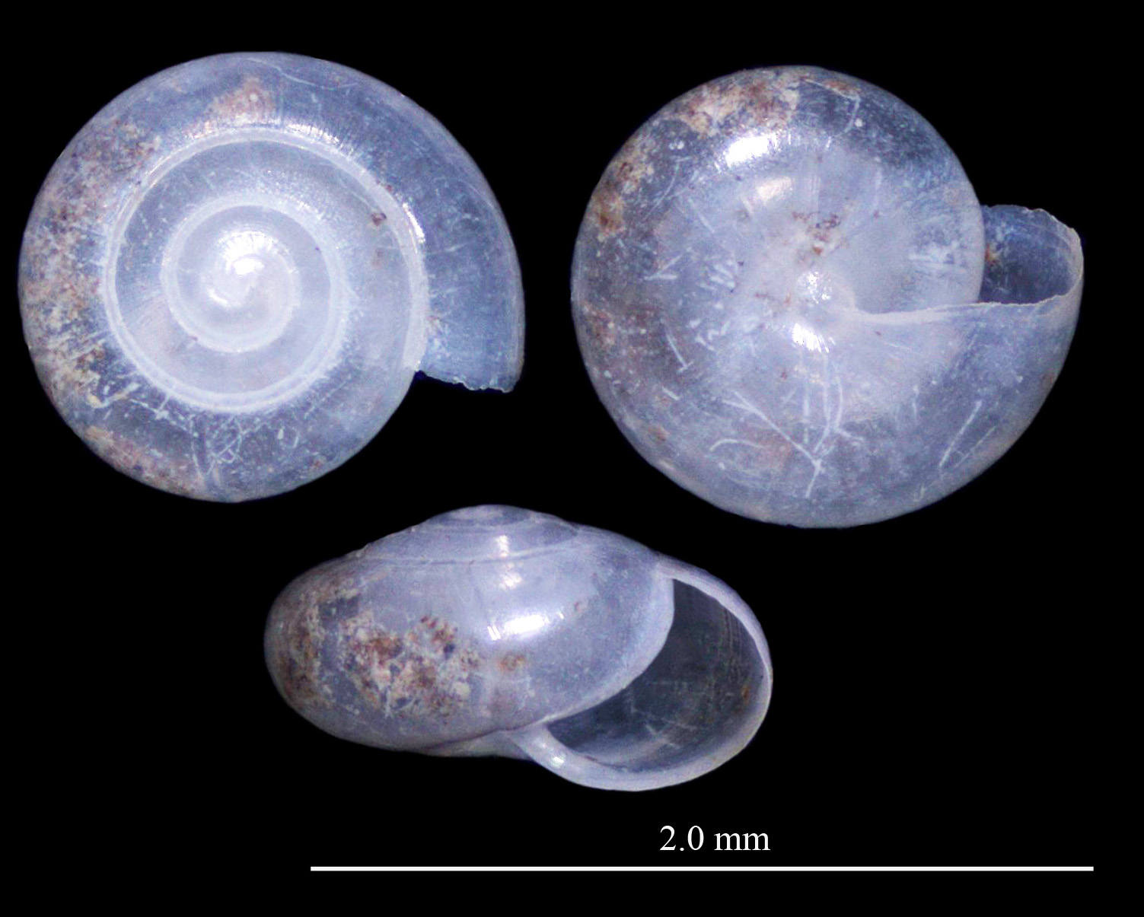
Snail 16
Notes:
4 whorls
< 2 mm
Shiny white or translucent surface
Relatively flat
Umbilicus closed

Slide 31
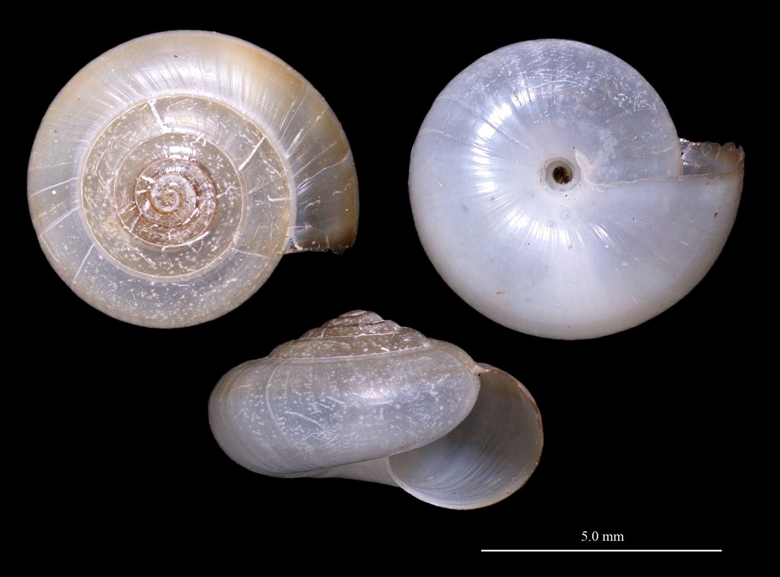
Snail 19
Notes:
5-5.5 whorls
> 5 mm
Surface translucent and matte finished
Transverse incised lines present
Umbilicus open and small
Relatively flat
Two-toned coloration - brownish above and white below

Slide 32
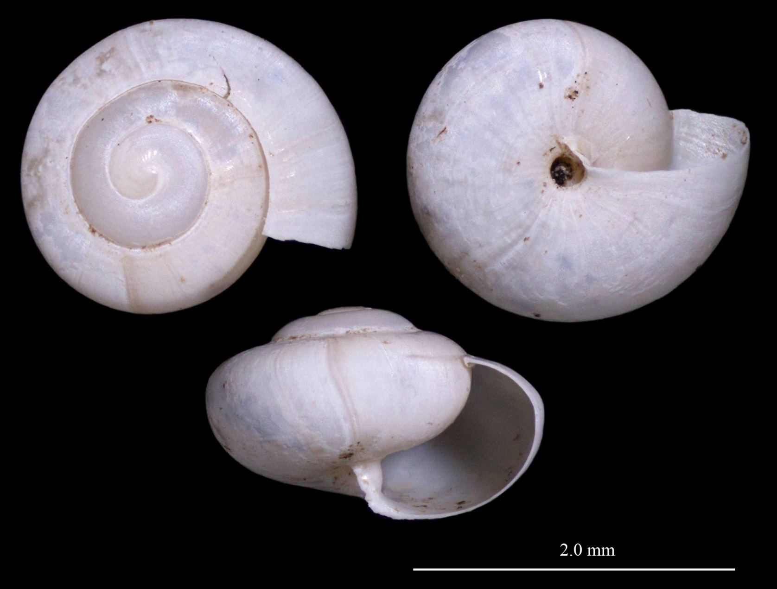
Snail 33
Notes:
3 whorls
> 2 mm
Surface flat white
Swelling on columellat
Umbilicus open and small
Relatively flat
Aperture oblique and flattened

Slide 33
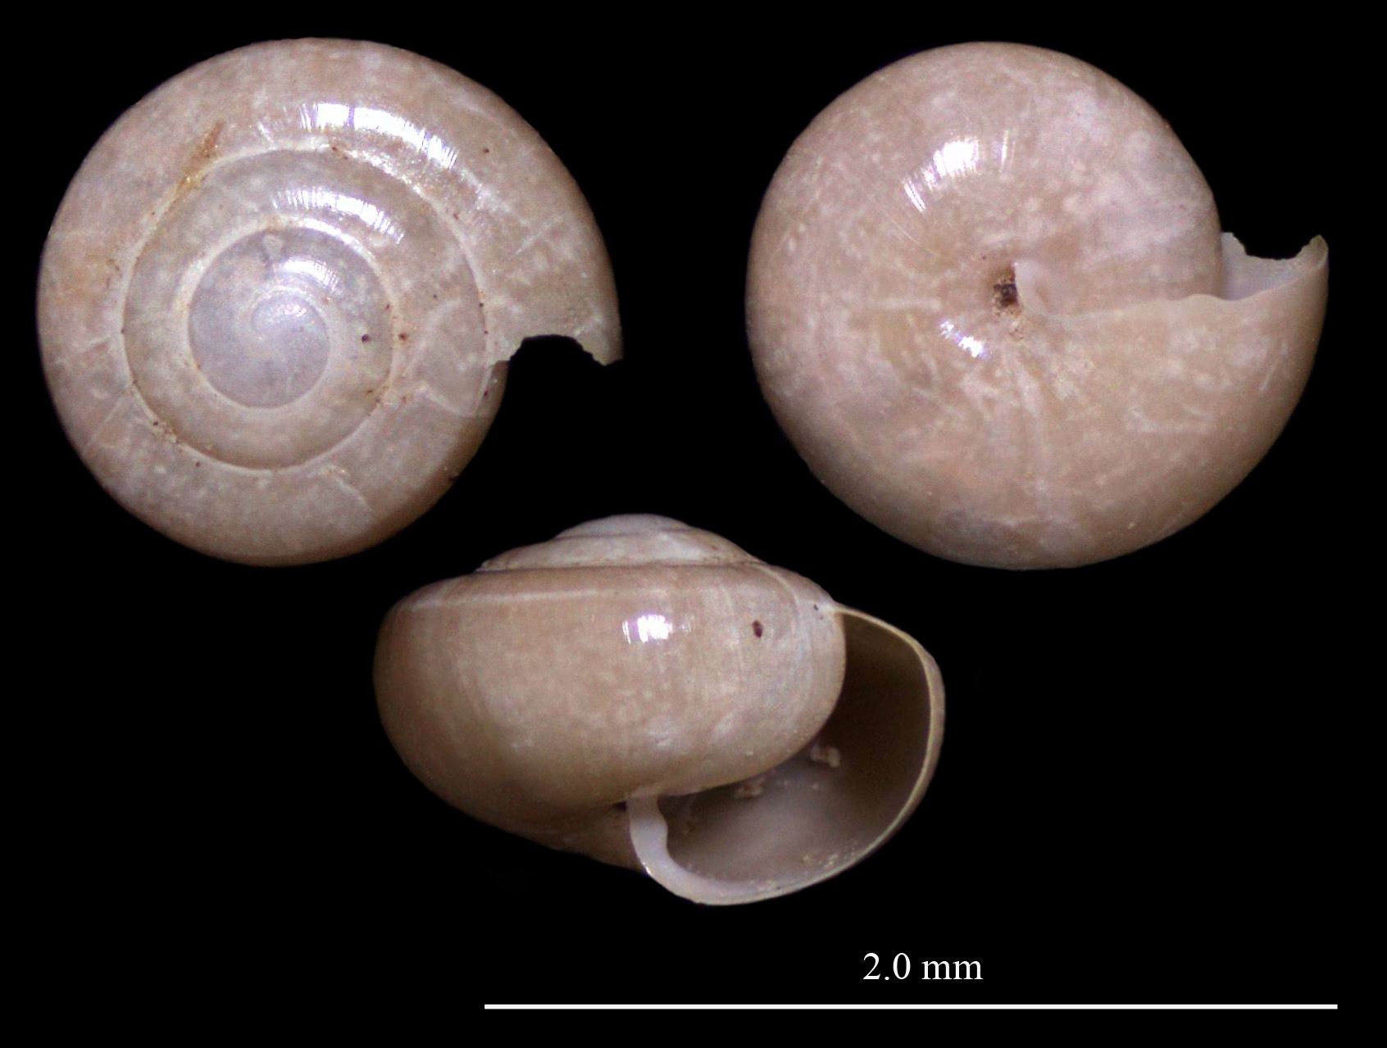
Snail 26
Notes:
3.5 whorls at 1.3 mm
Asymmetric aperture
Bump on columellar lip
Small umbilicus
Shiny surface with poorly developed transverse lines
Not any other white or brown disks

Slide 34
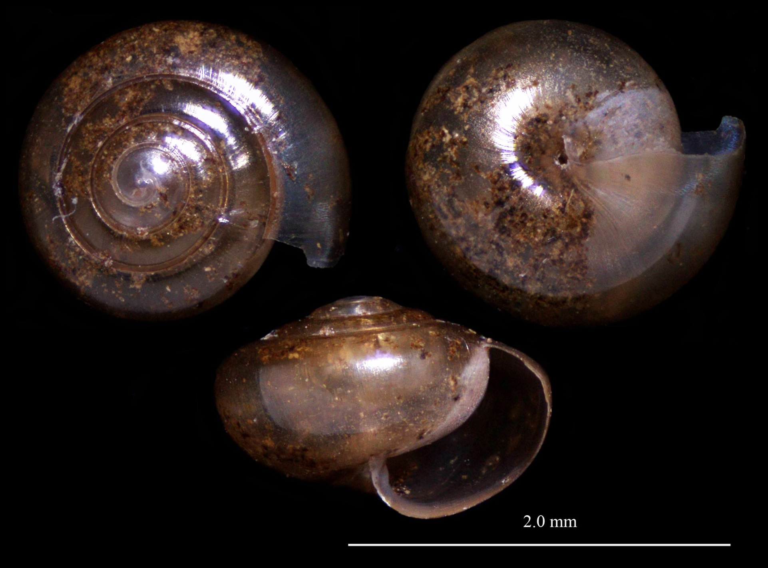
Snail 14
Notes:
> 4 whorls
Shiny surface
Relatively tall
Tiny umbilicus
Asymetric, flattened aperture
Weakly developed transverse lines

Slide 35
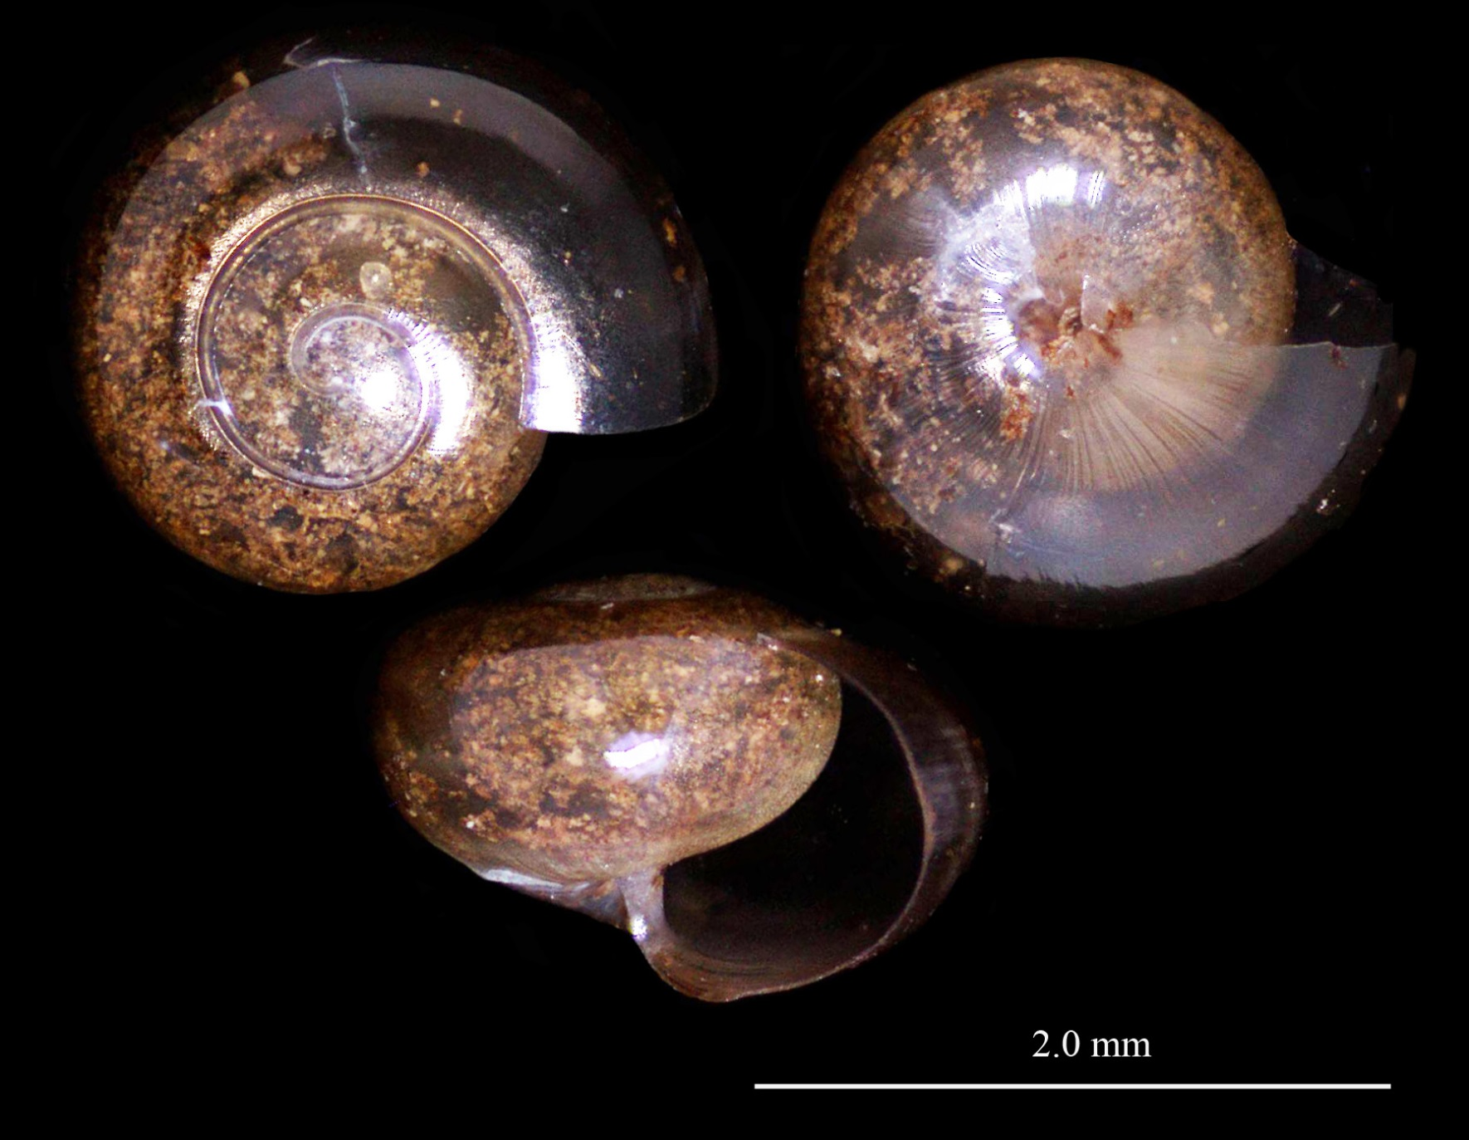
Snail 28
Notes:
2.5 whorls< 2 mm
Numerous transverse incised lines
Small umbilicus
Last whorl expanding rapidly
Apex rather flat
Shell transparent brown

Slide 36
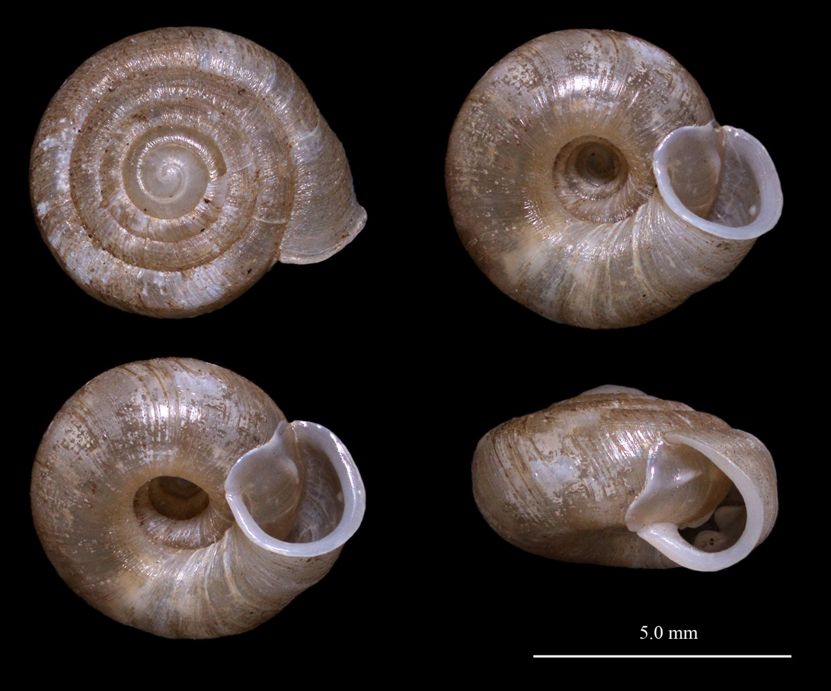
Snail 27
Plectopylidae
Notes:
Surface with transverse wrinkles and tiny papillae
Lip reflected in adults
One lamella near aperture
Complex parietal lamella system about 60 degrees inside of aperture
Palatal complex of about 5 longitudinal lamella and 1-2 small tubercles
Parietal and palatal complex repeated
Umbilicus wide

Slide 37
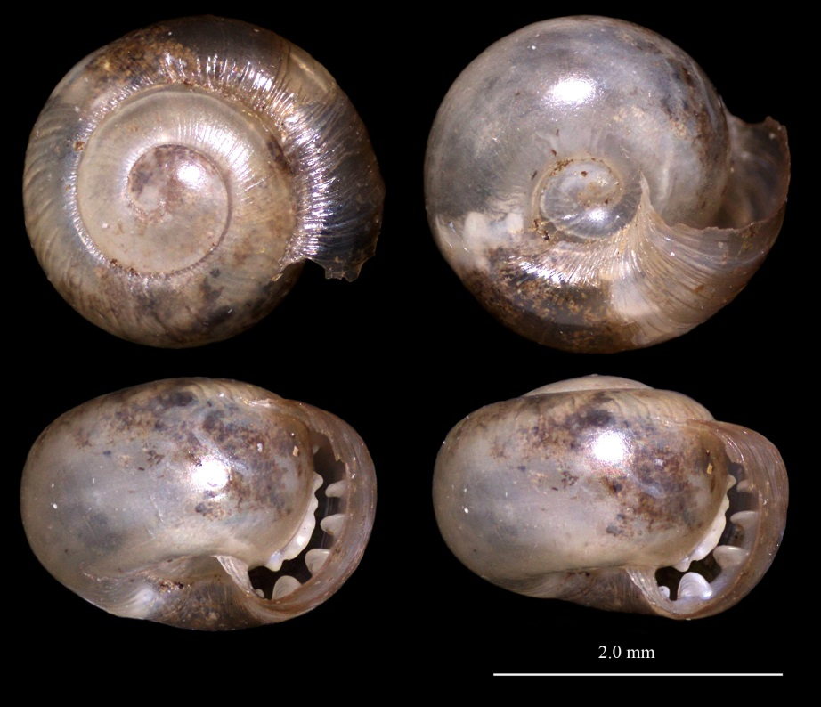
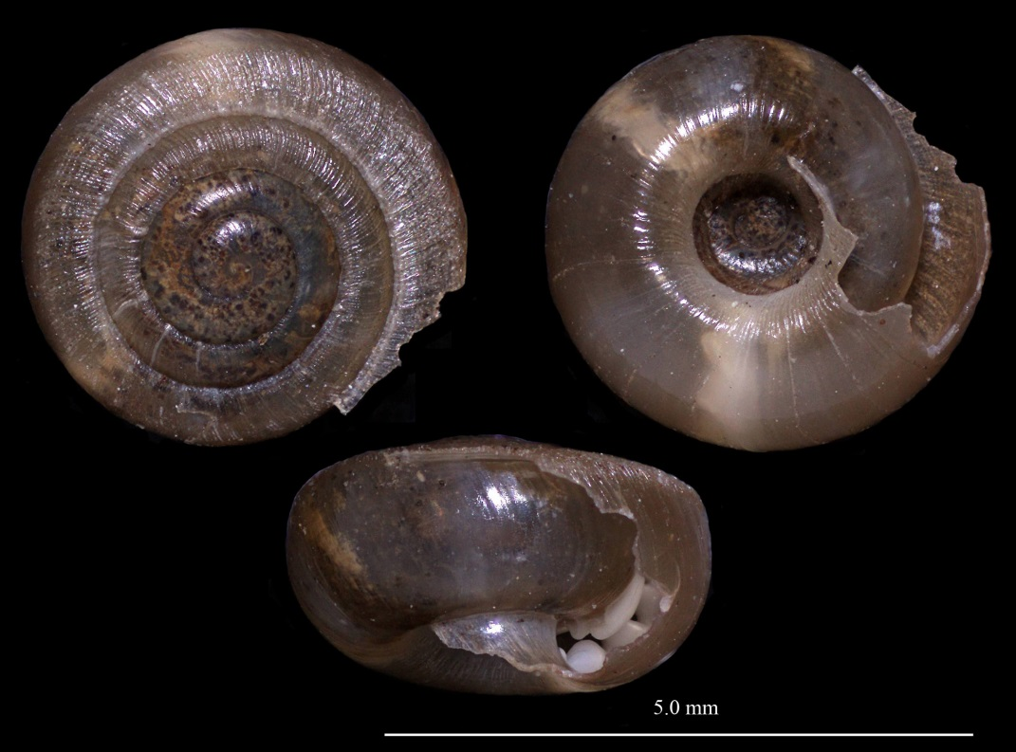
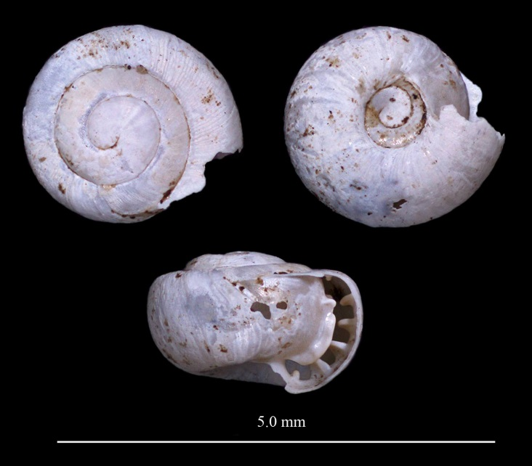
Snail 27
Plectopylidae
Notes:
Surface with transverse wrinkles and tiny papillae
Lip reflected in adults
One lamella near aperture
Complex parietal lamella system about 60 degrees inside of aperture
Palatal complex of about 5 longitudinal lamella and 1-2 small tubercles
Parietal and palatal complex repeated
Umbilicus wide

Slide 38
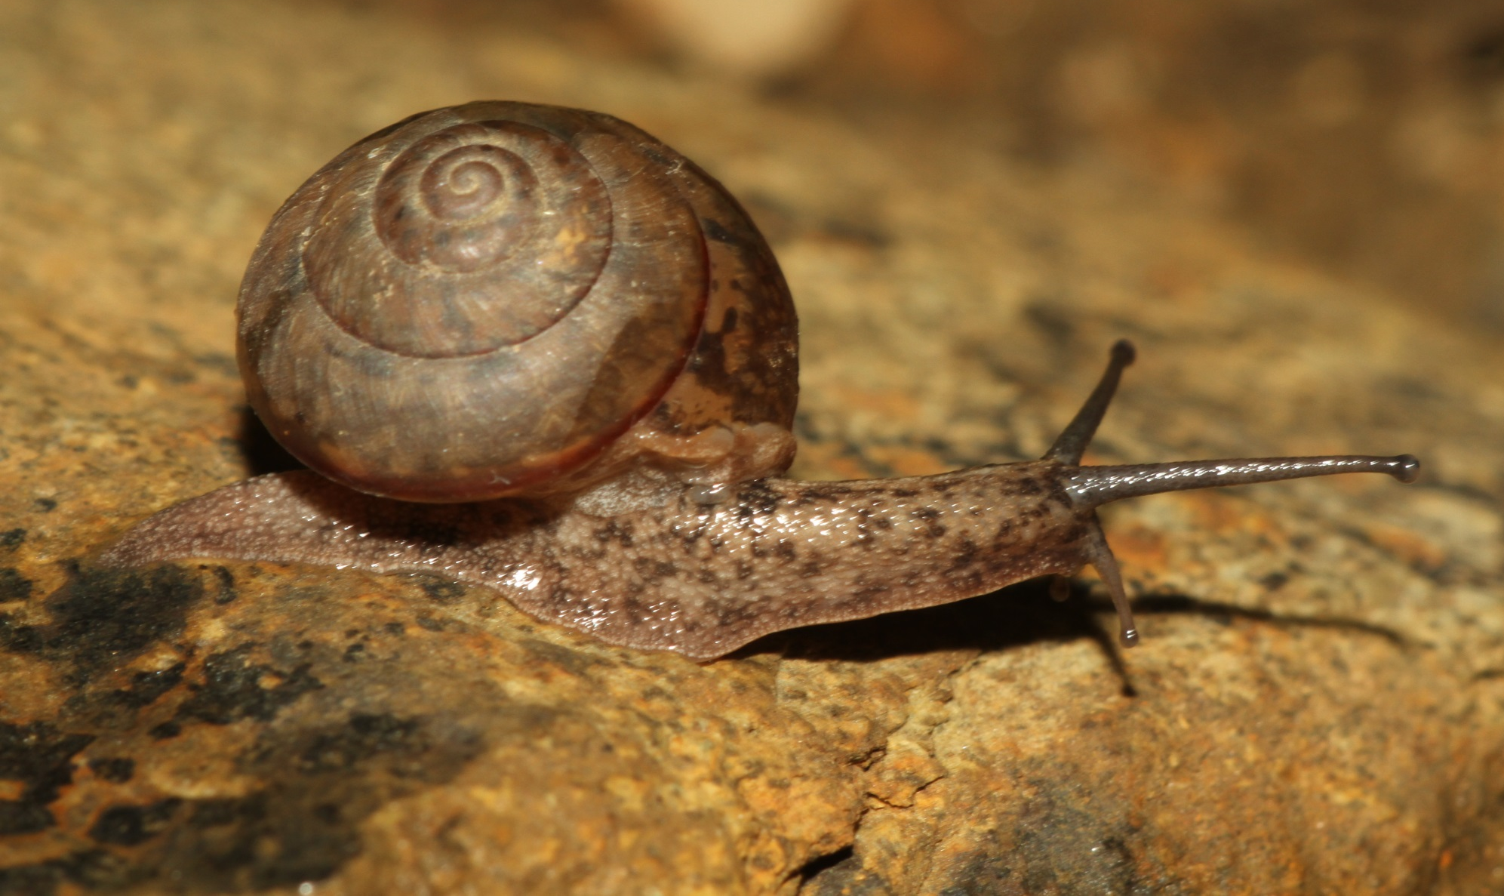
Snail 34
Ariophantidae – 19 mm shell

